Slide 1

Trends in Movie Production and Genre Popularity
A Comprehensive Analysis of IMDb Data

Slide 2
Problem Statement
This project analyzes the trends in movie production and genre popularity. We explore how genres have evolved and how runtime varies across genres.
Key questions include which genres have risen or fallen in popularity over time and how runtimes differ across movie types.

Slide 3
Dataset Overview
The IMDb dataset used contains attributes such as movie title, release year, genre, runtime, rating, and more.
It covers over 10,000 movies across multiple genres, providing a robust base for analysis.

Slide 4
Data Preprocessing
1. Handling Missing Data: Missing runtimes were filled with 0.
2. Runtime Conversion: Runtimes were standardized into minutes.
3. Splitting Genres: Movies with multiple genres were split into separate rows for better analysis.
4. Removing Unnecessary Columns: Unrelated columns such as 'poster' and 'fullplot' were dropped.

Slide 5
Visualization Goals
The goal of the visualization is to uncover patterns in movie production and genre trends. Specifically, we aim to:
Identify the most popular genres over time
Understand how average runtime varies by genre
Track genre production trends across decades.

Slide 6
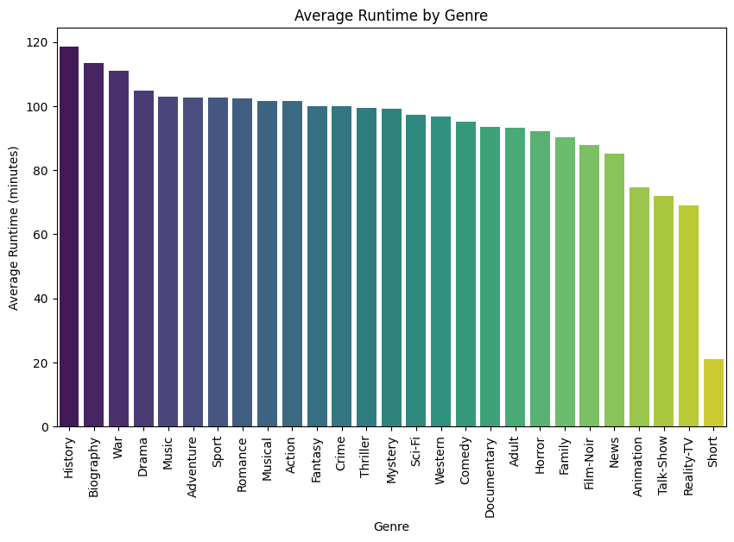
Average Runtime by Genre
The analysis shows that certain genres, like Adventure and Drama, have longer runtimes (often exceeding 120 minutes), while genres like Comedy and Short films have much shorter runtimes, usually under 90 minutes.

Slide 7
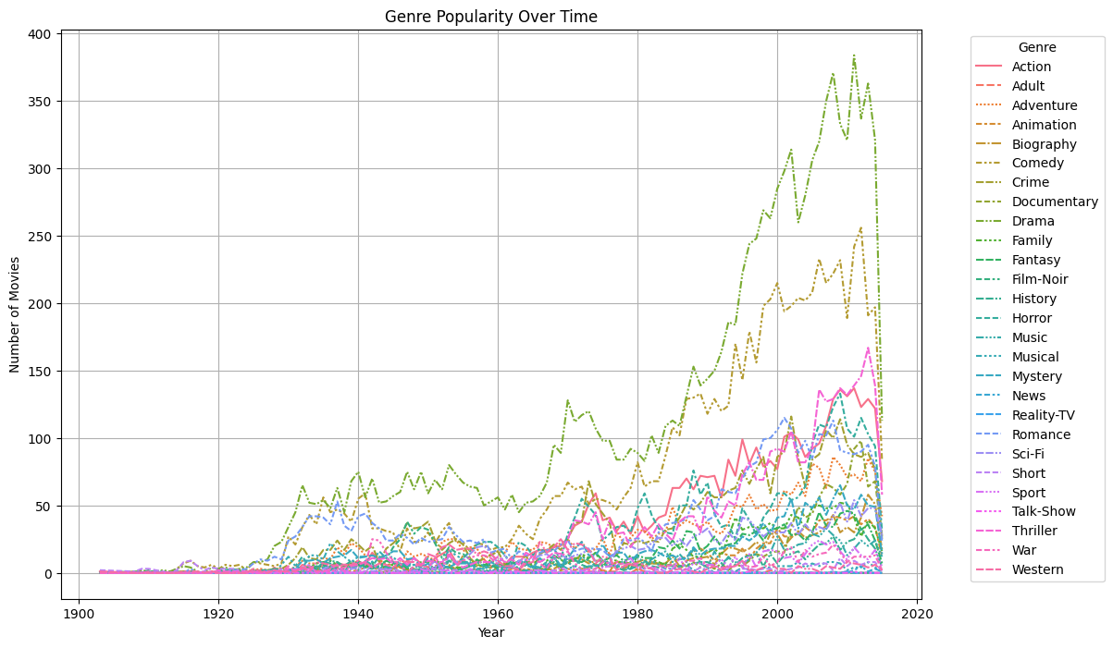
Popular Genres Over the Decades
A clear trend is the rise of Action and Sci-Fi genres, particularly after the 1980s. Meanwhile, Western and Musical genres have seen a sharp decline in production over the same period.

Slide 8
Top 5 Genres by IMDb Rating
Genres like Drama, Documentary, and Animation tend to have higher IMDb ratings, often above 7.5. This suggests these genres are generally well-received by audiences.

Slide 9
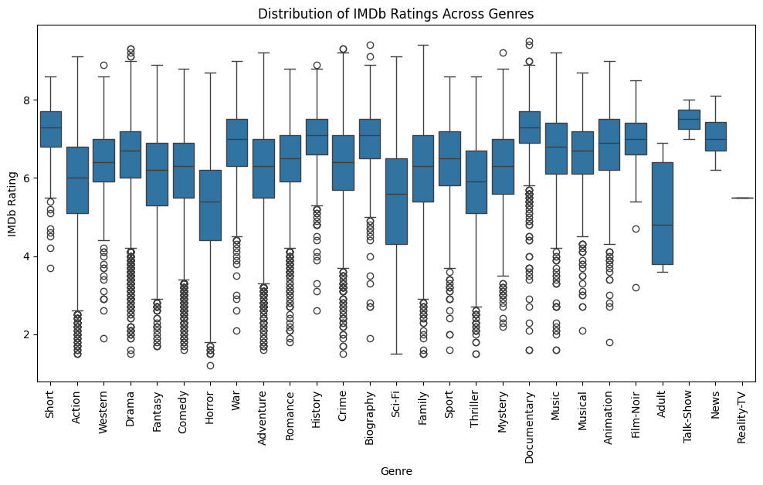
Genre Distribution in Recent Decades
Since the 2000s, there's been a notable increase in the production of Action, Sci-Fi, and Superhero movies. This coincides with advancements in visual effects and the globalization of cinema.

Slide 10
Findings: Genre Evolution
1. Rise of Action/Sci-Fi: These genres have seen explosive growth, fueled by technological advancements and audience demand.
2. Decline in Traditional Genres: Genres like Western and Musical have declined in both production and popularity.

Slide 11
Findings: Runtime Trends
1. Longer Movies in Popular Genres: Adventure and Drama films have progressively gotten longer, often exceeding 120 minutes.
2. Shorter Runtime Genres: Comedy and Animation films generally maintain runtimes under 90 minutes.

Slide 12
Conclusion
The analysis reveals significant shifts in the movie industry. Action and Sci-Fi movies dominate modern cinema, while traditional genres like Westerns are fading. There is also a noticeable trend towards longer movies, especially in popular genres like Drama and Adventure.

Slide 13
Limitations & Future Work
1. Missing Data: Some fields in the dataset were incomplete, which may have affected certain insights.
2. Future Directions: Further work could investigate the correlation between box office success and genre popularity or explore sentiment analysis of audience reviews.

Slide 14
References
1. IMDb Dataset
2. Seaborn, Pandas for Data Visualization and Analysis
3. Various academic papers on genre analysis and movie production trends.

Slide 15
Thank You!

