Slide 1



<H1> Welcome to Web Development </H1>
<ul>
<li>
Bibek Chalise
</li>
<li>
Bachelor’s Of Computer Engineering
</li>
<li>
work.bibekchalise@gmail.com
</li>
</ul>

Slide 2
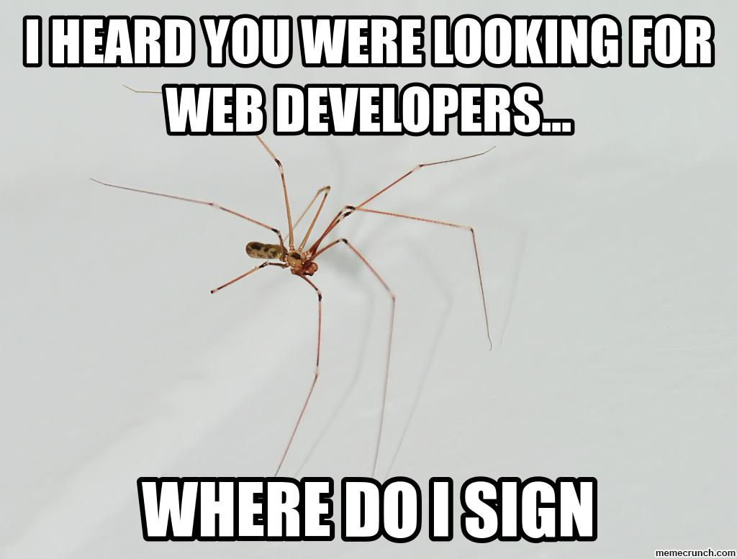

Slide 3
What to expect from this course?
Basics of web-development.
Compatability with the tools.
A good portfolio site.
A smooth learning curve.
The demands of the market.
A wide-spread opportunity.

Slide 4

Websites should be responsive.
So, should be you during this course.
😅

Slide 5
A good website should be interactive.
That’s what we are going to do now.

Slide 6
Good things takes time.
Designing a website is a art of time.
So, whenever you are into designing a website,
Do:
Take time to understand the need.
Build a conceptual model.
Understand the use case and user.
Don’t:
Never rush into coding.

Slide 7
The syllabus.
->HTML
->CSS
->JS
->Bootstrap
->Anything else you wish to learn within the scope of this course ( Basic frontend development.)

Slide 8
The Timeframe
Yet to be decided.

Slide 9
Let’s Start.

Slide 10

How people access the web?
Before understanding the code, we should know few things about web, website and web-pages.
People Normally access the web (websites) using a software called web-browser.
Firefox, Chrome and Edge are few popular one.
Users, type in a web-site address (URL) that leads you to a website.
www.lict.edu.np

Slide 11
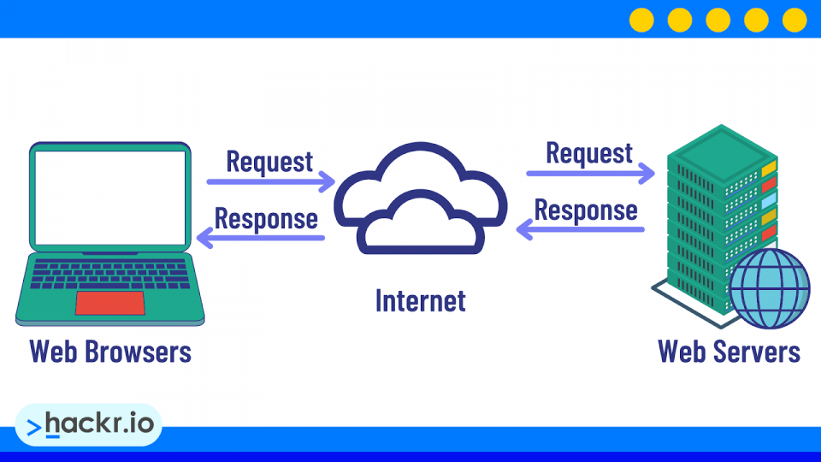
Web Servers
Whenever you ask your browser for a web-page the request is sent across the internet to a special computer known as a web-server which hosts the website.
Web-servers are dedicated computers connected to internet 24/7.
They responds to millions of requests each seconds as per the request of the user.

Slide 12
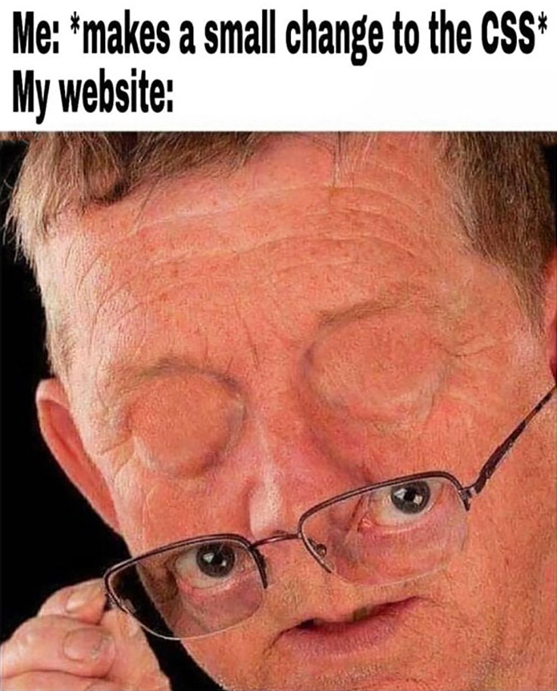
Devices
People are accessing websites on an increasing range of devices including desktop computers, laptops, tablets, and mobile phones
It is important to remember that various devices have different screen sizes and some have faster connections to the web than others

Slide 13
How the web works?
When you visit a website, the web server hosting that site could be anywhere in the world. In order for you to find the location of the web server, your browser will first connect to a Domain Name System (DNS) server.
Your computer contacts a network of servers called Domain Name System (DNS) servers. These act like phone books; they tell your computer the IP address associated with the requested domain name. An IP address is a number of up to 12 (IPV4) / 32 (IPV6) digits separated by periods / full stops. Every device connected to the web has a unique IP address; it is like the phone number for that computer.

Slide 14
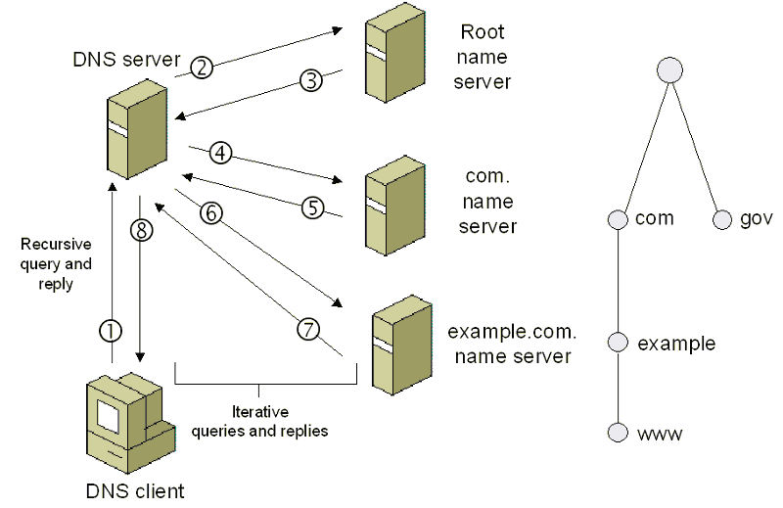

Slide 15
Structure of a word document
Body
Title
Paragraphs
Line breaks
Headings
Links
Tables
Images blah blah blah blah ……..

Slide 16
Structure of Web-pages
Body
Title
Paragraphs
Line breaks
Headings
Links
Tables
Images blah blah blah blah ……..

Slide 17
That concludes
We have experiece of writing documents on the word. It is designed in a such a way that, the document reader understands the format.
So, as a web-developer our main task is to design a document that can be clearly understood by the _________________________.
Hint: It. Startts with W__ and ends with _______ser.

Slide 18
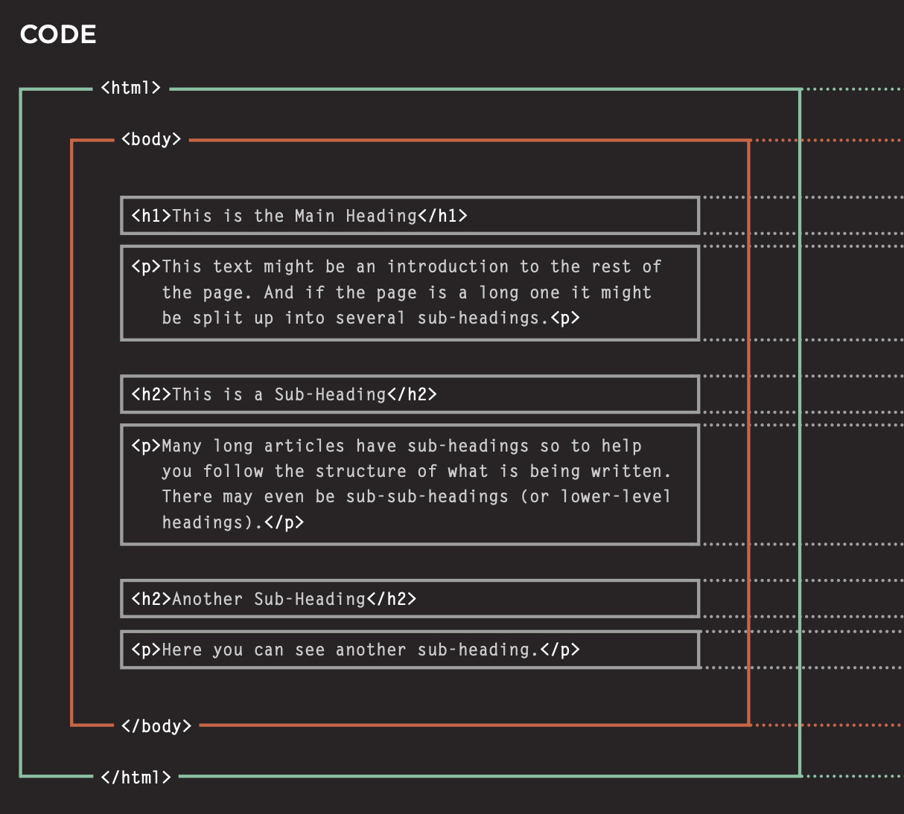

Slide 19
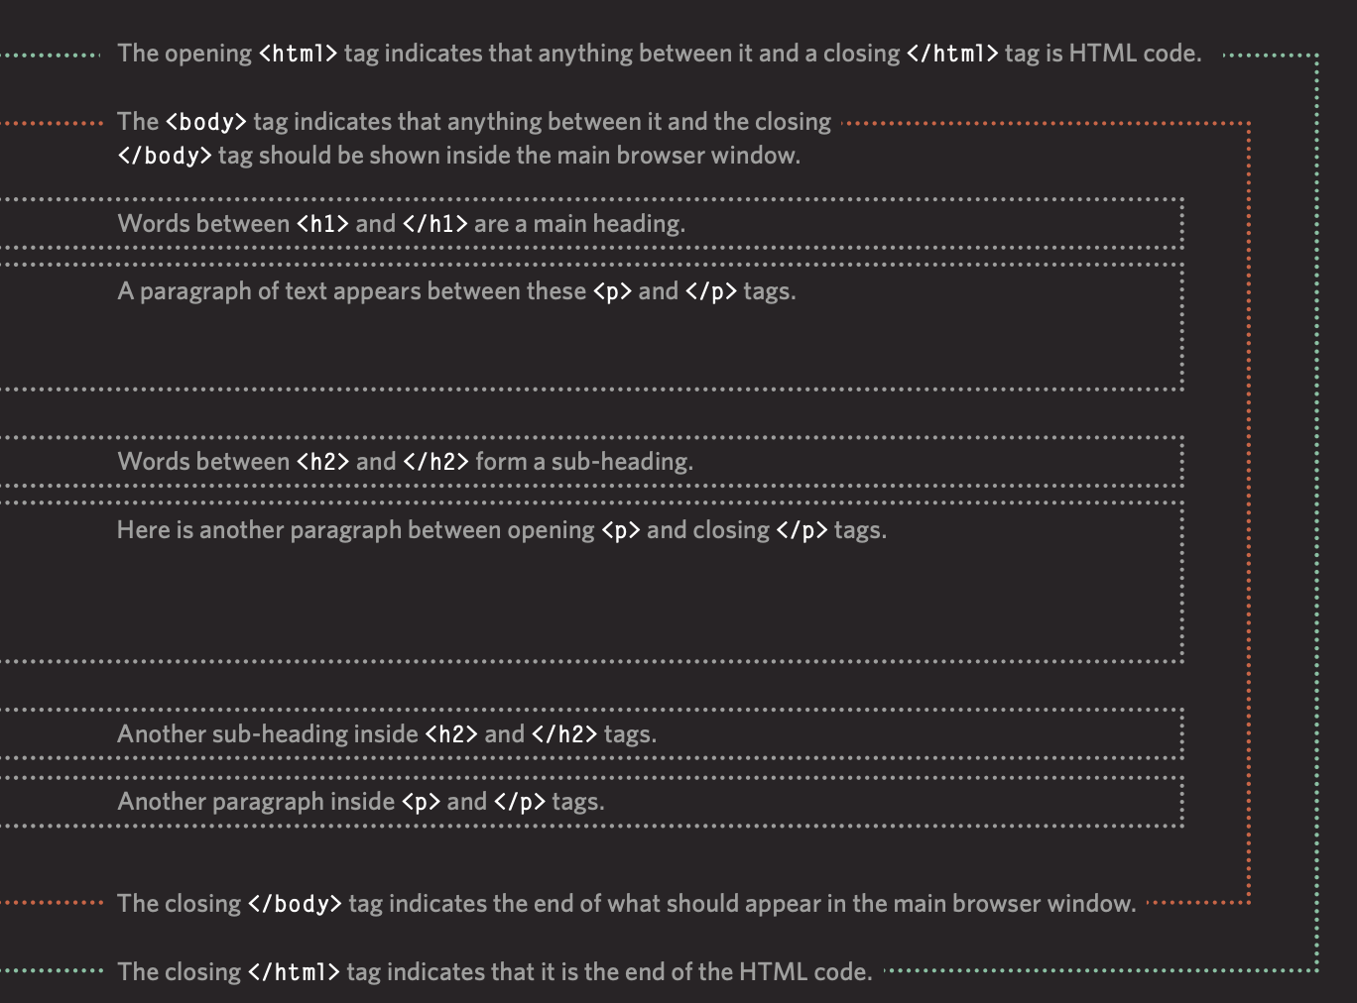

Slide 20
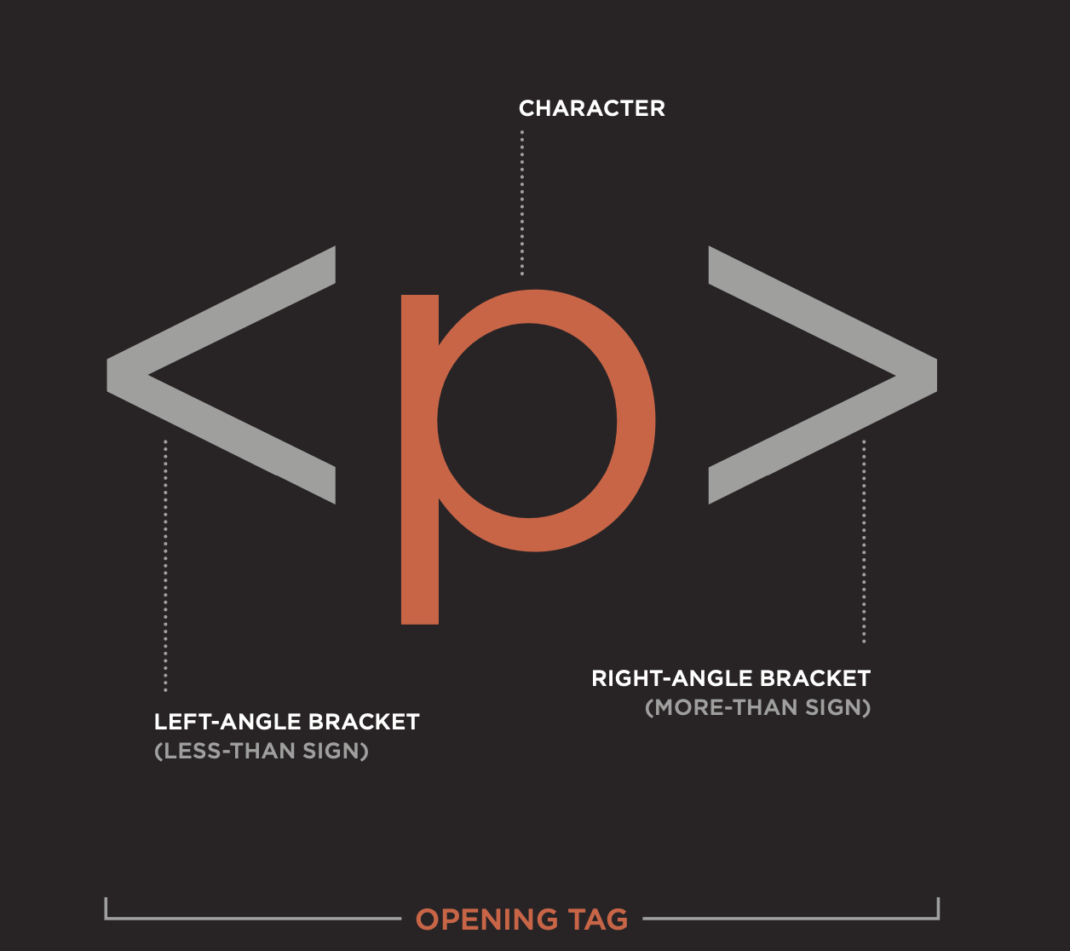
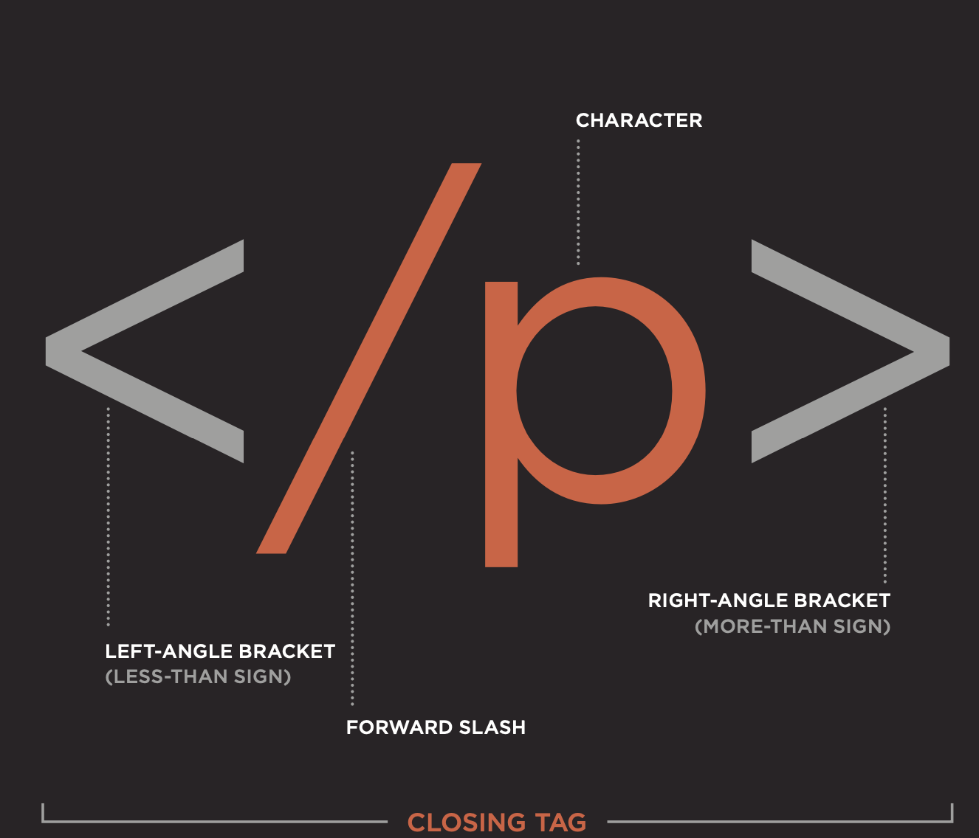
Tags

Slide 21
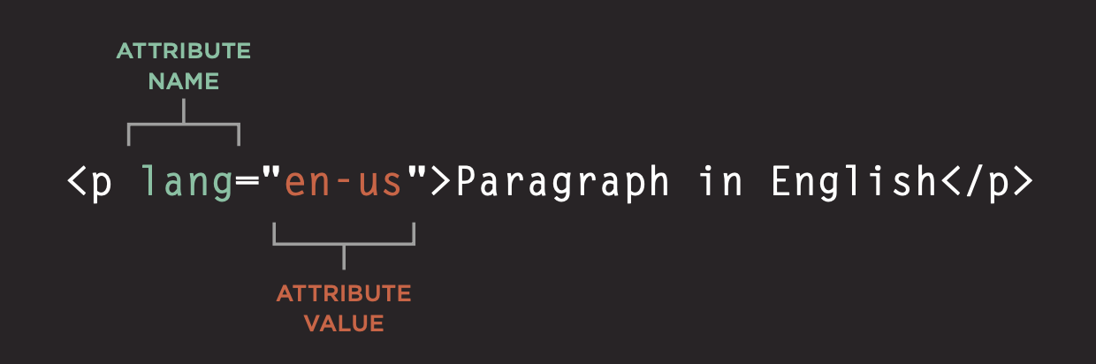
Attributes

Slide 22
BODY, HEAD, TITLE
<body
Everything inside this element is shown inside the main browser window.
<head>
Before the <body> element you will often see a <head> element. This contains information about the page (rather than information that is shown within the main part of the browser window that is highlighted in blue on the opposite page).
You will usually find a <title> element inside the <head> element.
<title>
It gives you the title of the web-page.

Slide 23
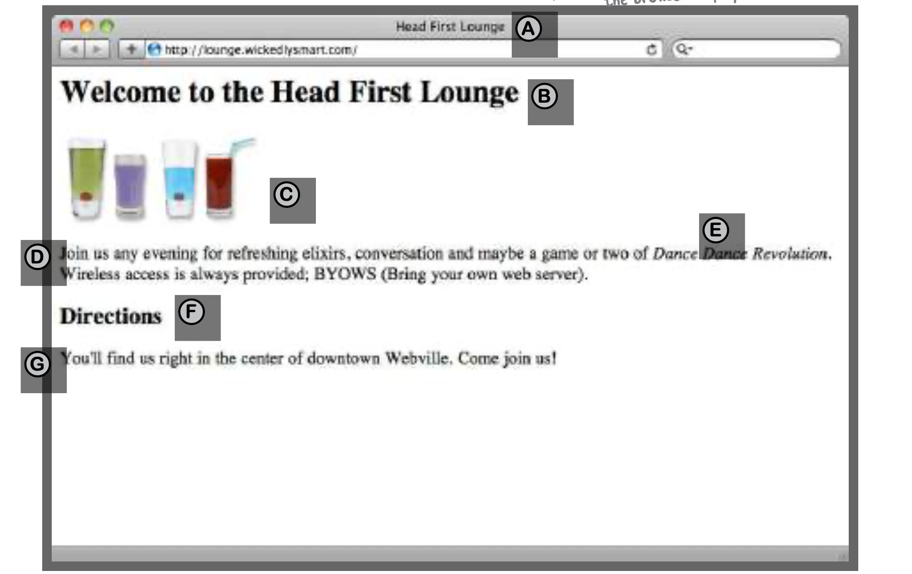
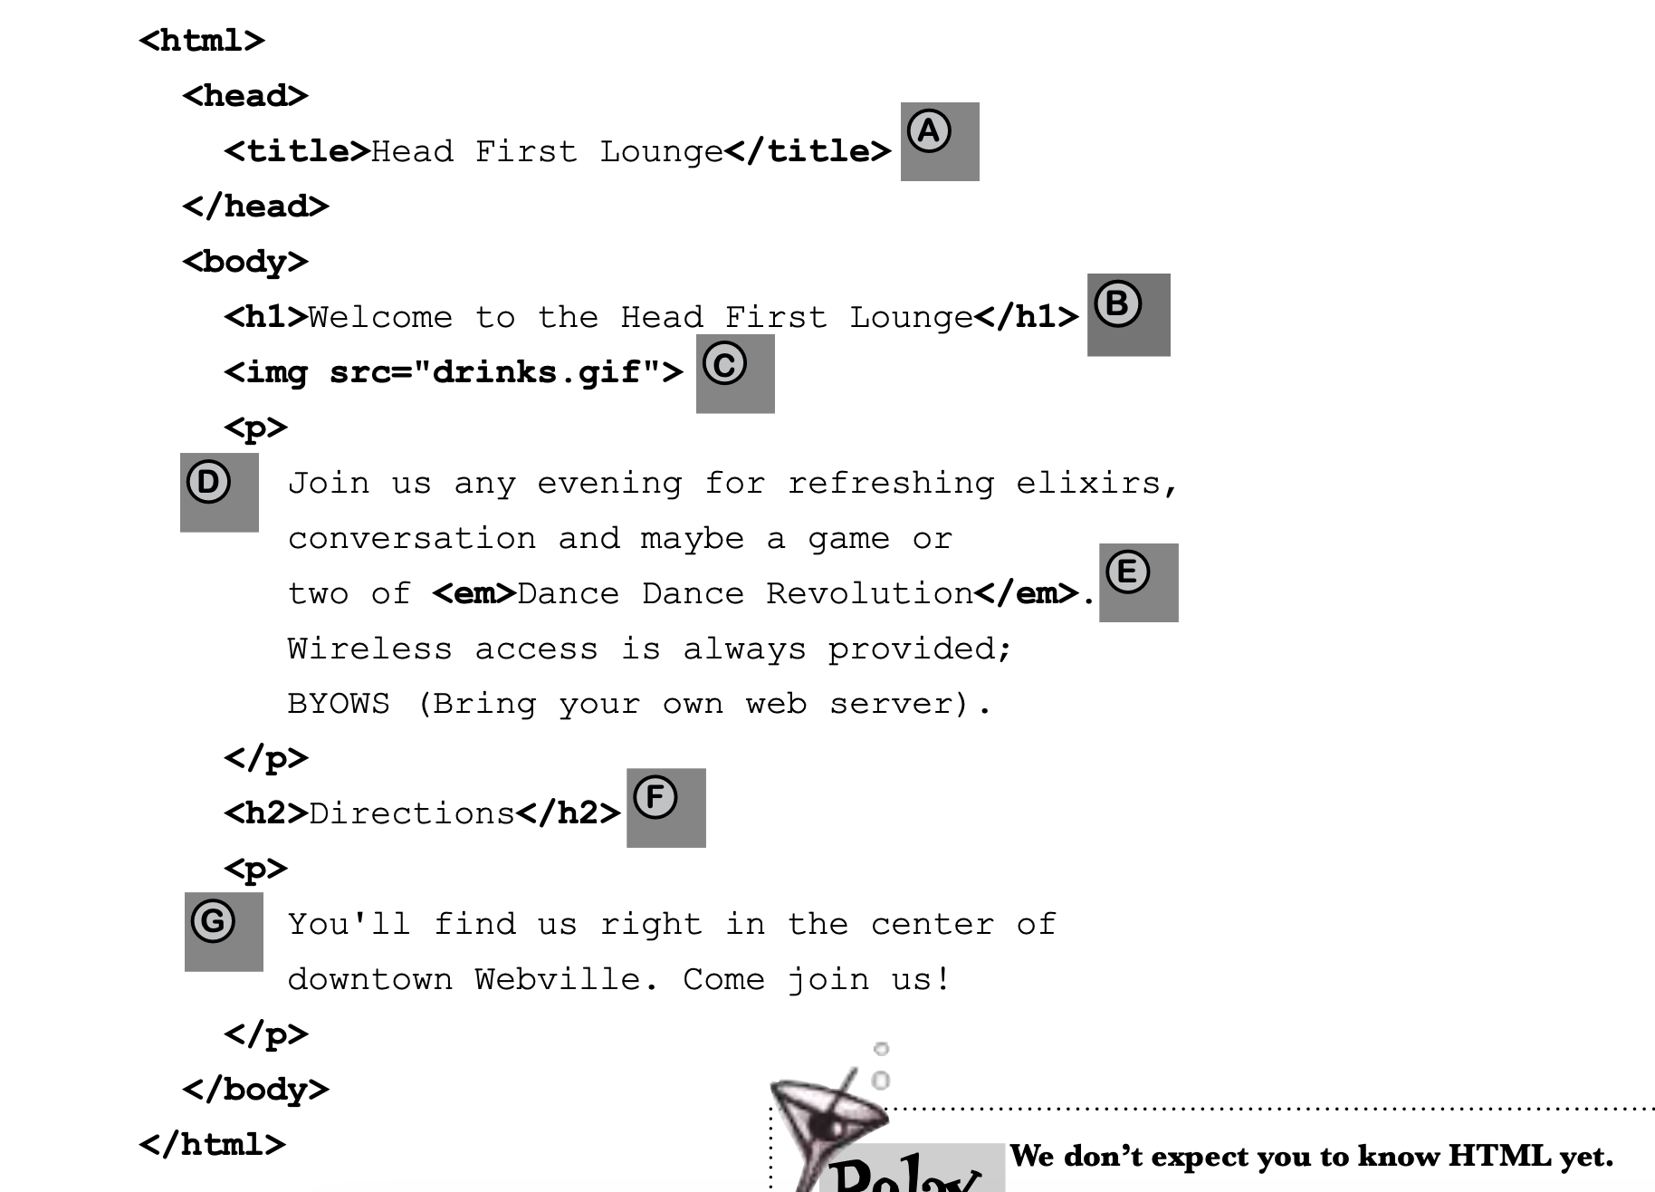

Slide 24
Installations
VsCode
Web-browser (Brave , Firefox, Chrome (Most recommended))

Slide 25
Thank you!
Feedbacks are appreciated.
Work.bibekchalise@gmail.com
https://www.chalisebibek.com.np/
https://www.linkedin.com/in/imbbek/
https://github.com/bibekebib

