Slide 1
A MAJOR PROJECT ON
Iot Based video surveillance Robot
TEAM
BIBEK GHIMIRE(PUR072BEX08)
BIBEK SHRESTHA(PUR072BEX011)
JAYARAM KARKI(PUR072BEX019)
NANUMAYA KAFLE (PUR072BEX024)

Slide 2
INTRODUCTION
IoT is A System which has the ability to transfer data over a network without requiring human to human or human to computer interaction
Surveillance is the monitoring of behavior, activities, or other changing information for the purpose of influencing, managing, directing , or protecting people
Designed to Monitor/spy in real time

Slide 3
OBJECTIVES
The main objectives of this system is to build a real time monitoring robotic vehicle.

Slide 4
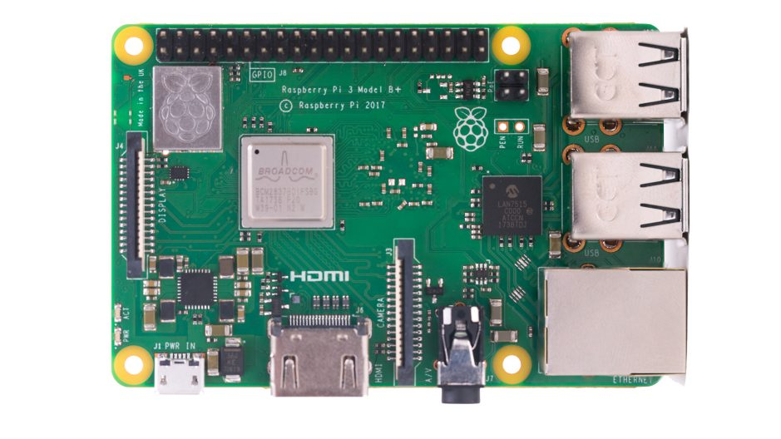
COMPONENTS REQUIRED
Raspberry Pi :
Small size computer which having its Raspbian OS
CPU: Quad-core 64-bit ARM Cortex A53 clocked at 1.4 GHz
1 GB RAM
40 GPIO pins
4 USB Ports
Inbuilt bluetooth and
network card

Slide 5
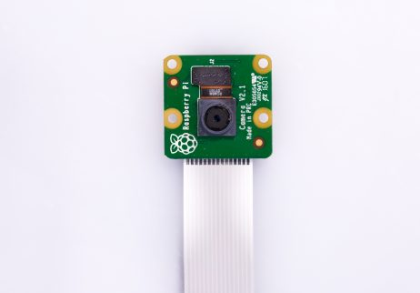
Contd…
Camera Module :
5MP resolution with fixed lens
Captures picture 2592x1944 pixel size.

Slide 6
Contd…
Chasis
H-Bridge Motor Driver
Lipo Battery
SD Card
Jumper Wires

Slide 7
Software Used
Raspbian os
Python IDle

Slide 8
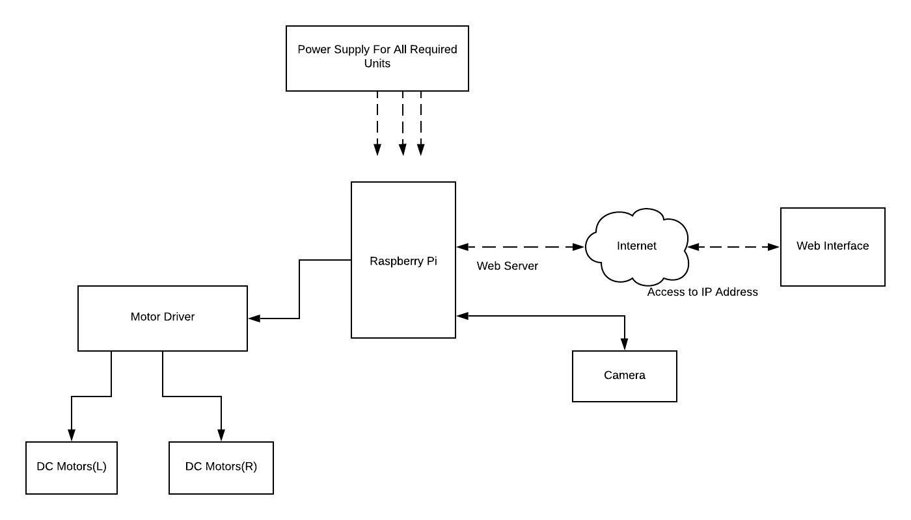
Block Diagram of the Proposed System

Slide 9
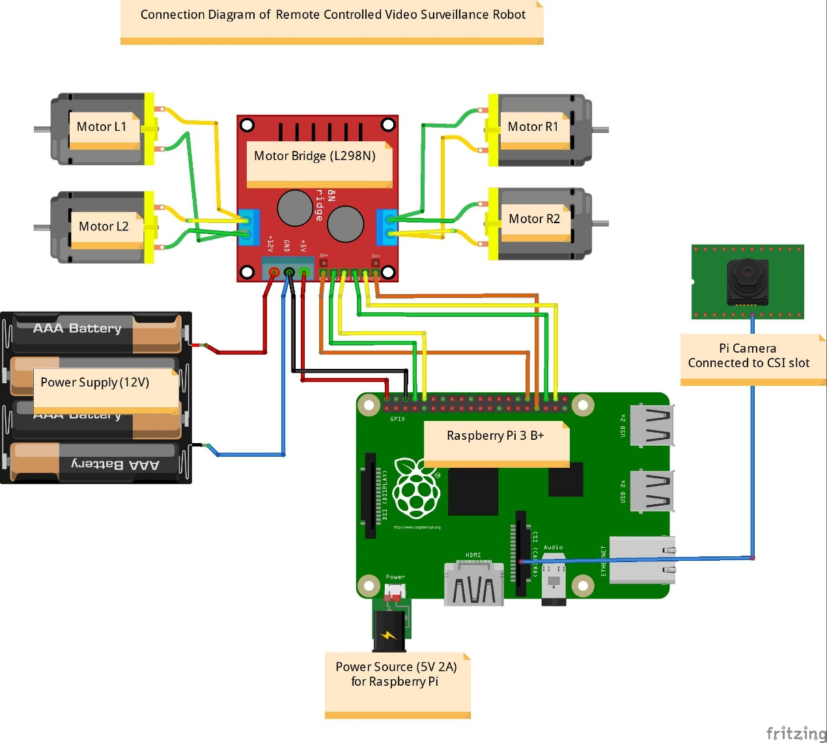
Connection Diagram

Slide 10
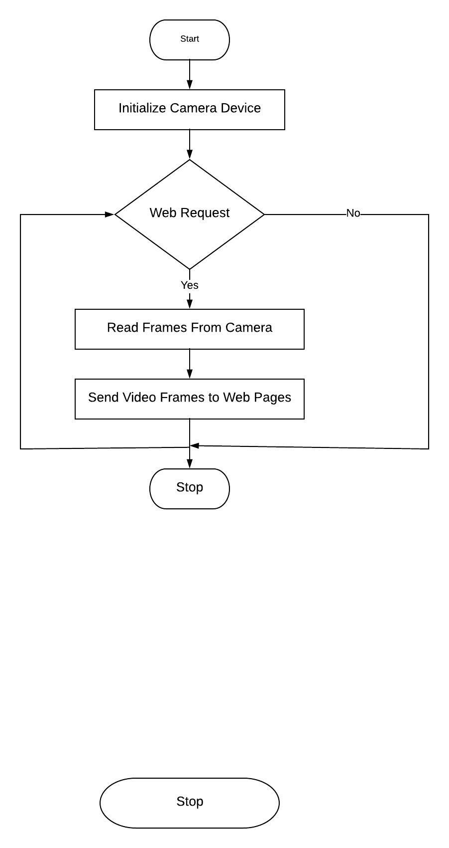
FLOWCHART: for video surveillance

Slide 11
OUTPUTs
Robot Part: chasis with Four motors, motor driver and raspberry pi
Surveillance Part: Pi Camera
Web interface for: Real time monitoring

Slide 12
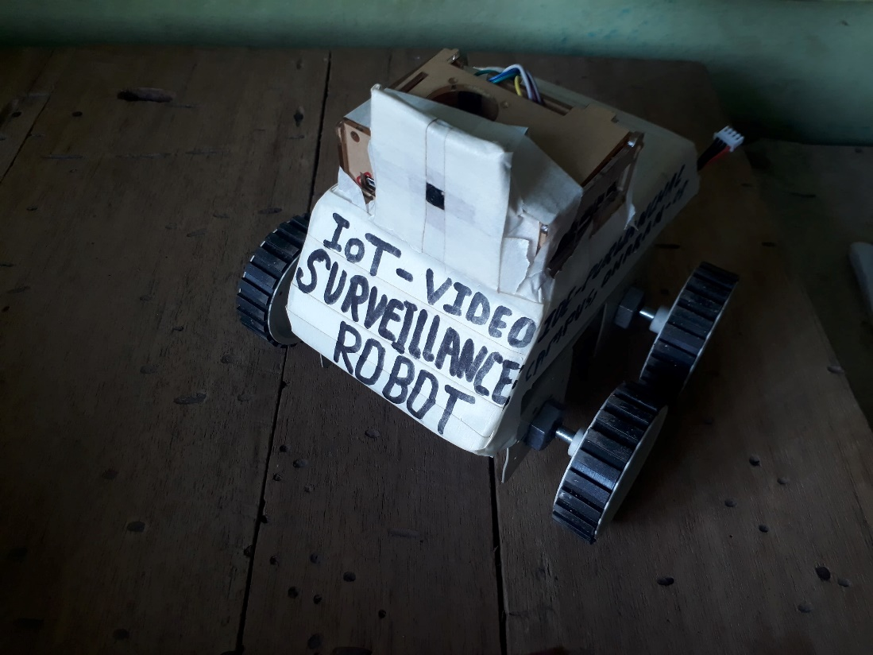
SNapshots

Slide 13
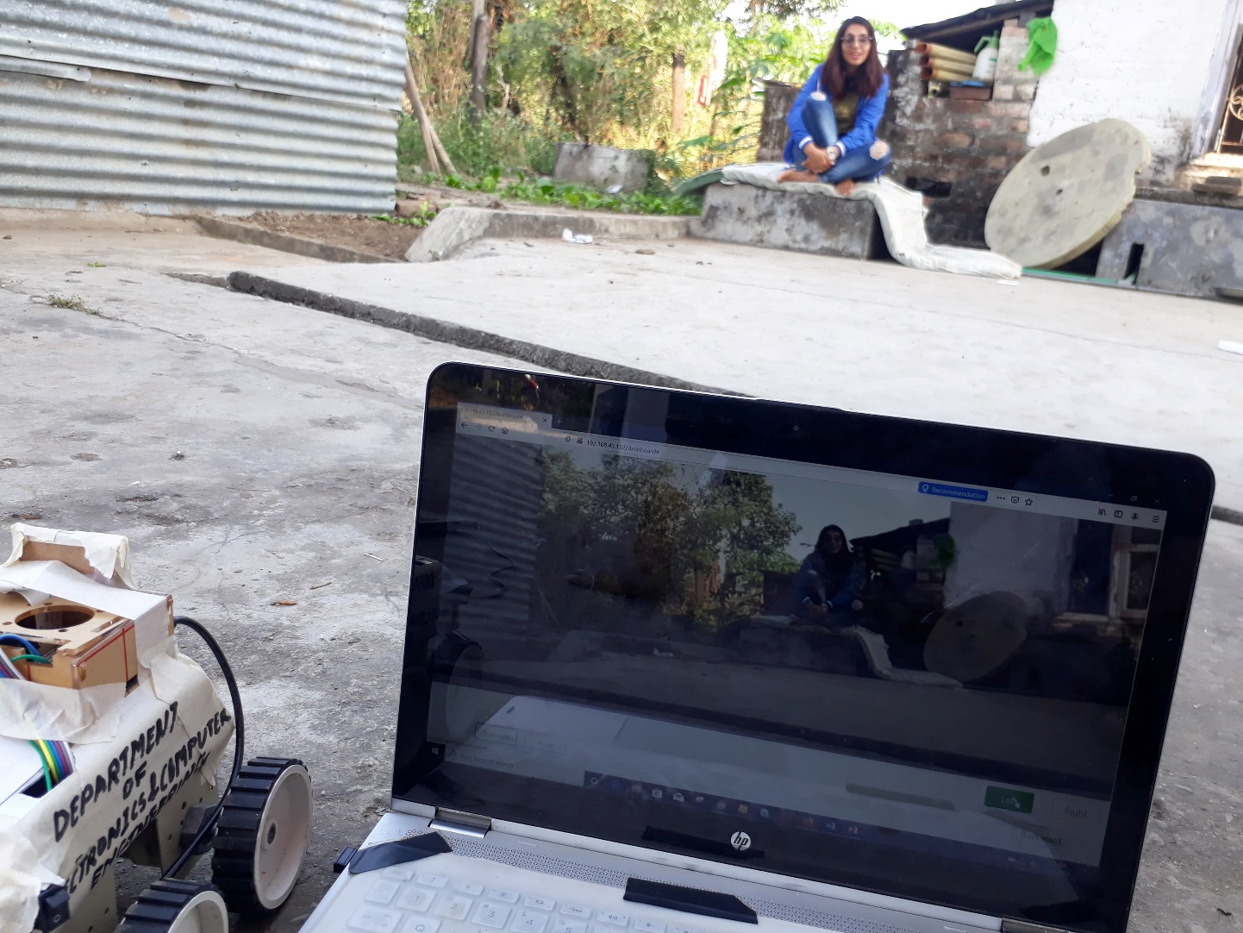

Slide 14
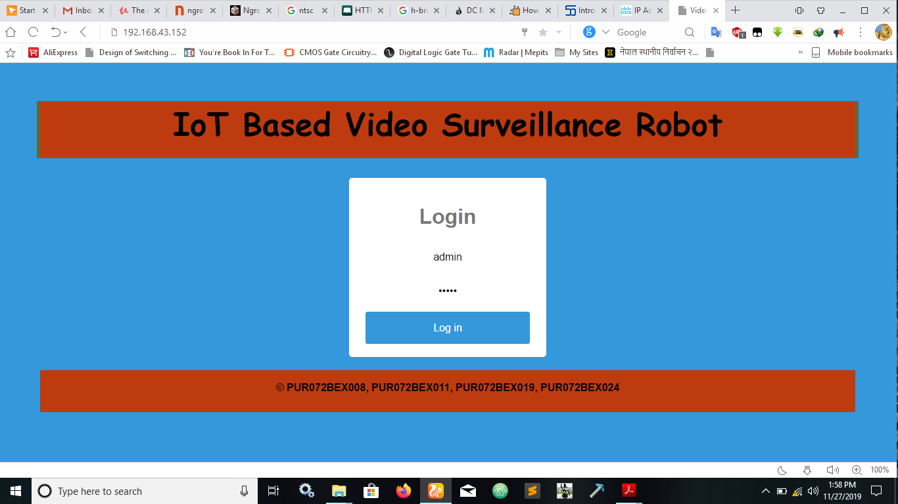

Slide 15
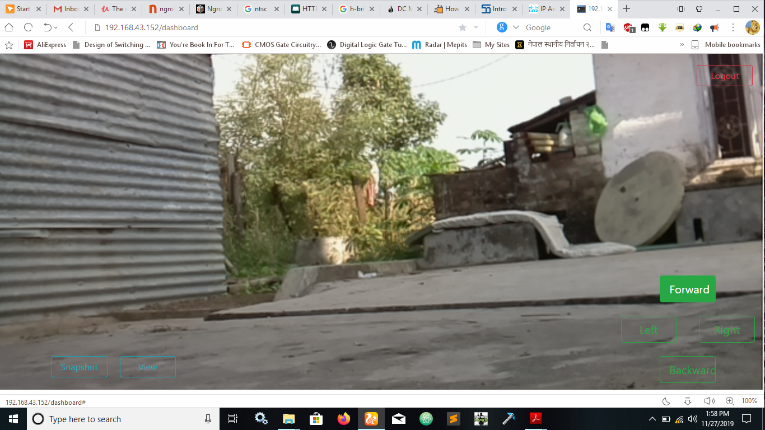

Slide 16
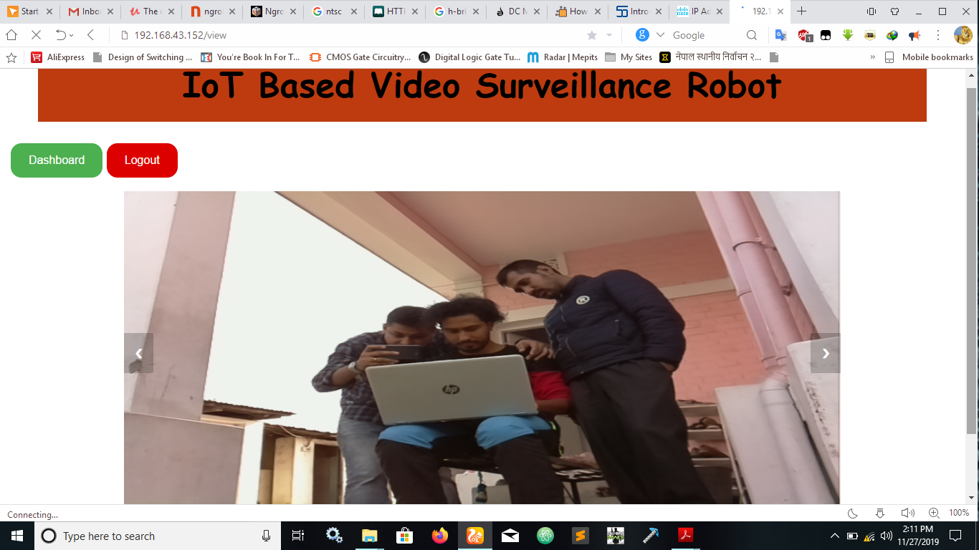

Slide 17
APPLICATIONS
This robot can be used as spy or in similar military purpose.
It can be used to explore the topography of remote place and also can be used to observe the behavior of strange animals.
It is also applicable in rescue operation during earthquake.

Slide 18
limitation
Only video no audio
Image Quality , resolution vs latency
Security

Slide 19
Future Enhancement
Facial recognition
Object Tracking
Adding different sensors to measure environmental parameter
Obstacle detection, GPS & GSM can be used for autonomous navigation

Slide 20
THANK YOU

