Slide 1
A MAJOR PROJECT ON
IOt Based video surveillance Robot

Slide 2
TEAM MEMBERS
BIBEK GHIMIRE(PUR072BEX008)
BIBEK SHRESTHA(PUR072BEX011)
JAYARAM KARKI(PUR072BEX019)
NANUMAYA KAFLE (PUR072BEX024)

Slide 3
INTRODUCTION
Surveillance is the monitoring of behavior, activities, or other changing information for the purpose of influencing, managing, directing , or protecting people.
Designed to Monitor/spy in real time.

Slide 4
OBJECTIVES
The main objectives of this proposed system is to build a real time monitoring robotic vehicle.
Objectives Completed
Robot Part: chasis with two motors, motor driver and raspberry- pi and can be controlled through web interface.
Objectives Remaining
Surveillance Part: Pi Camera

Slide 5
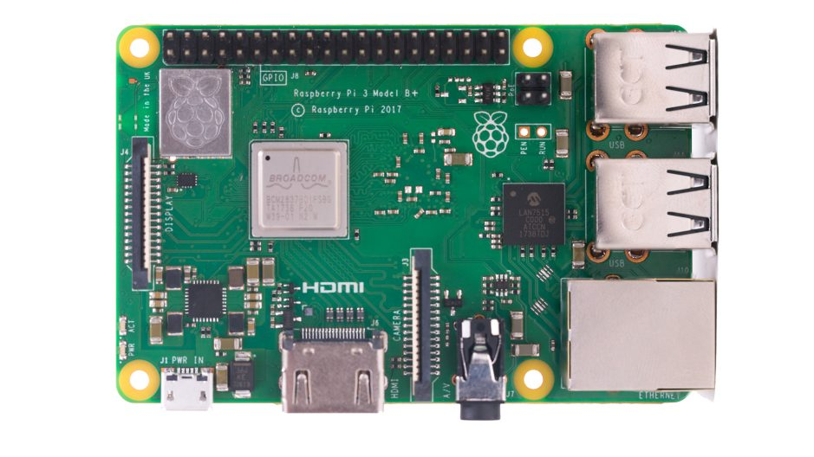
COMPONENTS REQUIRED
Raspberry Pi :
Small size computer which having its Raspbian OS
CPU: Quad-core 64-bit ARM Cortex A53 clocked at 1.2 GHz
1 GB RAM
40 GPIO pins
4 USB Ports
Inbuilt bluetooth and
network card

Slide 6
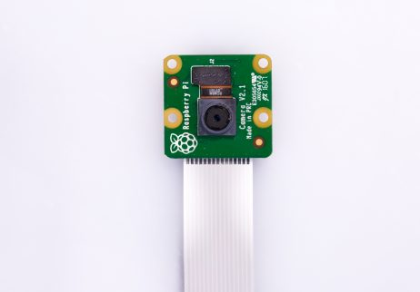
Contd…
Camera Module :
8MP resolution with fixed lens
Captures picture 3280x2464 pixel size.

Slide 7
Contd…
Chasis
H-Bridge Motor Driver
Lipo Battery
SD Card
Jumper Wires

Slide 8
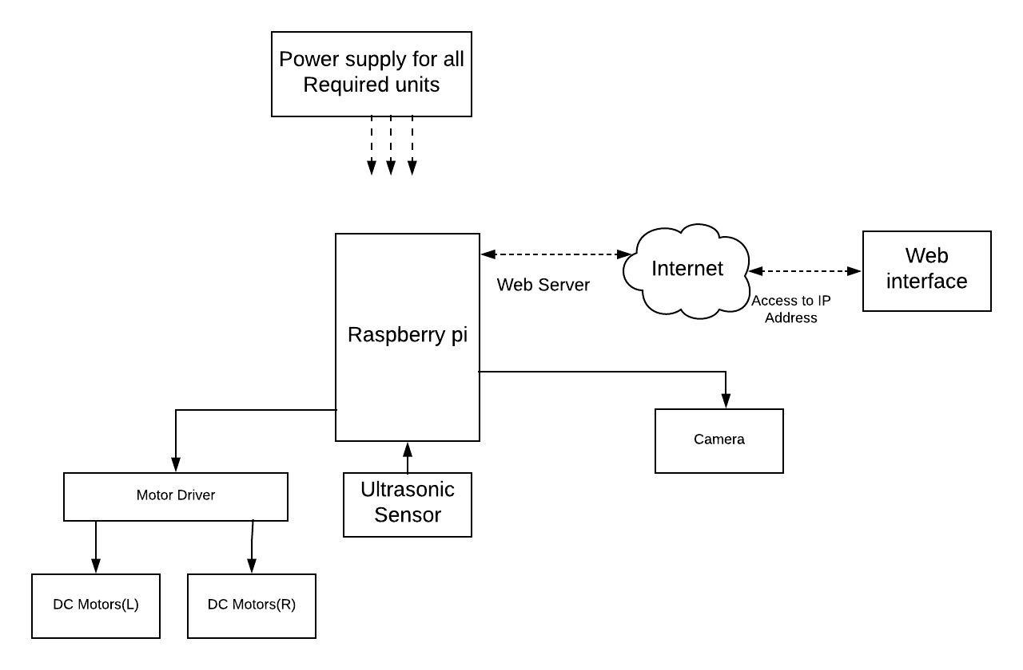
Block Diagram of the Proposed System

Slide 9
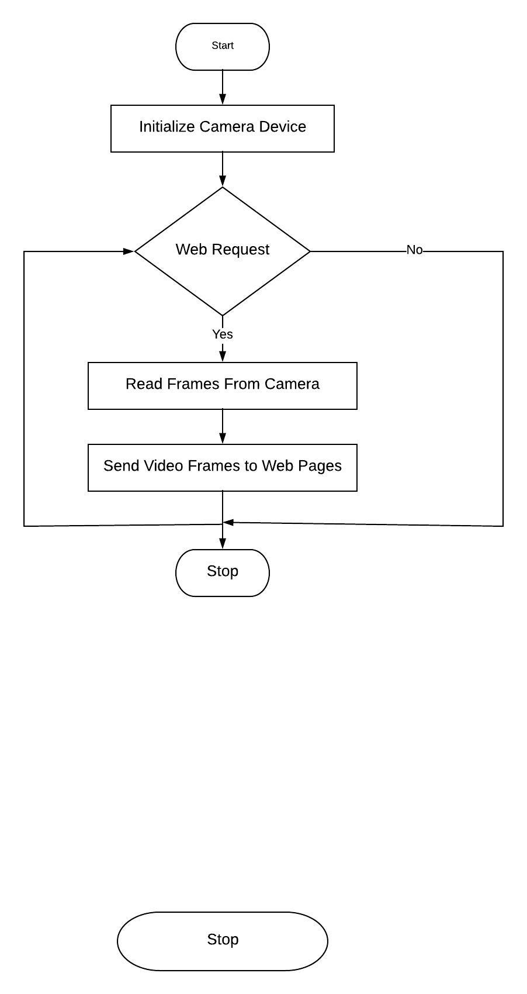
FLOWCHART: for video surveillance

Slide 10
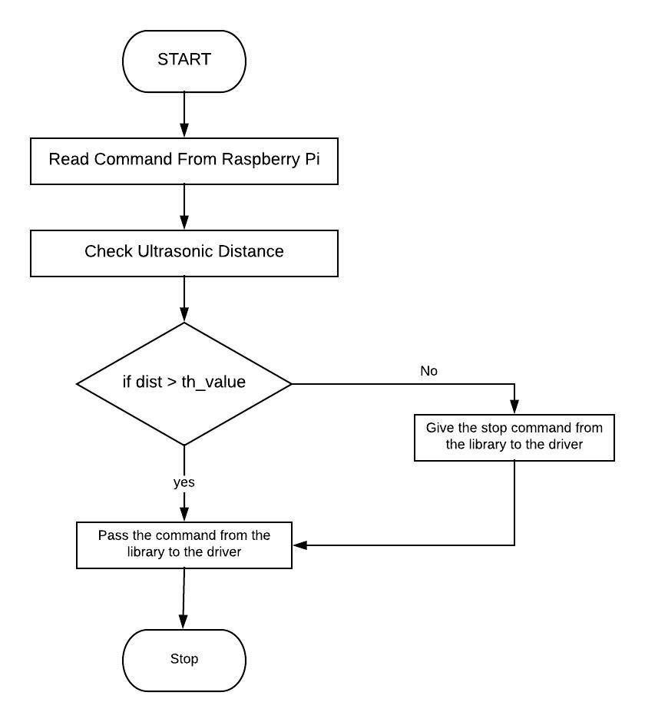
FLOWCHART: for Device Operation

Slide 11
OUTPUT accomplish
Robot can be controlled using the web interface.

Slide 12
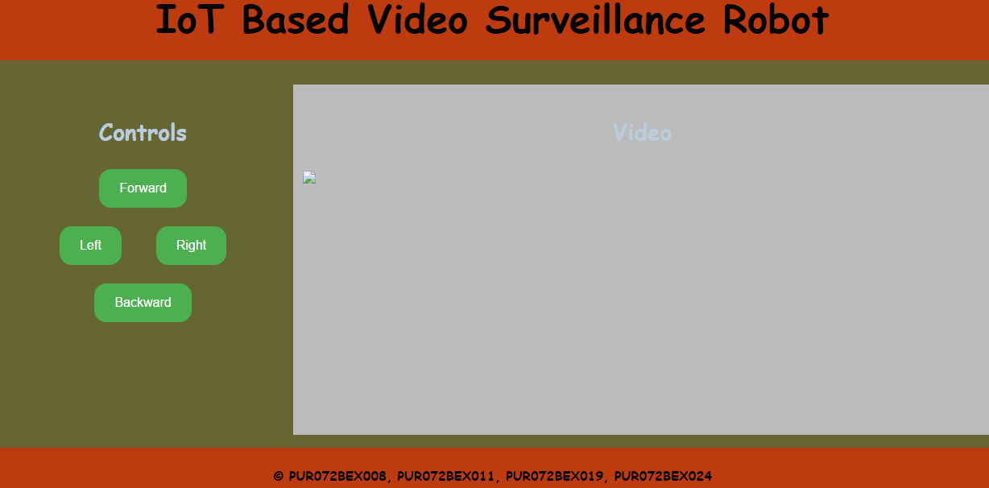
Screenshot of Website

Slide 13
APPLICATIONS
This robot can be used as spy or in similar military purpose.
It can be used to explore the topography of remote place and also can be used to observe the behavior of strange animals.
It is also applicable in rescue operation during earthquake.

Slide 14
REFERENCES
[1] G. Anandravisekar, A. Anto Clinton, T. Mukesh Raj, L. Naveen, "IoT Based Surveillance Robot".International Journal of Engineering Research & Technology (IJERT). ISSN: 2278-0181, March 2018
[2] Jordan Teicher, "The little-known story of the first IoT device". February 7, 2018.[Online].
Available: https://www.ibm.com/blogs/industries/little-known-story-first-iot-device
[3] V. Sriram, A. Sagar,S. Shanmugam, "IoT Based Real Time Monitoring Mobile Robot". School of Computer Science and Engineering, VIT University,Vellore, India. ISSN: 2321-9653, 2017

Slide 15
THANK YOU

