Slide 1
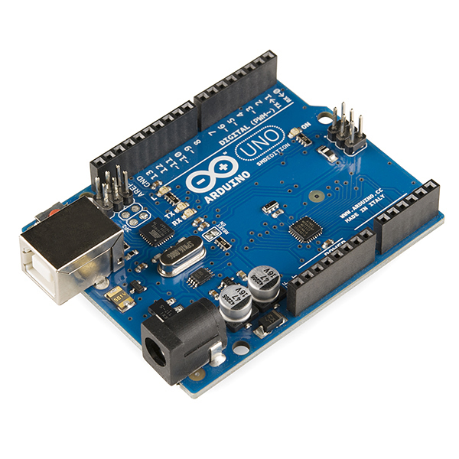
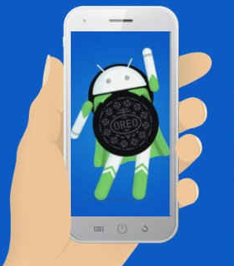
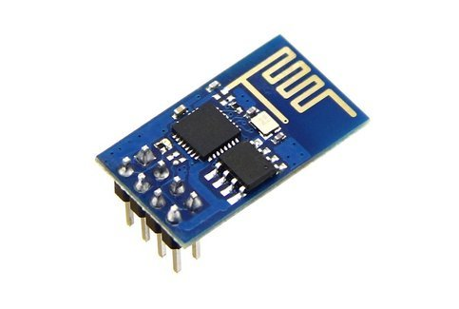
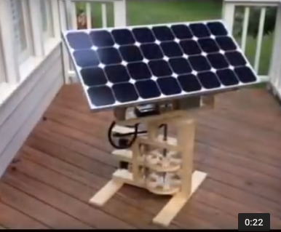
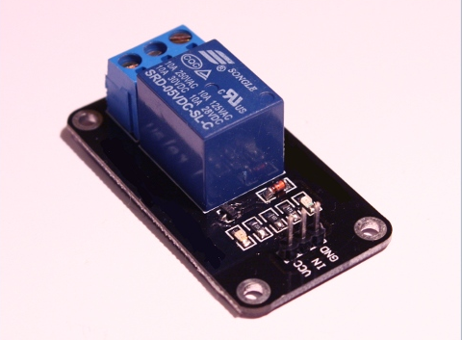

SMART SWITCH WITH AUTOMATED SOLAR PANEL
Internet
Arduino UNO
Wi-fi Module
Android Phones
(voice-recognition )
Automated Solar
Panel
Relays
Lights

Slide 2
THEME
The main theme of our project is to control the house appliances with voice automation and to use the solar panel for power supply to the appliances. (so that easy for the disabled person)
Our project will be smart with the use of technology in every appliances of our house so as to reduce the effort.
Our project will be based on the expo theme 'SMART CITY' i.e. if the technology is implemented in every houses eventually city will be smart.

