Slide 1
Operating System I/O Software
Bibek Parajuli

Slide 2
I/O Software is used for interaction with I/O devices like mouse, keyboards, USB devices, printers, etc.
I/O software is organized in the following ways:
User Level Libraries– Provides a simple interface to program for input-output functions.
Kernel Level Modules– Provides device driver to interact with the device-independent I/O modules and device controller.
Hardware-A layer including hardware controller and actual hardware which interact with device drivers.

Slide 3
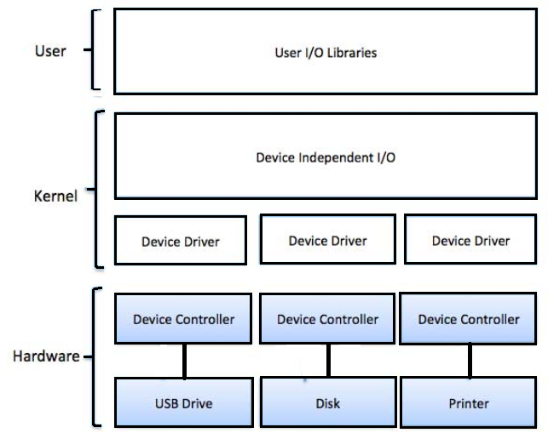

Slide 4
Goals Of I/O Software
Uniform naming: Naming of file systems in Operating Systems is done in a way that the user does not have to be aware of the underlying hardware name.
Synchronous versus Asynchronous: When the CPU is working on some process it goes into the block state when the interrupt occurs. Therefore most of the devices are asynchronous. And if the I/O operation is in a blocking state it is much easier to write the I/O operation. It is always the operating system’s responsibility to create such an interrupt-driven user program.
Error handling: Errors and mostly generated by the controller and also they are mostly handled by the controller itself. When the lower level solves the problem it does not reach the upper level.
Shareable and Non-Shareable Devices: Devices like Hard Disk can be shared among multiple processes while devices like Printers cannot be shared. The goal of I/O software is to handle both types of devices.

Slide 5
Device independence: Programs can access any I/O device. without specifying device in advance. (floppy, hard drive, or CD-ROM).
Buffering: Buffer has a major impact on I/O software as it is the one that ultimately helps store the data and copy data. Many devices have constraints and just to avoid it some data is always put into the buffer in advance so the buffer rate of getting filled with data and getting empty remains balanced.
Caching: Caching is the process in which all the most accessible and most used data is kept in a separate memory (known as Cache memory) for access by creating a copy of the originally available data. The reason for implementing this Caching process is just to increase the speed of accessing the data since accessing the Cached copy of data is more efficient as compared to accessing the original data.

Slide 6
INTERRUPT HANDLER
The mechanism for notifying the operating system that an external event has taken place is to interrupt the currently running thread and transfer control to an interrupt handler.

Slide 7
Function of Interrupt Handler
Perform any I/O request-related processing:
Devices interrupt for different reasons, such as transfer done or transfer error. This step can involve using data access functions to read the device's data buffer, examine the device's error register, and set the status field in a data structure accordingly.
Inform the device that the device is being serviced:
Informing a device about servicing is a device-specific operation that is required for the majority of devices.

Slide 8
Determine whether the device is interrupting and possibly reject the interrupt:
The interrupt handler first examines the device to determine whether this device issued the interrupt. Any device at the given interrupt priority level might have issued the interrupt. Device polling tells the system whether this device issued the interrupt.
Do any additional processing that could prevent another interrupt:
For example, read the next item of data from the device.

Slide 9
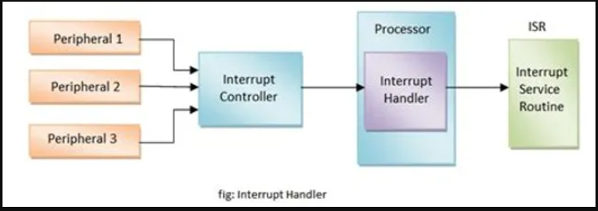

Slide 10
Thank You

