Slide 1

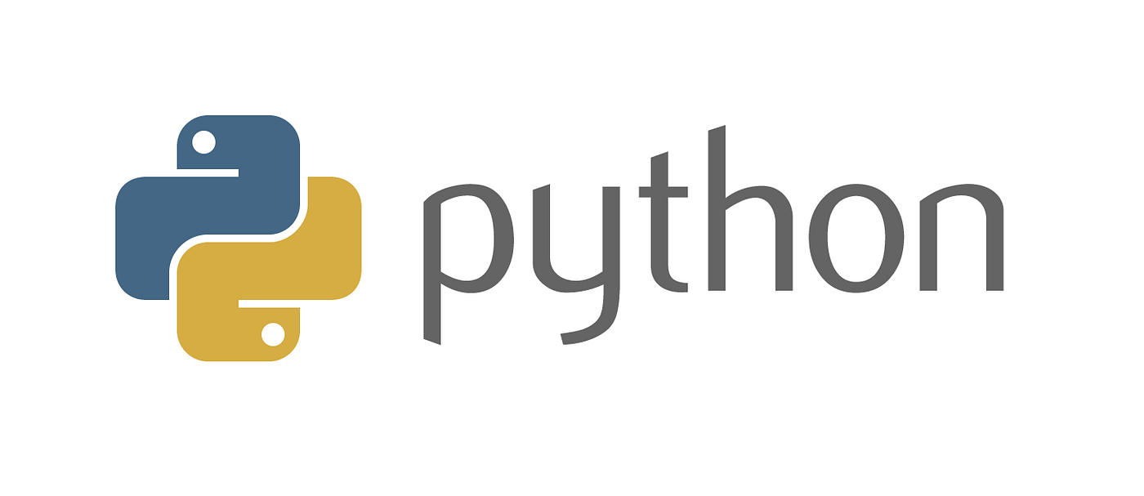
Project Training
BY BIBHURANJAN MOHANTY
DIRECTOR
OPENTECHZ PRIVATE LIMITED
BHUBANESWAR
ODISHA

Slide 2

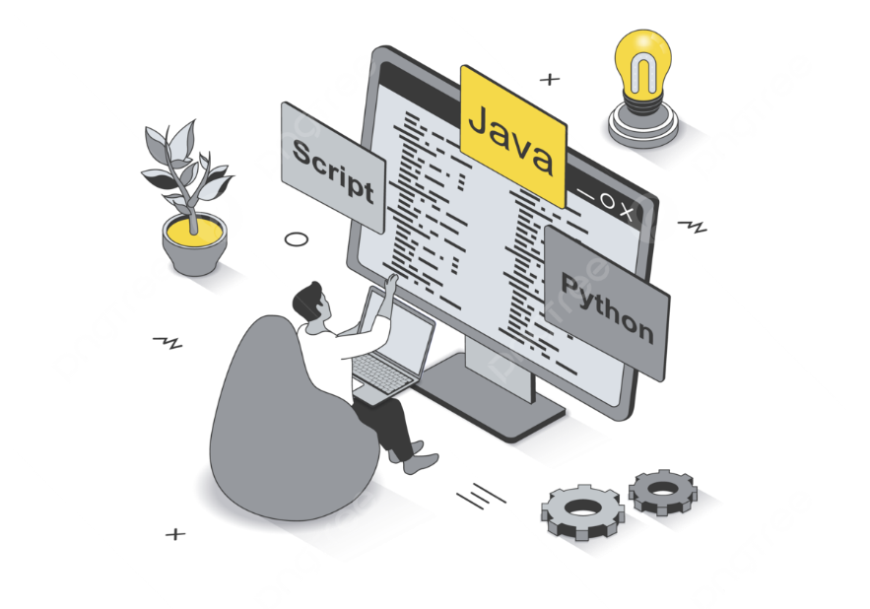

Outlines
Session-01 : Introduction to Python Fundamentals
Session-02 : Advanced Python Concepts
Session-03 : Introduction to Django and MySQL
Session-04 : Django Project Structure and Models
Session-05 : Django Views, Templates, and Forms

Slide 3
Outlines
Session-06 : Django Admin, Authentication, and REST APIs
Session-07 : SDLC & Project Background
Session-08 : Project Features
Session-09 : Viva Questions
Session-10 : PPT & Documentations

Slide 4
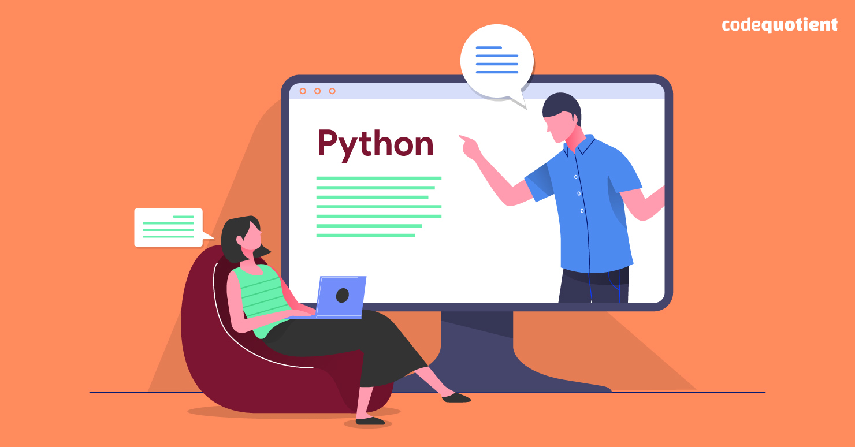
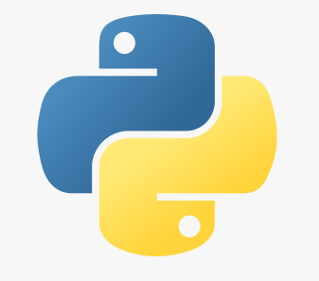
Session-01
Introduction to Python
Overview of Python
History and features
Python's role in web development
Setting up Python environment
Installing Python
Using IDEs (PyCharm, VS Code)

Slide 5
Session-01
Introduction to Python
Python Basics
Variables and data types
Basic operations and functions
Control Structures
Conditional statements
Loops

Slide 6
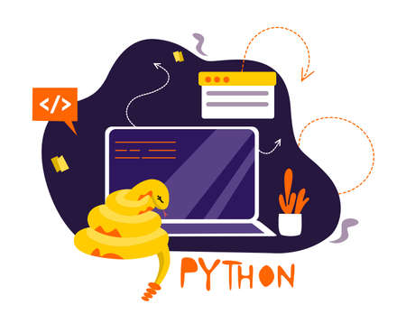
Session-01
Introduction to Python
Overview of Python
What is Python?
Definition:
Python is a high-level, interpreted programming language known for its readability and simplicity.
Purpose:
Designed to be easy to read and write, making it an excellent choice for beginners and experienced developers alike.

Slide 7

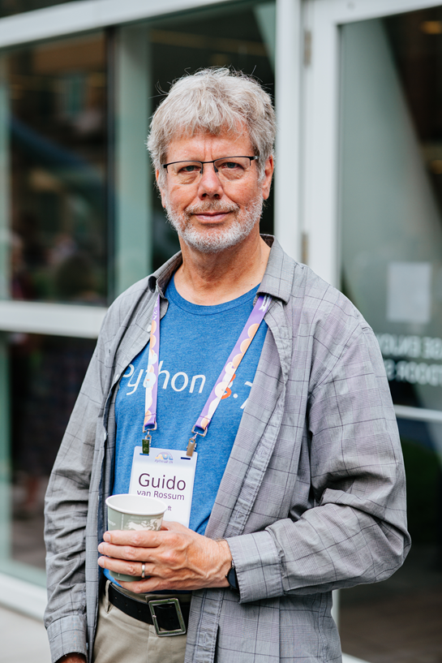
Session-01
Introduction to Python
History of Python?
Creation:
Python was created by Guido van Rossum and first
released in 1991.
Philosophy:
Emphasizes code readability and simplicity.
Evolution:
Python 2.0 (2000):Introduced new features like list comprehensions.
Python 3.0 (2008):Significant changes to improve the language's consistency and performance.

Slide 8

Session-01
Introduction to Python
Key Features:
Readability:
Clear and easy-to-read syntax.
Simplicity:
Simple and minimalistic design.
High-Level Language:
Abstracts low-level details.
Interpreted Language:
Large, active community with abundant resources and documentation.

Slide 9
Session-01
Introduction to Python
Key Features:
Dynamic Typing:
No need to declare variable types explicitly.
Extensive Libraries:
Rich standard library and a vast collection of third-party packages.
Portability:
Runs on various platforms (Windows, MacOS, Linux).
Community Support:
Runs on various platforms (Windows, MacOS, Linux).

Slide 10
Session-01
Introduction to Python
Why Choose Python?
Community Support
Readability
Extensive Libraries
WHY ?
Productivity
Versatility

Slide 11
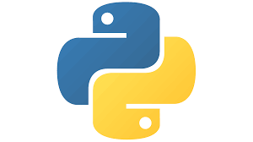
Session-01
Introduction to Python
Popular Use Cases:
Web Development: Frameworks like Django and Flask.
Data Science: Libraries like Pandas, NumPy, and Matplotlib.
Machine Learning: Libraries like TensorFlow, Keras, and Scikit-learn.
Automation: Scripts for automating repetitive tasks.
Game Development: Libraries like Pygame.

Slide 12
Session-01
Introduction to Python
Setting up Python Environment
Install Python:
Download:
Visit the official Python website.
Download the latest version for your operating system (Windows, MacOS, Linux).
Install:
Run the downloaded installer.
Ensure you check the option to Add Python to PATH during installation.

Slide 13
Session-01
Introduction to Python
Setting up Python Environment
Verify Installation:
Open Command Prompt/Terminal:
Windows: Open Command Prompt.
MacOS/Linux: Open Terminal.
Check Python Version:
python --version or python3 --version.

Slide 14
Session-01
Introduction to Python
Setting up Python Environment
Install a Code Editor:
Visual Studio Code:
Download from the official website.
Install and open Visual Studio Code.
Install Python Extension:
Go to the Extensions view by clicking the Extensions icon or pressing
Ctrl + Shift + X.
Search for “Python” and install the official Python extension by Microsoft.

Slide 15
Session-01
Introduction to Python
Setting up Python Environment
Setting Up a Virtual Environment:
Create a Virtual Environment:
Navigate to your project directory.
Run the following command python -m venv myenv
Activate the Virtual Environment:
Windows:
myenv\Scripts\activate

Slide 16
Session-01
Introduction to Python
Setting up Python Environment
Install Necessary Packages:
Using pip:
Install packages as needed, e.g., Django, Flask.
Example:
pip install django
pip install flask

Slide 17

Session-01
Introduction to Python
Python Basics
Variables and data types
Variables: Used to store data values.

Slide 18
Session-01
Introduction to Python
Python Basics
Data Types
Numeric: int, float, complex
Text: str
Sequence: list, tuple, range
Mapping: dict
Set: set, frozenset
Boolean: bool
None: NoneType

Slide 19



Session-01
Introduction to Python
Python Basics
Basic operations and functions
Arithmetic Operators:
Addition: +
Subtraction: -
Multiplication: *
Division: /
Floor Division (//):
Modulus (%)
Exponentiation (**)

Slide 20

Session-01
Introduction to Python
Python Basics
Basic operations and functions
Comparison Operators:
Equal (==)
Not Equal (!=)
Greater Than (>)
Equal (==)
Not Equal (!=)

Slide 21


Session-01
Introduction to Python
Python Basics
Basic operations and functions
Comparison Operators:
Greater Than (>)
Less Than (<)
Greater Than or Equal To (>=)
Less Than or Equal To (<=)

Slide 22



Session-01
Introduction to Python
Python Basics
Basic operations and functions
Logical Operators:
AND (and)
OR (or)
NOT (not)

Slide 23


Session-01
Introduction to Python
Python Basics
Assignment Operators: :
Assign (=)
Add and Assign (+=)

Slide 24





Session-01
Introduction to Python
Python Basics
Bitwise Operators :
AND (&)
OR (|)
XOR (^)
NOT (~)
Left Shift (<<)
Right Shift (>>)

Slide 25
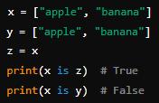

Session-01
Introduction to Python
Python Basics
Identity Operators:
Is (is)
Is Not (is not)

Slide 26

Session-01
Introduction to Python
Python Basics
Membership Operators:
In (in)
Not In (not in):

Slide 27
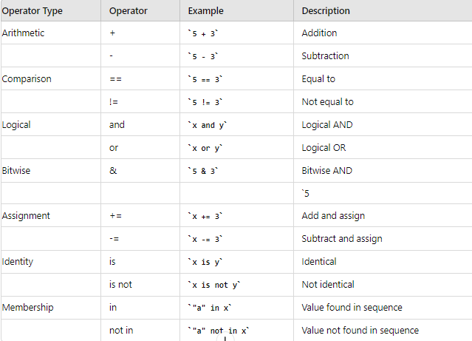
Session-01
Introduction to Python

Slide 28
Session-01
Introduction to Python
Control Statements

Slide 29
Session-01
Introduction to Python
Conditional statements (Decision Making)
if statement
if...else statement
if...elif...else staement
Nested if..else statement

Slide 30
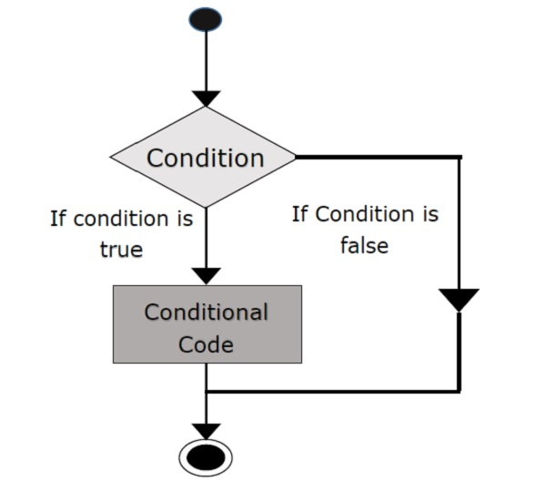
Session-01
Introduction to Python
The if statement
The if statement is a decision making statement. It is used to control the flow of execution of the statements and also used to test logically whether the condition is true or false.
Syntax
if test expression:
statement(s)

Slide 31
Session-01
Introduction to Python
Example
i = int (input(“Enter the number:”))
If (i<=10):
print(“ condition is true”)
Output
Enter the number: 9
Condition is true

Slide 32
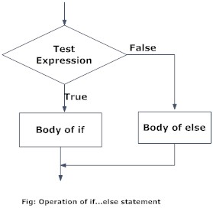
Session-01
Introduction to Python
The If … else statement
The if…else statement is called alternative execution, in which there are two possibilities and the condition determines which one gets executed.
Syntax
if test expression:
Body of if
else:
Body of else

Slide 33
Session-01
Introduction to Python
Example : Write a program to check if a number is Odd or Even
num = int(input(“Enter the number:”))
if (num % 2)== 0:
print (“Given number is Even”)
else:
print(“ Given number is Odd”)
Output
Enter the number: 9
Given number is Odd

Slide 34
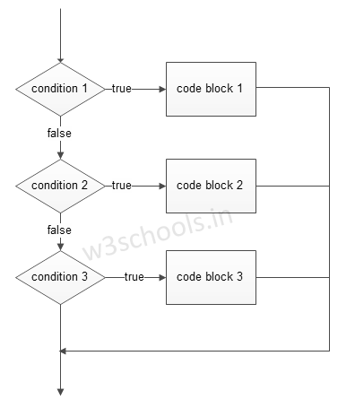
Session-01
Introduction to Python
The elif Statements
elif – is a keyword used in Python in replacement of else if to place another condition in the program. This is called chained conditional.
Chained conditions allows more than two possibilities and need more than two branches.
Syntax
if expression:
Body of if
elif expression:
Body of elif
else:
Body of else

Slide 35
Session-01
Introduction to Python
Example : Write a program to find largest among three numbers
a = int(input(“Enter 1st number:”))
b= int(input(“Enter 2nd number:”))
c= int(input(“Enter 3rd number:”))
if (a > b) and (a > c):
print("a is greater")
elif (b < a) and (b < c):
print(“b is greater")
else:
print(“c is greater")
OUTPUT
Enter 1st number:10
Enter 2nd number:25
Enter 3rd number:15
B is greater

Slide 36
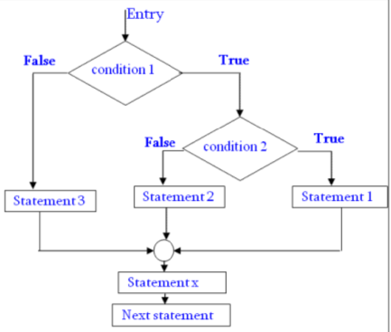
Session-01
Introduction to Python
The Nested if … else Statements
We can write an entire if… else statement in another if… else statement called nesting, and the statement is called nested if.
In a nested if construct, you can have an if … elif … else construct inside an if … elif.. Else construct.
Syntax
if expression1:
statement(s)
if expression2:
statement(s)
elif expression3:
statement(s)
else:
statement(s)
.

Slide 37
Session-01
Introduction to Python
Example : Write a program to find largest among three numbers
n = int(input(“Enter number:”))
If (n<=15):
if (n == 10):
print(‘play cricket’)
else:
print(‘play kabadi’)
Else:
print(‘Don’t play game’)
OUTPUT
Enter number : 10
Play cricket

Slide 38
Session-01
Introduction to Python
The Loop Control Statements
while statement
for loop statement
Nested loop staement

Slide 39
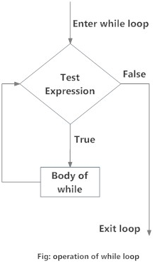
Session-01
Introduction to Python
The While loop statement
A while loop statement in Python programming language repeatedly executes a target statement as long as a given condition is true.
Syntax of while loop
while expression:
statement(s)

Slide 40
Session-01
Introduction to Python
Example : Write a program to find sum of number
num = int(input("Enter a number: "))
sum = 0
while(num > 0):
sum = sum+num
num = num-1
print("The sum is",sum)
OUTPUT
Enter a number: 10
The sum is 55

Slide 41
Session-01
Introduction to Python
Using else statement with while loops
Python supports to have an else statement associated with a loop statement.
If the else statement is used with a while loop, the else statement is executed when the condition false.
Program to illustrate the else in while loop
counter = 0
while counter < 3:
print("Inside loop")
counter = counter + 1
else:
print(“Outside loop")
OUTPUT
Inside loop
Inside loop
Inside loop
Outside loop

Slide 42
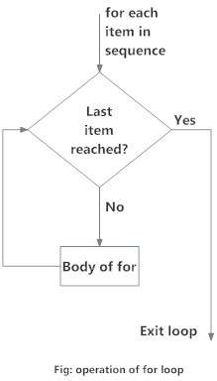
Session-01
Introduction to Python
For loop statement
The for loop is another repetitive control structure, and is used to execute a set of instructions repeatedly, until the condition becomes false.
The for loop in Python is used to iterate over a sequence (list, tuple, string) or other iterable objects. Iterating over a sequence is called traversal.
Syntax
for val in sequence:
Body of for loop

Slide 43
Session-01
Introduction to Python
Example : Write a program for addition of number using for loop
numbers = [6, 5, 3, 8, 4, 2, 5, 4]
sum1 = 0
for val in numbers:
sum1 = sum1+val
print("The sum is", sum1)
OUTPUT
The sum is 37

Slide 44
Session-01
Introduction to Python
for Loop and for Loop with else
Example-1
Example-2
genre = ['pop', 'rock', 'jazz']
for i in range( len (genre)):
print("I like", genre[i])
genre = ['pop', 'rock', 'jazz']
for i in range(len(genre)):
print("I like", genre[i])
else:
print("No items left.")
OUTPUT
I like pop
I like rock ​
I like jazz
OUTPUT
I like pop
I like rock ​
I like jazz
No items left.

Slide 45
Session-02
Advanced Python Concepts
Data Structures
Lists, tuples, sets, and dictionaries
Functions and Modules
Defining and calling functions
Importing modules and packages
Object-Oriented Programming
Classes and objects
Inheritance and polymorphism

Slide 46
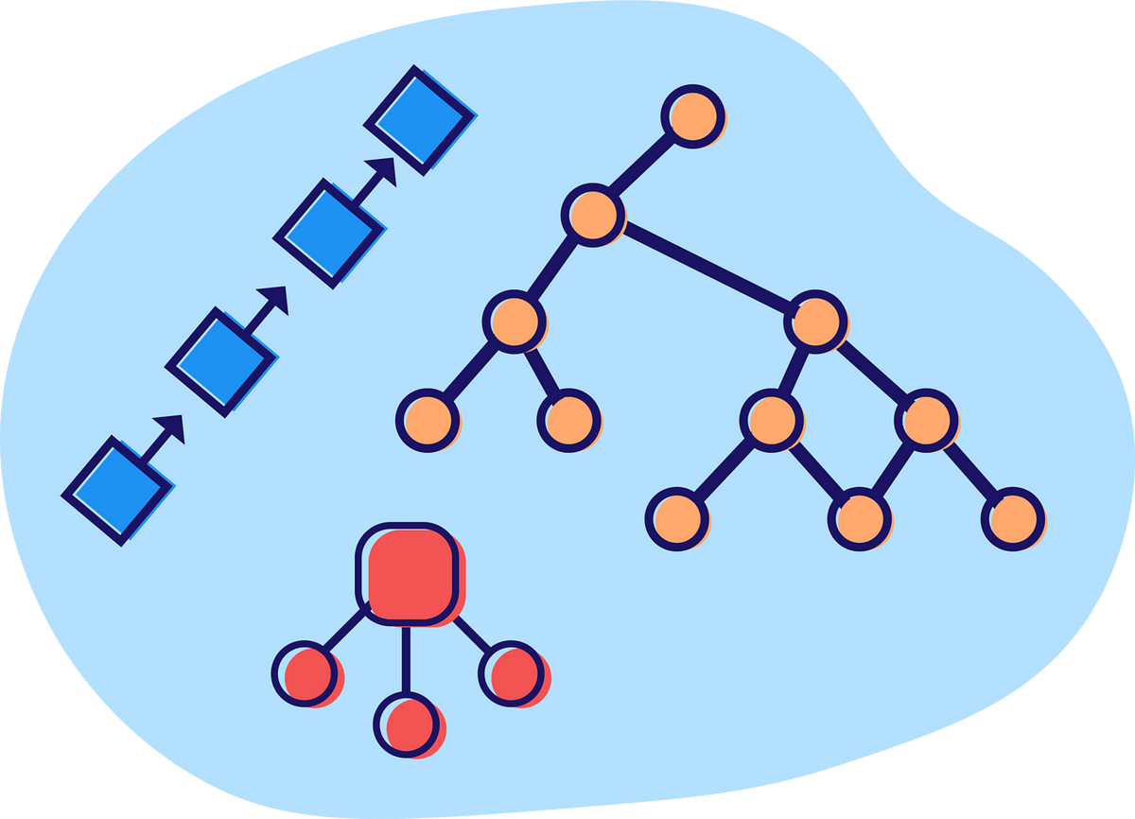
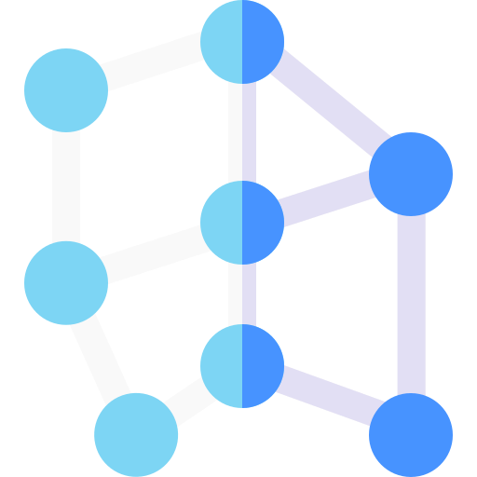
Session-02
Data Structures

Slide 47
Session-02
Data Structures
Inbuilt Data Structures
User Defined Data Structures
List
Dictionary
Tuple
Set
Linked List
Stack
Queue
Tree
Hash Map

Slide 48
Session-02
List
Tuple
Set
Dictionary
General Purpose
Most widely used data structure
Immutable (Can’t add or change)
Useful for fixed data
Faster than the lists
Sequence type
Store non-duplicate items
Very fast access vs Lists
Math Set Ops
Unordered, unchangeable
Store non-duplicate items
Unordered
Change size as needed
Key/value pairs
Change size as needed
Change size as needed
Uses square bracket “[…]”
Uses round bracket “(…)”
Allow duplicate values
Allow duplicate values
duplicate values ignored
Uses curly bracket “{…}”
immutable
Duplicate values ignored
Uses curly bracket “{…}”

Slide 49
Inbuilt Data Structures
Lists
Lists are used to store multiple items in a single variable.
List items are ordered, changeable, and allow duplicate values.
List items are indexed, the first item has index [0], the second item has index [1] etc.
FORMAT : variable_name = [ value1, …, value n]
Eg.
myList1 = [] # Create an empty list
myList2 = [1, 2, 3]
myList3 =[1, “Hello”, 3]
myList4 = [0] *3 #[0, 0, 0]

Slide 50
index
The first element of a List is index as 0 instead of 1.
The highest element number is one less than total number of elements.
index | 0 | 1 | 2 | 3 | 4
value | 0 | 0 | 0 | 0 | 0
Original: Value = [0, 0, 0, 0, 0]
Value[0] = 10
Value[1] = 1
Value[2] = 30
UpdatedValue = [10, 1, 30, 0, 0]
index | 0 | 1 | 2 | 3 | 4
value | 10 | 1 | 30 | 0 | 0

Slide 51
Example (Slicing)
index | 0 | 1 | 2 | 3 | 4
value | 10 | Apple | 12 | 13 | 14
myList = [10, “Apple”, 12, 13, 14]
print (myList[1:2]) => [‘Apple’]
print (myList[:2] => [10, ‘Apple’]
print (myList[2:]) => [12, 13, 14]
print (myList[-3:-1]) => [13, 14]
if 12 in myList: print(myList)
else: print("Not found") => [10, ‘Apple’, 12, 13, 14]

Slide 52
Example (Updating List)
myList = [10, “Apple”, 12, 13, 14]
print (myList) => Output: [10, 20, 30, 12, 13, 14]
myList.insert (3, 40)
print( myList) => Output: [10, 20, 30, 40, 12, 13, 14]
myList.append(15)
print( myList) => Output: [10, 20, 30, 40, 12, 13, 14, 15]
del myList[2]
print (myList) => Output: [10, 20, 40, 12, 13, 14, 15]
del myList [1:4]
print (myList) => Output: [10, 13, 14, 15]
myList.clear()
print(myList) => Output: []
myList[1:2] = [20, 30]
index | 0 | 1 | 2 | 3 | 4
value | 10 | Apple | 12 | 13 | 14

Slide 53
Example (Merging lists)
myList1 = [10, 20, 30]
myList2 = [40, 50, 60, 70, 80]
newList1 = myList1 + myList2
or
for index in myList2:
myList1.append(index)
or
myList1.extend(myList2)
print (myList1)
Output: [10, 20, 30, 40, 50, 60, 70, 80]
Copyright (c) O

Slide 54
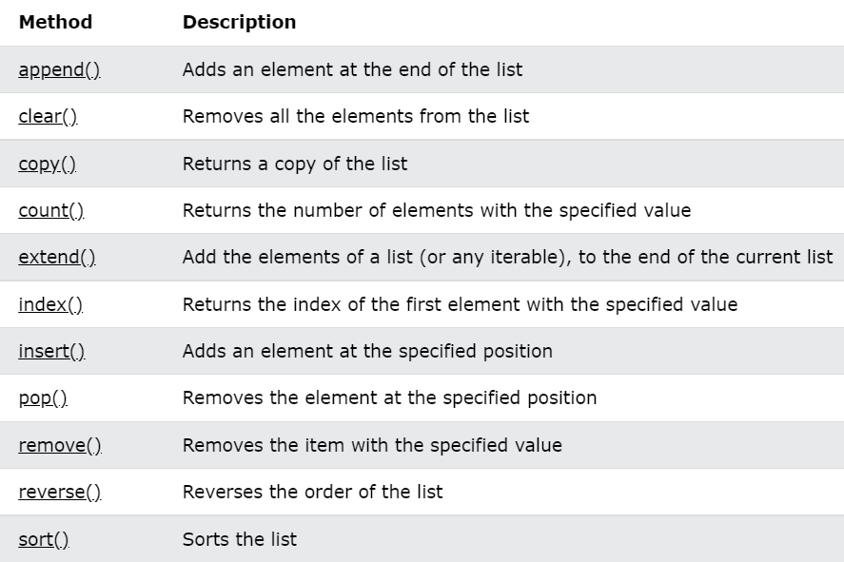
Methods in Lists

Slide 55
Session-02
List
Tuple
Set
Dictionary
General Purpose
Most widely used data structure
Immutable (Can’t add or change)
Useful for fixed data
Faster than the lists
Sequence type
Store non-duplicate items
Very fast access vs Lists
Math Set Ops
Unordered, unchangeable
Store non-duplicate items
Unordered
Change size as needed
Key/value pairs
Change size as needed
Change size as needed
Uses square bracket “[…]”
Uses round bracket “(…)”
Allow duplicate values
Allow duplicate values
duplicate values ignored
Uses curly bracket “{…}”
immutable
Duplicate values ignored
Uses curly bracket “{…}”

Slide 56

Tuple
Tuples are used to store multiple items in a single variable.
Tuple items are ordered, unchangeable, and allow duplicate values.
Tuple items are indexed, the first item has index [0], the second item has index [1] etc.
A tuple is a collection which is ordered and unchangeable.
Tuples are written with round brackets.
Eg.

Slide 57
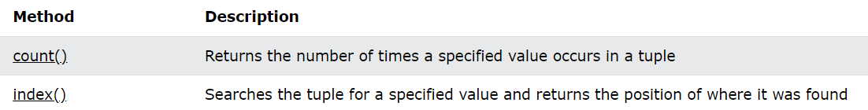
Methods in Tuple

Slide 58
Examples (Tuple)
myTuple = ("Apple", 10, "Orange", "Grapes", 20.0, 10)
print( myTuple[3]) => Grapes
print( myTuple[-1]) => 10
print( myTuple[2:4]) => (‘Orange’, ‘Grapes’)
print( myTuple[:4]) => (‘Apple’, 10, ‘Orange’, ‘Grapes’)
print( myTuple[2:]) => (‘Orange’, ‘Grapes’, 20.0, 10)
print( myTuple[-4:-1]) => (‘Orange’, ‘Grapes’, 20.0)
Copyright (c) NR Computer Learning Center . www.nrclc.com

Slide 59
Session-02
List
Tuple
Set
Dictionary
General Purpose
Most widely used data structure
Immutable (Can’t add or change)
Useful for fixed data
Faster than the lists
Sequence type
Store non-duplicate items
Very fast access vs Lists
Math Set Ops
Unordered, unchangeable
Store non-duplicate items
Unordered
Change size as needed
Key/value pairs
Change size as needed
Change size as needed
Uses square bracket “[…]”
Uses round bracket “(…)”
Allow duplicate values
Allow duplicate values
duplicate values ignored
Uses curly bracket “{…}”
immutable
Duplicate values ignored
Uses curly bracket “{…}”

Slide 60
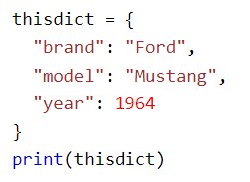
Dictionary
Dictionaries are used to store data values in key:value pairs.
A dictionary is a collection which is ordered*, changeable and do not allow duplicates.
Dictionaries are written with curly brackets, and have keys and values.
Eg.

Slide 61
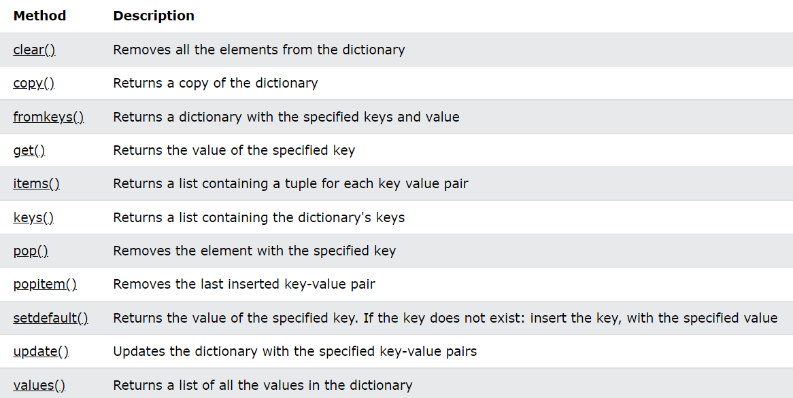
Methods in Dictionary

Slide 62
Example (Dictionary)
Friends = {"Sandy":25, "John": 20, "Jane": 22}
print(myFriends["Sandy“]) → output: 25
myFriends["Sandy"] = 30
print ( myFriends.items()) → output: ('Sandy',30), ('John', 20), ('Jane', 22)
myFriends.update ({"Sandy": 40})
print (myFriends.items()) → output: ('Sandy’,40), ('John', 20), ('Jane', 22)
myFriends.pop("Sandy")
print (myFriends.items()) → output: ('John', 20), ('Jane', 22)
myFriends.popitem()
print (myFriends.items()) → output: ('Sandy', 25), ('John', 20)
del myFriends["Sandy"]
print (myFriends.items()) → output: ('John', 20), ('Jane', 22)
del myFriends
print (myFriends.items()) → output: Error
print( Friends.items()) → output: ('Sandy’,25), ('John', 20), ('Jane', 22)
print( Friends.keys()) → output: ‘Sandy’, ‘John’, ‘Jane’
print( Friends.values()) → output: 25, 20. 22
Copyright (c) NR Computer Learning Center . www.nrclc.com

Slide 63
Session-02
List
Tuple
Set
Dictionary
General Purpose
Most widely used data structure
Immutable (Can’t add or change)
Useful for fixed data
Faster than the lists
Sequence type
Store non-duplicate items
Very fast access vs Lists
Math Set Ops
Unordered, unchangeable
Store non-duplicate items
Unordered
Change size as needed
Key/value pairs
Change size as needed
Change size as needed
Uses square bracket “[…]”
Uses round bracket “(…)”
Allow duplicate values
Allow duplicate values
duplicate values ignored
Uses curly bracket “{…}”
immutable
Duplicate values ignored
Uses curly bracket “{…}”

Slide 64

Inbuilt Data Structures
Sets
Sets are used to store multiple items in a single variable.
A set is a collection which is unordered, unchangeable*, and unindexed.
Sets are written with curly brackets.
Eg.

Slide 65
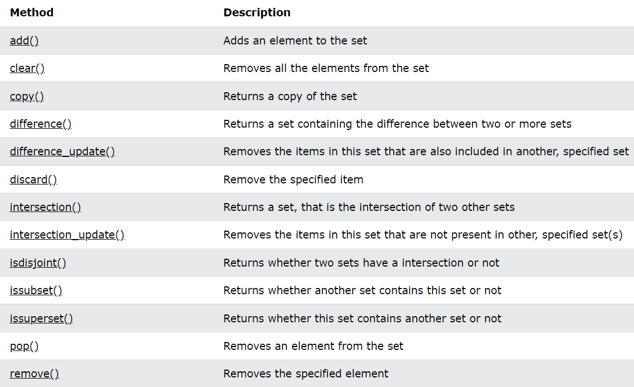
Methods in Set

Slide 66
Example (Set)
mySet1 = {"Apple", 10, "Orange", "Grapes", 20.0}
mySet2 = {30.0, 10, "Orange", "Apple", 40}
Print (mySet1 | mySet2) or print(mySet1.union(mySet2))
➔{"Apple", 40, 10, "Grapes", 20.0, “Orange”, 30.0}
Print (mySet1 & mySet2) or print(mySet1.intersection(mySet2))
{10, ‘Apple’, ‘Orange’}
Print (mySet1 – mySet2) or print(mySet1.difference(mySet2))
{‘Grapes’, 20.0}
Print (mySet1 ^ mySet2) or print(mySet1.symmetric_difference(mySet2))
➔ {‘Grapes’, 20.0, 30.0, 40}
A
B
A Union B
A
B
A interest B
A
B
A difference B
A
B
Copyright (c) NR Computer Learning Center . www.nrclc.com

Slide 67
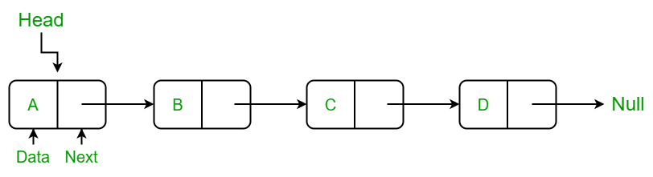
User Defined Data Structures
Linked List
Linked List is a linear data structure. Unlike arrays, linked list elements are not stored at a contiguous location; the elements are linked using pointers. They include a series of connected nodes. Here, each node stores the data and the address of the next node.

Slide 68
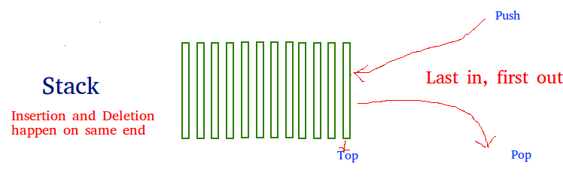
User Defined Data Structures
Stack
A stack is a linear data structure that stores items in a Last-In/First-Out (LIFO) or First-In/Last-Out (FILO) manner. In stack, a new element is added at one end and an element is removed from that end only. The insert and delete operations are often called push and pop.

Slide 69
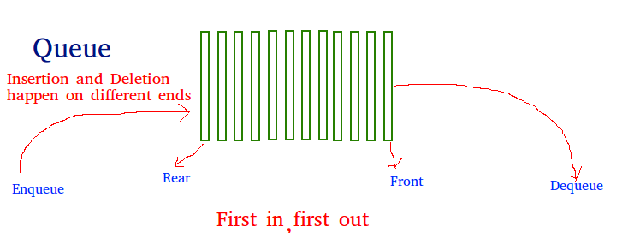
User Defined Data Structures
Queue
Like stack, queue is a linear data structure that stores items in First In First Out (FIFO) manner. With a queue the least recently added item is removed first. A good example of queue is any queue of consumers for a resource where the consumer that came first is served first.

Slide 70
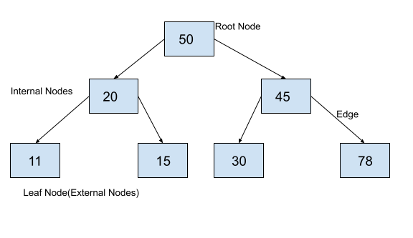
User Defined Data Structures
Tree
Tree represents the nodes connected by edges. It is a non-linear data structure. It has the following properties −
One node is marked as Root node.
Every node other than the root is associated with one parent node.
Each node can have an arbiatry number of child node.

Slide 71
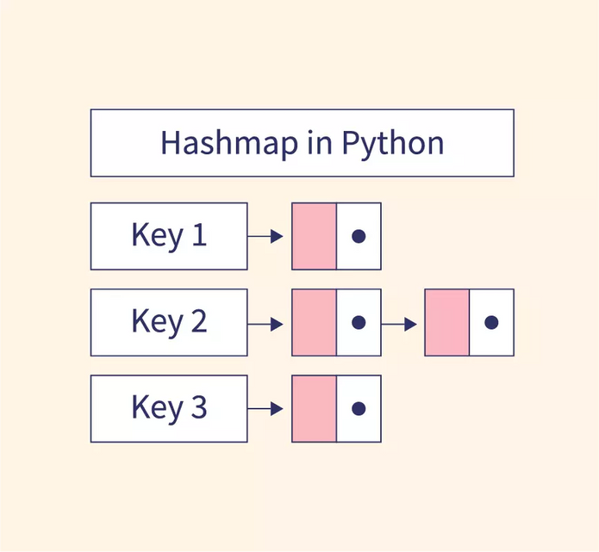
User Defined Data Structures
Hash Map
Hash maps are indexed data structures. A hash map makes use of a hash function to compute an index with a key into an array of buckets or slots. Its value is mapped to the bucket with the corresponding index. The key is unique and immutable. Think of a hash map as a cabinet having drawers with labels for the things stored in them. For example, storing user information- consider email as the key, and we can map values corresponding to that user such as the first name, last name etc to a bucket.

Slide 72
Session-03
Introduction to Django and MySQL
Overview of Django Framework
What is Django?
Setting up Django
Creating a Django project
Introduction to MySQL
Overview of MySQL
Setting up MySQL database
Configuring Django to use MySQL

Slide 73
Session-04
Django Project Structure and Models
Overview of Django Framework
Apps vs. projects
Defining models
Using Django ORM
Creating a Django app
python manage.py startapp
Defining and migrating models

Slide 74
Session-05
Django Views, Templates, and Forms
Django Views
Function-based views vs. class-based views
Displaying data with templates
Templates
Template system and inheritance
Forms
Creating and handling forms in Django
Form validation and submission

Slide 75
Session-06
Django Admin, Authentication
Django Admin
Customizing the admin interface
Registering models in admin
User Authentication
User login, logout, and registration
Implementing authentication

Slide 76
Session-07
SDLC & Project Background
SDLC
What is SDLC?
Project Background
Overview of the project
Modules in the project
Requirement Specification
Technologies Used

Slide 77
Session-08
Project Features

Slide 78
Session-09
Viva

Slide 79
Session-10
PPT & Documentation

Slide 80
Questions ?

Slide 81
Thank YOU

