Slide 1

🔑 Real-Time Problems
Problem Definition
Analysis
Design (flowchart/pseudocode)
Implementation

Slide 2
🟢 Problems
1. Sum of First N Natural Numbers
✅ Problem :
Calculate sum of first N natural numbers.
Input: N
Process: Loop from 1 to N, add each number
Output: Sum
🔍 Analysis :

Slide 3
🟢 Simple Problems
1. Sum of First N Natural Numbers
START
Input N
Sum = 0
FOR i = 1 to N
Sum = Sum + i
PRINT Sum
END
📐 Design :

Slide 4
2. Number Guessing Game
✅ Problem :
User guesses a number until they get it right.
Input: user guesses
Process: Random number generated, user guesses until correct
Output: Correct guess message
🔍 Analysis :

Slide 5
START
Generate random number
DO
Input guess
IF guess > random number
PRINT "Too high"
ELSE IF guess < random number
PRINT "Too low"
ELSE
PRINT "Correct"
WHILE guess != random number
END
📐 Design :

Slide 6
3. Prime Number Checker
✅ Problem :
Check if a number is prime.
Input: integer
Process: Loop from 2 to sqrt(n), check if divisible
Output: Prime or Not
🔍 Analysis :

Slide 7
START
Input number
IF number <= 1 THEN
PRINT "Not Prime"
ELSE
FOR i = 2 to number/2
IF number % i == 0 THEN
PRINT "Not Prime"
STOP
PRINT "Prime"
END
📐 Design :

Slide 8
4. ATM Withdrawal System (Simple)
✅ Problem :
Simulate ATM withdrawal with a balance check.
Input: balance, withdrawal amount
Process: Check if sufficient balance, deduct or deny
Output: Transaction status
🔍 Analysis :

Slide 9
START
Set balance = 10000
Input withdrawalAmount
IF withdrawalAmount <= balance
balance = balance - withdrawalAmount
PRINT "Withdraw successful, remaining balance: " + balance
ELSE
PRINT "Insufficient funds"
END
📐 Design :

Slide 10
⚙ Implementation

Slide 11
5. Simple Inventory System (Product Entry & Display)
Create a simple inventory system where the user can add up to 5 products (name + price) and then display them.
📌 Problem :
Input: Product name & price (up to 5 products)
Process: Store in array, loop to input & display
Output: List of products with prices
🔍 Analysis :

Slide 12
products = []
for i = 1 to 5
input productName
input productPrice
store productName, productPrice in products array
end for
for each product in products
print product name & price
end for
🔧 Design :

Slide 13
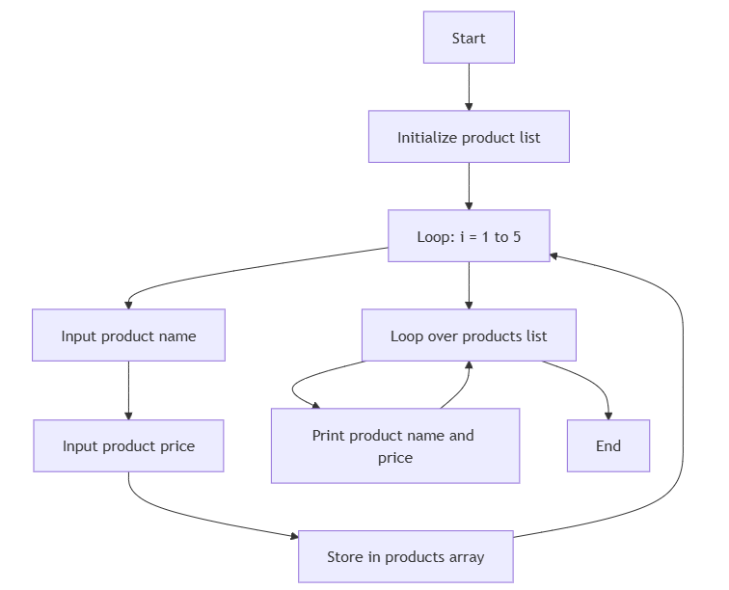
⚙ Flow Chart

Slide 14
⚙ Implementation

Slide 15
6. ATM System
Create an ATM system where a user can:
Deposit money
Withdraw money
Check balance
Exit
📌 Problem :
Input : Choice (1-4), Amount
Process : Use a loop to repeat options
Output : Current balance after every action
🔍 Analysis :

Slide 16
balance = 0
do
print menu
input choice
if choice = 1
input depositAmount
balance += depositAmount
else if choice = 2
input withdrawAmount
if withdrawAmount <= balance
balance -= withdrawAmount
else
print "Insufficient Balance"
else if choice = 3
print balance
end if
while choice != 4
🔧 Design :

Slide 17
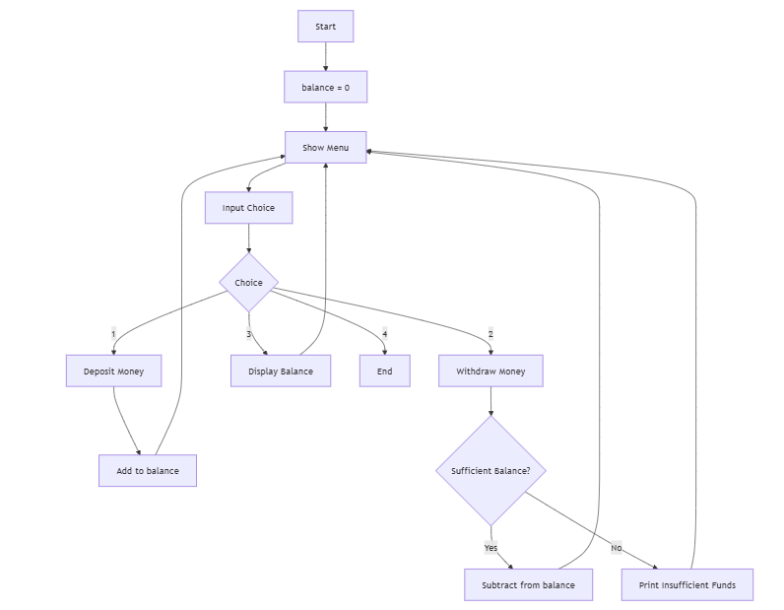
⚙ Flow Chart

Slide 18
⚙ Implementation

Slide 19
7. Student Grades Calculator
Calculate and display the average marks for 5 students, each having 3 subjects.
📌 Problem :
Input : 3 marks for 5 students
Process : Loop for students & subjects
Output : Average for each student
🔍 Analysis :

Slide 20
for student = 1 to 5
totalMarks = 0
for subject = 1 to 3
input marks
totalMarks += marks
end for
average = totalMarks / 3
print average
end for
🔧 Design :

Slide 21
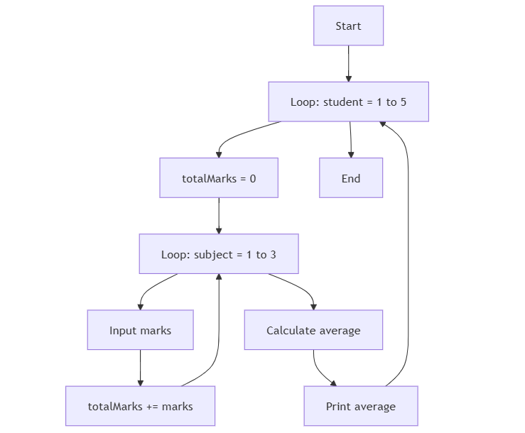
⚙ Flow Chart

Slide 22
⚙ Implementation

Slide 23
8. Password Verification
Allow the user 3 attempts to enter the correct password ("admin123"). Lock after 3 failures.
📌 Problem :
Input : Password (3 attempts)
Process : Compare each attempt
Output : Success or Lock Message
🔍 Analysis :

Slide 24
attempts = 0
correctPassword = "admin123"
while attempts < 3
input password
if password = correctPassword
print "Access Granted"
exit
else
print "Wrong Password"
attempts += 1
end while
print "Account Locked"
🔧 Design :

Slide 25
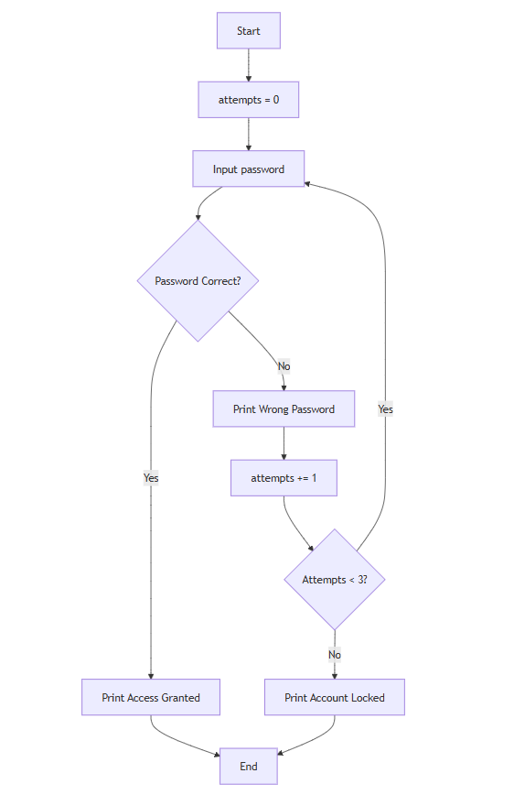
⚙ Flow Chart

Slide 26
⚙ Implementation

Slide 27
9. Prime Numbers Between Two Numbers
Print all prime numbers between two numbers provided by user.
📌 Problem :
Input : Start number, End number
Process : Loop through numbers, check prime
Output : List of prime numbers
🔍 Analysis :

Slide 28
input start, end
for num = start to end
isPrime = true
for i = 2 to num/2
if num % i = 0
isPrime = false
break
end for
if isPrime
print num
end for
🔧 Design :

Slide 29
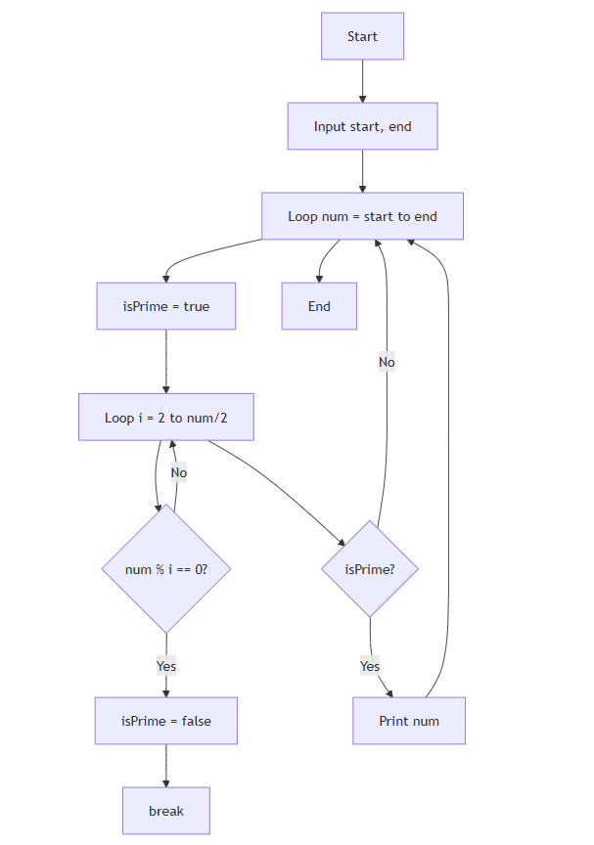
⚙ Flow Chart

Slide 30
⚙ Implementation

Slide 31
10. Prime Numbers Between Two Numbers
A parking lot has 3 floors, each with 5 slots. Vehicles can enter the lot, and the system must find the next available slot (floor and slot number) and assign it. If all slots are filled, the system should display "Parking Full". Use nested loops to scan each floor and slot.
📌 Problem :
3 Floors, each with 5 slots.
Status can be 0 (empty) or 1 (occupied).
When a car arrives, find the first available slot.
Nested loops required to check floors and slots.
🔍 Analysis :

Slide 32
floors = 3
slots = 5
parkingLot[floors][slots] = initialize to 0
while (true)
carArrives()
slotFound = false
for each floor from 0 to 2
for each slot from 0 to 4
if parkingLot[floor][slot] == 0
parkingLot[floor][slot] = 1
display "Assigned Floor:", floor, "Slot:", slot
slotFound = true
break inner loop
if slotFound break outer loop
if not slotFound
display "Parking Full"
🔧 Design :

Slide 33
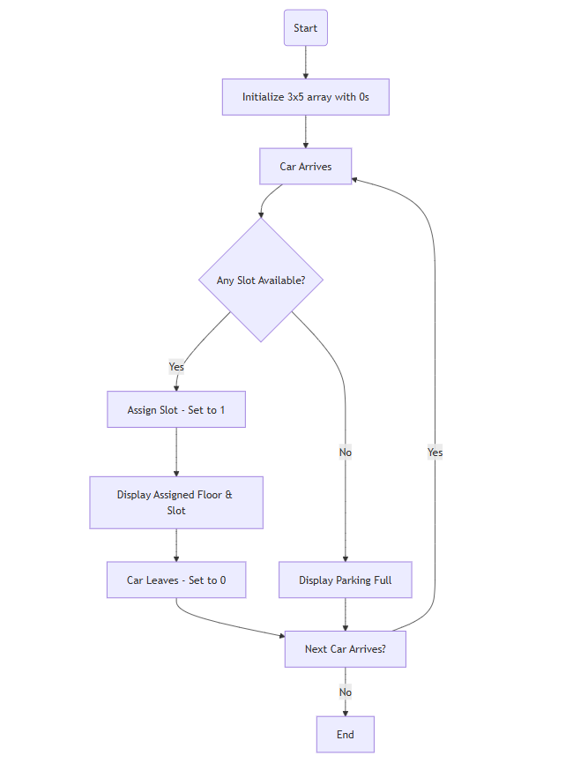
⚙ Flow Chart

Slide 34
⚙ Implementation

Slide 35
11. Library Management - Borrow/Return System
Library has 5 books with initial count of 3 copies each. Allow borrow and return. Each action updates the count and shows current inventory.
📌 Problem :
Array of 5 books.
Each book has initial 3 copies.
Loop for borrowing and returning books.
Print inventory after each action.
🔍 Analysis :

Slide 36
floors = 3
slots = 5
parkingLot[floors][slots] = initialize to 0
while (true)
carArrives()
slotFound = false
for each floor from 0 to 2
for each slot from 0 to 4
if parkingLot[floor][slot] == 0
parkingLot[floor][slot] = 1
display "Assigned Floor:", floor, "Slot:", slot
slotFound = true
break inner loop
if slotFound break outer loop
if not slotFound
display "Parking Full"
🔧 Design :

Slide 37
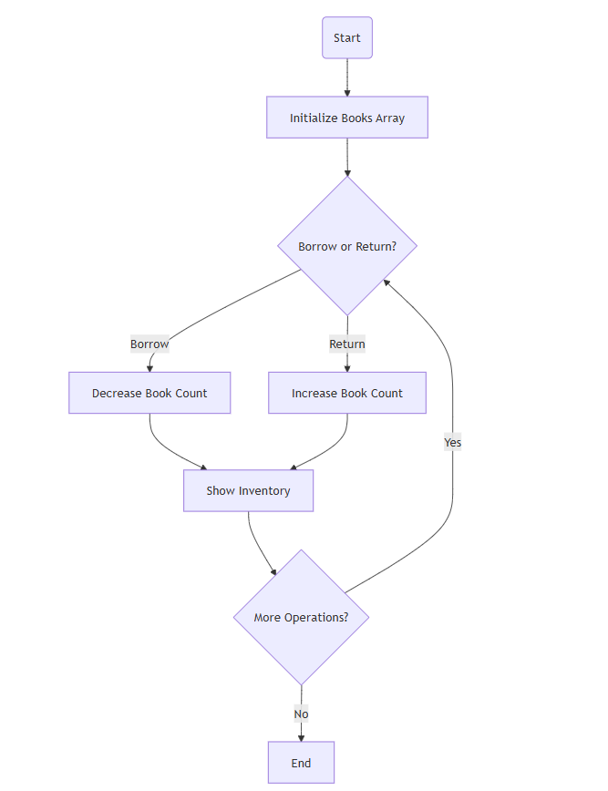
⚙ Flow Chart

Slide 38
⚙ Implementation

