Slide 1

React
Training
Presented By
  Bibhuranjan Mohanty
  Technical Anchor
  L&K Department

Slide 2
SESSION-02
01

Slide 3

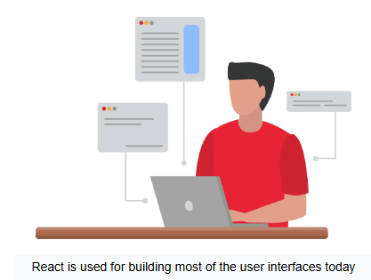
Objectives
Creating First React App
Project structure and folder organization
Writing your first React component
JSX – an Introduction
Rendering of Elements and Components in React
01

Slide 4
Creating First React App
01

Slide 5
Different Ways to Create React App
1. Using Create React App (CRA)
Recommended for beginners and quick prototypes.
It is the simplest way to start a new React project without manual configuration.
Pros: Easy setup, pre-configured with best practices, includes build scripts, hot reloading, and linting.
Command
Create React App Documentation
npx create-react-app my-app
cd my-app
npm start
01

Slide 6
Node Package Manager (npm)
vs.
Node Package Execute(npx)
npm will install the package & then executes It
Whereas
npx directly executes & then uninstalls that package
npm init react-app projectName
npx create-react-app projectName
01

Slide 7
Different Ways to Create React App
2. Using Vite
For faster builds and a more modern development experience.
Vite is a build tool that is much faster than CRA, providing a more efficient developer experience.
Pros: Fast startup, lightweight, optimized for development with instant hot module replacement.
Command
Vite Documentation
npm create vite@latest my-app --template react
cd my-app
npm install
npm run dev
01

Slide 8
VITE
Vite is a modern front-end build tool designed for fast and efficient development.
Created by Evan You (the creator of Vue.js), it's optimized for modern frameworks like React, Vue, and Svelte.
Features of Vite:
Instant Server Start: Extremely fast development server using native ES modules.
Hot Module Replacement (HMR): Instant updates without full-page reload.
Fast Builds: Leverages Rollup for fast and optimized production builds.
Out-of-the-Box Support: Works seamlessly with modern JavaScript frameworks (React, Vue, Svelte).
01

Slide 9
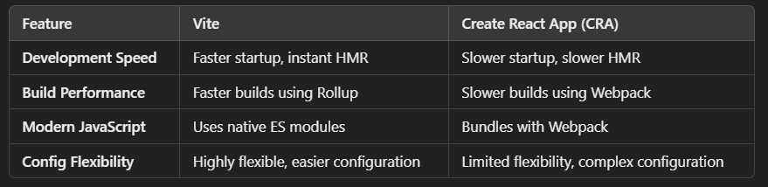
Advantages of Vite over Create React App (CRA):
Why Choose Vite?
Ideal for modern projects requiring fast development and build times.
Uses native ES module imports, reducing bundling complexity.
01

Slide 10
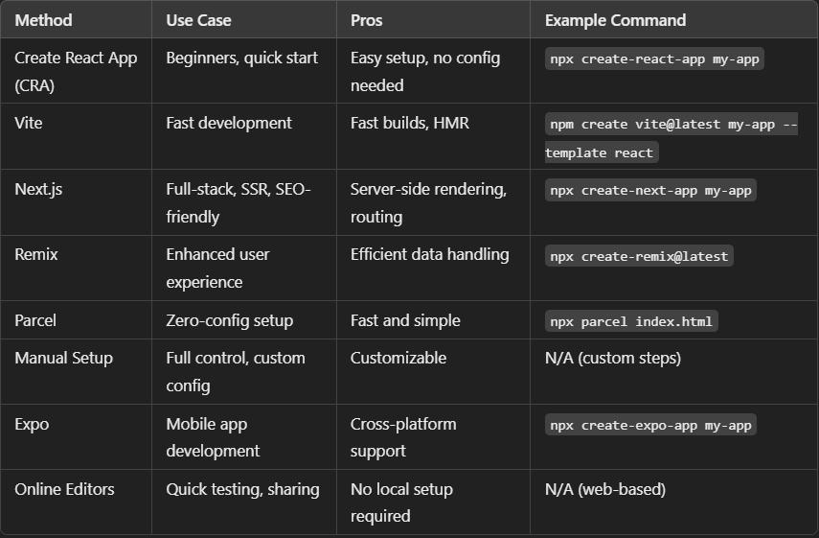
01

Slide 11
What is create-react-app ?
Create-react-app
Command-line interface (CLI)
helps to create
prerequisite environment
for a react project.
01

Slide 12
How do we create a react application or react Project?
Earlier
npm install create-react-app
Create-react-app
Now
npx create-react-app my-app
Or
npm init react-app my-app
Or
npm create vite@latest proj --template react
01

Slide 13
Project structure and folder organization
01

Slide 14
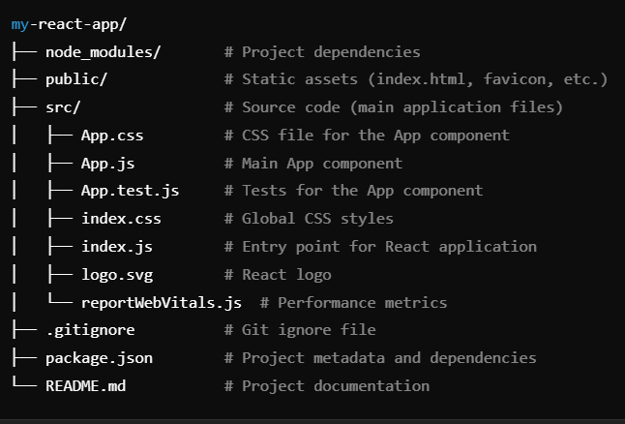
Default Project Structure
By default, Create React App generates the following folder structure:
01

Slide 15
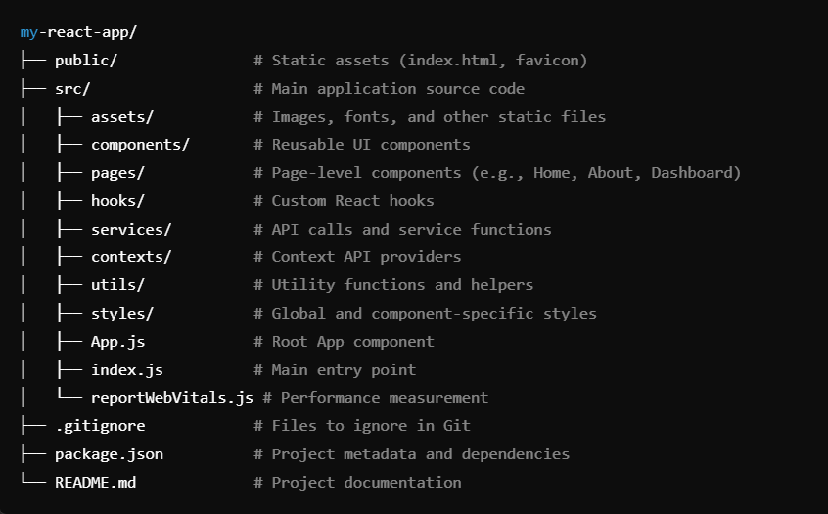
Enhanced Folder Structure for Better Organization
01

Slide 16
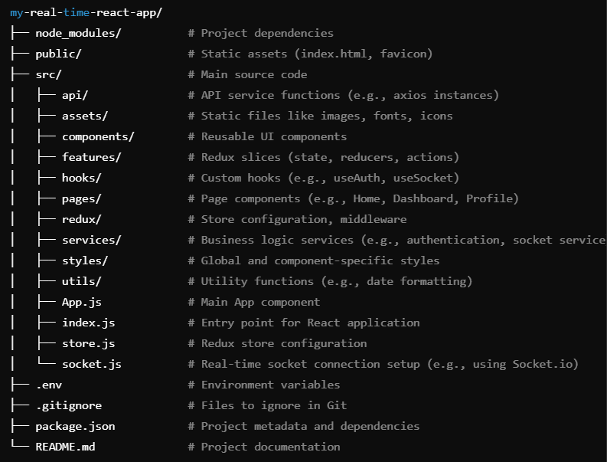
Detailed folder structure and organization for a real-time React app using Redux
01

Slide 17
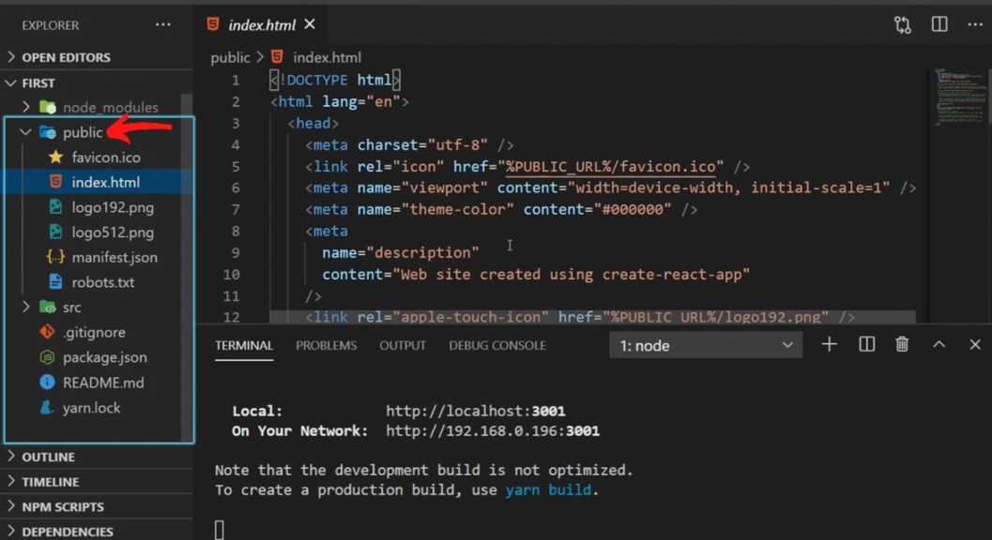
Where does the index.html reside in the default react project?
01

Slide 18
Writing your first React component.
01

Slide 19
Component.
Component is a reusable & independent piece of code .
Creating a Component :
function Welcome(){
return (<h1>Welcome to React World</h1>) ;
}
Rendering a Component :
<Welcome/> <Welcome><Welcome/>
01

Slide 20
Import - Export
Import:
Named exports are useful when you want to export multiple values and import them with their specific names, while default exports are handy for exporting a single value and giving it a custom name when importing .The choice between the two depends on the structure and requirements of your codebase.
import Welcome from “./Welcome.jsx”;
Default Export :
export default Welcome ;
Named Export :
export default Welcome ;
Import {Title} from ““./Welcome.jsx”
01

Slide 21
JSX – an Introduction
01

Slide 22
Writing Markup in JSX
Return a single root element
Close all the tags
camelCase most of the things
React Fragment
Fragment let you group a list of children without adding extra nodes to the DOM.
01

Slide 23
JSX with Curly Braces
function App(){
return (<p>5 * 5 = { 2 * 2 }</p>) ;
}
function App(){
let msg =“hello world !”;
return (<p>message says {msg}</p>) ;
}
01

Slide 24
Structuring Componets
01

Slide 25

01

Slide 26
Case Study
01

Slide 27
Let’s Check Our Understanding So far !
01

Slide 28
Quiz
1. What’s a special feature of JSX, not found in XML or XHTML?
JSX can use JavaScript expressions
JSX can return multiple elements
HTML attributes and event references do not have to be written in camelCase while writing JSX
All of the above
01

Slide 29
Quiz
2. When interpreted by the system, JSX elements are transformed into ______.
React.createElement() calls
Objects
appendChild() calls
None of the above
01

Slide 30
Quiz
3. True or False: Multi-line JSX has to be surrounded by parentheses.
True
False
01

Slide 31
Quiz
4. What symbol should be used to denote JavaScript expressions within JSX?
@
$
{}
#
01

Slide 32
Quiz
5. True or False: Comments in JSX are written using <!-- This is a comment --> notation.
True
False
01

Slide 33
Quiz
6. True or False: Calling React.createElement() triggers a DOM operation.
True
False
01

Slide 34
Quiz
7. True or False: React elements are simple objects.
True
False
01

Slide 35
Quiz
8. What is the name of the node that a React element needs to render on?
main node
root node
Render node
All of the above
01

Slide 36
Quiz
9. How many root nodes will you typically have in a React application?
2
0
3
1
01

Slide 37
Quiz
9. How many root nodes will you typically have in a React application?
2
0
3
1
01

Slide 38
Quiz
10. True or False: The name of a React component should start with a capital letter.
True
False
11. True or False: React components can contain other components.
True
False
01

Slide 39
Q & A
01

Slide 40
Thank You
01

