Slide 1

React
Training
Presented By
  Bibhuranjan Mohanty
  Technical Anchor
  L&K Department

Slide 2
SESSION-01
01

Slide 3
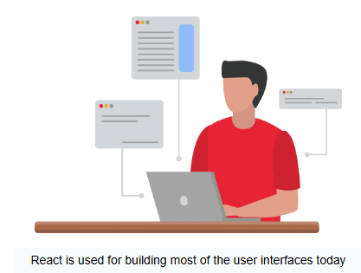

Objectives
Introduction to React
Features of React
Set Up a React Development Environment
Build and Run a Basic React App
01

Slide 4
Introduction to React
01

Slide 5
What is React?
At this point, let’s cite the React documentation that has summarized it nicely:
“React is a library for building user interfaces.”
React is just a library that makes it easy to develop user interfaces.
There are no services or methods to make API calls ,built-in models, or ORM.
React is only concerned with user interfaces.
01

Slide 6




When Should I Use React and When Is It Best to Avoid It?
When to Use React:
Building Interactive User Interfaces
Component-Based Development
Handling Complex State Management
Large-Scale Applications
Cross-Platform Development
When to Avoid React:
Simple Static Websites
SEO-Heavy Applications
Limited JavaScript Expertise
Simple Static Websites
Performance-Sensitive Applications with Minimal JavaScript
01

Slide 7

Key Features of React
Component-Based Architecture
JSX - JavaScript XML
Virtual DOM
Rich Ecosystem
Declarative UI
Fast Learning Curve
Unidirectional Data Flow
Community Support
01

Slide 8
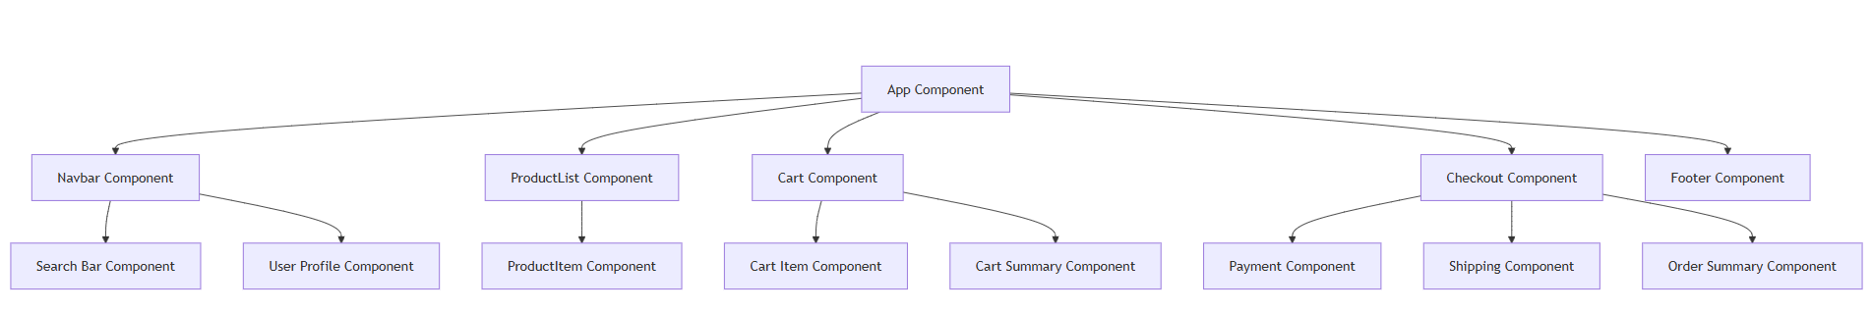
Key Features of React
Component-Based Architecture
01

Slide 9
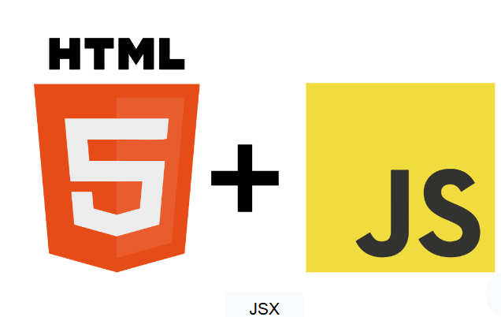
Key Features of React
JSX - JavaScript XML
<div id="app">
<p>A paragraph in JSX</p>
<p>Another paragraph</p>
</div>
Babel Compiler
React.createElement(
'div', { id: 'app' },
React.createElement('p', null, 'A paragraph in JSX'),
React.createElement('p', null, 'Another paragraph')
);
01

Slide 10
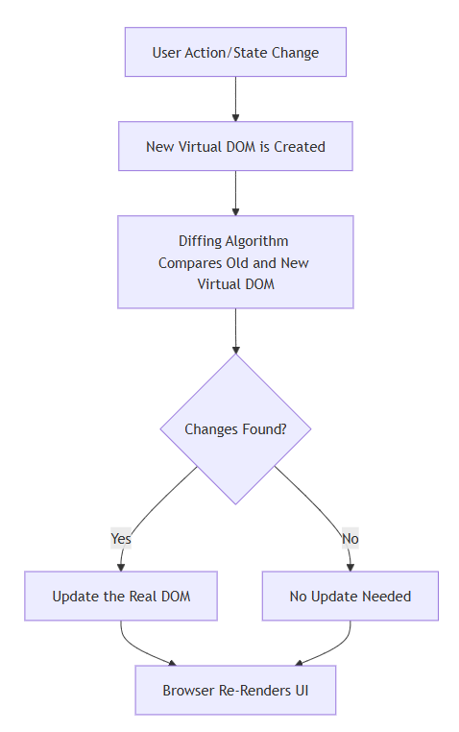
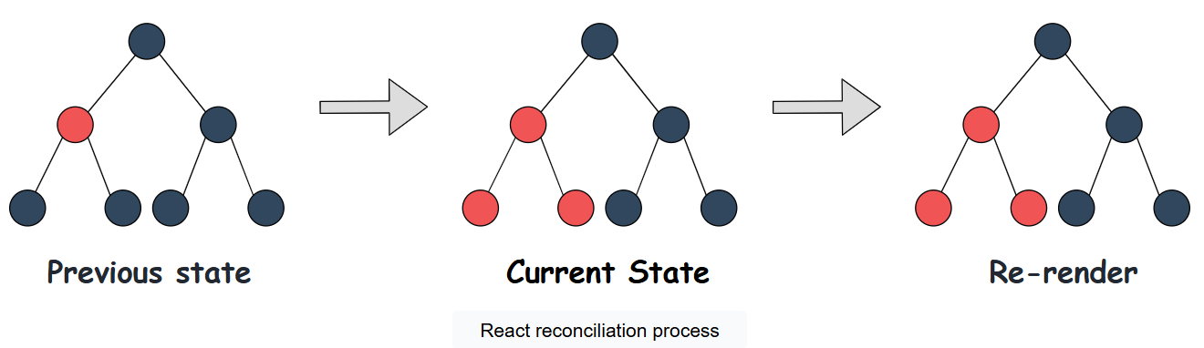
Key Features of React
Virtual DOM
The Virtual DOM is a lightweight copy of the actual DOM (Document Object Model) that React uses to optimize updates and rendering.
It improves the performance of React applications by reducing direct manipulations of the real DOM, which can be slow.
01

Slide 11
Key Features of React
SSR
Rich Ecosystem
Next.js
JSX Syntax
React Core Library
Navigation
React Hooks
React Router
DevTools
Build Tools
Testing
Data Fetching
Styling
State Management
React Developer Tool
Webpack
Jest
GraphQL
Styled Components
Redux
ContextAPI
Recoil
ESLint
Babel
Cypress
Axios
Tailwind CSS
Advanced
In-Built
Modern
Prettier
Vite
React Testing Library
SWR
CSS Modules
State
01

Slide 12
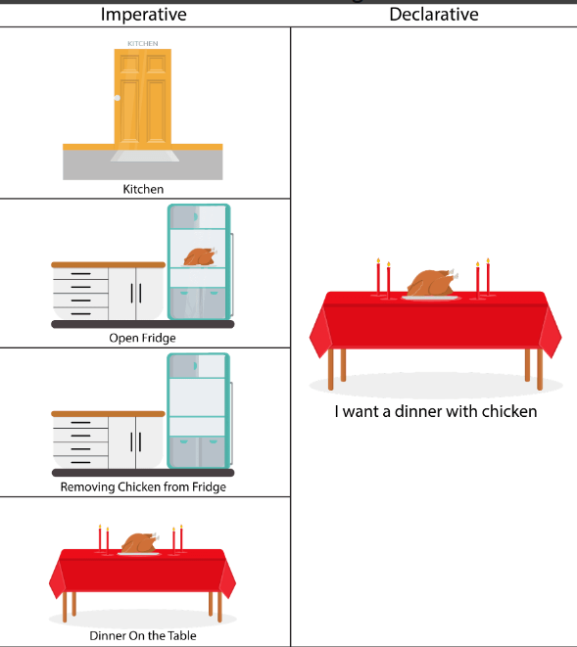
Key Features of React
Declarative UI
List = [1, 2, 3, 4, 5]
Requirement: Access its last element.
Imperative
Declarative
Loop through this list: [1, 2, 3, 4, 5]
Access the element at index list.length - 1
Return the element
I have this list: [1, 2, 3, 4, 5]
I want the last element of this list
01

Slide 13
Key Features of React
Fast Learning Curve
Simple and Intuitive Syntax
Component-Based Structure
Extensive Documentation
Rich Developer Tools
01

Slide 14
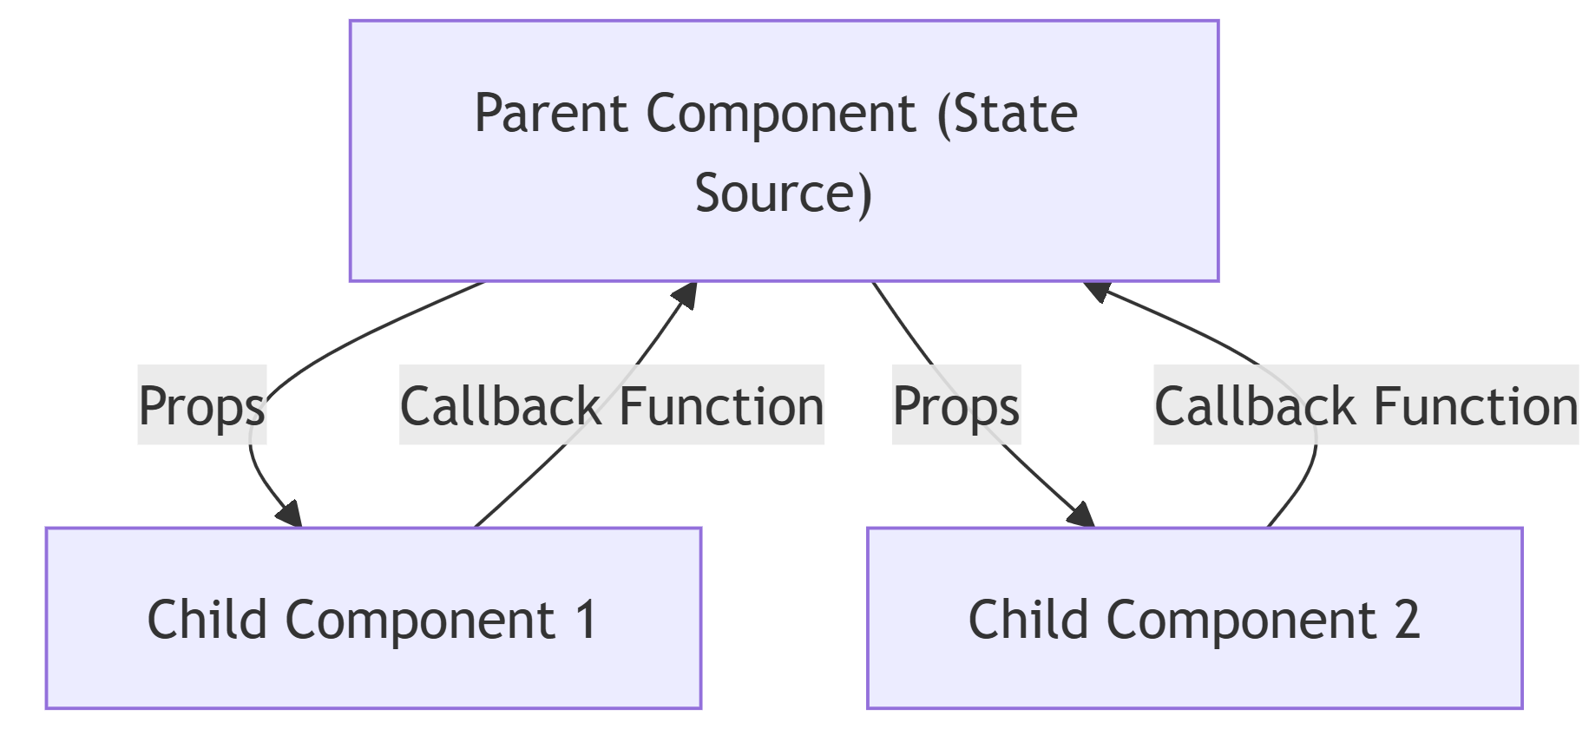
Key Features of React
Unidirectional Data Flow
In React, data flows in a single direction: from parent components to child components.
The parent component manages the state and passes data to child components via props.
This flow simplifies data management and helps prevent unexpected changes in the application state.
01

Slide 15
Key Features of React
Community Support
1. Official Documentation
4. Reddit
2. GitHub
5. Reactiflux Discord Community
3. Stack Overflow
6. Meetups & Conferences
01

Slide 16
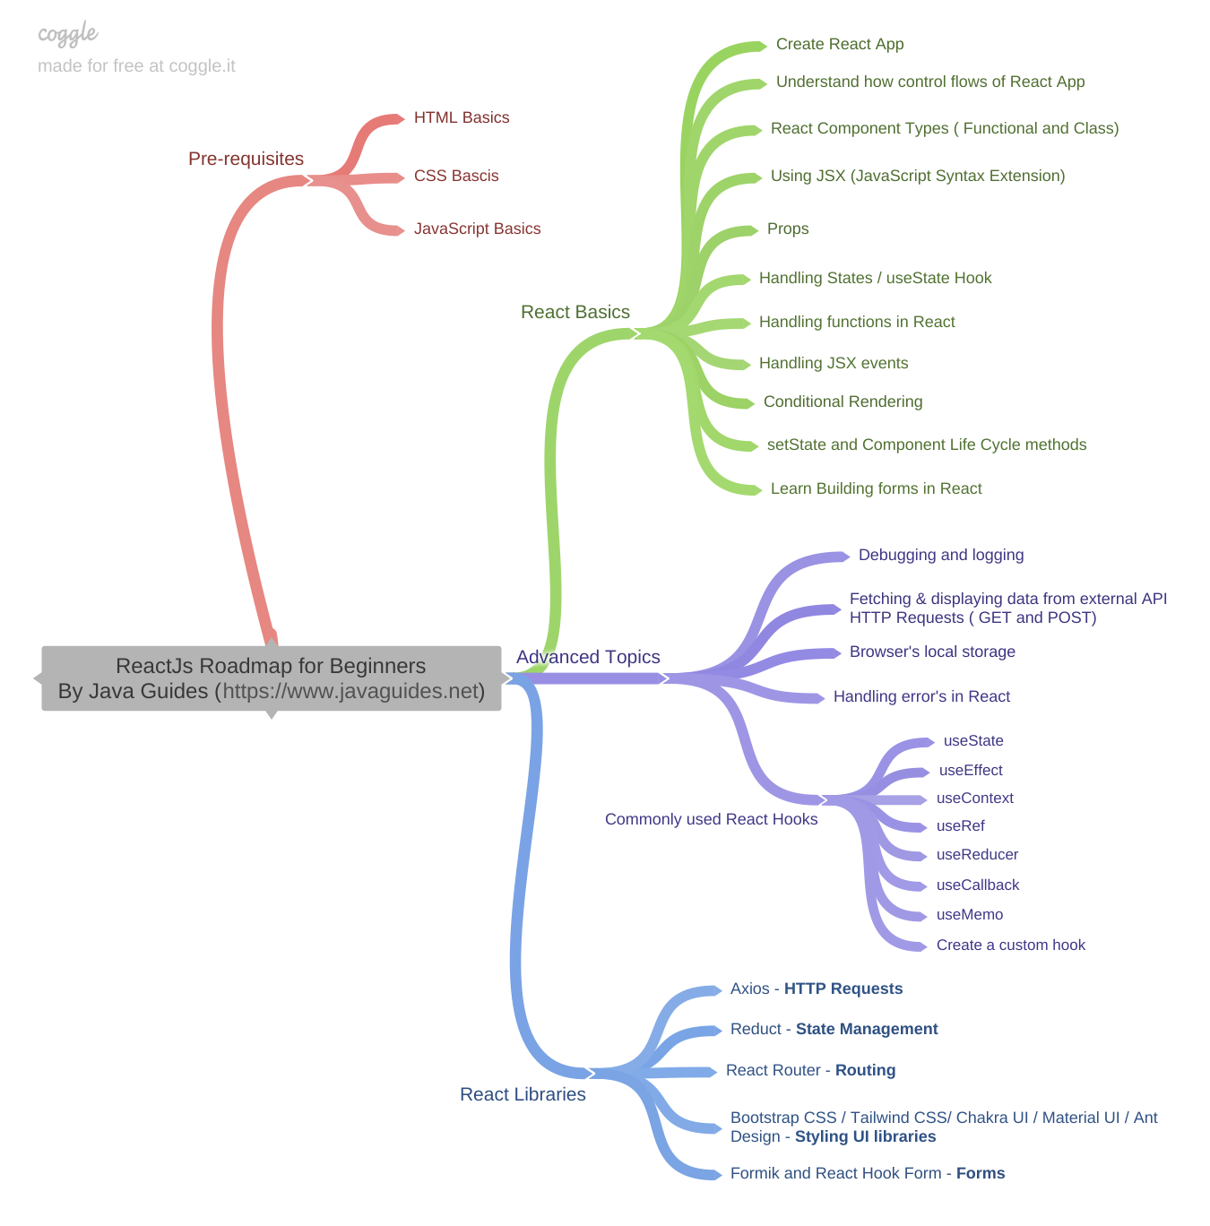
Learning Path
Reacts Learning Path
01

Slide 17







Setting Up the Development Environment
Tools and Setup
1. Node.js and npm
2. Yarn
3. Babel
4. Webpack
5. ESLint
6. Prettier
7. Editor
01

Slide 18
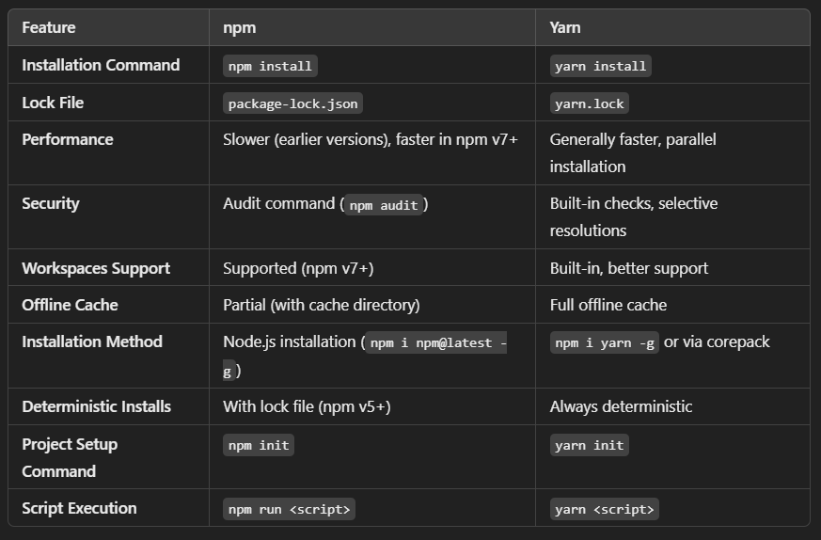
npm vs yarn
01

Slide 19
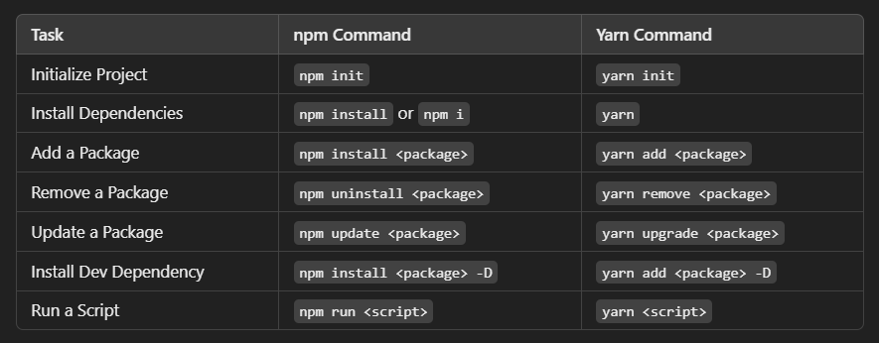
npm vs yarn
01

Slide 20
Different Ways to Create React App
1. Using Create React App (CRA)
Recommended for beginners and quick prototypes.
It is the simplest way to start a new React project without manual configuration.
Pros: Easy setup, pre-configured with best practices, includes build scripts, hot reloading, and linting.
Command
Create React App Documentation
npx create-react-app my-app
cd my-app
npm start
01

Slide 21
Different Ways to Create React App
2. Using Vite
For faster builds and a more modern development experience.
Vite is a build tool that is much faster than CRA, providing a more efficient developer experience.
Pros: Fast startup, lightweight, optimized for development with instant hot module replacement.
Command
Vite Documentation
npm create vite@latest my-app --template react
cd my-app
npm install
npm run dev
01

Slide 22
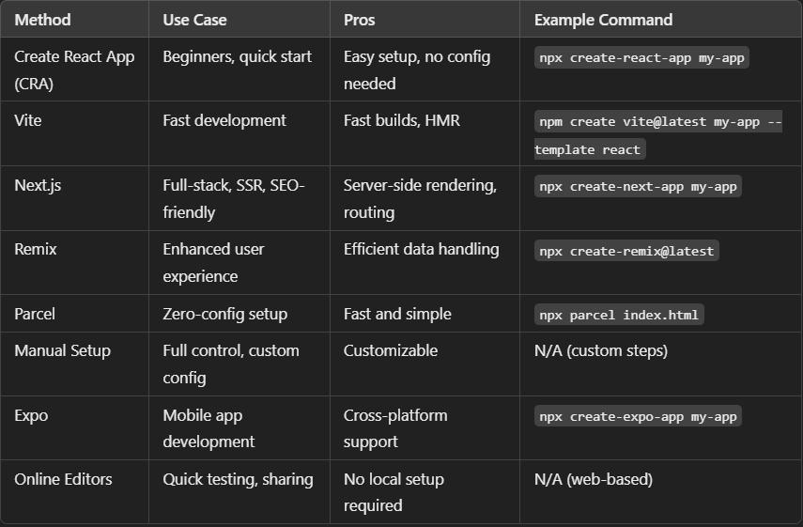
01

Slide 23
Let’s Check Our Understanding So far !
01

Slide 24
Quiz
1. React is mainly used for building _____.
A) Database
B) Connectivity
C) User interfaces
D) Design platform
01

Slide 25
Quiz
2. Which of the following is used to handle data in React ?
A)Component
B)State
C)Model
D)None of the above
01

Slide 26
Quiz
3. Which command is used to install create-react-app?
A) npm install -g create-react-app
B) npm create-react-app
C) install -g create-react-app
D) None of the above
01

Slide 27
Quiz
4. Everything in React is a _____.
A)Module
B)Package
C)Class
D)Component
01

Slide 28
Quiz
5. The ______ is an officially supported way to create a React application.
A) create
B) react-app
C) create-react-app
D) create react app
01

Slide 29
Quiz
6. What function allows you to render React content on an HTML page?
A) ReactDOM.render()
B) React.render()
C) React.mount()
D) ReactDOM.start()
01

Slide 30
Quiz
7. What is Reconciliation?
A) It is a process to set the state
B) The process through which React deletes the DOM
C) The process through which React updates the DOM
D) None of the above
01

Slide 31
Quiz
8. JSX allows us to write HTML elements in JavaScript and place them in the DOM without using the _____ method(s).
A) createElement
B) getElementById
C) All of the above
D) None of the above
01

Slide 32
Quiz
9. What command copies build dependencies, configuration files, and scripts into the app directory?
A) yarn build
B) yarn eject
C) yarn start
D) yarn copy
01

Slide 33
Q & A
01

Slide 34
Thank You
01

