Slide 1


PROJECT TRAINING
Learn to How To Build Project From Scratch

Slide 2

Agenda
Project Overview
Technology Stack
Step-by-Step Lesson Plan
Frontend and Backend Development
Testing and Deployment

Slide 3

Project Overview
A web application for managing employee data.
Features:
Guest Module: View/Search Employees.
Admin Module: Add, Edit, Delete Employees.
Goal:
Introduce students to full-stack development.

Slide 4
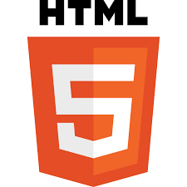
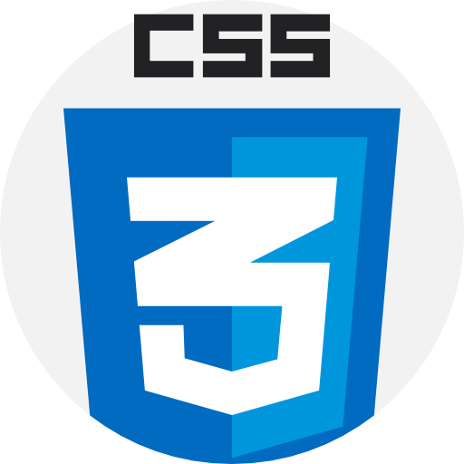
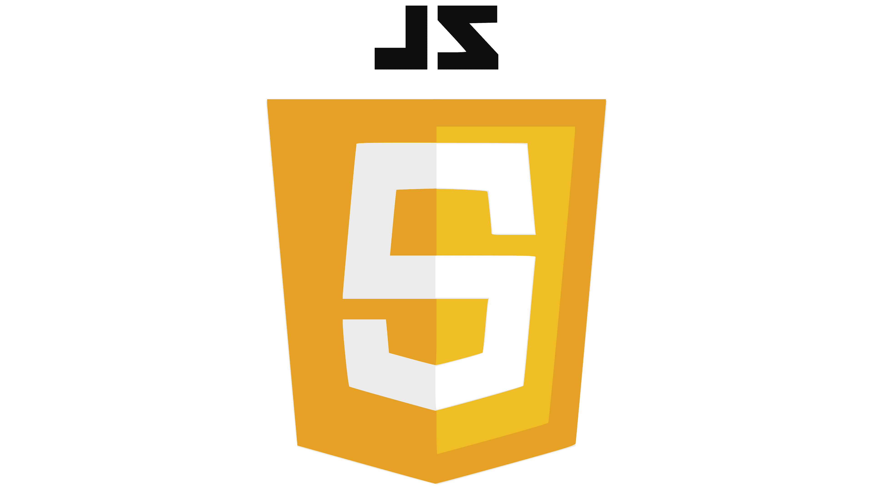



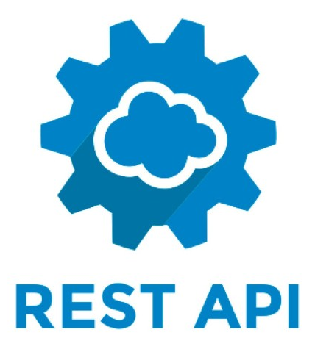




Technology Stack
Frontend: HTML5, CSS3, JavaScript, Bootstrap, jQuery.
Backend: Spring Boot, RESTful APIs.
Database: MySQL.
Development Tools: Eclipse, Postman, MySQL Workbench.

Slide 5
Lesson Plan
Introduction to technologies
Frontend development (Sessions 2–5)
Backend development (Sessions 6–8)
Integration and testing (Sessions 9–14)
Final deployment (Session 15)

Slide 6
Session | Topic | Key Highlights
1 | Introduction & Project Setup | Overview of the project, tools installation, Spring Boot setup, and understanding deliverables.
2 | HTML5 & CSS3 Basics | Structure of web pages, semantic tags, styling, and layout basics.
3 | Responsive Design with Bootstrap | Using grid systems, responsive design, and common Bootstrap components.
4 | JavaScript Basics | DOM manipulation, event listeners, and form validation.
5 | jQuery and AJAX | Simplifying DOM manipulation with jQuery and making asynchronous requests with AJAX.
6 | Spring Boot Basics | Understanding Spring Boot, project structure, and RESTful API architecture.
7 | Database Integration with MySQL | Configuring MySQL, creating tables, and integrating with Spring Data JPA.
8 | Developing CRUD APIs | Creating REST APIs for Create, Read, Update, and Delete operations and testing with Postman.

Slide 7
Session | Topic | Key Highlights
9 | Frontend-Backend Integration Part 1 | Fetching data from APIs, displaying data dynamically, and setting up the UI for CRUD.
10 | Frontend-Backend Integration Part 2 | Handling form submissions, edit, and delete functionality with AJAX calls.
11 | Building Guest Module | Implementing guest functionalities: View and search employees.
12 | Building Admin Module | Implementing admin functionalities: Add, edit, and delete employees.
13 | Form Validation | Validating forms on the frontend and backend for required fields and proper formats.
14 | Application Testing | Testing workflows, error handling, and debugging the application.
15 | Final Deployment | Packaging the project, deploying on a server, and project summary

