Slide 1
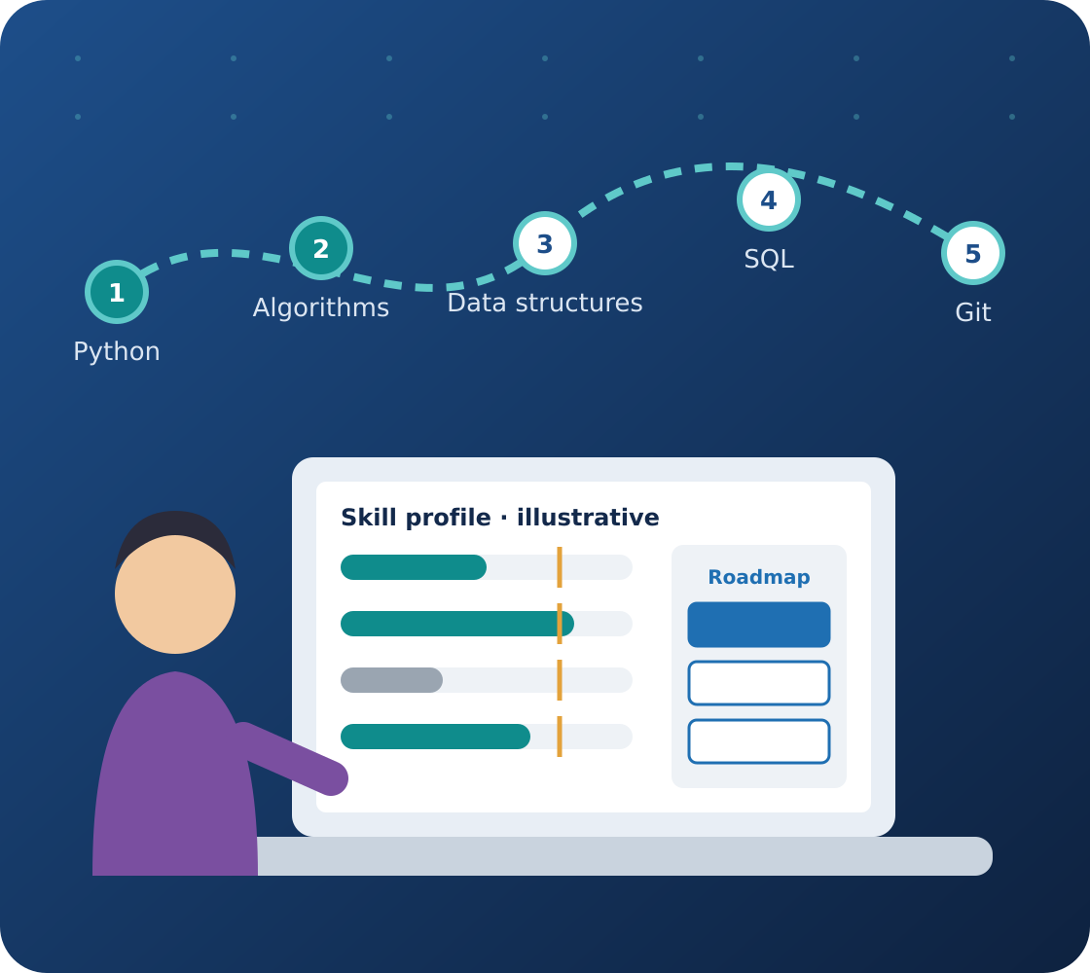
DISSERTATION PROPOSAL PRESENTATION
CareerPilot AI
An Explainable AI-Driven Career Readiness and Personalized Skill Development Platform
Python
FastAPI
React + TypeScript
PostgreSQL
Explainable Recommendations
Presented by
[Student Name] · [BITS ID]
Supervisor
[Supervisor Name], [Designation]
Organisation
[Organisation / Mentor Name]
BITS Pilani · CSIW ZG628T Dissertation · Academic Session 2026–2027
Notes:
Good morning/afternoon. We are [names], and our dissertation is CareerPilot AI — an explainable platform that helps students find their skill gaps for a chosen career and follow a personalised learning roadmap. This is a proposal; the system is not built yet. Our supervisor is [name].

Slide 2
Presentation Outline
OVERVIEW
What we will cover in the next 10–15 minutes
Problem and motivation
Core methods
01
05
Proposed solution
Database design
02
06
Objectives and scope
Evaluation plan
03
07
Architecture and workflow
Timeline and conclusion
04
08
Notes:
Here is our outline. We will start with the problem, then our proposed solution, objectives and scope, the architecture, our three core methods, the database, how we will evaluate it, and finally the timeline and conclusion.

Slide 3






Why Students Struggle With Career Preparation
THE PROBLEM
The gap between choosing a career and preparing for it
Unclear skill expectations for a chosen role
PROBLEM STATEMENT
How can a web application identify evidence-supported skill gaps and generate explainable, personalised learning roadmaps for a selected software career track?
Too much disconnected learning material
Hard to recognise one's own weaknesses
Uncertainty about what to learn first
Limited weekly study time
Why it matters
Learners differ in existing skills, prerequisites and available time — one roadmap cannot fit everyone.
Generic roadmaps ignore individual results
Notes:
Many students know which career they want but not which skills it needs or what to study first. They face lots of disconnected material and limited time, and generic roadmaps ignore what each student already knows. Our problem statement asks how a web app can identify evidence-supported skill gaps and generate explainable, personalised roadmaps.

Slide 4





CareerPilot AI in One Picture
OUR PROPOSED SOLUTION
An assessment-driven, explainable learning planner
Career Goal
Skill Assessment
Gap Analysis
Personalised Roadmap
Reassessment
Learner selects a supported track
Diagnostic questions gather evidence
Supported gaps from sufficient evidence
Ordered, time-fitted, explained activities
New evidence updates the roadmap
In one sentence: CareerPilot AI uses a learner's assessment evidence, skill prerequisites and weekly study time to recommend an explained, personalised learning roadmap.
Notes:
Our solution has five stages. The learner chooses a career track, takes a diagnostic assessment, the system analyses supported skill gaps, recommends an explained roadmap, and updates it after reassessment. In one sentence: we use assessment evidence, prerequisites and weekly time to recommend an explained roadmap.

Slide 5



What We Propose to Build
OBJECTIVES
Initial career track: Junior Python Backend Developer
Assessment
Recommendation
Learning management
Career-track selection
Curated role–skill database
Diagnostic assessment
Skill evidence and gap analysis
Prerequisite-aware recommendation
Weekly time-budget planning
Explainable roadmap generation
Secure authentication
Progress tracking
Reassessment support
Admin content management
RESEARCH CORE
the explainable assessment-to-roadmap recommendation mechanism.
Notes:
Our objectives fall into three groups: assessment, recommendation and learning management. Authentication and admin screens are necessary engineering, but our research core is the explainable assessment-to-roadmap recommendation mechanism.

Slide 6


What Is In — and Out — of the First Release
SCOPE
Final scope to be confirmed with our supervisor
In scope
Out of scope / future work
One track: Junior Python Backend Developer
Employment prediction
Curated skill groups (SD-01 to SD-07 to start)
Placement guarantees
Reviewed diagnostic questions
Multiple career tracks
Free, curated learning resources
Paid LLM APIs
Assessment and roadmap workflows
Running learner-submitted code
Progress tracking and reassessment
Job-board integration
Administrator interface
Synopsis scope: ~20–30 skills and 100–150 reviewed items. We may start smaller and grow, subject to supervisor approval.
Notes:
Our first release covers one track, Junior Python Backend Developer, with curated skills, reviewed questions, free resources, roadmaps and reassessment. We will not predict employment, guarantee placements, use paid LLM APIs or run learner code. The synopsis targets 20–30 skills and 100–150 items; we will confirm the final scope with our supervisor.

Slide 7






How React, FastAPI, Python and PostgreSQL Work Together
SYSTEM ARCHITECTURE
Proposed layered design
Student / Administrator
Browser access, authenticated by role
PostgreSQL
Users, skills, questions, attempts, estimates, resources and versioned roadmaps
React + TypeScript
Assessment screens, skill profile, roadmap dashboard
FastAPI backend
APIs, validation, authentication, trusted server-side scoring
Security
Role-based access; answer keys never sent to the browser early
Python recommendation engine
Evidence analysis, prerequisite graph, matching, time-budget scheduling
Notes:
The architecture has four layers. React with TypeScript provides the screens. FastAPI handles APIs, authentication and trusted server-side scoring. A Python engine does evidence analysis, prerequisite checks and scheduling. PostgreSQL stores users, assessments, evidence and versioned roadmaps. Answer keys never reach the browser before an attempt is finished.

Slide 8
How a Learner Uses CareerPilot AI
END-TO-END WORKFLOW
Proposed learner journey
1
LEARNER
2
LEARNER
3
LEARNER
4
EVIDENCE
5
EVIDENCE
Register or log in
Select career track
Set weekly study time
Take diagnostic assessment
Server scores responses
10
EVIDENCE
9
LEARNER
8
LEARNER
7
PLANNER
6
EVIDENCE
Reassess; roadmap updates
Track progress
Complete activities
Receive explained roadmap
View skill feedback
Important: completing an activity is recorded as progress — only an eligible reassessment creates new skill evidence.
Notes:
This is the learner journey in ten steps. Notice the colours: purple for learner actions, teal for evidence and blue for planner output. One key design rule: completing an activity is progress, not proof of skill — only a reassessment creates new evidence.

Slide 9
Diagnostic Assessment and Evidence States
CORE METHOD 1
Measuring what the learner can currently demonstrate
HOW IT WORKS
Evidence states (illustrative examples)
State | Example | System action
NOT_ASSESSED | No SD-01 answers | Offer assessment
INSUFFICIENT | 1 of 2 required answered | Ask for more evidence
DIAGNOSTIC_AVAILABLE | 2 of 2 answered, 1 correct | Score = 0.50
Each question is mapped to a skill (e.g. SD-01 Programming Fundamentals)
Scoring happens on the server: correct = 1, incorrect = 0, unanswered = missing
Score = correct eligible answers ÷ answers required by the coverage rule
Missing evidence is never treated as zero skill
0.50 means one of two items was correct — not "50% proficient" and not a validated measure of competence.
Notes:
Our first core method is the diagnostic assessment. Each question maps to a skill and is scored on the server. We use three evidence states. If a learner skips questions, we mark the skill as not assessed or insufficient, rather than assuming zero. A score of 0.50 means one of two items was correct — not 50 percent proficiency.

Slide 10
Gap Analysis and Prerequisite-Aware Planning
CORE METHOD 2
Rule-based, evidence-driven and constraint-aware
PLANNING RULES
PLANNER LOGIC (pseudocode)
Gap = max(0, target − score), only when evidence is sufficient
Prerequisite graph (a DAG) decides the learning order
Only published, reviewed resources are recommended
Weekly time budget is never exceeded (e.g. 180 min/week)
for skill in prioritised(supported_gaps(evidence)):
for res in published_resources(skill):
if prerequisites_ok(res, plan):
week = first_week_with_room(res.minutes)
plan.add(res, week,
reasons=collect_reasons())
Example: 90 + 60 + 75 = 225 min does not fit a 180-minute week, so the planner moves an activity to week 2.
Notes:
Our second method is planning. A gap is the difference between a configured target and the score, calculated only with sufficient evidence. A prerequisite graph sets the order, only reviewed resources are used, and the weekly time budget is never exceeded. The engine is rule-based and deterministic; we are not training a deep-learning model.

Slide 11
Explainable Recommendations
CORE METHOD 3
Every recommendation keeps the reasons that produced it
WHY IT IS EXPLAINABLE
Recommended (illustrative): LR-03 Algorithm Tracing
Week 2 · about 75 minutes · skill SD-02
The planner stores reason codes with each decision
Learner-facing text is generated from those stored codes
No post-hoc explanations invented after the fact
Earlier roadmaps and evidence stay in version history
Stored reasons
ASSESSED_GAP · RESOURCE_SKILL_MATCH · PREREQUISITE_FIRST · TIME_BUDGET_FIT
Explanation shown to the learner
"Your diagnostic evidence shows a learning need in algorithm reasoning. This activity is mapped to that skill and fits your weekly time."
Notes:
Our third method is explainability. The planner saves reason codes with each decision, and the learner sees an explanation generated from those exact codes. For example, Algorithm Tracing was chosen because of an assessed gap, a skill match, prerequisite order and time fit.

Slide 12
What PostgreSQL Will Store
DATABASE DESIGN
Conceptual entities — final schema designed during implementation
USER
CAREER_TRACK
SKILL
SKILL_PREREQUISITE
ASSESSMENT_VERSION
role
name
SD-01 … SD-07
skill → requires
published config
QUESTION_VERSION
ASSESSMENT_ATTEMPT
QUESTION_RESPONSE
SKILL_ESTIMATE
LEARNING_RESOURCE
skill mapping
user · version
attempt · answer
evidence state · score
skill · minutes · status
ROADMAP_VERSION
ROADMAP_ACTIVITY
RECOMMENDATION_REASON
ACTIVITY_PROGRESS
ROADMAP
refs skill estimates
resource · week
reason code
state · timestamps
user · track
KEY RELATIONSHIPS
A career track requires many skills
Questions provide evidence for mapped skills
Attempts contain responses; estimates reference eligible evidence
Roadmap versions reference the skill estimates they used
Activities reference published resources and store reasons
Progress never edits skill estimates
Notes:
In PostgreSQL we separate configuration, evidence and roadmap data. Assessment and question versions keep old scores reproducible, skill estimates link to the evidence they came from, and recommendation reasons are stored with each activity. Progress records never change skill estimates.

Slide 13
How We Will Evaluate the System
EVALUATION PLAN
Planned methodology — no experiments have been run yet
WHAT WE WILL MEASURE
Baseline comparison
RESULTS PENDING
Skill coverage
Prerequisite compliance
Weekly time-budget compliance
Resource relevance
Recommendation reproducibility
Explanation consistency
Measure | Fixed roadmap | Score-only | Proposed
Skill coverage | TBD | TBD | TBD
Prerequisite compliance | TBD | TBD | TBD
Time-budget compliance | TBD | TBD | TBD
Explanation consistency | TBD | TBD | TBD
We will test with fictional learner profiles. This checks the roadmap logic; it does not prove real students learn better — that would need a separate, approved study.
ALSO TESTED
Authentication, role-based access, server-side scoring and API behaviour (Pytest).
Notes:
To evaluate, we will compare our method with two baselines: a fixed roadmap and a score-only roadmap. We will measure skill coverage, prerequisite and time-budget compliance, relevance, reproducibility and explanation consistency. All results are still to be measured. Fictional profiles test the logic, not real learning outcomes.

Slide 14
Implementation Timeline and Milestones
PROJECT PLAN
Proposed 16-week work plan
1
2
3
4
5
6
7
8
9
10
11
12
13
14
15
16
Problem, literature review, scope
W1–2
Skill framework, architecture, DB design
W3–4
Diagnostic module + question bank
W5–6
Baseline and adaptive planner
W7–8
Resources, explanations, progress
W9–10
Reassessment, admin, integration tests
W11–12
Comparative evaluation, deployment prep
W13–14
Dissertation, demo, viva preparation
W15–16
2 Dec 2026
Mid-semester report
20 Jan 2027
Final report
Week 16
Final demonstration
Notes:
This is our 16-week plan, from scope and design through the assessment module, planner, explanations and reassessment, to evaluation and the dissertation. Our next milestones are the mid-semester report on 2 December 2026 and the final report on 20 January 2027.

Slide 15


Expected Outcomes and Limitations
CONCLUSION
What we expect to deliver — and what we will not claim
Expected outcomes
Limitations
A working, explainable career-preparation web app
Evidence-based skill feedback for learners
Prerequisite-aware, time-fitted roadmaps with reasons
A measured comparison against two baselines
One career track in the first release
Small, curated question bank and skill map
Algorithm evaluation, not learning-outcome proof
Does not predict employability or guarantee placement
CareerPilot AI supports structured learning decisions — assess fairly, explain every recommendation, and evaluate before claiming improvement.
Notes:
We expect to deliver a working, explainable web application with evidence-based feedback, prerequisite-aware roadmaps and a measured baseline comparison. Its limitations: one track, a small curated bank, algorithm-level evaluation only, and no employability prediction. CareerPilot supports learning decisions; it does not guarantee jobs.

Slide 16
Thank You — Questions?
THANK YOU
We welcome feedback from our supervisor and reviewers
KEY TAKEAWAYS
PRESENTED BY
1
Recommendations are based on assessment evidence
[Student Name]
[BITS ID]
[Email address]
2
Unknown evidence is never treated as zero skill
3
Prerequisites and weekly time shape the roadmap
SUPERVISOR
[Supervisor Name]
[Organisation]
4
Every recommendation is explained
CareerPilot AI is a proposed project. All examples, screens and values in this presentation are illustrative.
Notes:
Thank you. Our key takeaways: recommendations are evidence-based, unknown is never zero, prerequisites and time shape the plan, and every recommendation is explained. We welcome your questions and feedback.

