Slide 1
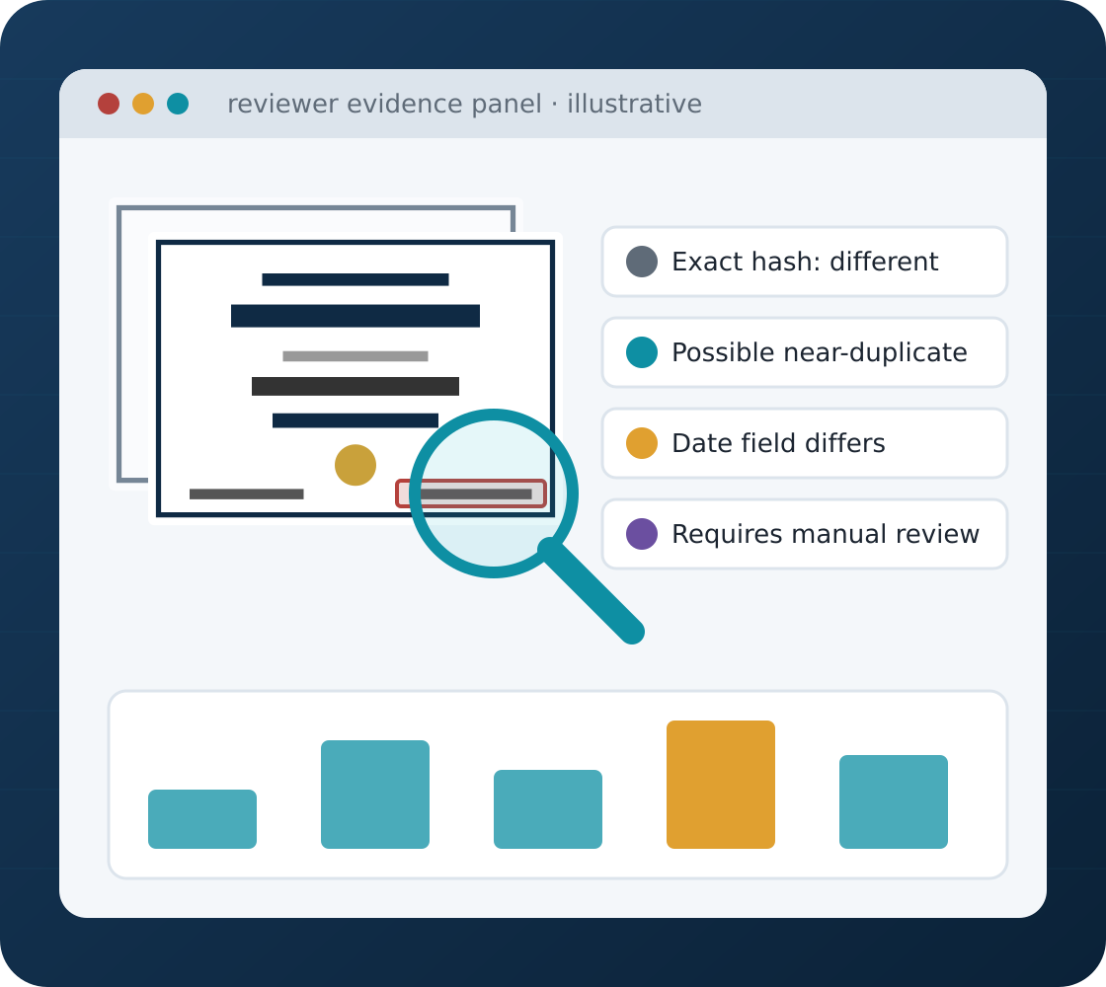
BITS PILANI · CSIW ZG628T DISSERTATION
DocuGuard AI
An Explainable AI-Based Document Tampering and Duplicate Submission Detection Platform
Student Training and Mentor Preparation
Python
FastAPI
React
PostgreSQL
OCR
Computer Vision
Academic Session 2026–2027
Proposal-stage training material · all documents shown are fictional · not an implemented or validated system
Notes:
TIME: 1 min (Section 1 · Motivation, problem & goals — 10 min total)
LESSON OBJECTIVE: Introduce DocuGuard AI as a proposed reviewer-assistance system.
EXPLAIN: DocuGuard AI is a proposed platform that helps organisations screen uploaded documents. It combines ordinary web development (React, FastAPI, PostgreSQL) with information retrieval, image processing, OCR and selected comparison techniques. Its output is evidence for a human reviewer, not an automatic verdict on authenticity.
EXAMPLE: A college admissions office receives hundreds of uploaded certificates. DocuGuard would point a reviewer to "this upload is byte-identical to one received last week" or "this certificate matches an earlier one except for the issue date".
KEY TERMS: Document screening = checking submissions for duplicates or differences that deserve attention. Reviewer assistance = the system supports, but does not replace, a human decision.
ASK STUDENTS: What is the difference between detecting a change and proving fraud?
SUGGESTED ANSWER: A detected change only shows that two versions differ. It does not show who made the change, whether it was authorised, or whether the document is fraudulent.
AVOID THESE MISUNDERSTANDINGS: Do not describe DocuGuard as a "fraud detector" or say it "authenticates" documents. Everything in this deck is proposed; all documents shown are fictional.
TRANSITION: "Let's see what you should be able to do by the end of today."

Slide 2









What Will You Learn Today?
01 · MOTIVATION, PROBLEM & GOALS
By the end of the session, students should be able to…
Explain the document-screening problem
Describe the main DocuGuard AI modules
Explain exact and near-duplicate detection
1
2
3
Understand hashing, OCR and similarity techniques
Draw the React / FastAPI / Python / PostgreSQL architecture
Describe a document's processing lifecycle
4
5
6
Explain experimental evaluation
Identify security and ethical risks
Defend the project during mentor review
7
8
9
Main outcome: describe and defend the complete proposed DocuGuard AI workflow — and its limitations.
Notes:
TIME: 1.5 min
LESSON OBJECTIVE: Set the nine learning outcomes for the session.
EXPLAIN: Students do not need advanced computer-vision knowledge on day one. They need to understand the input, each processing step, the outputs and the limitations. Each technical method on later slides answers a different question, so the outcomes build on each other.
EXAMPLE: Outcome 3 (exact vs near-duplicate) is needed before outcome 4 (hashing, OCR, similarity) makes sense, and both are needed to explain outcome 6 (the document lifecycle).
KEY TERMS: Learning outcome = something a student can do or explain afterwards, not just something they heard.
ASK STUDENTS: What is today's main learning outcome?
SUGGESTED ANSWER: Being able to describe and defend the complete proposed DocuGuard AI workflow, from upload to human decision, including its limitations.
AVOID THESE MISUNDERSTANDINGS: Students may think they must master OpenCV or OCR internals today. They don't; focus on purpose, inputs, outputs and limits of each method.
TRANSITION: "First, the whole project in sixty seconds."

Slide 3




What Is DocuGuard AI?
01 · MOTIVATION, PROBLEM & GOALS
An intelligent document-screening application — the project in 60 seconds
Document Upload
Analysis
Similarity & Difference Indicators
Human Review
Authorised users submit supported PDF, JPG or PNG files
Extracts information and compares with stored document records
Exact matches, possible near-duplicates and selected changes
A reviewer examines the evidence and records the final decision
Colour key used throughout:
Source document
Automated indicator
Human decision
Notes:
TIME: 1.5 min
LESSON OBJECTIVE: Explain the end-to-end idea in plain language.
EXPLAIN: Users upload supported files. The system extracts information, compares the new submission with stored records, and reports exact matches, possible near-duplicates and selected changes. A reviewer examines the evidence and records the final decision. Note the colour key, used throughout the deck: grey = source document, teal = automated indicator, purple = human decision.
EXAMPLE: Two certificates look almost identical but one has a changed issue date. Instead of a reviewer comparing every detail by eye, DocuGuard locates and displays the difference.
KEY TERMS: Indicator = a signal produced by an automated method (e.g. "hash matches"). Decision = a judgement made by an authorised person.
ASK STUDENTS: Does the application replace the reviewer?
SUGGESTED ANSWER: No. It provides screening evidence that supports human verification. The reviewer makes and records the final decision.
AVOID THESE MISUNDERSTANDINGS: Do not merge "indicator" and "decision". An automated indicator is never the final outcome.
TRANSITION: "Why is this screening hard in the first place?"

Slide 4




Why Is Document Screening Difficult?
01 · MOTIVATION, PROBLEM & GOALS
A fictional submission queue — the same problems repeat at scale
certificate_A.pdf
Identical re-upload
MAIN DIFFICULTY
Manual comparison is repetitive, while automated comparison methods each have different limitations.
certificate_A_scan.jpg
Rescanned copy
invoice_104.png
Converted from PDF
certificate_B.pdf
Date modified?
Manual review
Slow, repetitive, and hard to do consistently at volume
invoice_221.pdf
Inconsistent fields
form_17.jpg
Low-quality scan
Simple hashing
Misses rescans, compression and format changes
+ 240 more submissions
Manual review queue
Notes:
TIME: 1.5 min
LESSON OBJECTIVE: Show why document screening is difficult at scale.
EXPLAIN: Institutions and finance teams handle large document collections. Exact duplicates are easy to find with file hashes, but rescanning, compression, format conversion or editing changes the file bytes, so simple hashing misses them. Low-quality scans make text reading harder too.
EXAMPLE: The queue on the slide is fictional: the same certificate uploaded twice, a rescanned copy, an invoice converted from PDF to PNG, and a certificate whose date may have been modified.
KEY TERMS: File bytes = the raw binary content of a file. Metadata = extra information stored in a file (creation time, software used) that can differ even when the visible page is identical.
ASK STUDENTS: Why might two visually identical documents have different file hashes?
SUGGESTED ANSWER: Their underlying binary content differs because of compression, metadata, encoding or rescanning, even though they look the same on screen.
AVOID THESE MISUNDERSTANDINGS: "Different hash means different document" is false. "Same appearance means same file" is also false.
TRANSITION: "So what exactly are we trying to detect? There are five distinct questions."

Slide 5
What Exactly Are We Trying to Detect?
01 · MOTIVATION, PROBLEM & GOALS
Five distinct screening questions — they are not interchangeable
1
2
3
4
5
Exact duplicate
Near-duplicate
Textual inconsistency
Potential tampering indicator
Human verification
Are the complete file bytes identical?
Do documents look substantially similar despite binary differences?
Are extracted words, dates, names or amounts different?
Is there a selected change or visual inconsistency worth inspecting?
Does a flagged difference have a legitimate explanation?
SHA-256
Perceptual hash + text
OCR + field comparison
Region analysis + rules
Authorised reviewer
Remember: a near-duplicate is not automatically suspicious, an OCR difference may be a recognition error, and a visual anomaly may come from compression.
Notes:
TIME: 2 min
LESSON OBJECTIVE: Separate the five screening questions — one of the most important slides.
EXPLAIN: Exact duplicate, near-duplicate, textual inconsistency, potential tampering indicator and human verification are not interchangeable. Each uses different methods and has different failure modes. Perceptual similarity supports near-duplicate retrieval but does not prove tampering. OCR differences can come from scanning errors. Visual anomalies can come from compression.
EXAMPLE: A legitimate rescan is a near-duplicate but not suspicious. A changed amount is a textual inconsistency that may or may not be authorised.
KEY TERMS: Near-duplicate = substantially similar content despite different bytes. Tampering indicator = a selected change worth inspecting, not proof of tampering.
ASK STUDENTS: Is every near-duplicate document suspicious?
SUGGESTED ANSWER: No. Legitimate rescans, copies and format conversions are near-duplicates too.
AVOID THESE MISUNDERSTANDINGS: Treating "similar" as "suspicious", or treating an OCR mismatch as a real change without checking the image.
TRANSITION: "How would these checks change today's manual workflow?"

Slide 6
How Would DocuGuard Improve the Screening Workflow?
01 · MOTIVATION, PROBLEM & GOALS
Manual approach versus the proposed DocuGuard workflow
Manual approach
Receive document
Open document
Search previous records
Compare visually
Record decision
Today
DocuGuard
Upload document
Extract and index features
Retrieve similar submissions
Highlight differences
Present evidence
Reviewer decision
Proposed workflow
KEY MESSAGE
DocuGuard proposes to improve the efficiency and traceability of document screening.
Any time saving is an expected benefit to be measured — not a claim.
Notes:
TIME: 1.5 min
LESSON OBJECTIVE: Contrast the manual workflow with the proposed workflow.
EXPLAIN: Today a reviewer opens each document, searches previous records and compares visually. DocuGuard proposes to extract and index features, retrieve similar submissions automatically, highlight differences and present evidence before the reviewer decides. Any speed improvement is an expected benefit to be measured, not a claim.
EXAMPLE: Instead of searching a folder of 500 past certificates, the reviewer sees the three most similar ones and the one field that differs.
KEY TERMS: Indexing = storing extracted features (hashes, text vectors) so similar items can be found quickly. Traceability = being able to show later how a screening outcome was produced.
ASK STUDENTS: What additional information can DocuGuard provide beyond a similarity label?
SUGGESTED ANSWER: Supporting evidence: which records matched, what differs, where on the page, and the reviewer decision that was recorded.
AVOID THESE MISUNDERSTANDINGS: Do not say "DocuGuard is faster" before a measurement. Say "expected to reduce repetitive comparison; to be evaluated".
TRANSITION: "Let's put this into academic language."

Slide 7



Academic Foundation of DocuGuard AI
01 · MOTIVATION, PROBLEM & GOALS
Problem statement → aim → research question
PROBLEM STATEMENT
How can a lightweight document-processing platform identify exact and near-duplicate submissions and selected potentially suspicious alterations while preserving reviewable evidence?
AIM
Design, implement and evaluate an explainable document-screening platform that combines complementary comparison methods with human review.
PRIMARY RESEARCH QUESTION
How effectively can a combined hashing, OCR-based similarity and field/region comparison workflow identify duplicate documents and selected alterations compared with individual baseline methods?
Notes:
TIME: 1 min
LESSON OBJECTIVE: Distinguish problem statement, aim and research question.
EXPLAIN: The problem says what needs solving. The aim says what we will build and evaluate. The research question names what we will measure. Here the research question compares a combined workflow against individual baseline methods, which makes the project research rather than just software.
EXAMPLE: Problem: duplicates and alterations are hard to spot. Aim: build an explainable screening platform. Research question: does combining hashing, OCR similarity and field/region comparison beat each method alone on controlled data?
KEY TERMS: Baseline = a simple reference method used for comparison. Controlled experiment = a test where the changes are known in advance.
ASK STUDENTS: What makes this a research-oriented software project?
SUGGESTED ANSWER: It defines a measurable technical comparison among alternative screening methods, with outcomes evaluated on a labelled dataset.
AVOID THESE MISUNDERSTANDINGS: The research question is answered by experiments, not by assumptions or a demo.
TRANSITION: "Now the concrete objectives we propose to build."

Slide 8




What Are We Proposing to Build?
02 · SCOPE, MODULES, USERS & ARCHITECTURE
Ten objectives grouped by purpose
Upload
application development
Analysis
document-analysis algorithms
Review
application development
Evaluation
research component
Secure PDF/image upload
Document metadata registry
Exact duplicate detection
Near-duplicate retrieval
OCR / text extraction
Selected field-difference analysis
Evidence display and review queue
Authorised reviewer decisions
Audit trail and case history
Controlled experimental evaluation
Beyond CRUD: the analysis column needs document-analysis algorithms; the rest is careful application engineering.
Notes:
TIME: 2 min (Section 2 · Scope, modules, users & architecture — 15 min total)
LESSON OBJECTIVE: Show the ten objectives grouped by purpose.
EXPLAIN: Upload and Review objectives are mostly application development: forms, storage, permissions, records. Analysis objectives need document-analysis algorithms. Evaluation is the research component. Students must know which module owns which objective.
EXAMPLE: The review queue is a list page with filters (standard CRUD). Near-duplicate retrieval needs perceptual hashing, text extraction and similarity search.
KEY TERMS: CRUD = create, read, update, delete — standard database operations. Audit trail = a permanent record of who did what and when.
ASK STUDENTS: Which objective requires more than ordinary CRUD functionality?
SUGGESTED ANSWER: The analysis pipeline: exact and near-duplicate detection, OCR/text extraction and field-difference analysis.
AVOID THESE MISUNDERSTANDINGS: Do not underestimate the "simple" objectives: secure upload and audit history are where many projects fail review.
TRANSITION: "What is in — and out — of the first release?"

Slide 9


What Is Included in the First Release?
02 · SCOPE, MODULES, USERS & ARCHITECTURE
A bounded scope improves feasibility and evaluation quality
In scope
Out of scope
PDF / JPG / PNG files
Official issuer database verification
One or two fictional document templates
Universal detection of all forgery types
Exact duplicate detection
Legal authenticity determinations
Near-duplicate retrieval
Automatic rejection
OCR where required
Broad support for every document format
Selected field-level comparisons
Expensive deep-learning training infrastructure
Reviewer case management
Evidence reports
Basic audit logging
DocuGuard screens and supports review — it cannot certify that a document is genuine.
Notes:
TIME: 3 min
LESSON OBJECTIVE: Define a feasible, defensible scope.
EXPLAIN: A bounded scope improves feasibility and evaluation quality. The first release supports PDF/JPG/PNG and one or two fictional templates. It deliberately excludes issuer database verification, legal authenticity decisions, automatic rejection and expensive deep-learning training.
EXAMPLE: If a mentor suggests biometric face matching or a government verification API, record it as future work: it adds legal, privacy and integration complexity outside a 16-week dissertation.
KEY TERMS: Issuer verification = confirming a document with the organisation that issued it. Automatic rejection = the system refusing a submission without human review (excluded).
ASK STUDENTS: Can this system certify that a certificate is genuine?
SUGGESTED ANSWER: No. It supports selected screening comparisons only; official authenticity requires independent verification, e.g. with the issuer.
AVOID THESE MISUNDERSTANDINGS: Do not promise "detects all forgeries" or "production-grade forensics".
TRANSITION: "Who uses the system, and through which modules?"

Slide 10






Who Uses DocuGuard AI?
02 · SCOPE, MODULES, USERS & ARCHITECTURE
Three roles, seven proposed modules, role-based access control
Submission user
MAIN MODULES (PROPOSED)
Uploads authorised documents; may view permitted submission status.
Authentication
Similarity analysis
1
5
Uses modules 1 · 2 · 3
Secure upload
Reviewer workflow
2
6
Reviewer
Examines matches, highlighted differences and evidence reports.
Document registry
Audit & reporting
3
7
Uses modules 1 · 5 · 6 · 7
Administrator
Processing & extraction
Teal = analysis modules
Purple = human review
4
Manages users, permissions, document configurations and records.
Uses modules 1 · 3 · 6 · 7
RBAC: not every authenticated user should be able to view every uploaded document.
Notes:
TIME: 3 min
LESSON OBJECTIVE: Explain user roles, modules and role-based access control.
EXPLAIN: A submission user uploads authorised documents and sees permitted status. A reviewer examines matches, highlighted differences and evidence reports. An administrator manages users, permissions and document-type configurations. Role-based access control (RBAC) means permissions depend on role: not every logged-in user can open every document.
EXAMPLE: A student who uploads a certificate should see "under review", not other applicants' files or the reviewer's evidence panel.
KEY TERMS: RBAC = role-based access control. Authentication = proving who you are. Authorisation = what you are allowed to do.
ASK STUDENTS: Why should original documents be restricted?
SUGGESTED ANSWER: They may contain private or sensitive personal or organisational information, so access must be limited to authorised roles.
AVOID THESE MISUNDERSTANDINGS: Confusing authentication with authorisation: a logged-in user is authenticated, but may not be authorised to view a file.
TRANSITION: "How do the technologies fit together?"

Slide 11






How React, FastAPI, Python and PostgreSQL Work Together
02 · SCOPE, MODULES, USERS & ARCHITECTURE
Layered architecture of the proposed system
User / Reviewer
Browser access, authenticated by role
React + TypeScript frontend
Submission interface, results and reviewer dashboard
FastAPI REST backend
Authentication, upload management, request validation and APIs
Document processing services
Python — hashing, OCR, image processing, retrieval, comparison
File validation
Hash computation
PDF parsing
OCR
Similarity matching
Difference analysis
PostgreSQL
Metadata, analysis records, matches, users, audit history
Restricted file storage
Uploaded source files and controlled derived artifacts
Notes:
TIME: 4 min including Exercise D
LESSON OBJECTIVE: Present the layered architecture and component responsibilities.
EXPLAIN: React shows submission, results and reviewer screens. FastAPI handles authentication, upload management, validation and APIs. Python processing services do hashing, PDF parsing, OCR, similarity matching and difference analysis. PostgreSQL stores metadata, analysis records, matches, users and audit history. The document bytes live in restricted file storage; the database stores references to them. A separate background worker for slow jobs is a reasonable option, but describe it as proposed.
EXAMPLE: Uploading invoice_104.png: React sends the file, FastAPI validates and stores it, processing computes its hash and OCR text, and PostgreSQL records the results and file reference.
KEY TERMS: Layered architecture = each layer only talks to its neighbours. Storage reference = a path or key pointing to a file, stored in the database instead of the file itself.
ASK STUDENTS: Should uploaded documents be placed in a public frontend folder?
SUGGESTED ANSWER: No. They must be stored securely and accessed only through authorised backend workflows.
AVOID THESE MISUNDERSTANDINGS: Storing whole files in the database "because it is easier", or letting the browser fetch files by guessable URLs.
TRANSITION: "Let's follow one upload through these layers."
EXERCISE D — ARCHITECTURE (3 min): Students draw React → FastAPI → Python processing → PostgreSQL + restricted storage, and label who handles upload validation (FastAPI), analysis (Python services), persistence (PostgreSQL + storage) and user-facing evidence (React). ANSWER GUIDE: validation must be server-side; React only displays evidence it receives from authorised API calls.

Slide 12


What Happens When a Document Is Uploaded?
02 · SCOPE, MODULES, USERS & ARCHITECTURE
Proposed end-to-end upload and processing lifecycle
1
USER · REACT
2
USER · REACT
3
USER · REACT
4
FASTAPI
5
FASTAPI
Authenticate user
Select a supported document type
Upload PDF, JPG or PNG
Validate size, format and contents
Store safely in a restricted area
10
REVIEWER
9
PROCESSING
8
PROCESSING
7
FASTAPI
6
FASTAPI
Display results to authorised reviewer
Store derived evidence
Analyse the document
Add processing job
Create document metadata record
Never trust the file extension
Check the actual contents — a file named .pdf may not be a valid or safe PDF.
Production uploads need more
Parser-vulnerability awareness, resource limits and malware checks.
Notes:
TIME: 3 min
LESSON OBJECTIVE: Walk through the ten-step upload lifecycle.
EXPLAIN: Authenticate, choose a document type, upload, validate size/format/contents, store in a restricted area, create a metadata record, queue a processing job, analyse, store derived evidence, and show results to an authorised reviewer. File extensions cannot be trusted alone; the server inspects actual contents. Production systems also need parser hardening, resource limits and malware checks.
EXAMPLE: A file named report.pdf that is really an executable must be rejected by content checks, not accepted because of its name.
KEY TERMS: Magic bytes = the first bytes of a file that identify its real format. Processing job = a queued task so slow analysis does not block the upload request.
ASK STUDENTS: Why validate file contents instead of trusting ".pdf" or ".jpg"?
SUGGESTED ANSWER: A filename extension does not guarantee that the content is a valid or safe file of that type.
AVOID THESE MISUNDERSTANDINGS: Thinking validation is only a frontend concern; browser checks can be bypassed.
TRANSITION: "The first analysis step: are two files exactly the same?"

Slide 13

How Can We Detect Identical Files?
03 · HASHING, PERCEPTUAL SIMILARITY & OCR
Exact duplicate detection with SHA-256 — a deterministic content fingerprint, not an AI model
File A
certificate_A.pdf
4a7d1ed4 … c3f9e21b
EXERCISE B · Python hashing
SHA-256
import hashlib
def sha256_file(path):
digest = hashlib.sha256()
with open(path, "rb") as file:
for chunk in iter(lambda: file.read(65536), b""):
digest.update(chunk)
return digest.hexdigest()
✓ digests match
File B
certificate_A (copy).pdf
4a7d1ed4 … c3f9e21b
SHA-256
File C
one byte changed
91be06f2 … 5d7a0c44
SHA-256
✗ completely different
Digests are illustrative and abbreviated (a real SHA-256 digest has 64 hex characters).
Same digest → strong evidence the files are byte-identical.
Limitation: tiny byte changes alter the digest — a rescan looks identical but hashes differently.
Notes:
TIME: 7 min including Exercise B (Section 3 · Hashing, perceptual similarity & OCR — 20 min total)
LESSON OBJECTIVE: Explain SHA-256 for exact duplicate detection.
EXPLAIN: A cryptographic hash function turns any file into a fixed-length 256-bit digest. Matching digests are strong evidence that two files are byte-identical. Changing even one byte produces a completely different digest. SHA-256 is a deterministic fingerprint, not an AI model.
EXAMPLE: certificate_A.pdf uploaded twice → same digest → "Exact duplicate detected". The same certificate rescanned → different digest, even though it looks identical.
KEY TERMS: Digest = the hash output (64 hex characters for SHA-256). Deterministic = same input always gives the same output.
ASK STUDENTS: Is SHA-256 alone sufficient to detect rescanned duplicates?
SUGGESTED ANSWER: No. Rescanning changes the underlying bytes, so the digest changes.
AVOID THESE MISUNDERSTANDINGS: A different digest does NOT mean the documents look different. A matching digest does NOT prove the document is authentic — only that the bytes are identical.
TRANSITION: "So how do we catch documents that look the same but have different bytes?"
EXERCISE B — PYTHON HASHING (4 min): Walk through the code. Ask: (1) Why read as bytes ("rb")? — hashing works on raw binary content, not decoded text. (2) Why read in chunks? — large files don't need to fit in memory. (3) Why deterministic? — SHA-256 is a fixed mathematical function. (4) Why does one changed byte change the digest? — the avalanche property. (5) Why doesn't a hash prove authenticity? — it only compares bytes; an authentic-looking forgery uploaded twice also matches itself.

Slide 14
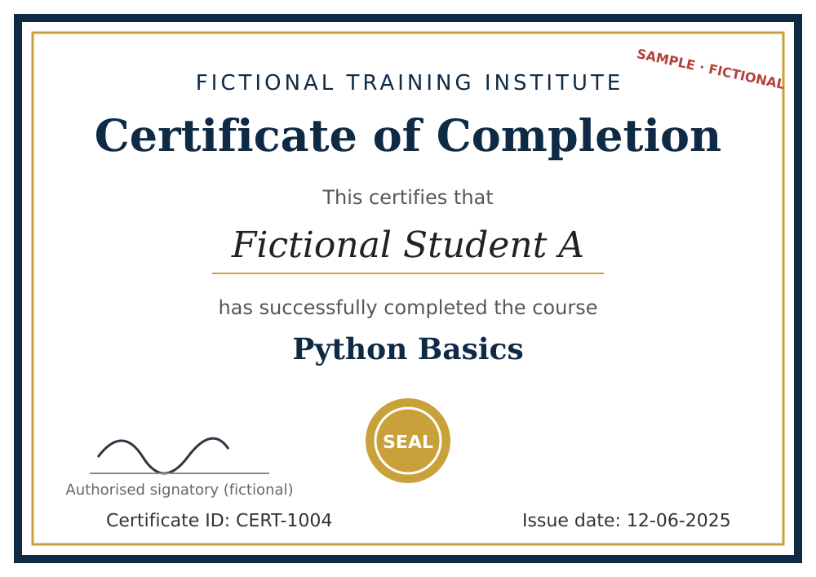
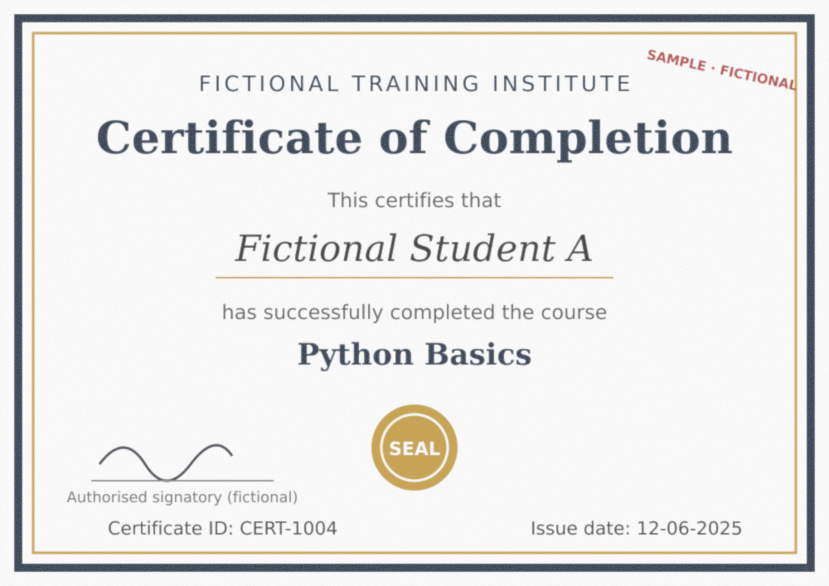
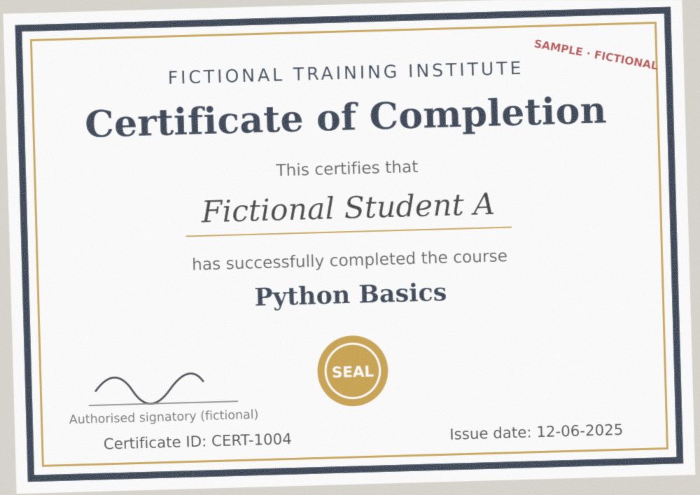
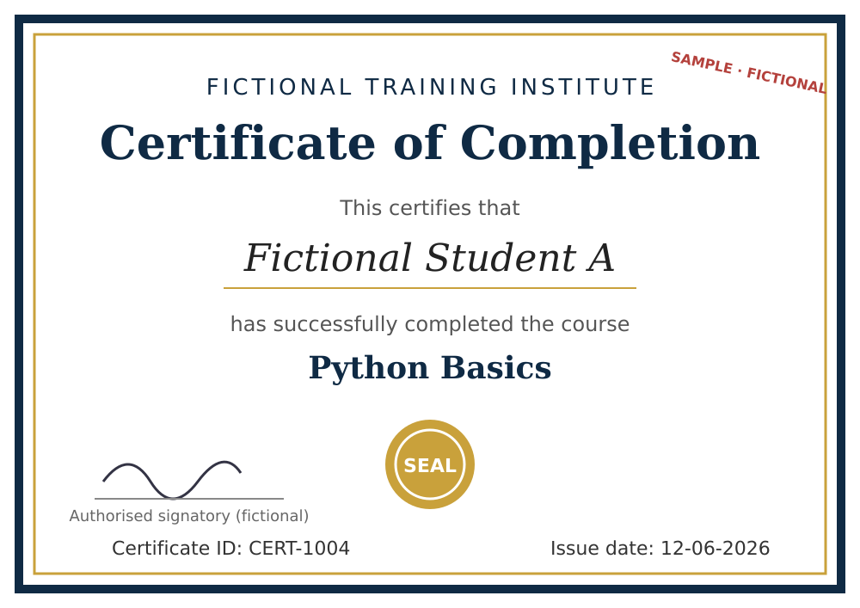
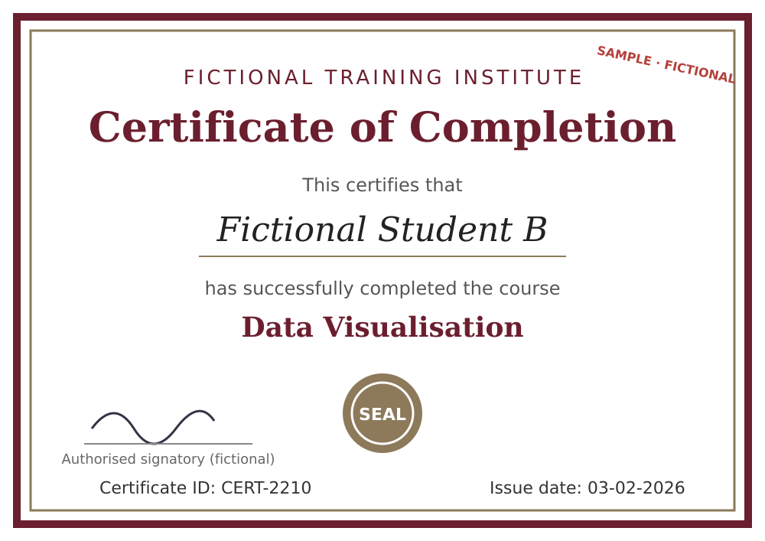
How Can We Compare Visually Similar Documents?
03 · HASHING, PERCEPTUAL SIMILARITY & OCR
Near-duplicate retrieval with perceptual hashing
1 PDF / image page
2 Normalise page image
3 Compute perceptual hash
4 Compare hash distance
Original (fictional)
Recompressed copy
Legitimate rescan
Small edit (date changed)
Unrelated certificate
Reference page
Expected: low distance
Expected: low distance
Expected: still low — edit may be missed
Expected: high distance
Perceptual ≠ cryptographic hash. Similar-looking pages give similar hashes, so lower distance can indicate visual similarity. It supports candidate retrieval only — it cannot prove authenticity, and thresholds must be evaluated on controlled examples.
Notes:
TIME: 7 min including Exercise A
LESSON OBJECTIVE: Explain perceptual hashing for near-duplicate retrieval.
EXPLAIN: A perceptual hash summarises visual characteristics of a page image, so visually similar pages get similar hashes. Pipeline: convert PDF/image to a normalised page image, compute the perceptual hash, compare the Hamming distance (number of differing bits). Lower distance suggests greater visual similarity for that hashing method. Thresholds must be chosen on validation data.
EXAMPLE: The four fictional thumbnails: a recompressed copy and a legitimate rescan should be close; a small date edit may also look close (risk!); an unrelated certificate should be far.
KEY TERMS: Perceptual hash = visual fingerprint (e.g. aHash, pHash, dHash). Hamming distance = count of differing bits between two hashes. Threshold = cut-off distance for "candidate near-duplicate".
ASK STUDENTS: Can two documents appear visually similar while containing a changed critical field?
SUGGESTED ANSWER: Yes. A small date or amount edit barely affects overall page appearance, so the perceptual hash distance can stay low.
AVOID THESE MISUNDERSTANDINGS: "Low distance = same document" and "low distance = genuine" are both wrong. Perceptual hashing finds candidates; it does not judge authenticity.
TRANSITION: "To compare the actual words and numbers, we need text — which brings us to OCR."
EXERCISE A — EXACT VS NEAR-DUPLICATE (3 min): Four fictional files: original, byte-identical copy, recompressed version, changed-date version. ANSWER GUIDE: original vs copy → SHA-256 matches. Original vs recompressed → SHA-256 differs; perceptual hash close → near-duplicate. Original vs changed date → SHA-256 differs; perceptual hash likely close (edit missed); OCR/field comparison finds the date difference. Limitation: neither hash type explains WHAT changed.

Slide 15
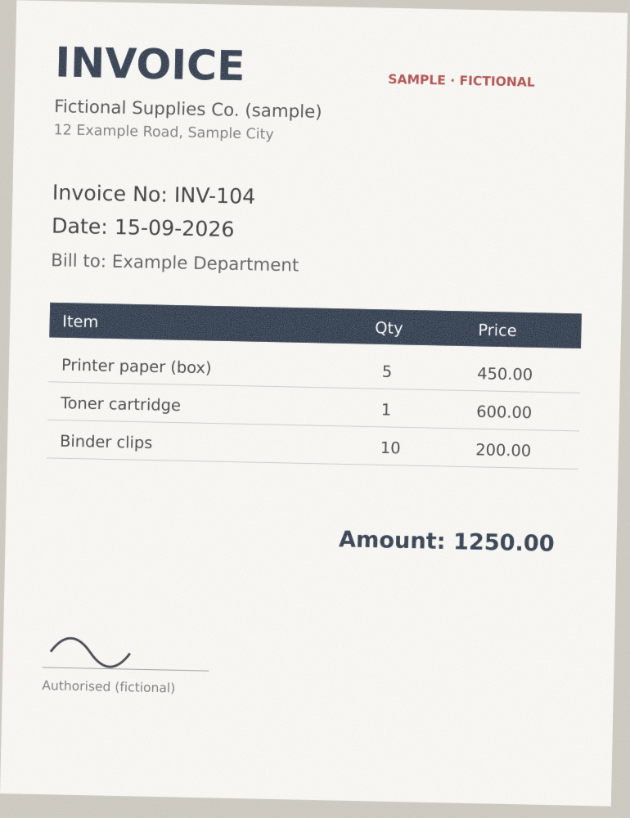



How Does OCR Read Scanned Documents?
03 · HASHING, PERCEPTUAL SIMILARITY & OCR
Optical Character Recognition converts visible text in an image into machine-readable text
EXTRACTED TEXT (illustrative)
POTENTIAL TOOLS
Tesseract OCR
Recognises text in images
Invoice No: INV-104
Date: 15-09-2026
Amount: 1250.00
OCR
PyMuPDF
Extracts text from text-based PDFs
Pillow / OpenCV
Prepares images before OCR
OCR can be wrong
Common confusions: 0 ↔ O, 1 ↔ l, 5 ↔ S. Poor scans, fonts and dates make errors more likely.
Which path?
Text-based PDF → extract text directly
Image-only scan → OCR needed
Scanned invoice (fictional)
Notes:
TIME: 6 min
LESSON OBJECTIVE: Explain OCR and when it is needed.
EXPLAIN: OCR converts visible text in an image into machine-readable text. Text-based PDFs often already contain selectable text, which PyMuPDF can extract directly without OCR. Image-only scans need OCR (e.g. Tesseract). Pillow/OpenCV prepare images first (greyscale, contrast, deskew) to improve recognition.
EXAMPLE: The fictional scanned invoice yields "Invoice No: INV-104", "Date: 15-09-2026", "Amount: 1250.00" — illustrative output.
KEY TERMS: OCR = optical character recognition. Tesseract = an open-source OCR engine (modern versions use an LSTM, a learned model). Preprocessing = cleaning the image before recognition.
ASK STUDENTS: Does OCR output always match the document perfectly?
SUGGESTED ANSWER: No. OCR can confuse similar characters (0/O, 1/l, 5/S), misread dates and struggle with poor scans or fonts. Comparisons must allow for recognition errors.
AVOID THESE MISUNDERSTANDINGS: Treating OCR text as ground truth. A "difference" may be an OCR mistake.
TRANSITION: "Once we have text from two documents, how do we compare it?"

Slide 16
How Can We Compare Extracted Document Text?
04 · TEXT, FIELDS & EXPLAINABLE PIPELINE
Normalisation, TF-IDF and cosine similarity
1 Extracted text
2 Normalisation
3 TF-IDF vectors
4 Cosine similarity
NORMALISATION EXAMPLE
DOCUMENT A
"Course Completion Certificate 2026"
cosine
similarity
Result
High text similarity (illustrative)
" COURSE Completion
Certificate, 2026 "
↓ lower-case, trim, remove punctuation
DOCUMENT B
"Course Completion Certificate 2026"
"course completion certificate 2026"
TF-IDF: weights words that are frequent in this document but rare across the collection.
Cosine similarity: how closely two text vectors point the same way (1 = same, 0 = unrelated).
Template trap: two certificates for different people share the same wording, so they can also score highly. Similarity ≠ authenticity.
Notes:
TIME: 3 min (Section 4 · Text, fields & explainable pipeline — 15 min total)
LESSON OBJECTIVE: Introduce text normalisation, TF-IDF and cosine similarity.
EXPLAIN: Normalisation makes text comparable: lower-case, remove extra spaces and punctuation, standardise date formats. TF-IDF represents a document as a vector of weighted terms: words frequent in this document but rare across the collection get more weight. Cosine similarity measures the angle between two vectors: 1 = same direction, 0 = nothing in common.
EXAMPLE: Document A and B both read "Course Completion Certificate 2026" → high similarity. But two certificates for different people from the same template also score high, because they share standard wording.
KEY TERMS: TF = term frequency; IDF = inverse document frequency. Vector = list of numbers representing a document. Cosine similarity = alignment between vectors.
ASK STUDENTS: Why can two unrelated certificates have high text similarity?
SUGGESTED ANSWER: They share standard template wording and differ only in a few fields such as name and date.
AVOID THESE MISUNDERSTANDINGS: Similarity is not authenticity, and high similarity does not mean "same person" or "duplicate".
TRANSITION: "Because templates dominate whole-text similarity, we also compare specific fields."

Slide 17
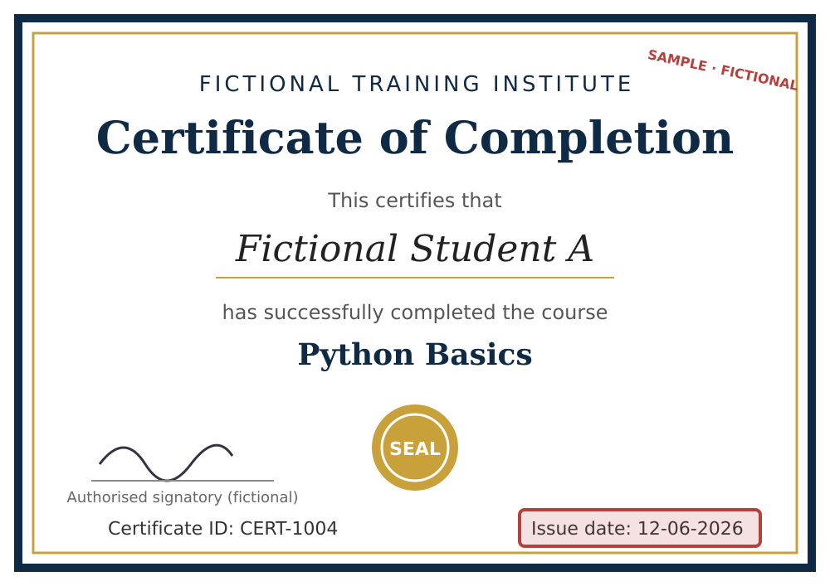
Finding Meaningful Changes
04 · TEXT, FIELDS & EXPLAINABLE PIPELINE
Field-level comparison of two fictional certificates · Exercise C
ORIGINAL
SUBMITTED
AUTOMATED INDICATOR (illustrative)
Potentially relevant difference detected:
Issue date changed
REVIEWER ACTION
Inspect both originals and verify whether the difference is legitimate.
Field | Original (fictional) | Submitted (fictional) | Status
Certificate ID | CERT-1004 | CERT-1004 | Same
Issue date | 12-06-2025 | 12-06-2026 | Different
Course title | Python Basics | Python Basics | Same
Student name | Fictional Student A | Fictional Student A | Same
Caution: an OCR misread can also create a false field difference.
Notes:
TIME: 4 min including Exercise C
LESSON OBJECTIVE: Show how field-level comparison isolates meaningful changes.
EXPLAIN: Instead of comparing whole texts, extract key fields (certificate ID, issue date, course, name) and compare them one by one. Fields can be found by text parsing, template-specific rules or OCR within known regions. Here only the issue date differs, so the system reports "Potentially relevant difference detected: issue date changed" — and a reviewer checks whether it is legitimate.
EXAMPLE: The fictional certificate CERT-1004: issue date 12-06-2025 in the original, 12-06-2026 in the submission. The reviewer might find a legitimate reissue — or not.
KEY TERMS: Key field = a value that matters for the decision. Template rule = knowledge of where a field appears on a known document layout.
ASK STUDENTS: Does detecting a changed date automatically establish forgery?
SUGGESTED ANSWER: No. It indicates a difference that needs contextual verification by an authorised reviewer.
AVOID THESE MISUNDERSTANDINGS: Forgetting OCR errors: a misread "5" as "6" would also create a false field difference.
TRANSITION: "Text isn't everything — some changes are visual. How do we locate them?"
EXERCISE C — OCR AND TEXT COMPARISON (3 min): Show the two fictional OCR outputs (dates 12-06-2025 vs 12-06-2026). Students find the changed field and discuss: what if OCR misread the original? ANSWER GUIDE: the reviewer must compare against the actual images; field differences should store the image region and OCR confidence as evidence.

Slide 18
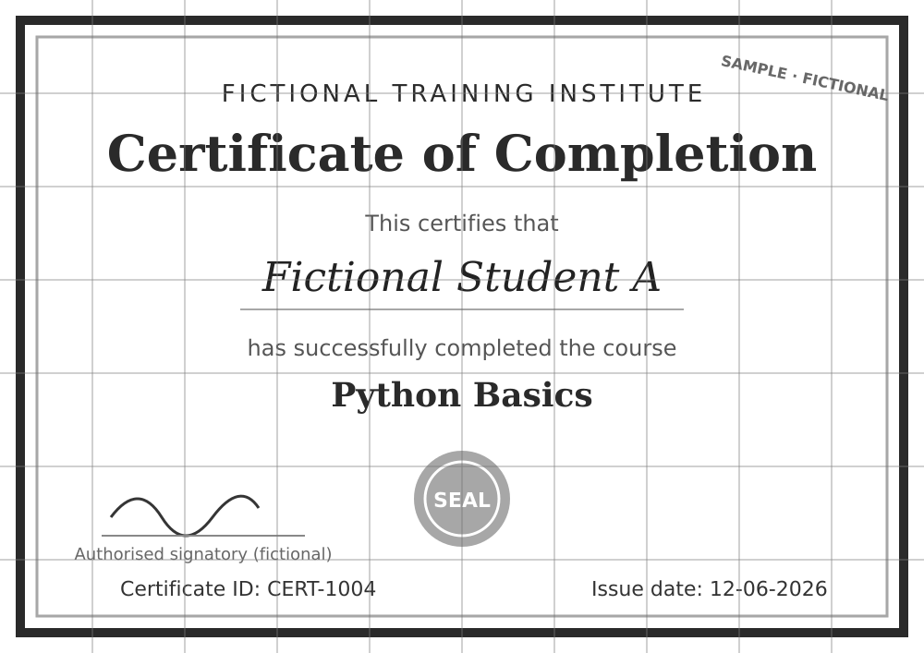
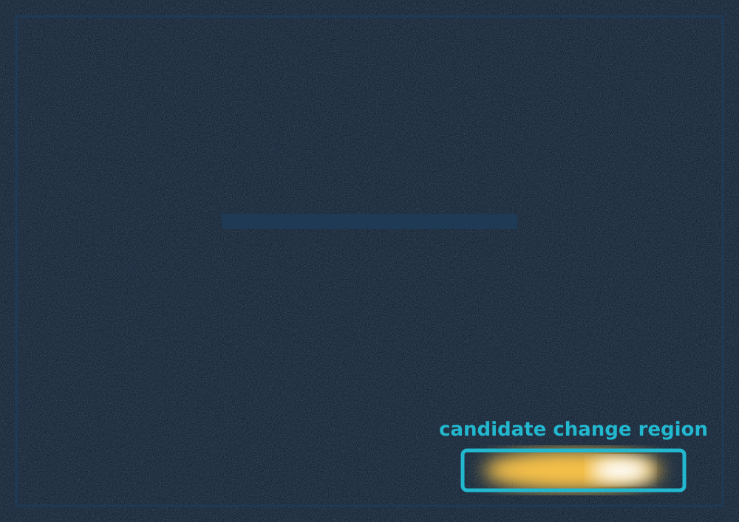
How Can Visual Differences Be Located?
04 · TEXT, FIELDS & EXPLAINABLE PIPELINE
Image preprocessing and selected region-level comparison · candidate tools: OpenCV and Pillow
Submitted page (fictional)
Normalised and aligned
Difference highlight (idealised)
PROPOSED STEPS
FALSE-ALERT SOURCES
1 Convert pages to a common image form
4 Compare selected regions
Scan angle
Lighting
Compression
2 Normalise size and orientation
5 Highlight candidate changes
Blur
Page crop
Legit stamps / notes
3 Align comparable pages
6 Store evidence for the reviewer
Notes:
TIME: 3 min
LESSON OBJECTIVE: Explain image preprocessing and region-level difference analysis.
EXPLAIN: Convert pages to a common image form, normalise size and orientation, align comparable pages, compare selected regions, highlight candidate changes and store the evidence. Without alignment and normalisation, visual differencing creates many false alerts. OpenCV and Pillow are candidate tools.
EXAMPLE: The three panels show the fictional original, a normalised/aligned greyscale version, and a difference map where only the issue-date region lights up — an idealised illustration.
KEY TERMS: Alignment (registration) = shifting/rotating one image to line up with another. Difference map = image showing where pixels differ. False alert = a flagged change that is not meaningful.
ASK STUDENTS: Why might a rescan show many differences even if the information is unchanged?
SUGGESTED ANSWER: Scanning changes alignment, brightness, resolution, noise and compression, so pixels differ everywhere.
AVOID THESE MISUNDERSTANDINGS: Do not claim any image operation detects all digitally altered text; legitimate stamps or annotations also create differences.
TRANSITION: "Now let's combine all these signals into one explainable pipeline."

Slide 19
How Do the Methods Work Together?
04 · TEXT, FIELDS & EXPLAINABLE PIPELINE
The combined, explainable screening pipeline
1 Uploaded document
EVIDENCE REPORT · illustrative example
2 Secure validation and storage
Exact hash: Different
3 SHA-256 exact matching
Perceptual similarity: Candidate near-duplicate
4 Page normalisation + perceptual hashing
Extracted text: One date field differs
5 PDF text extraction / OCR
6 Text and field comparison
Region evidence: Difference near the issue-date area
7 Selected region-level difference analysis
Final system status: Requires manual review
8 Evidence report
Signals may disagree — thresholds and decision rules must be documented. The highest automated status is "requires manual review".
9 Human reviewer
Notes:
TIME: 3 min
LESSON OBJECTIVE: Show how the methods combine into an explainable evidence report.
EXPLAIN: Each stage contributes one signal: SHA-256 for exact matches, perceptual hash for visual candidates, text/OCR and field comparison for content changes, region analysis for location. The evidence report brings them together for the reviewer. Signals may disagree, so thresholds and decision rules must be documented.
EXAMPLE: Illustrative report: exact hash different; perceptual similarity — candidate near-duplicate; one date field differs; region difference near the issue-date area; system status — requires manual review.
KEY TERMS: Explainable = the system shows WHY it flagged something. Signal = output of one method. Decision rule = documented logic combining signals into a status.
ASK STUDENTS: What is the main contribution of combining these methods?
SUGGESTED ANSWER: A traceable screening workflow that brings complementary evidence together for a reviewer — subject to experimental validation.
AVOID THESE MISUNDERSTANDINGS: Turning combined signals into a single "fraud score" or a final verdict. The highest status is "requires manual review".
TRANSITION: "A mentor will ask: is this really AI?"

Slide 20




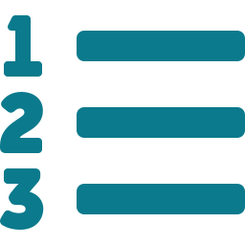
Is DocuGuard AI Really an AI/ML Project?
04 · TEXT, FIELDS & EXPLAINABLE PIPELINE
Classify each method honestly
DOCUGUARD DRAWS ON
Deterministic methods
Learned components
Human decision
Document intelligence
SHA-256 — not ML
Perceptual hashing — not necessarily ML
TF-IDF + cosine — feature representation & similarity
Explicit rules
OCR recognition models (e.g. Tesseract LSTM)
scikit-learn models only where justified
Reviewer interprets evidence
Records the final decision
Computer vision
Information retrieval
OCR
Similarity analysis
Applied ML where justified
Mentor asks "Which ML model did you train?" → state exactly which models, if any, were actually trained. Do not claim a custom deep-learning forgery detector.
Rule-based evidence analysis
Notes:
TIME: 2 min
LESSON OBJECTIVE: Classify each method honestly as deterministic, learned or human.
EXPLAIN: SHA-256 is not machine learning. Perceptual hashing is not necessarily machine learning. TF-IDF/cosine is a feature-representation and similarity method. OCR may use learned recognition models (Tesseract's LSTM). scikit-learn is used where justified. The whole system is an intelligent document-processing workflow; it must not claim a custom trained deep-learning forgery detector.
EXAMPLE: Honest wording: "We use a pre-trained OCR model and classical similarity methods; we did not train a neural forgery detector."
KEY TERMS: Deterministic method = fixed rules, same output every time. Learned component = model whose behaviour comes from training data.
ASK STUDENTS: What should we say if the mentor asks, "Which ML model did you train?"
SUGGESTED ANSWER: State exactly which models, if any, were actually trained. The proposal combines hashing, OCR, similarity and controlled evidence analysis rather than requiring a custom trained forgery detector.
AVOID THESE MISUNDERSTANDINGS: Over-claiming "AI" for every component, or apologising for not training a neural network — intelligent systems do not always need one.
TRANSITION: "How will we evaluate these methods fairly?"

Slide 21
How Will We Evaluate the Detection Methods?
05 · DATASET, BASELINES & EVALUATION
Proposed controlled dataset — every document is fictional; size subject to feasibility
≈150–250
1 Exact re-upload
Exact duplicate
2 Recompression
Near-duplicate
fictional source documents (target)
3 Rescanning simulation
Near-duplicate
2
4 Small text modification
Changed content
5 Changed date
Changed field
controlled templates: certificate, invoice
6 Changed amount
Changed field
9
7 Image replacement
Visual change
Source document family
8 Benign visual variation
Negative (not a tamper)
controlled transformation types
9 Unrelated document
Negative (unrelated)
Leakage rule: keep every variant of a source-document family in the same train / validation / test partition.
Notes:
TIME: 4 min (Section 5 · Dataset, baselines & evaluation — 10 min total)
LESSON OBJECTIVE: Describe the proposed controlled dataset and leakage rule.
EXPLAIN: The proposal targets roughly 150–250 fictional source documents across two templates, subject to feasibility. Each source gets controlled variants: exact re-upload, recompression, rescanning simulation, small text change, changed date, changed amount, image replacement, benign visual variation and an unrelated document. Because each change is known, results can be labelled precisely.
EXAMPLE: One fictional certificate becomes a "family" of nine variants. All nine must stay in the same split.
KEY TERMS: Synthetic/controlled dataset = documents created for research with known transformations. Data leakage = test results inflated because near-identical material was seen during development.
ASK STUDENTS: Why group related variants during dataset splitting?
SUGGESTED ANSWER: To avoid the evaluation exploiting near-identical source material already seen while tuning thresholds or models.
AVOID THESE MISUNDERSTANDINGS: Claiming results on fictional templates generalise to all real certificates. Disclose the synthetic nature clearly. No dataset has been collected yet.
TRANSITION: "To know if the combined pipeline helps, we need baselines."

Slide 22
What Will We Compare?
05 · DATASET, BASELINES & EVALUATION
Two simple baselines versus the proposed combined pipeline
Baseline A — SHA-256 only
Detects exact byte-identical submissions
SAME EVALUATION
Same test set
Same metrics
Thresholds fixed on validation data before the final test
Labelled controlled test set
Baseline B — OCR / text similarity only
Retrieves documents by extracted-text similarity
Proposed combined pipeline
Hashes + page similarity + extracted fields + region evidence
Method | Exact duplicates | Near-duplicates | Selected changes
SHA-256 only | Evaluate | Evaluate | Evaluate
OCR similarity only | Evaluate | Evaluate | Evaluate
Combined pipeline | Evaluate | Evaluate | Evaluate
Do not pre-fill this table with "high", "medium" or numbers — findings must come from experiments.
Notes:
TIME: 3 min
LESSON OBJECTIVE: Explain baselines and a fair comparison.
EXPLAIN: Baseline A (SHA-256 only) catches exact byte-identical files. Baseline B (OCR/text similarity only) retrieves documents by extracted text. The proposed combined pipeline adds page similarity, field and region evidence. All three run on the same test set with the same metrics. Thresholds are tuned on validation data and frozen before the final test.
EXAMPLE: If the combined pipeline finds no more changed-date cases than text similarity alone, the extra complexity is not justified — that is a valid research finding too.
KEY TERMS: Baseline = simple reference method. Validation set = data for tuning. Test set = data used once for the final result.
ASK STUDENTS: Why compare against a simple baseline?
SUGGESTED ANSWER: Without one, you cannot tell whether the extra complexity improves measured outcomes.
AVOID THESE MISUNDERSTANDINGS: Pre-filling the table with "high/medium/low" or numbers. Every cell says "Evaluate" until experiments run.
TRANSITION: "Which measurements will we actually report?"

Slide 23
How Will We Measure Success?
05 · DATASET, BASELINES & EVALUATION
Detection, evidence-quality and operational metrics · no results exist yet
DETECTION
Results template
NOT YET MEASURED
Confusion matrix (concept)
Precision and recall
F1-score
False-positive rate
Results per transformation type
Evaluation measure | Result
Exact duplicate precision | TBD
Near-duplicate recall | TBD
Tamper-flag F1-score | TBD
False-positive rate | TBD
Processing latency | TBD
Actually changed
Actually unchanged
Flagged
TP
correct flag
FP
false alert — wastes reviewer time
EVIDENCE QUALITY
Not flagged
FN
missed change
TN
correct pass
Highlighted field/region matches the change?
Evidence understandable to reviewers?
Precision = TP / (TP + FP)
of flagged documents, how many truly changed
Recall = TP / (TP + FN)
of truly changed documents, how many were flagged
OPERATIONAL
A false positive may lead to a legitimate document being flagged unnecessarily.
Processing latency · upload-to-report time
Reviewer task time — only with a proper study
Notes:
TIME: 3 min
LESSON OBJECTIVE: Define the evaluation metrics.
EXPLAIN: Precision: of the documents the system flagged, how many really had the controlled change. Recall: of the documents that really had a change, how many were flagged. F1 balances both. False-positive rate shows how often unchanged documents are flagged. Report per transformation type. Also judge evidence quality (does the highlighted region match the change?) and operational performance (latency, upload-to-report time). Reviewer task time only if a proper study is run.
EXAMPLE: If 20 documents are flagged and 15 truly changed, precision = 15/20 = 0.75 (a worked example, not a project result).
KEY TERMS: TP/FP/FN/TN = true positive, false positive, false negative, true negative. Latency = processing time per document.
ASK STUDENTS: Why are false positives important in document screening?
SUGGESTED ANSWER: They waste reviewer time and can cause unfair suspicion of legitimate submitters if findings are communicated carelessly.
AVOID THESE MISUNDERSTANDINGS: Quoting a single "accuracy" figure, or inventing results. All table values are TBD.
TRANSITION: "Now the application side: what do we store?"

Slide 24
What Information Does PostgreSQL Store?
06 · WEB APP, SECURITY & TESTING
Conceptual ER design — originals, analysis results and human decisions kept separate
USER
DOCUMENT
DOCUMENT_FILE
REVIEWER STATES
1
N
1
N
PK user_id · role
PK document_id · FK submitted_by · doc_type
PK file_id · sha256 · storage_ref
Pending Review
1
1
N
N
AUDIT_EVENT
ANALYSIS_RUN
DOCUMENT_MATCH
Under Review
1
N
PK event_id · FK actor_id · action · timestamp
PK run_id · FK document_id · status · method_versions
PK match_id · FK run_id · matched_document_id · match_type
1
1
Reviewed
N
N
REVIEW_DECISION
REVIEW_CASE
DIFFERENCE_EVIDENCE
N
1
PK decision_id · FK case_id · FK reviewer_id · outcome
PK case_id · FK run_id · state
PK evidence_id · FK match_id · field/region · description
A stored similarity score must never silently overwrite a reviewer judgement.
Conceptual schema with illustrative names. Header colours follow the deck key: grey = source, teal = automated, purple = human, navy = system.
Notes:
TIME: 3 min (Section 6 · Web app, security & testing — 10 min total)
LESSON OBJECTIVE: Explain the conceptual database and reviewer workflow.
EXPLAIN: Separate three things: original documents (DOCUMENT, DOCUMENT_FILE), derived analysis results (ANALYSIS_RUN, DOCUMENT_MATCH, DIFFERENCE_EVIDENCE) and human decisions (REVIEW_CASE, REVIEW_DECISION). AUDIT_EVENT preserves important actions. Review cases move Pending Review → Under Review → Reviewed. A stored similarity score must never silently overwrite a reviewer judgement.
EXAMPLE: If the analysis is re-run with a new threshold, a new ANALYSIS_RUN is created; the earlier run and the reviewer's decision stay intact.
KEY TERMS: Entity = a table. Primary key (PK) / foreign key (FK) = row identifier / link to another table. Audit event = immutable log record.
ASK STUDENTS: Why maintain analysis history?
SUGGESTED ANSWER: For traceability, reproducibility, audit and later review of how a screening outcome was produced.
AVOID THESE MISUNDERSTANDINGS: Storing only the latest score; overwriting decisions; mixing automated status and human outcome in one column.
TRANSITION: "How will React and FastAPI talk to each other?"

Slide 25
How Will the Web Application Be Developed?
06 · WEB APP, SECURITY & TESTING
Proposed React pages → FastAPI endpoints → JSON responses · all examples illustrative
React (TypeScript) pages
Candidate FastAPI endpoints
Illustrative response
1 Login
POST
/api/v1/documents
{
"document_id": "DOC-105",
"analysis_status": "completed",
"exact_duplicate": false,
"possible_near_duplicate": true,
"review_required": true,
"evidence_types": [
"text_difference",
"field_difference"
]
}
2 Document upload
Upload a document
GET
/api/v1/documents/{document_id}
3 Submission history
Document metadata
4 Analysis status
POST
/api/v1/documents/{document_id}/analyze
Start an analysis job
5 Document comparison
GET
/api/v1/analysis-runs/{analysis_id}
6 Reviewer evidence panel
Poll status and evidence
GET
/api/v1/review-cases
7 Review decision
Reviewer queue
8 Admin dashboard
POST
/api/v1/review-cases/{case_id}/decisions
Record a decision
Analysis can be slow → status workflow: queued → processing → completed / failed. The client polls; the backend controls every step.
Notes:
TIME: 3 min
LESSON OBJECTIVE: Show the proposed pages, endpoints and response format.
EXPLAIN: React (TypeScript) pages call FastAPI REST endpoints with an authentication token. Upload creates a document; analysis is triggered and runs as a job; the client polls the analysis run for status; reviewers list cases and post decisions. Because analysis can be slow, define a clear status workflow (queued → processing → completed / failed).
EXAMPLE: The illustrative JSON says: not an exact duplicate, possible near-duplicate, review required, with text and field differences as evidence types.
KEY TERMS: REST endpoint = URL + HTTP method. JSON = data format of requests/responses. Polling = the client asking periodically for the job status.
ASK STUDENTS: Why should the backend, rather than the browser, control file processing?
SUGGESTED ANSWER: To enforce validation, access permissions, processing limits and trustworthy record storage.
AVOID THESE MISUNDERSTANDINGS: Showing illustrative JSON as real output; letting the client decide "review_required".
TRANSITION: "Documents are sensitive — how will we protect them and test the system?"

Slide 26
How Will We Handle Sensitive Documents Responsibly?
06 · WEB APP, SECURITY & TESTING
Security around the whole document lifecycle, and planned tests
SECURITY CONTROLS (PROPOSED)
PLANNED TEST SCENARIOS
NOT YET EXECUTED
1 Upload valid PDF
6 Handle malformed files safely
Upload
Processing
2 Reject unsupported file
7 Deny cross-user document access
Authentication
File-type and size validation
Safe filenames and storage refs
Time and resource limits
Safe handling of malformed files
3 Detect an exact duplicate
8 Record reviewer decision
4 Flag a controlled near-duplicate
9 Preserve analysis history
5 Handle OCR failure
10 Handle processing failures
Storage
Review
Functional testing
Uploads, access, orchestration, persistence
Algorithm evaluation
Detection of labelled differences
Restricted file storage
Encryption in transit (deployment)
Retention and deletion policies
Role-based authorisation
Controlled document retrieval
Audit logging
Human verification before adverse decisions
Security validation
Upload, storage, processing, access
Usability review
Report only if a study is conducted
Notes:
TIME: 4 min
LESSON OBJECTIVE: Cover security, privacy and the four kinds of validation.
EXPLAIN: Uploads are a sensitive feature. Controls span the lifecycle: authentication and file validation at upload; resource limits and safe handling of malformed files during processing; restricted storage, encryption in transit and retention/deletion policies; RBAC, controlled retrieval, audit logging and human verification before any adverse decision. Distinguish functional testing, algorithm evaluation, security validation and usability review — only report a usability study if one is actually conducted.
EXAMPLE: Test 7: user A requests user B's document ID → the API must deny access without revealing anything about the file.
KEY TERMS: Retention policy = how long files are kept before deletion. Encryption in transit = HTTPS/TLS. Adverse decision = an outcome that harms the submitter (e.g. rejection).
ASK STUDENTS: What is one major risk of storing uploaded certificates carelessly?
SUGGESTED ANSWER: Unauthorised disclosure of sensitive personal information.
AVOID THESE MISUNDERSTANDINGS: Believing a working algorithm means a safe application. Testing must use fictional or properly authorised records only. None of the listed tests has been executed yet.
TRANSITION: "Finally: the plan, the demo and your mentor pitch."

Slide 27

From Project Proposal to Working Prototype
07 · DEMO, MENTOR PREP & Q&A
Proposed 16-week plan, college milestones and the planned demonstration
1
2
3
4
5
6
7
8
9
10
11
12
13
14
15
16
Literature, requirements, risk analysis
W1–2
DB, API & interface design, baselines
W3–4
Controlled dataset + analysis features
W5–6
Integration, initial tests, mid-sem report
W7–8
Evidence display + reviewer workflow
W9–10
Controlled evaluation + failure analysis
W11–12
Security, deployment prep, performance
W13–14
Final validation, dissertation, demo
W15–16
22 Oct 2026 · Abstract soft copy Passed — verify status
PLANNED DEMO · 5 fictional files → distinct evidence → reviewer decision → audit history
2 Dec 2026 · Mid-semester report Soft copy
20 Jan 2027 · Final report Soft copy
Original
Reference
Exact duplicate
Hash match
Recompressed
Near-duplicate
Changed date
Field difference
Unrelated
No match
Notes:
TIME: 3 min (Section 7 · Demo, mentor prep & Q&A — 10 min total)
LESSON OBJECTIVE: Present the 16-week roadmap, milestones and planned demonstration.
EXPLAIN: The bars show the proposed plan; adjust as real progress is made. Milestones are college soft-copy deadlines. The abstract deadline (22 October 2026) has already passed — verify the actual submission status rather than claiming it was submitted. The planned demo uses five labelled fictional files to show distinct evidence, then a reviewer decision and audit history. All demo outcomes remain unverified until implementation.
EXAMPLE: Demo storyline: original → exact duplicate (hash match) → recompressed (near-duplicate) → changed date (field difference) → unrelated (no match).
KEY TERMS: Milestone = fixed deadline. Demo script = a planned, repeatable sequence with known inputs and expected evidence.
ASK STUDENTS: What evidence should the project team preserve each week?
SUGGESTED ANSWER: Source-code changes (commits), tests and their results, screenshots of real progress, dataset records, experiment logs and supervisor feedback.
AVOID THESE MISUNDERSTANDINGS: Presenting mockups as working software; skipping the "unrelated document" case, which shows the system does not flag everything.
TRANSITION: "Let's rehearse explaining DocuGuard to a mentor."

Slide 28
Are You Ready to Explain DocuGuard AI?
07 · DEMO, MENTOR PREP & Q&A
Mentor presentation, viva questions and final recap
90-SECOND MENTOR EXPLANATION
MENTOR-VIVA QUESTIONS
“Our proposed project is DocuGuard AI, an explainable document-screening platform designed to assist institutions and organizations in identifying repeated document submissions and selected potentially suspicious alterations. The system will allow authorized users to upload PDFs and images through a React application. FastAPI will coordinate secure upload, analysis and review workflows, while Python libraries will perform file hashing, OCR, text comparison and selected image-processing tasks. We propose using SHA-256 for exact duplicate detection, perceptual hashing for visually similar documents, and OCR-based text and field comparison to identify selected differences. The results will be presented as supporting evidence for human verification rather than as definitive fraud judgments. PostgreSQL will store metadata, analysis findings, review records and audit history, while uploaded files will remain in restricted storage. For evaluation, we plan to prepare labeled fictional documents with controlled changes and compare the proposed combined workflow with simpler baseline methods. We will assess precision, recall, false alerts, evidence quality and processing performance. Our intended outcome is a traceable, reviewer-centered document-screening application that can be demonstrated on standard development hardware.”
What real-world problem does DocuGuard AI solve?
How does SHA-256 detect exact duplicates?
Why is SHA-256 insufficient for near-duplicates?
What is perceptual hashing?
What is OCR?
How does TF-IDF/cosine similarity help retrieval?
Suspicious change vs confirmed fraud — the difference?
Why is human review necessary?
How will the dataset be created and labelled?
How will the combined method be compared with baselines?
Why do you need React, FastAPI and PostgreSQL?
How will uploaded documents be protected?
What are the expected limitations?
How will you demonstrate the application?
What is the project's actual research contribution?
Upload securely
Compare with complementary methods
Present reviewable evidence
Require human verification
Evaluate with controlled experiments
Notes:
TIME: 7 min including Exercise E
LESSON OBJECTIVE: Rehearse the mentor explanation and viva answers.
EXPLAIN: Students should deliver the 90-second explanation without reading it, then answer viva questions accurately and without unsupported claims about authenticity. Listen for the key distinctions: exact vs near-duplicate, indicator vs decision, deterministic vs learned, proposed vs completed.
EXAMPLE: Good answer to Q7: "A suspicious change is a detected difference that needs review; confirmed fraud is a conclusion only an authorised investigation can reach — DocuGuard never outputs it."
KEY TERMS: Viva = oral examination. Research contribution = an explainable combination of complementary screening signals with a human-review workflow, evaluated against baselines.
ASK STUDENTS: What is the project's actual research contribution?
SUGGESTED ANSWER: An explainable combination of complementary screening signals, evaluated against simpler baselines on controlled data, inside an evidence-based human-review workflow — not a general-purpose fraud-certification system.
AVOID THESE MISUNDERSTANDINGS: Reading the script word for word; saying "the system detects fraud"; quoting results that do not exist.
TRANSITION: Close with the five recap ideas: upload securely, compare with complementary methods, present reviewable evidence, require human verification, evaluate with controlled experiments.
EXERCISE E — MENTOR SIMULATION (5 min): Assign roles — submission user, document reviewer, backend developer, document-intelligence developer, academic examiner. The examiner picks five questions from the list; each role answers from its perspective. ANSWER GUIDE: check every answer separates proposed from completed work and never claims fraud certification.

