Slide 1
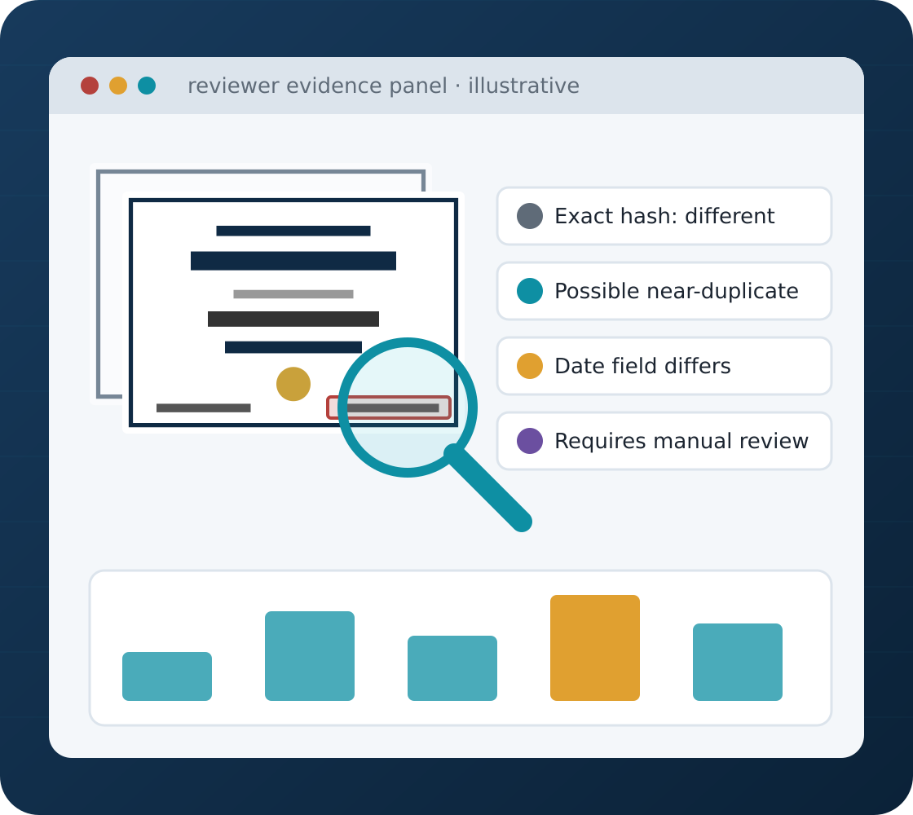
DISSERTATION PROPOSAL PRESENTATION
DocuGuard AI
An Explainable AI-Based Document Tampering and Duplicate Submission Detection Platform
Python
FastAPI
React + TypeScript
PostgreSQL
OCR
Computer Vision
Presented by
[Student Name] · [BITS ID]
Supervisor
[Supervisor Name], [Designation]
Organisation
[Organisation / Mentor Name]
BITS Pilani · CSIW ZG628T Dissertation · Academic Session 2026–2027
Notes:
Good morning/afternoon. We are [names], and our dissertation is DocuGuard AI — a proposed platform that helps organisations screen uploaded documents for duplicates and selected changes, and presents explainable evidence to a human reviewer. Our supervisor is [name].

Slide 2
Presentation Outline
OVERVIEW
What we will cover in the next 10–15 minutes
Problem and motivation
Core detection methods
01
05
Proposed solution
Database design
02
06
Objectives and scope
Evaluation plan
03
07
Architecture and workflow
Timeline and conclusion
04
08
Notes:
Here is our outline: the problem, our solution, objectives and scope, architecture and workflow, our three core detection methods, database design, evaluation plan, and finally the timeline and conclusion.

Slide 3






Why Document Screening Is Difficult
THE PROBLEM
Organisations receive large volumes of uploaded documents
Repeated uploads of identical files
PROBLEM STATEMENT
How can a lightweight platform identify exact and near-duplicate submissions and selected suspicious alterations while preserving reviewable evidence?
Rescanned or format-converted copies
Documents with modified dates or amounts
Inconsistent text fields across versions
Low-quality scans that are hard to read
Why it matters
Simple file hashing misses rescans, and manual review does not scale — reviewers need clear, traceable evidence.
Slow, repetitive manual comparison
Notes:
Institutions and finance teams receive many certificates and invoices. Some are identical re-uploads, some are rescanned or converted, and some may have changed dates or amounts. Simple hashing misses rescans, and manual comparison is slow. Our problem statement asks how to find these cases while preserving reviewable evidence.

Slide 4




DocuGuard AI in One Picture
OUR PROPOSED SOLUTION
Automated indicators support — never replace — a human reviewer
Secure Upload
Analysis
Indicators
Human Review
Authorised users submit PDF, JPG or PNG
Hashing, OCR and text extraction
Exact match, near-duplicate, changed fields
Reviewer checks evidence and decides
In one sentence: DocuGuard AI combines hashing, OCR, text and region comparison to give reviewers explainable evidence of duplicates and selected changes — never a "fraud confirmed" verdict.
Notes:
Our solution has four stages: secure upload, automated analysis, similarity and difference indicators, and human review. The key idea is that the system produces evidence for a reviewer — it never outputs "fraud confirmed".

Slide 5



What We Propose to Build
OBJECTIVES
Initial focus: one or two fictional document templates (certificates, invoices)
Upload & registry
Analysis
Review & evaluation
Secure PDF/image upload
Document metadata registry
Restricted file storage
Exact duplicate detection
Near-duplicate retrieval
OCR / text extraction
Field-difference analysis
Evidence panel and review queue
Reviewer decisions and audit trail
Controlled experimental evaluation
RESEARCH CORE
an explainable combination of complementary screening signals inside a human-review workflow.
Notes:
Our objectives fall into three groups: upload and registry, analysis, and review and evaluation. The research core is the explainable combination of complementary screening signals inside a human-review workflow.

Slide 6


What Is In — and Out — of the First Release
SCOPE
A bounded scope keeps the 16-week dissertation feasible
In scope
Out of scope / future work
PDF, JPG and PNG files
Issuer database verification
One or two fictional templates
Detecting every kind of forgery
Exact duplicate detection
Legal authenticity decisions
Near-duplicate retrieval
Automatic rejection
OCR where needed
Every document format
Selected field-level comparison
Deep-learning training infrastructure
Reviewer case management and evidence reports
Basic audit logging
DocuGuard screens documents and supports reviewers — it cannot certify that a document is genuine.
Notes:
In scope: PDF and image files, one or two fictional templates, exact and near-duplicate detection, OCR, field comparison, review cases and audit logging. Out of scope: issuer verification, legal authenticity decisions, automatic rejection and heavy deep-learning infrastructure.

Slide 7






How React, FastAPI, Python and PostgreSQL Work Together
SYSTEM ARCHITECTURE
Proposed layered design
User / Reviewer
Browser access, authenticated by role
PostgreSQL
Metadata, analysis runs, matches, evidence, decisions and audit history
React + TypeScript
Upload screens, results, reviewer evidence panel
FastAPI backend
Authentication, upload validation, APIs, job status
Restricted storage
Original files kept outside public folders; accessed only through the backend
Document processing
Hashing, PDF parsing, OCR, similarity and difference analysis
Notes:
React with TypeScript provides the screens. FastAPI handles authentication, upload validation and APIs. Python services do hashing, PDF parsing, OCR and comparison. PostgreSQL stores metadata and evidence, while original files stay in restricted storage and are accessed only through the backend.

Slide 8
What Happens When a Document Is Uploaded
END-TO-END WORKFLOW
Proposed processing lifecycle
1
USER
2
USER
3
USER
4
FASTAPI
5
FASTAPI
Authenticate user
Choose document type
Upload PDF, JPG or PNG
Validate size, format, contents
Store in restricted area
10
REVIEWER
9
PROCESSING
8
PROCESSING
7
FASTAPI
6
FASTAPI
Reviewer sees results
Store derived evidence
Analyse the document
Queue analysis job
Create metadata record
Security: file extensions are never trusted alone — the server checks actual file contents before processing.
Notes:
This is the upload lifecycle in ten steps — from authentication and upload, through server-side validation and storage, to analysis and the reviewer. Note that we never trust a file extension: the server checks the actual contents.

Slide 9
Exact and Near-Duplicate Detection
CORE METHOD 1
Two kinds of hashing for two different questions
HOW IT WORKS
Which method catches which case? (expected behaviour)
Case | SHA-256 | Perceptual hash
Exact re-upload | Match | Match
Recompressed copy | Different | Close
Legitimate rescan | Different | Close
Small date edit | Different | May still look close
Unrelated document | Different | Far
SHA-256 gives a fixed fingerprint of the file bytes
Same digest → strong evidence of byte-identical files
Perceptual hashing compares how pages look
Lower hash distance suggests a near-duplicate candidate
Neither hash explains what changed — that needs text and field comparison.
Notes:
Our first method uses two kinds of hashing. SHA-256 is a cryptographic fingerprint: the same digest means byte-identical files. Perceptual hashing compares how pages look, so recompressed or rescanned copies stay close. But a small date edit may still look close, which is why we also need text comparison.

Slide 10
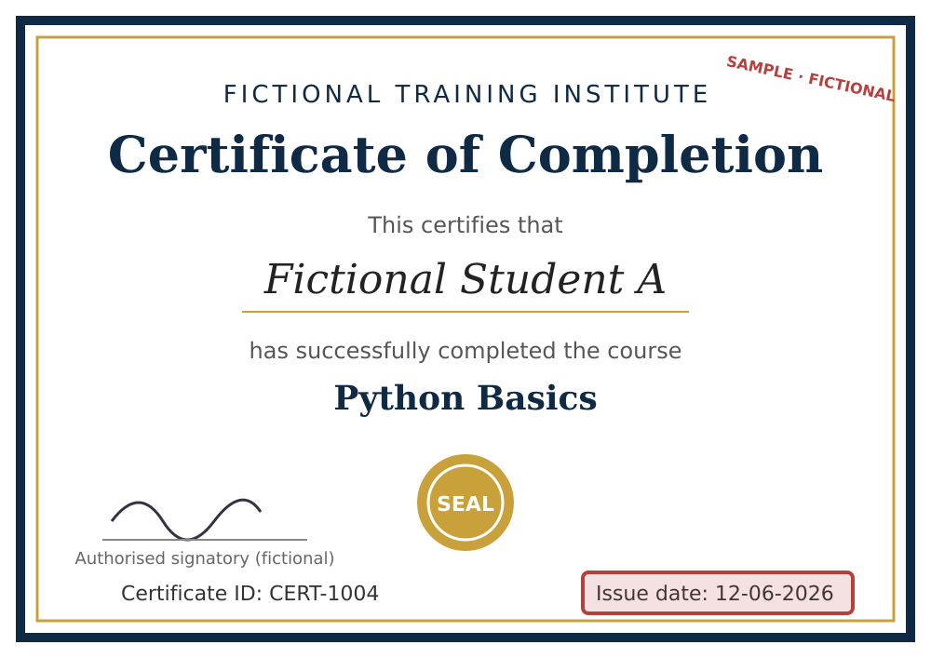
OCR and Field-Level Comparison
CORE METHOD 2
Finding which specific values differ
HOW IT WORKS
Text PDFs: extract text directly (PyMuPDF)
Scanned images: OCR with Tesseract
Normalise text, then compare key fields
OCR errors can create false differences, so evidence is kept for review
Fictional certificate — issue date 12-06-2025 → 12-06-2026 highlighted
Indicator: "Issue date changed" — the reviewer verifies whether it is legitimate.
Notes:
Our second method extracts text — directly from text PDFs, or with Tesseract OCR for scans — normalises it and compares key fields. In this fictional example only the issue date differs. The system flags it, and the reviewer decides whether it is legitimate. OCR errors can cause false differences, so the image evidence is kept.

Slide 11
The Combined Explainable Pipeline
CORE METHOD 3
Complementary signals brought together for the reviewer
PIPELINE
Exact hash: different
Not a byte-identical upload
Validate and store → SHA-256 exact match
Normalise page → perceptual hash
Extract text / OCR → field comparison
Region analysis → evidence report → reviewer
Perceptual similarity: candidate near-duplicate
Page looks very similar to an earlier submission
Extracted text: one date field differs
Difference located near the issue-date area
System status: requires manual review
The highest automated status — never "fraud confirmed"
Notes:
The third method combines everything. Each stage contributes one signal, and the evidence report brings them together: hash different, page similar, one date field differs, difference near the date area. The highest automated status is "requires manual review".

Slide 12
What PostgreSQL Will Store
DATABASE DESIGN
Conceptual entities — final schema designed during implementation
USER
DOCUMENT
DOCUMENT_FILE
role
submitted_by · type
sha256 · storage_ref
ANALYSIS_RUN
DOCUMENT_MATCH
DIFFERENCE_EVIDENCE
status · method versions
matched doc · type
field / region · description
REVIEW_CASE
REVIEW_DECISION
AUDIT_EVENT
run · state
reviewer · outcome
actor · action · time
KEY RELATIONSHIPS
A user submits many documents
Each document has a protected file reference
An analysis run produces matches and evidence
A review case references the analysis findings
An authorised reviewer records the decision
Audit events preserve important actions
Notes:
Our database separates original documents, automated analysis results and human decisions. Analysis runs keep history, and audit events record important actions, so every screening outcome can be traced.

Slide 13
How We Will Evaluate the System
EVALUATION PLAN
Planned methodology — no experiments have been run yet
WHAT WE WILL MEASURE
Baseline comparison
RESULTS PENDING
Precision and recall
F1-score
False-positive rate
Results per transformation type
Evidence quality (correct region?)
Processing time per document
Method | Exact dup. | Near dup. | Changes
SHA-256 only | TBD | TBD | TBD
OCR similarity only | TBD | TBD | TBD
Combined pipeline | TBD | TBD | TBD
We will build a controlled dataset of about 150–250 fictional documents with nine kinds of known changes. All variants of one source document stay in the same data split to avoid leakage.
ALSO TESTED
Upload validation, cross-user access denial, malformed files and reviewer decisions (Pytest).
Notes:
We will create a controlled dataset of about 150 to 250 fictional documents with known changes, and compare SHA-256 only, OCR similarity only and our combined pipeline using precision, recall, F1 and false-positive rate. No results exist yet — the table will be filled from real experiments.

Slide 14
Implementation Timeline and Milestones
PROJECT PLAN
Proposed 16-week work plan
1
2
3
4
5
6
7
8
9
10
11
12
13
14
15
16
Literature, requirements, risks
W1–2
DB, API, UI design, baselines
W3–4
Controlled dataset + analysis
W5–6
Integration, initial tests
W7–8
Evidence display + review workflow
W9–10
Controlled evaluation
W11–12
Security, performance
W13–14
Dissertation and demo
W15–16
2 Dec 2026
Mid-semester report
20 Jan 2027
Final report
Week 16
Final demonstration
Notes:
This is our 16-week plan, from design and dataset preparation through integration, the review workflow and evaluation, to the dissertation. Our next milestones are the mid-semester report on 2 December 2026 and the final report on 20 January 2027.

Slide 15


Expected Outcomes and Limitations
CONCLUSION
What we expect to deliver — and what we will not claim
Expected outcomes
Limitations
A working, reviewer-centred screening web app
Exact and near-duplicate detection with evidence
Field-level change indicators for review
A measured comparison against two baselines
Results apply to our fictional templates only
OCR and scan quality affect accuracy
Does not detect every type of forgery
Never a legal or official authenticity decision
Upload securely, compare with complementary methods, present reviewable evidence, require human verification, evaluate with controlled experiments.
Notes:
We expect to deliver a reviewer-centred screening app with duplicate detection, field-level indicators and a measured baseline comparison. Limitations: results apply to our fictional templates, OCR quality matters, and the system never makes legal authenticity decisions.

Slide 16
Thank You — Questions?
THANK YOU
We welcome feedback from our supervisor and reviewers
KEY TAKEAWAYS
PRESENTED BY
1
SHA-256 finds exact duplicates; perceptual hashing finds look-alikes
[Student Name]
[BITS ID]
[Email address]
2
OCR and field comparison show what changed
3
The reviewer always makes the final decision
SUPERVISOR
[Supervisor Name]
[Organisation]
4
Every claim will be tested on a controlled dataset
DocuGuard AI is a proposed project. All examples, screens and values in this presentation are illustrative.
Notes:
Thank you. Our key takeaways: two kinds of hashing for two questions, OCR to see what changed, the reviewer decides, and every claim will be tested. We welcome your questions.

