Slide 1
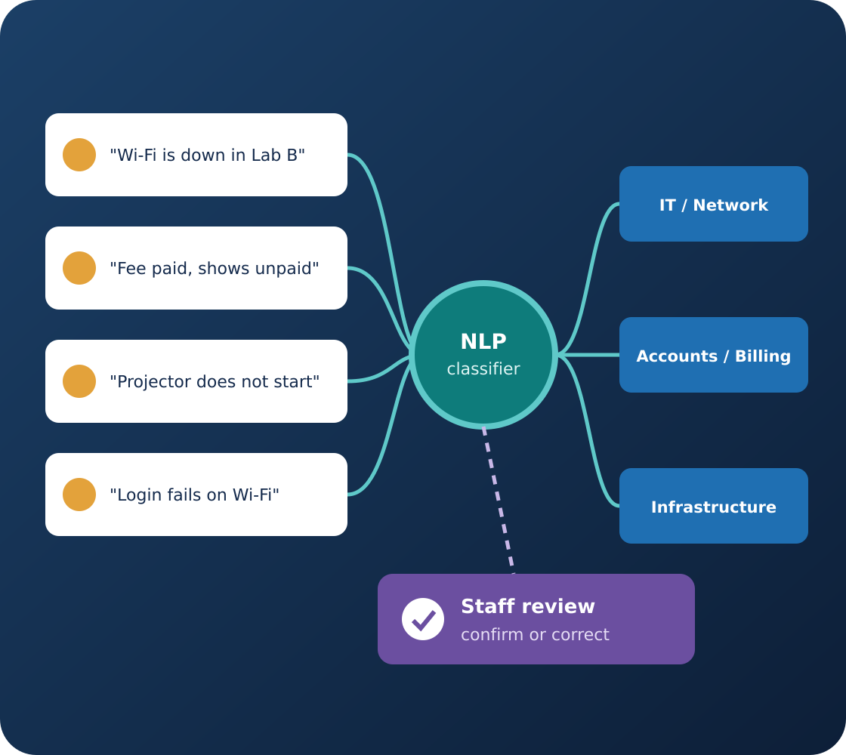
DISSERTATION PROPOSAL PRESENTATION
SmartHelp AI
Intelligent Complaint Classification and Routing System
Python
FastAPI
React
PostgreSQL
scikit-learn
Presented by
[Student Name] · [BITS ID]
Supervisor
[Supervisor Name], [Designation]
Organisation
[Organisation / Mentor Name]
BITS Pilani · CSIW ZG628T Dissertation · Academic Session 2026–2027
Notes:
Good morning/afternoon. We are [names], and our dissertation is SmartHelp AI — a proposed system that uses NLP to suggest complaint categories and route requests to the right department, with staff oversight. Our supervisor is [name].

Slide 2
Presentation Outline
OVERVIEW
What we will cover in the next 10–15 minutes
Problem and motivation
AI / NLP methods
01
05
Proposed solution
Database design
02
06
Objectives and scope
Evaluation plan
03
07
Architecture and workflow
Timeline and conclusion
04
08
Notes:
We will cover the problem, our solution, objectives and scope, architecture and workflow, the AI methods, database design, evaluation plan, and timeline and conclusion.

Slide 3




The Real-World Problem: Complaint Triage
THE PROBLEM
A busy campus helpdesk must read and route every request
Staff read and categorise every complaint by hand
PROBLEM STATEMENT
How can NLP suggest complaint categories so requests reach the right department, while staff keep oversight of every decision?
Wrongly assigned complaints need reassignment
Repetitive first-step work slows responses
Hard to trace the original routing decision
Why it matters
Example: "The fee was deducted but the portal still shows pending" — which department handles this?
Notes:
At a busy campus helpdesk, staff must read and categorise every complaint before assigning it. Wrong assignments need rework, and it is hard to trace the original decision. Take this example: "the fee was deducted but the portal still shows pending" — which department should handle it?

Slide 4




From Manual Routing to AI Assistance
OUR PROPOSED SOLUTION
We automate the repetitive first step, not human responsibility
Complaint Submitted
Classifier Suggests
Staff Confirm
Department Routing
User submits text through React
NLP model predicts a category
Staff confirm or correct the label
Business rule maps category to team
In one sentence: Use NLP to suggest complaint categories, then route requests with staff oversight — AI suggests, rules route, people decide.
Notes:
Our solution: the user submits a complaint, an NLP classifier suggests a category, staff confirm or correct it, and a business rule routes it to the department. AI suggests, rules route, people decide.

Slide 5



What We Propose to Build
OBJECTIVES
Three groups of proposed features
Application
AI component
Oversight
Registration and login
Complaint submission and tracking
Staff status updates
Basic admin analytics
TF-IDF text features
Compare three classifiers
AI-suggested category
Staff correction of labels
Department routing rules
Prediction + audit history
RESEARCH CORE
an NLP category suggestion with human-in-the-loop correction and full traceability.
Notes:
Our objectives cover the application, the AI component and oversight. The research core is the NLP category suggestion combined with human correction and full traceability.

Slide 6


What Is In — and Out — of the First Release
SCOPE
Scope control keeps the dissertation achievable
In scope
Out of scope / future work
User registration and login
Paid generative-AI APIs or chatbots
Complaint submission and tracking
Voice or image complaints
AI-suggested category
Multilingual classification
Department routing
External helpdesk integrations
Staff correction and status updates
Automatic complaint resolution
Basic admin analytics
The AI suggests a category — it never resolves complaints or replaces staff judgement.
Notes:
In scope: login, complaint submission and tracking, AI-suggested categories, routing, staff correction and basic analytics. Out of scope: paid chatbots, voice or image input, multiple languages, external integrations and automatic resolution.

Slide 7






How the Application Components Communicate
SYSTEM ARCHITECTURE
Proposed layered design
User / Staff / Admin
Three roles with different screens
PostgreSQL
Users, complaints, AI predictions, assignments and status history
React frontend
Complaint forms, dashboards, status display
FastAPI backend
REST APIs, authentication, validation, routing rules
Trust
React never queries the database or sends its own AI labels
Python NLP model
TF-IDF + selected classifier, loaded inside the backend
Notes:
React provides the screens for users, staff and admins. FastAPI handles APIs, authentication, validation and routing rules. The trained Python model runs inside the backend. PostgreSQL stores complaints, predictions, assignments and history. React never talks to the database directly.

Slide 8
One Complaint: End-to-End
END-TO-END WORKFLOW
Illustrative example — "Wi-Fi is down in Lab B"
1
USER
2
FASTAPI
3
NLP MODEL
4
FASTAPI
5
DATABASE
User submits complaint
FastAPI validates and authenticates
Model predicts: IT / Network
Rule routes to IT Support
Prediction, assignment, status stored
8
USER
7
DATABASE
6
STAFF
User tracks status
Final category saved separately
Staff confirm or override
Design rule: the original AI prediction is never overwritten — staff corrections are stored separately with history.
Notes:
Here is one illustrative complaint: "Wi-Fi is down in Lab B". FastAPI validates it, the model predicts IT / Network, a rule routes it to IT Support, and staff can confirm or override. The original prediction is never overwritten.

Slide 9
Text Classification and TF-IDF
AI METHOD 1
Supervised learning from labelled complaints
HOW IT WORKS
Illustrative training rows (not a real dataset)
Complaint text | Category
"Campus internet keeps dropping" | IT / Network
"Amount deducted; receipt unavailable" | Accounts / Billing
"Classroom projector is damaged" | Infrastructure
Input X = complaint text; label y = category
TF-IDF turns words into weighted numbers
Common words (e.g. "the") get low weight
TF-IDF is fitted on training data only
Real category labels must come from a selected, documented dataset — still a pending decision.
Notes:
We treat this as supervised text classification. Each training example pairs complaint text with a category. TF-IDF converts the text into weighted numbers, giving common words low weight. These rows are illustrative — the real dataset is still to be selected.

Slide 10
Candidate Classifiers
AI METHOD 2
Three lightweight models compared on real evidence
TRAINING AND SELECTION
Naive Bayes
Probabilistic baseline — a useful first benchmark
Train on labelled complaints; test on held-out data
Compare with macro-F1 because categories may be imbalanced
Save the selected pipeline with a model version
Load it in FastAPI to predict new complaints
Logistic Regression
Learns weights linking text features to categories
Linear SVM
Learns separating boundaries — strong for sparse text
Notes:
We will compare three classifiers: Naive Bayes as a baseline, Logistic Regression and Linear SVM. We will use macro-F1 because some categories may have fewer examples, and select the model based on measured results.

Slide 11
Responsible AI: Staff Can Correct Predictions
HUMAN IN THE LOOP
An AI prediction is a suggestion, not the final truth
WHY IT MATTERS
POST /api/v1/complaints · illustrative
Complaints can be ambiguous (e.g. "login fails on Wi-Fi")
Staff confirm or correct every uncertain label
We store both the AI label and the final label
Corrections show where the model needs improvement
Request:
{ "description": "Wi-Fi is down in Lab B" }
Response:
{ "id": "C-101", "status": "SUBMITTED" }
Stored separately: AI-predicted category + model version, and the staff-approved final category with who changed it and when.
Notes:
Because complaints can be ambiguous, staff must be able to correct predictions. We store both the AI label with its model version and the staff-approved final label, with who changed it and when. Here is the proposed API for submitting a complaint.

Slide 12
What PostgreSQL Will Store
DATABASE DESIGN
Conceptual entities — final schema designed during implementation
USERS
COMPLAINTS
AI_PREDICTIONS
role · credentials
text · owner · status
label · model version
CATEGORIES
DEPARTMENTS
ASSIGNMENTS
approved labels
service teams
routing · owner
STATUS_HISTORY
MODEL_VERSIONS
who · what · when
trained artifact
KEY RELATIONSHIPS
A complaint belongs to one user
Each complaint has an AI prediction with a model version
Categories map to departments
Assignments track which team owns a complaint
Status history records every change
Predictions are never silently overwritten
Notes:
Our database has eight main entities. Complaints link to users, predictions keep the model version, categories map to departments, and status history provides an audit trail. Predictions are never silently overwritten.

Slide 13
How We Will Evaluate the System
EVALUATION PLAN
Planned methodology — no experiments have been run yet
ML EVALUATION
Model comparison
RESULTS PENDING
Accuracy and per-class metrics
Precision and recall
Macro-F1
Confusion matrix
Error analysis
Model | Accuracy | Macro-F1
Naive Bayes | TBD | TBD
Logistic Regression | TBD | TBD
Linear SVM | TBD | TBD
There are no experimental scores yet. Model quality and software correctness will be reported separately — a good F1 score does not prove the app is secure.
ALSO TESTED
Role-based access, valid/invalid input, prediction persistence, staff override and routing (Pytest).
Notes:
We will evaluate the model with accuracy, precision, recall, macro-F1 and a confusion matrix on held-out data, and test the software separately. There are no scores yet — the table will be filled from real experiments.

Slide 14
Implementation Timeline and Milestones
PROJECT PLAN
Proposed 16-week work plan
1
2
3
4
5
6
7
8
9
10
11
12
13
14
15
16
Scope, dataset, architecture
Deliverable: requirements + dataset plan
W1–4
ML baseline and backend
Deliverable: baseline model + API foundation
W5–8
Workflow and React frontend
Deliverable: integrated complaint journey
W9–12
Testing and report
Deliverable: measured results + demo
W13–16
2 Dec 2026
Mid-semester report
20 Jan 2027
Final report
Week 16
Final demonstration
Notes:
Our 16-week plan has four phases: scope and dataset, ML baseline and backend, workflow and frontend, then testing and the report. Next milestones: mid-semester report on 2 December 2026 and final report on 20 January 2027.

Slide 15


Expected Outcomes and Limitations
CONCLUSION
What we expect to deliver — and what we will not claim
Expected outcomes
Limitations
A working complaint-triage web prototype
NLP category suggestions with staff oversight
A measured comparison of three classifiers
Full prediction and status history
English text and a fixed label set only
Dataset source still to be finalised
Ambiguous complaints need human review
Not production-ready without a security review
SmartHelp AI automates the repetitive first step of triage while keeping people responsible for every decision.
Notes:
We expect a working triage prototype with NLP suggestions, staff oversight and full history. Limitations: English only, a fixed label set, a dataset still to be finalised, and ambiguous cases need human review.

Slide 16
Thank You — Questions?
THANK YOU
We welcome feedback from our supervisor and reviewers
KEY TAKEAWAYS
PRESENTED BY
1
AI suggests the category
[Student Name]
[BITS ID]
[Email address]
2
Business rules route the request
3
People confirm or correct
SUPERVISOR
[Supervisor Name]
[Organisation]
4
Every decision is stored and traceable
SmartHelp AI is a proposed project. All examples, screens and values in this presentation are illustrative.
Notes:
Thank you. Our key takeaways: AI suggests, rules route, people decide, and everything is traceable. We welcome your questions.

