Slide 1


Slide 2
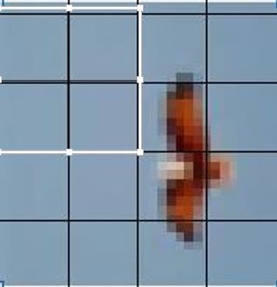
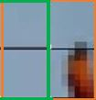

8 X 8
16 x 16
32 x 32

Slide 3
60 | 20 | 35 | 20 | 0 | 40 | 90 | 73
37 | 9 | 18

