Slide 1
Meridian
System Design Document
A fully AI-built, AI-operated blogging platform
Stack
NestJS ×4 · Vue 3 · SQLite · Tailwind CSS v4
AI Features
GPT-4o research · DALL-E / FLUX / Gemini · Kokoro TTS
Deployment
HuggingFace Spaces · Docker · Supervisord · GitHub Actions
A/B Testing
Two brand layouts — Editorial Light (A) & Dark Magazine (B)
Version
June 2026
Bibhu Mishra · Principal Cloud / DevOps Architect · LTIMindtree

Slide 2
What is Meridian?
meridian
Why It Exists
4
1
Bibhu Mishra set out to prove that AI should not just assist developers — it should be the developer. Meridian is that proof: a production-grade blogging platform where every line of application code was written by AI, every post is researched and published by AI, and the platform maintains itself with AI.
NestJS Microservices
Vue 3 SPA
What Makes It Remarkable
3
2
✦ Zero human-written application code — 100% Claude AI
✦ 2 research-backed posts auto-published every week
✦ Local on-device TTS reads any article aloud (Kokoro AI)
✦ Monthly AI rebranding reflects world events in the UI
✦ AI posts need admin approval before going live (HITL)
✦ MCP API lets any AI agent publish to the platform
SQLite Databases
AI Agent runs / week
5
14
Image AI providers
Documented flows
2
∞
Layout variants (A/B)
Auto-maintenance cycles

Slide 3
Platform Features at a Glance
meridian · June 2026
🤖
AI-Written Codebase
📝
Autonomous Publishing
🔊
Local Text-to-Speech
🎨
Monthly AI Rebranding
Every line of application code written by Claude AI through a guided development session. No human modified application source files.
GPT-4o agent runs every Saturday & Sunday at 3am UTC: discovers trending topics, deep-researches them, writes 1500+ word articles, and publishes with images.
Kokoro AI model runs on-device (no external API). Any article can be read aloud with chunked pre-fetch, seek slider, and pause/resume controls.
5-agent pipeline (Ideation → Code → Review → Test → Publish) reskins the UI monthly to reflect world events. Enforces WCAG AA contrast automatically.
⏸️
Human-in-the-Loop Approval
🔌
MCP API for External Agents
🪞
A/B Layout Testing
🛡️
AI-Driven Maintenance
AI-generated posts are saved as PENDING first. Admin reviews in a dedicated Pending Approval tab before the post goes live.
Full Model Context Protocol endpoint lets any MCP-compatible AI agent publish, manage, and query blog content programmatically.
Two complete brand identities — Editorial Light (A) and Dark Magazine (B). Randomly assigned once per browser; session-sticky via localStorage.
Monthly maintenance agent audits npm CVEs, ADA/WCAG compliance, SEO meta tags, and open Dependabot PRs — then patches and rebuilds automatically.

Slide 4
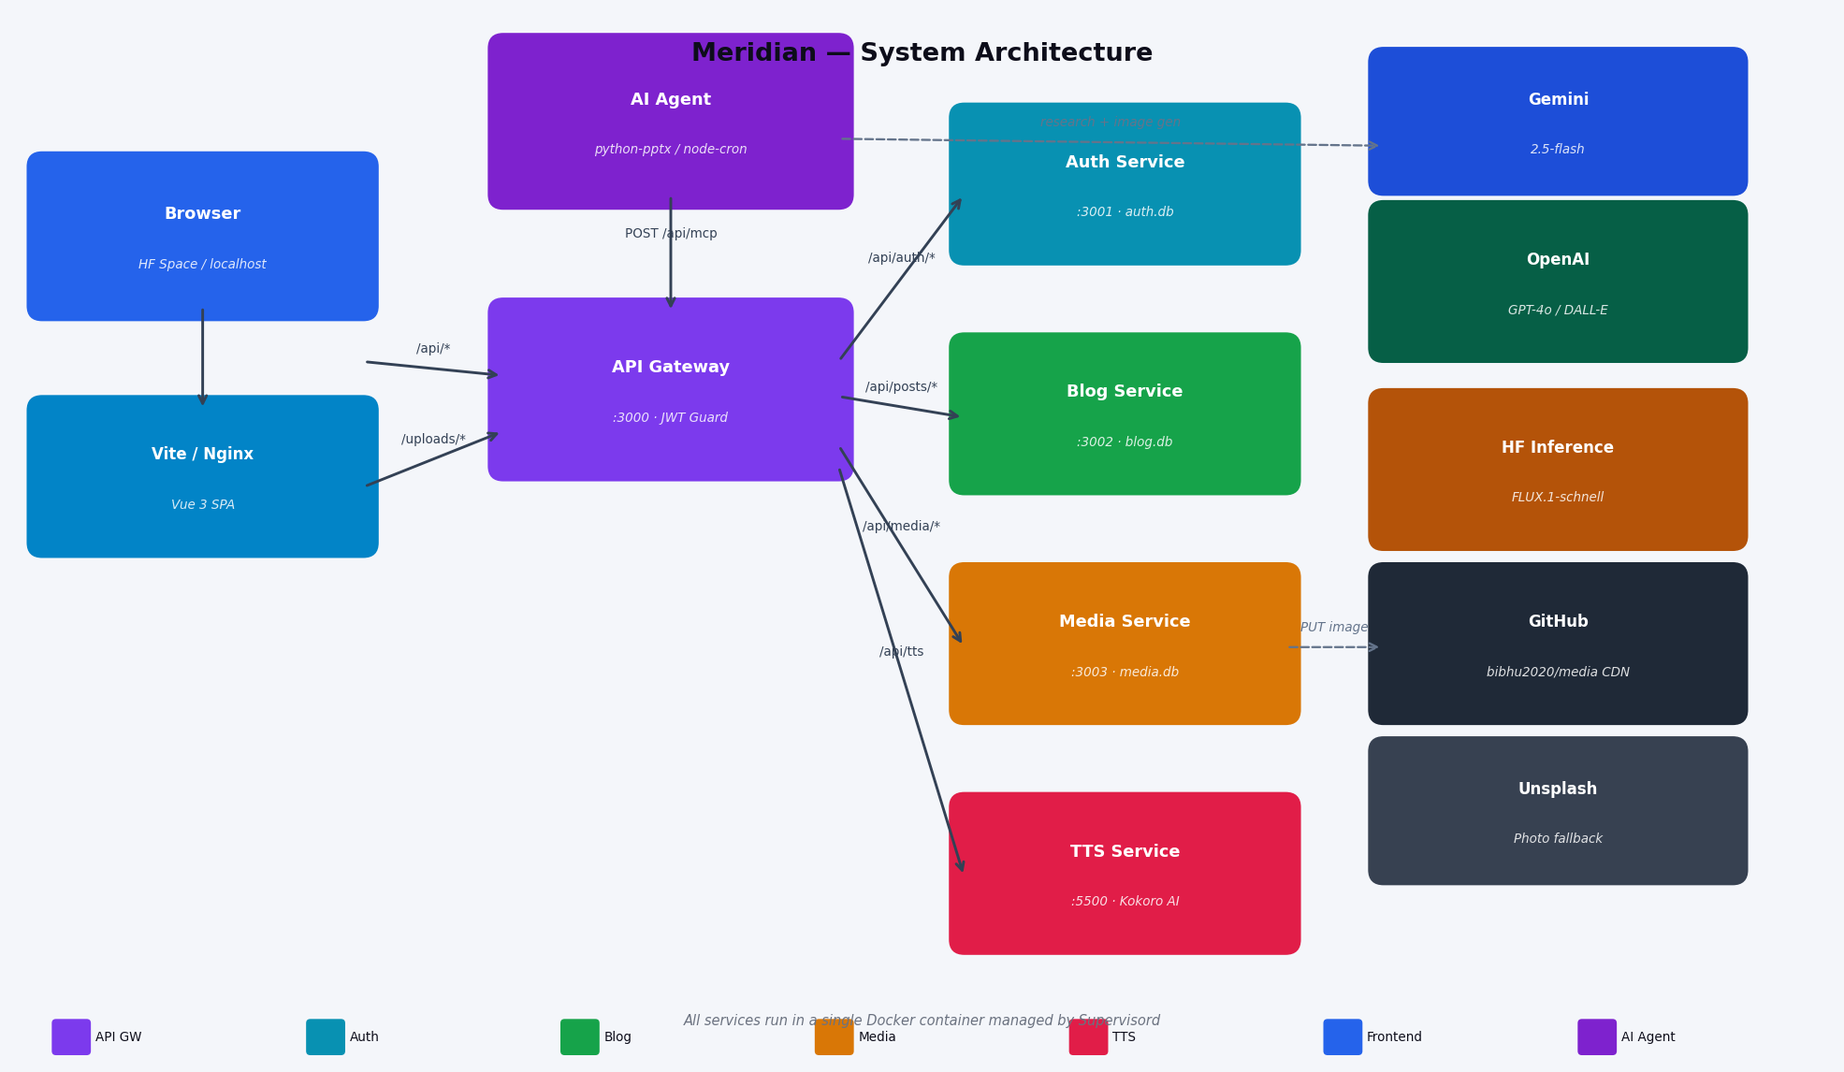
System Architecture
Service topology & external integrations
Architecture Overview
▸ Browser talks to Vite dev server (port 5173) or Nginx in production
▸ All /api/* traffic proxied to API Gateway :3000 — single public entry point
▸ Gateway holds JWT guards; internal services trust the forwarded Authorization header
▸ Auth :3001, Blog :3002, Media :3003 each own an isolated SQLite database
▸ TTS Service runs Kokoro AI as a Python process on :5500
▸ AI Agent publishes via POST /api/mcp using a dedicated service JWT
▸ 5-provider image chain: DALL-E 3/2 → FLUX.1 → Gemini → Unsplash
▸ All services run inside one Docker container managed by Supervisord
▸ GitHub Actions CI/CD: push → sync secrets → force-push to HF Space → rebuild

Slide 5
Architecture Deep Dive — Components & Data Model
Component
Port
DB
Responsibility
API Gateway
3000
—
JWT validation; proxies all routes via ProxyService.forward() and forwardWithFile()
Auth Service
3001
auth.db
Users, bcrypt passwords, JWT sign/validate. Shared secret: myblogs-secret-key-2024
Blog Service
3002
blog.db
Posts, categories, tags, comments, views. Seeds on empty DB. LIKE full-text search
Media Service
3003
media.db
Multer upload → GitHub CDN → fallback to local /uploads/. UUID filenames
TTS Service
5500
—
Python subprocess. POST /tts { text } → WAV blob. Kokoro AI local model
AI Agent
—
—
Python (post_agent) + Node (rebranding). Cron-triggered. Publishes via MCP API
Vue 3 Frontend
5173
—
Composition API, Pinia stores, TipTap editor, TTS player, A/B layouts, Tailwind v4
Nginx
80
—
Reverse proxy. Routes /api/* → Gateway, /uploads/* → Media Service

Slide 6
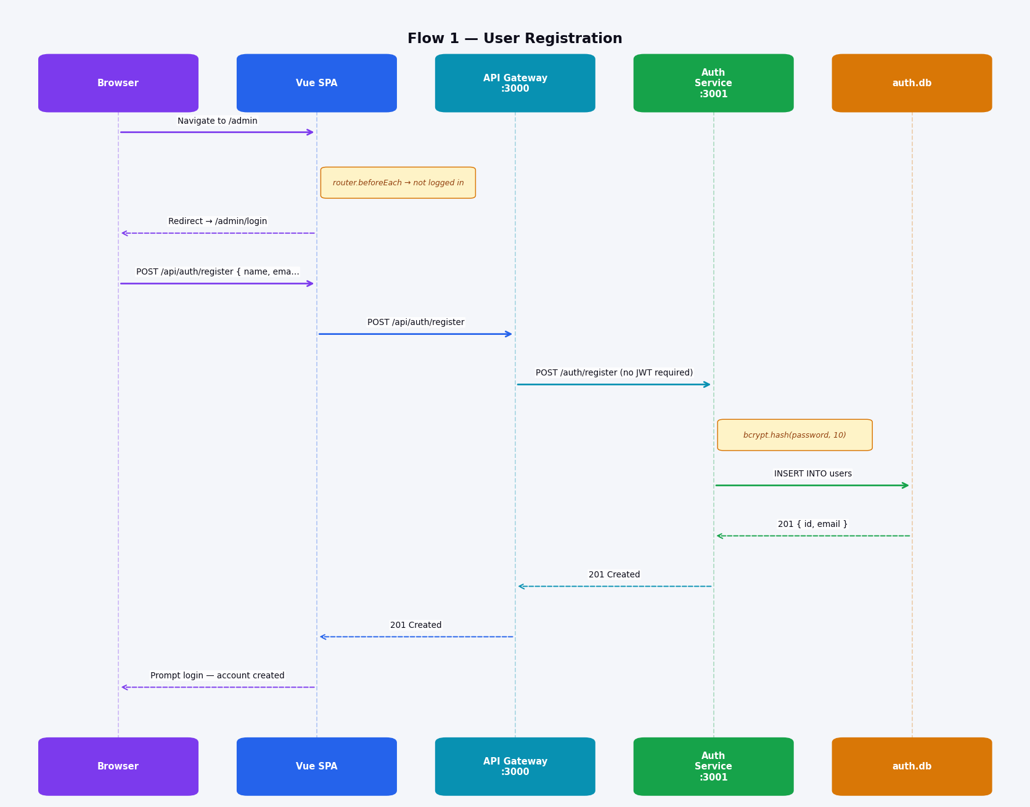
Flow 1 — User Registration
1 of 14 flows
Flow 1: User Registration
▸ Browser navigates to /admin; Vue Router guard detects no token
▸ Guard redirects to /admin/login (no API call needed)
▸ Registration form POSTs through API Gateway — no JWT required
▸ Gateway forwards to Auth Service :3001
▸ Auth Service bcrypt-hashes the password (10 salt rounds)
▸ Hashed credentials written to auth.db users table
▸ 201 Created bubbles back; user prompted to log in

Slide 7
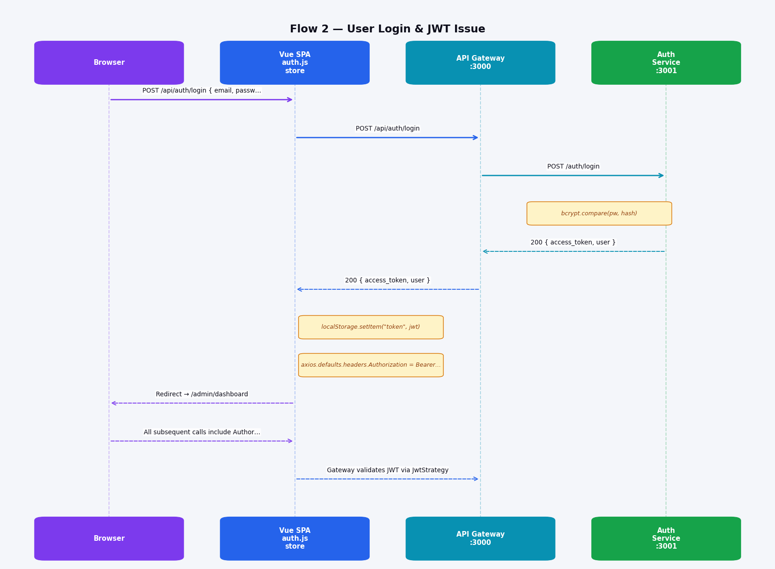
Flow 2 — User Login & JWT Issue
2 of 14 flows
Flow 2: User Login & JWT Issue
▸ Credentials POST through Gateway; Auth Service validates with bcrypt
▸ On match, Auth Service signs a JWT (HS256, 24h TTL)
▸ Token stored in localStorage by Pinia auth store
▸ Axios default header set — all subsequent requests carry the token
▸ Browser redirected to /admin/dashboard
▸ Every protected route is gated at the Gateway — internal services re-verify the forwarded header

Slide 8
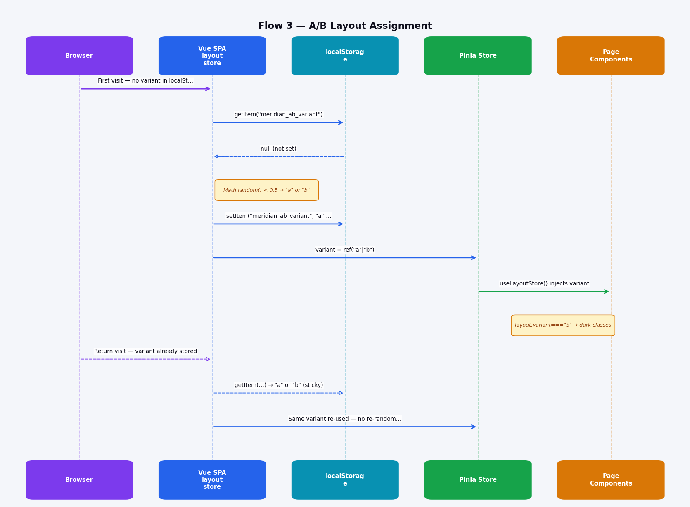
Flow 3 — A/B Layout Assignment
3 of 14 flows
Flow 3: A/B Layout Assignment
▸ On first visit, localStorage has no variant — coin-flip assignment
▸ Variant A = Editorial Light; B = Dark Magazine
▸ Result persisted to localStorage so same user always sees same layout
▸ Pinia layout store exposes variant as a reactive ref
▸ Every component uses :class or v-if bindings against layout.variant
▸ Return visits read the stored value — session-sticky by design

Slide 9
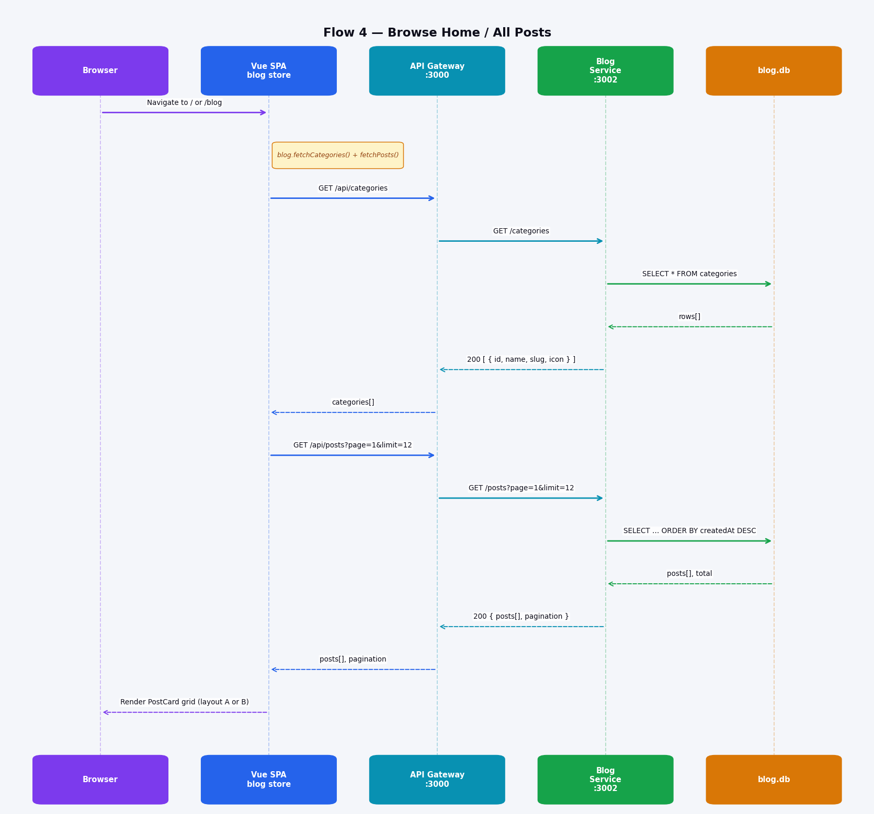
Flow 4 — Browse Home / All Posts
4 of 14 flows
Flow 4: Browse Home / All Posts
▸ Home & Blog pages trigger two lazy fetches via Pinia blog store
▸ Categories and posts fetched concurrently
▸ Posts paginated (12 per page), sorted by creation date DESC
▸ Pinia caches results — navigating back skips re-fetch
▸ PostCard grid renders in A (light editorial) or B (dark magazine) layout
▸ Category nav, tag chips, and pagination all driven from cached store state

Slide 10
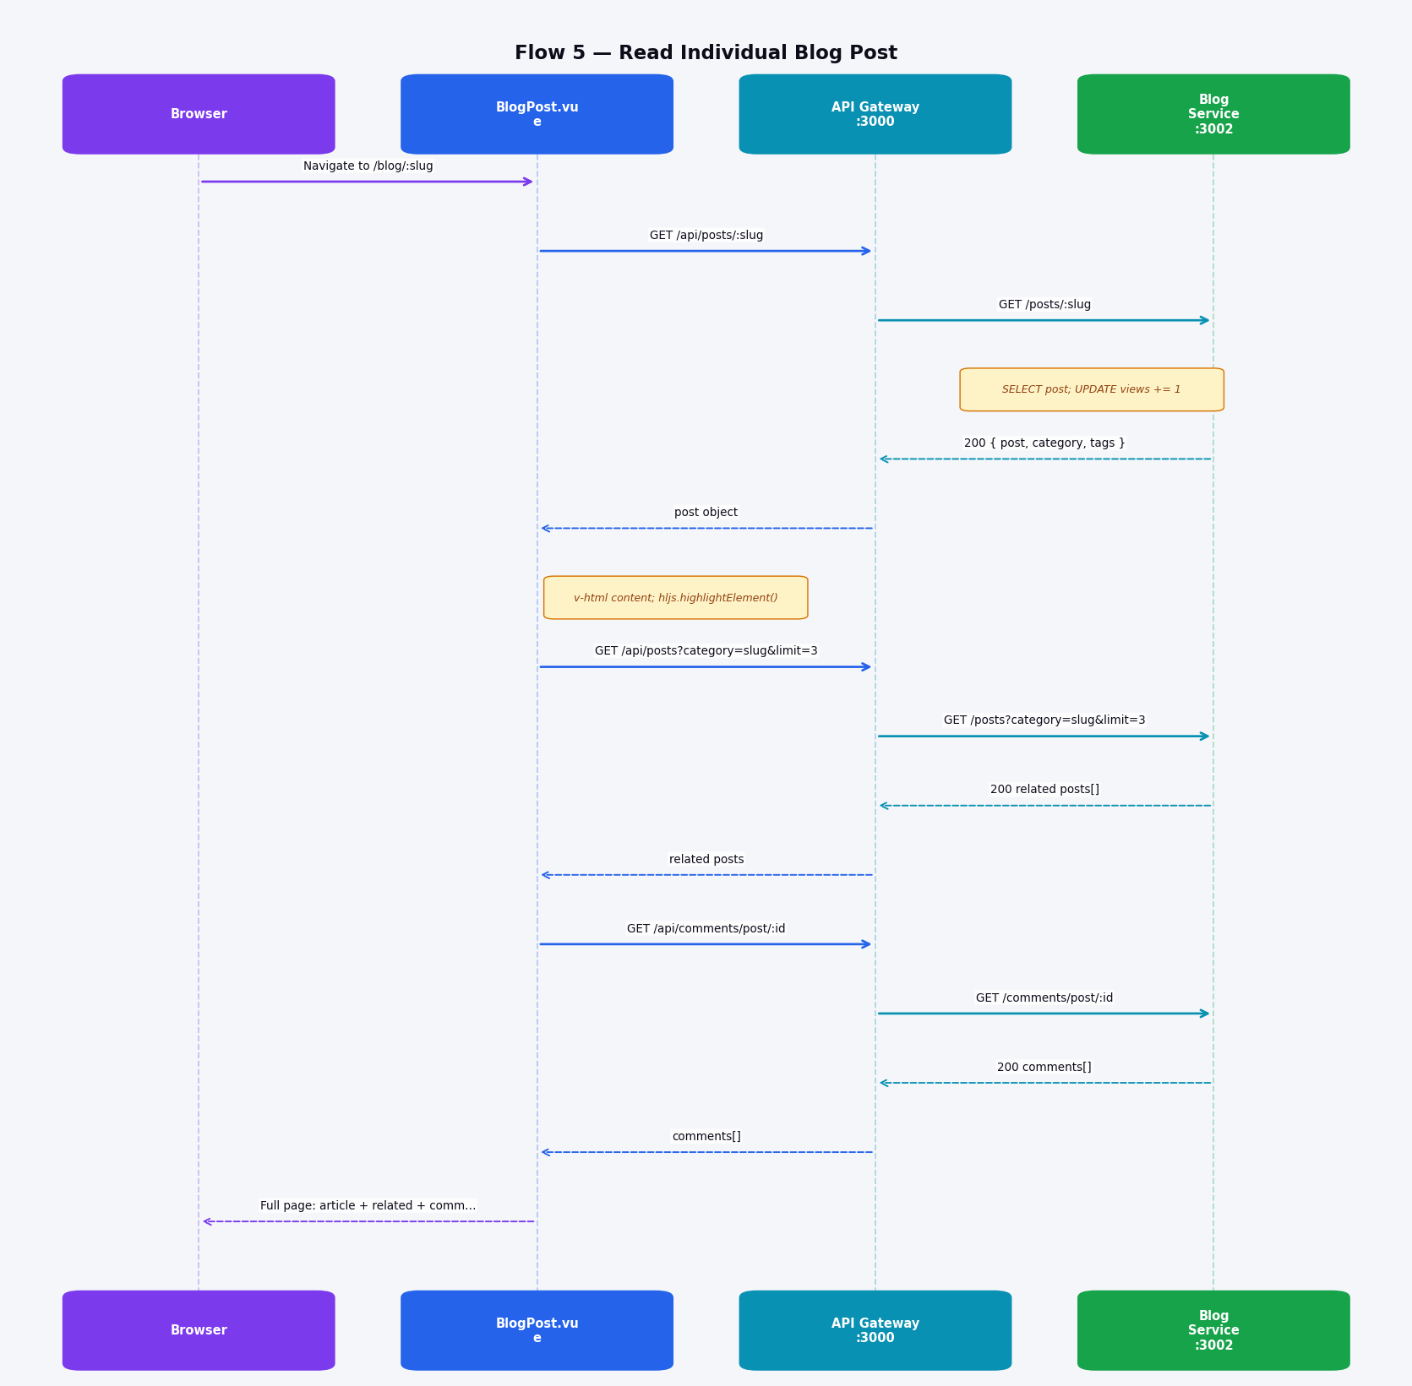
Flow 5 — Read Individual Blog Post
5 of 14 flows
Flow 5: Read Individual Blog Post
▸ Slug-based lookup — no numeric IDs exposed in URLs
▸ Blog Service increments the view counter on every fetch
▸ Content rendered via v-html; highlight.js syntax-highlights code blocks post-render
▸ Related posts fetched by same category (limit 3) in a follow-up request
▸ Comments fetched separately; only approved comments shown to readers
▸ All three requests resolve before full page paint

Slide 11
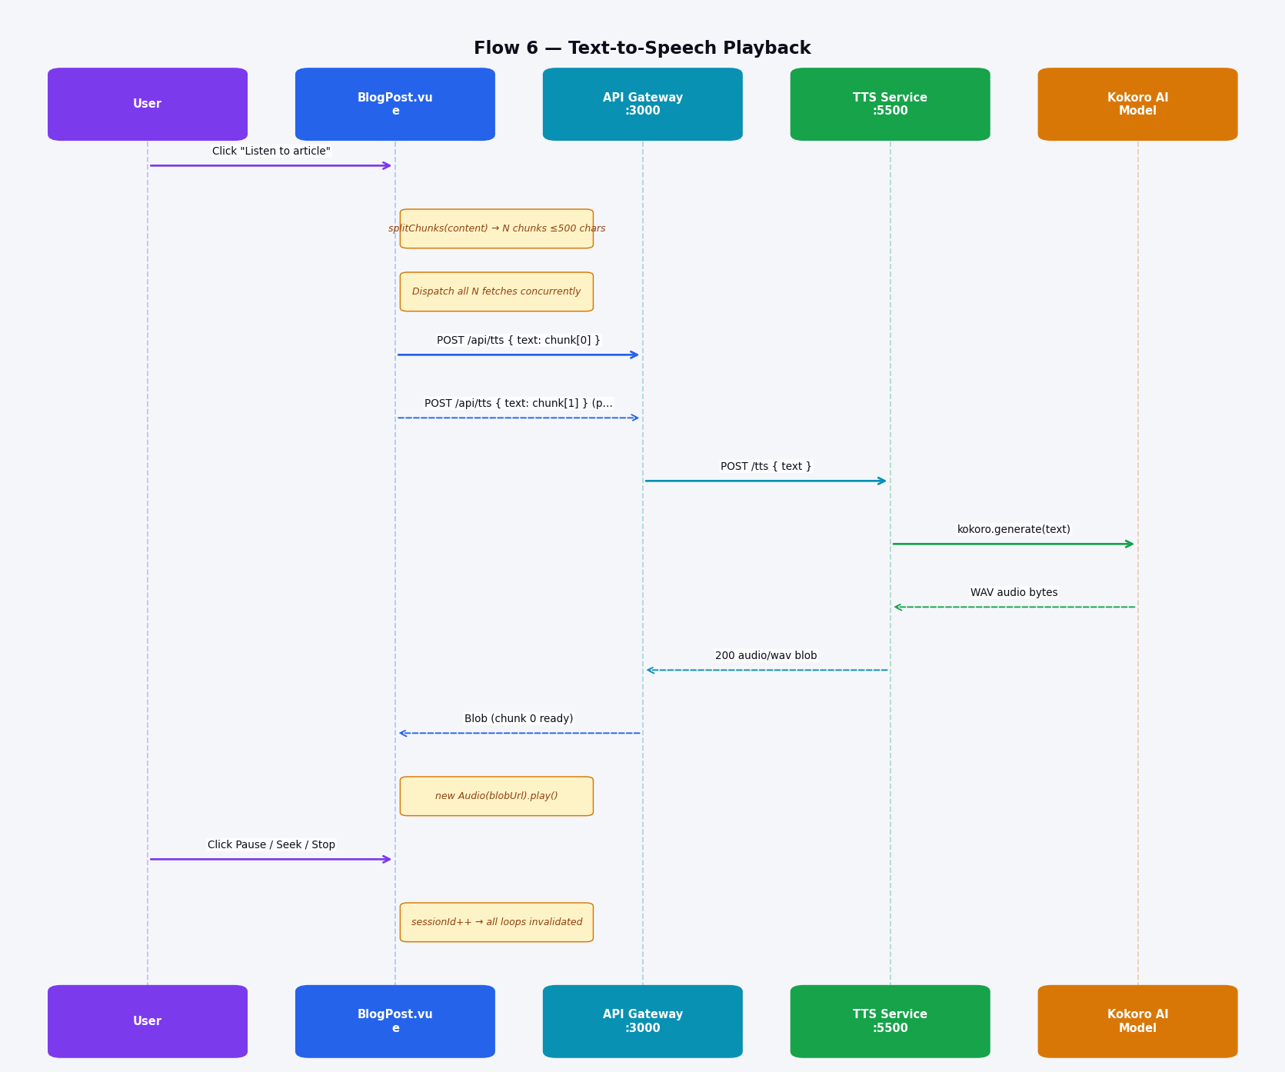
Flow 6 — Text-to-Speech Playback
6 of 14 flows
Flow 6: Text-to-Speech Playback
▸ Post content split into ≤500-char semantic chunks
▸ All N chunks dispatched as concurrent fetch requests — pre-fetch pipeline
▸ Playback starts with chunk 0 while later chunks download in background
▸ Kokoro AI is a local on-device model — no external TTS API cost
▸ Seek slider maps fraction → chunk index; cached blobs play immediately
▸ Stop increments a sessionId — all async loops check this and abort cleanly

Slide 12
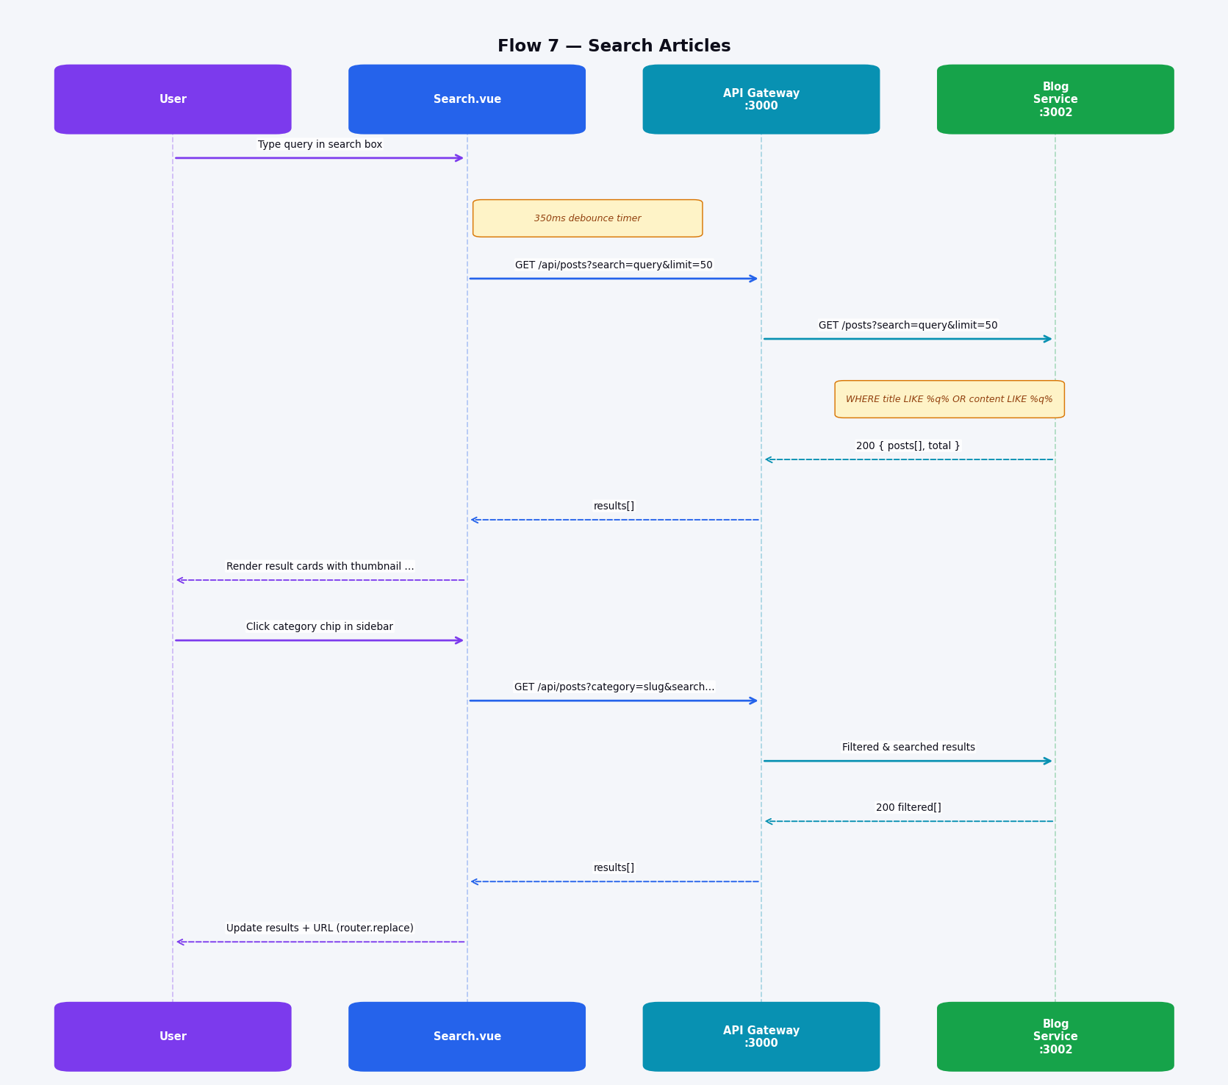
Flow 7 — Search Articles
7 of 14 flows
Flow 7: Search Articles
▸ 350ms debounce prevents server flood while typing
▸ Blog Service searches title AND content with SQL LIKE operators
▸ Returns up to 50 results, client renders cards with thumbnail and meta
▸ Category filter chips refine without clearing the search query
▸ URL updated via router.replace() — search links are bookmarkable
▸ Sidebar shows matching category counts for easy drill-down

Slide 13
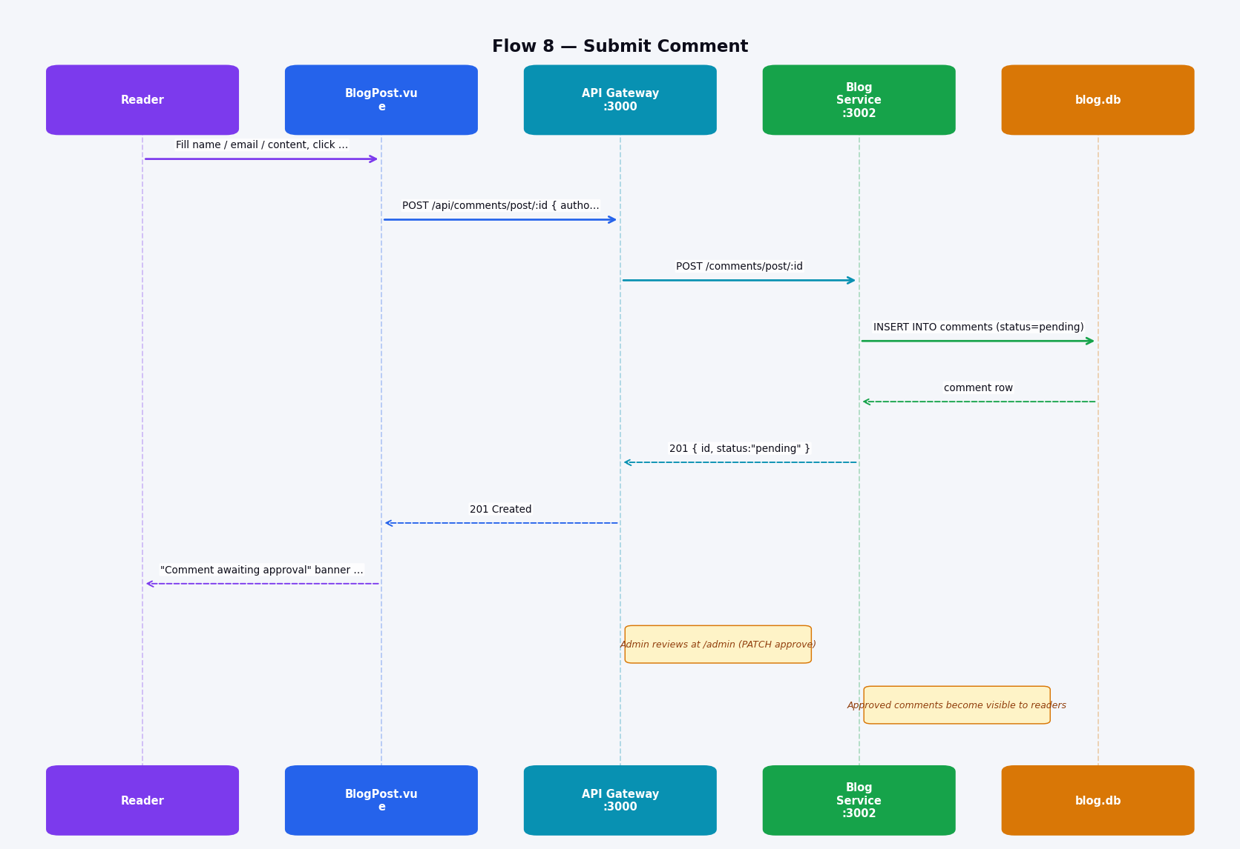
Flow 8 — Submit Comment
8 of 14 flows
Flow 8: Submit Comment
▸ No authentication required — open commenting for all readers
▸ Comments stored immediately with status='pending'
▸ Pending comments are invisible to public readers
▸ Reader sees a 'awaiting approval' confirmation banner instantly
▸ Admin reviews in /admin panel and PATCHes status to 'approved'
▸ Protects from spam without blocking legitimate engagement

Slide 14
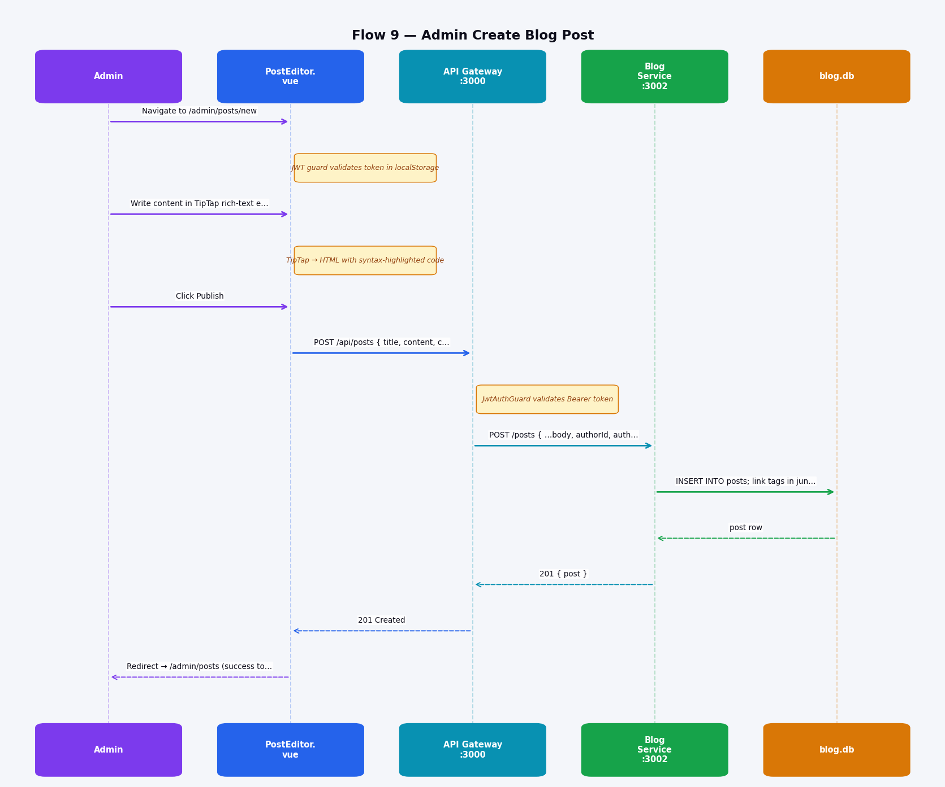
Flow 9 — Admin Create Blog Post
9 of 14 flows
Flow 9: Admin Create Blog Post
▸ Route /admin/posts/new protected by Vue Router JWT guard
▸ TipTap editor supports rich HTML: headings, blockquote, code, images, links
▸ CodeBlockLowlight provides syntax highlighting for 30+ languages
▸ JWT validated at Gateway before forwarding — unauthorized requests rejected at the edge
▸ Tags use a junction table posts_tags_tags (many-to-many relationship)
▸ On success, browser redirects to post list with a toast notification

Slide 15
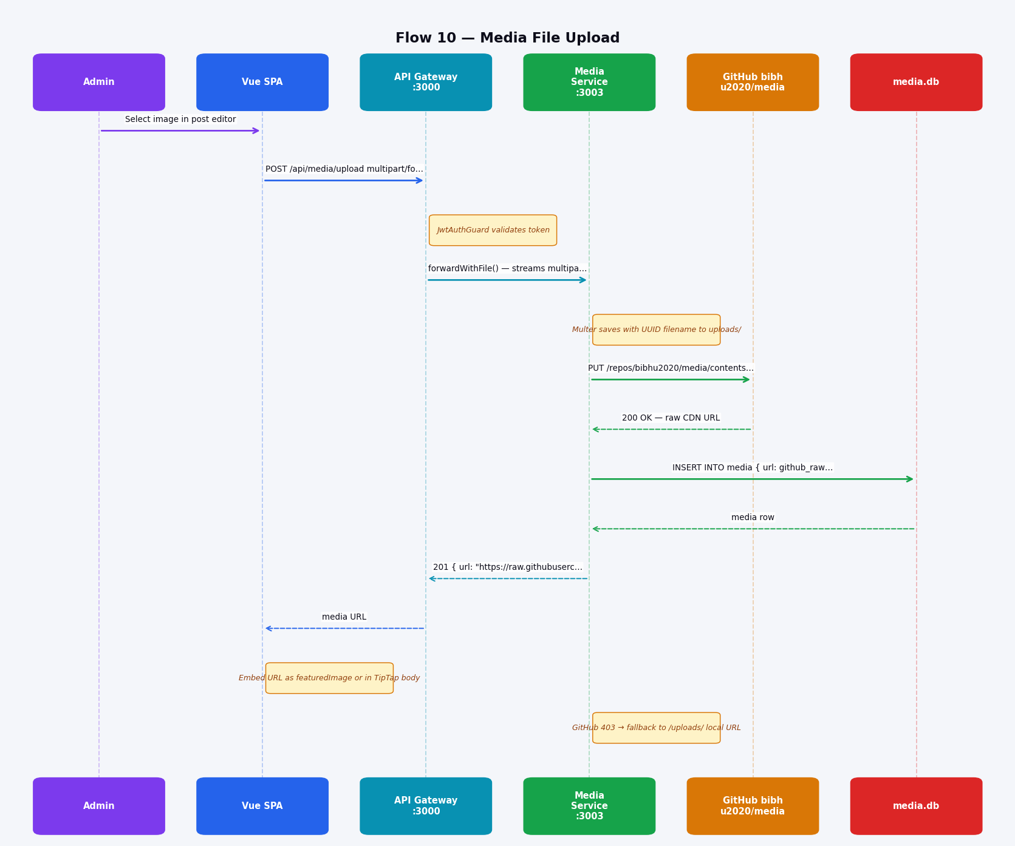
Flow 10 — Media File Upload
10 of 14 flows
Flow 10: Media File Upload
▸ File uploaded as multipart/form-data through Gateway forwardWithFile()
▸ Multer saves a UUID-named copy to media-service/uploads/ as a safety copy
▸ Media Service base64-encodes and PUTs to GitHub CDN repo via REST API
▸ GitHub returns a permanent raw.githubusercontent.com CDN URL
▸ URL stored in media.db and returned to the editor for embedding
▸ Graceful fallback: if GitHub returns 403, local /uploads/ path is used instead

Slide 16
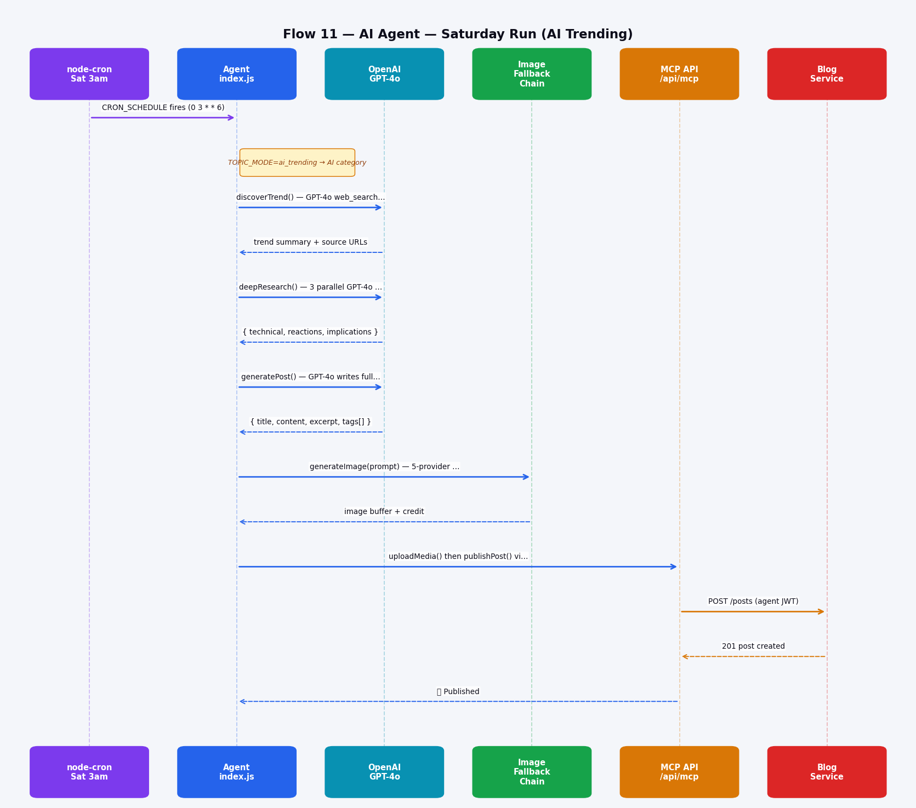
Flow 11 — AI Agent — Saturday Run (AI Trending)
11 of 14 flows
Flow 11: AI Agent — Saturday Run (AI Trending)
▸ node-cron fires every Saturday at 3am UTC
▸ TOPIC_MODE=ai_trending → always picks the AI/Technology category
▸ GPT-4o with web_search_preview discovers the week's top AI story
▸ 3 parallel research queries add depth: technical analysis, community reactions, future implications
▸ GPT-4o writes a full HTML article (~1500+ words) from combined research context
▸ Image from 5-provider fallback chain (DALL-E 3/2 → FLUX → Gemini → Unsplash)
▸ Post published via MCP REST API using a dedicated agent JWT

Slide 17
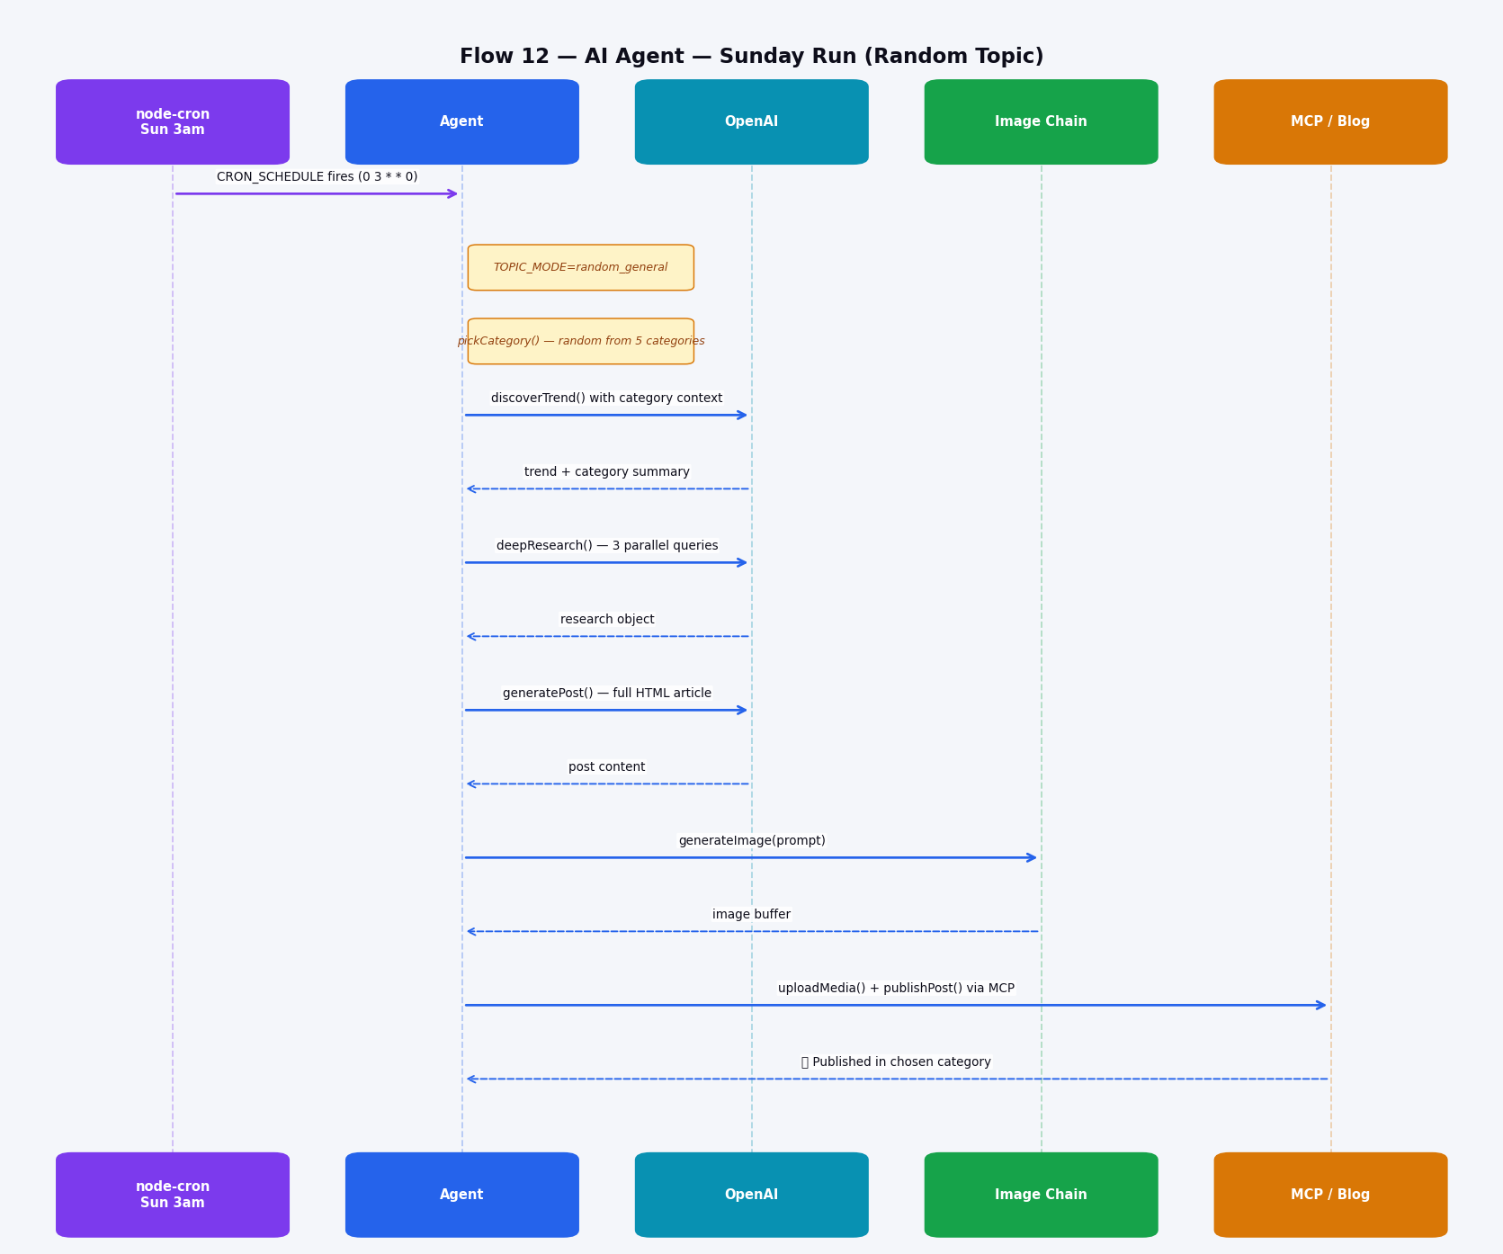
Flow 12 — AI Agent — Sunday Run (Random Topic)
12 of 14 flows
Flow 12: AI Agent — Sunday Run (Random Topic)
▸ node-cron fires every Sunday at 3am UTC
▸ TOPIC_MODE=random_general — diversity run
▸ Category randomly chosen from: Technology, Science, History, Travel, Knowledge
▸ Same deep 3-parallel-query research pipeline as Saturday
▸ GPT-4o writes a full article; image generated via fallback chain
▸ Ensures content variety — AI is not the only topic covered
▸ Two runs/week means ~8-9 new posts per month, fully automated

Slide 18
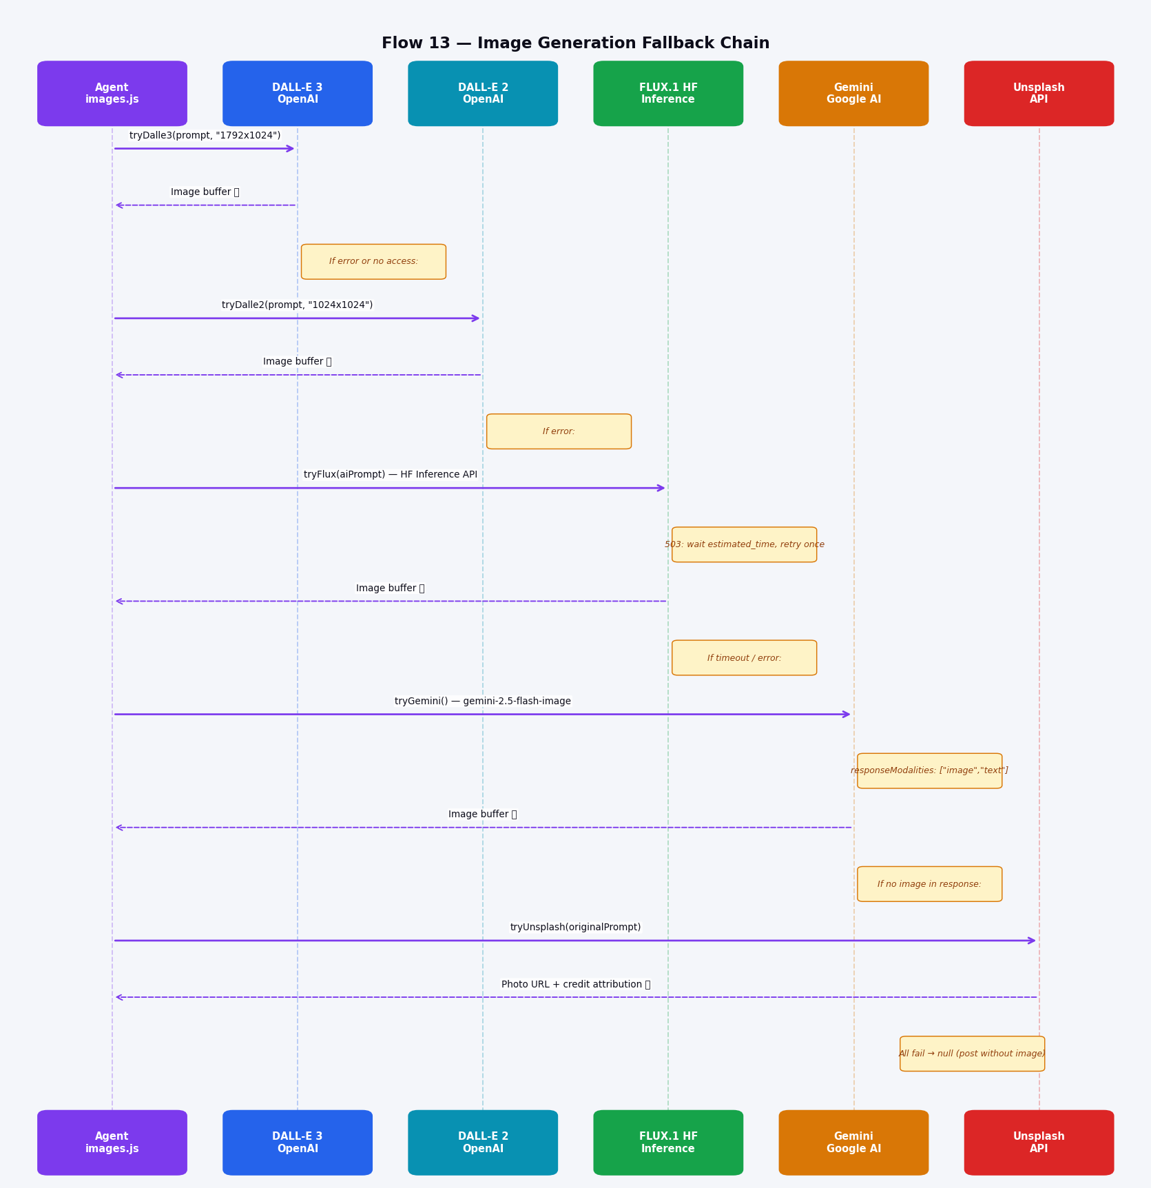
Flow 13 — Image Generation Fallback Chain
13 of 14 flows
Flow 13: Image Generation Fallback Chain
▸ Five-provider fallback ensures an image is almost always found
▸ DALL-E 3 attempted first — highest resolution (1792×1024) and quality
▸ DALL-E 2 fallback if account lacks DALL-E 3 access or quota exceeded
▸ FLUX.1-schnell via HF Inference API — free tier; smart 503 backoff with one retry
▸ Gemini 2.5 Flash image generation as fourth option
▸ Unsplash keyword search as final safety net — returns photo with attribution credit
▸ If all five fail, post is published without a featured image (very rare)

Slide 19
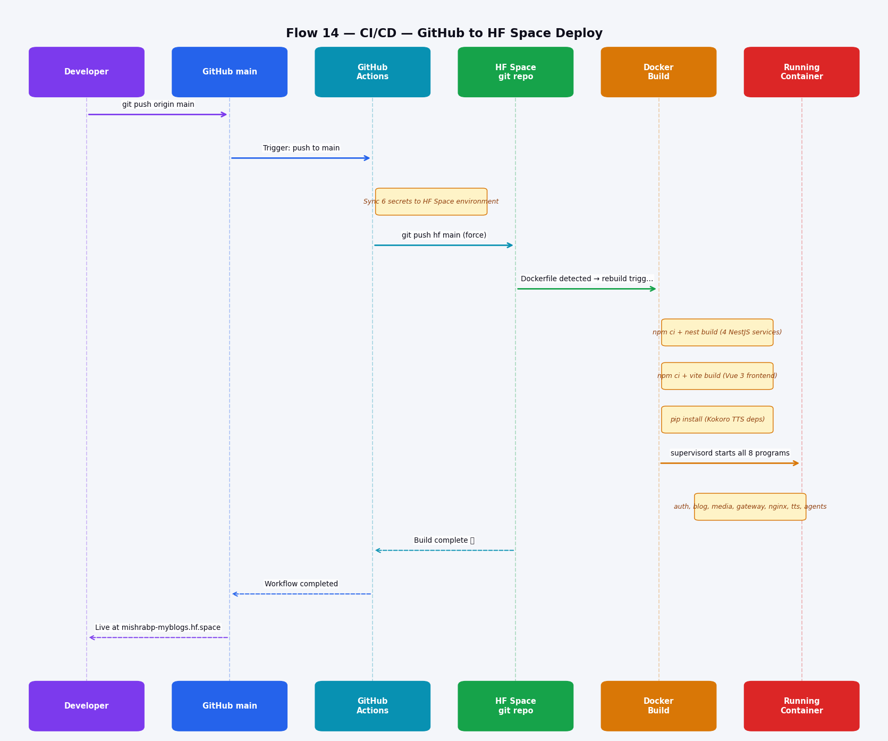
Flow 14 — CI/CD — GitHub to HF Space Deploy
14 of 14 flows
Flow 14: CI/CD — GitHub to HF Space Deploy
▸ git push to GitHub main triggers GitHub Actions workflow immediately
▸ Action syncs 6 secrets to HF Space: OPENAI, GEMINI, HF_TOKEN, GITHUB, UNSPLASH, SERVER_BASE
▸ Force-pushes code to HuggingFace Space git repository
▸ HF Space detects Dockerfile change and triggers autonomous Docker rebuild
▸ All 4 NestJS services + Vue 3 frontend compiled; Python TTS deps installed
▸ Supervisord starts 8 processes: gateway, auth, blog, media, nginx, tts, 2 agents
▸ Total time: ~30s for git push + ~5min for HF Docker rebuild

Slide 20
Technology Stack
Backend
Frontend
AI & ML
Infra & DevOps
NestJS v10
Vue 3 + Vite
GPT-4o + web_search_preview
Docker + Supervisord
4 independent microservices, TypeScript strict mode
Composition API; <script setup>; Vue Router 4; Pinia
Topic discovery; 3-parallel deep research; article writing
Single container; 8 processes managed by supervisord
TypeORM + SQLite
Tailwind CSS v4
DALL-E 3/2 → FLUX.1 → Gemini → Unsplash
Nginx
better-sqlite3; synchronize:true; per-service DB files
CSS-first config in style.css; @theme {} tokens
5-provider image fallback chain
Reverse proxy inside Docker; serves frontend assets
Passport JWT + bcrypt
TipTap
Kokoro AI (local)
GitHub Actions
HS256 tokens; 24h expiry; bcrypt rounds=10
StarterKit + CodeBlockLowlight + Image + Link extensions
On-device TTS; WAV output; chunked pre-fetch pipeline
CI/CD: push → sync secrets → git push to HF Space
Multer
highlight.js
openai-agents SDK
HuggingFace Spaces
UUID file uploads; GitHub CDN with /uploads/ fallback
Post-render syntax highlighting on .post-content pre code
Multi-agent rebranding pipeline with handoffs
Docker runtime; mishrabp-myblogs.hf.space
LangGraph 1.2
node-cron + python-cron
Post agent graph; interrupt_before for HITL approval
Sat+Sun 3am UTC automated post generation

Slide 21
Future Improvements — Roadmap Ideation
🔍 Semantic Search
🌐 Multi-Language AI
📣 Social Auto-Posting
Replace SQL LIKE with dense vector search (sqlite-vec or pgvector). Embed posts at publish time; query by cosine similarity for meaning-based results.
Auto-translate every published post to ES, FR, DE, ZH via AI. Serve language versions based on Accept-Language; add navbar language switcher.
On publish, AI generates platform-optimised captions and auto-posts to LinkedIn, Twitter/X, and Mastodon. Track social referral traffic back per post.
🤝 AI Comment Moderation
📊 Analytics Microservice
🗓️ Post Scheduling Queue
Replace manual approve/reject with an AI sentiment + spam classifier. Auto-approve positive comments; auto-reject spam; flag only edge cases for humans.
Beyond view counts: session duration, scroll depth, and read-completion rates. Lightweight pixel tracker; no third-party dependency; charts in admin dashboard.
Draft posts with a scheduled publish date. AI agent queues multiple posts and drip-publishes them. Calendar view in admin panel shows the upcoming schedule.
🗣️ Podcast / Audio Feed
🐘 PostgreSQL Migration
🖼️ AI Alt-Text Generation
Convert popular posts to podcast episodes with intro jingles, chapter markers, and an RSS feed compatible with Apple Podcasts and Spotify.
Upgrade from SQLite to PostgreSQL for concurrent writes, connection pooling, pg_trgm fuzzy search, and production-grade reliability. Keep SQLite for dev.
On every image upload, call a vision model to auto-generate descriptive alt text. Stored in media.db; surfaced in the post editor; improves ADA and SEO automatically.
★ These are AI-generated improvement ideations — please tune and prioritise as needed

Slide 22
Thank You
mishrabp-myblogs.hf.space
Bibhu Mishra · Principal Cloud / DevOps Architect · LTIMindtree
linkedin.com/in/mishrab
22 slides · 14 sequence diagrams · June 2026

