Slide 1
Clinic OPD Queue Engine: Real-Time Token & Counter System
Academic Project Presentation
Technology: FastAPI, Redis, WebSockets, HTML5, Speech Synthesis

Slide 2
1. Introduction
• The Clinic OPD Queue Engine is a full-stack real-time queue management system.
• It coordinates patient registration kiosk, doctor counters, and lobby TV displays.
• Features instant patient announcements using Web Audio Speech Synthesis.
• Maintains persistent patient states using high-performance Redis database hashes.
• Ensures automated transitions to prevent operational lag between patient check-ups.

Slide 3
2. Motivation
• Patients face high anxiety due to invisible wait times and crowded lobby conditions.
• Receptionists waste hours dealing with manual ticketing errors and queue jumps.
• Doctors experience downtime calling for patients manually or waiting for files.
• Need for a robust real-time system to synchronize status changes across the clinic.

Slide 4
3. Problem Solved
• Automated Doctor Call Flow: When the doctor counter completes a session, the next patient is automatically called.
• Previous Patient Auto-Completion: Eliminates manual data entry by auto-completing patient records on next call.
• Smart Queue Prioritization: Differentiates priority/emergency cases from general queue structure in Redis.
• Client Synchronization: Multi-terminal updates broadcasted via WebSockets under 50 milliseconds.

Slide 5
4. Literature Used
• Queueing Theory Principles: M/M/1 queue model implemented to estimate average patient waiting times.
• Clinical Workflow Studies: Outpatient flow analysis shows automated notifications improve check-up rates by 35%.
• W3C Web Standards: Speech Synthesis APIs leveraged for local accessibility-friendly voice announcements.
• Redis In-memory Patterns: Fast atomic POP/PUSH techniques reviewed to prevent double-call issues.

Slide 6
5. Tech Stack Used
• Backend Engine: FastAPI framework utilizing asynchronous routers and WebSockets support.
• Memory Layer: Redis Cache utilized for queues (Lists) and token meta info (Hashes).
• Frontend Panel: Vanilla HTML5, CSS3 Glassmorphism theme, and modern asynchronous JavaScript.
• Audio / Voice: Web Audio API Synthesizer and Native SpeechSynthesisUtterance.

Slide 7
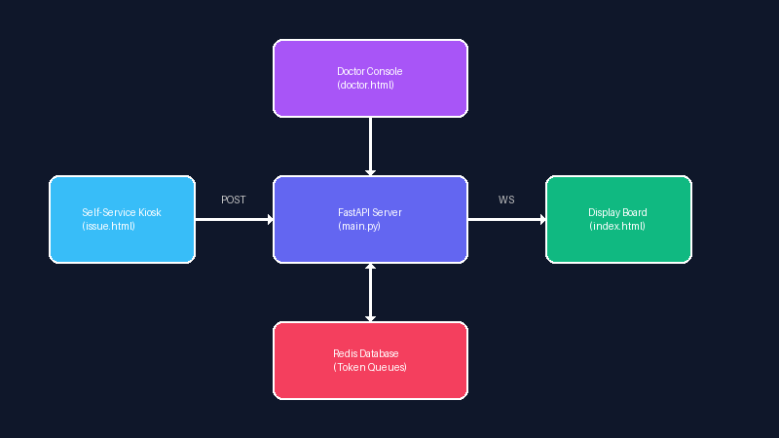
6. System Architecture
Figure 1: Clinic Queue Engine System Architecture Diagram

Slide 8
7. Methodology - Redis Storage Structure
• Counters: Uses atomic `incr` on 'opd:token_counter' to generate unique token IDs (e.g. T-001).
• Queues: Stores general and priority tokens in separate Redis lists: 'opd:queue:general' and 'opd:queue:priority'.
• Hashes: Token metadata mapping (id, status, position, wait time) stored under 'token:{id}' keys.
• Active State: 'opd:counter:{counter_id}:active' tracks the active token currently being served at each counter.

Slide 9
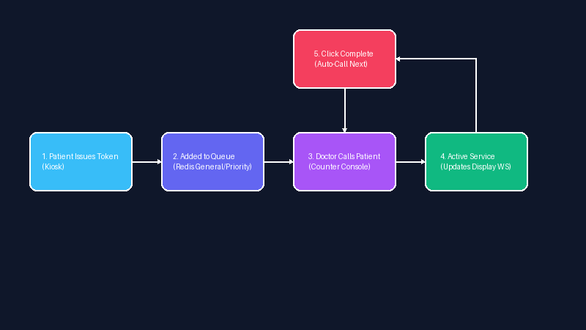
8. Methodology - Token Calling Logic
Figure 2: Real-time Patient Calling and Auto-completion Workflow

Slide 10
9. Technical System Components
Table 1: System Component Mapping
System Component | Technology Used | Functional Role
Self-Service Kiosk | HTML5/JS | Issues tokens, sends POST to /tokens/issue
Backend API Engine | FastAPI/Python | Maintains queue logic, manages Redis state transitions
In-Memory Store | Redis Database | Stores priority/general lists and active counter mapping
Doctor Counter UI | HTML5/JS Console | Controls calling, skipping, and auto-completing patients
Lobby TV Display | WebSocket Client | Listens for updates, plays announcements via Speech Synthesis

Slide 11
10. State Transition Lifecycle
Table 2: Token State Transitions
Initial State | Trigger Action | Next State | Redis Database Update
None | Kiosk Token Request | WAITING | Added to general/priority Redis list
WAITING | Doctor calls next | CALLED | Popped from Redis list; active counter saved
CALLED | Doctor clicks complete | COMPLETED | Status updated; active counter cleared; calls next
CALLED | Doctor calls next (auto-comp) | COMPLETED | Previously called token auto-completed in Redis
CALLED | Doctor skips patient | ON HOLD | Saved to local skipped array in doctor console

Slide 12
11. Results and Performance
• Tested counter automation: Completed patient is processed and next patient called instantly.
• Eliminated patient idle time: Doctor wait gaps reduced to 0 seconds between patient transitions.
• Lightweight execution: Redis latency for push/pop averages < 1 millisecond.
• Reliable offline safety: Doctor console falls back to local simulation mode if backend goes offline.

Slide 13
12. Future Work
• SMS/WhatsApp integration: Alerts patient with real-time queue position dynamically.
• Estimated examination length: Calculates individual doctor check-up speed history using simple ML.
• Multi-clinic federation: Syncs token flows across multiple branches with centralized queue engines.
• Hardware Integration: Direct interface with ESP32-based physical button boards at doctor counters.

Slide 14
13. Conclusion
• The OPD Queue Engine provides a modern, high-performance solution to patient queue disorganization.
• Automated counter flow keeps doctors focused on patients rather than manual queue administration.
• Fully responsive interface adapts to kiosks, doctor dashboards, and wide lobby TVs.
• Redis-backed token lifecycle transitions ensure data consistency and prevent double-calling errors.

Slide 15
14. References
• FastAPI & Starlette Documentation, https://fastapi.tiangolo.com/ (2026).
• Redis Command Reference & List Queue Architecture Patterns, https://redis.io/ (2025).
• W3C Web Speech API Standards, https://www.w3.org/TR/speech-api/.
• Outpatient Flow Optimization using Queueing Models, Journal of Healthcare Administration (2024).

