Slide 1



Slide 2

PRESENTATION BY:- BIBHUBRATA PARIDA
TITLE:- INTRODUCTION OF RESTAURANT
DATE:- 21/12/2021

Slide 3
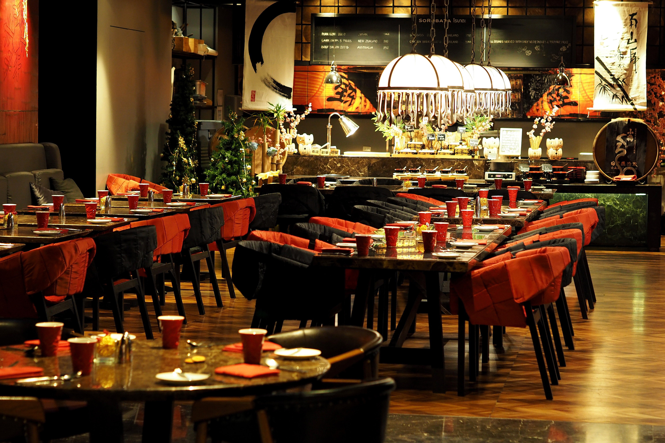
DESCRIPTION OF RESTAURANT:-
A restaurant, or, more informally, an eatery, is a business that prepares and serves food and drinks to customers. Meals are generaly served and eaten on the premises, but many restaurants also offer take-out and food delivery services. Restaurants vary greatly in appearance and offerings, including a wide variety of cuisines and service models ranging from inexpensive fast food restaurants and cafeterias, to mid-priced family restaurants, to high-priced luxury establishments.

Slide 4
HISTORY OF RESTAURANT:-
According an often-repeated account that was first published in 1853, the first restaurant was opened in 1765 by a Parisian named Boulanger. Boulanger's establishment on rue des Poulies, near the Louvre, served mostly bouillons restaurants—that is, "restorative broths."

Slide 5
IMPORTANCE:-
Beyond the basic purpose of restaurants to provide food and drink, restaurants have, historically, fulfilled a human need for connection and shaped social relations. In 21st century American life restaurants occupy an increasingly important place in shaping our overall economy and the nature and makeup of our cities.
REGULATION:-
Restaurants are subject to the same standards as factories and other work environments, though the implementation might differ. OSHA provides specific rules and regulations that restaurant owners must adhere to “keep their workforce free of serious recognized hazards,” according to the OSH Act. These include:
Posting an official OSHA poster that notifies employees of their rights under the OSH Act and a list of the owner’s obligations. The poster should be placed in a highly-visible area where there is a lot of floor traffic.
Keeping accurate and updated records of accidents and injuries that occur in the workplace.
Reporting any work-related fatalities, hospitalizations, loss of limbs or eyes to OSHA within eight hours of being altered of the event.
Allowing employees and their representatives easy access to their medical records.
Ensuring employees there will be no retaliation if they bring up safety concerns or contact OSHA.
New requirements and safety standards for restaurants.

Slide 6
VISION AND MISSION OF RESTAURANT:-
A good restaurant mission statement clearly defines your restaurant’s goals. It also explains why your restaurant exists, and what makes it different.
This will typically relate to the dining experience, how you will ensure absolute guest satisfaction or broader issues like the environment, for example. If you choose to make your mission statement about a broader problem, it works best when it is something that appeals to your target customer.
Here are three mission statement examples:
Dining experience: Create the best donuts in the world—Krispy Kreme
Guest satisfaction: Create memorable experiences for everyone—Nando’s
Broader issues: We believe it’s our responsibility to protect and preserve our oceans and marine life for generations to come—Red Lobster
Don’t Forget Your Vision Statement
Your restaurant vision is similar to your mission statement. It defines where you want your restaurant to be in the future.
When creating your vision, think about what the ultimate goal of your restaurant is. It could be something small like consistently providing exceptional fine dining experiences to guests or something more ambitious like global restaurant expansion.
To write a restaurant mission and vision statement, be specific and unique to your restaurant. They will strike the balance between being optimistic and matching the reality of your restaurant.

Slide 7
SERVING SERVICES:-
There are a number of service styles to be followed when it comes to how food and beverage should be served to the customers. The following are the most prominent styles −
Table Service
In this type of service, the guests enter the dining area and take seats. The waiter offers them water and menu card. The guests then place their order to the waiter. The table is covered in this service. It is grouped into the following types.
English or Family Service
Here, the host contributes actively in the service. The waiter brings food on platters, shows to the host for approval, and then places the platters on the tables. The host either makes food portions and serves the guests or allows the waiter to serve. To replenish the guests’ plates, the waiter takes the platters around to serve or to let the guests help themselves. This is a common family service in specialty restaurants where customers spend more time on premise.

Slide 8
SERVING SERVICES:-
REQUIRED MANPOWER:-
WAITER
DINE IN
SELF SERVICES
TAKE AWAY
TOKEN SYSTEM
WAITER:- The duties a waiter, waiting staff or server partakes in can be tedious and challenging but are vital to the success of the restaurant. Such duties include: preparing a section of tables before guests sit down (e.g., changing the tablecloth, putting out new utensils, cleaning chairs, etc.); offering cocktails, specialty drinks, wine,..
Plate Service
The food is served on guest's plate in the kitchen itself in predetermined portion. The accompaniments served with the food, the color, and the presentation are determined in the kitchen. The food plates are then brought to the guest. This service is commonly used in a coffee shop where service is required to be fast.

Slide 9
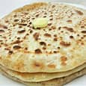
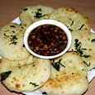
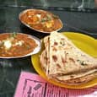
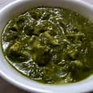
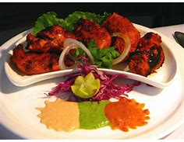
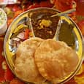
RECIPES AVAILABLE IN RESTAURANT-
ALLU PARATHA
KULCHA PARATHA
SHAHI PANNER
PALAK PANNER
PUNJABI CUSINE
CHOLE BHATURE

Slide 10

LOCATION STATERGY:-
ADDRESS- NEAR PATIA RAILWAY STATION,BUHBANESWAR
PINCODE- 756314
LANDMARK- PATIA SQUARE
CONTANCT- 9861558526
THANKYOU.
VISIT AGAIN.

Slide 11
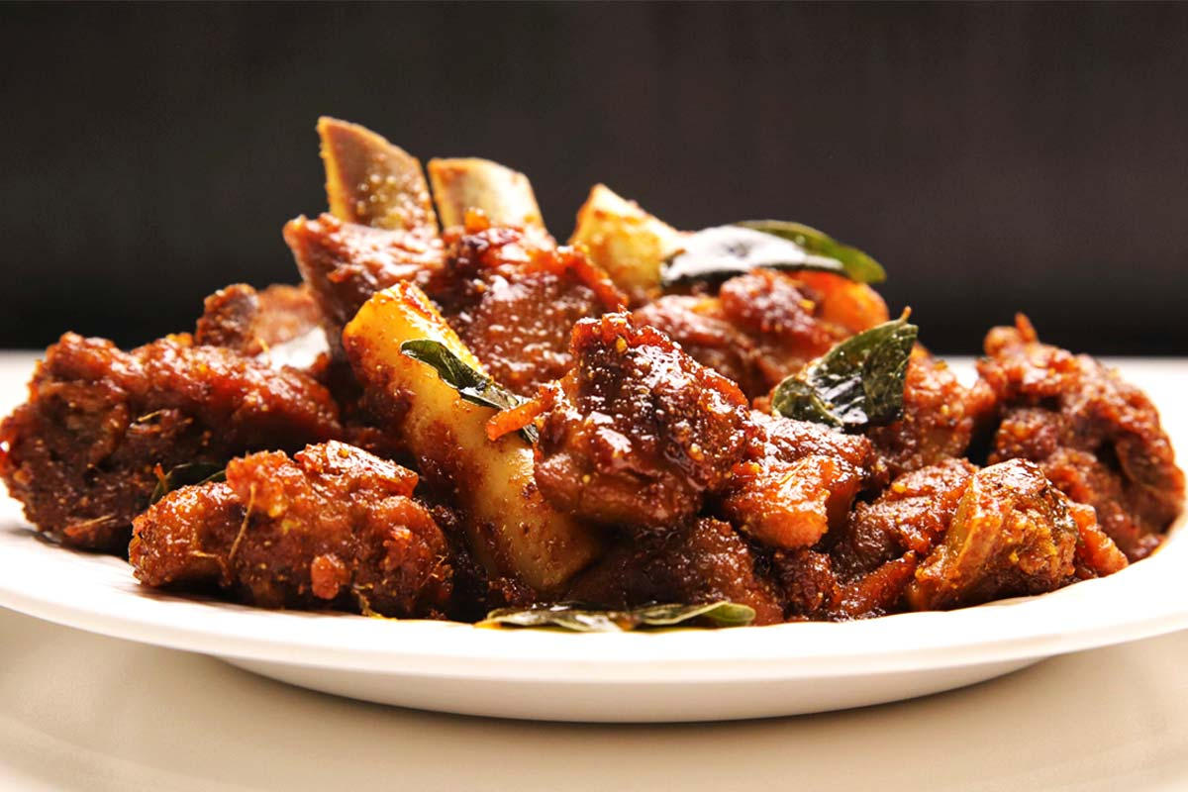
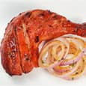
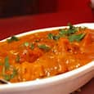
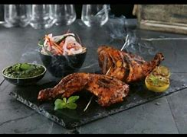
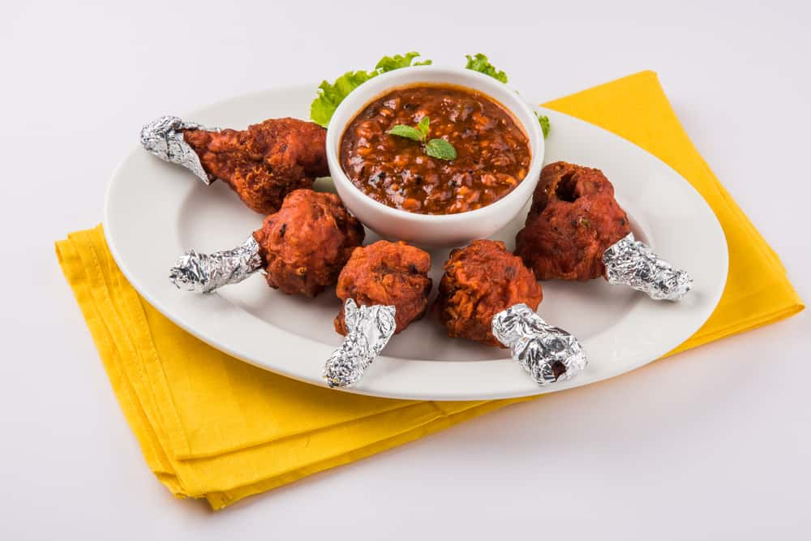
NON- VEG RECIPES AVAILABLE IN RESTURANT :-
TANDOORI CHICKEN
BUTTER CHICKEN
MUTTON KASA
CHICKEN LOLIPOP
FRIED CHICKEN

Slide 12
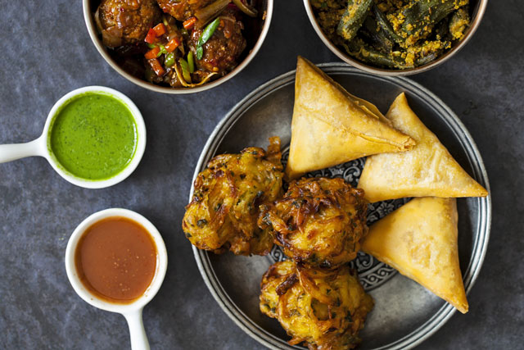
INDIAN APPETIZERS

