Slide 1


Angular Training
Session -9

Slide 2


Outlines
TypeScript

Slide 3
TypeScript
What is TypeScript?
Installation
Hello World
Why TypeScript?
Basic Type
Function & Class
Interface
Generic
Enum
Who Use TypeScript?
Conclusion
Q&A
References
Agenda

Slide 4


What is TypeScript?
Anders Hejlsberg
2012 , Microsoft
JavaScript Superset
Add new features & advantages to JavaScript
Language building up on JavaScript
Browser CAN’T execute it!

Slide 5
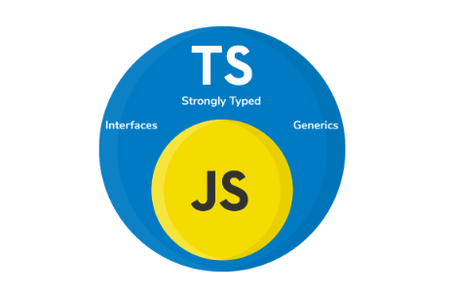
What is TypeScript?

Slide 6
What is TypeScript?
Typescript Vs Javascript
TypesScript is an Object oriented programming language whereas JavaScript is a scripting language (with support for object oriented programming).
TypeScript has static typing whereas JavaScript does not.
TypeScript uses types and interfaces to describe how data is being used.
TypeScript has interfaces which are a powerful way to define contracts within your code.
TypeScript supports optional parameters for functions where JavaScript does not.

Slide 7
Why TypeScript?
Transpiling allows you to generate ECMAScript
Typescript supports JS libraries and API documentation
Typescript introduces static typing
Typescript uses NPM
Typescript is easier to maintain
Typescript makes it easier to use React, Angular, and Vue.

Slide 8
Installation
The following tools you need to setup to start with TypeScript:
Node js
TypeScript compiler
IDE (VsCode)
npm install -g typescript
tsc -v
Version 4.0.2

Slide 9
What is TypeScript?
TypeScript Compilers
To compile TS code, we run the command tsc filename.ts. This will create a JS file of the same name, so we can eventually use it on the browser.
TypeScript (.ts)
TypeScript Compiler
Javascript (.js)

Slide 10

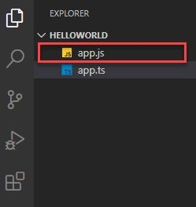


Hello World
compile the app.ts ﬁle
You will see the output as Hello, World!

Slide 11
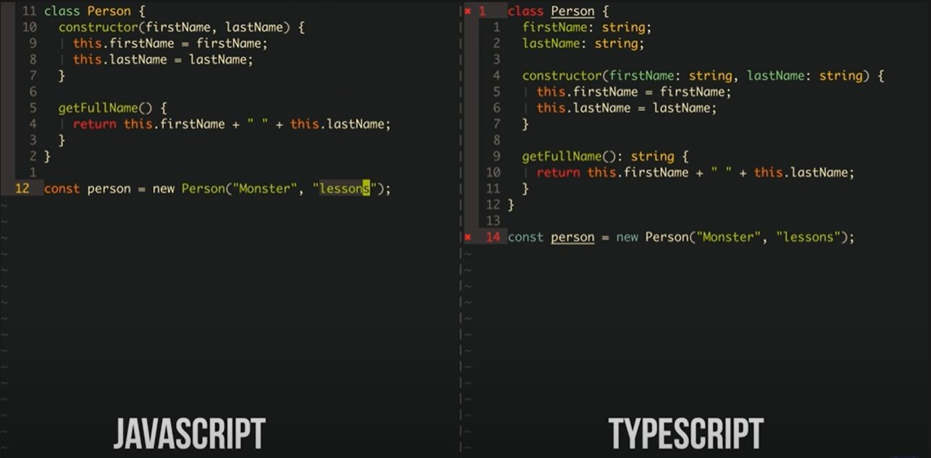
Why TypeScript?

Slide 12
TypeScript project configuration :
TypeScript uses a configuration file named tsconfig.json that holds a number of compilation options.
We can use the tsc command-line compiler to generate a tsconfig.json file by using the --init command
tsc –init
tsc --target

Slide 13
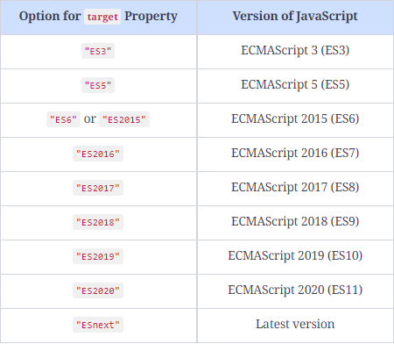
TypeScript project configuration :

Slide 14
Watching files for changes :
TypeScript also has a handy option that will watch an entire directory tree and if a file changes, it will automatically recompile the entire project.
tsc -w hello.ts

Slide 15
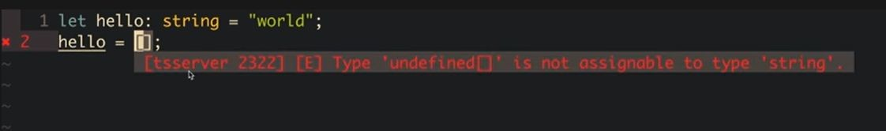
Why TypeScript?

Slide 16
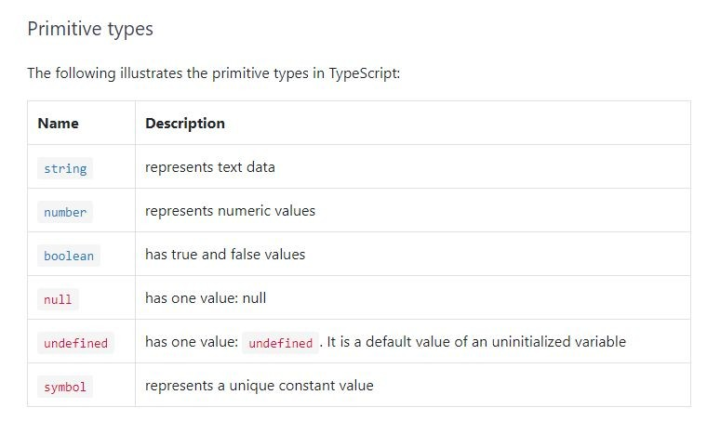
Basic Type
TypeScript inherits the built-in types from JavaScript. TypeScript types is categorized into:
Primitive type
Objective Type

Slide 17
Basic Type
Object types:
Function
Arrays
Classes
Objects
Tuples
Enum

Slide 18
Basic Type
Inferred Typing and Type Annotation
TypeScript uses a technique called inferred typing, or type inference, to determine the type of a variable. This means that even if we do not explicitly specify the type of a variable, the compiler will determine its type based on when it was first assigned
Inferred typing can be useful in TypeScript because it allows us to omit explicit type annotations in situations where the type can be easily determined from the context.
NOTE : Inferred typing relies on TypeScript’s type inference algorithm, which may not always make the correct type assignments.
Example :
let items = [1, 2, 3, null];
let items = [0, 1, null, 'Hi'];

Slide 19
Basic Type
The any Type
Explicit Casting
var item1 = <any>{ id: 1, name: "item1" }
var item1 = { id: 1, name: "item1" } as any;

Slide 20
Basic Type
The let and const Keywords
var index: number = 0;
if (index == 0) {
var index: number = 2;
console.log(`index = ${index}`);
}
console.log(`index = ${index}`);

Slide 21
Basic Type
Union Types, Type Guards, and Aliases
TypeScript allows us to express a type as a combination of two or more other types. These types are known as union types, and they use the pipe symbol (|) to list all of the types that will make up this new type.
function printObject(obj: string | number) {
// Log the value of obj
console.log(`obj = ${obj}`);
}
printObject(1);
printObject("string value");

Slide 22
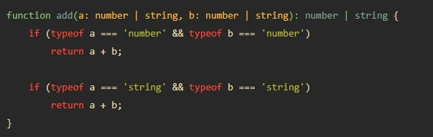
Basic Type
Type guards
When working with union types, the compiler will still apply its strong typing rules to ensure type safety.
function add( a: string | number, b: string | number): number |string {
return arg1 + arg2;
}
A type guard is an expression that performs a check on our type and then guarantees that type within its scope.

Slide 23
Basic Type
Type aliases
TypeScript introduces the concept of a type alias, where we can create a named type that can be used as a substitute for a type union.
Type aliases can be used wherever normal types are used and are denoted by using the type keyword,
type StringOrNumber = string | number;
function addWithTypeAlias(
arg1: StringOrNumber,
arg2: StringOrNumber)
{
return arg1.toString() + arg2.toString();
}
console.log( addWithTypeAlias(1, 2)); // Output: '12'
console.log( addWithTypeAlias('Hello', ' World')); // Output: 'Hello World'

Slide 24
Basic Type
Enums
enum DoorState {
Open,
Closed
}
function checkDoorState(state: DoorState) {
console.log(`enum value is : ${state}`);
switch (state) {
case DoorState.Open:
console.log(`Door is open`);
break;
case DoorState.Closed:
console.log(`Door is closed`);
break;
}
}

Slide 25
Basic Type
Conditional Expressions
(conditional) ? ( true statement ) : ( false statement );
When using object properties in JavaScript, and in particular nested properties, it is important to ensure that a nested property exists before attempting to access it.

Slide 26
Basic Type
Optional chaining
var objectA = {
nestedProperty: {
name: "nestedPropertyName"
}
}
function printNestedObject( obj) {
console.log("obj.nestedProperty.name = " + obj.nestedProperty.name);
}
printNestedObject(objectA);
//printNestedObject({});

Slide 27
Basic Type
function printNestedObject( obj: any) {
// Check if the input object is defined
if (obj != undefined
&& obj.nestedProperty != undefined
&& obj.nestedProperty.name) {
console.log(`name = ${obj.nestedProperty.name}`)
} else {
console.log(`name not found or undefined`);
}
}
printNestedObject(objectA);

Slide 28
Basic Type
function printNestedOptionalChain( obj: any) {
if (obj?.nestedProperty?.name) {
console.log(`name = ${obj.nestedProperty.name}`)
} else {
console.log(`name not found or undefined`);
}
}

Slide 29
Basic Type
function printNestedOptionalChain(obj: any) {
if (obj?.nestedProperty?.name) {
console.log(`name = ${obj.nestedProperty.name}`)
}
} else {
console.log(`name not found or undefined`);
}
}
printNestedOptionalChain(undefined);

Slide 30
Basic Type
function printNestedOptionalChain(obj: any) {
if (obj?.nestedProperty?.name) {
console.log(`name = ${obj.nestedProperty.name}`)
}
} else {
console.log(`name not found or undefined`);
}
}
printNestedOptionalChain({
aProperty: "another property",
});

Slide 31
Basic Type
function printNestedOptionalChain(obj: any) {
console.log(`name = ${obj.nestedProperty.name}`)
} else {
console.log(`name not found or undefined`);
}
}
printNestedOptionalChain({
nestedProperty: {
name: null,
},
});

Slide 32
Basic Type
function printNestedOptionalChain(obj: any) {
if (obj?.nestedProperty?.name) {
console.log(`name = ${obj.nestedProperty.name}`)
}
} else {
console.log(`name not found or undefined`);
}
}
printNestedOptionalChain({
nestedProperty: {
name:null
},
});

Slide 33
Basic Type
Nullish Coalescing operator (?? ) :
expr1 ?? `undefined or null`
This syntax provides an alternative value, which is provided on the right-hand side of the operator, to use if the variable on the left-hand side is either null or undefined.
function nullishCheck(a: number | undefined | null) {
console.log(`a : ${a ?? `undefined or null`}`);
}
nullishCheck(1);
nullishCheck(null);
nullishCheck(undefined);

Slide 34
Basic Type
Null or undefined operands
function testNullOperands(a: number, b: number | null | undefined) {
let addResult = a + (b ?? 0);
console.log(addResult);
}
testNullOperands(5,undefined);

Slide 35
Basic Type
Object Types
TypeScript introduces the object type to cover types that are not primitive types.
This includes any type that is not number, boolean, string, null, symbol, or undefined.
let structuredObject: object = {
name: "myObject",
properties: {
id: 1,
type: "AnObject"
}
};
function printObjectType(a: object) {
console.log(`a: ${JSON.stringify(a)}`);
}
printObjectType(structuredObject);
printObjectType("this is a string");

Slide 36
Basic Type
The Unknown Types
TypeScript introduces a special type into its list of basic types, which is the type unknown
The unknown type can be seen as a type-safe alternative to the type any.
A variable marked as unknown can hold any type of value, similar to a variable of type any.
A variable of type unknown can’t be assigned to a known type without explicit casting.
let u: unknown = "an unknown";
u = 1;
let aNumber2: number;
aNumber2 = u;
//aNumber2 = <number>u;

Slide 37
Basic Type
The never Type
This type is used to indicate instances where something should never occur.
function alwaysThrows() : never {
// Throw an error with a specified message
throw new Error("this will always throw");
// Return a value, but it will never be reached because of the thrown error
return -1;
}
alwaysThrows();

Slide 38
Basic Type
Object Spread
var firstObj = { id: 1, name: "firstObj" };
var secondObj = { ...firstObj };
console.log(`secondObj : ${JSON.stringify(secondObj)}`);
let emailObj: object = { email : " abc@example.com " };
let obj3 = { ... firstObj, ...emailObj };
console.log(`obj3 = ${JSON.stringify(obj3)}`);

Slide 39
Basic Type
Spread precedence
When using object spread, properties will be copied incrementally.
In other words, if two objects have a property with the same name, then the object that was specified last will take precedence.
Spread with arrays
let firstArray = [1, 2, 3];
let secondary = [3, 4, 5];
let thirdArray = [...firstArray, ...secondArray];
console.log(`third array = ${thirdArray}`);

Slide 40
Basic Type
Tuples
Tuples are a method of defining a type that has a finite number of unnamed properties, with each property having an associated type.
When using a tuple, all of the properties must be provided.
let tuple1: [string, boolean];
tuple1 = ["test", true];
tuple1 = ["test"];

Slide 41
Basic Type
Tuples destructuring
As tuples use the array syntax, they can be destructured or disassembled in two ways.
let tuple1: [string, boolean];
console.log(`tuple1[0] : ${tuple1[0]}`);
console.log(`tuple1[1] : ${tuple1[1]}`);
let [tupleString, tupleBoolean] = tuple1;
console.log(`tupleString = ${tupleString}`);
console.log(`tupleBoolean = ${tupleBoolean}`);

Slide 42
Basic Type
Optional tuple elements
let tupleOptional: [string, boolean?];
tupleOptional = ["test", true];
tupleOptional = ["test"];
console.log(`tupleOptional[0] : ${tupleOptional[0]}`);
console.log(`tupleOptional[1] : ${tupleOptional[1]}`);

Slide 43
Basic Type
Tuples and spread syntax
let tupleRest: [number, ...string[]];
tupleRest = [1];
tupleRest = [1, "string1"];
tupleRest = [1, "string1", "string2"];

Slide 44
Basic Type
Object destructuring
let complexObject = {
aNum: 1,
bStr: "name",
cBool: true
}
let { aNum, bStr, cBool } = complexObject;
console.log(`aNum : ${aNum}`);
console.log(`bStr : ${bStr}`);
console.log(`cBool : ${cBool}`);
let { aNum: objId, bStr: objName, cBool: isValid } = complexObject;

Slide 45
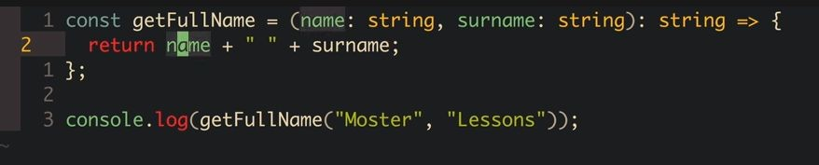
Function
TypeScript functions are the building blocks of readable, maintainable, and reusable code.

Slide 46
Basic Type
Function Signatures and the void Keyword
// This function calculates the result of (a * b) + c
function calculate(a, b, c) {
// Return the result of (a * b) + c
return (a * b) + c;
}
// Log the result of calling the calculate function with arguments 3, 2 and 1
console.log("calculate() = " + calculate(3, 2, 1));
console.log("calculate() = " + calculate("2", "3", "1"));

Slide 47
Basic Type
Function with Optional parameters
function concatValues(a: string, b?: string) {
console.log(`a + b = ${a + b}`);
}
// Call the function with two arguments
concatValues("first", "second");
// Call the function with only one argument
concatValues("third");
Note: Any optional parameters must be listed last in the parameter list of the function definition. We can have as many optional parameters as we like as long as nonoptional parameters precede the optional parameters.

Slide 48
Basic Type
Function with Default parameters
function concatWithDefault(a: string, b: string = "default") {
console.log(`a + b = ${a + b}`);
}
concatWithDefault("first", "second");
concatWithDefault("third");
Note: Any optional parameters must be listed last in the parameter list of the function definition. We can have as many optional parameters as we like as long as nonoptional parameters precede the optional parameters.

Slide 49
Basic Type
Function with Rest parameters
If we do not specify any parameters in a function definition, we can still access the values that were provided when the function was invoked.
function testArguments() {
for (var i = 0; i < arguments.length; i++) {
console.log(`argument[${i}] = ${arguments[i]}`);
}
}
testArguments(1, 2);
testArguments("first", "second", "third");

Slide 50
Basic Type
Function with Rest parameters
function testArguments(...args: (string[] | number[])) {
for (let i in args) {
// Log each argument in the format `args[i] = argument_value`
console.log(`args[${i}] = ${args[i]}`);
}
}
// Call the `testArguments` function with different arguements
testArguments("1");
testArguments(10, 20);

Slide 51
Function: overloading
Function overrides
TypeScript provides an alternative to union types when defining a function and allows a function signature to provide different parameter types.
function add(a: string, b: string): string;
function add(a: number, b: number): number;
function add(a: any, b: any) {
return a + b;
}
add("first", "second");
add(1, 2);
add(true, false);

Slide 52
Function: overloading
Interfaces
Interfaces provide us with a mechanism to define what properties an object must implement and is, therefore, a way for us to define a custom type.
By defining an interface, we are describing the properties and functions that an object is expected to have in order to be used by our code.
interface IIdName {
id: number;
name: string;
}
let idObject: IIdName = {
id: 2,
name: "this is a name",
};
Interfaces do not generate any JavaScript code. This means that interfaces are constructs only used in the TypeScript compilation step and language services and are there to ensure type safety.

Slide 53
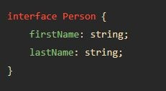
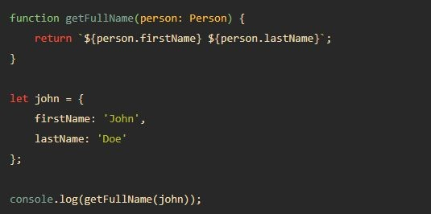
Interface

Slide 54
Function: overloading
Optional Properties and Prefixing Interface Names
Interface definitions may also include optional properties similar to functions that specify optional parameters using the question mark (?) syntax.
interface IOptional {
id: number;
name?: string;
} let optionalId: IOptional = {
id: 1,
};
let optionalIdName: IOptional = {
id: 2,
name: "optional name",
};

Slide 55
Function: overloading
Weak Types in Interfaces
When we define an interface where all of its properties are optional, this is considered to be a weak type. In other words, we have defined an interface, but none of the properties of the interface are mandatory.
interface IWeakType {
id?: number;
name?: string;
}
let weakTypeNoOverlap: IWeakType = {
description: "a description",
};
TypeScript is strongly type even weak types.

Slide 56
Function: overloading
The in Operators
interface IIdName {
id: number;
name: string;
}
interface IDescrValue {
descr: string;
value: number;
}
function printNameOrValue(obj: IIdName | IDescrValue): void {
if ('id' in obj) {
console.log(`obj.name : ${obj.name}`);
}
if ('descr' in obj) {
console.log(`obj.value : ${obj.value}`);
}
}

Slide 57
The Usage in Operators
Function: overloading
interface IIdName {
id: number;
name: string;
}
interface IDescrValue {
descr: string;
value: number;
}
function printNameOrValue(obj: IIdName | IDescrValue): void {
if ("id" in obj) {
console.log(`obj.name : ${obj.name}`);
}
if ("descr" in obj) {
console.log(`obj.value : ${obj.value}`);
}
}
printNameOrValue({
id: 1,
name: "nameValue",
});
printNameOrValue({
descr: "description",
value: 2,
});

Slide 58
Function: overloading
The keyof Operators
TypeScript allows us to iterate through the properties of a type and extract the names of its properties through the keyof keyword, which we can use as a string literal type.
interface IPerson {
id: number;
name: string;
}
type PersonPropertyName = keyof IPerson;
function getProperty(key: PersonPropertyName, value: IPerson) {
console.log(`${key} = ${value[key]}`);
}
getProperty("id", { id: 1, name: "firstName" });
getProperty("name", { id: 2, name: "secondName" });
getProperty("telephone", { id: 3, name: "thirdName" });

Slide 59
Classes in Typescripts

Slide 60
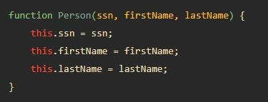


ES5

Slide 61
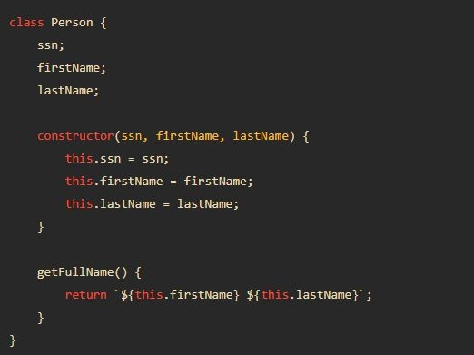

ES6

Slide 62
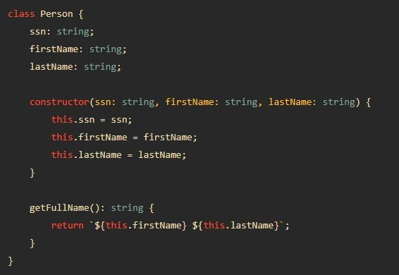

TypeScript

Slide 63
Class Constructors and Modifiers

Slide 64
Constructor Parameter Properties and Property Accessors
TypeScript also introduces a shorthand version for access modifiers that can be applied to parameters in a constructor function.
class ClassWithCtorMods {
constructor(public id: number, private name: string)
{
}
}
let myClassMod = new ClassWithCtorMods(1, "test");
console.log(`myClassMod.id = ${myClassMod.id}`);
console.log(`myClassMod.name = ${myClassMod.name}`);

Slide 65
The readonly property in TypeScript
This is similar to the concept of the const keyword and means that once a value has been assigned to a readonly property, it is not allowed to be modified.
class ClassWithReadonly {
readonly name: string;
constructor(_name: string) {
this.name = _name;
}
setNameValue(_name: string) {
this.name = _name;
}
}

Slide 66
property accessors
class ClassWithAccessors {
private _id: number = 0;
get id(): number {
console.log(`get id property`);
return this._id;
}
set id(value: number) {
console.log(`set id property`);
this._id = value;
}
}
let classWithAccessors = new ClassWithAccessors();
classWithAccessors.id = 10;
console.log(`classWithAccessors.id = ${classWithAccessors.id}`);

Slide 67
Static Functions and Namespaces
A class can mark a function with the static keyword, meaning that there will only be a single instance of this function available throughout the code base.
When using a static function, we do not need to create an instance of the class in order to invoke this function.
class StaticFunction {
static printTwo() {
console.log(`2`);
}
}
StaticFunction.printTwo();

Slide 68
Static properties
In a similar manner to static functions, classes can also have static properties.
If a class property has been marked as static, then there will only be a single instance of this property throughout the code base.
class StaticProperty {
static count = 0;
updateCount() {
StaticProperty.count++;
}
}
let firstInstance = new StaticProperty();
let secondInstance = new StaticProperty();
firstInstance.updateCount();
console.log(`StaticProperty.count = ${StaticProperty.count}`);
secondInstance.updateCount();
console.log(`StaticProperty.count = ${StaticProperty.count}`);

Slide 69
Namespaces in TypeScript
When working within large projects, and particularly when working with large numbers of external libraries, there may come a time when two classes or interfaces share the same name. To handle such situations, TypeScript employs namespaces.
A namespace in TypeScript is a way to organize code and ensure that class names remain unique.
To create a namespace in TypeScript, we use the namespace keyword followed by the desired name of the namespace.
Within the namespace block, we can define one or more classes or interfaces.
namespace FirstNameSpace {
export class NameSpaceClass {
}
class NotExported {
}
}

Slide 70
Exporting a class from a namespace
let notExported = new FirstNameSpace.NotExported();
let nameSpaceClass = new FirstNameSpace.NameSpaceClass();

Slide 71
Inheritance in TypeScript
In TypeScript, inheritance can be used by classes and interfaces
TypeScript uses the extends keyword to implement inheritance

Slide 72
Interface inheritance
interface IBase {
id: number;
}
interface IDerivedFromBase extends IBase {
name: string;
}
class IdNameClass implements IDerivedFromBase {
id: number = 0;
name: string = "nameString";
}

Slide 73
Multiple inheritance in interfaces
interface IBase {
id: number;
}
interface IDerivedFromBase extends IBase {
name: string;
}
interface IMultiple extends IDerivedFromBase, IBase {
description: string;
}
let multipleObject: IMultiple = {
id: 1,
name: "myName",
description: "myDescription",
};

Slide 74
Class inheritance
class BaseClass implements IBase {
id: number = 0;
}
class DerivedFromBaseClass
extends BaseClass
implements IDerivedFromBase {
name: string = "nameString";
}

Slide 75
A class with multiple interfaces
interface IFirstInterface {
id: number;
}
interface ISecondInterface {
name: string;
}
class MultipleInterfaces implements IFirstInterface, ISecondInterface {
id: number = 0;
name: string = "nameString";
}

Slide 76
The super Function
If a derived class has a constructor, then this constructor must call the base class constructor using the super keyword, or TypeScript will generate an error.
class BaseClassWithCtor {
private id: number;
constructor(id: number) {
this.id = id;
}
}
class DerivedClassWithCtor extends BaseClassWithCtor {
private name: string;
constructor(id: number, name: string) {
super(id);
this.name = name;
}
}

Slide 77
Function Overriding
Function overriding is when a derived class defines a method that has the same name as a base class method.
The derived class can determine whether or not to call the implementation of the function in the base class.

Slide 78
class BaseClassWithFn {
print(text: string) {
console.log(`BaseClassWithFn.print() : ${text}`)
}
}
class DerivedClassFnOverride extends BaseClassWithFn {
print(text: string) {
console.log(`DerivedClassFnOverride.print(${text})`);
}
}
let derivedClassFnOverride = new DerivedClassFnOverride();
derivedClassFnOverride.print("test");

Slide 79
Protected Member
Classes can mark both properties and functions with the protected keyword.
If a property is marked as protected, then it is not accessible outside of the class itself, similar to the behavior of the private keyword.
It is, however, accessible to derived classes, which is different from private variables that are not accessible to derived classes

Slide 80
class BaseClassProtected {
protected id: number;
private name: string = "";
constructor(id: number) {
this.id = id;
}
}
class AccessProtected extends BaseClassProtected {
constructor(id: number) {
super(id);
console.log(`base.id = ${this.id}`);
console.log(`base.name = ${this.name}`);
}
}

Slide 81
Abstract Classes
An abstract class is a class that can’t be instantiated. In other words, it is a class that is designed to be derived from.
The purpose of abstract classes is generally to provide a set of basic properties or functions that are shared across a group of similar classes.
Abstract classes are marked with the abstract keyword.

Slide 82
abstract class EmployeeBase {
public id: number;
public name: string;
constructor(id: number, name: string) {
this.id = id;
this.name = name;
}
}
class OfficeWorker extends EmployeeBase {}
class OfficeManager extends OfficeWorker {
public employees: OfficeWorker[] = [];
}
let joeBlogg = new OfficeWorker(1, "Joe");
let jillBlogg = new OfficeWorker(2, "Jill");
let jackManager = new OfficeManager(3, "Jack");

Slide 83
Abstract Class Methods
An abstract class method is similar to an abstract class in that it is designed to be overridden.
In other words, declaring a class method as abstract means that a derived class must provide an implementation of this method. For this reason, abstract class methods are not allowed to provide a function implementation.
abstract class EmployeeBase {
public id: number;
public name: string;
abstract doWork(): void;
constructor(id: number, name: string) {
this.id = id;
this.name = name;
}
}

Slide 84
abstract class EmployeeBase {
public id: number;
public name: string;
abstract doWork(): void;
constructor(id: number, name: string) {
this.id = id;
this.name = name;
}
}
class OfficeWorker extends EmployeeBase {
doWork() {
console.log(`${this.name} : doing work`);
}
}

Slide 85
The instanceof Operator
class A {}
class BfromA extends A {}
class CfromA extends A {}
class DfromC extends CfromA {}
console.log(`A instance of A :
${new A() instanceof A}`);
console.log(`BfromA instance of A :
${new BfromA() instanceof A}`);
console.log(`BfromA instance of BfromA :
${new BfromA() instanceof BfromA}`);

Slide 86
Any Questions?

Slide 87
References
prototype inheritance
ES6 allowed you to deﬁne a class
https://www.typescripttutorial.net/
https://www.typescriptlang.org/
TypeScript type annotations

