Slide 1


Angular Training
Session -18

Slide 2


Outlines
Decorator
Angular Directives
Angular Component
Angular Container and Nested Components
Template VS TemplateUrl
Angular Pipes
Nested Components
Styling Components
Databinding

Slide 3
Decorators
Decorators are a way to decorate members of a class, or a class itself, with extra functionality.
When you apply a decorator to a class or a class member, you are actually calling a function that is going to receive details of what is being decorated, and the decorator implementation will then be able to transform the code dynamically, adding extra functionality, and reducing boilerplate code.
They are a way to have metaprogramming in TypeScript, which is a programming technique that enables the programmer to create code that uses other code from the application itself as data.

Slide 4
Enabling Decorators Support in TypeScript
Currently, decorators are still an experimental feature in TypeScript, and as such, it must be enabled first.
TypeScript Compiler CLI
tsc --experimentalDecorators
tsconfig.json
{
"compilerOptions": {
"experimentalDecorators": true
}
}

Slide 5
Using Decorator Syntax
A decorator is a function that is called with a specific set of parameters. These parameters are automatically populated by the JavaScript runtime and contain information about the class, method, or property to which the decorator has been applied.
The number of parameters, and their types, determine where a decorator can be applied.
To illustrate this syntax, let’s define a class decorator as follows:
function simpleDecorator(constructor: Function) {
console.log('simpleDecorator called');
}
This function, due to the parameters that it defines, can be used as a class decorator function and can be applied to a class definition as follows:

Slide 6
@simpleDecorator
class ClassWithSimpleDecorator {
}
let instance_1 = new ClassWithSimpleDecorator();
let instance_2 = new ClassWithSimpleDecorator();
console.log(`instance_1 : ${JSON.stringify(instance_1)}`);
console.log(`instance_2 : ${JSON.stringify(instance_2)}`);
OUTPUT :
simpleDecorator called
instance_1 : {}
instance_2 : {}
We apply a decorator using the “at” symbol (@), followed by the name of the decorator function.
Note: Decorators are only invoked once when a class is defined.

Slide 7
Multiple decorators
Multiple decorators can be applied one after another on the same target.
function secondDecorator(constructor: Function) {
console.log(`secondDecorator called`);
}
@simpleDecorator
@secondDecorator
class ClassWithMultipleDecorators {
}
Note: Decorators are called in the reverse order of their appearance within our code.

Slide 8
Types of Decorators
Decorators are functions that are invoked by the JavaScript runtime when a class is defined.
Depending on what type of decorator is used, these decorator functions will be invoked with different arguments.
Class decorators:
These are decorators that can be applied to a class definition.
Property decorators:
These are decorators that can be applied to a property within a class.
Method decorators:
These are decorators that can be applied to a method on a class.
Parameter decorators:
These are decorators that can be applied to a parameter of a method within a
class.

Slide 9
Example :
// Define a function called classDecorator which takes a constructor function as input
function classDecorator(
constructor: Function
) {}
// Define a function called propertyDecorator which takes an object and a string property key as input
function propertyDecorator(
target: any,
propertyKey: string
) {}

Slide 10
Example :
// Define a function called methodDecorator which takes an object, a string method name, and an optional property descriptor object as input
function methodDecorator(
target: any,
methodName: string,
descriptor?: PropertyDescriptor
) {}
// Define a function called parameterDecorator which takes an object, a string method name, and a number representing a parameter index as input
function parameterDecorator(
target: any,
methodName: string,
parameterIndex: number
) {}

Slide 11
// Define a class called ClassWithAllTypesOfDecorators and apply the classDecorator to it
@classDecorator
class ClassWithAllTypesOfDecorators {
// Apply the propertyDecorator to the id property of the class
@propertyDecorator
id: number = 1;
// Apply the methodDecorator to the print method of the class
@methodDecorator
print() { }
// Apply the parameterDecorator to the id parameter of the setId method of the class
setId(@parameterDecorator id: number) { }
}

Slide 12
Class Decorators :
// Define a function called classConstructorDec which takes a constructor function as input and logs it to the console
function classConstructorDec(constructor: Function) {
console.log(`constructor : ${constructor}`);
}
// Apply the classConstructorDec decorator to the ClassWithConstructor class
@classConstructorDec
class ClassWithConstructor {
constructor(id: number) { }
}
OUTPUT :
constructor : function ClassWithConstructor(id) {
}

Slide 13
Property decorators:
// Define a function called propertyDec which takes an object and a string property name as input and logs them to the console
function propertyDec(target: any, propertyName: string) {
console.log(`target : ${target}`);
console.log(`target.constructor : ${target.constructor}`);
console.log(`propertyName : ${propertyName}`);
}
// Define a ClassWithPropertyDec class and apply the propertyDec decorator to its nameProperty property
class ClassWithPropertyDec {
@propertyDec
nameProperty: string | undefined;
}
OUTPUT :
target : [object Object]
target.constructor : function ClassWithPropertyDec() {
}
propertyName : nameProperty

Slide 14
Method decorators:
// Define a methodDec function which logs the target, method name, descriptor, and target method
function methodDec(
target: any,
methodName: string,
descriptor?: PropertyDescriptor
) {
console.log(`target: ${target}`);
console.log(`methodName : ${methodName}`);
console.log(`descriptor : ${JSON.stringify(descriptor)}`);
console.log(`target[methodName] : ${target[methodName]}`);
}
// Define a ClassWithMethodDec class and apply the methodDec decorator to its print method
class ClassWithMethodDec {
@methodDec
print(output: string) {
console.log(`ClassWithMethodDec.print(${output}) called.`);
}
}

Slide 15
Method decorators:
OUTPUT :
target: [object Object]
methodName : print
descriptor : {"writable":true,"enumerable":true,"configurable":true}
target[methodName] : function (output) {
console.log("ClassWithMethodDec.print(".concat(output, ") called."));
}

Slide 16
Parameter decorators:
function parameterDec(target: any,
methodName: string,
parameterIndex: number) {
console.log(`target: ${target}`);
console.log(`methodName : ${methodName}`);
console.log(`parameterIndex : ${parameterIndex}`);
}
class ClassWithParamDec {
print(@parameterDec value: string) {
}
}
OUTPUT :
target: [object Object]
methodName : print
parameterIndex : 0

Slide 17
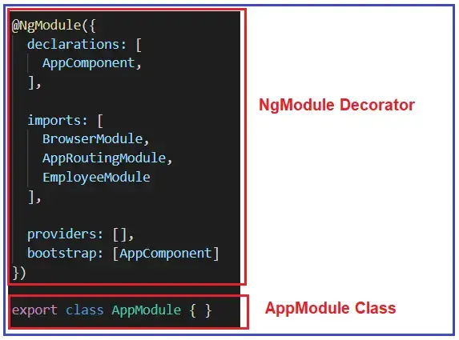
Angular Decorators
Decorators are the features of Typescript and are implemented as functions.
The name of the decorator starts with @ symbol following by brackets and arguments.
-The @NgModule decorator provides the necessary metadata to make the
AppModule class as a module.

Slide 18
Note: If you want to create a module in angular, then you must decorate your class with @NgModule decorator. Once a class is decorated with @NgModule decorator, then only the class works as a module.
Commonly used Decorators:
@NgModule to define a module.
@Component to define components.
@Injectable to define services.
@Input and @Output to define properties
Note: All the above built-in decorators are imported from @angular/core library and so before using the above decorator, you first need to import the decorators from @angular/core library.
import { Component } from ‘@angular/core’;

Slide 19
Types of Decorators in Angular:
Class Decorators: @Component and @NgModule
Property Decorators: @Input and @Output (These two decorators are used inside a class)
Method Decorators: @HostListener (This decorator is used for methods inside a class like a click, mouse hover, etc.)
Parameter Decorators: @Inject (This decorator is used inside class constructor).
Note: In Angular, each decorator has a unique role.

Slide 20
Angular Components
According to Team Angular, A component controls a patch of screen real estate that we could call a view and declares reusable UI building blocks for an application.
The core concept or the basic building block of Angular Application is nothing but the components. That means an angular application can be viewed as a collection of components and one component is responsible for handling one view or part of the view.
An Angular Component encapsulates the data, the HTML Mark-up, and the logic required for a view.
You can create as many components as required for your application.
Every Angular application has at least one component that is used to display the data on the view.

Slide 21
Technically, a component is nothing but a simple typescript class and composed of three things as follows:
- Class (Typescript class)
- Template (HTML Template or Template URL)
- Decorator (@Component Decorator)
Template:
The template is used to define an interface with which the user can interact.
As part of that template, you can define HTML Mark-up; you can also define the directives, and bindings, etc.
The template renders the view of the application with which the end-user can interact i.e. user interface.

Slide 22
Class:
The Class is the most important part of a component in which we can write the code which is required for a template to render in the browser.
You can compare this class with any object-oriented programming language classes such as C++, C# or Java.
The angular component class can also contain methods, variables, and properties like other programming languages.
The angular class properties and variables contain the data which will be used by a template to render on the view.
Similarly, the method in an angular class is used to implement the business logic like the method does in other programming languages.

Slide 23
Decorator:
In order to make an angular class as a component, we need to decorate the class with the @Component decorator.
Decorators are basically used to add metadata.
Note: Whenever we create any component, we need to define that component in @NgModule.

Slide 24
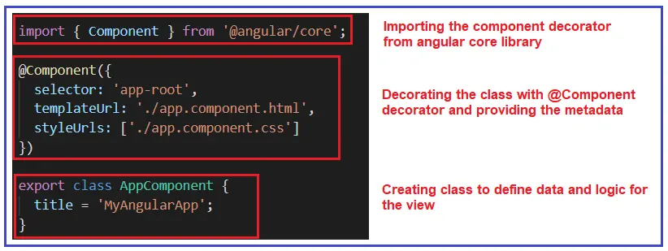

Slide 25

How to create a Component in Angular?

Slide 26
Template VS TemplateUrl in Angular
Different ways to create Templates in Angular
Inline template (template)
External Template (templateUrl)

Slide 27
Angular Nested Components
The Angular framework allows us to use a component within another component and when we do so then it is called Angular Nested Components.
The outside component is called the parent component and the inner component is called the child component.

Slide 28
Styling Angular Components
Option1: Component Inline Style
Option2: Component External Style
Option3: Template Inline Style using style tag
Option4: Template Inline Style using link tag
Option5: Global Style
Option6: ngClass and ngStyle

Slide 29
Component Inline Style
@Component({
selector: 'app-test1',
templateUrl: './test1.component.html',
styles: [
`p { color:blue}`,
`h1 {color:blue}`
],
})

Slide 30
Component External Style
@Component({
selector: 'app-root',
templateUrl: './app.component.html ',
styleUrls: ['./app.component.css‘,
,'.another.stylesheet.css'
]
})

Slide 31
Both Inline & External Style
@Component({
selector: 'app-root',
templateUrl: './app.component.html',
styles:[`p {color:yellow}`],
styleUrls: ['./app.component.css'],
})

Slide 32
Template Inline Style using style tag
<style>
h1 {
color: blue;
}
</style>
<h1>
app works!
</h1>

Slide 33
Template Inline Style using link tag
<link rel="stylesheet" href="assets/css/morestyles.css">
<h1>
app works!
</h1>

Slide 34
Global Styles
Include global styles in the styles array of the angular.json file.
This is useful for styles that need to be applied globally across the entire application.
"styles": [
"src/styles.css",
// Add other global stylesheets
]

Slide 35
NgClass Directive
Include global styles in the styles array of the angular.json file.
This is useful for styles that need to be applied globally across the entire application.
NgClass with a String
<element [ngClass]="'cssClass1 cssClass2'">...</element>
NgClass with Array
<element [ngClass]="['cssClass1', 'cssClass2']">...</element>
NgClass with Object
<element [ngClass]="{'cssClass1': true, 'cssClass2': true}">...</element>

Slide 36
ngStyle Directive
The Angular ngStyle directive allows us to set the many inline style of a HTML element using an expression.
The expression can be evaluated at run time allowing us to dynamically change the style of our HTML element.
ngStyle Syntax
<element [ngStyle]="{‘ styleNames': styleExp}">...</element>
<some-element [ngStyle]="{'font-size': '20px'}"></some-element>
color: string= 'red';
<div [ngStyle]="{'color': color, ‘font-size':20px}">Change my color</div>

Slide 37
Style Priority
The styles are applied in the following order
Component inline styles i.e. Styles defined at @Component.styles
Component External styles i.e. @Component.styleUrls
Template Inline Styles using the style tag
Template External Styles using the link tag

Slide 38
Add Bootstrap Library
Bootstrap is a popular front-end framework for building responsive web applications, and we can integrate it into an Angular application to quickly create stylish and responsive user interfaces.
Steps to install and use Bootstrap in an Angular project:
1. Install Bootstrap:
npm install bootstrap
2. Import Bootstrap CSS:
/* Add this line at the top of styles.css */
@import "~bootstrap/ dist / css /bootstrap.css";

Slide 39
3. Add Bootstrap JavaScript (Optional):
If you plan to use Bootstrap's JavaScript components, such as modals or carousels, you can import Bootstrap's JavaScript files into your project.
Angular.json
"scripts": [
"node_modules /bootstrap/dist/js/bootstrap.js"
]
4. Use Bootstrap Components:
<!-- Example of using Bootstrap components in an Angular template -->
<nav class="navbar navbar-expand-lg navbar-light bg-light">
<a class="navbar-brand" href="#">My Angular Bootstrap App</a>
<!-- Add other Bootstrap components here -->
</nav>

Slide 40
Data Binding in Angular Application
Data binding is one of the most important features provided by Angular Framework which allows communicating between the component and its view.
Why do we need Data Binding?
Whenever you want to develop any data-driven web application, then as a developer you need to keep the focus on two important things i.e. Data and the UI (User Interface) and it is more important for you to find an efficient way to bind them (Data and UI) together.
The angular framework provides one concept called Data Binding which is used for synchronizing the data and the user interface (called a view).

Slide 41
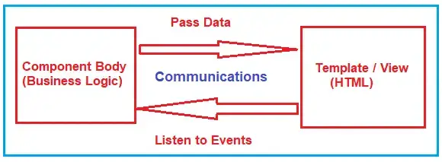
What is Data Binding in Angular Application?
In Angular, Data Binding means to bind the data (Component’s filed) with the View (HTML Content). That is whenever you want to display dynamic data on a view (HTML) from the component then you need to use the concept Data binding.
Data Binding is a process that creates a connection to communicate and synchronize between the user interface and the data. In order words, we can say that Data Binding means to interact with the data and view. So, the interaction between the templates (View) and the business logic is called data binding.

Slide 42
Types of Data Binding in Angular:
One-way Data Binding
Where a change in the state affects the view (i.e. From Component to View Template) or change in the view affects the state (From View Template to Component).
Template
Component
Template
Component
Two-way Data Binding
Where a change from the view can also change the model and similarly change in the model can also change in the view (From Component to View Template and also From View template to Component).
Template
Component

Slide 43
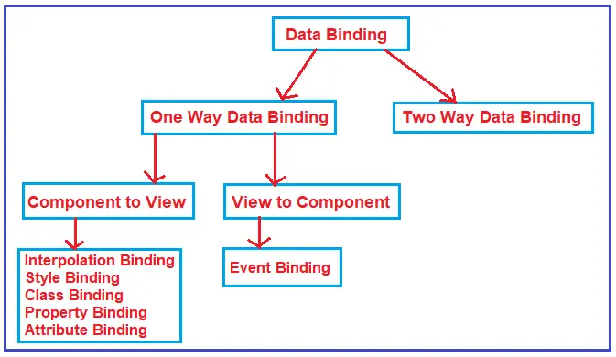

Slide 44
Examples of Angular Data Bindings:
Interpolation
Property Binding
Attribute Binding
Class Binding
Style Binding
Event Binding
Two-way binding

Slide 45
Angular Interpolation
If you want to display the read-only data on a view template (i.e. From Component to the View Template), then you can use the one-way data binding technique i.e. the Angular interpolation.
Interpolation allows us to include expressions as part of any string literal, which we use in our HTML.
You can use interpolation wherever you use a string literal in the view
The Angular uses the {{ }} (double curly braces) in the template to denote the interpolation.
Syntax : {{ templateExpression }}
The content inside the double braces is called Template Expression
The Angular first evaluates the Template Expression and converts it into a string. Then it replaces Template expression with the result in the original string in the HTML.
Whenever the template expression changes, the Angular updates the original string again

Slide 46
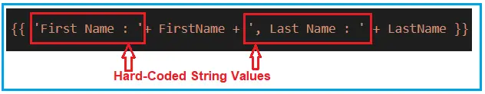
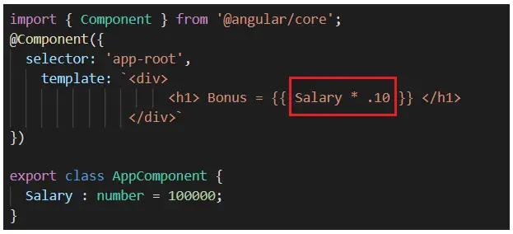
Angular Interpolation with hardcoded string
Angular Interpolation with Expression:

Slide 47

Interpolation in Angular with Ternary Operator:
import { Component } from '@angular/core';
@Component({
selector: 'app-root',
template: `<div>
<h1> Last Name : {{ LastName ? LastName : 'Not Available' }} </h1>
</div>`
})
export class AppComponent {
LastName : string = null;
}
Method Interpolation in Angular Application:
Displaying Images using Angular Interpolation:

Slide 48
Angular Property Binding

Slide 49
The Property binding allows us to bind HTML element property to a property in the component.
Whenever the value of the component changes, the Angular updates the element property in the View.
We can set the properties such as class, href, src, textContent, etc using property binding.
We can also use it to set the properties of custom components or directives (properties decorated with @Input).
The Syntax :
[binding-target]=”binding-source”
The binding-target (or target property) is enclosed in a square bracket []. It should match the name of the property of the enclosing element.
The Binding source must be a template expression. It can be property in the component, method in component, a template reference variable or an expression containing all of them.
Example : span[ innerHTML] = ‘ FirstName’.

Slide 50
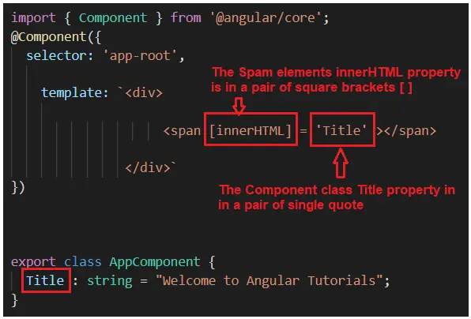

Slide 51
Angular Interpolation and Property Binding
Interpolation in Angular is just an alternative approach for property binding. It is a special type of syntax that converts into a property binding.
Scenarios where we need to use interpolation instead of property binding :
1. If you want to concatenate strings then you need to use angular interpolation instead of property binding

Slide 52
Working with non-string (Boolean) data:
import { Component } from '@angular/core';
@Component({
selector: 'app-root',
template: `<div>
<button [disabled] = ‘ IsDisabledClick' > Click Here </button>
</div>`
})
export class AppComponent {
IsDisabledClick : boolean = true;
}
<button disabled = {{IsDisabledClick} > Click Here </button>
With the above changes in place, irrespective of the IsDisabledClick property value of the component class, the button is always disabled. Here we set the IsDisabled property value as false but when you run the application, it will not allow the button to be clickable.

Slide 53
Providing Security to Malicious Content:
From the security point of view, both Angular data binding and Angular Interpolation protect us from malicious HTML content before rendering it on the web browser.
import { Component } from '@angular/core';
@Component({
selector: 'app-root',
template: `<div>
{{MaliciousData}}
</div>`
})
export class AppComponent {
MaliciousData : string = "Hello <script>alert('your application is hacked')</script>";
}

Slide 54
import { Component } from '@angular/core';
@Component({
selector: 'app-root',
template: `<div [innerHTML] = 'MaliciousData'>
</div>`
})
export class AppComponent {
MaliciousData : string = "Hello <script>alert('your application is hacked')</script>";
}
Both interpolation & property binding does not set the attributes of the HTML elements.

Slide 55
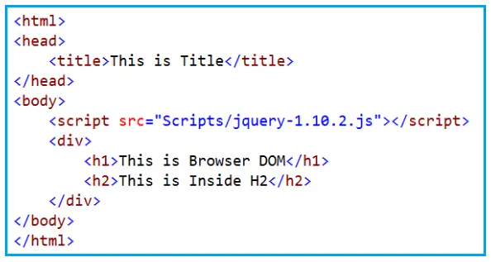
HTML Attribute VS DOM Property
What is DOM?
The DOM stands for Document Object Model. When a browser loads a web page, then the browser creates the Document Object Model (DOM) for that page.
The DOM is an application programming interface (API) for the HTML, and we can use the programming languages like JavaScript or JavaScript frameworks like Angular to access and manipulate the HTML using their corresponding DOM objects.

Slide 56
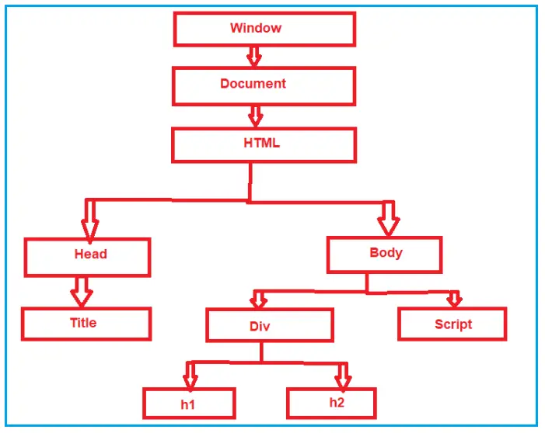
HTML Attribute VS DOM Property
DOM contains the HTML elements as objects, their properties, methods, and events and it is a standard for accessing, modifying, adding or deleting HTML elements.
Interpolation example: <button disabled='{{IsDisabled}}’>Click Me</button>
Property binding example: <button [disabled]=’IsDisabled’>Click Me</button>
The Angular data-binding is all about binding to the DOM object properties and not the HTML element attributes.

Slide 57
What is the difference between the HTML element attribute and DOM property?
The Attributes are defined by HTML whereas the properties are defined by the DOM.
The attribute’s main role is to initializes the DOM properties. So, once the DOM initialization complete, the attributes job is done.
Property values can change, whereas the attribute values can never be changed.
Angular binding works with the properties and events, and not with the attributes.
Example :
import { Component } from '@angular/core';
@Component({
selector: 'app-root',
template: `<div>
<input id=‘ inputId ' type='text' value=‘ Alok '>
</div>`
})
export class AppComponent {
}

Slide 58
Angular Attribute Binding

Slide 59
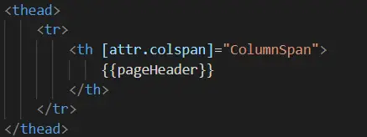
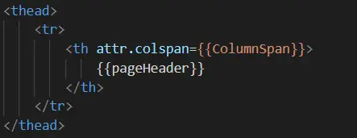
In Angular Interpolation and Property Binding, we have seen that they both (Interpolation and Property Binding) are dealing with the DOM Properties but not with the HTML attributes.
But there are some HTML elements (such as colspan, area, etc) that do not have the DOM Properties.
With Attribute Binding in Angular, you can set the value of an HTML Element Attribute directly. So, the Attribute Binding is used to bind the attribute of an element with the properties of a component dynamically.
Note: The Angular team recommends using the property binding or Interpolation whenever possible and use the attribute binding only when there is no corresponding element property to bind.

Slide 60
Angular Class Binding

Slide 61
The Angular Class Binding is basically used to add or remove classes to and from the HTML elements.
It is also possible in Angular to add CSS Classes conditionally to an element, which will create the dynamically styled elements and this is possible because of Angular Class Binding.
import { Component } from '@angular/core';
@Component({
selector: 'app-root',
template: `<div>
<button [class] = ‘ClassesToApply' >Click Me</button>
</div>`
})
export class AppComponent {
ClassesToApply : string = ‘ italicClass boldClass';
}

Slide 62
If we want then we can also combine both class binding with the normal class
import { Component } from '@angular/core';
@Component({
selector: 'app-root',
template: `<div>
<button class='colorClass ' [class] = 'ClassesToApply' >Click Me</button>
</div>`
})
export class AppComponent {
ClassesToApply : string = 'italicClass boldClass';
}

Slide 63
Adding or removing a single class
If we want to add or remove a single class, then we need to use the prefix ‘class’ within a pair of square brackets and followed by a DOT (.) and the name of the class that you want to add or remove.
import { Component } from '@angular/core';
@Component({
selector: 'app-root',
template: `<div>
<button class=‘ colorClass ' [ class.boldClass]='ApplyBoldClass'>Click Me</button>
</div>`
})
export class AppComponent {
ApplyBoldClass: boolean = true;
}

Slide 64
Angular Class Binding using “!” symbol:
import { Component } from '@angular/core';
@Component({
selector: 'app-root',
template: `<div>
<button class='colorClass' [class.boldClass]='!ApplyBoldClass'>Click Me</button>
</div>`
})
export class AppComponent {
ApplyBoldClass: boolean = false;
}

Slide 65
Add or Remove multiple classes in Angular:
In order to add or remove multiple style classes in angular, the angular framework provides one directive called ngClass directive which we can use to remove or add multiple classes
import { Component } from '@angular/core';
@Component({
selector: 'app-root',
template: `<div>
<button class='colorClass' [ngClass]=‘AddCSSClasses() '>Click Me</button>
</div>`
})
export class AppComponent {
ApplyBoldClass: boolean = true;
ApplyItalicsClass: boolean = true;
AddCSSClasses() {
let Cssclasses = {
boldClass: this.ApplyBoldClass,
italicsClass: this.ApplyItalicsClass
};
return Cssclasses;
}
}

Slide 66
Angular Style Binding

Slide 67
The Angular Style Binding is basically used to set the style in HTML elements.
We can use both inline as well as Style Binding to set the style in the element in Angular Applications.
import { Component } from '@angular/core';
@Component({
selector: 'app-root',
template: `<div>
<button style=‘color:red ' [ style.font-weight]="IsBold ? 'bold' : 'normal'">Click Me</button>
</div>`
})
export class AppComponent {
IsBold: boolean = true;
}
Note : The style property name can be written in either dash-case or camelCase.

Slide 68
Some styles like font-size have a unit extension. To set the font-size in pixels, we need to use the following syntax.
import { Component } from '@angular/core';
@Component({
selector: 'app-root',
template: `<div>
<button style='color:red' [style.font- size.px ]="FontSize">Click Me
</button>
</div>`
})
export class AppComponent {
FontSize: number = 40;
}

Slide 69
Multiple Inline Styles in Angular Application:
If we want to set multiple inline styles in the angular application, then you need to use NgStyle directive
import { Component } from '@angular/core';
@Component({
selector: 'app-root',
template: `<div>
<button style='color:red' [ngStyle]="AddCSSStyles()">Click Me </button>
</div>`
})
export class AppComponent {
IsBold: boolean = true;
FontSize: number = 40;
IsItalic: boolean = true;
AddCSSStyles() {
let CssStyles = {
'font-weight': this.IsBold ? 'bold' : 'normal',
'font-style': this.IsItalic ? 'italic' : 'normal',
'font-size.px': this.FontSize
};
return CssStyles;
}
}

Slide 70
Angular Event Binding

Slide 71

When a user interacts with an application in the form of a keyboard movement, button click, mouse over, selecting from a drop-down list, typing in a textbox, etc. it generates an event. These events need to be handled to perform some kind of action.
How Does Event Binding work in Angular?
With event binding, you can also use the on- prefix alternative as shown below .This is known as the canonical form.

Slide 72
Angular Two Way Binding

Slide 73
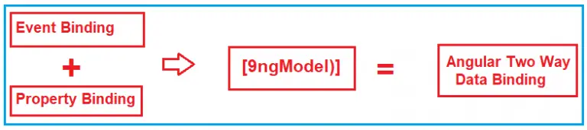
The most popular and widely used data binding mechanism in Angular Application is two-way data binding.
The two-way data binding is basically used in the input type field or any form element where the user type or provide any value or change any control value on the one side and on the other side, the same automatically updated into the component variables and vice-versa is also true.

Slide 74
The two-way data binding in Angular is actually a combination of Property Binding and Event Binding.
The Syntax is given below:
<input [value] = ‘data’ (input) = ‘data = $event.target.value’>

Slide 75
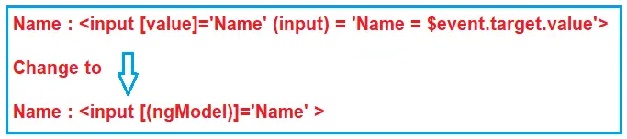
Two-Way Binding using ngModel Directive:
The ngModel directive combines the square brackets of property binding with the parentheses of event binding in a single notation.
The syntax to use ngModel for two-way data binding is given below.
<input [(ngModel)] = ‘data’>

Slide 76
import { Component } from '@angular/core';
@Component({
selector: 'app-root',
template: `<div>
Name : <input [(ngModel)]=‘Name’>
<br>
You entered : {{Name}}
</div>`
})
export class AppComponent {
Name: string = ‘ Alok ';
}

Slide 77
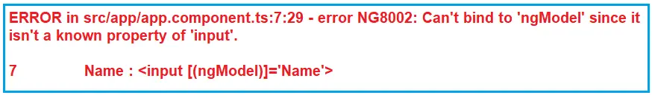
Steps to use ngModel Directive:
Open app.module.ts file
2. Include the following import statement in it
import { FormsModule } from ‘@angular/forms’;
3. Also, include FormsModule in the ‘imports’ array of @NgModule
imports: [BrowserModule, FormsModule]

Slide 78
Case Study : Product Management System
Requirements:
Display Product List:
Display a list of products with their names, prices, and quantities.
Add New Product:
Allow users to add new products to the system with a name, price, and initial quantity.
Edit Product Details:
Enable users to edit the details (name, price, quantity) of existing products.
Delete Product:
Provide the ability to delete products from the system.

Slide 79
Angular Directives

Slide 80
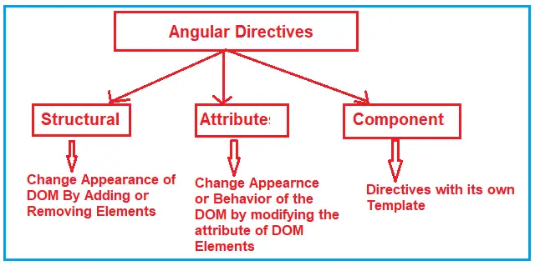
The Angular directive helps us to manipulate the DOM. You can change the appearance, behavior, or layout of a DOM element using the Directives.
There are three kinds of directives in Angular:

Slide 81
Structural Directives:
Structural directives can change the DOM layout by adding and removing DOM elements. All structural Directives are preceded by Asterix symbol
NgIf (*ngIf)
NgSwitch (*ngSwitch)
NgFor (*ngFor)

Slide 82
Attribute Directives:
Attribute Directives are basically used to modify the behavior or appearance of the DOM element or the Component.
1. NgStyle: This NgStyle Attribute Directive is basically used to modify the element
appearance or behavior.
2. NgClass : This NgClass Attribute Directive is basically used to change the class attribute of the element in the DOM or in the Component to which it has been attached.

Slide 83
Component Directives
Components are special directives in Angular. They are the directive with a template (view)
The Component is also a type of directive in angular with its own template, styles, and logic needed for the view.
The Component Directive is the most widely used directive in the angular application and you cannot create an angular application without a component.
A component directive requires a view along with its attached behavior and this type of directive adds DOM Elements.
The Component Directive is a class with @Component decorator function.
The naming convention for components is name.component.ts.

Slide 84
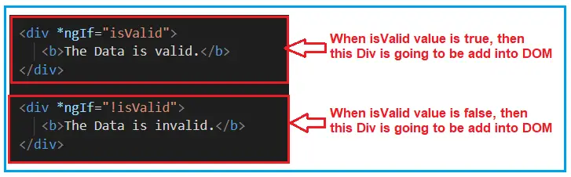
Angular ngIf Directive
The ngIf is a structural directive and it is used to add or removes the HTML element and its descendant elements from the DOM layout at runtime conditionally.
The ngIf directive works on the basis of a boolean true and false results of a given expression. If the condition is true, the elements will be added into the DOM layout otherwise they simply removed from the DOM layout.
The syntax : *ngIf = “expression”

Slide 85
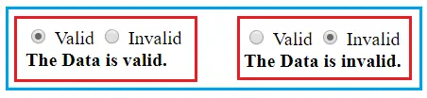
Example :

Slide 86
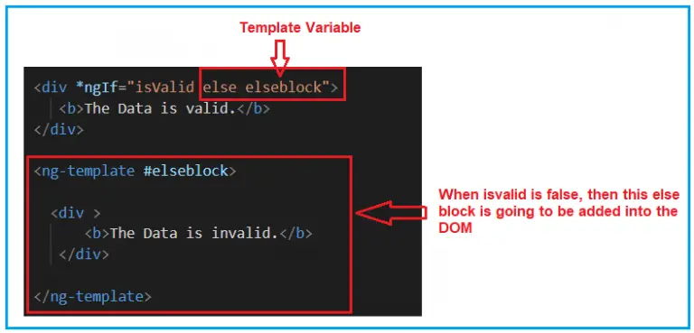
Angular NgIf directive with else block:
<div *ngIf = “condition; else elseBlock”>…</div>
<ng-template #elseblock>….</ng-tempalte>

Slide 87

NgIf with Then and else:
<div *ngIf="isValid then thenblock else elseblock"> </div>
<ng-template #thenblock>
<div>
<b>The is Then Block</b>
</div>
</ng-template>
<ng-template #elseblock>
<div >
<b>The is Else Block</b>
</div>
</ng-template>

Slide 88
Angular ngSwitch Directive
The Angular ngSwitch directive is actually a combination of two directives i.e. an attribute directive and a structural directive.
The ngSwitch directive lets you add/remove HTML elements depending on a match expression. ngSwitch directive used along with ngSwitchCase and ngSwitchDefault
ngSwitch
<div [ngSwitch]="Switch_Expression">
<div *ngSwitchCase="MatchExpression1”> First Template</div>
<div *ngSwitchCase="MatchExpression2">Second template</div>
<div *ngSwitchCase="MatchExpression3">Third Template</div>
<div *ngSwitchCase="MatchExpression4">Third Template</div>
<div *ngSwitchDefault?>Default Template</div>
</div>
ngSwitchCase
ngSwithDefault

Slide 89
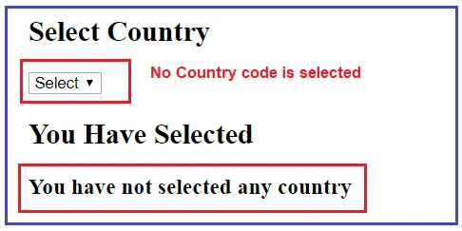
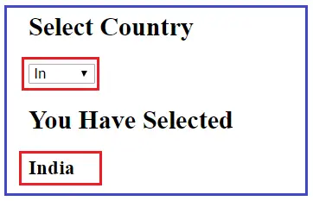

Slide 90
Angular ngFor Directive
The ngFor is an Angular structural directive, which repeats a portion of the HTML template once per each item from an iterable list (Collection).
The syntax : *ngFor=”let <value> of <collection>”
<tr *ngFor="let customer of customers;">
<td>{{customer.customerNo}}</td>
<td>{{customer.name}}</td>
<td>{{customer.address}}</td>
<td>{{customer.city}}</td>
<td>{{customer.state}}</td>
</tr>

Slide 91
Example : Display Employees

Slide 92
ngFor – Local Variables:
Index: This variable is used to provide the index position of the current element while iteration.
First: It returns boolean true if the current element is the first element in the iteration else it will return false.
Last: It returns boolean true if the current element is the last element in the iteration else it will return false.
Even: It returns boolean true if the current element is even element based on the index position in the iteration else it will return false.
Odd: It returns boolean true if the current element is an odd element based on the index position in the iteration else it will return false.

Slide 93
Angular ngFor trackBy
The use of trackBy is to improve the performance of the angular application.
It is usually not needed by default but needed only when application running into performance issues.
The Angular ngFor directive may perform poorly with the large collections. A small change to the collection such as adding a new item or removing an existing item from the collection may trigger a cascade of DOM manipulations.

Slide 94
Angular ngFor trackBy
The use of trackBy is to improve the performance of the angular application.
It is usually not needed by default but needed only when application running into performance issues.
The Angular ngFor directive may perform poorly with the large collections. A small change to the collection such as adding a new item or removing an existing item from the collection may trigger a cascade of DOM manipulations.

Slide 95
Attribute Directives

Slide 96
ngStyle Directive
The Angular ngStyle directive allows us to set the many inline style of a HTML element using an expression.
The expression can be evaluated at run time allowing us to dynamically change the style of our HTML element.
Syntax : <element [ngStyle]="{‘styleNames': styleExp}">...</element>
Example :
<p [ngStyle]="{'font-size': '20px'}">Set Font size to 20px</p>
<p [ngStyle]="{'font-size.em': '3'}">...</p>
Change Style Dynamically
color: string= 'red';
<input [(ngModel)]="color" />
<div [ngStyle]="{'color': color}">Change my color</div>
<div [ngStyle]="{'background-color ': status === 'error' ? 'red' : 'blue' }"></<div>

Slide 97
ngStyle multiple attributes
<p [ngStyle]="{'color': 'purple',
'font-size': '20px',
'font-weight': 'bold'}">
Multiple styles
</p>
Specifying CSS Units in ngStyle
CSS has several units for expressing a length, size etc. The units can be em, ex, %, px, cm, mm, in, pt, PC etc.
<input [(ngModel)]="size" />
<div [ngStyle]="{'font-size.px': size}">Change my size</div>

Slide 98
Using object from Controller
class StyleClass {
'color': string= 'blue';
'font-sizeclass StyleClass {
'color': string= 'blue';
'font-size.px': number= 20;
'font-weight': string= 'bold';
}.px': number= 20;
'font-weight': string= 'bold';
}
styleClass: StyleClass = new StyleClass();
<div [ngStyle]="styleClass">size & Color</div>

Slide 99
ngClass Directive
Its allows us to add or remove CSS classes to an HTML element.
ngClass makes adding a conditional class to an element easier, hence dynamically changing the styles at runtime.
NgClass with a String
<element [ngClass]="'cssClass1 cssClass2'">...</element>
We can also use the ngClass without a square bracket. In that case, the expression is not evaluated but assigned directly to the class attribute. <div ngClass="primary big">Sample Text</div>
NgClass with Array
<element [ngClass]="['cssClass1', 'cssClass2']">...</element>
NgClass with Object
<element [ngClass]="{'cssClass1': true, 'cssClass2': true}">...</element>

Slide 100
ngClass Directive
Applying class from component
Conditionally applying class
numbers = [30, 40, 50, 60, 70, 80]
getClass(num) {
if (num <= 50) return 'primary';
else return 'secondary';
}
<ul>
<li *ngFor="let num of numbers">
<div [ngClass]="getClass(num)">{{ num }}</div>
<div [ngClass]="{ primary: num <= 50, secondary: num > 50 }">
{{ num }}
</div>
</li>
</ul>

Slide 101
Custom Directives

Slide 102
Create a custom directive using the @Directive decorator.
We will create both custom attribute directive & custom Structural directive
How to setup selectors
Pass value to it using the @input.
How to respond to user inputs,
Manipulate the DOM element (Change the Appearance) etc.
.

Slide 103
Creating Custom Attribute Directive
1. Create a new file and name it as tt-class.directive.ts. import the necessary libraries that we need.
import { Directive, ElementRef, Input, OnInit } from '@angular/core‘
2. Decorate the class with @Directive
@Directive({
selector: '[ttClass]',
})
export class ttClassDirective implements OnInit {
}
3. Our directive needs to take the class name as the input. The Input decorator marks the property
ttClass as the input property. It can receive the class name from the parent component.
@Input() ttClass: string;

Slide 104
Creating Custom Attribute Directive
4. - We attach the attribute directive to an element, which we call the parent element.
- To change the properties of the parent element, we need to get the reference.
- Angular injects the parent element when we ask for the instance of the ElementRef
in its constructor.
constructor(private el: ElementRef) {
}
- ElementRef is a wrapper for the Parent DOM element. We can access the DOM
element via the property nativeElement.
- The classList method allows us to add the class to the element.
ngOnInit() {
this.el.nativeElement.classList.add( this.ttClass);
}

Slide 105
Creating Custom Attribute Directive
import { Directive, ElementRef, Input, OnInit } from '@angular/core'
@Directive({
selector: '[ttClass]',
})
export class ttClassDirective implements OnInit {
@Input() ttClass: string;
constructor(private el: ElementRef) {
}
ngOnInit() {
this.el.nativeElement.classList.add( this.ttClass);
}
}

Slide 106
Creating Custom Attribute Directive
app.component.css
.blue {
background-color: lightblue;
}
<button [ttClass]="'blue'">Click Me</button>

Slide 107
Custom Directive in Angular
To create a custom directive, we'll typically work with attribute or structural directives.
Creating a custom attribute directive in Angular:
1. Create the Directive:
import { Directive, ElementRef } from '@angular/core';
@Directive({
selector: '[appMyCustomDirective]'
})
export class MyCustomDirectiveDirective {
constructor(private el: ElementRef) {
el.nativeElement.style.backgroundColor = 'yellow';
}
}
ng generate directive my-custom-directive
2. Implement the Directive:
3. Use the Directive:
<div appMyCustomDirective>
This div has the custom directive applied.
</div>
4. include your custom directive in your
Angular module's declarations array

Slide 108
Creating a custom structural directive in Angular
1. ng generate directive my-structural-directive
2. Implement the Directive:
import { Directive, Input, TemplateRef, ViewContainerRef } from '@angular/core';
@Directive({
selector: '[appMyStructuralDirective]'
})
export class MyStructuralDirectiveDirective {
@Input() set appMyStructuralDirective(condition: boolean) {
if (condition) {
this.viewContainer.createEmbeddedView( this.templateRef);
} else {
this.viewContainer.clear();
}
}
constructor(
private templateRef: TemplateRef<any>,
private viewContainer: ViewContainerRef
) { }
}
3. Use the Directive:
<div *appMyStructuralDirective="true">
This content will be shown if the condition is true.
</div>
<div *appMyStructuralDirective="false">
This content will be removed if the condition is false.
</div>
4. include your custom directive in your Angular module's declarations array.

Slide 109
Multiple user events, like mouse enter and inputs, can also be handled in custom directives using @HostListener and @Input tags, respectively
import { Directive, ElementRef, HostListener, Input } from "@angular/core";
@Directive({
selector: "[appAlterBackgroundHandler]"
})
export class AlterBackgroundHandlerDirective {
constructor(private el: ElementRef) { }
@Input() appAlterBackgroundHandler = "";
@HostListener("mouseenter") onMouseEnter() {
this.changeBgColor( this.appAlterBackgroundHandler );
}
@HostListener("mouseleave") onMouseLeave() {
this.changeBgColor("blue");
}
private changeBgColor( color: string) {
this.el.nativeElement.style.backgroundColor = color;
}
}
<!-- handling events and inputs -->
<div>
<h3 [appAlterBackgroundHandler]="'green'">Handling User Inputs and Events</h3>
</div>

Slide 110
Angular Container and Nested Components

Slide 111
Component Communication
Parent to Child Communication
Child to Parent Communication
Interaction when there is no parent-child relation

Slide 112
Parent to Child Communication
If the Components have a parent-child relationship then, then the parent component can pass the data to the child using the @input Property.
Using @Input Decorator to Pass Data
Create a property (someProperty) in the Child Component and decorate it with @Input(). This will mark the property as input property
export class ChildComponent {
@Input() someProperty: number;
}
In the Parent Component Instantiate the Child Component. Pass the value to the someProperty using the Property Bind Syntax
<child-component [someProperty]=value></child-component>

Slide 113
How to Pass data to a child component
In Angular, the Parent Component can communicate with the child component by setting its Property.
To do that the Child component must expose its properties to the parent component. The Child Component does this by using the @Input decorator
In the Child Component :
- Import the @Input module from @angular/Core Library
- Mark those property, which you need data from the parent as input property using @Input decorator
In the Parent Component :
Bind the Child component property in the Parent Component when instantiating
the Child

Slide 114
@Input Decorator
The @Input Decorator is used to configure the input properties of the component.
This decorator as also supports change tracking.
When you mark a property as input property, then the Angular injects values into the component property using Property Binding.
The Property Binding uses the [] brackets.
import { Component, Input } from '@angular/core';
@Component({
selector: 'child-component',
template: `<h2>Child Component</h2>
current count is {{ count }}
`
})
export class ChildComponent {
@Input() count: number;
}

Slide 115
Bind to Child Property in Parent Component
import { Component} from '@angular/core';
@Component({
selector: 'app-root',
template: `
<h1>Welcome to {{title}}!</h1>
<button (click)="increment()">Increment</button>
<button (click)="decrement()">decrement</button>
<child-component [count]=Counter></child-component>` ,
styleUrls: ['./app.component.css']
})
export class AppComponent {
title = 'Component Interaction';
Counter = 5;
increment() {
this.Counter++;
}
decrement() {
this.Counter--;
}
}

Slide 116
Various ways to use @Input Decorator
We used input @Input Decorator to mark the property in child component as input property.
There are two ways you can do it Angular.
1. Using the @Input decorator to decorate the class property
export class ChildComponent {
@Input() count: number;
}
2. Using the input array meta data of the component decorator
@Component({
selector: 'child-component',
inputs: ['count'],
template: `<h2>Child Component</h2>
current count is {{ count }}
`
})
export class ChildComponent {}

Slide 117
Aliasing input Property
export class ChildComponent {
@Input(‘ MyCount ') count: number;
}
In the parent component, we can use the MyCount as shown below template:
<h1>Welcome to {{title}}!</h1>
<child-component [MyCount]=ClickCounter></child-component>

Slide 118
Detecting the Input changes
Passing the data to child component is not sufficient, the child Component needs to know when the input changes so that it can act upon it.
There are two ways of detecting when input changes in the child component in Angular
1. Using OnChanges LifeCycle Hook
2. Using Input Setter

Slide 119
1. Using OnChanges LifeCycle Hook
ngOnChanges is a lifecycle hook, which angular fires when it detects changes to data-bound input property.
This method receives a SimpeChanges object, which contains the current and previous property values. We can Intercept input property changes in the child component using this hook.
How to use ngOnChanges for Change Detection
Import the OnChanges interface,SimpleChanges,SimpleChange from @angular/core library.
2. Implement the ngOnChanges() method. The method receives the SimpleChanges object containing the changes in each input property.

Slide 120
1. Using OnChanges LifeCycle Hook
import { Component, Input, OnChanges, SimpleChanges, SimpleChange } from '@angular/core';
@Component({
selector: 'child-component',
template: `<h2>Child Component</h2>
current count is {{ count }}`
})
export class ChildComponent implements OnChanges {
@Input() count: number;
ngOnChanges(changes: SimpleChanges) {
for (let property in changes) {
if (property === 'count') {
console.log('Previous:', changes[property].previousValue);
console.log('Current:', changes[property].currentValue);
console.log('firstChange:', changes[property].firstChange);
}
}
}
}

Slide 121
1. Using OnChanges LifeCycle Hook
This method receives all the changes made to the input properties as SimpleChanges object.
The SimpleChanges object whose keys are property names and values are instances of SimpleChange.
SimpleChange class Represents a basic change from a previous to a new value. It has three class members.
Property Name | Description
previousValue:any | Previous value of the input property.
currentValue:any | New or current value of the input property.
FirstChange():boolean | Boolean value, which tells us whether it was the first time the change has taken place

Slide 122
2. Using Input Setter
We can use the property getter and setter to detect the changes made to the input property.
In the Child Component create a private property called _count
private _count = 0;
Create getter & setter on property count and attach @Input Decorator. We intercept the input changes from the setter function.
@Input()
set count(count: number) {
this._count = count;
console.log(count);
}
get count(): number { return this._count; }

Slide 123
Child to Parent Communication

Slide 124
The Child to Parent communication can happen in three ways.
Listens to Events from Child
Uses Local Variable to access the child in the Template
Uses a @ViewChild to get a reference to the child component

Slide 125
Listens to Child Event
This is done by the child component by exposing an EventEmitter Property.
We also decorate this Property with @Output decorator.
When Child Component needs to communicate with the parent it raises the emit event of the EventEmitter Property.
The Parent Component listens to that event and reacts to it.
EventEmitter Property
- To Raise an event, the component must declare an EventEmmitter Property.
- The Event can be emitted by calling the .emit() method
- Example :
countChanged: EventEmitter<number> = new EventEmitter()
- Then call emit method passing the whatever the data you want to send
this.countChanged.emit( this.count);

Slide 126
@Output Decorator
Using the EventEmitter Property gives the components ability to raise an event. But to make that event accessible from parent component, you must decorate the property with @Output decorator

Slide 127
How to Pass data to parent component using @Output ?
In the child component
- Declare a property of type EventEmitter and instantiate it
- Mark it with a @Output Decorator
- Raise the event passing it with the desired data
In the Parent Component
- Bind to the Child Component using Event Binding and listen to the child events
- Define the event handler function

Slide 128
Example :
Place a counter to the child component. Then raise an event in the child component whenever the count is increased or decreased. Then bind to that event in the parent component and display the count in the parent component.

Slide 129
child.component.ts :
import { Component, Input, Output, EventEmitter } from '@angular/core';
@Component({
selector: 'child-component',
template: `<h2>Child Component</h2>
<button (click)="increment()">Increment</button>
<button (click)="decrement()">decrement</button>
current count is {{ count }}
`
})
export class ChildComponent {
@Input() count: number;
@Output() countChanged: EventEmitter<number> = new EventEmitter();
increment() {
this.count++;
this.countChanged.emit(this.count);
}
decrement() {
this.count--;
this.countChanged.emit(this.count);
}
}

Slide 130
Parent Component
import { Component} from '@angular/core';
@Component({
selector: 'app-root',
template: `
<h1>Welcome to {{title}}!</h1>
<p> current count is {{ClickCounter}} </p>
<child-component [count]=Counter (countChanged)="countChangedHandler($event)"></child-component>` ,
styleUrls: ['./app.component.css']
})
export class AppComponent {
title = 'Component Interaction';
Counter = 5;
countChangedHandler(count: number) {
this.Counter = count;
console.log(count);
}
}

Slide 131
Parent uses local variable to access the Child in Template

Slide 132
Parent Template can access the child component properties and methods by creating the template reference variable
Child Component
import { Component} from '@angular/core';
@Component({
selector: 'child-component',
template: `<h2>Child Component</h2>
current count is {{ count }}
`
})
export class ChildComponent {
count = 0;
increment() {
this.count++;
}
decrement() {
this.count--;
}
}

Slide 133
Parent component
import { Component} from '@angular/core';
@Component({
selector: 'app-root',
template: `
<h1>{{title}}!</h1>
<p> current count is {{child.count}} </p>
<button (click)="child.increment()">Increment</button>
<button (click)="child.decrement()">decrement</button>
<child-component #child></child-component>` ,
styleUrls: ['./app.component.css']
})
export class AppComponent {
title = 'Parent interacts with child via local variable';
}
The “child” is called template reference variable, which now represents the child component

Slide 134
Parent uses a @ViewChild() to get reference to the Child Component

Slide 135
Injecting an instance of the child component into the parent as a @ViewChild is the another technique used by the parent to access the property and method of the child component
The @ViewChild decorator takes the name of the component/directive as its input. It is then used to decorate a property. The Angular then injects the reference of the component to the Property

Slide 136
Child Component
import { Component} from '@angular/core';
@Component({
selector: 'child-component',
template: `<h2>Child Component</h2>
current count is {{ count }}
`
})
export class ChildComponent {
count = 0;
increment() {
this.count++;
}
decrement() {
this.count--;
}
}

Slide 137
Parent Component
import { Component, ViewChild } from '@angular/core';
import { ChildComponent } from './child.component';
@Component({
selector: 'app-root',
template: `
<h1>{{title}}</h1>
<p> current count is {{child.count}} </p>
<button (click)="increment()">Increment</button>
<button (click)="decrement()">decrement</button>
<child-component></child-component>` ,
styleUrls: ['./app.component.css']
})
export class AppComponent {
title = 'Parent calls an @ViewChild()';
@ViewChild(ChildComponent) child: ChildComponent;
increment() {
this.child.increment();
}
decrement() {
this.child.decrement();
}
}

Slide 138
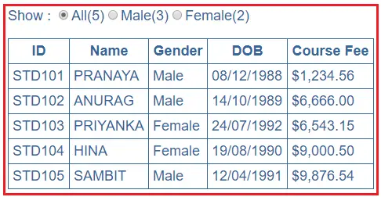
Exercise :

Slide 139
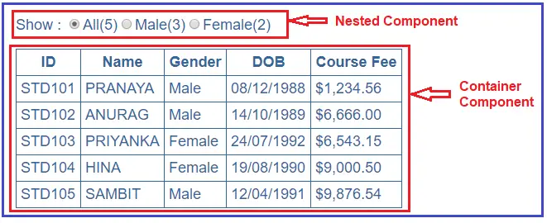
StudentListComponet
StudentCountComponet

Slide 140
Angular Component Input Properties
The Angular Component Input Properties are used to pass the data from container component to the nested component

Slide 141
Angular Component Output Properties
The Angular Component Output Properties are used to to pass the data from the nested component to the container component.

Slide 142
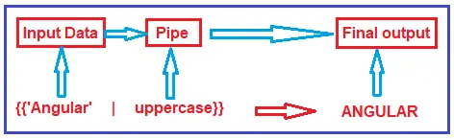
Angular Pipes
The angular pipes transform the data into a specific format before displaying them to the end-users.
Using the Pipe (|) operator, we can apply the pipes features to any of the property in angular application.
Syntax to use Pipes in Angular Application:

Slide 143
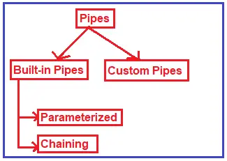
Types of Pipes in Angular:

Slide 144
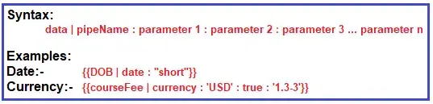
Angular Parameterized Pipes
In Angular, we can pass any number of parameters to the pipe using a colon (:) and when we do so, it is called Angular Parameterized Pipes.
The syntax :

Slide 145
Date Pipe:
today: number = Date.now();
<p>Date Pipe : {{today | date}}</p>
<p>Full Date : {{today | date:'fullDate'}}</p>
<p>Mediate Date : {{today | date:'medium'}}</p>
<p>Short Date : {{today | date:'short'}}</p>
<p>Date (dd/MM/yyyy) : {{today | date:'dd/MM/yyyy'}}</p>
<p>Time : {{today | date:'h:mm a z'}}</p>
<p>Medium Time : {{today | date:'mediumTime'}}</p>

Slide 146
Currency Pipe:
<p>Currency USD in Symbol : {{salary | currency:'USD':true}}</p>
<p>Currency INR in Symbol : {{salary | currency:'INR':true}}</p>
<p>Currency USD in Code : {{salary | currency:'USD':false:'4.2-2'}}</p>
<p>Currency INR in Code : {{salary | currency:'INR':false:'1.3-3'}}</p>

Slide 147
Angular Custom Pipe
ng g pipe MyTitle –flat
import { Pipe, PipeTransform } from '@angular/core';
@Pipe({
name: 'myTitle'
})
export class MyTitlePipe implements PipeTransform {
transform(name: string, gender: string): string {
if (gender.toLowerCase() == "male")
return "Mr. " + name;
else
return "Miss. " + name;
}
}
<td>{{student.Name | myTitle:student.Gender}}</td>

