Slide 1


Industry, Pollution &
Public Health in Europe
Do polluting industries really shorten lives? A region-by-region look using E-PRTR emissions and Eurostat health records across the NUTS2 regions of Europe.
NUTS2 REGIONS · 2007–2024 · 30+ COUNTRIES

Slide 2
THE BUILDING BLOCK
First, a quick primer: what is NUTS?
NUTS (Nomenclature of Territorial Units for Statistics) is the EU's official system for dividing member states into regions of comparable size — so a mortality rate in Poland can be fairly compared to one in Spain.
COUNTRY
e.g. Germany
NUTS 1
This study works at NUTS2 level — roughly the size of a Spanish autonomous community or a German Regierungsbezirk. Big enough for solid statistics, small enough to see real regional gaps.
major socio-economic zone
NUTS 2 — used in this study
region · ~300 across Europe
NUTS 3
~300 NUTS2 regions cover the countries in this study.
province / district
Context
02 / 14

Slide 3
WHERE THE NUMBERS COME FROM
The data behind this study
E-PRTR
Eurostat
European Pollutant Release & Transfer Register
Life expectancy & cause-specific mortality
6 raw datasets — facility, sector & national level, split by air and water releases
2 datasets — life expectancy at birth, and mortality rates across 15 disease categories
Coverage: 2007 – 2024, 30+ European countries, geolocated down to the individual industrial facility
Coverage: 2010 – 2024, reported for every NUTS2 region, by sex and age group
8
880K+
300+
17
DATASETS COMBINED
DATA POINTS ANALYSED
NUTS2 REGIONS
YEARS OF EMISSIONS DATA
Figures reflect cleaned, deduplicated records used in the analysis; several hundred thousand additional facility-level water release records feed the regional emissions view.
Context
03 / 14

Slide 4
WHAT WE SET OUT TO TEST
Two hypotheses
1
HYPOTHESIS ONE
2
HYPOTHESIS TWO
The more industry a region has, the worse its life expectancy and health.
The more hazardous pollutants released, the more disease-related deaths.
Heavily industrialised regions should show shorter lifespans and higher disease-related mortality than less industrial ones.
Regions with higher releases of toxic, cancer-linked, or respiratory-harming chemicals should show elevated mortality from related diseases.
Hypotheses
04 / 14

Slide 5


KEEPING THE JARGON IN CHECK
Meet the pollutants that matter for health
AIR — respiratory & cardiovascular risk
WATER — disease & toxicity risk
Fine dust (PM2.5 / PM10) soot & particles that lodge deep in lungs
Heavy metals mercury, lead, arsenic, cadmium
NOx & SOx combustion gases that irritate airways
Persistent pesticides DDT, lindane, aldrin — build up over time
Heavy metals arsenic, cadmium, chromium, nickel
Industrial chemicals PCBs & dioxins, hormone disruptors
PAHs & benzene family linked to cancer risk
Plastics additives phthalates (DEHP), linked to health harm
Asbestos long-term lung disease
Solvents benzene, trichloroethylene — cancer-linked
Pollutants
05 / 14

Slide 6
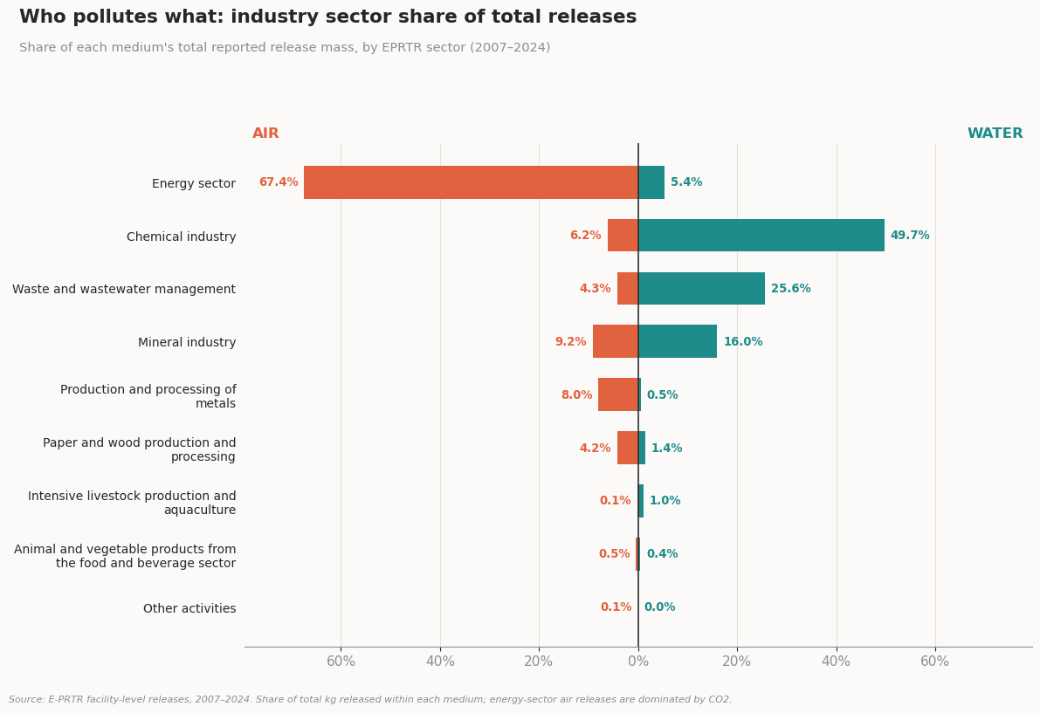

THE INDUSTRY OVERVIEW
How is industry distributed across Europe?
67% of all reported air-release mass comes from the energy sector — almost entirely CO₂ from power generation.
50% of all reported water-release mass comes from the chemical industry.
Air and water pollution are essentially two different stories — the sector that dominates one medium barely registers in the other.
Industry overview
06 / 14

Slide 7
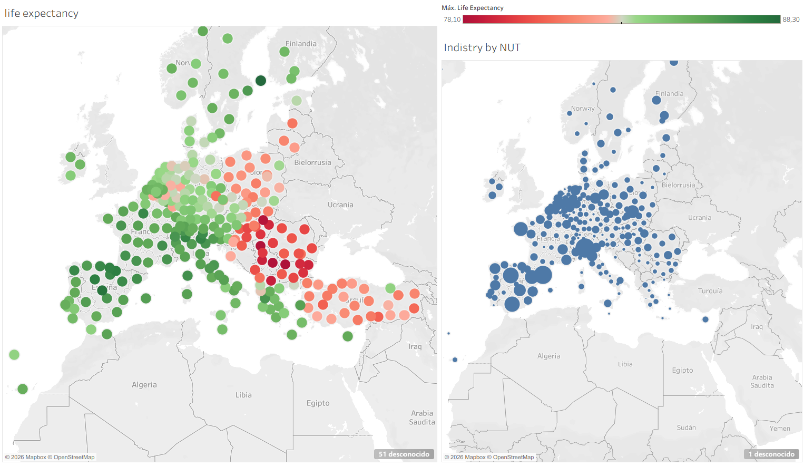
THE INDUSTRY OVERVIEW
How is industry distributed across Europe?
Industry overview
06 / 14

Slide 8
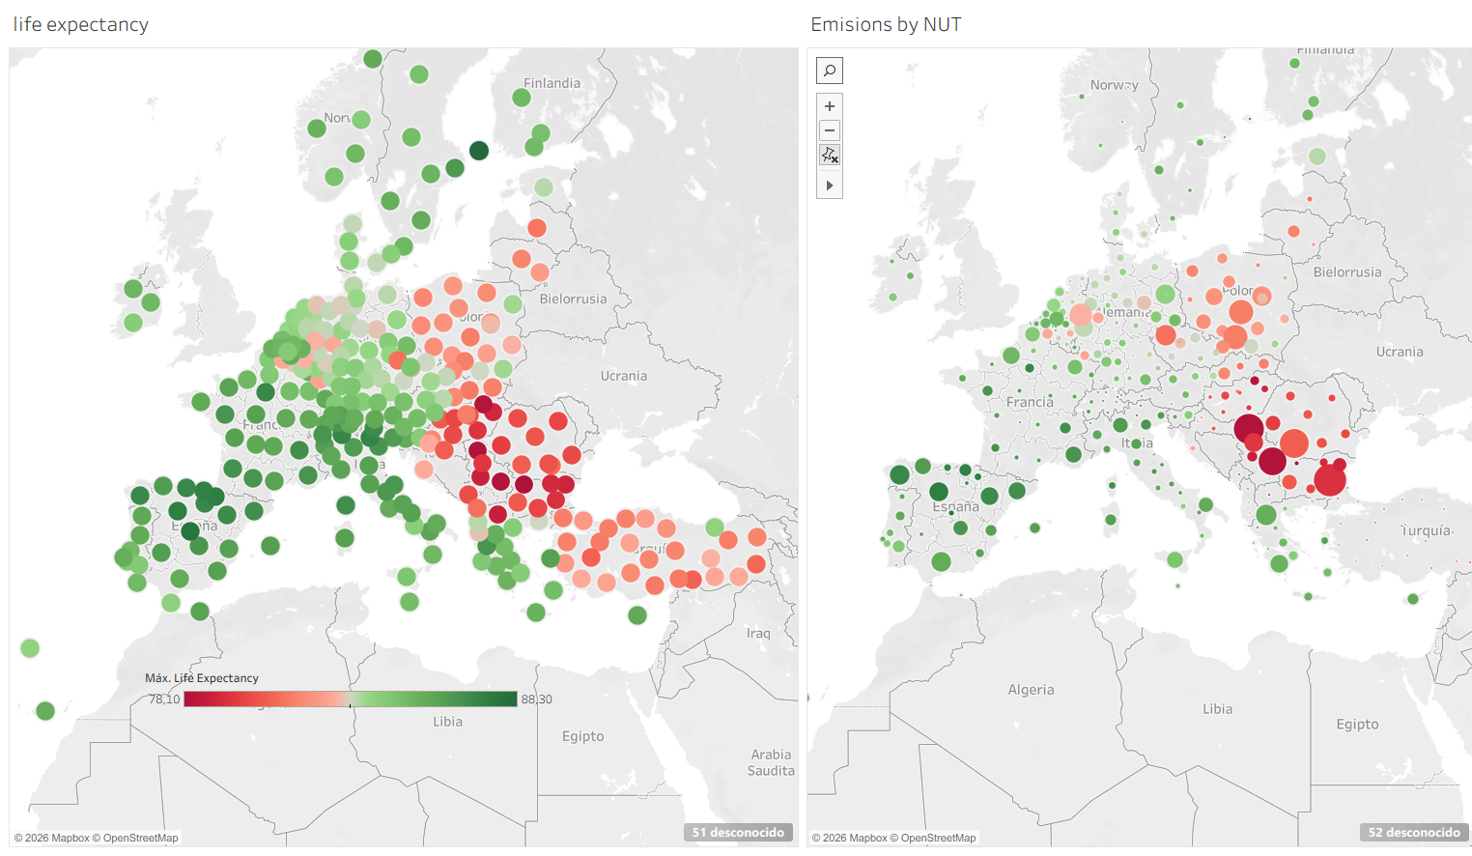
THE INDUSTRY OVERVIEW
How is pollution distributed across Europe?
Industry overview
06 / 14

Slide 9
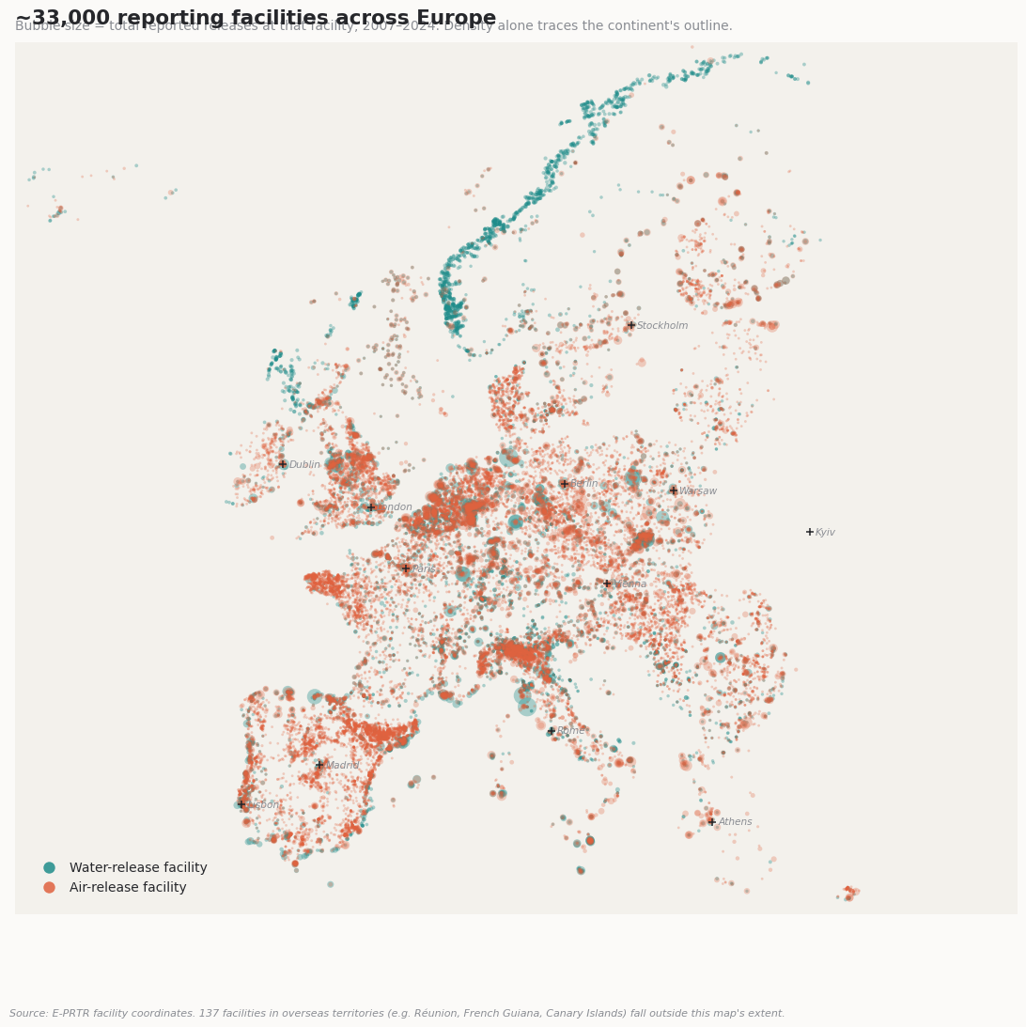
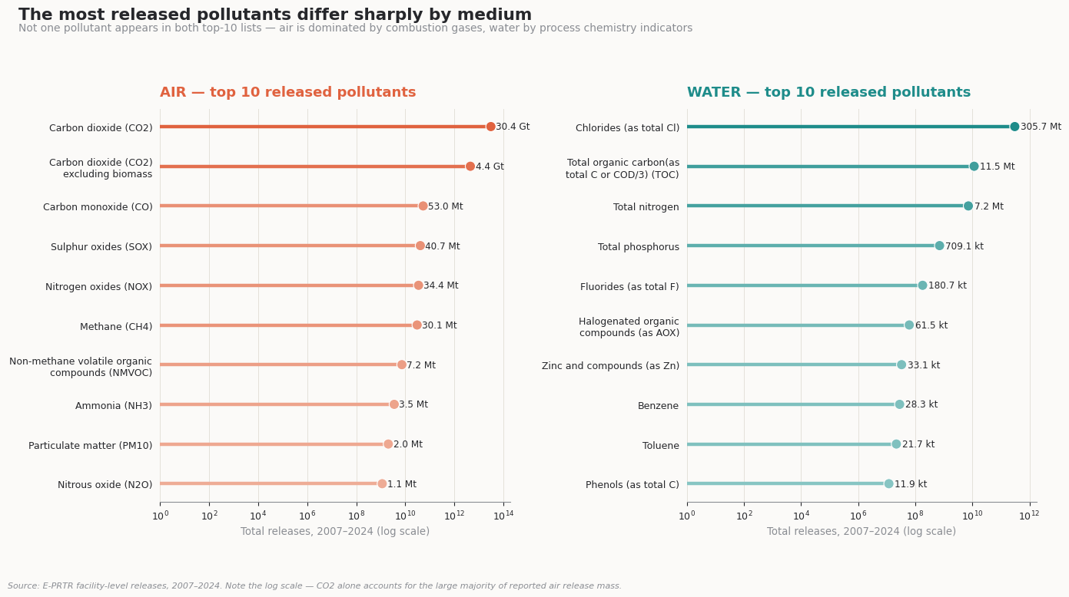
WHERE IT HAPPENS & WHAT'S RELEASED
~33,000 facilities, and the chemicals they report
Facility density alone traces the outline of Europe — a good sanity check on the data.
Not one pollutant appears in both top-10 lists: air releases are dominated by combustion gases (CO₂, CO, NOx), water releases by process-chemistry indicators (chlorides, nitrogen, phosphorus).
Industry overview
07 / 14

Slide 10
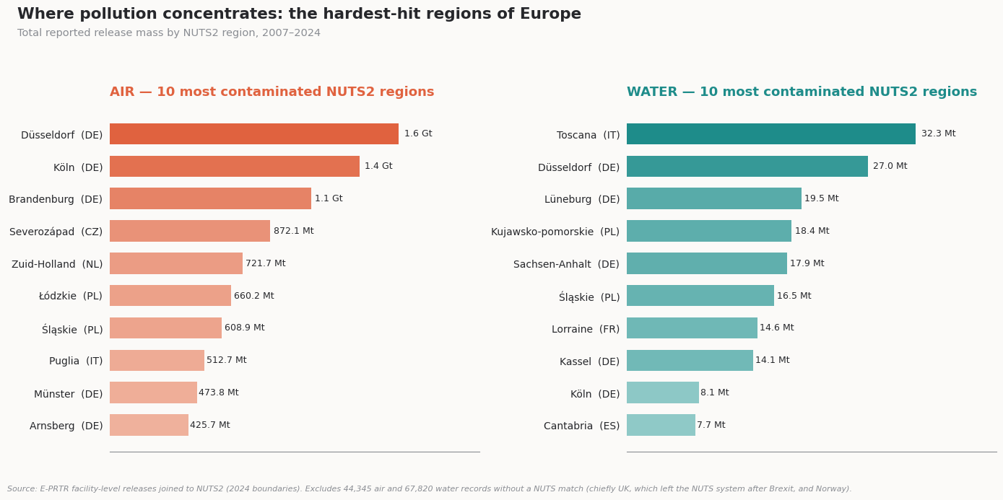
NAMING NAMES
The NUTS2 regions carrying the heaviest industrial load
Regional ranking
08 / 14
German industrial belts (Düsseldorf, Köln, Brandenburg), the Czech Severozápad coal basin, and Polish industrial regions top the air ranking. For water, Toscana (Italy) and several German regions lead.

Slide 11
THE HEALTH SIDE OF THE MAP
Where life expectancy is lowest — and disease burden highest
LOWEST LIFE EXPECTANCY (2024)
HIGHEST DISEASE-LINKED MORTALITY (2023, per 100k)
Top 5 causes of death across all regions: ischaemic heart disease, stroke, heart attack, lung cancer and chronic respiratory disease — the exact conditions linked to air pollution exposure.
Regional ranking
09 / 14

Slide 12

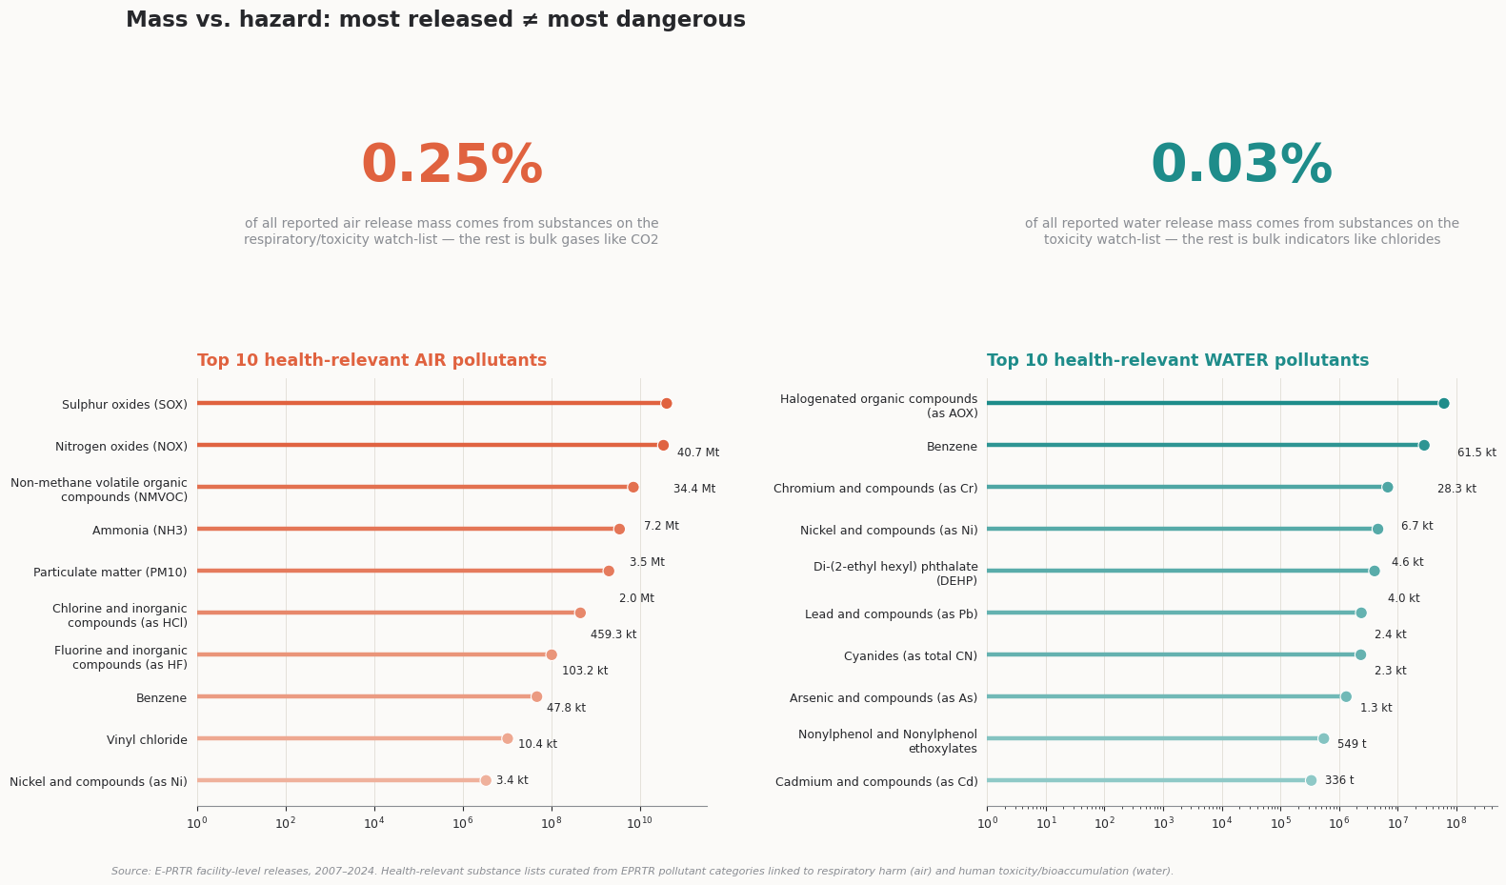
PUTTING THE TWO SIDES TOGETHER
Industry vs. health: a more complicated picture
The regions with the heaviest industrial emissions (Germany, Czechia, Poland, Italy) are not the same regions with the lowest life expectancy or highest disease mortality (Bulgaria, Hungary, Romania, Serbia).
So is Hypothesis 2 wrong?
Not necessarily — it's untested, not disproven. Total release mass is dominated by bulk, low-toxicity substances (CO₂, chlorides). The truly hazardous pollutants are a tiny slice of that volume, so "more pollution" (by weight) is a weak stand-in for "more health risk."
A fair test needs the hazardous-pollutant load matched directly to each region's health outcomes — controlling for income, healthcare access and urbanisation. That's exactly the next step.
Findings
10 / 14

Slide 13
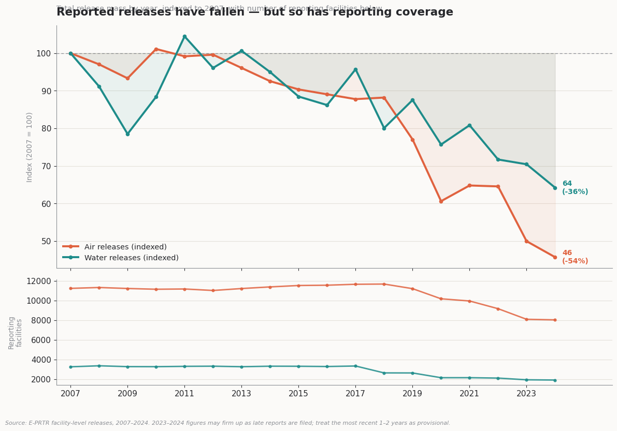
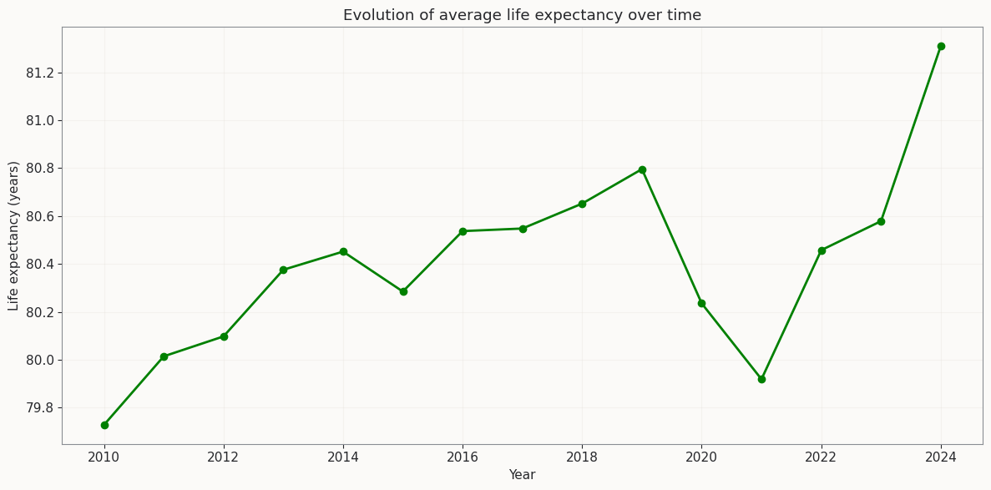
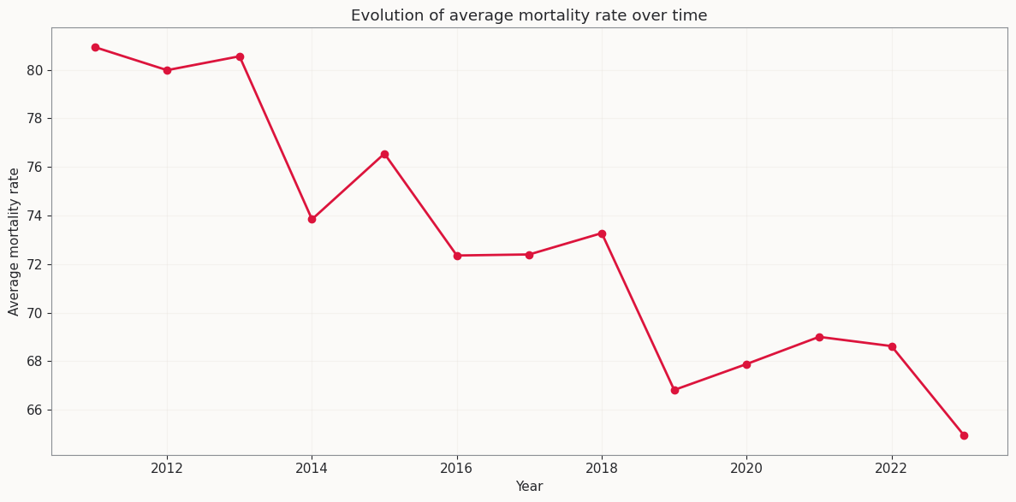
THE TRAJECTORY
The bigger picture: two decades of change
Reported emissions fell 36–54% since 2007 while average life expectancy rose and mortality declined. Suggestive, not proof: part of the emissions drop reflects fewer reporting facilities, and health gains have many drivers beyond pollution.
Findings
11 / 14

Slide 14
VERDICT
Conclusions: revisiting our two hypotheses
H1 · MORE INDUSTRY = WORSE HEALTH
H2 · MORE POLLUTANTS = MORE DISEASE
Not supported by a simple regional comparison
Still open — correctly specified, not yet tested
The worst life expectancy and mortality sit in lower-industry Eastern European regions, not the German/Czech/Polish industrial belts. Income, healthcare access and urbanisation likely dominate the picture.
Hazardous substances are under 0.3% of reported release mass, so total volume was too blunt a test. A region-by-region match of hazardous-pollutant load to disease mortality hasn't been run yet.
Bottom line: this first pass maps the landscape and rules out the naive story — it doesn't yet give us a clean causal answer. That requires a properly merged, controlled analysis.
CONCLUSIONS
12 / 14

Slide 15
VERDICT
Finding
WORST POLLUTANTS = LOWER LIFE EXPECTANCY
The amount is not what matters most , but the toxicity
The toxicity does affect the life expectancy, though further analysis should be carried on to prevent other health affecting activities might affect, like smokig or alcoholism
CONCLUSIONS
12 / 14

Slide 16
WHERE THIS GOES NEXT
Next steps: from exploration to prediction
1
Control for confounders
Add income, healthcare access and urbanisation so any pollution effect isn't just picking up wealth differences.
2
Model the relationship properly
Regression and time-lag analysis: pollution today may show up in health outcomes years later, not immediately.
3
Predict health risk by postal code
Train a machine-learning model to output a local health-risk score for any postal code — the flagship next deliverable.
Next steps
13 / 14

Slide 17



FROM PROJECT TO PRODUCT
Turning this into an environmental-health consultancy
Who buys it
What we sell
How it's priced
Ministries of health & environment
Regional risk-scoring dashboard
Public tender / govt. contracts
EU regional development funds
Postal-code health-risk API
Annual dashboard subscription
City & urban planning agencies
Custom policy-impact reports
Per-report consulting fees
Insurance & ESG investors
Early-warning alerts on new hotspots
Free public tier as a lead funnel
The data pipeline built for this project is the product: keep it live, keep it updated, and sell the insight — not just the report.
14 / 14

