Slide 1

Statistics to decide where to travel making decisions based in actual facts - safe traveling is our main goal
- We do the investigation, you enjoy your vacation -
By Zidene Aourdache and Bibian Gonzalez
Shark
attacks
Everything you need to know

Slide 2
In a world where uncertainty hits harder when you get out of our comfort zone with your loved ones
We present you: statistic you can trust to make decisions based in facts (and not some made-up experience you might have seen in socials)

Slide 3
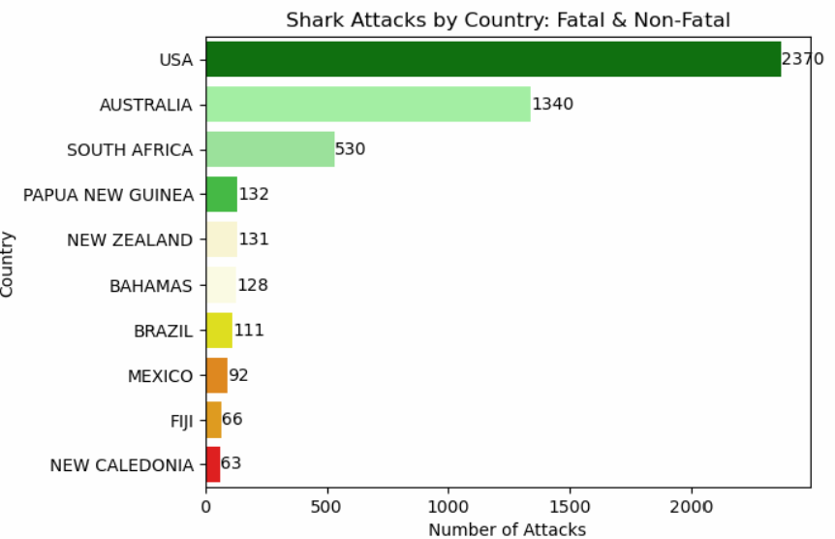
Here we can see the top 10 countries with the greatest amount of attacks, including the deadly ones but also the ones that were just minor injuries

Slide 4
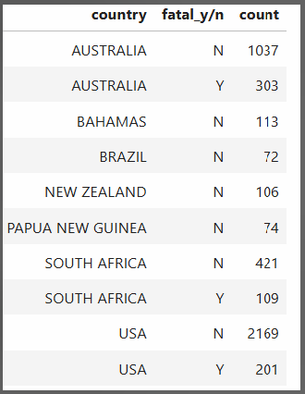
Fatal vs non-fatal attacks
Here you can see the difference between the deadly attacks vs the ones that were just injuries. Just 3 countries have registered deadly encounters

Slide 5
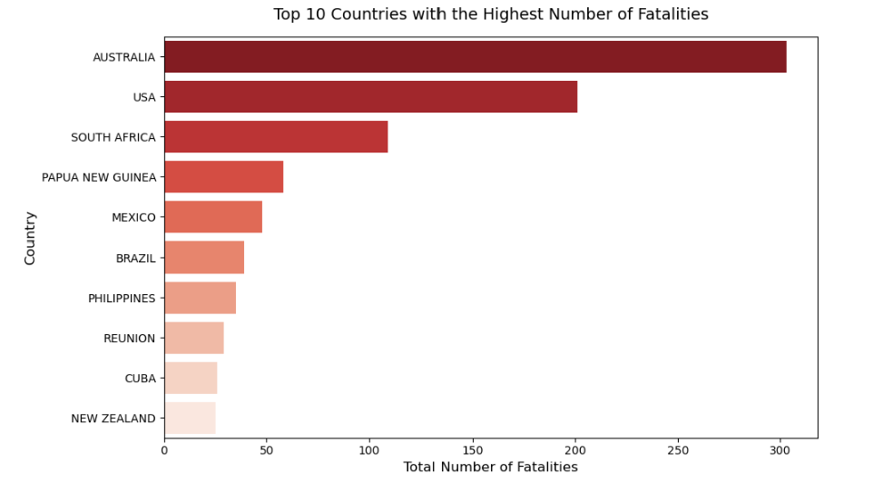
Countries you definitely will want to avoid to do water-based sports

Slide 6
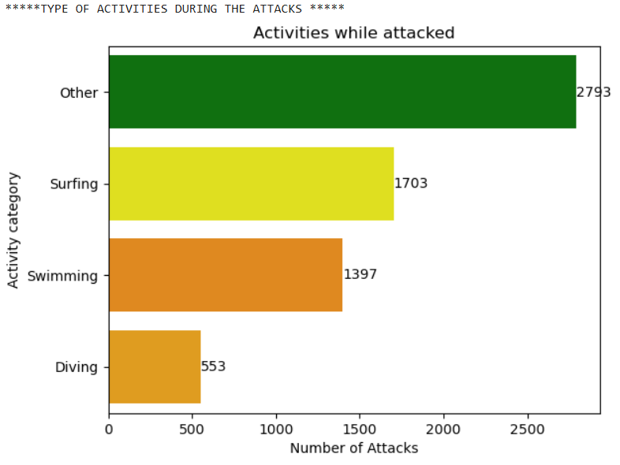
Most dangerous sports when it comes to shark attacks
More than the half of the attacks happened during those activities
Surfing
Swimming
Diving

Slide 7
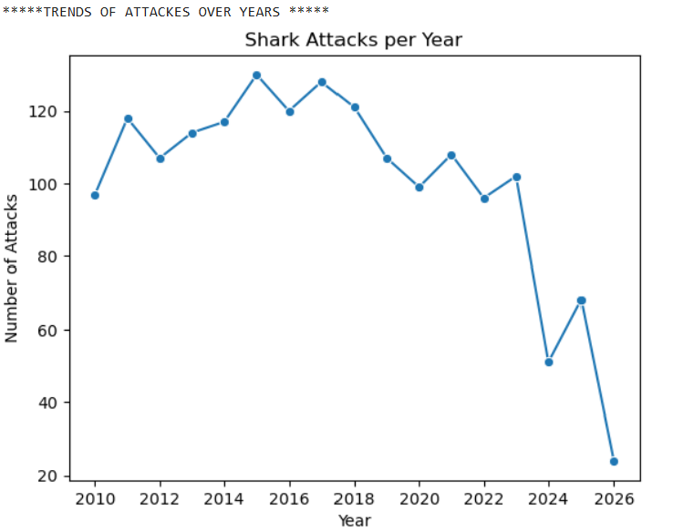
How have they evolved over the years
The decline of the attacks have decreased significantly during the last decade. People have become more aware and also more respectful with the marine eco system
Notes:
So I guess people have become more aware and also more respectful with the marine eco system

