Slide 1
Team Member
Urbanize Away
HackerEarth
Bibin Philip Sam Software Consultant Web, Cloud technologies - .NET framework
Theme: Open Innovation

Slide 2
Air Pollution
Air pollution refers to the release of pollutants into the air—pollutants which are detrimental to human health and the planet as a whole.
Burning fossil fuels, such as coal, natural gas, releases gases and chemicals into the air that cause air pollution. These gases come from cars and trucks, factories, engines, generally anything that combusts fossil fuels.
According to the World Health Organization (WHO), each year air pollution is responsible for nearly seven million deaths around the globe. Nine out of ten human beings currently breathe air that exceeds the WHO’s guideline limits for pollutants, with those living in low- and middle-income countries suffering the most.
The most effective way to control air pollution is to speed up our transition to cleaner fuels and industrial processes. By switching over to renewable energy sources, such as wind and solar power, maximizing fuel efficiency in our vehicles and replacing our gasoline-powered cars and buses with electric versions, we'll be limiting air pollution at its source while also curbing the global warming that heightens so many of its worst health impacts.

Slide 3
Air Pollution - Problems & Solutions
Vehicle emissions are the most significant source of air pollution in the urban environment worldwide, impacting the climate and the health of millions of people. Vehicles like cars, buses and trucks are one of the leading causes of air pollution.
Solutions
1. Clean vehicle and efficient fuel technologies provide us with an affordable, available means of reducing transportation-related air pollution and climate change emissions. These include fuel-efficient vehicles that use less oil; cleaner fuels that produce fewer emissions; and electric cars, buses and trucks that can entirely remove tailpipe emissions.
2. Strong governance and state policies also help in curbing the air pollution. Vehicle emission standards have helped cut pollution from these vehicles.
Example,
Installing solar panels on public transportation buses will help to save fuel, slashing emissions and cutting pollution.

Slide 4
Technology reduces urban air pollution
Car exhaust fumes contain poisonous gasses such as carbon monoxide, nitrogen oxides, and particulate matter that cause lung cancer, heart failure, asthma and other diseases. Although new cars are required to meet emissions standards, older cars, those with high kilometres and cars that have been modified, or not well maintained, can malfunction and have significant higher emission levels, leading to high levels of air pollution.
Car sharing presents a good antidote to not just reducing pollution by bringing down the number of cars plying on the city roads but also decongesting the roads. The concept of car-sharing or pooling in urban mobility is deeply rooted in the Indian Government's 'Smart Cities' initiative.
Countries across the world are deploying innovative technologies to de-congest and de-pollute roadways. Technologies like big data and fast data analytics, geo coding, route and capacity optimization through software, continuous and real time updating of information, etc are playing a huge role in achieving these goals. Smart tech such as GPS, Google apps, maps, navigation tools and other mobile pivoted technologies can indeed solve a lot many other problems such as fuel wastage, pollution, unsafe roads and direct and indirect economic losses.
The following option uses technology to detect and monitor cars emitting harmful gases:
Vehicle Pollution detection and monitoring system

Slide 5
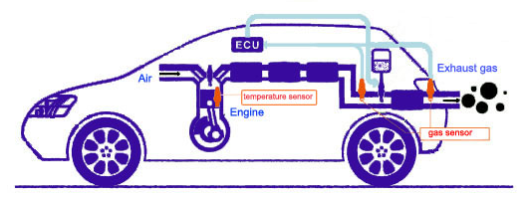
Vehicle pollution detection & monitoring system
Monitoring and controlling of air quality is most important for healthy life and safe environment. A system that monitors and detects the vehicular pollution is absolutely necessary and inevitable.
With the unfolding of semi-conductor gas sensors for detecting the various gases, it can be fitted at the emission outlets of vehicles that detects the pollution. Since the sensors are placed at the exhaust, there is no chance of any mixing of other pollutions from vehicles or from the environment, changing the actual sensor value or working condition of the system. While driving the vehicle, the gases leave the exhaust pipe of the vehicle and sensed by the sensors to measure their concentrations accordingly. When the emission, temperature level shoots beyond the already set threshold level, the car owner can be notified via an app or on the LCD of the car.

Slide 6
Vehicle pollution detection & monitoring system
Use Case
Smart monitoring of emissions from car has become necessary and inevitable in Delhi. Delhi cannot afford to stagnate and remain moribund with only one archaic PUC programme that was originally designed for older technologies. This is becoming increasingly ineffective and even irrelevant for more advanced emissions control systems in the newer fleet that need a very different policing approach to keep them low-emitting on the road. This reality of Delhi is real for other cities of India as well.

Slide 7
Cloud-Based Applications with IoT Proposed System
The integration of Internet of Things (IoT) and cloud computing can play a pivotal role in the development of smart cities. The advent of the IoT and cloud computing brings a new approach, enabling to collect, transfer, store and share information on the logistics flow for better cooperation and interoperability among devices.
IoT is an evolution in computer technology and communication that aims to connect objects together via the Internet. IoT uses smart devices designed for sensors. Sensors are the primary source of IoT data. The purpose of the sensory devices are to collect data and send it to a robust cloud control platform like Microsoft Azure.
The cloud’s computational and storage resources can be used to produce, analyze, and save sensor information. IoT devices are portable and, with the involvement of the cloud, they can integrate significant security measures, renovations, and discoveries.
Cloud computing is an appropriate Internet platform for storing and processing smart device data, such as connected cars, smart cities, Wi-Fi and sensors. It makes IoT systems robust. They can be used to track data offline. Developers can also set up digital servers, run applications, and launch a database to help drive their IoT response.
The cloud simplifies data throughout IoT information collecting and processing additives, considering simple setup and integration of latest issues, while retaining low deployment charges and complex data processing.
There is no risk of data loss as the data is stored on separate servers, especially in well-supported infrastructure. While the cloud helps compile the data, it likewise prevents privacy and security issues. With robust authentication and encryption agreements, the cloud empowers customers by providing full security features.
As IoT applications generate large quantities of data and include multiple computational add-ons, e.g. real-time processing and analytics processes, integration with cloud computing infrastructure can be cost saving.
Accurate information could be accessed, analyzed, and controlled by cloud-based enabling technologies to assist experts, government officials, and people in making smarter policies to enhance the standard of peoples’ life. When devices and information are connected to cloud facilities, expenses may be reduced and efficiency improved. Through the assistance of the Internet of Things, vehicles especially like cars could enhance resource transmission, reduce accidents and remove pollutants.

Slide 8
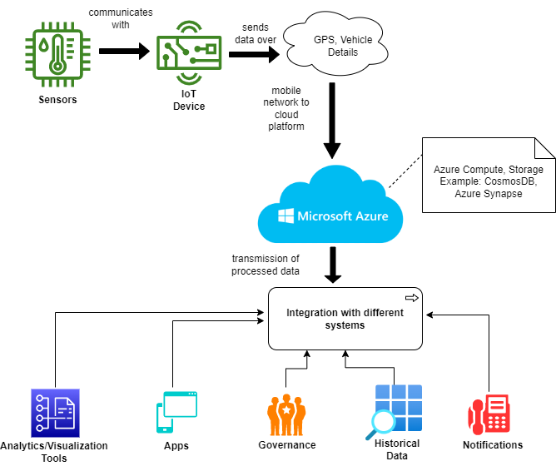
System Design

Slide 9
Working of the system
The proposed system defines an excellent way to control the pollution in vehicles like cars. The main pollutants from cars are the oxides of carbon and nitrogen, which can be easily spotted these days with the help of semiconductor gas sensors. Other sensor like temperature sensor can determine the heat generated from engine. The sensors detects toxic gases, heat, measure power and pressure. These sensors connect and trasmit data to the MCU (microcontroller unit), which is a small computer on a single metal-oxide-semiconductor (MOS) VLSI integrated circuit (IC) chip. A microcontroller contains one or more CPUs (processor cores) along with memory and programmable input/output peripherals. The MCU can now pass-on these data to the IoT device.
The IoT device acts as a inter-networking of physical devices, here the device is car. The proposed system uses Global System for Mobile Communication (GSM) & Global Positioning System (GPS). GSM digitizes and compress the data, whereas GPS provides geolocation and time information to a GPS receiver in all weather conditions. The temperature of engine, power consumption and level of gas which is emitted are stored in the Azure cloud database, and the mobile network acts as a bridge between the IoT device and Azure's database like Azure Cosmos DB.
Azure Cosmos DB is a multi-model NoSQL database that supports hosting various types of data that are transactional in nature. Here we focus on the performance of geospatial queries on big data within Azure Cosmos DB, that are demonstrated by query execution times on a large dataset, and show how to do data enrichment with Spark based Azure Synapse Analytics.
Azure Synapse provides a single service for all workloads when processing, managing and serving data for immediate business intelligence and data prediction needs. The latter is made possible by its integration with Power BI and Azure Machine Learning, due to Synapse's ability to integrate mathematical machine learning models.
Now the car and pollutants data are stored inside the cloud, monthly once this database gets changed and compared with the historical data. If the vehicle persists to be emitting toxic gases beyond the thershold limit, then a notification, via email and sms, can be sent to the vehicle owner notifying that the car requires immediate maintance. If the owner doesn't take action even after repeated reminder, then a stern warning or termination of their car for pooling can be issued.
Accurate information could be accessed, analyzed, and controlled by cloud-based enabling technologies to assist experts, government officials, and people in making smarter policies to enhance the standard of peoples’ life. When devices and information are connected to cloud facilities, expenses may be reduced and efficiency improved. Through the assistance of the Internet of Things, vehicles especially like cars could enhance resource transmission, reduce accidents and remove pollutants. This model will be of great use for the government also, in order to maintain the transport laws uniform across the country.

Slide 10
Microsoft's commitment to remove carbon footprint
Microsoft has committed to becoming carbon negative by 2030 and to ultimately remove Microsoft’s carbon footprint from the environment by 2050.
Microsoft conducted a study with industry experts to determine the energy use and carbon emissions associated with Azure Compute, Storage compared with compute and storage equivalents deployed in traditional enterprise datacenters.
The results show that Azure Compute are 52–79% and Azure Storage are 71–79% more energy efficient than compute, storage equivalents deployed in traditional enterprise datacenters, depending on the type of enterprise deployment. In addition to providing greater energy efficiency through the Microsoft Cloud, they purchase renewable electricity for more than 95 percent of their consumption, which includes the datacenters that power Azure Compute, Storage.
When renewable energy is taken into account, carbon emissions from Azure Compute are 92–98% and Azure Storage are 79–83% lower than traditional enterprise datacenter deployments of compute and storage equivalents.

Slide 11
Demo
GitHub: https://github.com/bibinphilip/he-air-pollution/
Youtube: https://youtu.be/xpZ4BNmhmb8

Slide 12
Thank you

