Slide 1
Chapter 1
Introduction to Java in the Context of Software Engineering

Slide 2
Agenda
Introduction to Java
  Object-Oriented Member of the C-Language Family
Introduction to Software Engineering
  Extended Unified Process Methodology

Slide 3
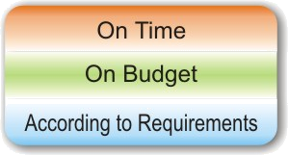
Introduction
The fundamentals of Java programming in the context of
  Object-oriented software engineering
  Unified-Process-based software development methodology
Delivering
projects…

Slide 4

Unified Modeling Language
Standard modeling language for software application design
  Object Management Group (OMG) standard
    www.omg.org and www.uml.org
Use of UML to emphasize the concept of visual modeling
  Activity diagrams to visualize the “learning layout” of each chapter

Slide 5
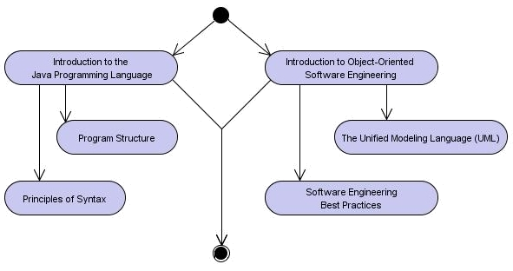
Learning Objectives
UML Activity Diagrams illustrate the elements of learning in each chapter

Slide 6
Software Engineering Skills
Learning connections visual in each chapter to point out diverse, interdisciplinary skills development
  Technical, organizational, communication, and leadership skills
  Understanding of process-related issues

Slide 7
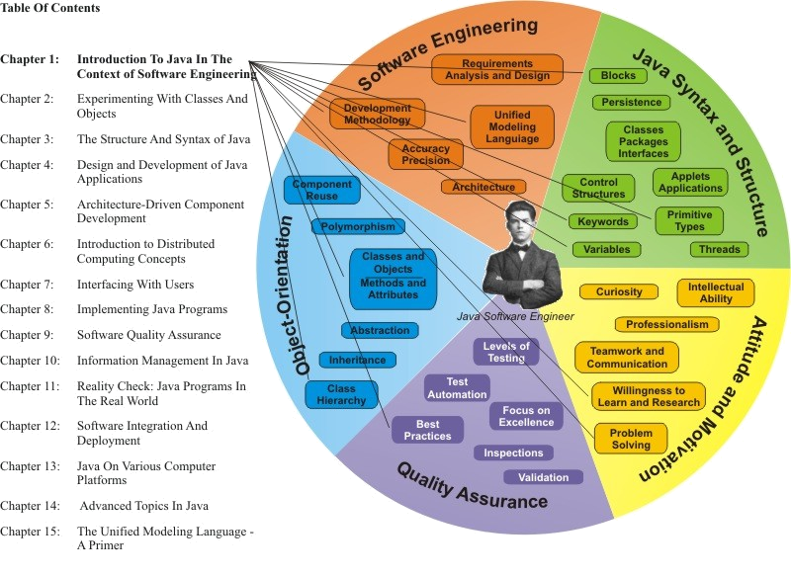
Learning Connections

Slide 8
Learning Modules
Object-orientation
Extended Unified Process Methodology
Iterations

Slide 9
Welcome to Java
High-level English-like syntax
  Statements
  Keywords
  Structural elements
  Program logic (semantics)
Example Java statement:
String response =
JOptionPane.showInputDialog
(“Enter an integer value”);
Notes:
Statements:
Expression ending with ;
Branch (if, switch) and loop (while, for, do) and control flow: break and continue
Return statement
Throw statement
Block
Try block
Types:
Primitive (boolean, byte, short, char, int, long, float byte)
Arrays
Classes
Interfaces
Null

Slide 10
Java Expressions
An expression is a variable, a method call, or a combination of subexpressins joined by operators
x
Math.sin(x)
x + Math.sin(x)
x++
x == y && (z >0 || w > 0)

Slide 11
Java Statements
A statement is one of the following:
Expression ending with “;”
Branch (if, switch) and loop (while, for, do) and nonlinear control flow: break and continue
Return statement
Throw statement
Block
Try block

Slide 12
Software Engineering
Life-cycle methodology
  Formal: unified
  Agile: extreme programming, Scrum
  References
    www-306.ibm.com/software/awdtools/rup
    www.controlchaos.com
Object-orientation
Process-centric
  Use cases
  Functional and supporting disciplines
  Architecture-driven

Slide 13
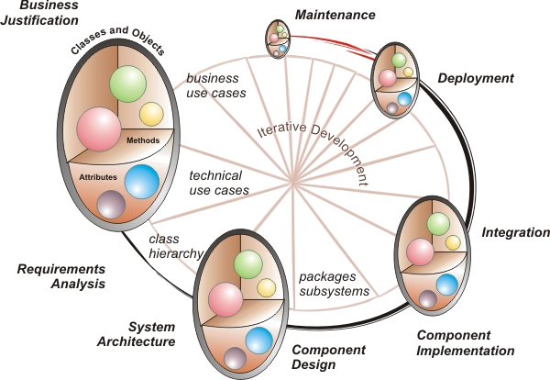
Life-Cycle Perspective

Slide 14
The Java Programming Language
Developed by Sun Microsystems (JCP)
  Ref. www.java.sun.com
Member of the C-family of programming languages
Highly portable
  Available on many platforms
  Available for client, server, mobile systems
Object-oriented
  5 data types (primitives, array, class, interface, null)
  Includes eight primitive types
Supports modern technology features
  Multi-threading
  Security
  Multimedia
  Networking
Based on design patterns
  Separation of concerns
  Low-coupling; high-cohesion

Slide 15
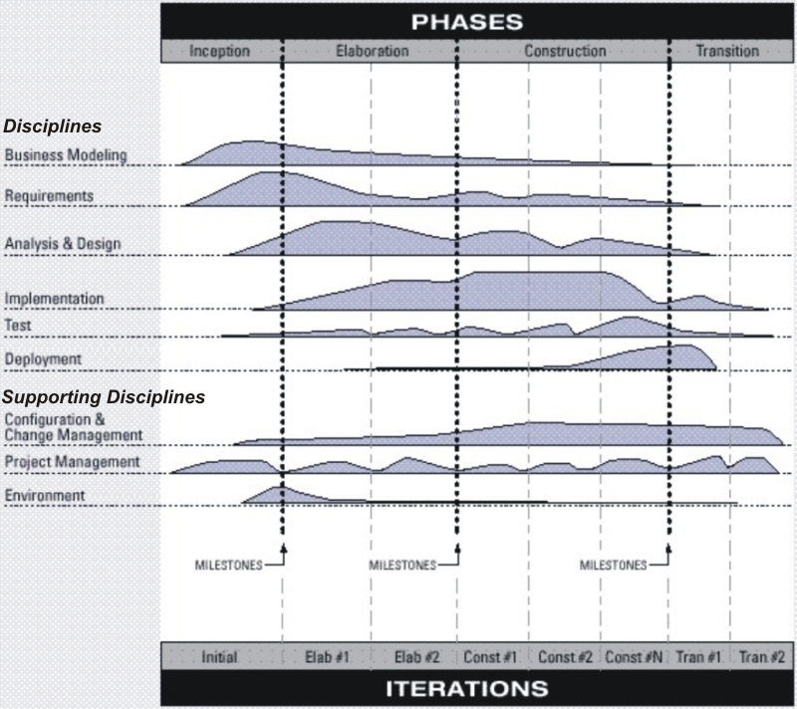
Methodology Preview
Book focused on formal methodology
  Agile choices should be made on the basis of knowing the formal approach (UP)
(Rational) Unified Process
  Formal methodology
  Focus on process,
  documentation, iterative
  approach, end-to-end
  approach
Agile variations
  Stakeholder involvement
  Lighter-weight processes
  Focus on adaptability
  Small, experienced teams

Slide 16
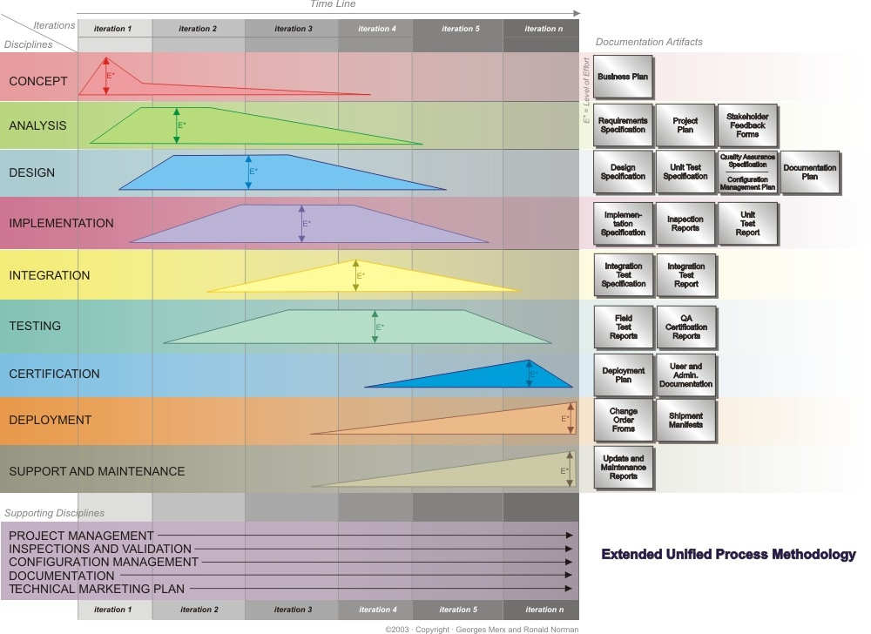

Slide 17
Functional Disciplines
Concept: initial concept development and business justification
Analysis: formal requirements analysis
Design: component design, class hierarchy, and creation of a system architecture
Implementation: component development and unit test
Integration: component integration and integration test
Testing: all aspects of testing the developed components
Certification: acceptance testing and release certification
Deployment: roll-out to customers
Support and Maintenance: incident tracking and management; new releases (updates, upgrades) – planning for follow-on product(s)

Slide 18
Support Disciplines
Project management: deliverable, deadline, and resource management
Inspections and validation: software quality assurance practices
Configuration management: management of all intellectual property
Documentation: all user and programmer documents
Technical marketing plan: product marketability, e.g. competitive position; unique selling propositions; pricing; etc.

Slide 19
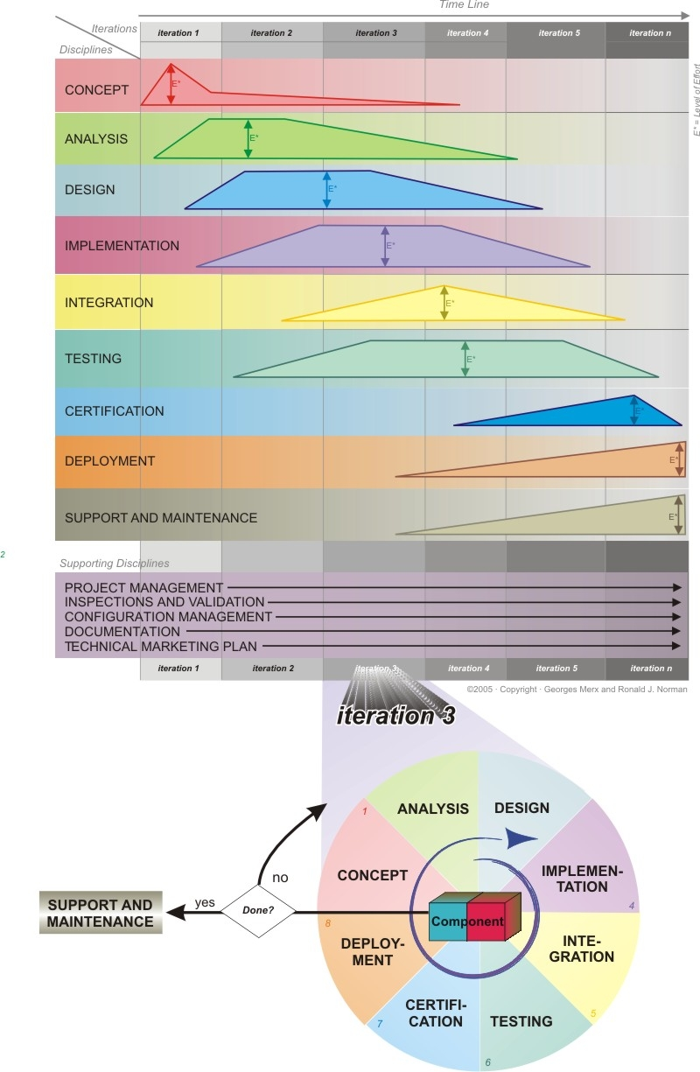
Iterations
Breaking the project into logically complete sub-projects
  Specified duration
Iterative adjustments

Slide 20
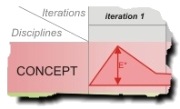
Position in Process
The Concept
phase addresses
the business planning activities of a project
Key deliverable: Business Plan
  Initial time and resource planning
  Project scope and focus
  Justification and budget
  Approval to proceed

Slide 21
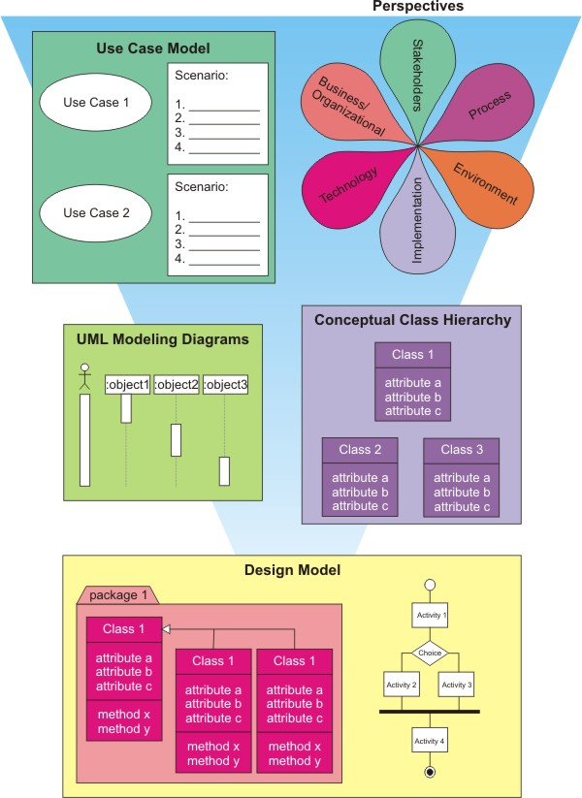
Domain Model
From use case model to design model

Slide 22

Project Examples
The VotingProgram
  Develop a simple voting program
  Develop a Java solution for an interior design company

