Slide 1
Chapter 10
Information Management in Java

Slide 2
Agenda
Persistent data storage
Data hierarchy
File input-output (I/O)
Serialization
Database access
Support and maintenance

Slide 3
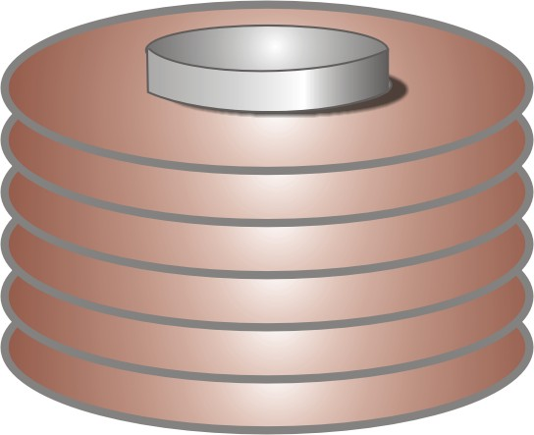
Primary vs. Secondary Storage
Data and results must be permanently storable. In computer systems, we therefore differentiate between primary – volatile – storage in RAM, and persistent secondary storage on any permanent storage device such as a hard disk.
When data is stored on disk, it resides in files. You can think of a file as a named data container on disk. Files are organized according to the information structure they contain, but fundamentally, a file is simply a stream of bytes.

Slide 4
File I/O in Object-Oriented Java Programs
In object-oriented programs, data (attributes) and executable functions (methods) are combined into the structures known as objects; the processes for extracting the data for persistent storage (serialization) and recreating objects with attributes and methods for programmatic access (deserialization) are built into Java using the interface Serializable

Slide 5
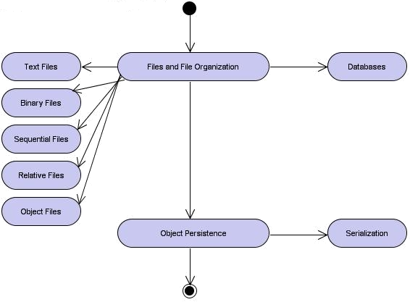
Learning Layout

Slide 6
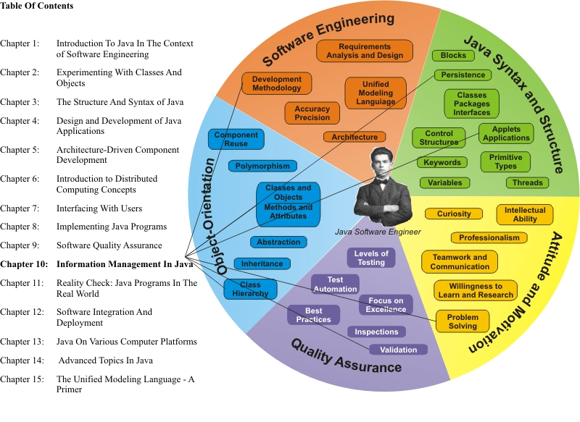
Learning Connections

Slide 7
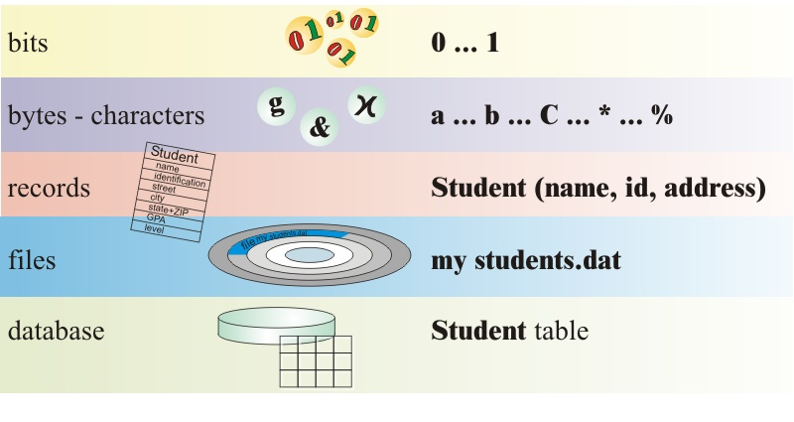
Data Hierarchy

Slide 8
Typical Storage Devices
CD-ROM/CD-RW disks – DVD-ROM/DVD-RW disks
Digital tapes
Solid state memory devices, such as USB flash drives and SD-cards
Floppy and ZIP disks
External hard disks

Slide 9
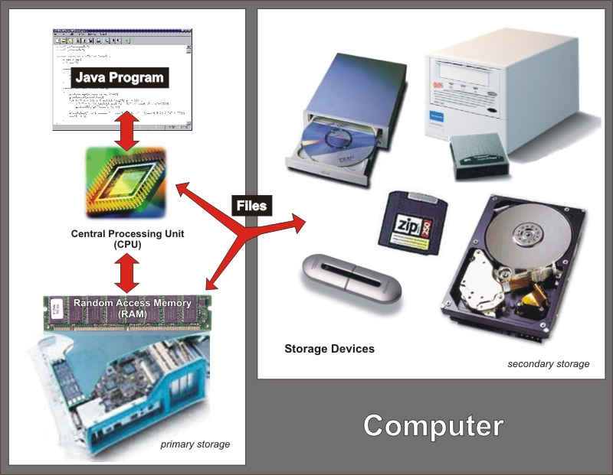
Storing Information in Files

Slide 10
High-Level Java I/O
Fortunately for Java software engineers, the low-level complexity of physical file input-output (I/O) is managed by the JVM and the operating system of the platform where the program is executed.
The programmer can perform these file operations using high-level, English-like statements.
  Establishing access to a file is described as opening the file.
  By opening a file, a logical file identifier is associated with the physical file (or path) name, and all subsequent file I/O operations occur when file operation methods interact with the logical file object.
  Note that there is no open keyword in Java like you may find in other languages.
  Opening a file in Java results from creating a new (logical) file object from a physical file.

Slide 11
Serialization
Serialization therefore takes objects of classes that implement the Serializable interface and writes data files with sufficient metadata to reconstruct the object when it is later reloaded (read) back into memory from the file

Slide 12
Java Files
In Java, files are managed for performance reasons as buffered streams of data. Streams and their associated buffers and filters are used for different types of input-output (I/O) operations

Slide 13
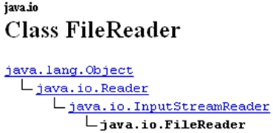
Example: class FileReader

Slide 14
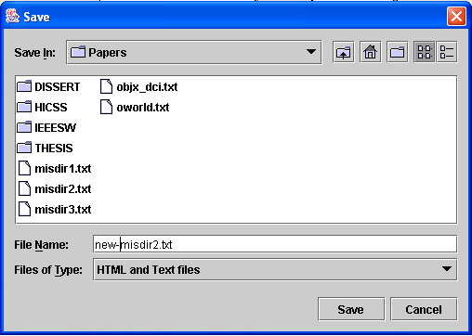
FileChooser Dialog

Slide 15
Object I/O
Classes FileInputStream, FileOutputStream, ObjectInputStream, and ObjectOutputStream are used to read and write objects
  Even arrays of objects can be read/written

Slide 16
Database Access
Most modern business applications use relational database technology to store and retrieve data
Commercial relational databases emerged in the early 1970s, and some of the more prominent products on the market today include:
  Oracle (Oracle Corp)
  DB2 (IBM Corp)
  Sybase (Sybase Corp)
  SQL Server (Microsoft Corp)
  Access (Microsoft Corp)
  Focus (Information Builders Inc.)
  MySQL (Open Source)

Slide 17
Java Support for Relational Database Access
Java Data Base Connectivity (JDBC) is used to connect
Structured Query Language (SQL) statements can be embedded to interact with the database (tables)

Slide 18
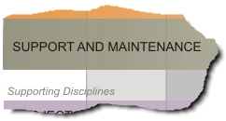
Position in Process
the Support and
Maintenance
phase is often
the longest-duration period in a project: the years during which a product is supported and in use by customers or internal users

