Slide 1
Chapter 11
Reality Check: Java Programming in the Real World

Slide 2
Agenda
Multi-tier architecture
  Clients and servers
Remote-Method Invocation (RMI)

Slide 3
Multi-Tier Architecture (1)
Most practical software applications today are divided into three (or more) architectural tiers with client and server software logically separated
  The client tier provided the user interface
  The server tier provides services to the client; it is often subdivided into additional service tiers, such as web server, application server, etc.
  The third architectural tier is the database server tier: it provides information management services
The server tiers may be distributed across multiple hardware systems, if the software was implemented for full scalability

Slide 4
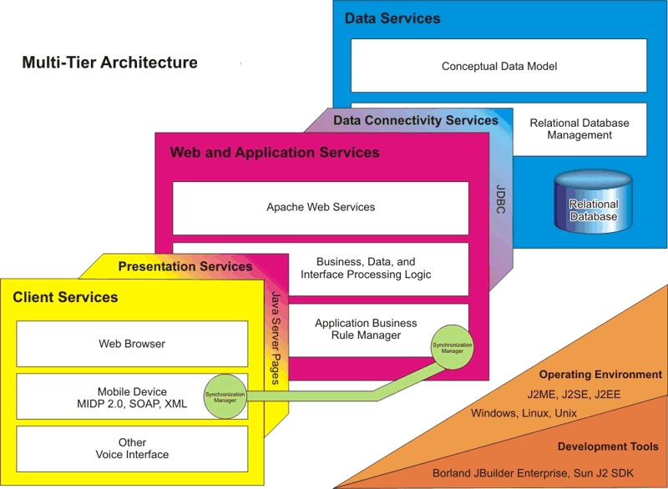
(2)

Slide 5
Java Packages
A greater diversity of Java classes and packages are required to implement distributed functionality
  Java 2 Enterprise Edition (J2EE)
    Java servlets
    Java Server Pages (JSPs)
    Enterprise Java Beans (EJBs)
While these components add complexity and provide many new capabilities not covered in this text, in the end, this means just a broader collection of classes that follow now familiar object-oriented behavior patterns

Slide 6
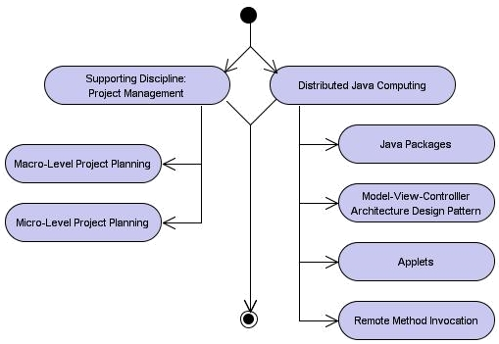
Learning Layout

Slide 7
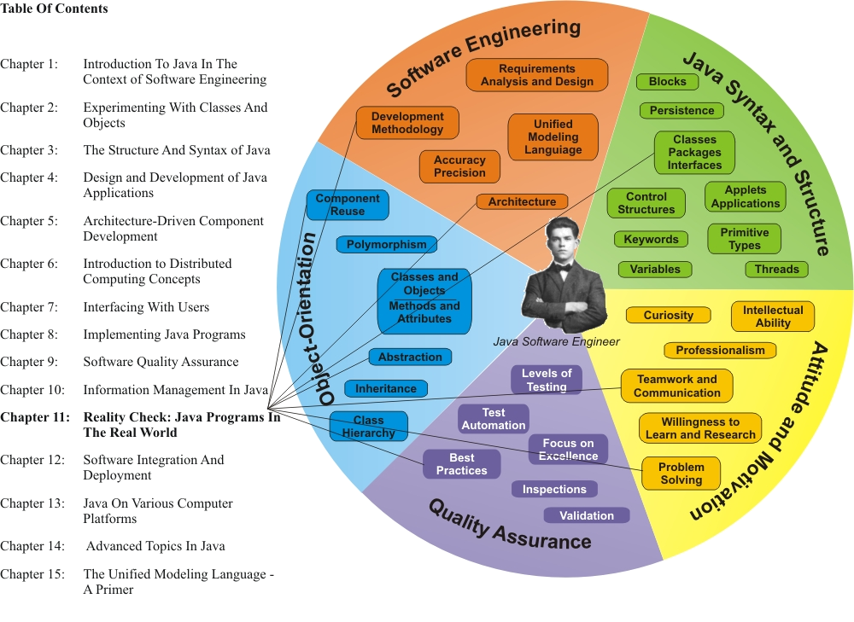
Learning Connections

Slide 8
Reviewing Major Java Packages
J2SE™ (Java 2 Platform, Standard Edition) – Desktop solutions for standalone applications and also for browser-based applets
J2EE™ (Java 2 Platform, Enterprise Edition) – Enterprise solutions for eCommerce and eBusiness. For example, software developers may create server-side and client-side, large scale distributed applications, such as a web shopping cart application for an online retail site
J2ME™ (Java 2 Platform, Micro Edition) – Used for resource-constrained consumer solutions for cell phones and other mobile devices (embedded solutions)

Slide 9
Remote Method Invocation (RMI) (1)
When an application follows the client-server model, the Java Remote Method Invocation (RMI) technology may be used
  RMI is used when all components of a distributed application are developed in Java
  CORBA support is also available in Java for integration of heterogeneous (java/non-Java), distributed application components

Slide 10
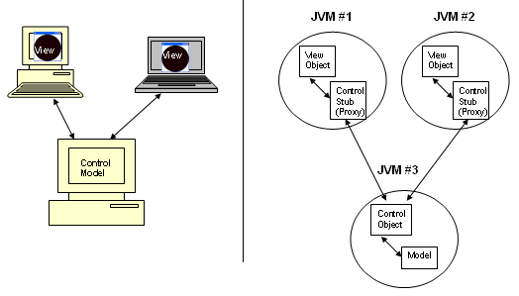
Remote Method Invocation (RMI) (2)

Slide 11
Java Applets
The simplest form of a web-centric Java application is the Java applet
An applet is a program written in Java, stored on a web server, and delivered via the user computer’s web browser, but otherwise logically very similar to a Java client application run on the client computer
When a user runs a Java technology-enabled browser to view a web (HTML) page that contains an applet reference, the applet code is transferred to her system and executed by the Java Virtual Machine (JVM) embedded in the browser (assuming appropriate security permissions)

Slide 12
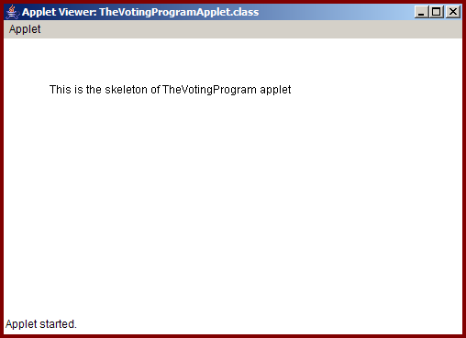
Applet Example

Slide 13
Distributed Computing Technologies
The technologies participating in web-centric applications and their development include:
  Web services, e.g. Apache HTTP Server
  Application services, e.g. JBoss, IBM Websphere, BEA Weblogic, Borland Enterprise Server, Microsoft Internet Information Server (IIS), Tomcat
  J2EE (servlets, JavaServer Pages, Enterprise Java Beans, JavaServer Faces)
  XML and SOAP

Slide 14
Design Patterns
Origins: field of architecture | patterns in designing buildings and towns - Christopher Alexander:
  “Each pattern describes a problem which occurs over and over again in our environment and then describes the core of the solution to that problem in such a way that you can use this solution a million times over, without ever doing it the same way twice.”
In software engineering, Erich Gamma, Richard Helm, Ralph Johnson, and John Vlissides (“The Gang of Four”) applied Alexander’s principles to software design
  “Solution to a problem in a context”

Slide 15
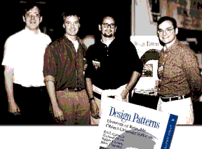
Definition
A design pattern names, abstracts, and identifies the key aspects of a common design structure that make it useful for creating a reusable object-oriented design.
(GOF)

Slide 16
Pattern Elements
Pattern name
  Design vocabulary
  “Handle” for communication
Problem description
  Context, pattern target
Solution description
  Abstract description of design elements
Consequences
  Results, trade-offs from the pattern applications

Slide 17
Purpose
Name, explain, and standardize important and recurring design patterns in object-oriented systems
  Easier to successfully reuse previous designs and architectures
  Expressed patterns are more accessible to more developers
  Improved documentation and training
  Easier maintenance
The choice of language is important
  Smalltalk, C++, C#, and Java support object-oriented design patterns

Slide 18
Pattern Description
Pattern descriptions follow a consistent format
  Pattern Name and Classification
  Intent
  Also Known As
  Motivation
  Applicability
  Structure
  Participants
  Collaborations
  Consequences
  Implementation
  Sample Code
  Known Uses
  Related Patterns

Slide 19
Types of Patterns
Purpose
  Creational
  Structural
  Behavioral
Scope
  Classes
    Applies primarily to class relationships
  Objects
    Most patterns are in the object scope

Slide 20
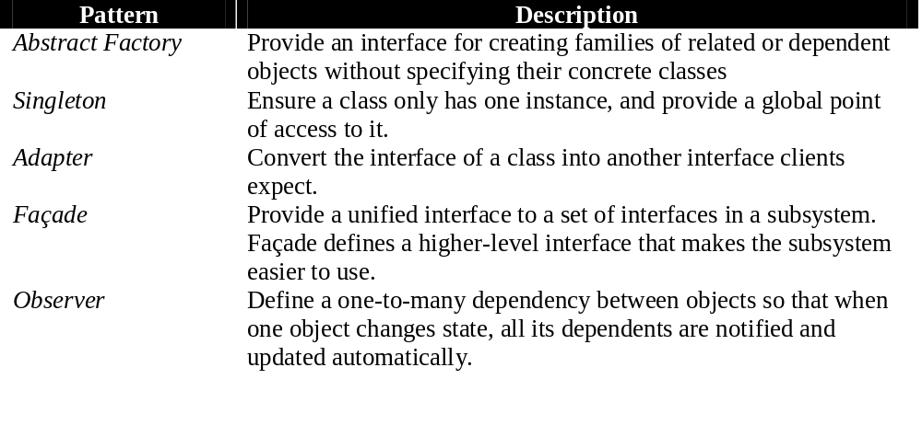
Some of the Most Popular Patterns

Slide 21
Generic Methods
The most recent release of the Java Software Development Kit, J2SE SDK 5.0, added support for generic methods and classes
  Generics further support polymorphism by enabling a generic code component to determine safely at runtime what the type of a parameter is and to handle it accordingly

Slide 22
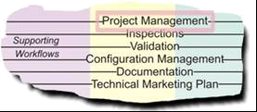
Position in Process
the supporting
disciplines,
here Project
Management,
span the entire life cycle, albeit with varying intensity across the spectrum of iterations
The need for smart and flexible project management is critical in completing quality projects on time, on budget, and according to stakeholder requirements

Slide 23
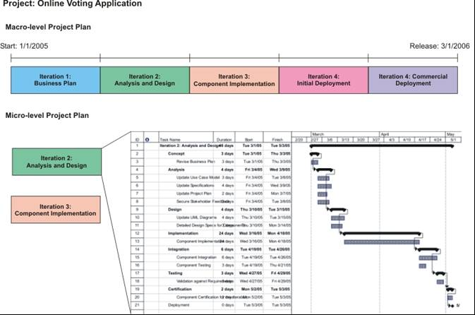
Macro/Micro-Level Project Planning

Slide 24
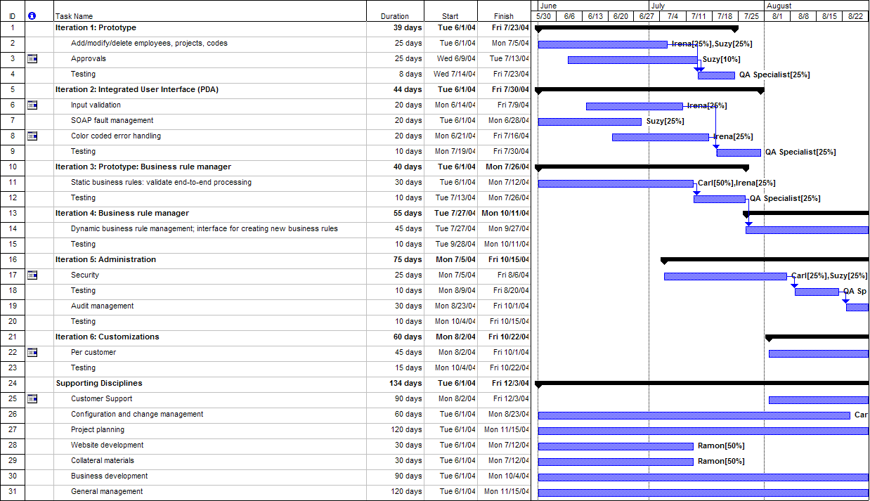
Macro-Level Plan using Microsoft Project®

Slide 25
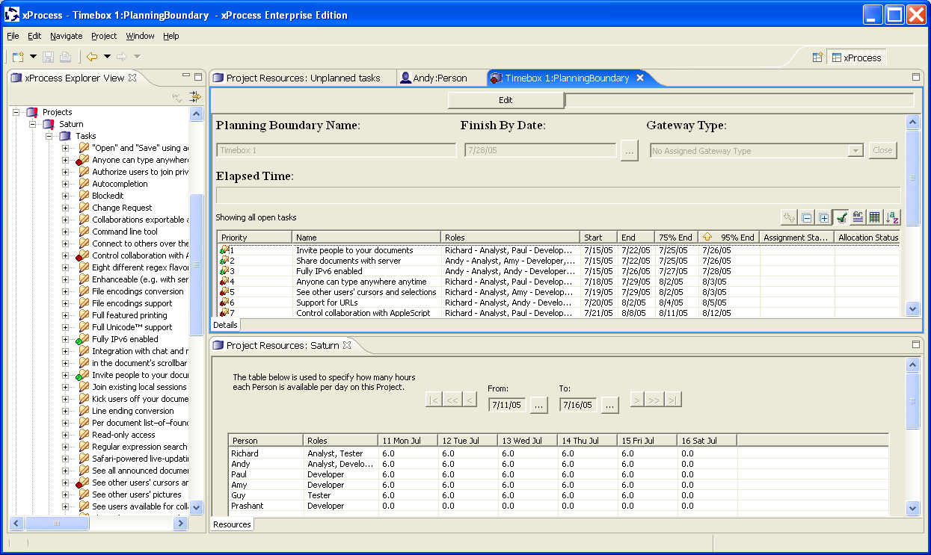
Example Agile Project Management Tool: xProcess®
Copyright IVIS/Andy Carmichael

