Slide 1
Chapter 12
Software Integration and Deployment

Slide 2

Agenda
System Integration
  Validation of
  integrated
  operability
Deployment
Outsourcing
Abstract data structures
Inspections and Validation

Slide 3
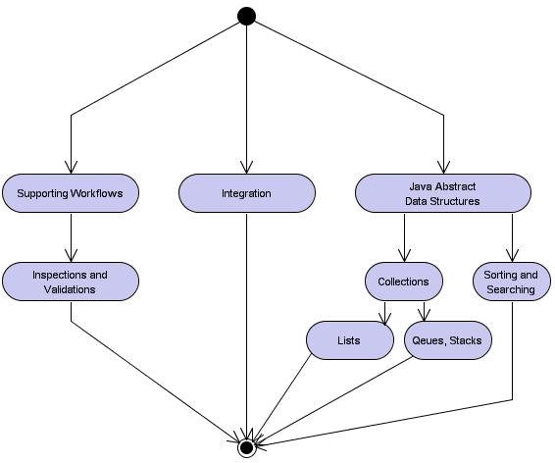
Learning Layout

Slide 4
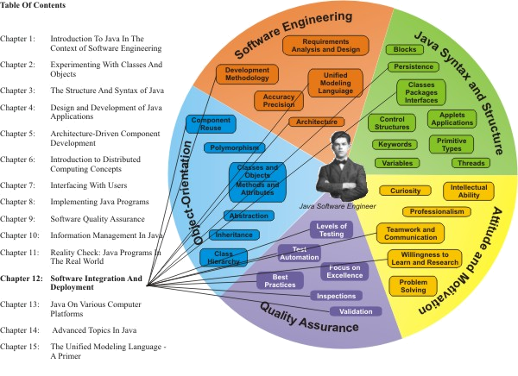
Learning Connections

Slide 5
Lab versus Production
What works well in the development lab does not necessarily operate error-free on a destination production system!

Slide 6
Outsourcing
Many software developers are concerned about their work being outsourced to a low-cost offshore supplier.
It is true that companies have ramped up the movement of skilled (“white-collar”) jobs overseas, given the ready availability of large numbers of well-educated professionals in countries like India and China whose labor rates are much lower than U.S. equivalents.
For the ambitious software engineer, no better employment insurance exists than the development of cross-disciplinary skills as described in the “Learning Connections” sections in the book.
The combination of these skills and responsibilities cannot realistically be outsourced overseas, because they involve many person-to-person interactions and require a hands-on, detailed understanding of the domain being addressed by the software project.

Slide 7
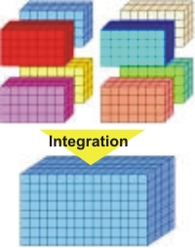
System Integration
Among the final steps in a software development project are the integration of all constituent components and subsystems and the deployment of the complete, integrated system
An integrated solution is comprised of validated modules assembled into the desired software solution and tested in the target hardware and software configurations listed as the required environment in the Requirements Specification

Slide 8
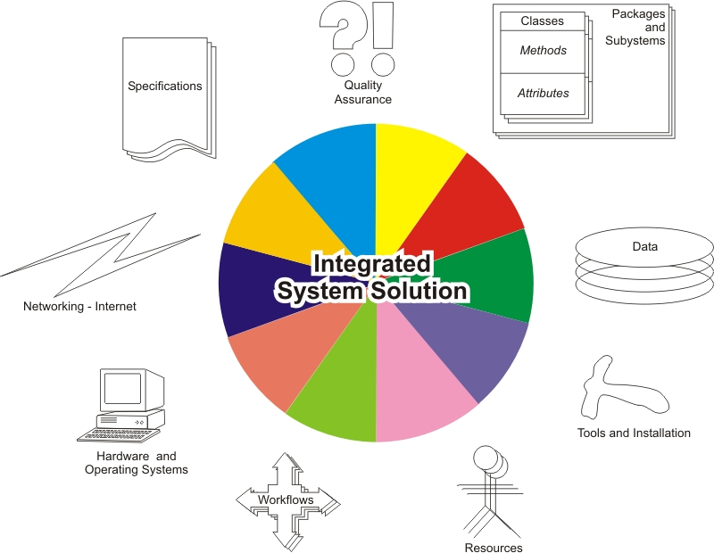
System Integration Perspectives

Slide 9
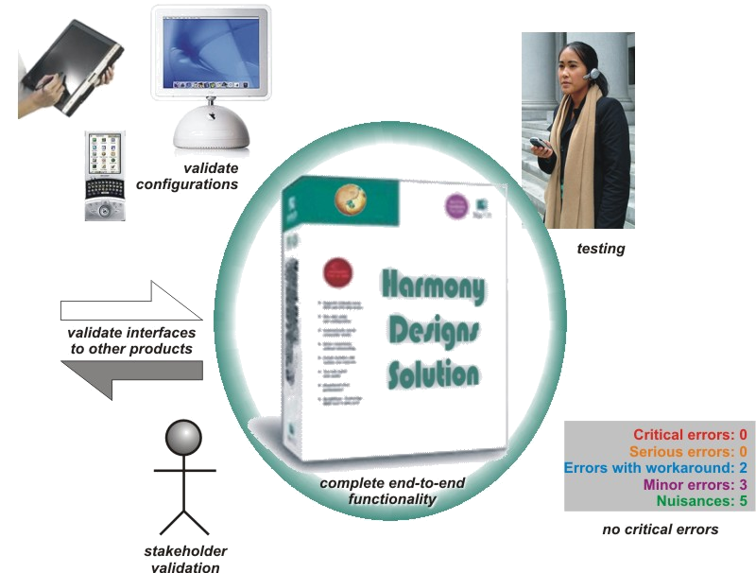
Product Readiness

Slide 10
Deployment Viability
No outstanding critical errors – operational capability is certified
Distribution process and channel(s) are established and ready to go operational
Support process and resources are in place
Functional requirements have been met and validated
Non-functional requirements have been met and validated
  Including scalability, performance, etc.
A viable product maintenance process is in place

Slide 11
Abstract Data Types
In Java, abstract data structures are implemented using object-oriented concepts
The structures may contain members of class or primitive types
Often, these objects are deconstructed (serialized/deserialized) for persistent storage or transport
The concept of structure imposes an organization on the data or objects which allows for powerful data manipulation, typically for one of the following functions:
  Sorting
  Searching
  Storing, retrieving, modifying, and deleting in order within a group
  Extracting mathematical or logical information (relationships)

Slide 12
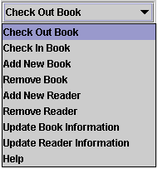
Example: Ordered List

Slide 13
Collections
The Collection interface is the root of the collection hierarchy and is implemented to represent a group of objects
Some Collection subclasses are ordered (e.g. Lists) and others are unordered; some allow duplicate elements and others do not (e.g. Sets)

Slide 14
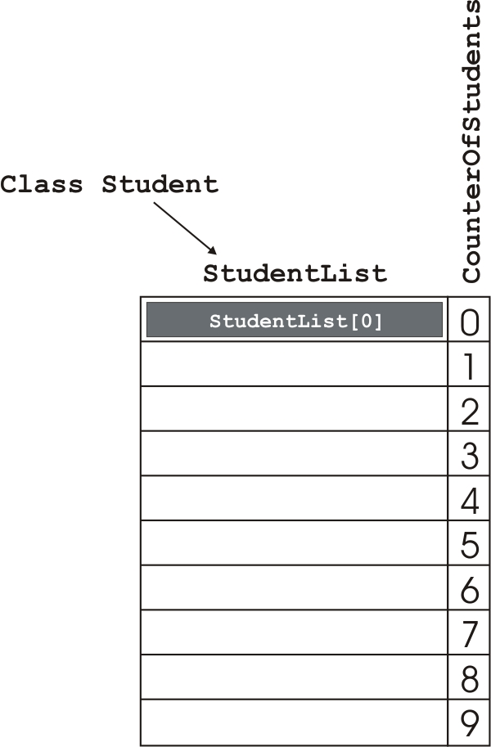
Array of Objects

Slide 15
Linked List
A linked list is a sequence of self-referential class objects
  The objects are called nodes and connected by reference links
  Stacks and queues are linked lists with constraints
  All support sequences of data where the number of elements is unpredictable in advance of program execution
  Class LinkedList is provided in java.util

Slide 16
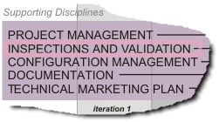
Position in Process
The supporting
workflow Inspections
and Validation
provides for software
quality assurance and control over every stage of the product life cycle. The specific approach includes an inspection regime as well as the formal validation of milestones and management of all deliverables.

Slide 17
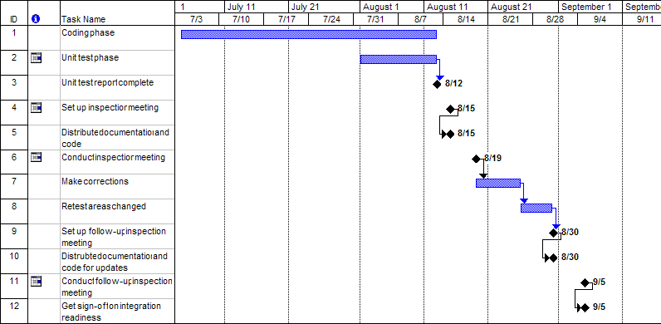
Code Inspection Plan Example

