Slide 1



Chapter 13
Java on Various Computer Platforms

Slide 2
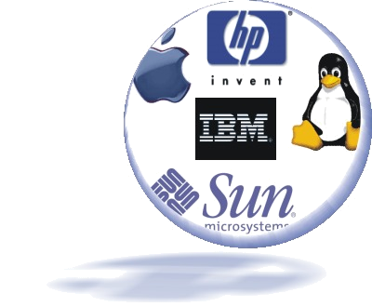
Agenda
Platforms
Networking with
Java
Configuration
management

Slide 3
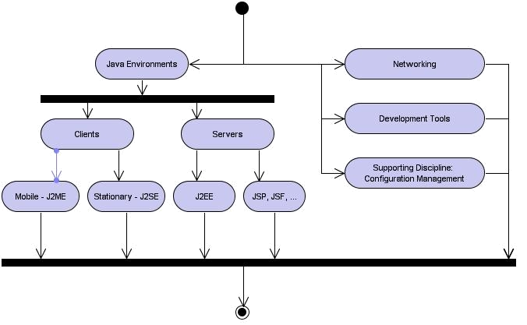
Learning Layout

Slide 4
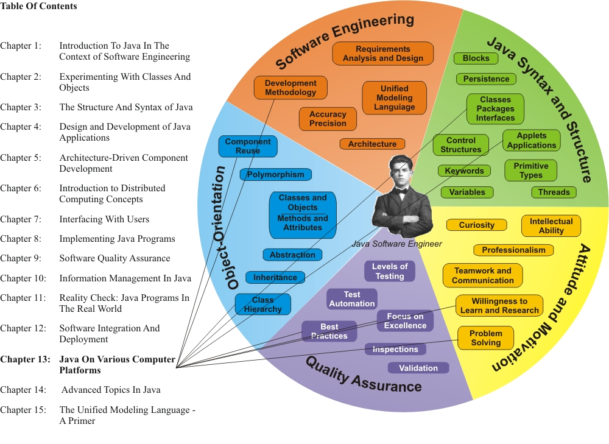
Learning Connections

Slide 5
Operating Systems
Distributed Java applications have proliferated on the UNIX and Linux computer operating systems available on numerous (server) hardware system platforms from vendors such as IBM, Sun Microsystems, and Hewlett-Packard
The system vendors have adapted Java for optimal performance on their systems, often by providing extended libraries and development tools and ensuring optimal performance for Java applications on their systems

Slide 6
Java HotSpot Technology
Rather than the traditional Just-in-Time (“JIT”) compilation techniques that translate Java application bytecodes into native machine code at run time, compiling each method the first time it is invoked, the Java HotSpot Virtual Machine interprets and analyzes the program for critical performance “hot spots”
A global native-code optimizer is then applied to the hot spots, efficiently focusing the Java HotSpot compiler on the performance-critical parts of the program
  The monitoring of hot spots is continued as the program runs, optimizing the hot spot performance gains on-the-fly based on user needs

Slide 7
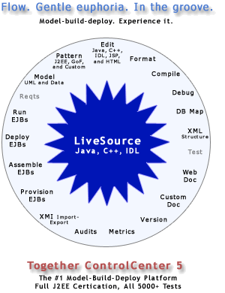
Example: Borland Development Environment

Slide 8
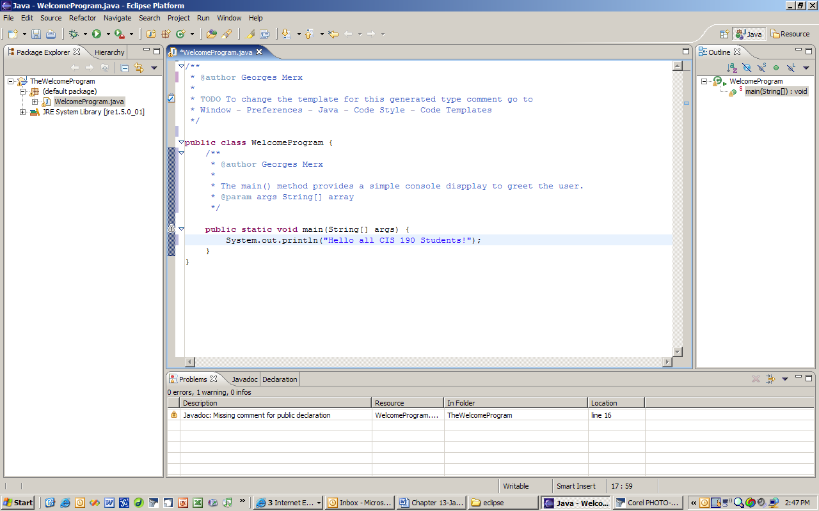

Example: Eclipse Development Environment
The Eclipse Foundation a not-for-profit association, has developed a comprehensive, extensible set of software development tools under the banner of Eclipse® Interactive Development Environment (current release: 3.0): the Eclipse Project

Slide 9
Popular Commercial UML Tools
IBM® Rational Rose™
Microsoft® VISIO™
Borland® ControlCenter™
Visual-Paradigm for UML™ from Visual-Paradigm

Slide 10
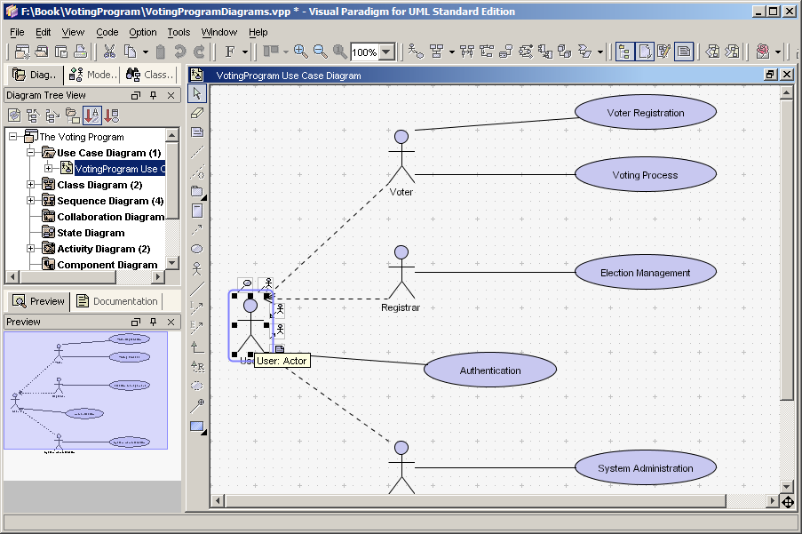
Example: Visual Paradigm

Slide 11
java.net (1)
With java.net, remote files located on a server are accessed from the client just like local files, using Java data streams. The location is specified as a Uniform Resource Locator (URL), and once a connection is established, the file is opened and read from, or written to, using the same type of buffered I/O available with local file streams.

Slide 12
java.net (2)
In a distributed computing environment, Java subsystems communicate with their Java and non-Java counterparts across communication links – typically Internet/TCP-IP-connections, usually using Internet and web technologies (e.g. HTTP; SOAP)
  The access to these communication functions is provided through high-level interfaces available in the java.net library
  The classes in this package encapsulate the complexities of networked interaction so that application programmers do not have to concern themselves with the intricacies of remote communications

Slide 13
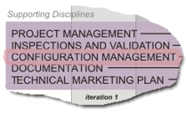
Position in Process
When software
projects reach a
certain level of
complexity, an
urgent need arises
to manage all the
resources and artifacts associated with the project in a very organized fashion
The Intellectual Property (IP) contained in the project deliverables is the core value of the project
The process and associated computer software tools used to help manage these resources, deliverables, and artifacts are generically described as Configuration Management

Slide 14
Intellectual Property
Projects fail when the Intellectual Property (IP) associated with the project – its documentation and code – are not properly organized and managed: Configuration Management addresses these issues

Slide 15
Source Code Control
Source code control is a subset of Configuration Management: it keeps track of the changes made to programming source files, recording what was changed, when it was changed, and by whom
It provides a version numbering scheme, so you can tell which version of a file is the most recent
It allows for the controlled, authenticated retrieval of previous versions of files and projects, so that you can roll back to an older version when the new version has become so unstable that a return to the last stable version is warranted

