Slide 1
Chapter 14
Advanced Topics in Java Software Engineering

Slide 2
Agenda
Advanced topics
  Mobile computing with Java
    J2ME
  Programming with XML and SOAP
  Developing web and application services
Technical Documentation
Technical Marketing Plan

Slide 3
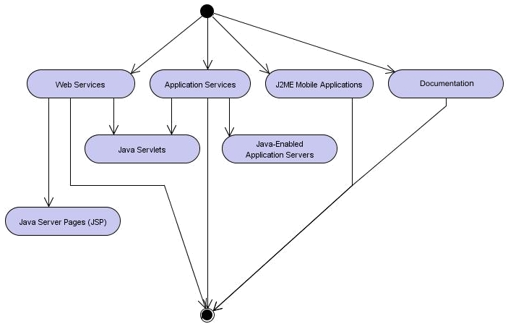
Learning Layout

Slide 4
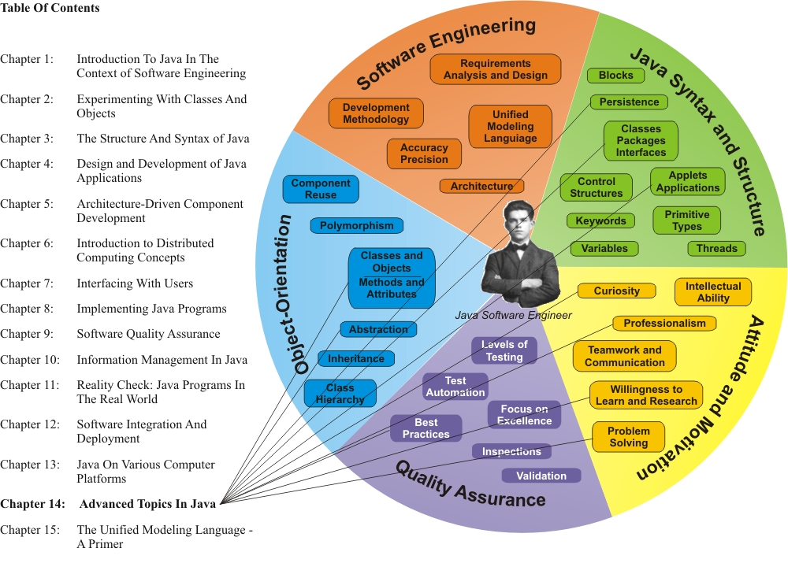
Learning Connections

Slide 5
J2ME Platform (1)
The portable version of Java is available from Sun Microsystems as the Java 2 Platform, Micro Edition (J2ME)
Because small and portable devices fall into a broad range of power and capability, the J2ME package is subdivided into multiple components, depending on the type of target device platform
More capable devices are governed by the Connected Device Configuration (CDC), while lower-end devices run under the Connected Limited Device Configuration (CLDC)
Profiles for each configuration further target specific device capabilities, and optional packages are available for specific market/customer/solution requirements

Slide 6
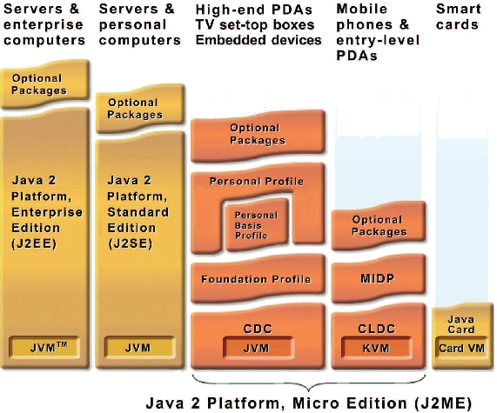
J2ME Platform (2)

Slide 7
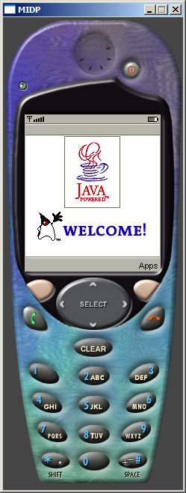
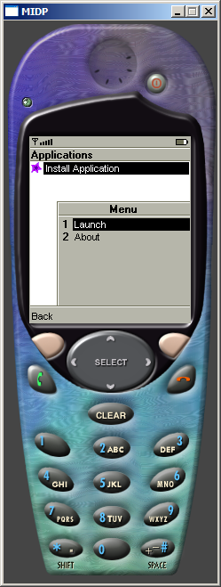
Mobile Java Applications

Slide 8

Service-Oriented Architecture
Web and application services provide functions to software application clients across an Internet connection
They liberate the client side from logic processing, allowing for “thin-client” system architectures
These types of services are today often described within the framework of a service-oriented architecture

Slide 9
SOAP and XML in Java Applications
Clients request a service over HTTP at a given location on the server (expressed as a Uniform Resource Locator or URL) using the SOAP protocol
The data associated with the interaction across the remote connection is typically packaged in XML
The service receives the request, processes it, and returns a response

Slide 10
XML
The Extensible Markup Language, XML, is an industry-standard, system- and platform-independent way of representing data
Like HTML (Hypertext Markup Language), XML encloses data in tags, but XML tags relate to the meaning of the enclosed text, whereas HTML tags only specify how to display the enclosed text

Slide 11
XML Example
<priceList>
<computer>
<name>JCN Laptop</name>
<price>1495.00</price>
</computer>
<computer>
<name>Tell Laptop</name>
<price>1395.00</price>
</computer>
</priceList>

Slide 12
SOAP
The Simple Object Access Protocol (SOAP) facilitates interoperability among a wide range of programs and platforms by ensuring vendor-independent end-to-end data transport
SOAP combines the proven Web tech­no­logy of HTTP with the flexibility and extensibility of XML

Slide 13
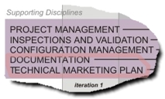
Position in Process
The Documentation
workflow tracks the
development and
maintenance of all
documentation, internal
and external, electronic
and hard-copy
  This also includes online help and web-based product information
If the intention is to market and sell the software product being developed, it is recommended that a Technical Marketing Plan accompany the development of the software product
  This ensures that marketability issues flow into the requirements process from the start of the project, and that the characterization for marketing and sales purposes of the product and its features is an integral part of its development

Slide 14
Documents
The documents, produced by project contributors, fall into a number of categories:
  Specifications
  Reports
  Information Forms
  User Documentation
  Online Help and Tutorials
  Notes

Slide 15
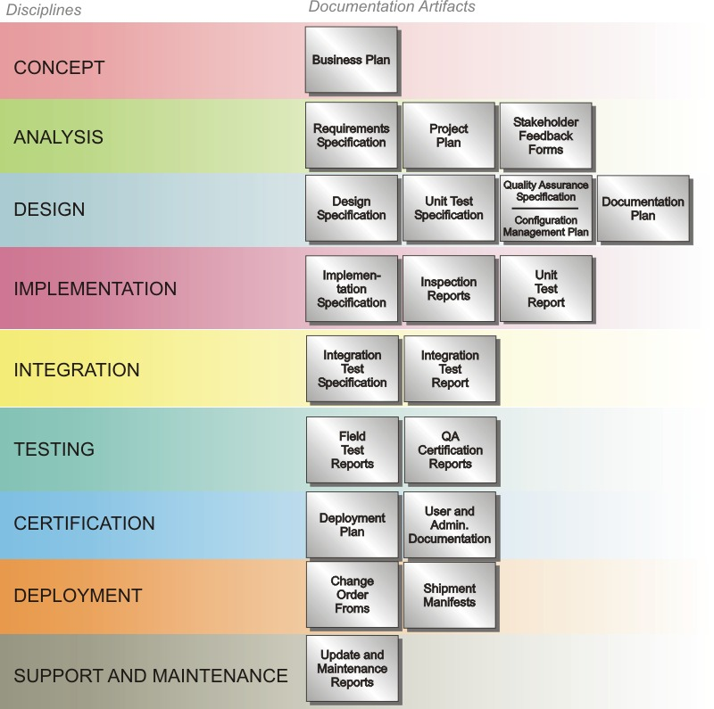
Documentation
Artifacts

Slide 16
Javadoc
The Java SDK includes a documentation creation utility called Javadoc, which is used to produce program documentation in the form of HTML files straight from Java source code files
Javadoc files describe:
  packages
  classes and interfaces
  constructors and methods
  fields/attributes

Slide 17

Technical
Marketing Plan (1)
A Technical Marketing Plan accompanies commercial product development. If your product is destined to be sold, a solid, validated marketing plan is a critical component of the project

Slide 18
Technical Marketing Plan (2)
Outline:
  Target market, customer profile
  Market segmentation
  Distribution channels (direct, indirect)
  Product description (product and service components)
  Competitive analysis and position (unique advantages)
  Rollout plan, including budget and training required
  The Four Ps:
    Packaging: online and/or hardcopy sales, name, image
    Position: characterization of the product against competition
    Price: pricing of products and services, discounts
  Promotion: advertising, public relations, third-party alliances

Slide 19
Book Summary
This book has introduced you to software development using the Java programming language from the perspective of commercial object-oriented software engineering. Java has become extremely popular around the world for the development of new software programs for a number of important reasons:
  Easy-to-learn and –use syntax and structure (no pointers; automatic memory management; support for data persistence; …)
  Efficiency and reuse through abstraction and object-orientation; compliance with object-oriented software methodology (e.g. Design Patterns; UML; …); support for Design Patterns
  Portability through virtual machine architecture and run-time availability on most platforms (performance optimization using Hotspot technology)
  Distributed computing through support for Internet, Web, application services (RMI, XML, SOAP, CORBA)
  High-level support for advanced computing such as multi-threading and multimedia formats

