Slide 1
Chapter 15
The Unified Modeling Language: a Primer

Slide 2

Agenda
The Three Amigos
The Unified Modeling Language (UML)

Slide 3
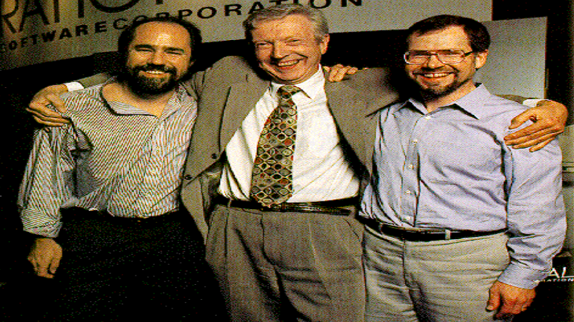
UML
Grady Booch,
Ivar Jacobson,
and Jim Rumbaugh – historically and fondly known in the UML community as The Three Amigos – are often credited with the dominant contribution to the Unified Modeling Language

Slide 4
Rational®
Rational Software Corporation, now a division of IBM® Corporation, is a dominant provider of Unified Process and UML technology, tools, and services
UML is standardized by the Object Management Group
  www.uml.org and www.omg.org

Slide 5
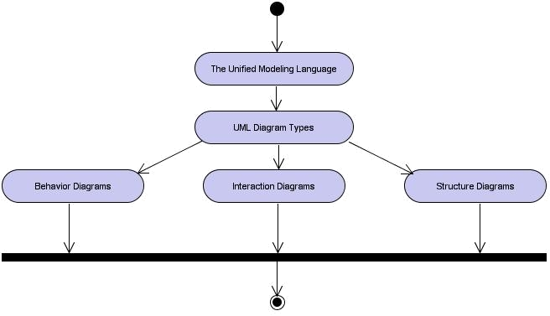
Learning Layout

Slide 6
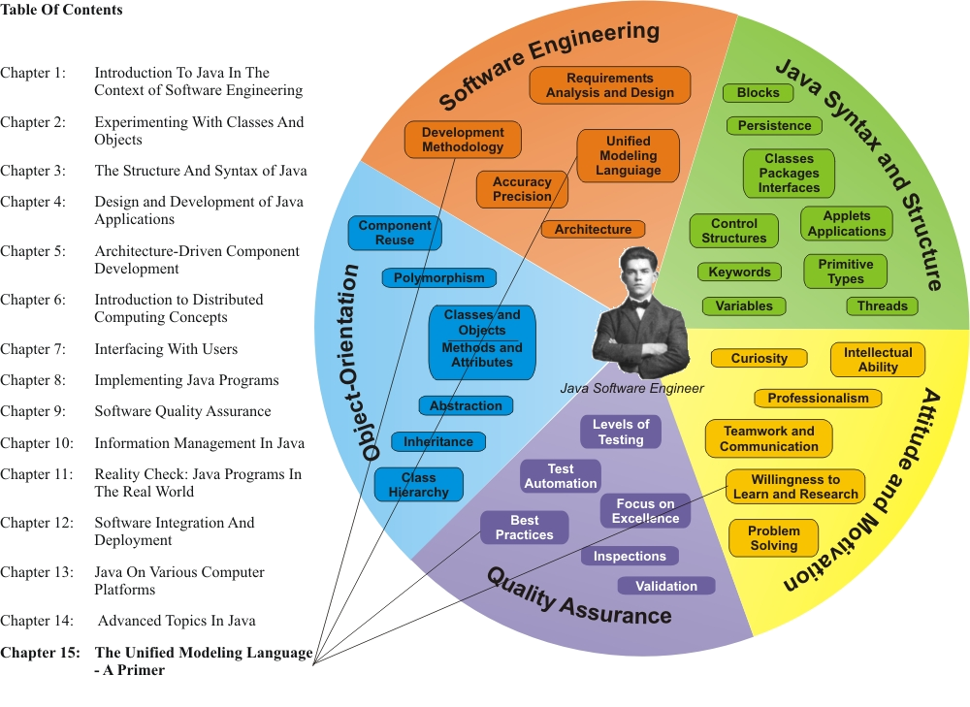
Learning Connections

Slide 7
UML Diagram Types
Behavior Diagrams
  Illustrate the dynamic interactions between elements (over time)
  Activity Diagram, State Machine Diagram, Use Case Diagram, and the four interaction diagrams
Interaction Diagrams
  A subset of behavior diagrams which emphasize object interactions
  Communication Diagram, Interaction Overview Diagram, Sequence Diagram, and Timing Diagram
Structure Diagrams
  Show the static relationships between design elements, irrespective of time
  Class Diagram, Composite Structure Diagram, Object Diagram, Component Diagram, Deployment Diagram, and Package Diagram

Slide 8
Summary of UML Diagrams (1)
Activity Diagram
  Depicts high-level business processes, including data flow, or to model the logic of complex logic within a system
Class Diagram
  Shows a collection of static model elements such as classes and types, their contents, and their relationships
Communication Diagram
  Shows instances of classes, their interrelationships, and the message flow between them. Communication diagrams typically focus on the structural organization of objects that send and receive messages. Formerly called a Collaboration Diagram
Component Diagram
  Depicts the components that compose an application, system, or enterprise. The components, their interrelationships, interactions, and their public interfaces are depicted
Composite Structure Diagram
  Depicts the internal structure of a classifier (such as a class, component, or use case), including the interaction points of the classifier to other parts of the system
Deployment Diagram
  Shows the execution architecture of systems. This includes nodes, either hardware or software execution environments, as well as the middleware connecting them

Slide 9
Summary of UML Diagrams (2)
Interaction Overview Diagram
  A variant of an activity diagram which overviews the control flow within a system or business process. Each node/activity within the diagram can represent another interaction diagram
Object Diagram
  Depicts objects and their relationships at a point in time, typically a special case of either a class diagram or a communication diagram
Package Diagram
  Shows how model elements are organized into packages as well as the dependencies between packages
Sequence Diagram
  Models the sequential logic, in effect the time ordering of messages between classifiers
State Machine Diagrams – Behavioral and Protocol
  Describes the states an object or interaction may be in, as well as the transitions between states. Formerly referred to as a state diagram, state chart diagram, or a state-transition diagram. A behavioral state machine examines the behavior of a class; a protocol state machine illustrates the dependencies among the different interfaces of a class
Timing Diagram
  Depicts the change in state or condition of a classifier instance or role over time. Typically used to show the change in state of an object over time in response to external events
Use Case Diagram
  Shows use cases, actors, and their interrelationships

Slide 10
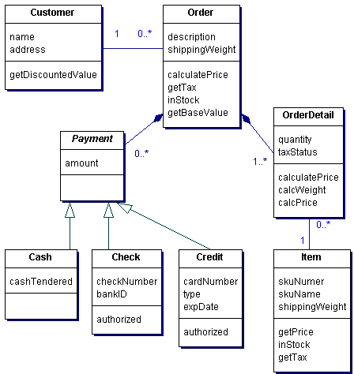
Sample Class Diagram

Slide 11
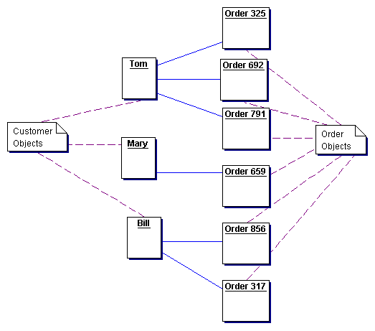
Sample Object Diagram

Slide 12
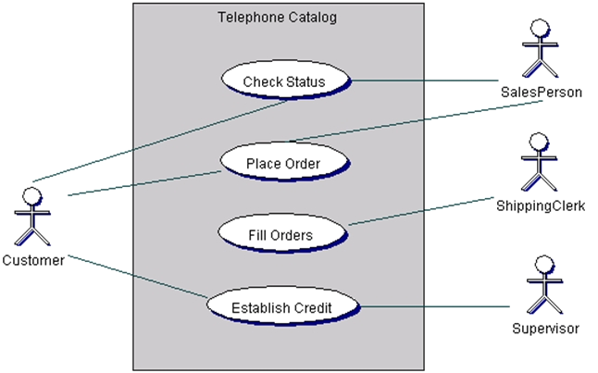
Sample Use Case Diagram

Slide 13

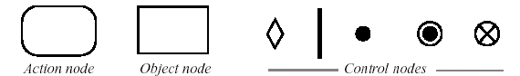
Activity Diagram Notations

Slide 14
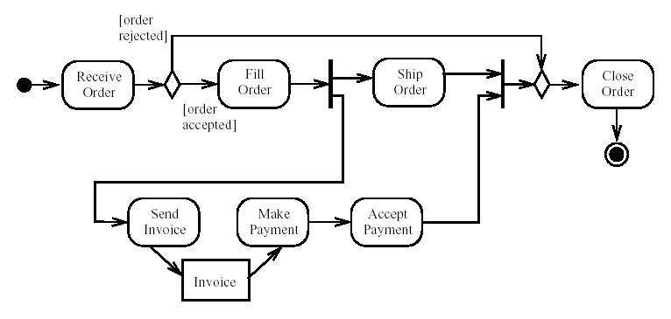
Sample Activity Diagram

Slide 15
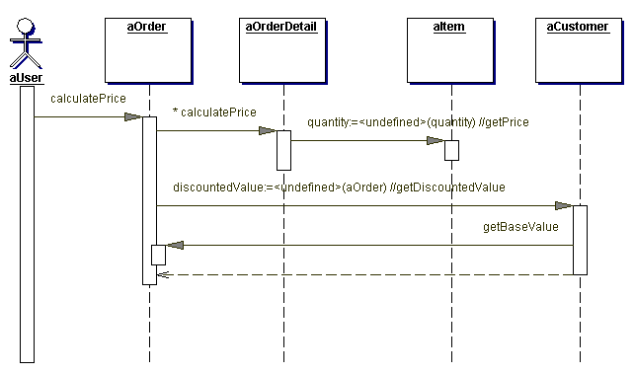
Sample Sequence Diagram

Slide 16
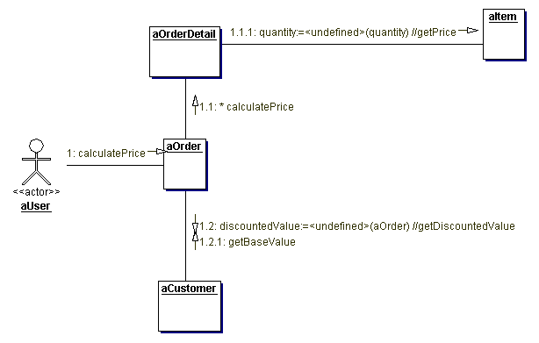
Sample Communication Diagram

Slide 17
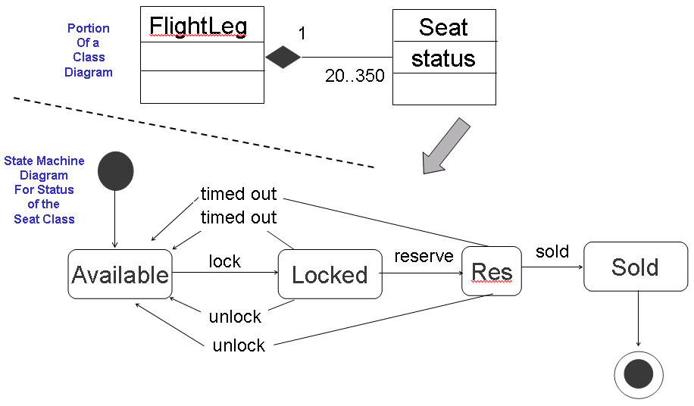
Sample State Machine Diagram

Slide 18
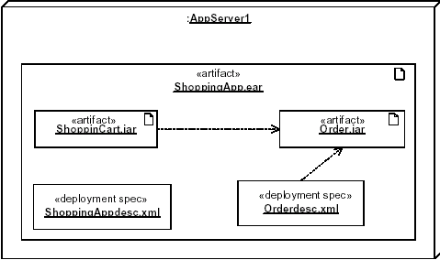
Sample Deployment Diagram

Slide 19


