Slide 1
Chapter 2
Experimenting with Classes and Objects

Slide 2
Agenda
Elements of object orientation
  Class and objects
  Component reuse
  Class hierarchy
Requirements Analysis
  Requirements Specification

Slide 3
Introduction (1)
The purpose of information systems is to create value by transforming data from a raw form to a more structured form

Slide 4
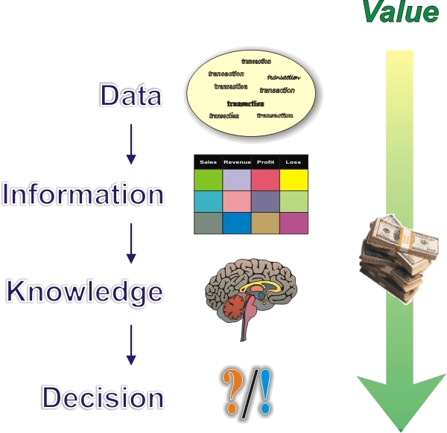
Introduction (2)

Slide 5
Object-Orientation
Definition
  Representing in code the concepts of objects: characteristics (called attributes) and behaviors (called methods)
  O-O features/benefits/capabilities
    Abstractions (cohesive)
    Instantiation
    Inheritance
    Polymorphism
    Encapsulation
  Objects can be members of classes
    Classes are templates for objects

Slide 6
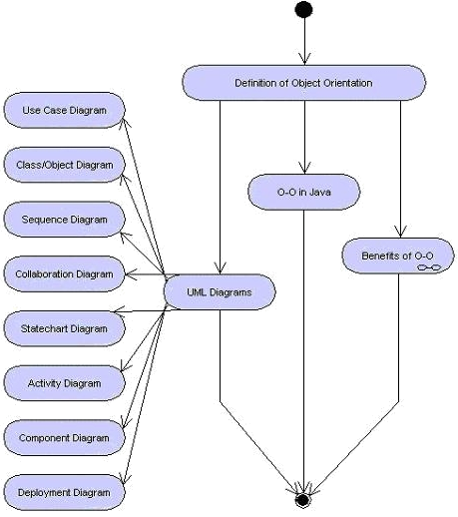
Learning Objectives

Slide 7
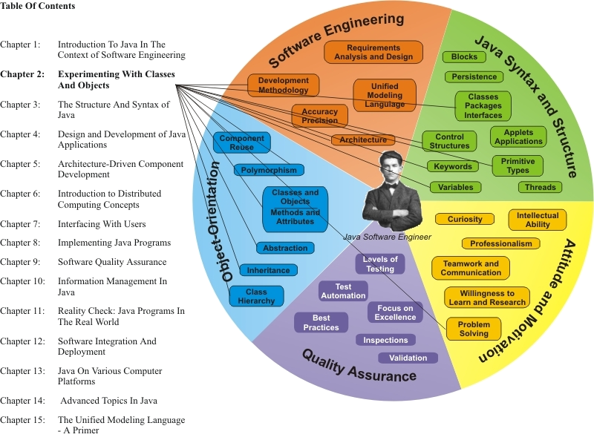
Learning Connections

Slide 8
Use Cases

Slide 9
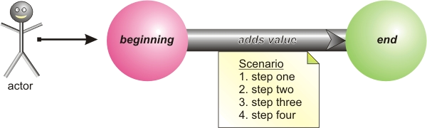
The Use Case
What is a use case?
Examples:
  “get money from my ATM”
  ‘buy an item in a store”
  “enter start and end times on a timecard”
  “issue a ticket”

Slide 10
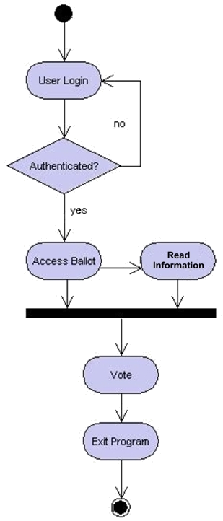
Sample Activity Diagram

Slide 11
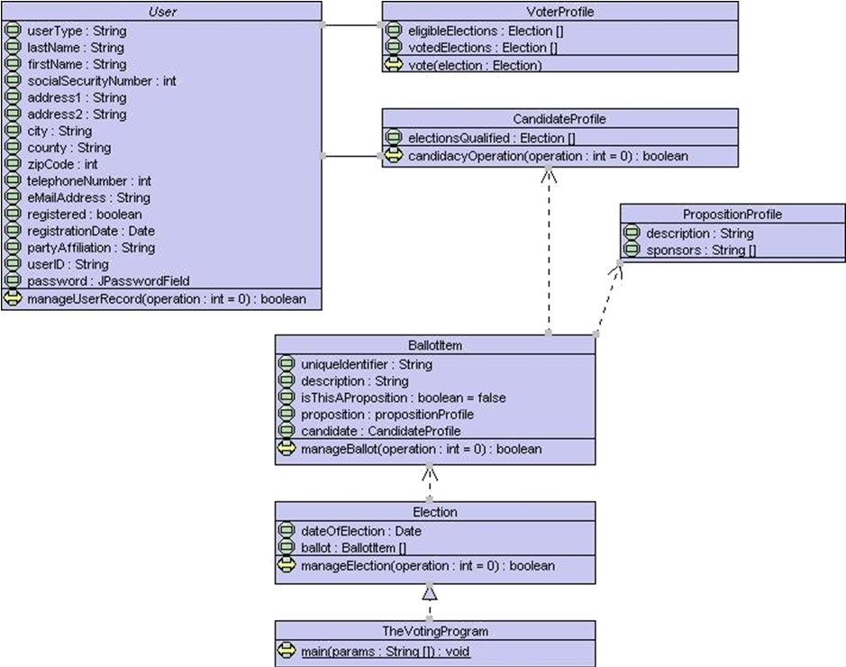
Sample Class Diagram

Slide 12
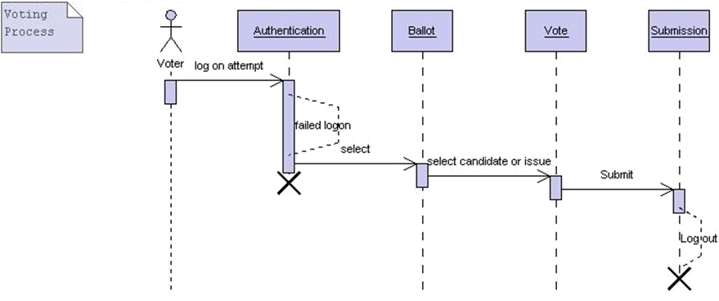
Sample Sequence Diagram

Slide 13
Classes and Objects
Classes/objects contain attributes and methods
Classes are templates for objects (e.g. blueprints)
Objects are said to be members of classes
  Objects are also called instances
Objects are instantiated to hold specific data
  Class “Vehicle” → object “myGreen1997FordTaurus”

Slide 14
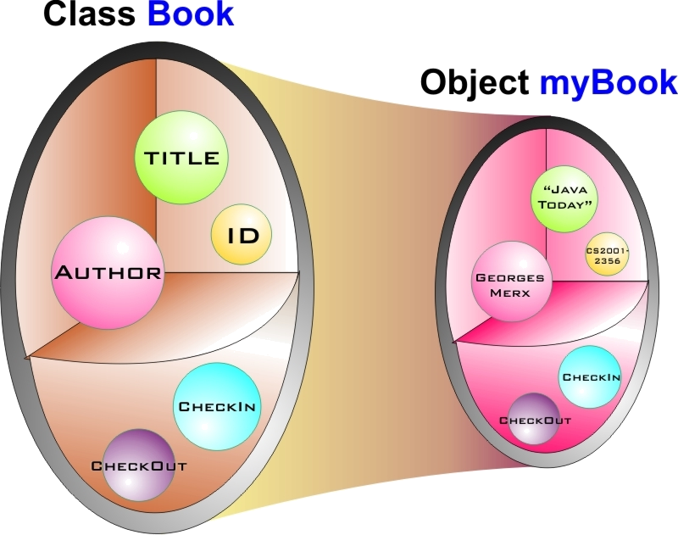
Visualization

Slide 15
Classes
A program can be composed of one or more classes
  The main() method provides the program entry point and must exist in a stand-alone program
  Attributes are variables declared at the class/object level (outside of methods)
  Variables are named locations in (random-access) memory

Slide 16
Objects
Also called instances, are instantiated – sing the new keyword from classes to store data about specific objects
Contain the same methods and attributes as the classes from which they are created
A keyword is a reserved Java syntax element used for a specific predefined purpose
Example:
  Sedan myCar = new Sedan();
assignment
class
variable
keyword
constructor

Slide 17
Constructors
Constructors are methods invoked at object creation time
  Usually provide initialization code
  Not required
    Default constructor created and invoked internally and automatically
  No return type
  Same name as class

Slide 18
Component Reuse (1)
Extends keyword (introduction)
  Class can be the child of a parent class → inheritance
  Example:
  class Sedan extends Vehicle
Class hierarchy
  Super- and subclasses
    Also called parent- and child classes
    Subclasses inherit attributes and methods from parent classes
  Avoiding overlap between classes → component reuse

Slide 19
Component Reuse (2)
Principles of reuse
  Componentization, modularity
  Separation of concerns
    High cohesion, low coupling
    Application of design patterns
Design patterns are documented best practices in softwqare design and implementation

Slide 20
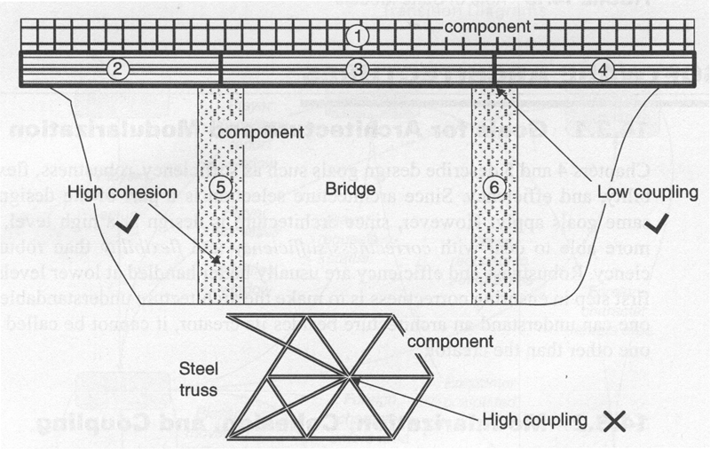
Cohesion vs. Low Coupling
Coupling
Strength of interaction between modules in system
Cohesion
Degree to which the tasks performed by a single module are functionally related

Slide 21
Terminology
system
A is purposeful collection of inter-related components working together to achieve some common objective. A system may include software, mechanical, electrical and electronic hardware and be operated by people. System components are dependent on other system components
component
A modular part of a system that encapsulates its contents and whose manifestation is replaceable within its environment. A component defines its behavior in terms of provided and required interfaces. As such, a component serves as a type, whose conformance is defined by these provided and required interfaces (encompassing both their static as well as dynamic semantics).
module
A separate and distinct unit of a process, system, or subject area that may be used as a conceptual component of a model or a part in a system.

Slide 22
OO Modularization Techniques
Organizing your code can be done by defining interfaces, abstract classes, and implementation classes
Top level and inner classes
Static and instance attributes
Public, protected, and private attributes
Public, protected and private methods

Slide 23

Position in Process
The Analysis
phase addresses
the requirements
acquisition and analysis activities of a project
Key deliverable: Requirements Specification
  Stakeholder analysis
  Requirements – human, system
  Solution environment/architecture
  Validation

Slide 24
Requirements Analysis
Stakeholder analysis
  Understanding all sources of requirements
    Humans, systems, applications
Requirements acquisition
  Collecting all the requisite information without bias
Requirements analysis
  Organization and prioritization
  Evaluation and validation
  Analysis use cases and classes

Slide 25
Requirements Specification
Formal document to capture project requirements
  Should not contain design in formation → Design Specification
  Developed iteratively (version control)
  Complete and detailed enough in each iteration to allow for an unambiguous design effort
Use-case driven
UML diagrams

Slide 26

Requirements Specification Outline
General Section:
  System Name
  Project Vision and Description
  Stakeholder Analysis
  Risk Management
  Architecture Diagram
  Subsystems Description
For Each Use Case:
  Use Case Name
  Brief Description
  Actors
  Preconditions
  Primary Scenario (Flow of Events)
  Secondary Scenarios
  Diagrams
  Postconditions
  Extension Points
  Other Requirements
What were the requirements for the Segway Scooter?

Slide 27

The Voting
Program
Developing a simple application to exercise basic programming skills
  Computer-based voting for candidates or propositions
Includes graphical user interface and simple input-process-output logic
  Improved iteratively across multiple chapters

Slide 28
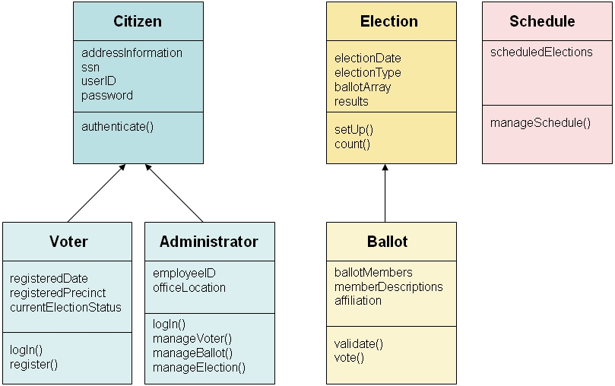
The Voting Program Prototype

