Slide 1
Chapter 3
The Structure and Syntax of Java

Slide 2
Agenda
Learning the language
Principles of object orientation
Enumerations

Slide 3
Java Resources
Extensive resources available in print and on the Internet
  Visit www.java.sun.com
  Find the Java Reference and Tutorial pages
  Use www.google.com to find specific information on a topic, e.g.
    “java jbutton tutorial”
  Search www.amazon.com for “Java” books

Slide 4
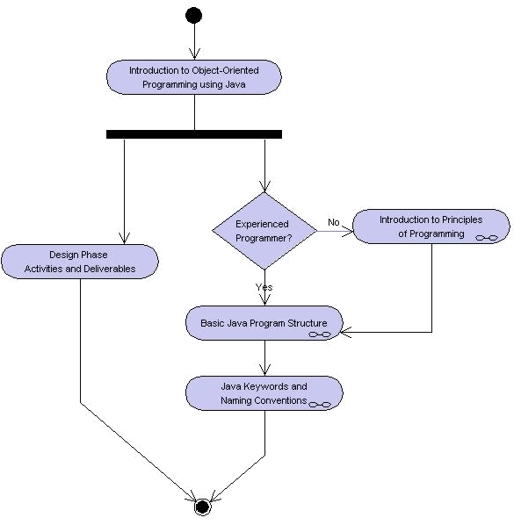
Learning Layout

Slide 5
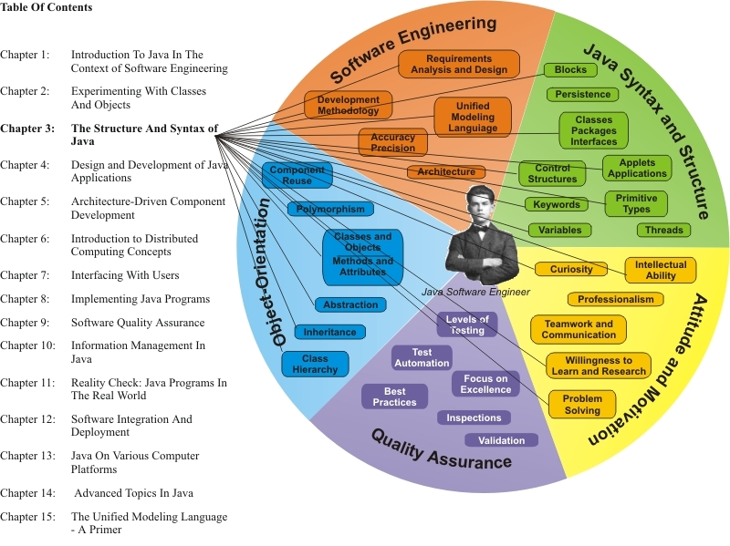
Learning Connections

Slide 6
Learning the Language
Java programming
  Syntax
    Key words, special characters, variable and method names, …
  Structure
    Program navigation
    Component organization
    Data structures
  Semantics
    Code logic (← problem solving)
    Algorithms

Slide 7
Approach
Code logic is like human logic, only more rigorous
  Attention to detail
  Small errors confuse the compiler → errors
Design (planning) required
Modular approach works best
  Low coupling, high cohesion

Slide 8
Other Object-Oriented Programming Languages
SmallTalk
  Rigorously object-oriented
C++
  Extension of C
C#, Visual Basic
  Microsoft .NET languages
Borland Delphi
  Successor to Pascal
others

Slide 9
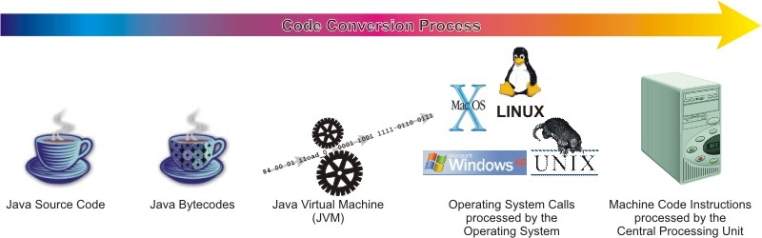
Java Compilation
Source code → English-like statements
Compilation → conversion to bytecodes/native code
Bytecodes interpreted/executed by Java runtime during execution
  Runtime is platform-specific
Platform: processor/OS/Programming env
Java Platform: JVM/Java API/Java Language-IDE

Slide 10
Java Primitive Types
Keyword | Description | Size/Format
Integers
byte | Byte-length integer | 8-bit two's complement
short | Short integer | 16-bit two's complement
int | Integer | 32-bit two's complement
long | Long integer | 64-bit two's complement
Real numbers
float | Single-precision floating point | 32-bit IEEE 754
double | Double-precision floating point | 64-bit IEEE 754
Other types
char | A single character | 16-bit Unicode character
boolean | A boolean value (true or false) | true or false
Ref. http://java.sun.com/docs/books/tutorial/java/nutsandbolts/datatypes.html

Slide 11
Java Data Types
Primitive types (8)
Arrays
Classes
Interfaces
null

Slide 12
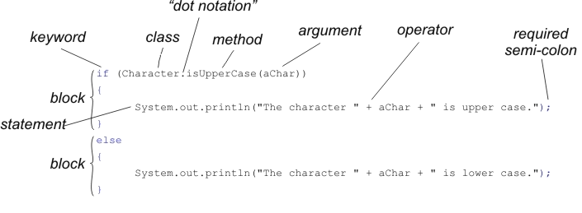
Java Syntax (1)

Slide 13
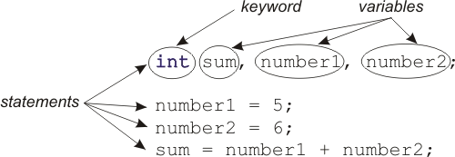
Java Syntax (2)
Groups of statements → blocks delineated by braces ({ and })

Slide 14
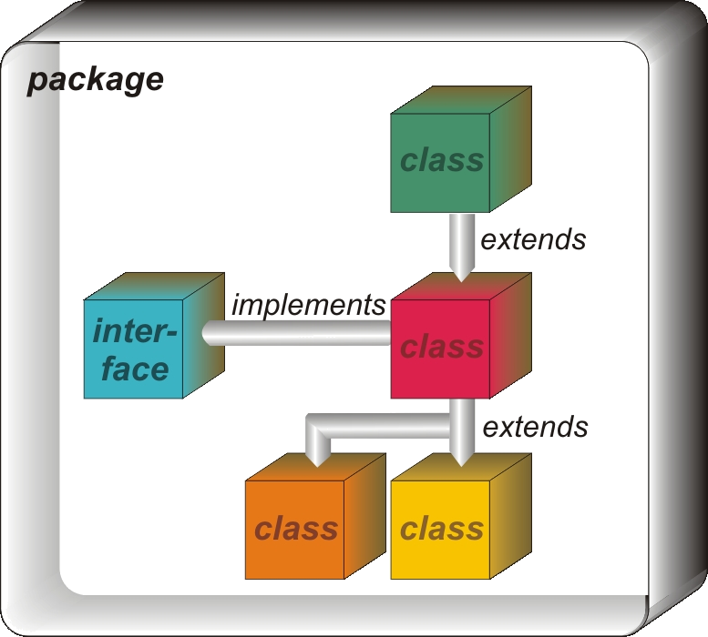
Class Hierarchy
Classes are
organized
  Hierarchy
  Interfaces
Objects follow
class organization
  Abstraction
  Composition
  Inheritance

Slide 15
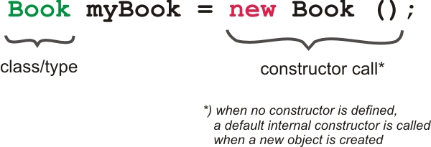
Object Instantiation
Constructors are methods that are invoked automatically when creating a new object of this class
  May be overloaded

Slide 16
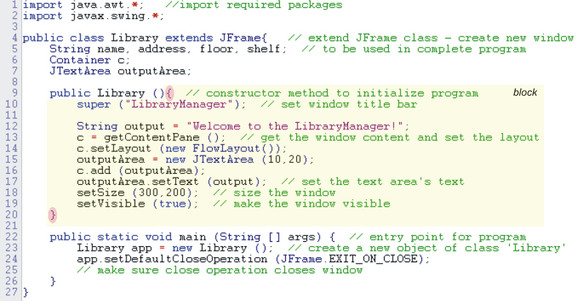
Example Class with Constructor

Slide 17
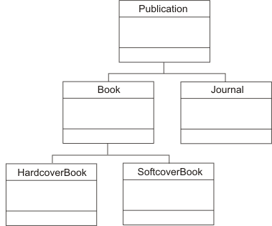
Polymorphism
public interface Publication {
public String getName();
// …
}
public class Book implements Publication {
// …
}
public class HardcoverBook extends Book {
// …
}
public class Library {
// instance variables
public static void main (String args []) {
Publication myPublication = new HardcoverBook();
/* create an object of Publication type
and initialize it using the
constructor HardcoverBook */
System.out.println(myPublication.getname());
// remaining code statements
}
}

Slide 18
Enumerations
J2SE 5.0 introduced us to a special class type called enumerations. An enumeration is declared using the enum keyword and provides a powerful, flexible organization for constant variables and their manipulation.
public enum FlowType { SEQUENTIAL, PARALLEL, CONCURRENT }
FlowType ft = FlowType.PARALLEL;
Can be used inside switch statements

Slide 19
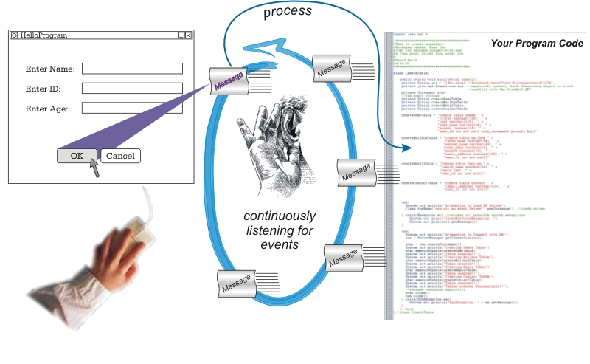
Introduction to Graphical User Interfaces: Events

Slide 20
Graphical Controls
Buttons, menus, windows, …
  Light-weight (Swing), implemented in Java
    JButton, JRadioButton, JTextField, JFrame, …
  Variable look-and-feel: Windows, Unix, Metal, …
  Event-driven
    Model-View-Controller pattern

Slide 21
GUI and Networking
Client
  Skinny (HTML/JavaScript, AJAX)
  HTTP:GET, PUT
  Thin (Applet)
  HTTP, URLConnection (GET, PUT), Sockets
  Thick (AWT, Swing)
  HTTP, Sockets, RMI
Server:
  Web server with servlets (Tomcat) vs. interpreters
  Custom server

Slide 22
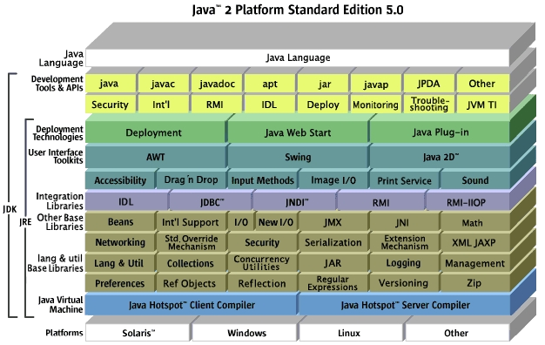
J2SE 5.0

Slide 23
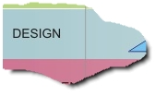
Position in Process
(1)
In this first part
of coverage for the
Design phase, we
focus on the design model
  Development of the class hierarchy from the use cases and UML diagrams

