Slide 1
Chapter 4
Design and Development of Java Applications

Slide 2
Agenda
Major areas of software engineering skills development
History of software engineering

Slide 3
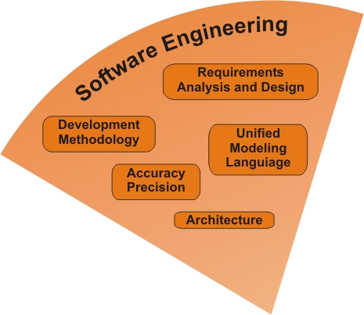
Skill: Software Engineering
Combination
technical and
process-oriented skills
  Analysis and design
  Programming
  Project and configuration management
  Leadership
  Documentation/communication

Slide 4
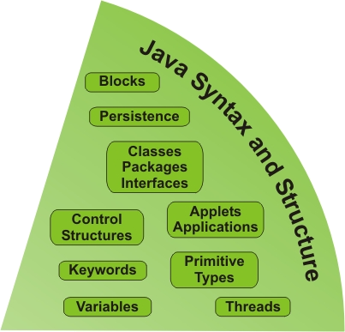
Skill: Java Syntax and Structure
Language skills
  Syntax
  Structure
  Semantics
    Programming logic
  Translating design to code
  Validation and quality assurance
    Unit testing
    Integration

Slide 5
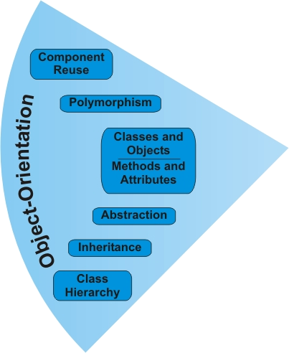
Skill: Object-Orientation
Understanding and
applying principles
of O-O
  Abstraction
  Inheritance
  Polymorphism
  Encapsulation
  Classes and objects
    Attributes and methods

Slide 6
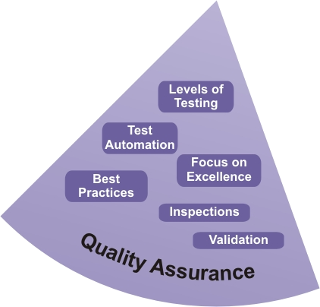
Skill: Quality Assurance
Continuous improve-
ment
  Attention to QA
  issues at every step
Shared team responsibility
  Peer reviews, inspections
  Follow-through
  Defect tracking
Testing and validation, auditing
  Closed-loop corrective action

Slide 7
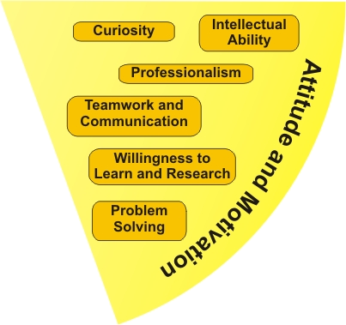
Skill: Attitude and Motivation
Problem-solving,
learning-oriented
Tenacious focus on
solutions
Positive, collaborative approach
Accepting of critical input
Smart and educated

Slide 8
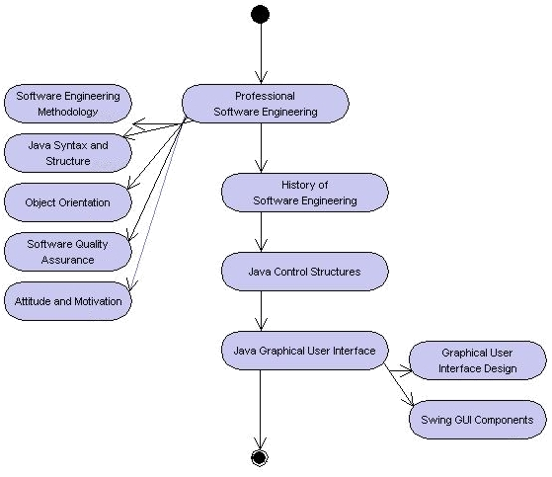
Learning Layout

Slide 9
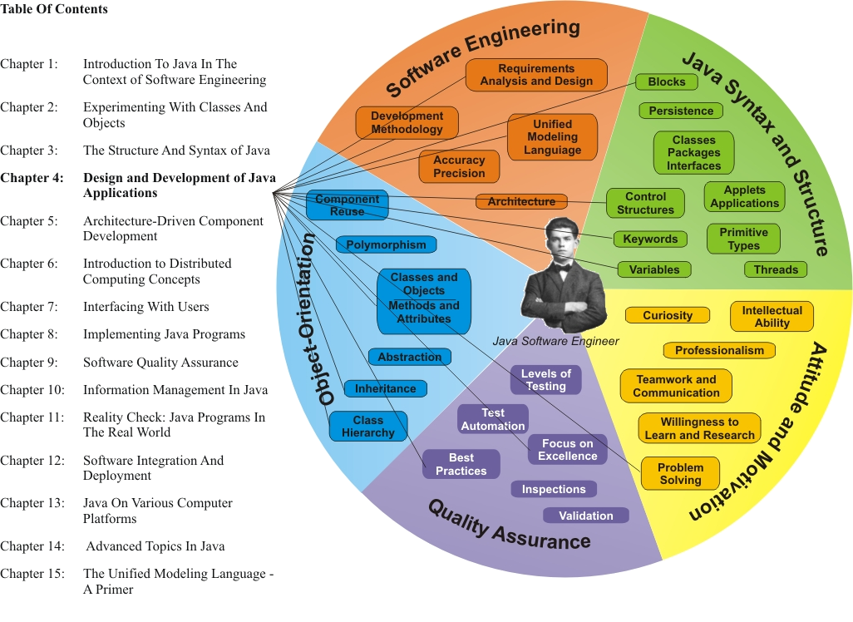
Learning Connections

Slide 10
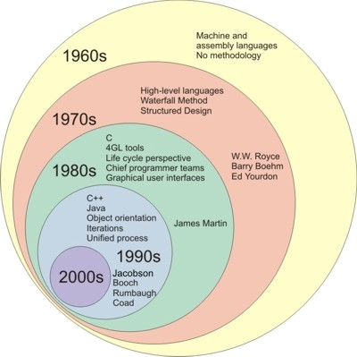
History

Slide 11
Platform
Processor, OS , Programs
P3
Programs
P3
Programs
P2
Machine
Code
P2
Batch Processor
P2
OS
P1
Processor
P1
Processor
P1
Processor
Beffore1950s
1960s
1970s
Mike Sobolewski
Notes:
Session #, Speaker Name
Assembly languages were first developed in the 1950s,
Unix (officially trademarked as UNIX®) is a computer operating system originally developed in the 1960s and 1970s by a group of AT&T employees at Bell Labs including Ken Thompson, Dennis Ritchie and Douglas McIlroy.

Slide 12
Virtual and Distributed Platforms
MP3
Metaprograms
MP2
MOS
VP3
Programs
Grid
VP2
Java API
MP1
P3
Programs
VP1
JVM
P2
OS
P1
HypervisorProcessor
Software cannot operate without a platform or be platform independent.
Mike Sobolewski
Notes:
Session #, Speaker Name

Slide 13
Intergrid Programming
Grid vs. Metacomputing Platforms
Intergrid Applications
mcP3
Metacompute Grid
Applications
cP3
mcP2
Metacompute OS
Compute Grid
Applications
mcP1-3
Service Providers
mcP1-2
Cybernodes
Resource Scheduler
cP2
mcP1-1
Network Resources/Processors
cP1
Mike Sobolewski
Notes:
Session #, Speaker Name

Slide 14
Major Milestones
The Waterfall Method (W.W. Royce)
The Spiral Model (Boehm)
Object-Modeling Technique (Rumbaugh)
Object-Oriented Software Engineering (Jacobson)
Object-Oriented Analysis and Design (Booch, Coad and Yourdon)
Modeling in Color with UML (Coad)
Rational Unified Process (IBM)
Other Unified Process-derived approaches: Design Patterns, Extreme Programming

Slide 15


Process Models
Capability Maturity Model® Integration (CMMI) is a process improvement approach that provides organizations with the
essential elements of
effective processes
  Carnegie-Mellon Software Engineering Institute

Slide 16
Five levels of the CMM
According to the SEI,
"Predictability, effectiveness, and control of an organization's software processes are believed to improve as the organization moves up these five levels. While not rigorous, the empirical evidence to date supports this belief."
Level 1 - Initial
Processes are usually not documented and change based on the user or event. The organization does not have a stable environment and may not know or understand all of the components that make up the environment.
Level 2 - Repeatable
Some software development processes are repeatable, possibly with consistent results. The processes may not repeat for all the projects in the organization.
Level 3 - Defined
The organization’s set of standard processes are established and subject to some degree of improvement over time. These standard processes are used to establish consistency across the organization.
Level 4 - Managed
Using process metrics, management can effectively control the process (e.g., for software development ).
Level 5 - Optimized
Focus on continually improving process performance through both incremental and innovative technological improvements.

Slide 17
Key Process Areas of CMMI
Abbreviation | Area | Category | Maturity Level
REQM | Requirements Management | Engineering | 2
PMC | Project Monitoring and Control | Project Management | 2
PP | Project Planning | Project Management | 2
SAM | Supplier Agreement Management | Project Management | 2
CM | Configuration Management | Support | 2
MA | Measurement and Analysis | Support | 2
PPQA | Process and Product Quality Assurance | Support | 2

Slide 18
 | Area | Category | Maturity Level
PI | Product Integration | Engineering | 3
RD | Requirements Development | Engineering | 3
TS | Technical Solution | Engineering | 3
VAL | Validation | Engineering | 3
VER | Verification | Engineering | 3
OPD | Organizational Process Definition | Process Management | 3
OPF | Organizational Process Focus | Process Management | 3
OT | Organizational Training | Process Management | 3
IPM | Integrated Project Management | Project Management | 3
ISM | Integrated Supplier Management | Project Management | 3
IT | Integrated Teaming | Project Management | 3
RSKM | Risk Management | Project Management | 3
DAR | Decision Analysis and Resolution | Support | 3
OEI | Organizational Environment for Integration | Support | 3
OPP | Organizational Process Performance | Process Management | 4
QPM | Quantitative Project Management | Project Management | 4
OID | Organizational Innovation and Deployment | Process Management | 5
CAR | Causal Analysis and Resolution | Support | 5

Slide 19
Object Orientation
Object-Orientation Characteristics
Classes and objects, attributes and methods
Abstraction
Component reuse
Polymorphism
Inheritance
Encapsulation
Message communication

Slide 20
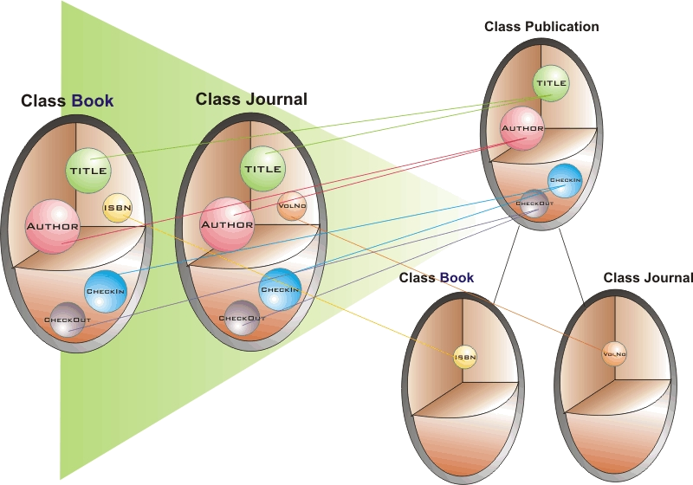
Abstraction

Slide 21
Selection Statements
if…else statement blocks control program flow based on a condition being true/false
switch statement provides alternative courses of action based on value of variable

Slide 22
Repetition Statements
do… loops execute a block of statements 0 to n times while a condition is true
while… loops execute a block of statements 1 to n times while a condition is true
for… loops execute a block of statements n times

Slide 23
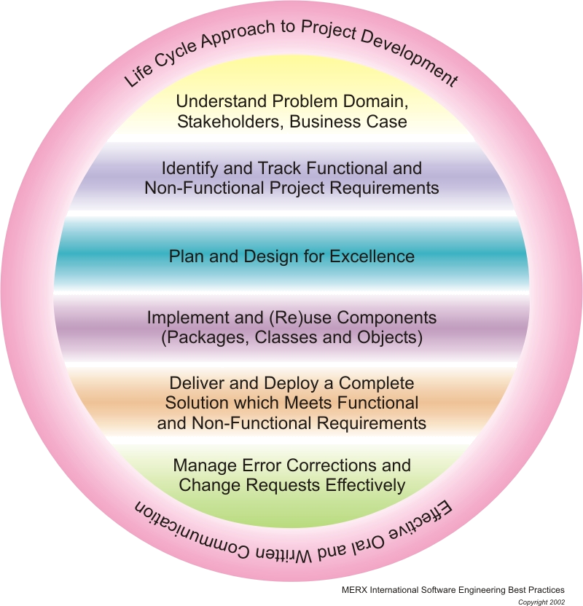
Best Practices

Slide 24
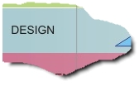
Position in Process
(2)
In this second part
of coverage for the
Design phase, we
focus on documentation
Key deliverable: Design Specification
  Design use cases
  Class hierarchy
  Detailed UML model

Slide 25
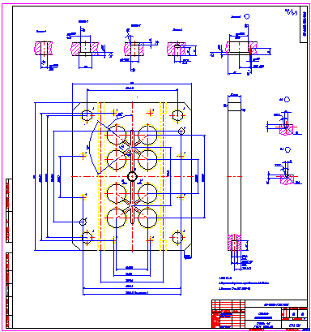
Design Specification
Introduction
Description of Project Design
Functional Overview
  System-Level UML Diagrams
System Architecture
Class Hierarchy
  Map of Use Case Model to Class Hierarchy
Component Definition and Design
  For each component:
    UML Class Diagram
    UML Interaction Diagrams
    User Interface/Look-and-Feel Design
  Prototype Description and Evaluation (if applicable)
  Environment
    Software, Hardware, Networking Required
  Other Non-Functional Requirements (performance etc.)
Supporting Disciplines
  Updated Macro-Level Project Plan
  Current- and Next-Iteration Micro-Level Project Plan
  Quality Assurance Plan Summary
  Configuration Management Plan Summary
  Documentation Plan Summary

Slide 26
Prototyping
Conceptual prototype
Architectural prototype
Usability prototype
Planned activity
  Resources, budget, milestones
Subject to validation
Separate from product design and development

