Slide 1
Chapter 5
Architecture-Driven Component Development

Slide 2
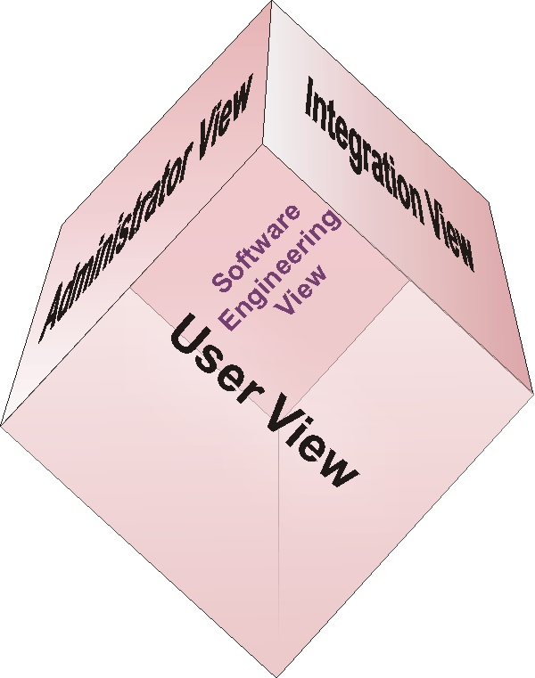
Agenda
Perspectives
Architecture diagrams
Java component
interaction and integration

Slide 3
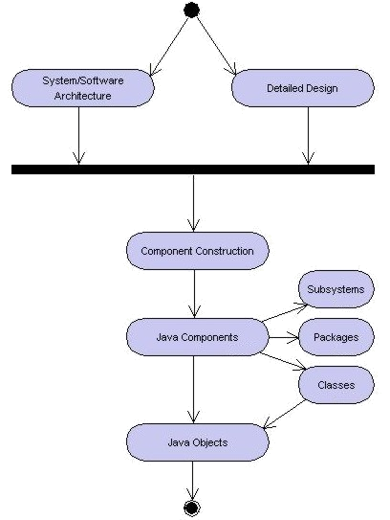
Learning Layout

Slide 4
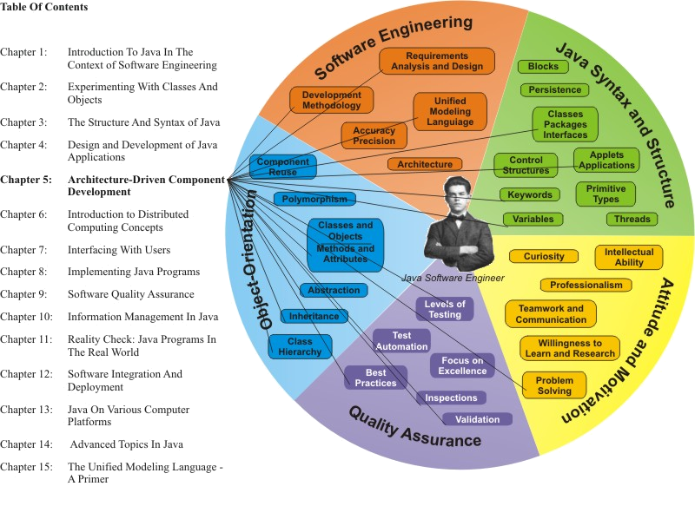
Learning Connections

Slide 5
Elements of Modular Decomposition
High cohesion, low coupling
  “Cohesion refers to the functional relatedness of the entities within a module; coupling refers to the interdependency among different modules.” (Jia)
Abstraction
Integration

Slide 6
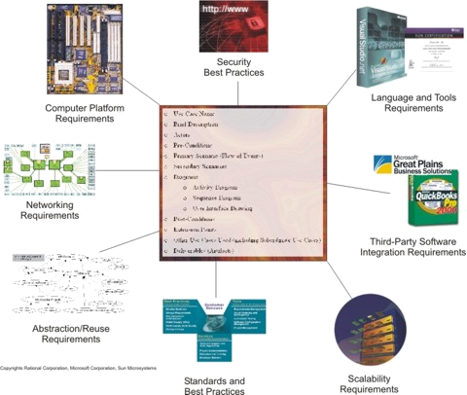
Requirements Decomposition
Stakeholder
Requirements
Technical
Requirements
Environmental
Requirements
Quality
Requirements
Security
Requirements

Slide 7
Modular Programming (1)
Careful creation of comprehensive domain and use case models
Systematic development of a flexible, reusable system architecture
  Logical and physical organization
Packages, subsystems
Creating interfaces and super/subclass relationships which maximize the reuse of components
  Application of proven design patterns
  Use of polymorphism and encapsulation

Slide 8
Modular Programming (2)
Method call parameters setup to support flexible component reuse
Developing a comprehensive, well-designed design model and class hierarchy
  Abstracting reusable components (attributes and methods)
  Organizing classes into packages and subsystems
  Support for remote invocation
Use of available third-party components and technologies which augment system flexibility and extensibility

Slide 9
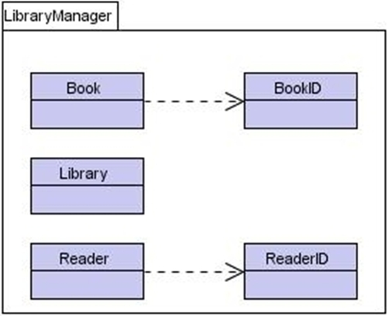
UML Package Diagram

Slide 10
Interfaces
// Interface code:
interface Vehicle {
public void trackMiles();
/* method required in class
implementing this interface */
}
// Class code:
class Car implements Vehicle {
public void trackMiles(){
//...
}

Slide 11
Enumerations
Enumerations are a special kind of class
  Key word enum
  Added Release 5.0
  Declares a set of constants represented by identifiers (enumeration constants)
  Enumerations can have constructors, fields, and methods like other classes

Slide 12
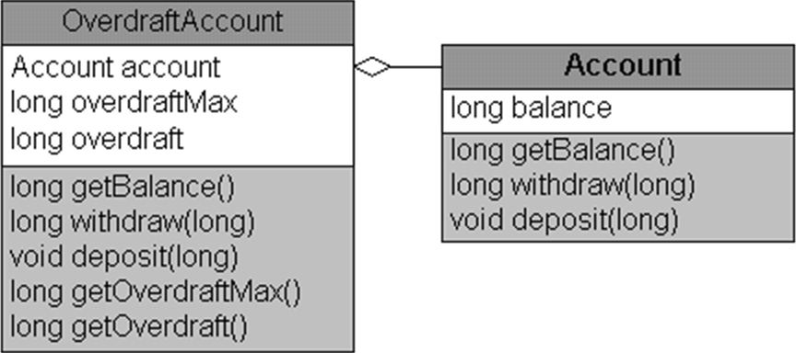
Composition

Slide 13
Object-Orientation Best Practices
Design the class hierarchy for flexible reuse of components, using proven Design Patterns and applying polymorphism
Encapsulate objects to provide stable, secure access (implement information hiding)
Implement inheritance to generalize reusable methods and attributes through abstraction

Slide 14
Sample Unit Test Specification Outline
Brief system and subsystems description
Identification of important interfaces and connections (internal and external)
Summary of organizational software quality assurance best practices relevant to unit testing
  Risk management
  Project management (resources, time, budget)
  Error discovery, tracking, reporting: closed-loop corrective action
  Expected quality levels – error severity management
Unit test descriptions and scripts
For each unit test:
  Test title and description
  Test prerequisites/preconditions
  Set-up needed (e.g. test/data files; database schema/records; test automation tools; reporting tools)
  Testing scripts (step-by-test description of unit test)
  Expected outcomes (white-box; black-box; recovery)
  Areas not covered – dependencies on other components – interfaces
  Result documentation
Requirements validation and certification

Slide 15
Build Management
Configuration management support discipline
  Releases, versions
  Quality assurance
  Validation testing
  Defect tracking and correction

Slide 16
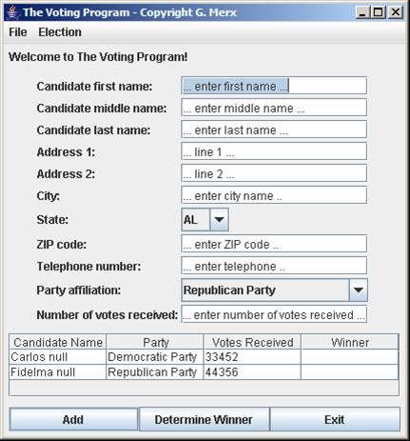
Example Java GUI

Slide 17
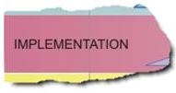
Position in Process
Implementation
phase: construction
of most of the code
Component implementation
Unit testing
Integration and validation
Iterative approach
  Tactical corrections/ adjustments

Slide 18
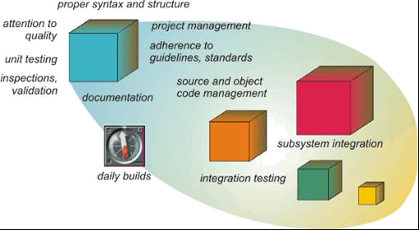
Quality Implementation Process

