Slide 1
Chapter 6
Introduction to Distributed Computing Concepts

Slide 2
Agenda
Distributed application concepts
  Enterprise computing
Overview of agile methodologies
Information persistence
  Files
Scope

Slide 3
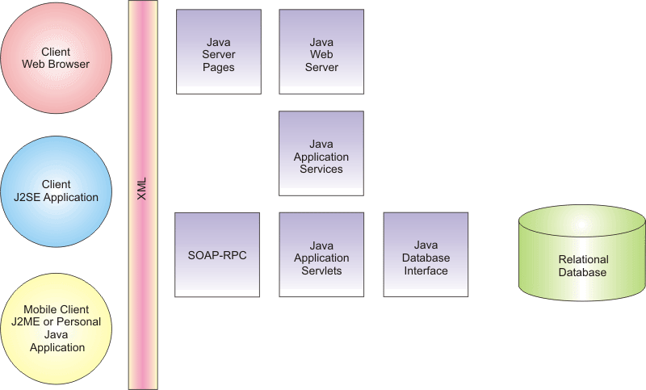
Distributed Computing (1)

Slide 4
Distributed Computing (2)
Java technologies in support of distributed solutions include:
  Remote Method Invocation (RMI) for all-Java applications
  Support for the Object Management Group’s Common Object Request Broker Architecture (OMG CORBA) standard
  Java servlets and Java Server Pages (JSPs)

Slide 5
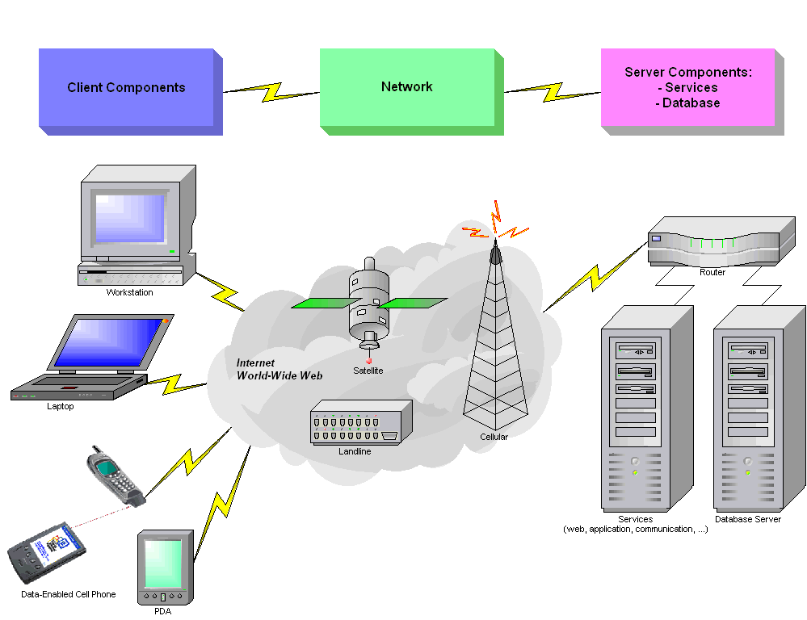
High-level Distributed Architecture

Slide 6
Agile Techniques
Most applicable:
  When the project is small and well-defined
  When the team working on the project is local, relatively small (ten people or fewer), and quite experienced
  When the technology is well-known, such as in a reimplementation or upgrade of an existing product
  When the customers/stakeholders explicitly understand and accept the risks of a streamlined development life cycle

Slide 7

Agile Methodologies
Extreme Programming
Feature Driven Development
SCRUM
  Scrum is an agile, lightweight process that can be used to manage and control software and product development using iterative, incremental practices. It wraps existing engineering practices, including Extreme Programming and RUP.

Slide 8
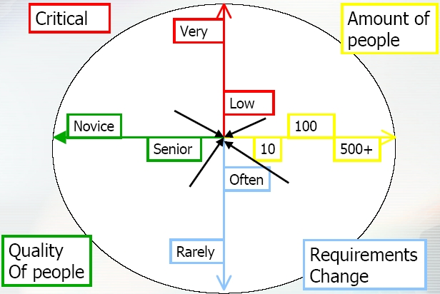
Extreme Programming (1)
When to use
Up: often
Down: rarely

Slide 9
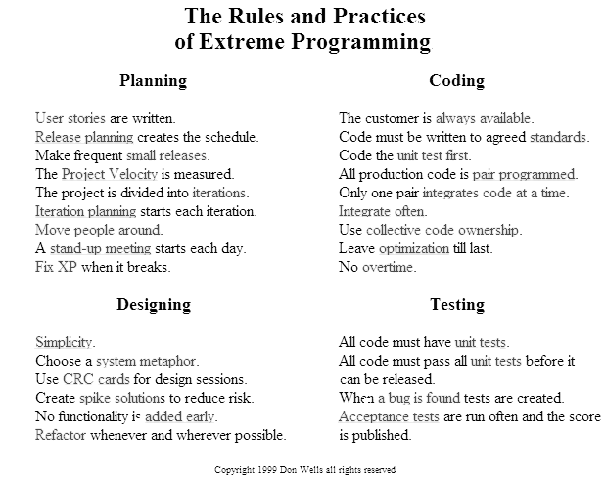
Extreme Programming (2)

Slide 10
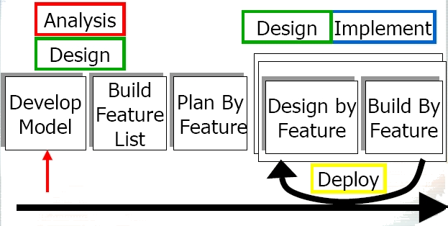
Feature-Driven Development

Slide 11
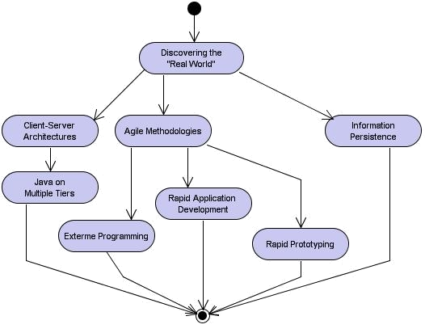
Learning Layout

Slide 12
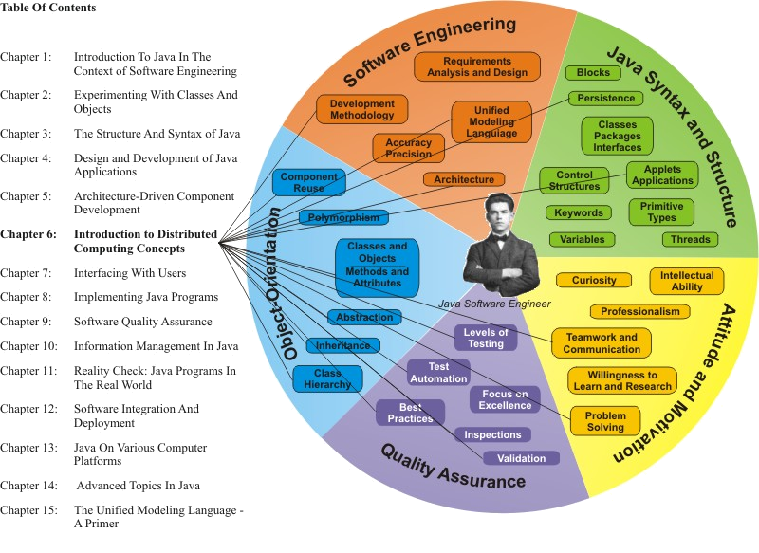
Learning Connections

Slide 13
Commercial Applications
Continuous productivity improvement – process improvement
Quality improvement, improved support and maintainability
Better, faster decisions
Cost or resources savings
Centralized data management; reduced duplication of data; integration of critical information
Shorter time to market for products and/or services
Sustainable competitive advantages

Slide 14
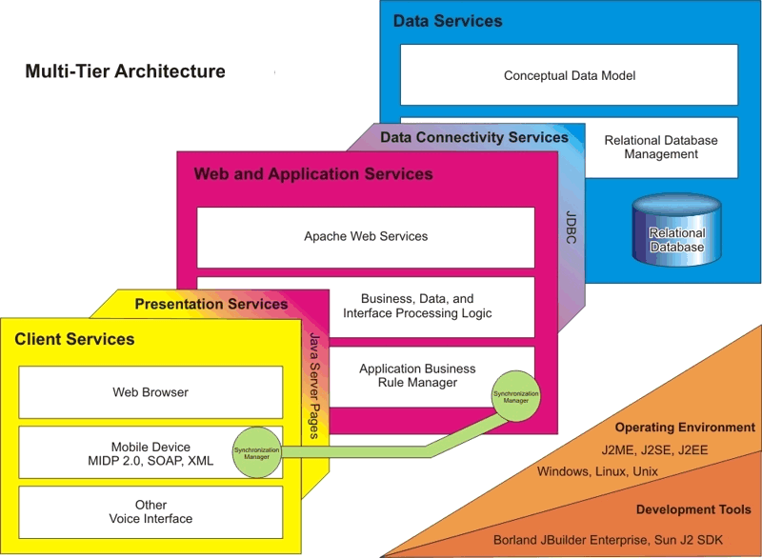
Multi-Tier Architecture

Slide 15
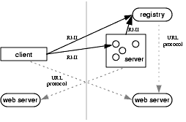
Java RMI
Remote Method Invocation

Slide 16
Java Server Faces (JSF)
Java Server Faces technology includes:
  A set of APIs for representing UI components and managing their state, handling events and input validation, defining page navigation, and supporting internationalization and accessibility
  A JavaServer Pages (JSP) custom tag library for expressing a JavaServer Faces interface within a JSP page

Slide 17

Persistence (1)
Making data persistent is the object-oriented terminology for writing data to a file or database
A file is an organized data structure on a storage device, often a hard disk (HD), which allows for the preservation of information, even when a system or device is no longer powered
Files contain data, but also headers with file management information and some end-of-file indication

Slide 18
Persistence (2)
Example: reading an object from a file
  ObjectInputStream ss =
  new ObjectInputStream(new
  FileInputStream(fileName));
  try {
  candidate =
  (Candidates)ss.readObject();
  } catch (IOException e) {
  // deal with I/O error
  }

Slide 19

Position in Process
The integration of
components occurs at
multiple levels:
  Class and object-level integration: parameters and return values must match the design expectations
  Package-level integration: classes are assembled into appropriate, reuse-oriented packages
  Subsystem-level integration: packages are integrated to provide the functionality of an entire subsystem
  System-level integration: all subsystems together provide the system as specified in the Design Specification

Slide 20
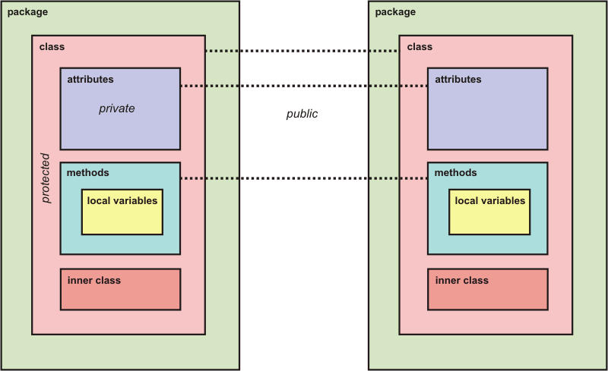
Understanding Scope

Slide 21
Integration Testing
Integration testing of
  Classes and objects
  Packages
  Subsystems
  interfaces
Alpha and beta testing

Slide 22
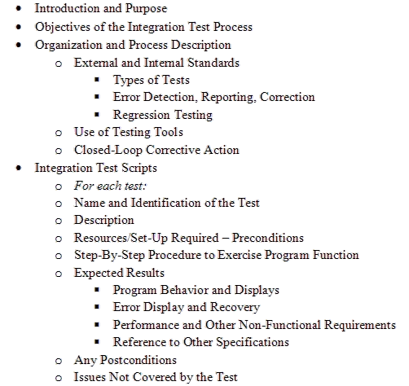
Sample Integration Test Specification Outline

Slide 23
Refactoring
Refactoring is a disciplined technique for restructuring an existing body of code, altering its internal structure without changing its external behavior.
Its heart is a series of small behavior preserving transformations. Each transformation (called a 'refactoring') does little, but a sequence of transformations can produce a significant restructuring.
Since each refactoring is small, it's less likely to go wrong. The system is also kept fully working after each small refactoring, reducing the chances that a system can get seriously broken during the restructuring.

