Slide 1
Chapter 7
Interfacing with Users

Slide 2

Agenda
GUI support
  awt
  javax.swing
GUI design principles
Model-view-controller pattern

Slide 3
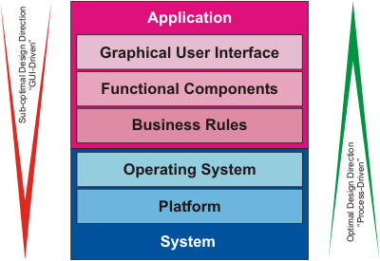
GUI Design Best Practice
Software engineering best practice: design the program user interface after the functional components have been determined from a work process perspective

Slide 4
GUI Design Principles (1)
Use industry and de facto standards where available. If a program is written for a particular platform, then favor the accepted visualization standards for that platform; otherwise either provide an adaptable GUI, or use a platform-neutral GUI like Sun’s METAL look-and-feel.
Use familiar, consistently named user interface artifacts; examples: “OK” and “Cancel” buttons with proper short cuts and organized with correct tab sequences; consistent menu layouts and menu selections with familiar, consistent shortcuts; tooltips for each artifact; well-organized, naturally sequenced display and interaction components.
Activate only logically usable elements – inactivate components, which should logically not be accessible, given the sequence in the workflow in process. Inactivation may be implemented as graying out or simply not showing a user interface component that has no function in the current context.

Slide 5
GUI Design Principles (2)
Provide context-specific online help for all interactions, components, and functions. Implement function key F1 to access the program Help function and Shift-F1 to change the cursor to a question mark for context-specific help queries.
Use GUI artifacts conservatively: avoid font changes, colors, icons, and images, unless there is a clear, justifiable purpose for overriding the default look and behaviors. Use the available screen “real estate” sparingly; don’t waste space, but organize artifacts logically and consistently according to their work process function and sequence.
Avoid cluttering containers; include a maximum of seven elements in a single container (“Miller’s Law”), whenever possible; use labeled containers (frames) to group related GUI elements.
Ensure that all GUI components can be localized for other languages and cultures. Account for differences in script direction in certain languages, if necessary.

Slide 6
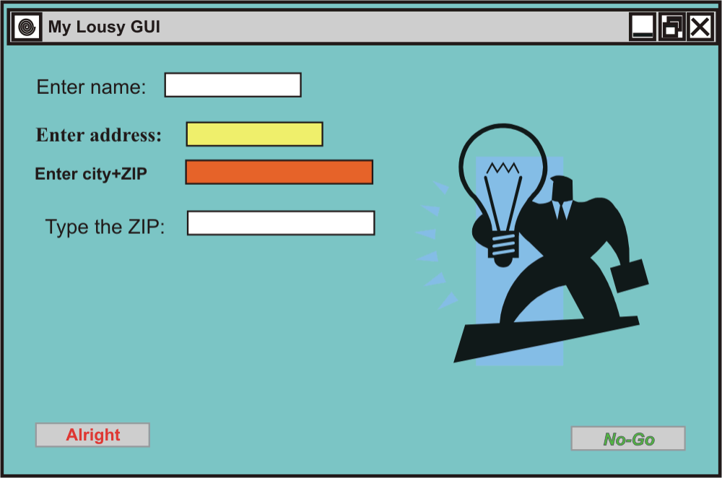
Bad GUI Example
Colors
Consistency
Fonts
Illustration relevance
Button position
Use of screen real estate

Slide 7
Model-View-Controller
Architectural design pattern
  Model: the model component of the pattern represents the business rules and algorithms, the core functional components
  View: the view component provides the user interface and interaction
  Controller: the controller component governs the program navigation functions

Slide 8
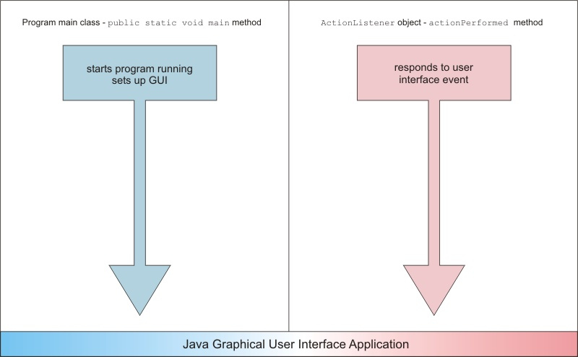
Event-Handling Model
Two entry points
Start-up
Event occurrence

Slide 9
awt Library
The awt library contains the core components for creating user interfaces and for displaying graphics and images
  Some components are for display purposes only, such as labels
  Others are interactive: this means that they generate events when activated by the user
    AWTEvent is the parent class for all possible awt events
  awt also includes the Container class which provides a receptacle for other awt components, including layout managers, which help position components in a graphical environment

Slide 10
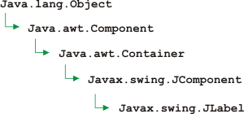
swing Library
swing components extend the core awt graphical components
They are easily identified, as they all start with a “J,” as in JRadioButton, JLabel, and JPanel
They are “lightweight,” meaning that they do not directly interface with underlying operating system calls, and are implemented entirely in Java, making them independent of the underlying operating environment and improving the portability of the resulting application
They provide the typical application with a way to interface with users using well-recognized graphical interface components

Slide 11
GUI Elements
Labels
  JLabel
Buttons
  JButton
Text Fields
  JTextField
Text Areas
  JTextArea
Check Boxes
  JCheckBox
Radio Buttons
  JRadioButton
Choice Lists
  JComboBox
  JList
  Multiple-selection lists
Scroll Bars
  JScrollPane
Other
  JPopupMenus

Slide 12
Platform Look-and-Feel
UIManager.
getSystemLookAndFeelClassName() retrieves the look-and-feel of the current operating platform and allows the programmer to let the program dynamically set its look-and-feel according to the platform on which it is running at this time

Slide 13
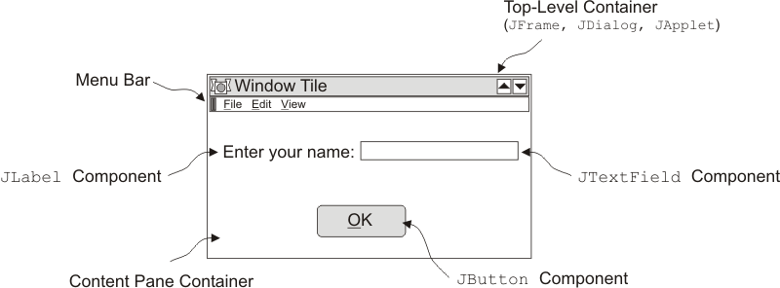
Container Hierarchy

Slide 14
Layout Managers
Java layout managers provide for the logical grouping of components, depending on the intended functional layout. The following layout managers are among those available:
  Flow layout
  Border layout
  Box layout
  Card layout
  Grid layout
  GridBag layout

Slide 15
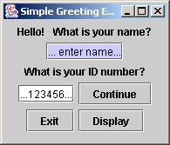

Example: Flow Layout

Slide 16
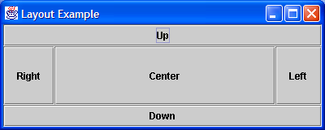
Example: Border Layout

Slide 17
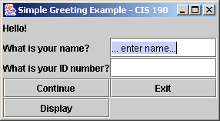
Example: Grid Layout

Slide 18
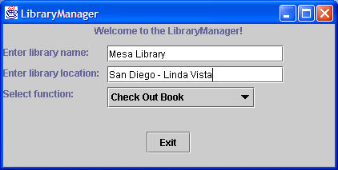
Example: GridBag Layout

Slide 19
GridBag Parameters
gridx - specifies the cell containing the leading edge of the component
gridy - specifies the cell at the top of the component
gridwidth - specifies the number of cells in a row
gridheight - specifies the number of cells in a column
weightx - specifies how to distribute extra horizontal space
weighty - specifies how to distribute extra vertical space
  anchor - determines where to place the component: the absolute values are: CENTER, NORTH, NORTHEAST, EAST, SOUTHEAST, SOUTH, SOUTHWEST, WEST, NORTHWEST; the relative values are: PAGE_START, PAGE_END, LINE_START, LINE_END, FIRST_LINE_START, FIRST_LINE_END, LAST_LINE_START, LAST_LINE_END; the default value is CENTER
fill - determines whether to resize the component, and if so, how: NONE, HORIZONTAL, VERTICAL, BOTH
insets (top, left, bottom, right) - the space that a container must leave at each of its edges
ipadx - specifies the internal padding of the component in the horizontal direction
ipady - specifies the internal padding of the component in the vertical direction

Slide 20
Event Listeners
Interaction Type | Type of Listener
Button click, Return pressed in text field, or menu item selection | ActionListener
Main window close button activated | WindowListener
Mouse button click while the cursor is over a component | MouseListener
Mouse moved over a component | MouseMotionListener
Component becomes visible | ComponentListener
Component gets keyboard focus | FocusListener
A table or list selection changes | ListSelectionListener
… implements ActionListener
  Integrated
  Inner class
  Separate class

Slide 21
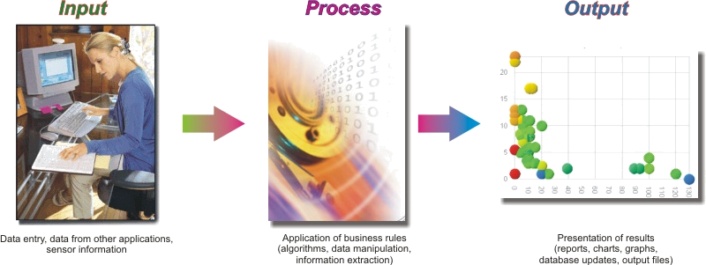
Types of Applications
Business, entertainment, scientific/technical, …

Slide 22

Position in Process
It is important to
understand the Testing
Phase as a formal phase
of testing at this stage
in the development process, not as the first instance of testing overall: testing activities should permeate the development process from the earliest activities of concept validation to the verification of ongoing maintenance activities after the product is generally released

Slide 23
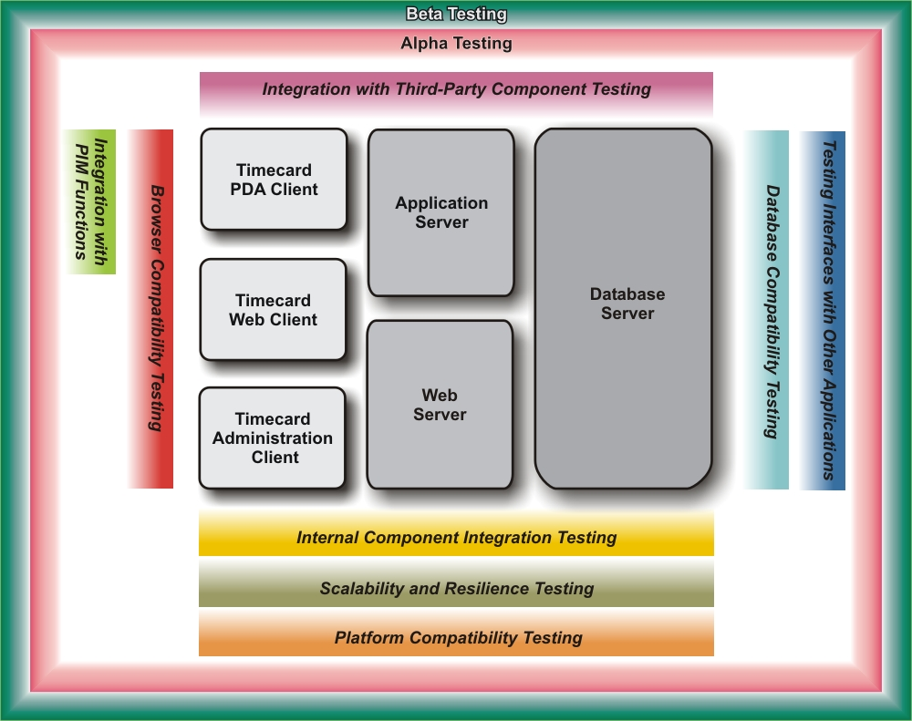
Test Coverage
Example:
Electronic
Timecard
Application

Slide 24


Customer Testing
Alpha testing
  Initial exposure to customers of some functions
Beta testing
  Initial customer implementation – productive use

