Slide 1
Chapter 8
Implementing Java Programs

Slide 2
Agenda
Implementation
  Effective team work
Certification
Multi-tasking
  Multiple threads
Multimedia support

Slide 3
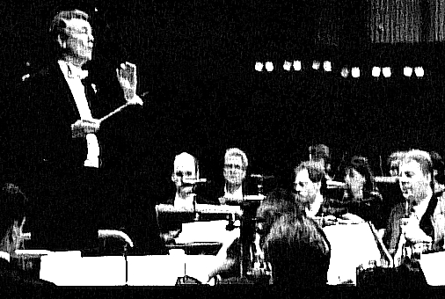
Implementation Coordination
Implementation
  Largest team
  size
  Coordination
  Project management
  Error avoidance

Slide 4
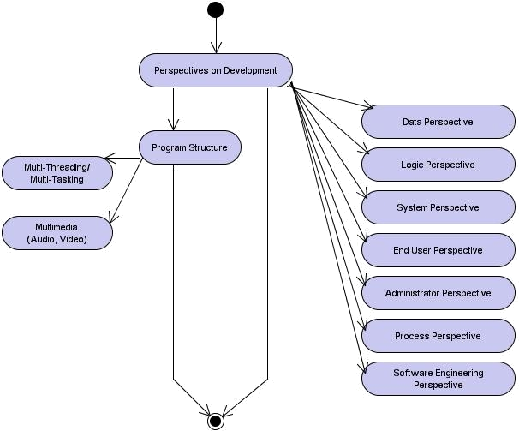
Learning Layout

Slide 5
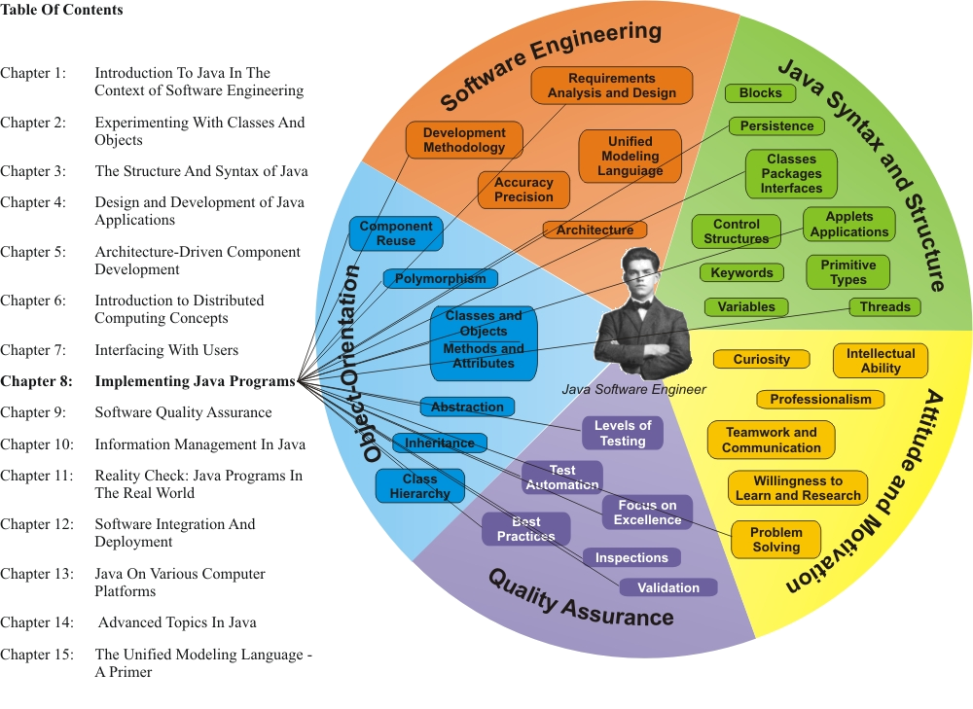
Learning Connections

Slide 6
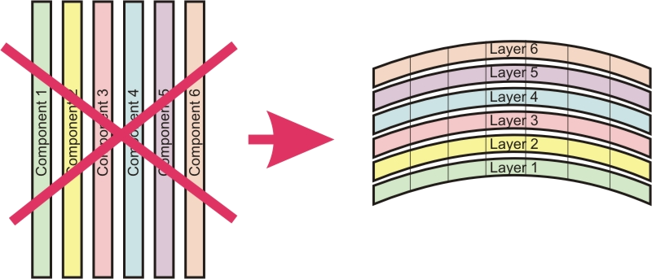
Effective Teamwork
Develop project a layer at a time
  Iterations
  Nightly builds

Slide 7
Product Perspectives (1)
End user perspective
Administrator perspective
Process perspective
Software engineering perspective
Data perspective
Logic perspective
System perspective

Slide 8
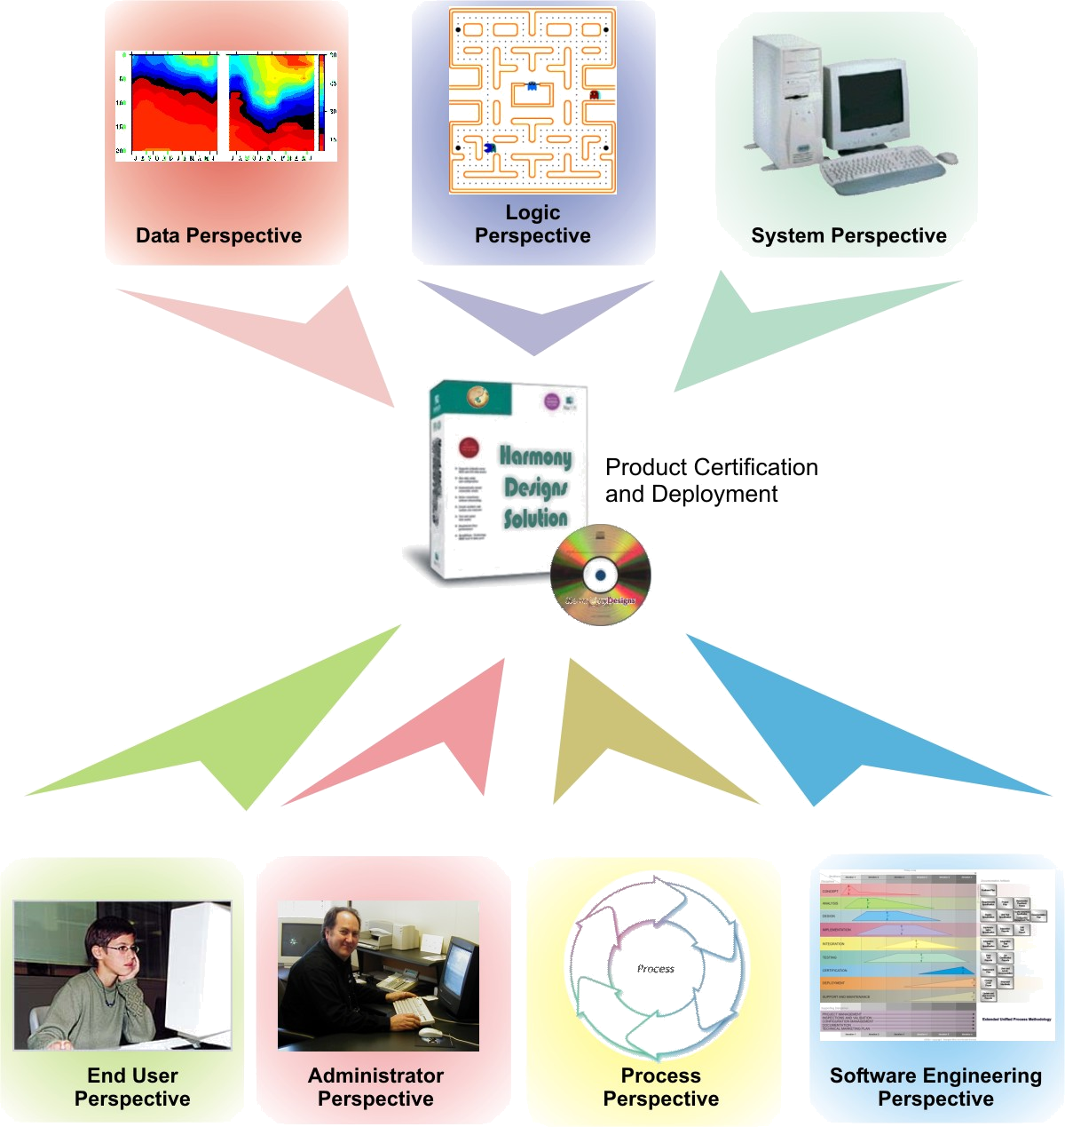
Product Perspectives (2)

Slide 9
Reusable Components
The characteristics of a well-structured, reusable component include:
  One purpose, one entry and one exit point
  Clearly defined, well-protected interfaces (parameters and return values)
  Low coupling, high cohesion
  The creation of functional value
  Flexibility to use in a variety of scenarios (e.g. polymorphism)
  Simplicity – proper structure and sequencing of class hierarchy and packages (e.g. abstraction)
  Extensibility – flexible ability to create child class extensions (e.g. inheritance)
  If for external reuse, adherence to Javabean™ packaging and documentation (e.g. Javadoc™) standards

Slide 10
Multithreading
A thread is a part of a program set up to run on its own while the rest of the program does something else
A single program can have lots of threads if that is what is needed to get the job done. Threading is also called multitasking

Slide 11
Multimedia (1)
The support of multimedia functionality in Java is provided by a collection of classes in different packages, including awt, image, and graphics.
The simplest form of multimedia is an animation, or the display in rapid sequence of a related series of frames

Slide 12
Multimedia (2)
Java provides basic support for animation and video of visual multimedia data as well as various sound formats
  In the standard J2SE SDK, Java 2 supports the following basic sound file formats:
    WAVE
    AU
    AIFF
    AIFF-C
    SND
More advanced video and audio formats, such as AVI and MP3, are supported via the Java Media Framework (JMF)

Slide 13
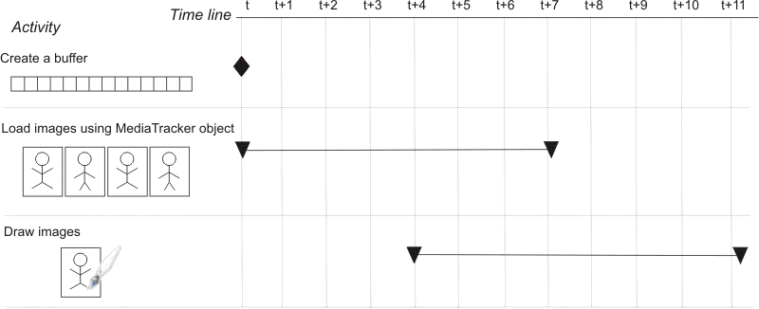
Animation Visualization

Slide 14
Java Media Framework
The Java Media Framework API (JMF) enables audio, video and other time-based media to be added to applications and applets built on Java technology
  Heavy weight components are used in JMF as they permit using native rendering methods for higher frame rate video

Slide 15
Initial Operational Capability
The synthesis of the requirements analysis, design, and implementation activities is reviewed from the perspective of Initial Operational Capability (IOC)
  IOC is a milestone that encompasses the validation of all the constituent project components as a product solution, in the context of stakeholder (or market) requirements

Slide 16
Certification
Certification is a quality assurance process that validates that a product meets all productization requirements. Typically, the following areas are reviewed:
  Functionality meets requirements (Requirements and Design Specifications)
  Product has no outstanding major errors
  Product meets quality requirements (functional and non-functional)
  Product is supportable
  All documentation is in place

Slide 17
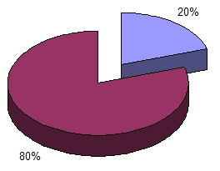
Error Handling
In most applications, 20% of the code handles the primary scenario where the function works beginning-to-end without error or interruption, while the remaining 80% handles error and exception handling and recovery

Slide 18

Position in Process
In this phase of the
development life cycle,
the Certification Phase,
the code should be
complete and validated.
Early customers have added their feedback, and all errors of any significance have been corrected and released into the most current version.
This phase is strictly under the control of Quality Assurance (QA)
A product shall not be released for general distribution unless QA certifies that it meets all agreed-upon requirements within agreed-to quality parameters (functional and non-functional).
QA issues a Certification Report at the end of this phase.

