Slide 1
Chapter 9
Software Quality Assurance

Slide 2

Agenda
Software quality
assurance
Industry-standard
software methodology models
Bug???

Slide 3
Software Quality Assurance (SQA)
Software Quality Assurance (SQA) is an organization’s quality control discipline implemented organizationally, technically, and procedurally to ensure that all participants assigned to a software engineering project adhere to software quality assurance best practices agreed to by project stakeholders.

Slide 4
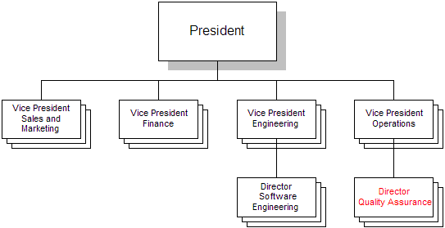
Suggested SQA Position

Slide 5
Cost of Errors
Software bugs cost the U.S. economy nearly $60 billion a year, with $22 billion of that avoidable if the industry improved testing so that more errors could be detected earlier, according to a study commissioned by the National Institute of Standards and Technology

Slide 6
SQA Responsibilities
Process control: ensuring that all contributors follow agreed upon software engineering process guidelines established in writing by the company
Adherence to best practices and standards: establishing and enforcing agreed upon quality standards, from documentation to testing to certification; following industry best practices like CMMI or ISO 9000
Testing: appropriate testing according to agreed upon standards at every phase in the development life cycle; test automation to ensure regression control
Inspection: critical evaluation of completed components; validation against requirements
Closed-loop corrective action: exception reporting, tracking, and resolution
Configuration management: reliable tracking of all intellectual property (IP), such as all versions of source and object code files; documentation; specifications; test data files; etc.

Slide 7
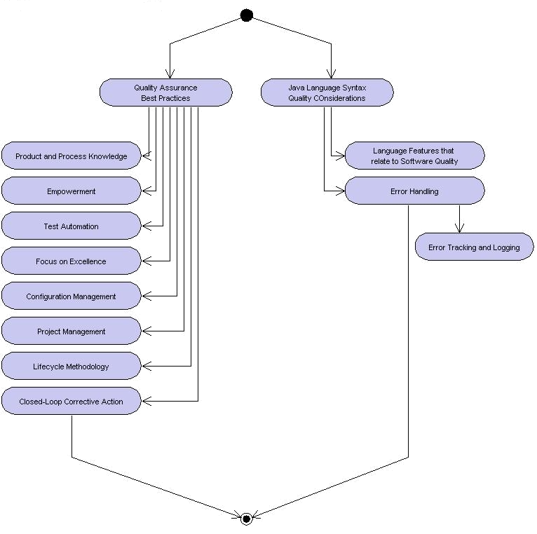
Learning Layout

Slide 8
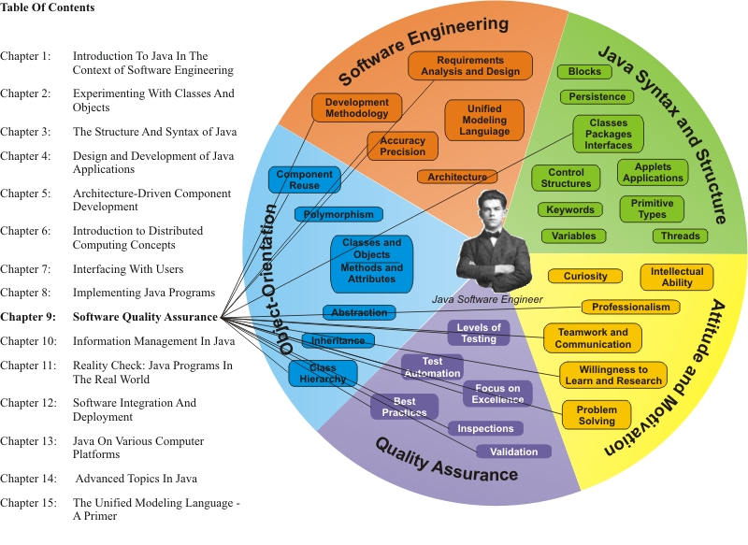
Learning Connections

Slide 9
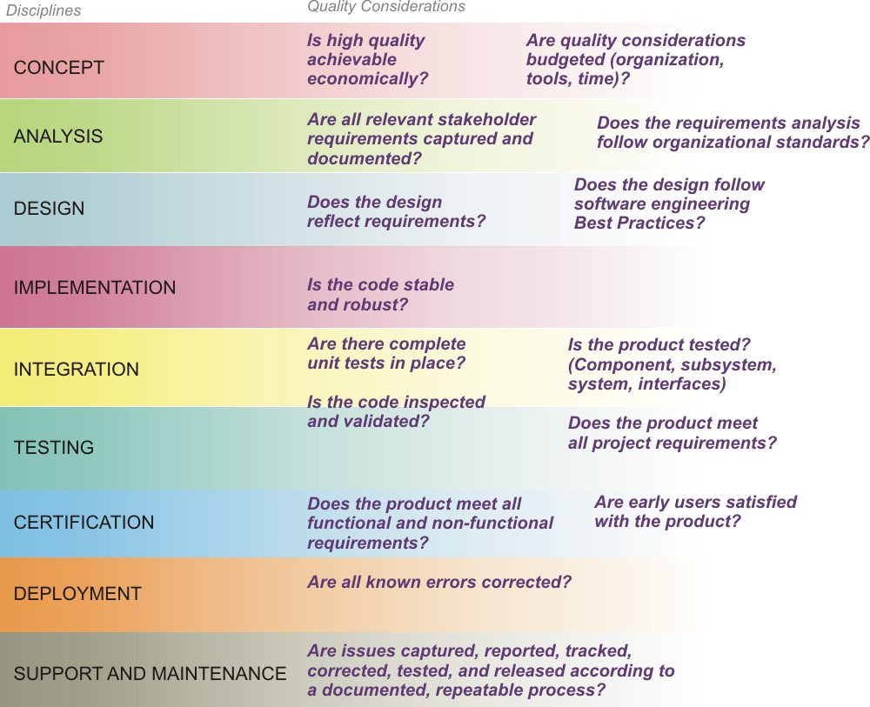
Quality in Every Discipline

Slide 10
Types of Errors
Functional errors: a function does not operate as the requirement specifies
Logic errors: a function generates an incongruent result such as incorrect data
User interface errors: access to a function is constrained because of incorrect or inefficient user accessibility
Non-functional problems: such as excessive lag time, hard to read, poor organization/layout, etc.

Slide 11
Quality Determinants
Complete implementation of requirements
Improved work process (faster, easier, more reliable)
Resilience: does not “crash,” recovers from errors gracefully
Efficiency: uses system and network resources sparingly, supports as many users as needed (scalability)
Quality measurements (number of errors per lines of code, severity of errors, etc.)
Stakeholder satisfaction with the implementation

Slide 12
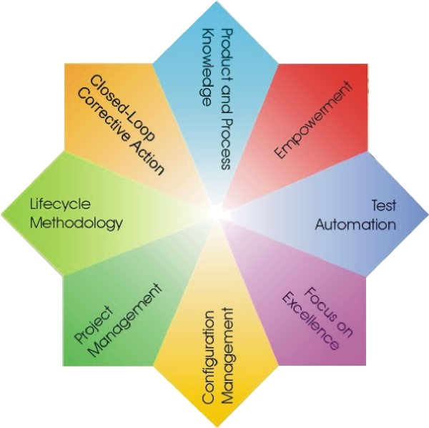
SQA
Best
Practices

Slide 13
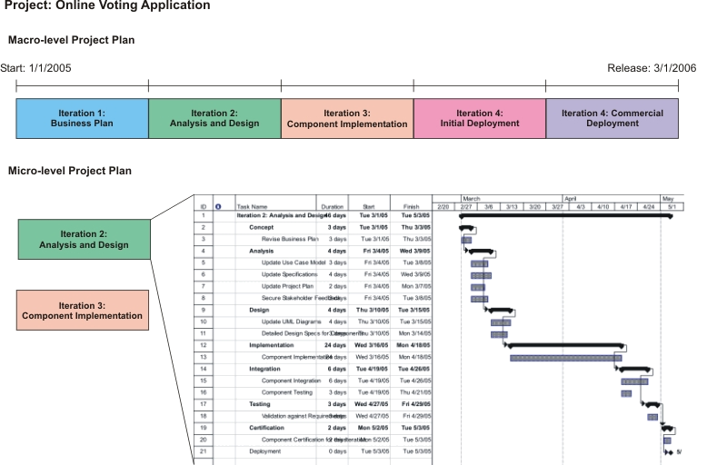
Software Project Management

Slide 14
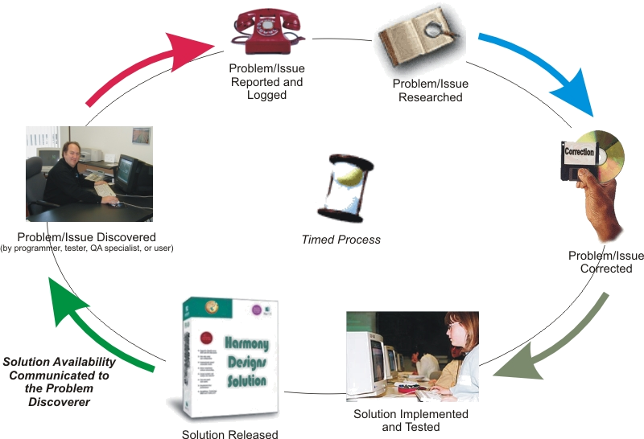
Closed-Loop Corrective Action

Slide 15
Inspections
The engineer responsible for a component finishes development and unit testing.
The engineer calls an inspection and provides appropriate documentation to inspection participants as far in advance as possible and in accordance to the particular process being followed. Inspection team members should include peers, supervisors, potential customers, if possible, quality assurance and technical writing specialists, and anyone else who can positively contribute to the inspection process.
During the inspection meeting(s), the engineer positively justifies the validity of his/her implementation. The team critically inspects every aspect of the deliverable, seeking problems, incorrectly implemented functionality (as compared to the Requirements and Design Specifications), inadequacies, discontinuities, and weaknesses.
All problems are documented, corrected subsequently by the engineer, with a follow-up inspection to ensure that all inadequacies have been properly removed, without regressions.

Slide 16
Verification and Validation
Verification involves the reduction and hopefully elimination of known defects. Verification also tests requirements that are necessary for successful deployment and operation of the software product, but which are not necessarily functional domain requirements. Performance and throughput, peak-workload processing performance, user interface testing, documentation and procedures testing, and backup and recovery testing are examples of non-functional areas of requirement.
Validation involves the checking of milestones and deliverables against written commitments, typically documented in the project’s Requirements Specification. This process also provides for the validation of the work processes associated with the project and its outcomes against agreed-upon standards.

Slide 17
Developing for Quality
Work within the plan, respect the Specifications; if in doubt, get input from stakeholders; use inspection and validation processes
Use common Design Patterns which encapsulate object-orientation best practices, e.g. Model-View-Controller; Façade; Creator; Pure Fabrication; etc. and implement principles of Low Coupling and High Cohesion
Pursue abstraction and flexibility of logic; build components to be replaceable
Use minimal scope for memory components
Base design decisions on underlying work processes and their optimization
Account for future changes and scalability
Standardize input and output interfaces for interoperability
Document everything; use JavaDoc to create standard-format source documentation; provide online help

Slide 18
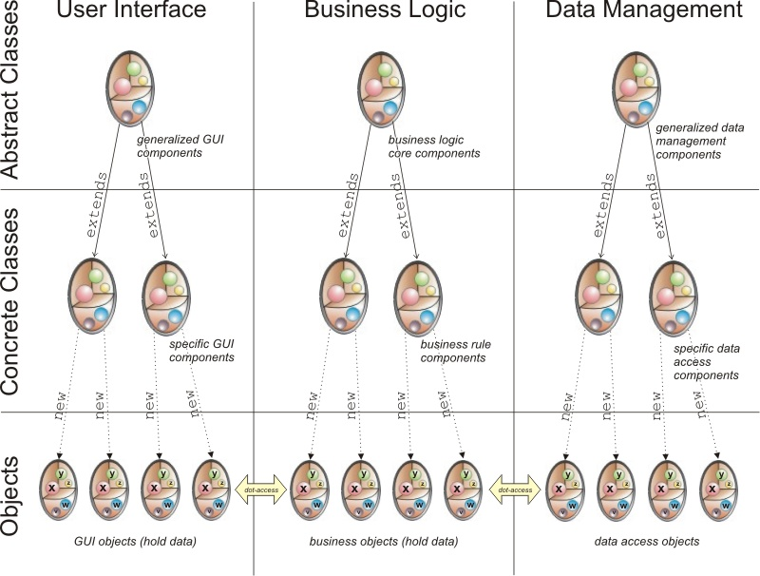
Separation of Concerns

Slide 19

Position in Process
The process of
deployment is
critical, because
this is the phase where significant customer installations take place and where the product experiences the first extensive exposure to use under operational conditions

Slide 20
Maintenance and Support
The maintenance and support work process includes the following activities:
  problem acquisition, via telephone, email, or website incident report
  if genuine, problem analysis, categorization, and documentation
  assignment for resolution
  resolution tracking
  inclusion in upcoming release (“point release”)
  informing incident initiator of solution availability
  closing the incident when solution is available

Slide 21
try…catch Block
try {
ss.close();
} catch (IOException e) {
System.out.println
(“I/O Error on closing “ +
e.toString());
noError = false;
}

