Slide 1
From Programming to
Architectures
Mike Sobolewski
TTU Computer Science
sobol@cs.ttu.edu

Slide 2
What is a System?
A system - a regularly interacting group of components forming a unified whole to accomplish a specific objective.
An architecture - a coherent organizational structure of a system. An architecture can be hierarchically decomposed into modules that interact via links that connect modules, and constraints for assembling modules.
What all systems (subsystems) have in common?
  Domain: the intent and states with which actions are done.
  What the system is responsible for?
  Process: the act or action of moving in a path from domain state to state.
  How is the system used?
  Carrier: one that carries the process.
  How does the system fulfill its responsibilities?

Slide 3
Working Complex Systems
Five common characteristics to all complex systems:
There is some hierarchy to the system.
This view says that a complex system is always hierarchic.
The primitive components of a system depend on your point of view.
One man's primitive is another’s complexity (triplets).
Components are more tightly coupled internally than they are externally.
The parts form components independent of other components.
There are common patterns of simple components which give rise to complex behavior.
The complexity arises from the interaction or composition of components, not from the complexity of the components themselves.
Complex systems which work evolved from simple systems which worked.
Or stated more strongly: complex systems built from scratch don't work, and can not be made to work.

Slide 4
Prospects
Tempering Expectations
Difficulty Area
low Networking (TCP/IP, etc.)
low Workstations, PCs (X, MS windows, etc.)
low Mass storage
some Distributed Integrating Frameworks
some Distributed resource manager
some Distributed TP manager
some Configuration management
some Security and administration
high Feature linking among various models
Fully integrated tool suites
Nearly total global D/M distributed database integration
Complete, unified D/M enterprise model
∞

Slide 5
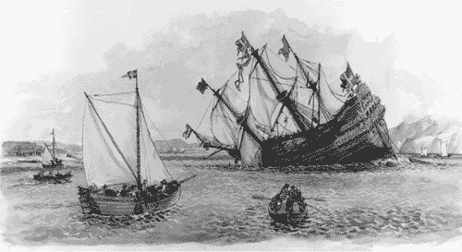
The Warship Vasa
Vasa Museum, Stockholm, Sweden
http://www.tar.hu/softarchpract/part01.html
Notes:
In the 1620s, Sweden and Poland were at war. The king of Sweden, Gustavus Adolphus, was determined to put a swift end to it and commissioned a new warship the likes of which had never been seen before. The Vasa was to be the world's most formidable instrument of war: 70 meters long, able to carry 300 soldiers, and with an astonishing 64 heavy guns mounted on two gun decks. Seeking to add overwhelming firepower to his navy to strike a decisive blow, the king insisted on stretching the Vasa's armaments to the limits. Her architect, Henrik Hybertsson, was a seasoned Dutch shipbuilder with an impeccable reputation, but the Vasa was beyond even his broad experience. Two-gun-deck ships were rare, and none had been built of the Vasa's size and armament.Like all architects of systems that push the envelope of experience, Hybertsson had to balance many concerns. Swift time to deployment was critical, but so were performance, functionality, safety, reliability, and cost. He was also responsible to a variety of stakeholders. In this case, the primary customer was the king, but Hybertsson also was responsible to the crew that would sail his creation. Also like all architects, Hybertsson brought his experience with him to the task. In this case, his experience told him to design the Vasa as though it were a single-gun-deck ship and then extrapolate, which was in accordance with the technical environment of the day. Faced with an impossible task, Hybertsson had the good sense to die about a year before the ship was finished.The project was completed to his specifications, however, and on Sunday morning, August 10, 1628, the mighty ship was ready. She set her sails, waddled out into Stockholm's deep-water harbor, fired her guns in salute, and promptly rolled over. Water poured in through the open gun ports, and the Vasa plummeted. A few minutes later her first and only voyage ended 30 meters beneath the surface. Dozens among her 150-man crew drowned.Inquiries followed, which concluded that the ship was well built but "badly proportioned." In other words, its architecture was flawed. Today we know that Hybertsson did a poor job of balancing all of the conflicting constraints levied on him. In particular, he did a poor job of risk management and a poor job of customer management (not that anyone could have fared better). He simply acquiesced in the face of impossible requirements.The story of the Vasa, although more than 375 years old, well illustrates the Architecture Business Cycle: organization goals beget requirements, which beget an architecture, which begets a system. The architecture flows from the architect's experience and the technical environment of the day. Hybertsson suffered from the fact that neither of those were up to the task before him.

Slide 6
Complexity
Software is inherently complex because
We attempt to solve problems in complex domains
We are forced by the size of the problem to work in teams
Software is incredibly malleable building material
Discrete and distributed systems are prone to unpredictable behavior
Software systems consist of many pieces, many of which communicate
Technical incompetence and non-engineering approach
This complexity has led to many problems with large software projects. The term "software crisis" was first used at a NATO conference in 1968.

Slide 7
Software Crisis
The "software crisis" manifests itself in
Cost overruns and schedule slippage
User dissatisfaction with the final product
Buggy software and brittle software
Poor maintainability
Some factors that impact on and reflect complexity in software
Large namespaces (variables, functions, etc) that are visible
Constraints on the time-sequence of operations (real-time constraints)
Memory management (garbage collection and address spaces)
Concurrency
Distribution
Security
Event driven user interfaces

Slide 8
Development Myths
A general statement of objectives" is all I need from the customer. I will fill in the details later.
As a customer I can keep changing my mind and redefining the intent of a program. After all, software is flexible, isn't it?
I have got to begin coding because we are already late!
The only deliverable for a successful project is a source code listing.
It is impossible to assess the quality of a program until after it is written and working.
Once the program is written, we are done.
Any competent computer scientist or engineer can design programs.
Let us run a few test cases and then we'll be finished!
I know what the program does, I don't have time to document it.
I am working on programs that were originally written 30 years ago. How can I use modern software engineering techniques?

Slide 9
CS vs. SE
A software crisis encompasses many problems
Myths cause management confusion and technical resistance
A software life cycle model helps to deal with problems (design, manufacturing, retirement)
Software engineering addresses the life cycle in a systematic way (design, manufacturing, retirement) PSP, TSP, CMM, unified process (inception, elaboration, construction, transition), agile processes (XP, FDDP, DSDM)

Slide 10

Influences on Architecture technical, business, social
Architect’s Influences
Customer
and End User
Developing
Organization(s)
Requirements
(Qualities)
Architecture
Design
Commercializing
Organization
Implementation
Technical
Environment
Architect(s)
Innovate or Die
System
Architect’s
Experience

Slide 11
Innovate or Die
Years
Durability of
Competitive Advantage
5
4
3
2
1
Improve engineering
Reduce product
Create a
productivity 10%-20%
development
“Category Killer”
cycle time by 30%
Product

Slide 12
Popular Definitions of “Architecture”
Organizational
  Functional - Mission tasks (subtasks) to be done
  Logical - Communications links between functions areas
  Physical - Resources used to execute functions
System
  Components - Major elements of system
  Connections - Links between components
  Constraints - Environment & behavior bounds
Software
  Components - Major SW design relevant structures
  Connections - Data and control flow mechanisms
  Constraints - Performance, construction rules and resources

Slide 13
Software Architecture
The SW architecture of a computing system is the coherent organization of the system, which comprise software components, the externally visible properties of those components, and the relationship among them.
The architecture view of system is:
an abstract view that distils away details of implementation, algorithm, and data representation
concentrates on the behavior and interactions of “black box” components
developed as the first step toward the designing a system that has a collection of desired properties
the realization of early design decisions regarding decomposing the system into parts
The design view of system is:
the product of system technical requirements
the plan of right steps to ensure that the system will perform as expected

Slide 14
Module, Classifier, Component, Part
Module - a separate and distinct unit of a process, system, or subject area that may be used as a conceptual component of a model or a part in a system.
Software Module - a unit of software storage and manipulation. Software modules include source code modules, binary code modules, and executable code modules.
Classifier - a collection of instances that have something in common. A classifier can have features that characterize its instances. Classifiers include interfaces, classes, datatypes, and components.
Component - a modular part of a system that encapsulates its contents and whose manifestation is replaceable within its environment. A component defines its behavior in terms of provided and required interfaces. As such, a component serves as a type, whose conformance is defined by these provided and required interfaces (encompassing both their static as well as dynamic semantics).
Part - an element representing a set of instances that are owned by a containing classifier instance or role of a classifier. (See role.) Parts may be joined by attached connectors and specify configurations of linked instances to be created within an instance of the containing classifier.
Role - the named set of features defined over a collection of entities participating in a particular context. Collaboration: The named set of behaviors possessed by a class or part participating in a particular context. Part: a subset of a particular class which exhibits a subset of features possessed by the class. Associations: A synonym for association end often referring to a subset of classifier instances that are participating in the association.

Slide 15
Context of Architecture
Requirements
(inception, elaboration)
• system characteristics
• user needs
Architecture
(elaboration)
• design elements
• interactions among elements
• constraints on elements/interactions
Design
(elaboration)
• modularization and detailed interfaces
• algorithms and data types
Implementation
(elaboration, construction, transition)
• representation and encoding
Architecture implies:
• description and prescription
• multiple views
• importance of style
• capture form and context

Slide 16
A Natural Continuation of Current Work
Reuse
Standards
Megaprogramming
Software
Architecture
Very Long Lived Systems
Application Complexity
Defined Processes

Slide 17
Why do we need Software Architecture?
Greater Cost Savings
Life-Cycle
Maintenance Issues
Systems/Hardware Issues
Increased Emphasis
on Standards
Software Reuse
Reuse Of Analysis & Design
Need for Adaptability
Difficulties in
Implementing Reuse
Need for Long-Lived Systems

Slide 18
What Makes a "Good" Architecture?
Well-defined modules whose functional responsibilities are allocated on the principles of information hiding and separation of concerns.
Each module should have a well-defined interface that encapsulates or "hides" changeable aspects from other software that uses its facilities.
Quality attributes should be achieved using well-known architectural tactics specific to each attribute.
Never depend on a particular version of a commercial product or tool. If it depends upon a particular commercial product, it should be structured such that changing to a different product is straightforward and inexpensive.
Modules that produce data should be separate from modules that consume data - increased modifiability.
Well-defined processes or tasks that do not necessarily mirror the module decomposition structure - processes may thread through more than one module.
Every task or process should be written so that its assignment to a specific processor can be easily changed, perhaps even at runtime.
Feature a small number of simple interaction patterns. This will aid in understandability, reduce development time, increase reliability, and enhance modifiability.

Slide 19
Intermediate Views of Architecture
An architectural pattern (style) is a description of elements and relation types together with a set of constraints on how they may be used.
A reference model is a division of functionality together with data flow between the pieces.
A reference architecture is a reference model mapped onto software elements (that cooperatively implement the functionality defined in the reference model) and the data flows between them.

Slide 20
SW Architecture Relationships
Reference
Model
Reference
Architecture
Software
Architecture
System
Architecture
Architectural
Pattern

Slide 21
SW Architecture Relationships
Reference
Model
Reference
Architecture
Software
Architecture
Architectural
Pattern
Project Management
Architecture
Technical
Architecture
System
Architecture

Slide 22
Software Architectural Patterns
Data Flow Systems
  Batch Sequential
  Pipes and Filters
Call and Return Systems
  Main Program and Subroutines
  Object-Oriented Systems
  Hierarchical Layers
Independent Components
  Communicating Processes
  Event Systems
  Service-oriented
Data-Centered Systems
  Transactional Database Systems (Repository)
  Blackboards
  Space-based (Tuple Spaces, JavaSpaces)
Virtual Machines
  Rule-Based Systems
  Interpreters
  JITs
Key features and rules for combining those features
so that architectural integrity is preserved

Slide 23
Different Views of Architecture
Academic View
SW Developer’s View
Components
Connections
Constraints
Components
Data Flow
Control Flow
Timing, etc.
Layering, stds, etc.
HW/SW allocation

Slide 24
Framework-Based View of Architecture
System Requirements,
and Vision for Changes
COTS
capabilities
Components
Connections
Constraints
Components
Data Flow
Control Flow
Timing, etc.
Layering, stds, etc.
HW/SW allocation
Integration
COTS Products
Framework
(SW Infrastructure)
Custom/COTS
Integration Software
Networking
(OSI)
Profile
Other Profiles
Technical
Reference
Model
Data Element
Standards
A framework is a collection of SW artifacts that is usable by several different apps;
Is a kind of common denominator for a family of apps.
We create frameworks because we want to reuse group of classes and algorithms among them.

Slide 25
Conceptual View of Generic Application Framework
Client generic environment
Framework kernel and API
messages
call-backs
subclassing
subclassing
messages
call-backs
Domain application
Domain kernel and API

Slide 26
Frameworks
A framework consists of:
• a set of generic services accessible by any domain
• a set of programmatic and user interfaces
• a set of protocols for data and command exchange
• a set of utilities for decision making
• a philosophy which embraces cross-functional working
• an approach which allows multi-vendor computing systems
• an approach to support standards

Slide 27
Application Functional Components
End user
in/out
Presentation
Logic
Business
Logic
Data
Management
Data
Processing
(DML)
Database
Processing
(DBMS)
Database
in/out
Database
Application Distribution Points?

Slide 28
Distribution Points
Application Components
Presentation Logic
Business Logic
Data Management
DP
RP
DBL
RDM
DDM
Distributed
Presentation
(DP)
Client
Server
Remote
Presentation
(RP)
Client
Server
Distributed
Business
(DB)
Client
Server
Remote
Data
Management
(RDM)
Client
Server
Distributed
Data
Management
(DDM)
Client
Server
Combination
DBL-DDM
Case
Client
Server

Slide 29
Distributed Architecture Rules
• cooperative distributed processing -
distributed data, transaction, and workflow management
• fine granularity security
• local autonomy
• no reliance on central site
• continuous operation
• location transparency and location independence
• fragmentation independence
• replication independence
• distributed query processing
• hardware independence
• operating system independence
• network independence
• DBMS independence
• wrappers for existing applications
• simple is beautiful - object technology

Slide 30
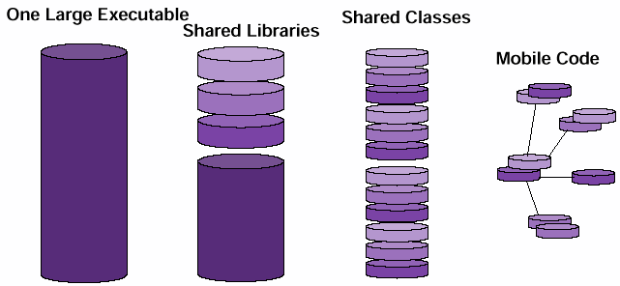
Shrinking Programs
OLE - One Large Executable
Shared Libraries
Share classes
Mobile Code
Program units becoming smaller

Slide 31
Interface/Implementation Distinction
Interfaces are forever
Implementation is for now, can change
Mobile code allow multiple implementations
Clients need to know a service interface; what not how

Slide 32
Change Over Time
Needs of the system evolve faster than the system
Many decisions implemented in runtime
It’s less about knowing and more about not knowing
Access to a network with reconnection to the network

Slide 33
Barriers to integration
• Multiple application programs for a single user
• Wide variety of user interfaces
• Non-availability of source code
• Incompatible formats
• No general translator between formats
• Inability to make function calls out of applications
• Inability to share common data
Open standards

Slide 34
Architecture and Reuse
What Kinds of Architectures Best Support Reuse?
Object-
Oriented
Systems
Maximum
Reuse
Potential
Event
Systems

Slide 35
OO Systems - Why?
Key reuse mechanisms:
objects
  encapsulation
  abstraction
classes
  generalization
  specialization
pattern-based
  analysis
  design

Slide 36
Event Systems
Key Ideas
Event Manager
Components can announce (broadcast) events
(for example changed)
Components can register for events of interest
and associate operations with them for example
(addObserver)
Upon event announcement the corresponding
operations are automatically invoked
by the system (for example update).
Hence, invocation is implicit, although explicit
invocation is often still provided (for example
in the MVC pattern, model is used explicitly by
view and via update implicitly by other components)
addObserver
changed
update
update
Components

Slide 37
Event Systems
Advantages
Provides significant support for reuse
  Can integrate components simply by registering their interest in the events of the system
Eases system evolution
  Loose coupling helps eliminate name dependencies between components
  Can add/replace components without interfering with existing objects
  Changes localized to system register/event manager
Upward compatible
  Can still have explicit invocation

Slide 38
What is Service Oriented Pattern?
An SOA application is a composition of services
A “service” is the atomic unit of an SOA
Services encapsulate a compute process
Service Providers Register themselves
Service use involves: Discover, Find, Bind,
Execute
Most well-known instance is RMI, Jini, Web
Services, FIPER/SORCER
Service
Registry
Discover,
Find
Discover,
Register
Service
Consumer
Service
Provider
Bind,
Execute

Slide 39
Different Directory Services
Service
Registry
Service
Consumer
Lookup
Response
Host 1
Service
Provider
A
Register
Service
Provider
B
Service
Provider
C
Request
Service
Provider
D
Host 2
What is registered? (component, component description)
How it is activated? (dynamic, static)
How to find registry? (static, dynamic discovery)
How to invoke service? (call on a remote reference - protocol irrelevant, over a specific protocol and a generated proxy for it

Slide 40
Service Oriented Architecture – RMI/JERI
RMI
Registry
Naming.bind
Naming.rebind
Naming.unbind
Naming.lookup
Get live stub/proxy
Generate stub/proxy
Client
Server
Invoke
interface method
Exported interfaces

Slide 41
Web Services – SOAP/WSDL
UDDI
Get WSDL
Register WSDL
HTTP
Client
App
Server
Execute operation of
portType described in SAOP
Generate stub
(static, dynamic, DII)
portTypes
on application server

Slide 42
Peer-to-Peer – JXTA
Rendezvous
Peer
Find advertisement
Advertise
Peer
Peer
Pipe binding
Communicate

Slide 43
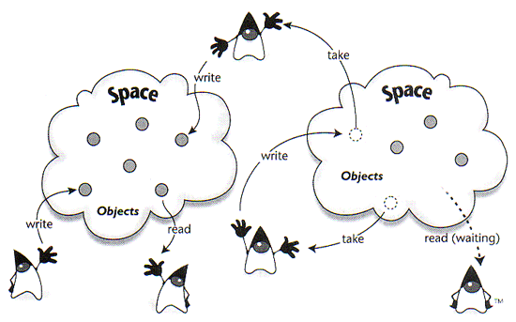
JavaSpaces
Processes use spaces and simple operations to coordinate
JavaSpace: a place on the network to exchange and store objects
A tuple-space inspired by David Gelernter's Linda
Operates as a Jini service
Uses Jini programming model: leasing, events, transactions
For distributed persistence and algorithms

Slide 44
SW Architecture Relationships
Reference
Model
Reference
Architecture
Software
Architecture
System
Architecture
Architectural
Pattern

Slide 45
Class Model vs. Architecture and Design
Reference Architecture
Computing System
Framework Modules
DP
DP
SW Architecture
DP
DP
DP
DP
DP
Integration Modules
Design
DP
DP
DP
Domain Modules
Feasibility Study

Slide 46
System and Architecture Qualities
System are frequently redesigned
  the replacement is functionally identical
because they are:
  difficult to maintain
  port
  scale
  too slow
  compromised by hackers
The architecture support for qualities is the mapping of system’s functionality onto SW structures

Slide 47
System Quality Discernable at Runtime
Performance
Security
Availability
Functionality
Usability
  Learnability
  Efficiency
  Memorability
  Error avoidance
  Error handling
  Satisfaction

Slide 48
System Quality not Discernable at Runtime
Modifiability
  Extending or changing capabilities
  Deleting unwanted capability
  Adapting to new operating environments
  Restructuring
Portability
Reusability
Integrability
Scalability
Testability

Slide 49
Integrabilty
Factors affecting integrability
• Published interfaces
• Programmatic interfaces
• Published data formats
• Porting to many platforms
• Communication interfaces as a network accessible service
• Adherence to de facto standards for that domain

Slide 50
Business Qualities
Time to market
Cost
Projected lifetime of the system
Targeted market
Rollout schedule
Extensive use of legacy systems

Slide 51
Qualities of the Architecture
Conceptual integrity (unification at all levels)
Correctness and Completeness
(meeting system’s requirements)
Buildability – ease of constructing a desired system
(cost and time)
Scalability
Manageability
Accessibility
Interoperability (Horizontal flexibility)
Changeability (Vertical flexibility

Slide 52
Environment Complexity
Decomposition
Structure
  Data driven
  Operations
  Control Strategy
Loose Coupling / Independent Components
Not the number of classes or LOCs, but their interrelationship.
Global knowledge does not exist in distributed systems.

Slide 53
Structured Programming
A top-down approach, characterized by development of control structures for major subsystems before defining their components, which in turn are developed at their highest level before their details are considered.
The concept of system shape – input-processing-outpt view
A deliberate restriction in the use of nesting and branching constructs inside the programming language used. Ideally, only statement concatenation, selection of statements based on the testing of a condition, and iteration are permitted [Dijkstra68].
Avoid decision splitting – keep the actions taken based on a decision as close as possible
Module – subprogram (e.g., a procedure, function, subroutine) coupling (loosely coupled) and cohesion (module components are tightly bound)

Slide 54
The Three Most Common SP Methodologies
Jackson Structured Programming, which is based on aligning data structures with program structures,
Dijkstra's structured programming, which is based on splitting programs into sub-sections, each with a single point of entry and of exit,
and a view derived from Dijkstra's which also advocates splitting programs into sub-section with a single point of entry, but is strongly opposed to the concept of a single point of exit.

Slide 55
Procedural Systems
Functional decomposition is natural way to deal with complexity
Change creates opportunities for mistakes and unintended consequences and nothing you can do will stop changes
Requirements always change
Functional decomposition implies weak cohesion and tight coupling
Changing a function, or even data used by a function, can wreak havoc on other functions
Functional decomposition focuses on the wrong thing – functions – that leads to a cascade of changes from which it is difficult to escape
Cohesion refers to how closely the operations in a routine are related.
Coupling refers to strength of connection between two routines.

Slide 56
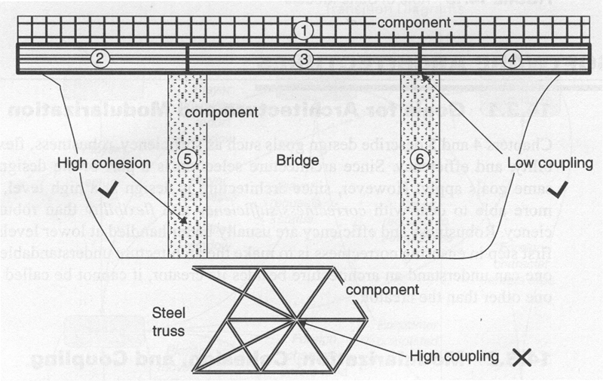
Coupling and Cohesion
Coupling
Strength of interaction between modules in system
Cohesion
Degree to which the tasks performed by a single module are functionally related

Slide 57
Object-Oriented Paradigm
The structured paradigm consists of structured systems analysis, structured design, structured programming and structured testing. They were introduced between 1975 and 1985, and looked promising at the time.
Two problems with structured paradigm:
  Could not scale up: good for programs with 5,000 or 50,000 LOCs, but inadequate for products with 500,000 LOCs or more.
  Could not reduce maintenance costs.
The reason is that structured techniques are either action oriented (such as data flow analysis) or data oriented (such as Jackson method) but not both.
Object-oriented paradigm considers data and action to be of equal importance (active data).
In structured paradigm, there are abrupt transitions between specification phase and the design phase. In object-oriented paradigm, the transition is smooth, because objects enter the life cycle at the very beginning. The objects are extracted in the analysis phase, designed in the design phase, and coded in the implementation phase. Thus, the object-oriented paradigm is an integrated approach.

Slide 58
Class Model vs. Architecture and Design
Reference Architecture
Computing System
Framework Classes
DP
DP
SW Architecture
DP
DP
DP
DP
DP
Integration Classes
Design
DP
DP
DP
Domain Classes
Feasibility Study

Slide 59
UML Modeling in System Development
Requirements
Tests
System
Tests
Define
Use Case,
Deployment
Diagrams
System
System
Level
Integrate
Architecture
Subsystem
Components
Tests
Integration
Tests
Define
Component,
Interaction
Diagrams
Component
Level
Integrate
Design
Code Module
Components
Tests
Unit
Tests
Define
Class,
Package
Diagrams
Class
Level
Generates

Slide 60
UML Modeling in System Development
Requirements
Use Case,
Deployment
Diagrams
Define
System
Tests
Tests
System
System
Level
Integrate
Architecture
Component,
Interaction
Diagrams
Define
Integration
Tests
Tests
Subsystem
Components
Component
Level
Integrate
Design
Class,
Package
Diagrams
Define
Unit
Tests
Tests
Code Module
Components
Class
Level
Generates

Slide 61
UML Packages
Classes
Design
Composite
Structures
SW Architecture
Components
Deployments
System Architecture

Slide 62
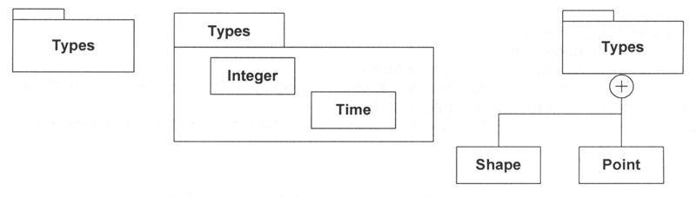
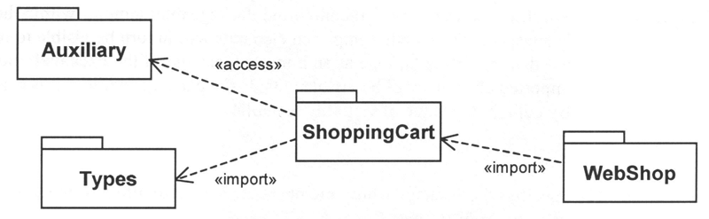
Packages
Examples of packages with members
Public and private package imports

Slide 63
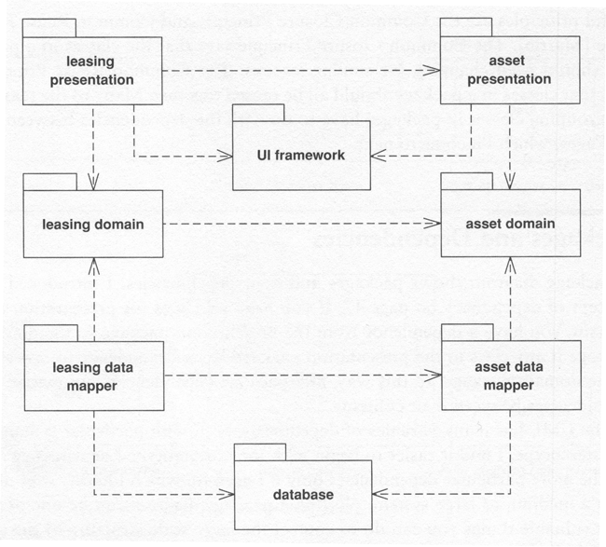
Package Diagram

Slide 64
Packages and Dependencies
How do you chose which classes to put in which package?
Common Closure Principle
  Classes in a package should need changing for similar reasons
Common Reuse Principle
  Classes in a package should be reused together
Acyclic Dependency Principle
  Avoid cycles in dependencies
Stable Dependency Principle
  More dependencies coming into package the most stable package’s interface needs to be
Stable Abstraction Principle
  Stable packages tend to have higher proportion of interfaces and abstract classes

Slide 65
Packages - Comments
Namespace for classes
The dependency relationships are not transitive
Indicate global dependency by <<global>>
Keep application’s dependencies under control
Reduce the interface of the package by exporting only a small subset of the operations (Façade DP) and make supporting classes private visibility
A compile-time grouping
For run-time grouping use component diagrams

Slide 66
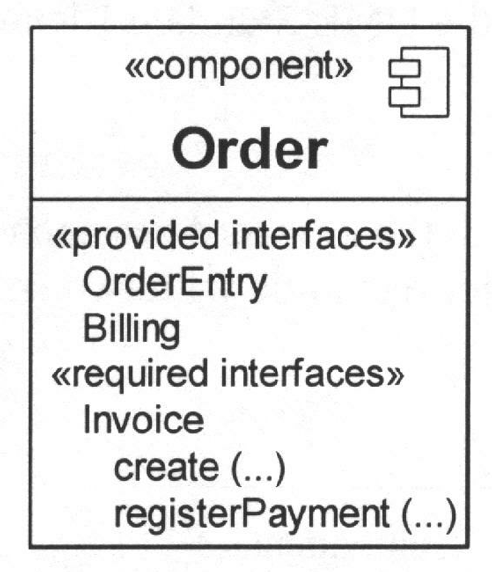
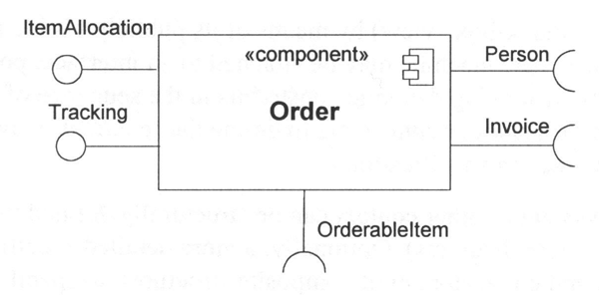
Component
Black box notation
The ball-and-socket notation
Listed internally

Slide 67
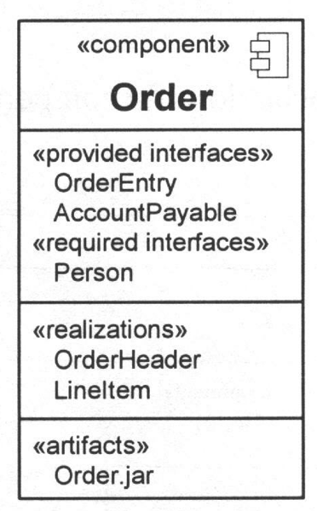
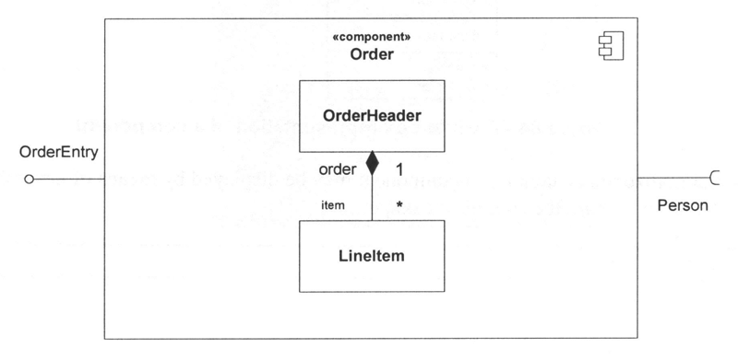
Internal Structure of Component
White-box notation
Nested representation
<<realizations>>

Slide 68
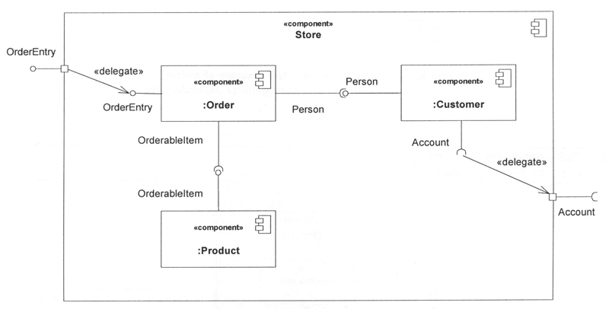
Complex Component
White-box component in terms of other components

Slide 69
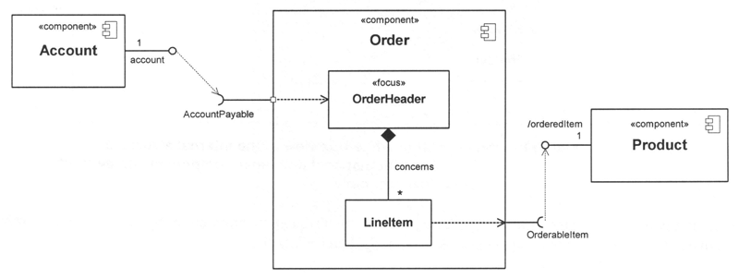
Component
White-box component with wiring through dependencies on a structure diagram

Slide 70
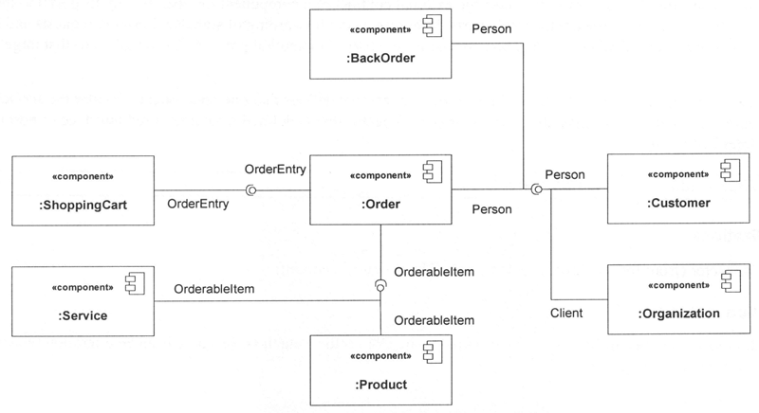
Component Diagram
White-box component in terms of other components

Slide 71
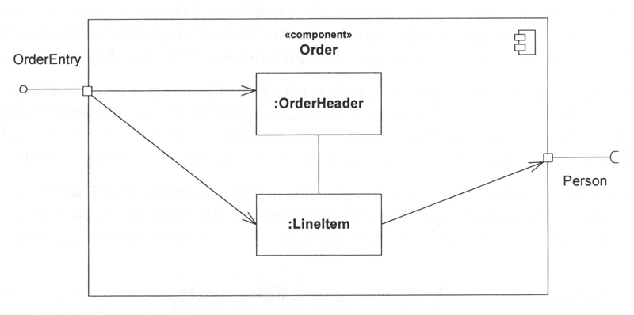
Component – Composite Structure
White-box component with delegation connectors (ports) and two parts

Slide 72
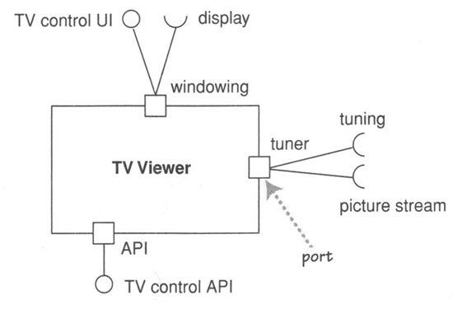
A Component with Multiple Ports

Slide 73
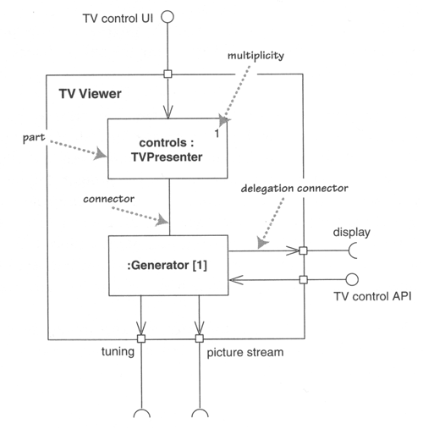
Component with Internal Parts

Slide 74
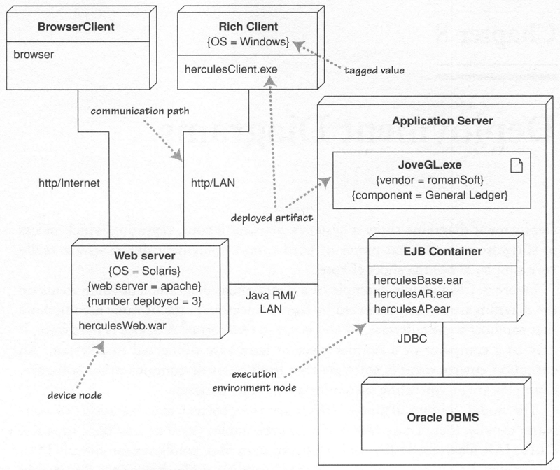
Deployment Diagram

Slide 75
Domain, Metadomain, Carrier Facility (DMCF)
Generic Paradigm: Domain (What)
Metadomain (How)
Carrier (Who)
The metasystemic paradigm is defined as a metamodeling approach where each three-layer metamodel is used to specify the three-layer model.
Domain: the states of process with which actions are done.
What I am responsible for?
Metadomain: the act or action of moving in a path from state to state.
How am I used?
Carrier: one that carries the process
How do I fulfill my responsibilities?

Slide 76
DMC Facility (DMCF)
Domain
Metadomain
Carrier
Computer Science
Executable Code
OS
Processor (VM)
Source/Binary code
Compiler Rules
Compiler Runtime
Data
Control Strategy (main)
Functions (Operations)
Goal
Knowledge (Rules)
Inference Engine
Semantics
Syntax
Alphabet
Sociology/Psychology
Values
Management
Resources
(People, Buildings, Equipment)
Mind
Spirit
Body
Engineering
Product
Process
(Design, Manufacturing)
Organization (Virtual)
SW Engineering
CS
Project Management
Engineering
Photography
Aperture
Shutter Speed
Film/Chip (ISO)
von Neumann Model vs.
Memory
Control Unit
Arithmetic Logic Unit
FPGA
Binary Inputs
Propagation Combination Gates
Notes:
Short for Field-Programmable Gate Array, a type of logic chip that can be programmed. An FPGA is similar to a PLD, but whereas PLDs are generally limited to hundreds of gates, FPGAs support thousands of gates. They are especially popular for prototyping integrated circuit designs. Once the design is set, hardwired chips are produced for faster performance.
A von Neumann architecture is a computer design model that uses a single storage structure to hold both instructions and data. The term describes such a computer, which implements a Turing machine, and the common "referential model" of specifying sequential architectures, in contrast with parallel architectures.
The separation of storage from the processing unit is implicit in the von Neumann architecture. The term "stored-program computer" is generally used to mean a computer of this design.

Slide 77
Metasystemic Paradigm
From Programming to Architecture
Executable Code
OS
Processor (VM)
Source Code
Binary Code
Compiler
Data Structures
Control Strategy (main)
Operations
Signature
Algorithm
Method, Function
Manifest
*.class
*.jar
Referent
Conceptual Model
Runtime Model
Attributes (Fields)
Operations (Interface)
Class (Fields, Methods)
UI-PI
Business Logic
Business Object
Model (Observable)
Controller (Mediator)
View (Observer)
Design Intent
Interactions (Interaction Diagram)
Part (Class Diagram)
Constraints (Use Cases)
Interfaces (Interaction Diagram)
Component (Composite Structure)
Constraints/Qualities (Use Cases)
Connections (Interaction Diagram)
Components (Component Diagram)

Slide 78
Find what varies and encapsulate it!
Many design patterns use encapsulation to create layers between objects
Identify where things vary (commonality analysis)
  Finding out how thing are common
  Defines the family in which these elements belong
  Seeks structure that is unlikely to change over time
  Defines domain and metadomain (process) of DMC
  Gives the architecture its longevity
Identify how they vary (variability analysis)
  Reveals how family members vary
  Makes sense within a given commonality
  Captures structure that is likely to change
  Defines specific process and implementation in DMC
  Drives architecture fitness for use

Slide 79
A Paradigm for Finding Components
Identify the nouns present, and create objects representing them. Then find the verbs relating to these nouns (actions) and implement them by adding methods to the objects.
Leads to larger class hierarchies than we might want
Use commonality and variability analysis as a primary architectural and design approach than looking for at just nouns and verbs.

Slide 80
Commonality and Variability Analysis
By looking at what these objects must do (cohesive domain perspective), we determine how to call them (process perspective) .
Domain level
AbstractClass
Commonalty analysis
+operations
Process level
Variability analysis
ConcreteClass
ConcreteClass
+operations
+operations
Carrier level
When implementing these classes, ensure that the API provides sufficient information to enable proper implementation and decupling.

Slide 81
Interfaces and Specialization
Interface (Abstract Class)
  Defines the commonality
  What interface is needed to handle the responsibilities of this component?
Derived classes
  Defines the variability
  Given this particular implementation (this variation), how can I implement it with the given specification?
Process perspective
  Identifies the interface I need to use to handle all the cases of the domain (commonality
  Given the interface, how can I implement this particular case (this variant).

Slide 82
Object-Oriented Hiding Paradigm
Encapsulation:
  Reduced side effects: the object data and the way it implements its responsibilities are shielded from changes caused by other objects.
  Any kind of hiding: implementation, derived classes, design details, instantiation rules.
  Domain: accessibility (public, protected, private) and hiding data elements and types (via abstract classes, interfaces) - the object is responsible for its state only.
  Process: accessibility and hiding private methods - the only way to affect an object is to call a method on that object.
  Carrier: accessibility hiding internal classes, the internals of class are unknown to other classes
Polymorphism
  Many (poly) different forms (morphs) of behavior for the same call – simplified interaction diagrams.
  Domain: the same domain for multiple types
  Process: getting different behavior through the abstract (supercast) reference
  Carrier: classes derived from abstract classes or implementing the same interfaces

Slide 83
Modular DMC Decomposition
Each module (component, part, class) of a hierarchical computing system should define clearly three DMC levels.
An object is an entity with responsibilities. A special, self-contained holder of both data and operations that operate on that data. An object’s data is protected from external objects. A class implements the methods and data of an object of its type.
Object orientation supports modularity to isolate variation
In the OO paradigm, you must constantly think about your problem from all three levels: domain, process, carrier.
Interface/abstract class:
  Domain: placeholder for other classes
  Metadomain: generalized behavior for classes that implement specifics of the intent the interface/abstract class represents
  Carrier: does not create instances

Slide 84
OO Metasystemic Paradigm
Using objects shifts responsibility to a more local, cohesive, and loosely coupled level
At the domain level , an object is a set of reachable states and responsibilities of its class - defined intent
At the process level, an object is a set of messages that can be sent by other objects or by itself -specified interfaces
At the carrier level, an object is a class that implements its methods in particular programming environment - executable classes
Notes:
Systemic approach to OO programming is expressed by formulating a coherent body of principles at three levels:
Domain of component unification - Attributes
Process of interactions- Interfaces (operations)
Carrier implements interactions – Classes (fields, methods)
Metasystemic approach to OO programming is expressed by hierarchical systemic analysis to all component three-levels:
OO Apps
Frameworks and Patterns
Architectures

Slide 85
From Model to System
Referent
Conceptual Model
Runtime Model Modeling (4 blocker)
Constraints/Qualities (Use Cases)
Connections (Interaction Diagram)
Components (Component Diagram) Elaborating (framework, feasibility study)
Reference Model
Architectural Pattern
Reference Architecture Architecting (top level design)
Requirements
Specification
Implementation Developing (designing and implementing)
Problem & App Domains
SW Deployment
Computing System Deploying

Slide 86
From File Transfer to Virtual Services
Services
Database Servers
File Servers
CORBA
Web
RMI/Jini
Web Services
Groupware
TP Monitors
1982
1986
1990
1995
1998
2001
SOOA + Web + SPOA

Slide 87
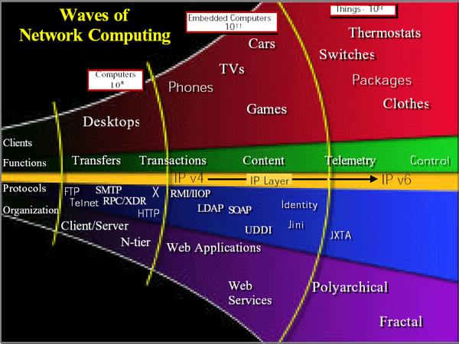
Waves of Network Computing
UPnP
SLP
Salutation
BT/SDP
Ninja

Slide 88

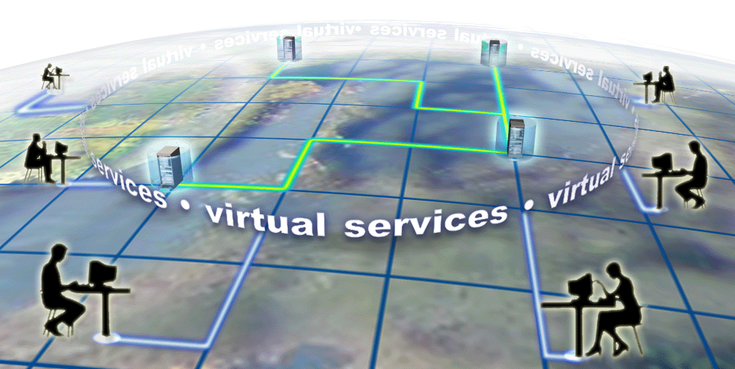
Data Flow Reversal
applications
computing power
files
data
storage
From the Internet ….
…. to Grid Computing

Slide 89
From Percepts to SOOA (SORCER)
Selector
Interface
Service Method
Context
Service Methods
Exertion (Task, Job)
Task
Tasker
Simple Federation (Single Context)
Job
Jobber
Compound Federation (Multiple Contexts)
Exertion
Service Provider
Federation
Exertion Space
Service Federations
SGrid (Virtual Services)
Subject
Complements
Percept
Values
Attributes
Term
Semantics
Syntax
Alphabet
Attributes
Interfaces
Servicer
Network
Operation
Network
Object/Peer

Slide 90
Interoperable Framework-Based
View of Architecture
iGrid Mission Requirements
Interoperability
System Requirements,
and Vision for Changes
COTS
capabilities
Components
Data Flow
Control Flow
Timing, etc.
Layering, stds, etc.
HW/SW allocation
Integration
COTS Products
Framework
(SW Infrastructure)
Custom/COTS
Integration Software
Networking
(OSI)
Profile
Other Profiles
Technical
Reference
Model
Data Element
Standards

Slide 91
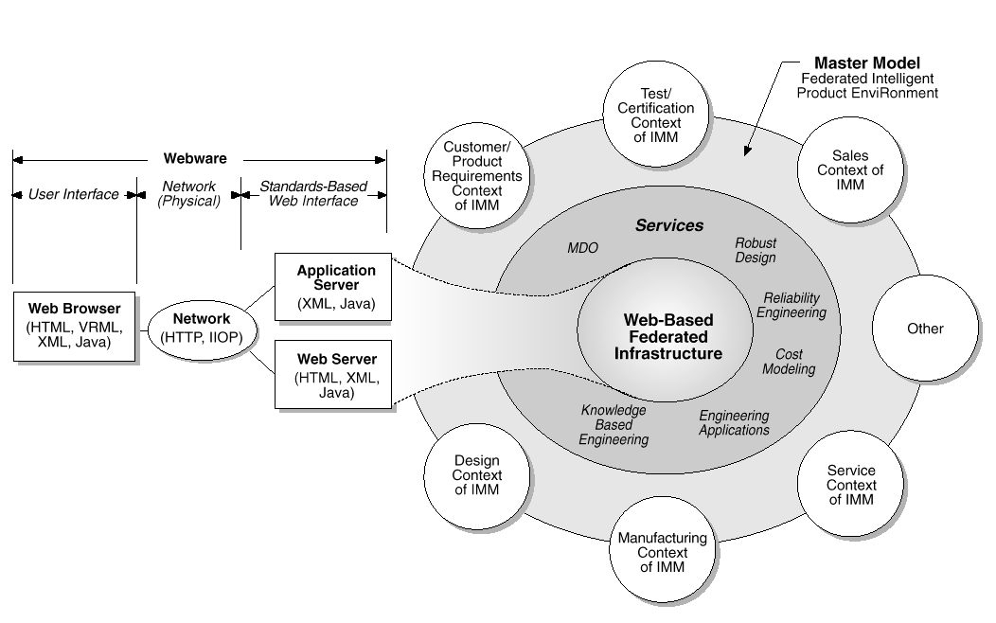
FIPER/SORCER Conceptual Architecture
Web-Centric and Web-Aware Architecture
with Virtual Services to IMM

Slide 92
Intergrid (iGrid)
• Existing client/server infrastructure is geared for a single-server functionality
• SOA is a paradigm shift within a paradigm shift
• Objects break up the client and server sides of an application into service components that can play together and roam across networks
• iGrid is the killer infrastructure that is bringing services to masses

Slide 93
iGrid Architecture Qualities
Accessibility - Web centricity, Service UI
Manageability – Autonomic and federated services
Scalability - Network centricity
Adaptability - Code mobility
Integrability – Interoperable framework-based
Services appear as network objects identified by type

Slide 94
From System to Model
Deployment Modeling
Problem & App Domains Referent
SW Deployment Conceptual Model
Computing System Runtime Model
System
Validation
Referent
Conceptual Model
Runtime Model
System
Validation
Validation of modeling process
Verification of simulation process

Slide 95
Diagrammatic Metasystemic
Decomposition = 3+1
Metasystem
P
Meta
system
C
D
System

Slide 96
Metasystem, System, and Subsystems
Metasystem
Process
Subsystems
Carrier
Domain
System

Slide 97
Project & Architecture Views
Technical
Architecture
Physical
Architecture
Requirements
Architecture
Pattern
System
Architecture
PM
Architecture
SW
Architecture
Deployment
Project
Reference
Model
System
Architecture
SW
Architecture
Tools
Repository
Hosts
Process
PM
Architecture
SW
R&D
Carrier
Domain

Slide 98
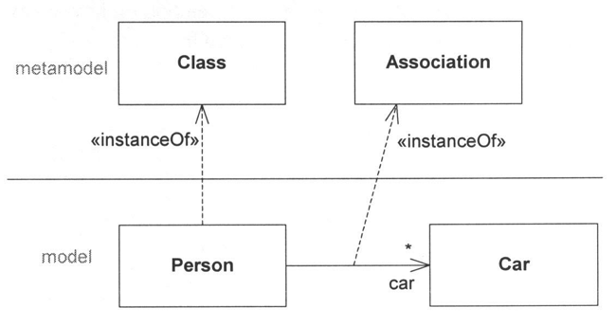
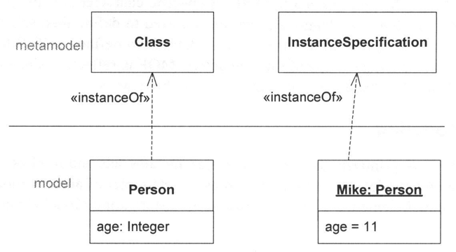
Metamodeling Layers
The language specification, or the metamodel
The user specification, or the model
Objects of the model

Slide 99
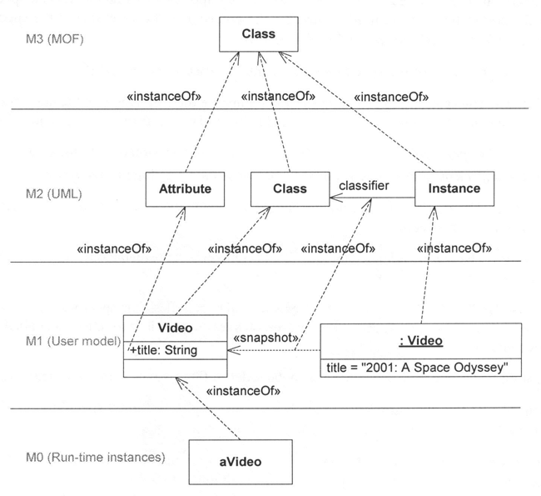
The 4-level Metamodel Hierarchy
Metadomain
Domain
Process
Carrier

Slide 100
Metamodeling with DMCF
Metametadomain
M3 meta-metamodel
<<metamodel>>
DMCF
<<instanceOf>>
Domain
M2 metamodel
<<instanceOf>>
<<instanceOf>>
<<metamodel>>
<<metamodel>>
Computing
System
Compiler
<<instanceOf>>
<<instanceOf>>
<<instanceOf>>
<<instanceOf>>
<<metamodel>>
<<metamodel>>
<<metamodel>>
<<metamodel>>
Architecture
Component
Part
Class
<<instanceOf>>
<<instanceOf>>
<<instanceOf>>
<<instanceOf>>
<model>>
<model>>
<model>>
<model>>
ArchitectureZ
ComponentY
PartX
ClassT
Metadomain
M1 user model
<<instanceOf>>
<<instanceOf>>
<<instanceOf>>
Carrier
M0 runtime instances
aComponent
anInstance
Notes:
Metamodels for Computing Systems have been presented in terms of DPC levels. You have to create user models: instances of Architecture Component, Part, and Class

Slide 101
VV&A
Validation: is the process of determining that a model of simulation is an accurate representation of the universe of reference from the perspective of the intended use of the model and simulation.
Results
Validation
Referent
Runtime Model
M0
Modeling
Simulation
Validation
Verification
M1
Conceptual Model
Your research verification, validation and accreditation

Slide 102
Object Model
Results
Validation
Referent
Runtime Model
M0
Modeling
Simulation
Validation
Verification
M1
Object Model
Referent
Object Model

Slide 103
Design, Implement, and Deploy
UCDs
UCD
CD
SB
ID
ClD
PD
DD
Referent
Design
Object Model
4-blocker
classes
Implement
Deploy
Object Model
System

Slide 104
High Level VV&A Process
M&S VV&A
System
M&S
Asset
M&S
Major
Component
M&S
M&S Verification,
Validation, and
Accreditation
Verification
Accreditation
Validation
Conceptual
Model
Verification
Validation
Methodology
Accreditation
for Intended
Use
Design
Verification
Face
Validation
Head-to-Head
Comparison
Other
Methods
Functional
Decomposition
SME Panel
Accreditation
Data
Accreditation
Support
Code
Verification
Software Quality
Assessment
Accreditation
Report
Validation
Report
Documentation
Assessment
Validation
Report
VV&A Complete
Verification
Report

Slide 105
Architecture-based R&D
Requirements
4-blocker
Design & Construction
Architecture Elaboration
Reference
Architecture
[accepted]
[else]
Framework
Design
Domain
Design
Integration
Design
Framework
Extension
Feasibility
Study
Domain
Construction
Integration
Construction
Framework
Construction
Framework
Validation
System
Validation
[else]
[accepted]
[accepted]
[else]

Slide 106
If You Only Remember Six Things…
SW Architecture Relationships
Class Model vs. Architecture and Design
Metasystem, System, and Subsystems
Architecture-based R&D
Three Objectives for Architecture
VV&A

Slide 107
SW Architecture Relationships
Reference
Model
Reference
Architecture
Software
Architecture
System
Architecture
Architectural
Pattern

Slide 108
Class Model vs. Architecture and Design
Reference Architecture
Computing System
Framework Classes
DP
DP
SW Architecture
DP
DP
DP
DP
DP
Integration Classes
Design
DP
DP
DP
Domain Classes
Feasibility Study

Slide 109
Metasystem, System, and Subsystems
Metasystem
Subsystems
Management
Carrier
Domain
System

Slide 110
Project & Architecture Views
Technical
Architecture
Physical
Architecture
Requirements
Architecture
Pattern
System
Architecture
PM
Architecture
SW
Architecture
Deployment
Project
Reference
Model
System
Architecture
SW
Architecture
Tools
Repository
Hosts
PM
Architecture
Management
SW
R&D
Carrier
Domain

Slide 111
Three Objectives for Architecture
Changeability
(Vertical flexibility)
Interoperability
(Horizontal flexibility)
Cost to Performance
and Schedule
Seek:
  High Changeability (coupling, cohesion, patterns)
  High Interoperability (frameworks, patterns, standards)
  Low Cost & Short Delivery Times (COTS)
(Commercial product
exploitation - “best value”)

Slide 112
VV&A
Results
Validation
Referent
Runtime Model
Modeling
Simulation
Validation
Verification
Conceptual Model
Your research verification, validation and accreditation

Slide 113
Architecture-based R&D
Requirements
4-blocker
Design & Construction
Architecture Elaboration
Reference
Architecture
[accepted]
[else]
Framework
Design
Domain
Design
Integration
Design
Framework
Extension
Feasibility
Study
Domain
Construction
Integration
Construction
Framework
Construction
Framework
Validation
System
Validation
[else]
[accepted]
[accepted]
[else]

Slide 114
Summary
Architecture
  Gain understanding and manage system complexity
  Determine the architecture (modularization)
  Use and contribute to the framework
  Apply design patterns
  Design individual components, parts (runtime)
Design
  Design interfaces and classes
  Apply design patterns
  Reduce many-to-many associations
  Design packages (compile-time)
Construction
  Implement interfaces and classes
  Test against use cases, state, and component models

Slide 115
Three Laws of Computing
Moore's Law
  Computing power doubles every 18 months
Gilder's Law
  Network bandwidth capacity doubles every 12 months
Metcalfe's Law (Net Effect)
  Value of network increases exponentially as number of participants increases

