Slide 1

Business Pilot
www.Incodea.com
Business Process Management Software

Slide 2
Architecture
Centralized Server
Java based client software for creating / modifying / analyzing process.
Web based interaction: Users interact with the workflow software through a web browser and an e-mail account.
Notes:
Java VM – platform independent

Slide 3
Why Business Pilot?
Accessible to companies of any size
  Pricing models appropriate for small, medium and large sized companies.
  Ease of use: Mangers who define the process can easily create and publish workflows after a few hours of training.
  Server hosting is available, lessening the need for on-site IT staff
  Platform independent
Notes:
Business Pilot can work with any computer with internet access and an available e-mail account. There is no need to add or modify network infrastructure.
Managers can simply add new tasks, connect them and configure them without having to use any code or programming skills.
For smaller businesses with fewer workflows, Icondea will operate and maintain your Business Pilot server, lessening the need for IT support staff.
I will touch on this more later.

Slide 4
Ideal for Certain Types of IOWF
Users interact with workflows in Business Pilot through e-mail and web-based forms.
  Vendors and clients can access your workflows without installing any software
  Existing network infrastructure can be used

Slide 5
Negative Aspects
Analysis tool is very limited
  Detects some errors in the workflow, but has no facility for performance simulation or estimation
Resource classification tool is not very well developed
Not Petri-net based
  This has some positive aspects
    Workflows appear less cluttered
    Workflow construction is more accessible to non-technical individuals

Slide 6
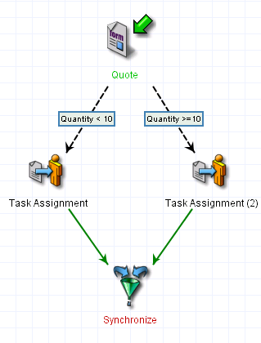
Example Analysis Tool Problem
The analysis tool will not complain when given this workflow

Slide 7
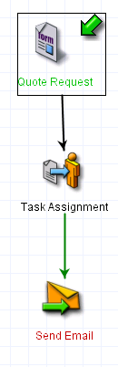
Activity Based Syntax
State is not graphically modeled
State can be stored by global variables or variables that are attached to tasks.

Slide 8
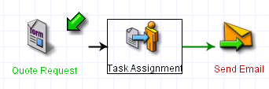
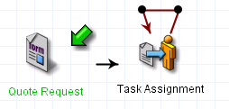
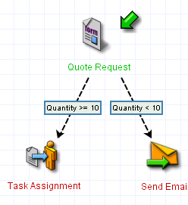
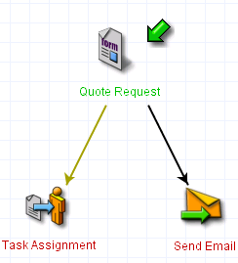
Basic Constructs
Sequence
Iteration
Selection
Parallelism
Notes:
Because selection is achieved using ‘guards’, selection does not have to be exclusive.

Slide 9
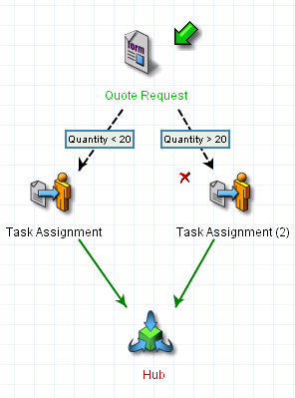
OR Join

Slide 10
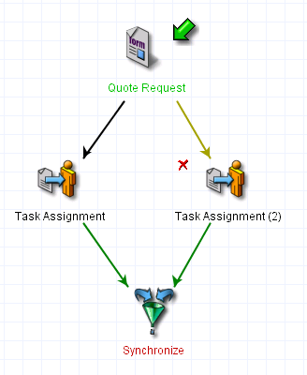
AND Join
AND joins are accomplished by using a special ‘Synchronizer’ task

Slide 11
Reporting
Reports are generated as web pages
Reports can describe
  Bottlenecks
  Workloads
  Running Processes

Slide 12
Resource Classification
Individual resources can be easily assigned to tasks
To assign a group or role to a task one must use SQL statements to retrieve appropriate resources from a database
A more developed resource tool would be beneficial
Notes:
Business Pilot tries to make workflow definition and enactment accessible to non-technical people. Forcing people to use SQL and databases to assign roles or groups to tasks undermines this goal.

Slide 13
Task Assignment
Tasks are assigned to resources
‘Pulling’ of tasks is not supported
Resources can be assigned to tasks explicitly
While multiple resources can be assigned to a single task, only one of them can signify its completion.

Slide 14
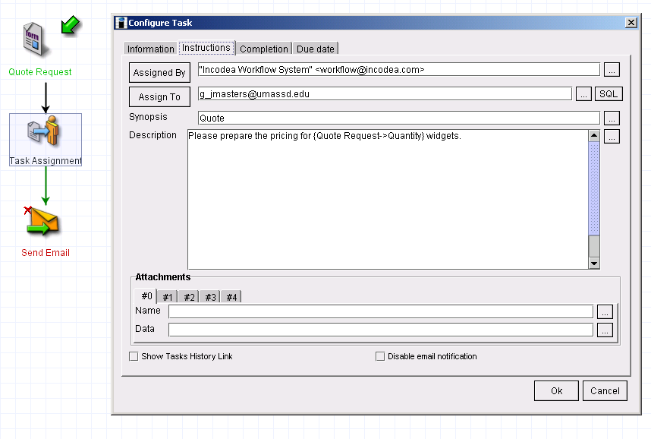
Task Configuration Example

Slide 15
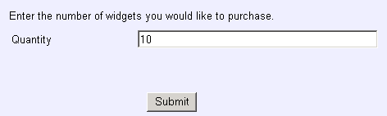
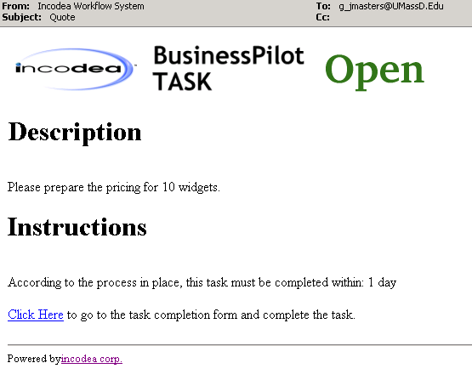
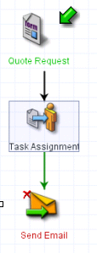
Task Configuration Example (2)
Client fills out form
Resource receives this task

Slide 16
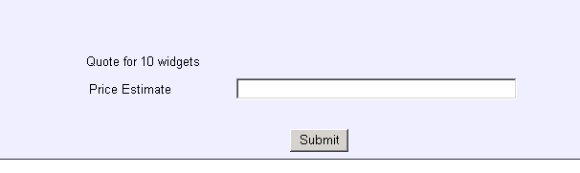
Task Configuration Example (3)
Upon completion of form the price estimate is automatically sent to the customer.

Slide 17
Inter-organizational Workflows (1)
Business Pilot supports asynchronous and synchronous communications between workflows within Business Pilot
Asynchronous communication is supported for interaction with other WFMS
Inheritance of workflows is not allowed

Slide 18
Inter-Organizational Workflows (2)
Possible
Using Business Pilot and external WFMS
Using Only Business Pilot
Architecture
Capacity Sharing | Yes | NA
Chained Execution | Yes | Yes
Subcontracting | Yes | Yes
Case Transfer & ECT | No | No
Loosely Coupled | Yes | No

Slide 19
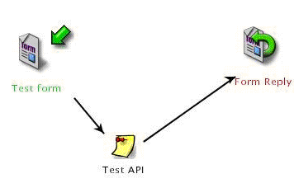
External Element API
Business Pilot can communicate with other WFMS and software using its External Element API
An API ‘task’ is placed in a workflow. This task interfaces with user supplied Java code

Slide 20
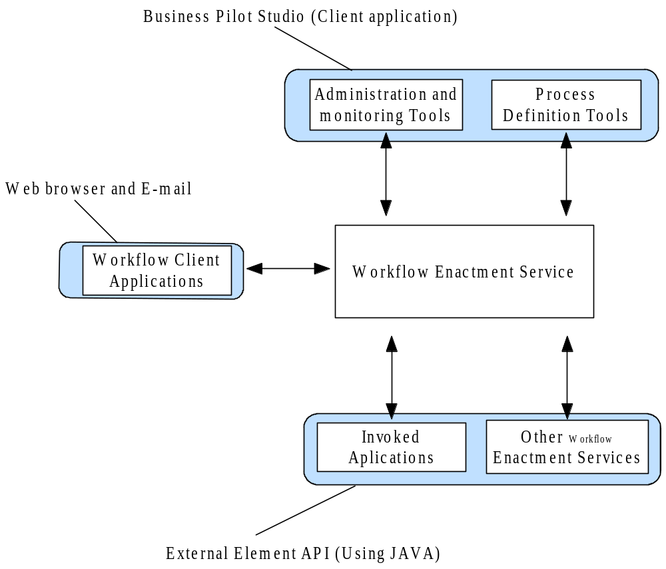
WFMC Interfaces

Slide 21
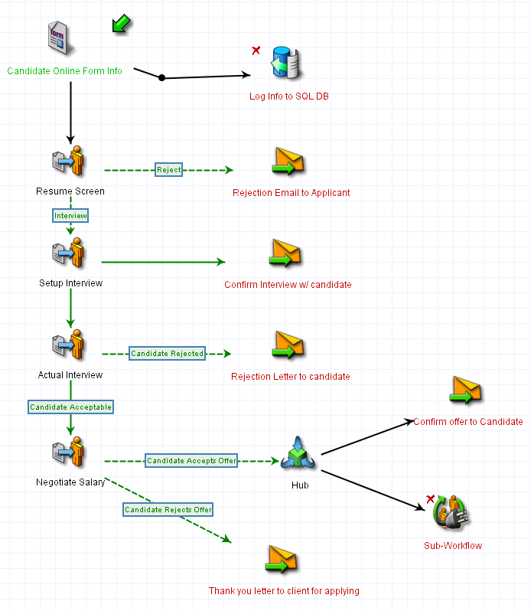
Example Process

Slide 22
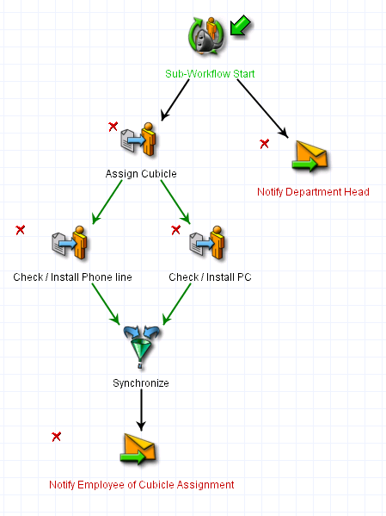
Example Sub- Process
Notes:
Sub-process could belong to another organization in a IOWF.

Slide 23
Conclusion
Business Pilot is a viable WFMS for companies with business processes of any size
It has a few key weaknesses but it is strong in many areas
Notes:
Key advantages: Runs on any platform, uses existing infrastructure and is one of the few WFMS that is approachable by smaller companies.

