Slide 1
Process Mining and Security:
Detecting Anomalous Process Executions and Checking Process Conformance
Wil van der Aalst
Ana Karla A. de Medeiros
Eindhoven University of Technology
Department of Information and Technology
a.k.medeiros@tm.tue.nl

Slide 2
Outline
Motivation
Process Mining: α-algorithm
Detecting Anomalous Process Execution
Checking Process Conformance
Conclusion and Future work

Slide 3
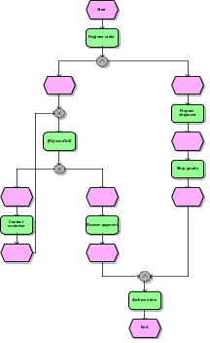
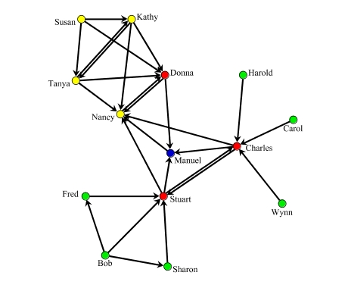
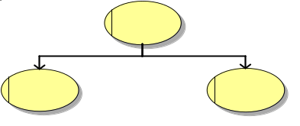



Process Mining:
Overview
2) process model
3) organizational model
4) social network
1) basic performance metrics
5) performance characteristics
6) auditing/security
If …then …

Slide 4
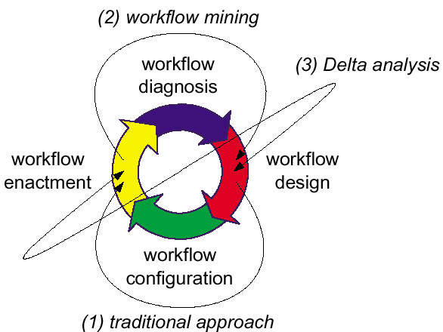
Motivation
Workflow Mining (What is the process?)
Delta analysis (Are we doing what was specified?)
Performance analysis (How can we improve?)

Slide 5
Motivation
How can we benefit from process mining to verify security issues in computer systems?
Detect anomalous process execution
Check process conformance

Slide 6
Process Mining –
Process log
Minimal information in noise-free log: case id’s and task id’s
Additional information: event type, time, resources, and data
In this log there are three possible sequences:
case 1 : task A
case 2 : task A
case 3 : task A
case 3 : task B
case 1 : task B
case 1 : task C
case 2 : task C
case 4 : task A
case 2 : task B
case 2 : task D
case 5 : task E
case 4 : task C
case 1 : task D
case 3 : task C
case 3 : task D
case 4 : task B
case 5 : task F
case 4 : task D
  ABCD
  ACBD
  EF

Slide 7
Process Mining –
Ordering Relations >,→,||,#
Direct succession: x>y iff for some case x is directly followed by y.
Causality: x→y iff x>y and not y>x.
Parallel: x||y iff x>y and y>x
Unrelated: x#y iff not x>y and not y>x.
case 1 : task A
case 2 : task A
case 3 : task A
case 3 : task B
case 1 : task B
case 1 : task C
case 2 : task C
case 4 : task A
case 2 : task B
...
  ABCD
  ACBD
  EF
A>B
A>C
B>C
B>D
C>B
C>D
E>F
A→B
A→C
B→D
C→D
E→F
B||C
C||B

Slide 8
Process Mining – α-algorithm
Let W be a workflow log over T. α(W) is defined as follows.
T_{W} = { t ∈ T | ∃_{σ ∈ W} t ∈ σ},
T_{I} = { t ∈ T | ∃_{σ ∈ W} t = first(σ) },
T_{O} = { t ∈ T | ∃_{σ ∈ W} t = last(σ) },
X_{W} = { (A,B) | A ⊆ T_{W} ∧ B ⊆ T_{W} ∧ ∀_{a ∈ A}∀_{b ∈ B} a →_{W} b ∧ ∀_{a1,a2 ∈ A} a₁#_{W} a₂ ∧ ∀_{b1,b2 ∈ B} b₁#_{W} b₂ },
Y_{W} = { (A,B) ∈ X | ∀_{(A′,B′) ∈ X}A ⊆ A′ ∧B ⊆ B′⇒ (A,B) = (A′,B′) },
P_{W} = { p_{(A,B)} | (A,B) ∈ Y_{W} } ∪{i_{W},o_{W}},
F_{W} = { (a,p_{(A,B)}) | (A,B) ∈ Y_{W} ∧ a ∈ A } ∪ { (p_{(A,B)},b) | (A,B) ∈ Y_{W} ∧ b ∈ B } ∪{ (i_{W},t) | t ∈ T_{I}} ∪{ (t,o_{W}) | t ∈ T_{O}}, and
α(W) = (P_{W},T_{W},F_{W}).

Slide 9
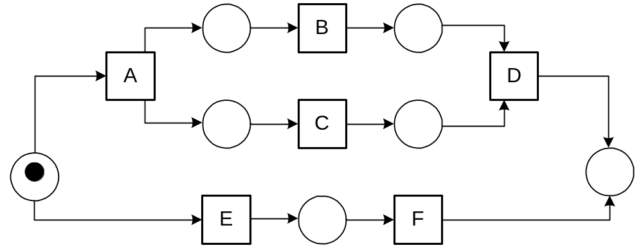
Process Mining –
α-algorithm
A→B
A→C
B→D
C→D
E→F
  ABCD
  ACBD
  EF
B||C
C||B

Slide 10
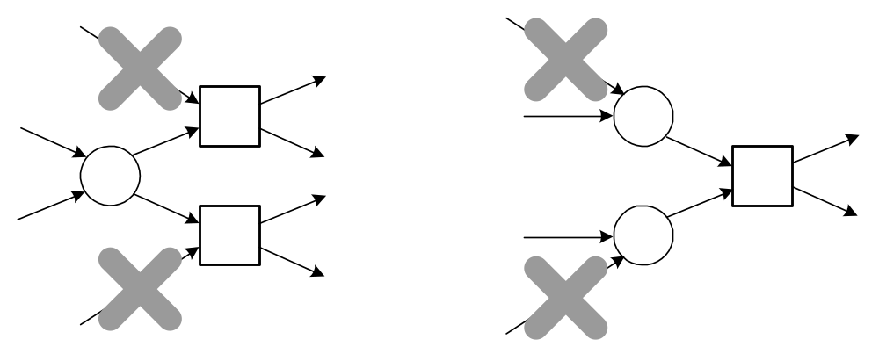
Process Mining –
α-algorithm
If log is complete with respect to relation >, it can be used to mine SWF-net without short loops
Structured Workflow Nets (SWF-nets) have no implicit places and the following two constructs cannot be used:

Slide 11
Detecting Anomalous
Process Executions
Use the α-algorithm to discover the acceptable behavior
  Log traces = audit trails
  Cases = session ids
  Complete log only has acceptable audit trails
Verify the conformance of new audit trails by playing the “token game”

Slide 12
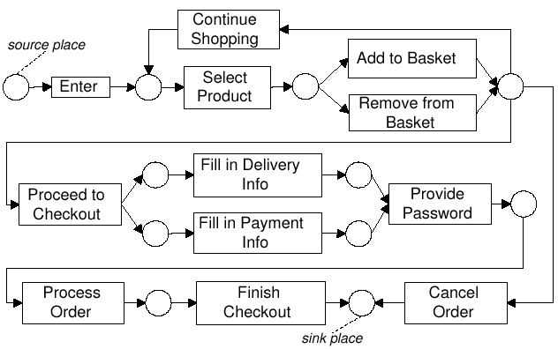
Detecting Anomalous
Process Executions
✓
Enter, Select Product, Add to Basket, Cancel Order

Slide 13
Detecting Anomalous
Process Executions
Enter, Select Product, Add to Basket, Proceed to Checkout, Fill in Delivery Info, Fill in Payment Info, Process Order, Finish Checkout
✗

Slide 14
Checking Process
Conformance
Verify if a pattern holds
Provide Password → Process Order
So…
Provide Password > Process Order and
NOT Process Order > Provide Password

Slide 15
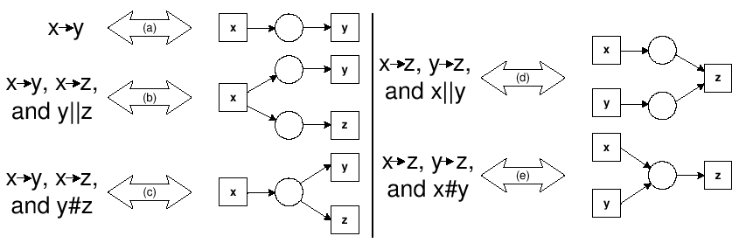
Checking Process
Conformance
Provide Password → Process Order
(!) Token game can be used to verify if the pattern holds for every audit trail

Slide 16
Conclusion and
Future Work
  Conclusion
  Process mining can be used to
    Detect anomalous behavior
    Check process conformance
  Tools are available at our website www.processmining.org
  Future Work
  Apply process mining to audit trails from real-life case studies

Slide 17

Questions?
  www.processmining.org

