Slide 1
Inheritance in Petri Net Designs
Application of the Inheritance Concept in Design of Inter-Organizational Workflows

Slide 2
Goals
Subtyping - interface inheritance: Can the subclass use or conform to the interface of the superclass?).
Projection inheritance -all new methods (i.e., methods added in the subclass) are hidden.
Substitutability - Can the superclass be replaced by the subclass without breaking the system?
Subclassing - (implementation inheritance: Can the subclass use the implementation of the superclass?),

Slide 3
Constraints
Maintain soundness
Avoid Deadlocks
Transition enabling
Reachable markings
ect.…..

Slide 4
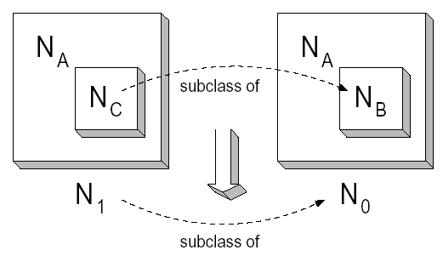
Technical Definitions
Abstraction Let N = (P; T,M, F, lo) be a labeled P/T-net. For any I ⊆ Lv, the abstraction operator I is a function that renames all transition labels in I to the silent action . Formally, I (N) = (P, T, M, F, l1) such that, for any t ∈ T, lo(t) ∈ I implies l1(t) = and lo(t) ∈ I implies l1(t) = lo(t).
Inheritance. For any two sound WF-nets N0 and N1 in W, N1 is a subclass of N0 under projection inheritance, denoted N1 .pj N0, if and only if there is an I ⊆ Lv such that (I (N1); [i]) .b (N0; [i]).

Slide 5
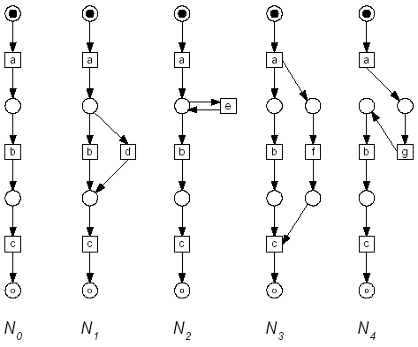
Inheritance example

Slide 6
Question
Are all 4 IOWF subclasses of No?

Slide 7
Answer
N2, N3, N4 are subclasses of No
N1 is NOT a subclass of No

Slide 8

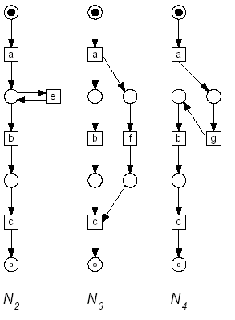
Subclasses of No

Slide 9

N1 not a Subclasses

Slide 10

Greatest Common Denominator (GCD)
The GCD of a set of WF-nets is a WF-net that captures the part these nets have in common, i.e., the part where they agree on.

Slide 11
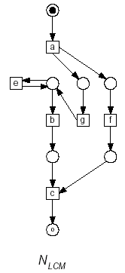
Least Common Multiple (LCM)
Any sequence generated by one of the four nets can also be generated by.

Slide 12
Contractor Example
Two Domains Contractor and Subcontractor
Contractor sends an order to the subcontractor. Then, the contractor sends a detailed specification to the subcontractor and the subcontractor sends a cost statement to the contractor. Based on the specification the subcontractor manufactures the desired product and sends it to the contractor. For this very simple business-to-business protocol a sequence diagram is suitable.

Slide 13
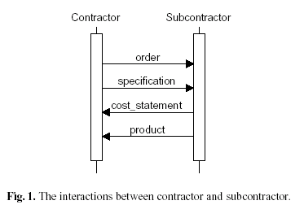
Domain interactions

Slide 14
Basic Info
May think of the domain as a class or object
Tasks in the domains can be thought of as Methods
The tasks from each domain are connected by Channels
“NOTE” It should always be clear whether a domain is activated or not.

Slide 15
Tiers
Overall view
Public view
Private View
Tiers Differ in the amount of information that is viewable

Slide 16
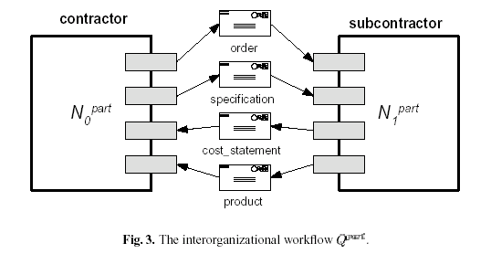
Overall View

Slide 17
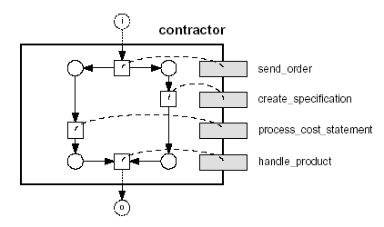
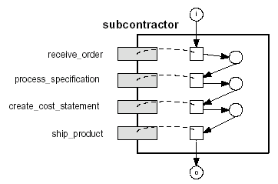
Public View

Slide 18
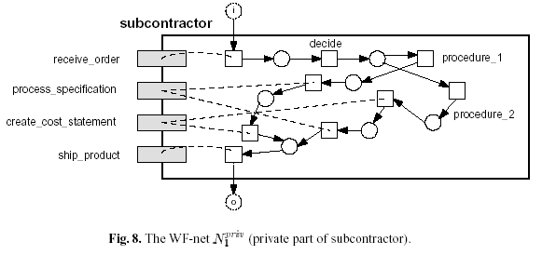
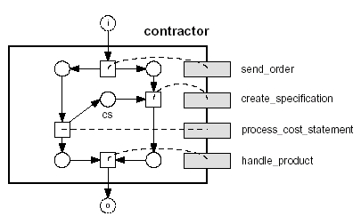
Private View

Slide 19
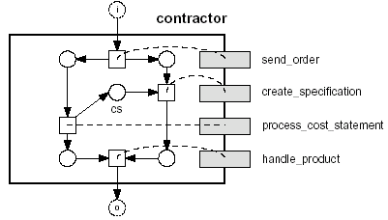
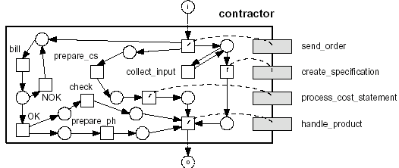
Contractor Subclasses

Slide 20
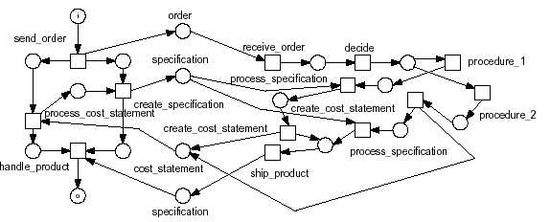
Flatten IOWF (with Details)

Slide 21
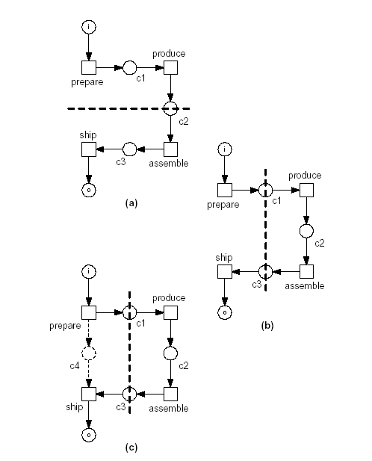
Partitioning – Clear starting and ending point

Slide 22
E-Books
The following IOWF is an example of an “E-bookstore”
4 domains – customer, bookstore, publisher, shipper
Interface allows use/interchangeability between any 4 of these domains

Slide 23
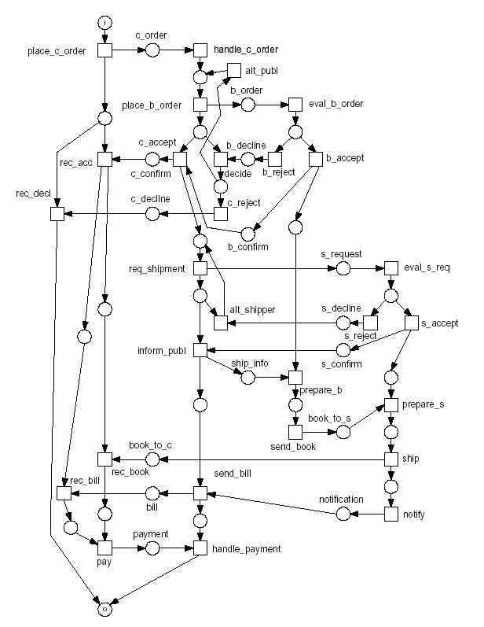

Slide 24
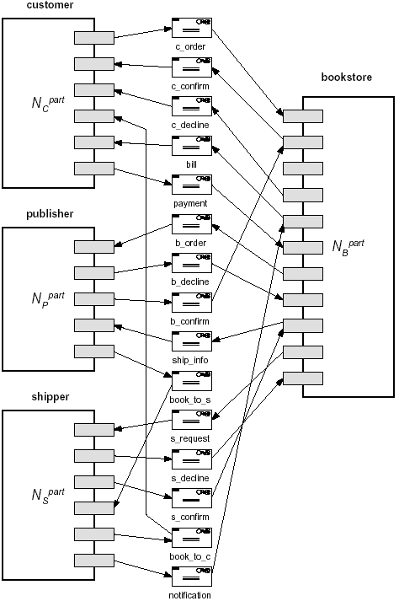

Slide 25
Customer
The customers role is relatively simple
They can place the order through a bookstore receive the book and bill and then pay

Slide 26
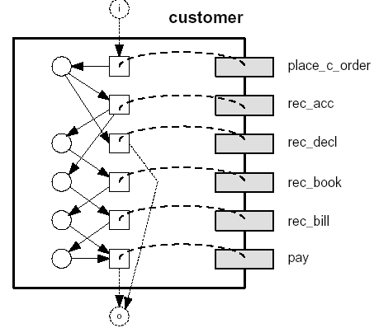
Customer

Slide 27
Bookstore
The role of the bookstore is to receive an order from a customer, send the information to the publisher and notify the shipper to send the book.

Slide 28
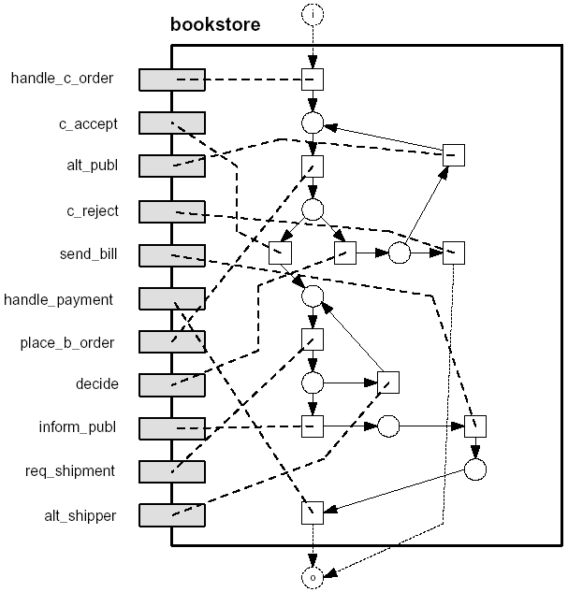
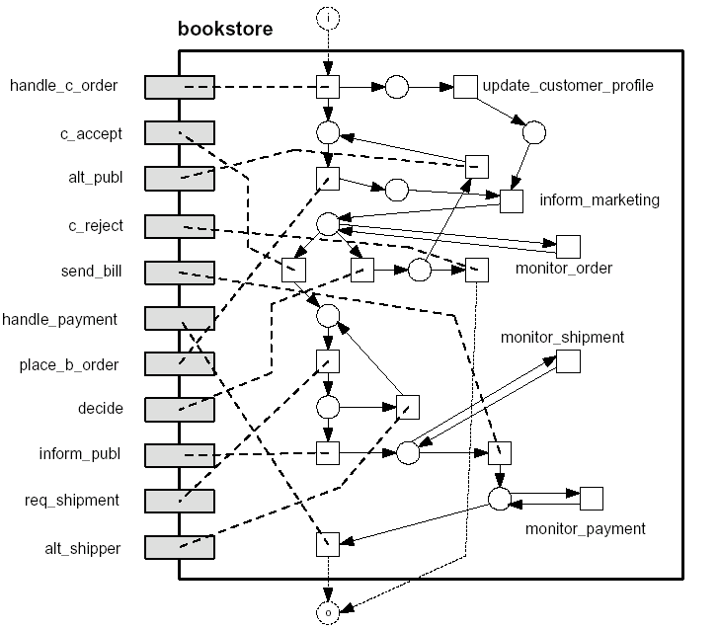
Bookstore

Slide 29
Shipper
The shipper receives the information from the bookstore and publisher sends the book and then notifies the customer.

Slide 30
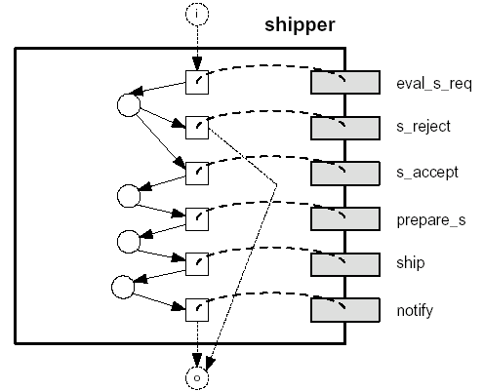
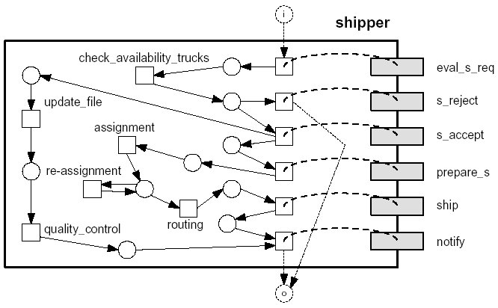
Shipper

Slide 31
Publisher
The role of the publisher is to receive payments form the bookstore deal with orders from the bookstore and deal with shipping info with the shipper.

Slide 32
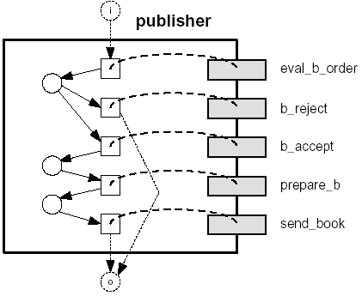
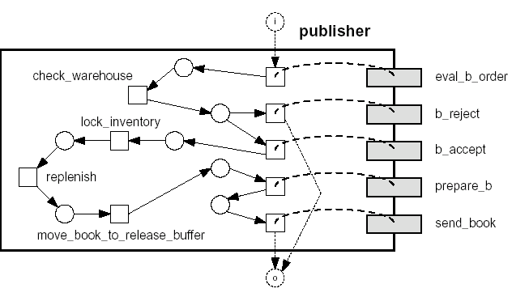
Publisher

Slide 33
Benefits
Simplicity – Diagrams allow for a quick and simple view of how the system works.
Implementation - can be done in a quick and simple manner
Relationships between domains are easily detectable
Reusability tasks are easily accessible

Slide 34
E-books
Through inheritance we are able to interact with any book store, publisher, shipper or customer. We are not restricted to any single domain but do have to deal with the system constraints.

Slide 35
Resources
“Inheritance of Interorganizational Workflows: How to agree to disagree without loosing control?”
by W.M.P. van der Aalst http://tmitwww.tm.tue.nl/staff/wvdaalst/Publications/p109.pdf
“Inheritance of Dynamic Behavior in UML” W.M.P. van der Aalst http://tmitwww.tm.tue.nl/staff/wvdaalst/Publications/p161.pdf
“Inheritance of Workflows An approach to tackling problems related to change” http://wwwis.win.tue.nl/~debra/2R480/iw.pdf

