Slide 1
COMPLEXITY

Slide 2
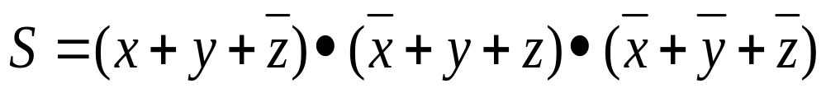
Satisfiability(SAT) problem
Conjunctive normal form(CNF): Let S be a Boolean expression in CNF. That is, S is the product(and) of several sums(or).
For example,
where addition and multiplication correspond to the and and or Boolean operations, and each variable is either 0 (false) or 1 (true)
A Boolean expression is said to be satisfiable if there exists an assignment of 0s and 1s to its variables such that the value of the expression is 1

Slide 3
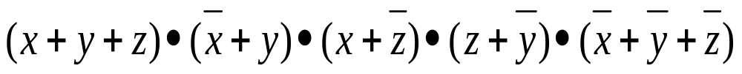
Satisfiability(SAT) problem
Example:
Can x, y, z be set so that this expression is true? (NO, in the above case)
SAT problem is to determine whether a given expression is satisfiable
At least one is true
All three the same
At least one is false

Slide 4
Decision problems
Problems with answer either “yes” or “no”
Decision problem can be viewed as language-recognition problem:
  U is the set of possible inputs to the problem
  L ⊆ U is the set of inputs which yield “yes”
  L is the language corresponding to the problem

Slide 5
Class of Decision Problems
P: Problems could be solved by deterministic algorithm in polynomial time
NP: Problems for which exists a non-deterministic algorithm whose running time is a polynomial in the size of the input
Note: Whether P = NP is not known, but most people believe P ≠ NP

Slide 6
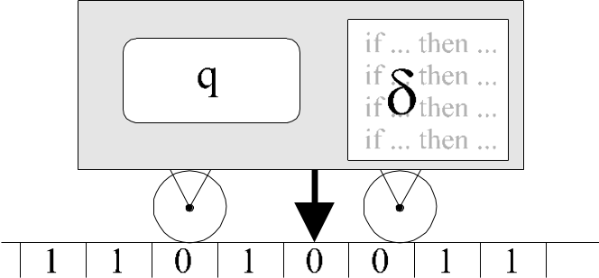
DETERMINISTIC TURING MACHINE (DTM)
Formally: {Q, Σ, δ, q₀, F}, where:
Q – the set of control states of machine
Σ – alphabet (the set of symbols) of tape,
− transition function:
δ: Q × Σ → Q × Σ × {R, L, N}
q₀ – initial control state,
F – the set of final states

Slide 7
DTM – PERFORMANCE
{Q, Σ, δ, q₀, F}
Start from a certain tape position with state q₀
Read symbol s from the tape
By basing on such data (state q = q₀, symbol s) calculate from function δ a new state q’, new symbol s’, which we write at the tape, and one of symbols R, L or N, corresponding to direction of the machine movement
Repeat the above operation until the machine finds itself in a state belonging to F

Slide 8

NONDETERMINISTIC TURING MACHINE (NDTM)
{Q, Σ, δ, q₀, F},
Definition analogous to DTM, however transition function δ(q,s) can have multiple values
Result of calculations is positive, if at least one of the ways of the machine performance leads to a success
100011010110
10101110111
In other words: while running the „program” NDTM is able to forecast in a magic way, which value of transition function should be chosen (e.g. whether to write 1 or 0) in purpose of obtaining positive result (if it is possible)

Slide 9
Definitions and Classifications
NP-Hard: A problem X is called an NP-hard problem if every problem in NP is polynomially reducible to X
NP-Complete: A problem X is called an NP-complete problem if:
  X belongs to NP, and
  X is NP-hard
Also, X is NP-complete if X∈NP and Y is polynomially reducible to X for some Y that is NP-complete
NP-complete problems are the hardest problems in NP

Slide 10
Fundamental Result
Cook’s theorem: The SAT problem is NP-complete
Once we have found an NP-complete problem, proving that other problems are also NP-complete becomes easier
Given a new problem Y, it is sufficient to prove that Cook’s problem, or any other NP-complete problem, is polynomially reducible to Y

Slide 11
Vertex Cover (VC) Problem
A vertex cover of G=(V, E) is V’⊆V such that every edge in E is incident to some v∈V’
VC: Given undirected G=(V, E) and integer k, does G have a vertex cover with ≤k vertices?

Slide 12
Dominating Set (DS) Problem
A dominating set D of G=(V, E) is D⊆V such that every v∈V is either in D or adjacent to at least one vertex of D
DS: Given G and k, does G have a dominating set of size ≤k ?

Slide 13
More Problems
CLIQUE: Does G contain a clique of size ≥k?
3SAT: Give a Boolean expression in CNF such that each clause has exactly 3 variables, determine satisfiability

Slide 14
Reduction Examples
All NP problems
SAT
Clique
3SAT
Vertex Cover
3-Colorability
Dominating Set

Slide 15
Reduction
Let L₁ and L₂ be two languages from the input spaces U₁ and U₂
We say that L₁ is polynomially reducible to L₂ if there exists a polynomial-time algorithm that converts each input u₁∈U₁ to another input u₂∈U₂ such that u₁∈L₁ if and only if u₂∈L₂
Note: The algorithm is polynomial in the size of the input u₁

Slide 16
Reduction
Typ_o1 P1(i1)
{
Typ_i2 i2 = Encode(i1); //polynomial
Typ_o2 o2 = P2(i2);
Typ_o1 o1 = Decode(o2); //polynomial
return o1;
}

Slide 17
CLIQUE → VC
VC is NP: This is trivial since we can guess a cover of size ≤k and check it easily in poly-time
Goal: Transform arbitrary CLIQUE instance into VC instance such that CLIQUE answer is “yes” if and only if VC answer is “yes”

Slide 18
CLIQUE → VC
CLIQUE(G,k) has the same answer as VC(G’,n-k), where n = |V| and G’ is a complement of G
G
G’

Slide 19
VC → DS
G’ has DS D of size k if and only if G has VC of size k
vw
v
w
v
w
vz
vu
uw
z
u
z
u
zu
G
G’

Slide 20
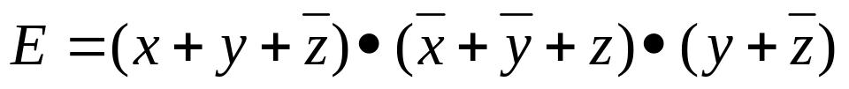






SAT → CLIQUE
G has m-clique (m is the number of clauses in E), if and only if E is satisfiable (assign value 1 to all variables in clique)

Slide 21
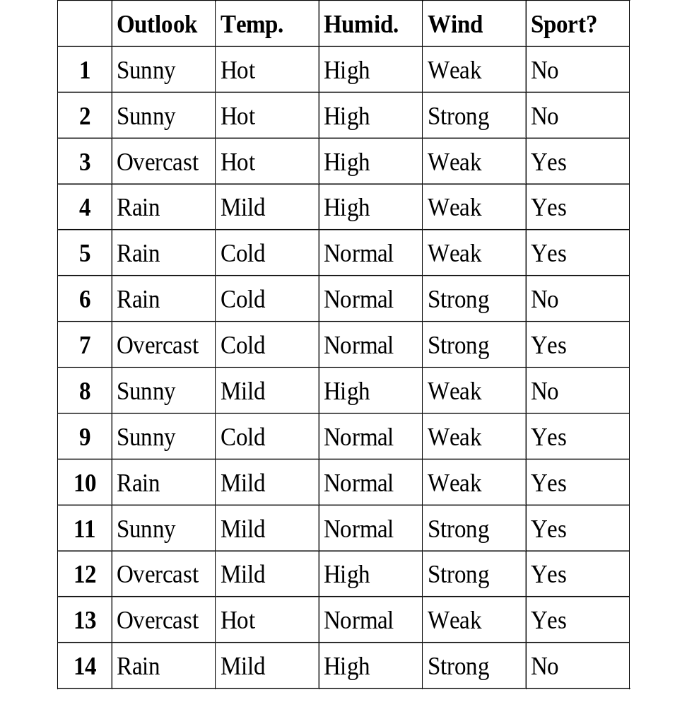
Decision Reducts
{O,T,H} and any its subset is not a reduct
{T,H,W} and any its subset is not a reduct
{O,W} and any its subset is not a reduct
The only reducts are
{O,T,W},{O,H,W}

