Slide 1
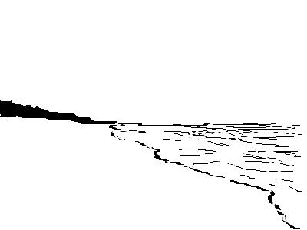
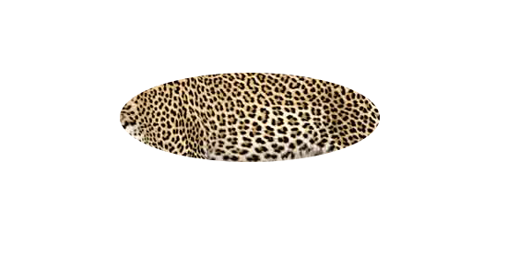
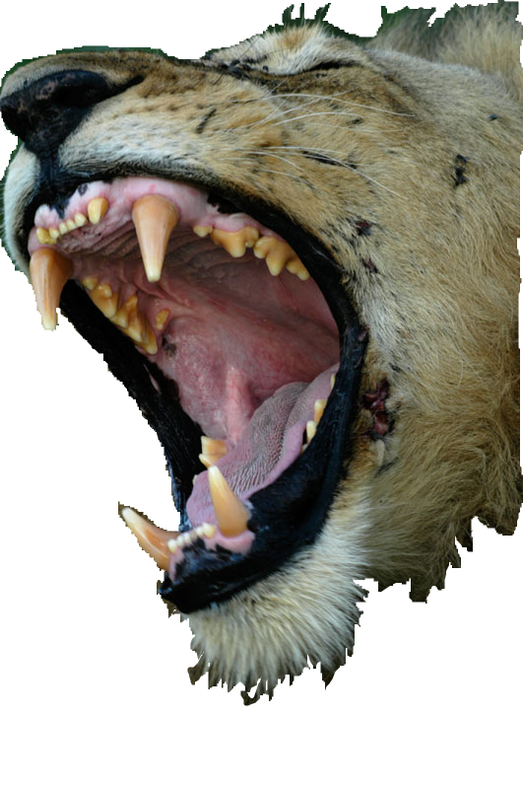
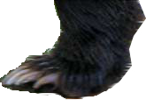
10 HORNS and CROWNS
blasphemy blasphemy blasphemy blasphemy blasphemy
7 HEADS
Leopard
Bear’s feet
NATIONS

