Slide 1


Twenty – One Church Planting Designs/Models for the Twenty-First Century
By
Tom Cheyney

Slide 2
Acknowledgements
I would like to thank Dr. Curt Watke for his contribution while serving at the North American Mission Board as the Strategic Resourcing Unit Associate. His contribution to early stages of this work is appreciated. Further development can be gleaned from Starting Reproducing Congregations: a guidebook for contextual new church development by Sanchez, Smith and Watke.
Also Dr. Ken Weathersby, J. David Putman, Dr. Ian Butain and Dr. Daniel J. Morgan wrote the handouts for these materials each from personal experience.

Slide 3
Acknowledgements
There are many terms used for the various designs a church plant can take. The three main terms that are used interchangeably are:
  Church Planting Models
  Church Planting Designs
  Church Planting Strategies
Perhaps the best term is a combination of at least two. Think about the term Church Planting Designs/Models. How about Church Planting Strategy Designs? Which one works for you?

Slide 4
Twenty – One Church Planting Strategy Designs For the Twenty-First Century
The new century that we minister in requires a passion and courage of apostolic style and individuals courageous enough to reach out to a lost and dying world. Church planting must be a chief focus of evangelism and mission thrust in this day. In order for the church to continue, there needs to be an awakening in order that it can continue to thrive. Often that means that what we did to start churches in the twentieth century might not work in the twenty-first century. Our prayer is that God will raise up a generation of missional people like the apostle Paul who will preach Christ and plant evangelical healthy churches across North America. Far too many church plants fail because their leaders follow a model that may have worked elsewhere instead of seeking God’s face about the unique model required for that particular area.

Slide 5
Twenty – One Church Planting Strategy Designs For the Twenty-First Century
While some planters see church planting models as mere myth, others see the validity of having examples to study in the effort to get a glimpse of what God might be saying about how to plant their next new work! Regardless of the debate regarding myths for models or strategies for the planting of new churches, there appears to be at least six areas and 14 to 21 designs that a new church could consider. For a study of specific models, consider attending a models workshop offered by the Strategic Readiness Team entitled Twenty-one Church Planting Designs for the Twenty-first Century with Tom Cheyney and Dennis Mitchell.

Slide 6
Twenty – One Church Planting Designs For the Twenty-First Century
Ten Questions To Ask Yourself Before
You Select a Design
What are my particular gifts when it comes to planting a new work?
Who really are the people I am trying to touch and target for a group?
What human, material and financial resources are available to the new work?
What adjustments must I make to the model design to help the planting effort become successful?
What degree of freedom is realistic within this framework to stretch the church planting vision?

Slide 7
Twenty – One Church Planting Designs For the Twenty-First Century
Ten Questions To Ask Yourself Before You Select a Design
Are there any characteristics within this model and strategic design that helps the plant or distracts from the plant’s eventual success. ?
Have I made any unrealistic assumptions due to my passion and optimism?
Will this design work in the community selected?
What are the basic assumptions that move this design?
Have I written down a list of strengths and weaknesses regarding this design and found the strengths outweigh the liabilities?
Remember the selection of the right model is critical. Even though the plant usually reflects the personality and passion of the planter, proper selection of design is crucial assuring that the church will fit into the culture in which the new work is being started.

Slide 8
First a Quick
Models Overview
Preaching Points for Deacons & Lay Ministers
Multi-housing-based Church Planting
Portable Church-based church Planting
Team-based Church Planting
Event-based Church Planting
Multi-site Church Planting
Affinity-based Church Planting

Slide 9
First a Quick
Models Overview
Program-based Church Planting
College-based Church Planting
Purpose-Driven-based Church Planting
Minister-of-Missions-based Church Planting
Relation-based Church Planting
Ministry-based Church Planting
Pioneering-based Church Planting

Slide 10
First a Quick
Models Overview
Mother/Daughter-based Church Planting
Cross Cultural-based Church Planting
The Missional Sunday School-based Church Planting
Associational-based Church Planting
Second generation-based Church Planting
Seeker Focused-based Church Planting
An expanded training manual
can be downloaded @
www.ChurchPlantingVillage.net
Church Planters Resources Library

Slide 11
First a Quick
Models Overview
A Few Bonus Ones
1040 Window-based Church Planting
The Church Plant Based on a Split
Parachute Drop-based Church Planting
The Apprentice-based Church Plant
Multi Denomination-based Church Plant
The Restart-based Church Plant
The High Impact-based Church Plant
House Church-based Church Planting

Slide 12
Planting Source/Models
Planting agency
  Local church
  Denomination, etc.
Motivation
  evangelistic
  logistical
  expansionists, etc.
Result
  multiple congregations
  autonomous church, etc

Slide 13
Twenty – One Church Planting Designs For the Twenty-First Century
1. Parenting Models (Sponsoring)
Usually when you think of the parenting model, you use the idea of a mother/ daughter church relationship. This is where the mother church assumes the responsibilities of starting daughter churches. Some modern-day parishioners use the term “hiving off” of a new congregation, but the design is the same. This is when an existing church contributes to the new church plant resources of people, monies, guidance, coaching and sometimes use of the present church facilities as well.

Slide 14
Twenty – One Church Planting Designs For the Twenty-First Century
1. Parenting Models (Sponsoring)
A. Offspring Congregations:
Split Cell-based Church Plant Design –
Remember that growing cells can often split off and serve as the foundation for a new church plant.
Mother/Daughter-based Church Planting Design – This is when the church begins out of an existing church with a church planter who goes out with other people who will serve as leaders from the mother church.

Slide 15
Twenty – One Church Planting Designs For the Twenty-First Century
1. Parenting Models (Sponsoring)
Offspring Congregations Designs (Cont.)
Mission Sunday School-based Church Planting Design – Many a new work has been launched from a Sunday school class that met as a mission off site of the existing church and was the nucleus for the new work.
Second Generation-based Church Planting Design - These are new works based on a particular affinity group but targeted towards the second or third generation of that group within North America.

Slide 16
Twenty – One Church Planting Strategy Designs For the Twenty-First Century
1. Parenting Models (Sponsoring)
B. Satellite Congregations Designs – These are new work units that either operate alongside the main church or break off and become self-supporting. More will be addressed later in this manual.
Mother/Daughter -based Church Planting Design
Multi-Housing-based Church Planting Design
House Church-based Church Plant Design

Slide 17
Twenty – One Church Planting Strategy Designs For the Twenty-First Century
1. Parenting Models (Sponsoring)
C. Revitalization Congregations Designs – These are models who work in the area of restarting or reopening once dead works as new churches.
Sponsoring Church Revitalization Plant design
D. Reclamation Congregations Designs
Sponsoring Church Reclamation Plant Design – Similar to the above design but usually works with a church in trouble yet still in existence.

Slide 18
Twenty – One Church Planting Strategy Designs For the Twenty-First Century
2. Pioneering Models (sponsoring)
The Pioneering model is that which a church planter usually starts from scratch without even having a core group. This model often has no sponsoring church per say so the planter does not have much core group development in place when he begins. In days past, people have referred to this launch type as starting from dirt and dirt only. Additionally, team members are slow to follow and the task falls to the responsibility of the planter to draw the net and gather people via relational and evangelistic skills.

Slide 19
Twenty – One Church Planting Strategy Designs For the Twenty-First Century
2. Pioneering Models (sponsoring)
Critical in this model is the ability to start fast with the gathering of core group members and assimilation techniques. Strengths to this model include being able to fashion the new work according to biblical priorities and community contextualization. There are a variety of planter’s types that are involved in the use of pioneering models.

Slide 20
Twenty – One Church Planting Strategy Designs For the Twenty-First Century
2. Pioneering Models (sponsoring) – Often this is when a church commissions a panting team to start a new work of similar or different style. It is not limited to a sponsored church though.
A. Planter Initiator Designs – These designs or models are built off of some type of catalytic individual serving as the gather of talent for the new work. He either sees an area and begins working early on the plant, develops the best case design or model for an effective launch, or offers hands on assistance to the church planter.
Pioneering Based Church Planting Design
Planter Developer Designs
Planter Multiplier Designs
Planter Strategist Designs

Slide 21
Twenty – One Church Planting Strategy Designs For the Twenty-First Century
3. Partnering models (sponsoring)
The partnering model consists of individual or groups coming together to start a new work. This cooperative effort is at the heart of being Southern Baptist. History has demonstrated that this cooperative effort between churches and churches, churches and denominations’ agencies can result in the beginning of many new works for Kingdom expansion. Here are a few ways that partnering can be achieved.

Slide 22
Twenty – One Church Planting Strategy Designs For the Twenty-First Century
3. Partnering models (sponsoring)
Here are a few ways that partnering can be achieved:
Multiple Sponsorship Designs – When two or more churches join in planting a new work
Multi Congregation Designs – When many churches share the same building, usually within an urban area.
Preaching Points for Deacon Plant Design – Deacon led plants as an outreach.

Slide 23
Twenty – One Church Planting Strategy Designs For the Twenty-First Century
3. Partnering models (sponsoring)
Here are a few ways that partnering can be achieved:
Cluster Partnership Plant Design – When you begin more than one church in a target area placing them on opposite ends of a target area large enough to support multiple new works.
Adoption Designs – When existing churches seek affiliation with a particular association or denomination.

Slide 24
Twenty – One Church Planting Strategy Designs For the Twenty-First Century
3. Partnering models (sponsoring)
Here are a few ways that partnering can be achieved:
Key Church Designs – This concept has been widely used in the south with the writing of the book by Allen with the same title. The Key Church Model calls for the sponsoring church to make the commitment to launch new works on the equivalent of launching new ministries within the main church. A new form is now called the ACTS 1:8 Church Planting Model.

Slide 25
Twenty – One Church Planting Strategy Designs For the Twenty-First Century
4. Propagating models (sponsoring)
Closely akin to the pioneering model and designs, the propagating models distinctive feature is that their efforts seek the greatest church multiplication. This model seeks to expand kingdom growth through new churches launching and then starting other new churches.

Slide 26
Twenty – One Church Planting Strategy Designs For the Twenty-First Century
5. People Group Models
Geodemographic Church Planting Designs
Portable Church Based Church Planting Design

Slide 27
Twenty – One Church Planting Strategy Designs For the Twenty-First Century
5. People Group models
Mono-cultural Church Planting Designs
Affinity Based Church Planting Design
Anglo
Hispanic
African American
Korean
Cambodian
Russian
Laotian
A expanded training manual
can be downloaded @
www.ChurchPlantingVillage.net
People Groups

Slide 28
Twenty – One Church Planting Strategy Designs For the Twenty-First Century
5. People Group models
Affinity Based Church Planting Design
Native American
Vietnamese
Filipino
Haitian
Deaf
Military
Governmental
Medical
Post Modern
A expanded training manual
can be downloaded @
www.ChurchPlantingVillage.net
People Groups

Slide 29
Twenty – One Church Planting Strategy Designs For the Twenty-First Century
Cross-cultural Church Planting Designs
Cross Cultural Based Church Planting Design
Multicultural Church Planting Designs
Generational Church Planting Designs
College Based Church Planting Design
All of these models and designs are based around various groups that either have a particular affinity, generational similarity, or ethnic diversity and make up a target grouping. For an excellent discussion on the subject see Starting Reproducing Congregations: a guidebook for contextual new church development by Sanchez, Smith and Watke.

Slide 30
Three Fears Other Churches Have Towards Church Planting
Answers:
The fear of losing “their” people to the new work. Yes there are always fringe church hoppers who will skip to the new church, but the present members who are committed usually stay connected because they feel they have found a church that meets their needs. And no ethical planter really should go after active members of another church. I have found that these type of individuals are not planters but pastors and only seek to build their own kingdom.

Slide 31
Three Fears Other Churches Have Towards Church Planting
Answers:
The fear of losing “their” people to the new work.
The fear of competition with the new church. Behind this fear lies the assumption: “This is my turf, no one else allowed.” No pastor nor planter has the right to exclusive rights to a particular area. Someone said it well, “Churches may compete for Christians, but there is no competition for sinners.” A church plant which starts from scratch will usually find 85% of its members coming from the unchurched and most of them will be new believers!
The fear that the new church will grow and succeed and get all the glory while the existing church just plods along.

Slide 32
Three Fears Other Churches Have Towards Church Planting
Answers:
The fear of losing “their” people to the new work.
The fear of competition with the new church.
The fear that the new church will grow and succeed and get all the glory while the existing church just plods along. We often fear that our church will think less of us if another church grows. That probably is personal pride. The blocking of new churches for fear we won’t shine as brightly is spiritually sick. What do we do? By God’s grace we determine to live by our faith, not our fears. That is where a new church plant can help. Are you willing to help it?

Slide 33
Eight pieces of advice as you design your strategy:
Make your program flexible enough to adjust to the strengths and needs of the groups involved.
Focus on sharing Christ and His purposes for the Church.
Support, rather than restrict, the natural development of the church in its own cultural setting.
Make the church plant a part of the overall program of the church. Give it meaningful representation and empowerment for the work of the kingdom.
Choose church planting models that lead to self-supporting works that results in spontaneous reproduction and multiplication.
Prepare for shifts in immigration patterns when starting multiethnic churches. Groups of different socio-economic backgrounds arrive in waves. The strategies for reaching them will vary.
Make sure the attitudes and perspectives of the mothering agency do not stifle the vision and ownership of the new church. If the mother church holds on to the new work, it may result in dependency.
Paternalistic attitudes will weaken a group’s capacity to establish self-supporting and self-propagating churches.

Slide 34
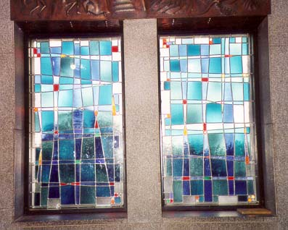
“Side Door” Based Church Planting…
#1
An effective strategy model is that of the larger parenting church hosting a new plant with a cross-cultural or multi-ethnic new congregation. This is usually called side door based church planting. It is easy to start with leadership in place. The new work already has facilities they can use. It complements the parenting church with diversity. Resources can generate financial responsibility. A word of caution should be expressed that the parenting church does not make the new work a group that sees itself as second class.

Slide 35
Preaching Points for Deacons
#2
This is an area where more work ought to be done. This design uses deacons and key lay leaders to form a team from either one church or various churches to begin a preaching point. Often these pop up in community centers, trailer parks, or other areas that a new work could be started in a low key way.

Slide 36
Preaching Points for Deacons
#2
Advantages: Money for starting comes from existing churches and most of the time it is the older churches first attempt towards church planting.
There is a healthy transition from preaching point to new church plant.
Attractive to local associations and conventions as a means towards planting others in the future.
New plant feels connected to mother church because it grew out of the outreach strategy of the older church.

Slide 37
Preaching Points for Deacons
#2
Disadvantages: It could lead to competing visions for the new launch team.
Pastor of existing church could seek to drive new works strategy.
As a preaching point responsibility becomes unclear as towards who is in charge. No one is responsible for consequences.
Accountability is clouded.
Who is leading the new work- deacons or pastor? No clear implementation strategy is in place.

Slide 38
Multi-Housing Based Church Planting
#3
What Is a Multi-housing Community?
It is where more than one family is grouped together by common boundaries, shared amenities, and in many cases by sharing the same building. The North American Mission
Board Church Planting Group strategy is focused on five types of multi-housing communities: private apartments, condominiums, manufactured-housing, senior-housing, and public housing communities. Most of these communities are seemingly perfectly situated and offer many things, but are missing “church.” Do we have genuine community without church?

Slide 39
Multi-Housing Based Church Planting
Where can a church be located in a multi-housing community?
The Response:
The Planting of thousands of multi-housing community churches to reach the lost/unchurched in North America involving bivocational and lay leaders and hundreds of thousands of ministry team members.
A expanded training manual
can be downloaded @
www.ChurchPlantingVillage.net
Simple Church

Slide 40
Multi-Housing Based Church Planting
Where can a church be located in a multi-housing community?
Seven General Steps for Planting Churches in Multi-housing Communities:
1. Pray and seek the will of the Lord.
2. Secure proper denominational endorsement and needed resources.
3. Build solid relationships with owners/managers.
4. Conduct surveys and get to know the community leaders: schools, law enforcement, and public officials.

Slide 41
Multi-Housing Based Church Planting
Where can a church be located in a multi-housing community?
Seven General Steps for Planting Churches in Multi-housing Communities:
5. Determine the church planting approach based on doors that are open, data analysis, and needs.
6. Enlist and train key leaders and ministry teams for church plants.
7. Carry out powerful initial evangelistic events and follow through or you’re through.

Slide 42
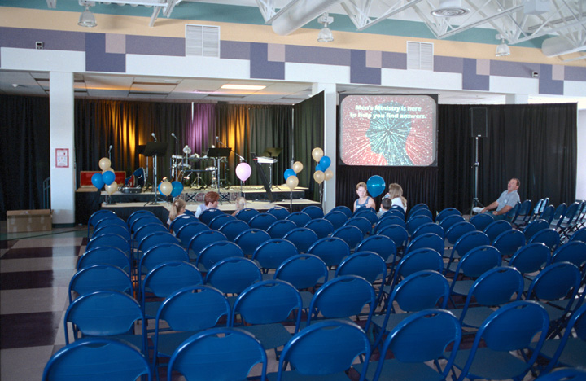
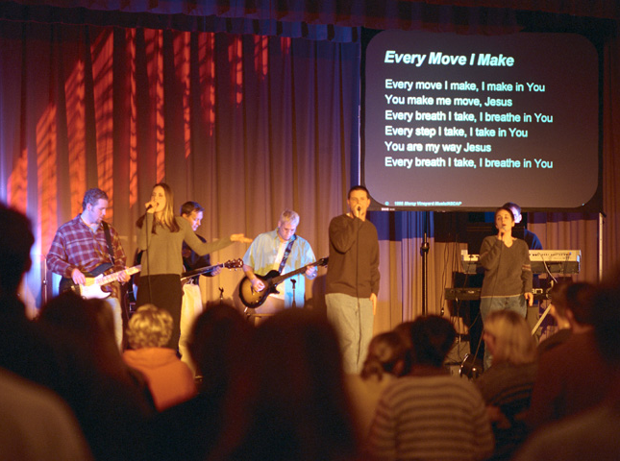
Portable Church Based Church Planting
#4
Portable Church Based Church Planting

Slide 43
Portable Church Based Church Planting…
This model is a mobile model that builds on available rental facilities in the target area. Schools, Gyms, Theaters, & Civic centers all are part of this strategy.

Slide 44
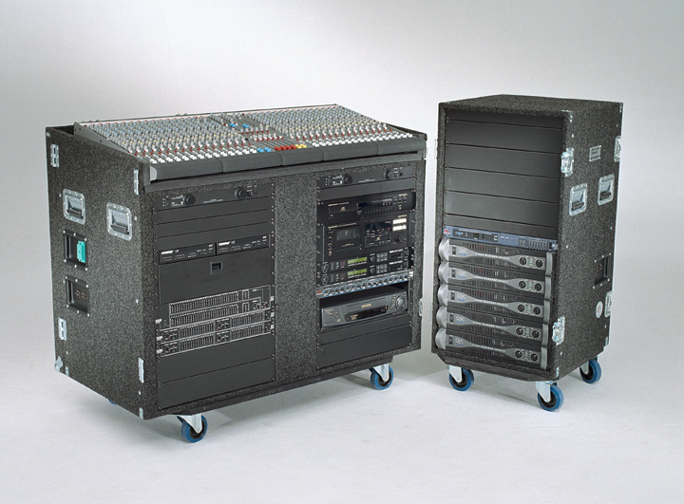
Portable Churches are …
Everywhere - 24,000 in the U.S. alone
Impact 6,000,000+ people per weekend
Meeting in schools, theaters and ???
Less expensive than fixed-site churches - $200 vs. $5,000/seat
www.portablechurch.com

Slide 45
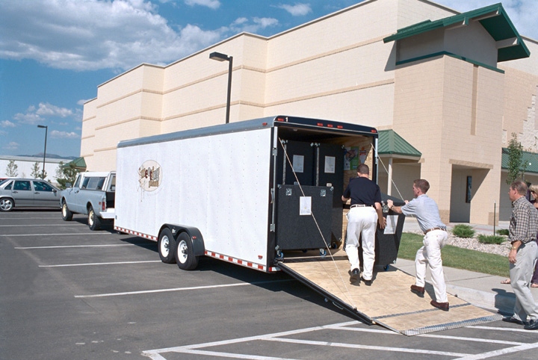
Sample Portable Church Budgets
1) Micro church (<150)
2) Small church (<300)
3) Medium Church (<600)
4) Large Church (<900)
5) Extra Large Church (<1200)
6) XXL Church (1200+)
7) Contemporary service in the gym
8) Youth Ministry off-site (budget)
9) Youth Ministry off-site (large)
$25,000
$60,000
$90,000
$120,000
$160,000
$210,000
$75,000
$15,000
$65,000

Slide 46
Team Based Church Planting
#5
Team Based Church Planting is becoming a popular form of planting new churches. It builds on team members complementing one another to best grow the church. Usually such team planting requires supportive staff to raise at lease 50% of their financial support. A very popular way to do this today is planting churches near colleges and seminaries where students could become part time staff. Also Bivocational team members are part of the mix in the usual team plant.

Slide 47
Planting Team
Advantages
  Can be agency based
  Team drawn from several sources
    gifts driven
  Raise own support
  Can move after stabilization
  Promotes indigenous leadership
A expanded training manual
can be downloaded @
www.ChurchPlantingVillage.net
Church Planters Resources Library

Slide 48
Planting Team (cont)
Disadvantages
  Agency
    Isolation of team
    Stifling control
  Team disintegration
  Strong team weakens indigenous leadership
  Time to contextualize ministry

Slide 49
Team Based Church Planting
Team Based Church Planting is not the only way to plant a new work, but it is becoming a very well used model. The team church planting model presents the best means for effective church planting. The bible supports the use of teams. Team church plants are usually the ones that have showed great success across all areas of the globe. Building a well balanced church planting team is a great way to start a new work.

Slide 50

Event Based Church Planting
#6
Event Based Church Planting has been used by some planters in special areas. One planter launched a new work in our nation’s capital using a ten week strategy of events to launch the church. The danger is that you must equal what you experienced when the initial events are over or flight begins to downsize the new work rapidly.
A expanded training manual
can be downloaded @
www.ChurchPlantingVillage.net
Church Planters Resources Library

Slide 51

The Multi-Site Church Planting Strategy:
One church operating in multiple locations!
#7
A expanded training manual
can be downloaded @
www.ChurchPlantingVillage.net
Church Planters Resources Library

Slide 52
Satellite Plants (Hub church)
Expects plant to remain semi-autonomous
Advantages
  No limit to core group
  Focus on mission
  Both groups fill other’s gaps
    Must guard plants
  Fits in rural or limited growth areas
  Attracts young visionary leaders

Slide 53
Satellite Plants (cont.)
Disadvantages
  Can hurt other area churches
  Hub can suck in resources

Slide 54
Adoption
Adapted to situation
Advantages
  Local knowledge, presence
  facilities
  Core group
Disadvantages
  Growth problems don’t go away
    demographic shifts
    facilities
    location
  Adopted group can be threatened

Slide 55
Affinity-based Church Planting
#8
Affinity-based church planting involves the starting of a church among a specific people or cultural group. The culture can be defined ethnically, by language, socioeconomic factors, lifestyle preferences, or other distinguishing characteristics. North America will not be won to Christianity by establishing more of the same churches we now have, but by the establishing of multi-cultural churches to reach all groups.

Slide 56
Affinity Based Church Planting
Affinity Based Church Planting (forms)
Anglo
Hispanic
African American
Korean
Cambodian
Russian
Laotian
Native American
Vietnamese
Filipino
Haitian
Deaf
Military
Governmental
Medical
Post Modern
A expanded training manual
can be downloaded @
www.ChurchPlantingVillage.net
People Groups

Slide 57

Program Based Church Planting…
#9
is the planting of a church that will minister to people and grow through a variety of church programs. These programs will consist of some combination of evangelism; discipleship; youth, children, men, women ministries; music; missions; and social ministries.
A expanded training manual
can be downloaded @
www.ChurchPlantingVillage.net
Church Planters Resources Library

Slide 58
Program Based Church Planting
Program based church planting is the planting of a church which is driven by program. In other words, its major organizing principle is program. Its strategy to accomplish its mission is by nature program. Its primary value is program. The non-negotiable in the church is that it will revolve around certain programs. The building blocks of the church are program.

Slide 59
Program Based Church Planting
If the usual response to new ideas in a church is, ‘We’ve never done it that way before,’ chances are you have a program based church.
A program based Southern Baptist church historically organizes around and expresses itself through Sunday School, Discipleship Training, Women’s Missionary Union, Brotherhood and Music programs.

Slide 60
Program Based Church Planting
However, many other programs have risen to the forefront in recent times. Many churches have branched out to include youth programs, Awanas, visitation programs, TeamKid, First Place, home bible study programs, college programs, Promise Keeper programs, women’s fellowship programs, recreation programs and many others. When a need surfaces in a program based church, the church seeks for a program to address the need.
Program based churches tend to be staff, dollar and worker intensive. Offering quality programs that reach a community require much expertise and energy. Churches that succeed in providing quality programming are usually rewarded with growth, recognition and prosperity.
<Program Based Church advertising slogans: We are a full service church. A church for the whole family>
Program based churches tend to be clergy led, building centered and institutional in nature. They are usually stable and steady. The Builder generation tends to prefer program based churches because they best express the institutional and stability values of builders.
Suburbia and county seat churches have had great success with the program based approach. These contexts have the resources and population to sustain good program based churches.
Program based churches also attract middle class families. This further explains their success in suburbia. Busy families can be attracted to a church that serves the whole family, offers community and demands little in return. However, some have accused program based churches of fostering a consumer Christian mentality.
Most church plants today tend to be program based churches. This is unintentional. Most planters intend to start purpose, seeker or relationally based churches; however, the church evolves over time to focus on program. These churches tend to be contemporary in style, but program in nature as bible study, youth, music, outreach and other programs define their church. The programs become the defining and driving force behind the church. Planters tend to create what they know from their experience, and most come from program based backgrounds. Just because a church has contemporary worship or small groups does not mean that it is not program based. In fact, these may become the very programs the church revolves around.
We as Southern Baptists have a rich heritage in the program based tradition. It has been very good to us. When other denominations were in decline, we prospered and emerged as the dominant non-Catholic religious player in America. Our success is in no small part due to the effectiveness of the program based church design.
Program based churches are believed to be a creation of Arthur Flake from his 1922 book, Building a Standard Sunday School. It is here were the five star Baptist church movement (Sunday School, Training Union, WMU, Brotherhood and Music Ministry) was first espoused. This movement which reached its apex in the 1940s and 1950s advocated the consolidation of smaller churches into larger ones capable of supporting a full program. This movement reinforced the practice of churches expressing themselves as program based. Most Baptist churches today are program based and it has not been until recently that other drivers have been given serious consideration in Southern Baptist contexts.
In short, program based churches have dominated the Southern Baptist landscape for seventy years. They reflect an organizational pattern where the church is constructed around various programs. Traditionally, Sunday School has been the primary program or anchor around which the church revolves. However, in recent times other programs have arisen that are key in the mission of the church. In the right context, program based churches are effective, stable and still needed.

Slide 61
Program Based Church Planting
However, many other programs have risen to the forefront in recent times. Many churches have branched out to include youth programs, Awanas, visitation programs, TeamKid, First Place, home bible study programs, college programs, Promise Keeper programs, women’s fellowship programs, recreation programs and many others. When a need surfaces in a program based church, the church seeks for a program to address the need.

Slide 62
Program Based Church Planting
Program based churches tend to be staff, dollar and worker intensive. Offering quality programs that reach a community require much expertise and energy. Churches that succeed in providing quality programming are usually rewarded with growth, recognition and prosperity.
Program Based Church advertising slogans: We are a full service church. A church for the whole family.

Slide 63
Program Based Church Planting
Program based churches tend to be clergy led, building centered and institutional in nature. They are usually stable and steady. The Builder generation tends to prefer program based churches because they best express the institutional and stability values of builders.

Slide 64
Program Based Church Planting
Suburbia and county seat churches have had great success with the program based approach. These contexts have the resources and population to sustain good program based churches.
Program based churches also attract middle class families. This further explains their success in suburbia. Busy families can be attracted to a church that serves the whole family, offers community and demands little in return.

Slide 65
Program Based Church Planting
However, some have accused program based churches of fostering a consumer Christian mentality.

Slide 66
Program Based Church Planting
Most church plants today tend to be program based churches. This is unintentional. Most planters intend to start purpose, seeker or relationally based churches; however, the church evolves over time to focus on program. These churches tend to be contemporary in style, but program in nature as bible study, youth, music, outreach and other programs define their church. The programs become the defining and driving force behind the church.

Slide 67
Program Based Church Planting
Planters tend to create what they know from their experience, and most come from program based backgrounds. Just because a church has contemporary worship or small groups does not mean that it is not program based. In fact, these may become the very programs the church revolves around.
We as Southern Baptists have a rich heritage in the program based tradition. It has been very good to us.

Slide 68
Program Based Church Planting
When other denominations were in decline, we prospered and emerged as the dominant non-Catholic religious player in America. Our success is in no small part due to the effectiveness of the program based church design.

Slide 69
Program Based Church Planting
Program based churches are believed to be a creation of Arthur Flake from his 1922 book, Building a Standard Sunday School. It is here were the five star Baptist church movement (Sunday School, Training Union, WMU, Brotherhood and Music Ministry) was first espoused. This movement which reached its apex in the 1940s and 1950s advocated the consolidation of smaller churches into larger ones capable of supporting a full program.

Slide 70
Program Based Church Planting
This movement reinforced the practice of churches expressing themselves as program based. Most Baptist churches today are program based and it has not been until recently that other drivers have been given serious consideration in Southern Baptist contexts.

Slide 71
Program Based Church Planting
In short, program based churches have dominated the Southern Baptist landscape for seventy years. They reflect an organizational pattern where the church is constructed around various programs. Traditionally, Sunday School has been the primary program or anchor around which the church revolves. However, in recent times other programs have arisen that are key in the mission of the church. In the right context, program based churches are effective, stable and still needed.

Slide 72
College Based Church Planting
#10
The equipping of university students to plant simple churches wherever students gather is becoming quite popular. Some state conventions have coined the term “Semester Churches” while others still us the term College Based Planting. In the northeast where universities are many the term student led church is also used frequently.

Slide 73
College Based Church Planting
There is no one method for starting churches for every college campus in North America. Each campus has a unique identity with unique mixtures of ethnicities and socio-economic strata. A one-size-fits-all approach to starting churches cannot address the variety of contexts found today on North American college campuses. Therefore, the collegiate church starting strategy emphasizes contextualized church starting models. This strategy does not require that the new churches meet on the college campus. Instead a variety of meeting places are possible. The four models below are suggestive only and focus on possible meeting places for the new churches.

Slide 74
College Based Church Planting
Church within a Church – The local church offers its facilities for the purpose of housing a collegiate church. The leadership of the collegiate church works closely with the leadership of the local church in an intentional collaborative effort.
On-Campus Church – The collegiate church meets on the college campus because the local church partnering with the collegiate church is unable to house the collegiate church. Meeting on-campus is more strategic for reaching the targeted students.

Slide 75
College Based Church Planting
Off-Campus Church – Because there is neither a local church able to house the collegiate church nor an area on the college campus to meet, the collegiate church meets in a site separate from the local church. The local church is nevertheless working together with the collegiate off-campus church to facilitate its numeric and spiritual growth.
International Collegiate Church – This is either a multi-cultural church consisting of a variety of ethnic groups or a mono-cultural church consisting of one ethnic group. One key characteristic of this church is that its attendees are not citizens of the United States or Canada and whose time in North America is limited.

Slide 76
College Based Church Planting
COLLEGIATE CHURCH PLANTING STRATEGY
Designed to set broad parameters for starting collegiate churches in a variety of contexts throughout North America...
Resource: Collegiate Evangelism,
North American Mission Board, SBC
(770) 410-6301
gjennings@namb.net
www.studentz.com/collegiate

Slide 77
College Based Church Planting
Principles
Integrate through intentional partnerships, existing national, state, associational, campus and local church collegiate strategies with the collegiate church planting strategy of NAMB.
Identify local churches that are interested in planting collegiate churches and partner with them to implement a collegiate church planting strategy for their context.
Invite collegians to answer the call to start churches and equip them with the necessary resources, training, pathways, and mentors to facilitate a collegiate church starting strategy.

Slide 78
Purpose Driven Based Church Planting
#11
…is the planting of a church that will focus on the five purposes of a church as identified by Rick Warren. The five purposes are outreach, worship, fellowship, discipleship, and service.
A expanded training manual
can be downloaded @
www.ChurchPlantingVillage.net
Church Planters Resources Library

Slide 79
Purpose Driven Based Church Planting
Purpose Driven Church Planting is an approach to planting that takes as its foundational insights the teaching of Pastor Rick Warren in his book The Purpose Driven Church. There are several emphases that are distinctive about the approach, or at least were distinctive at the time of the book’s release, and have been adopted by others since then.

Slide 80
Purpose Driven Based Church Planting
Twelve of these distinctives are:
Building on five biblical purposes
Advocating crowd-to-core growth
Culturally relevant worship style
Independent of buildings
Targeted evangelism
Seeker-sensitive events
A simple path to maturity
Balanced small groups

Slide 81
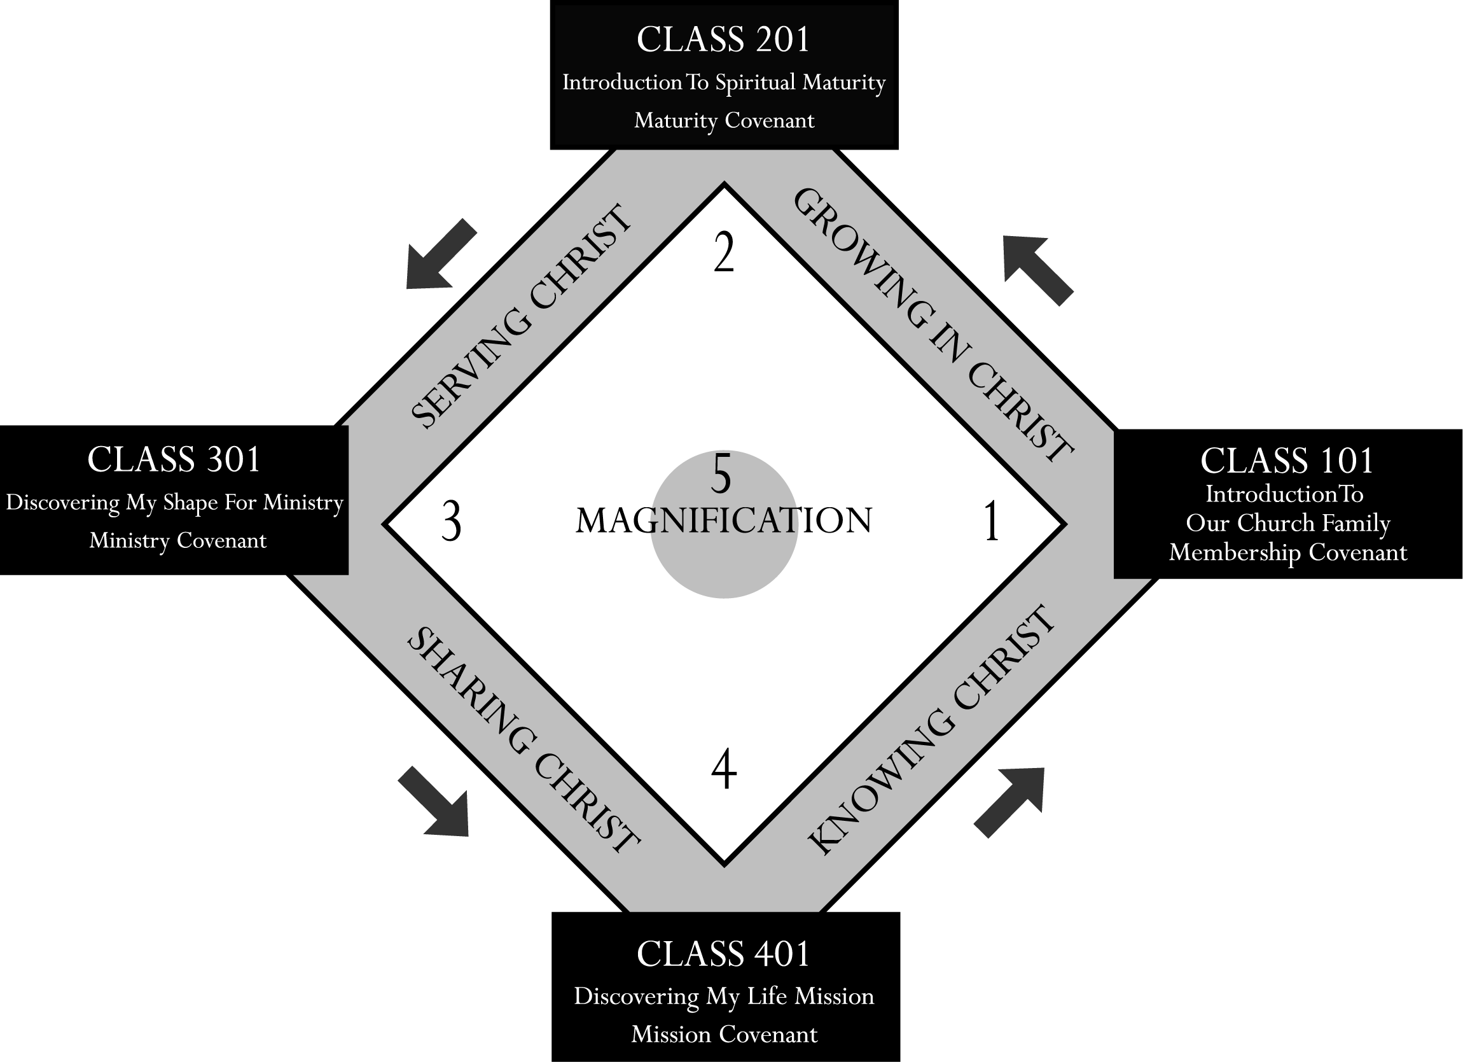

Slide 82
Purpose Driven Based Church Planting
Twelve of these distinctives are: (Continued)
Progressive commitment
Focus on church health not church growth
Mobilizing members for ministry
Simple structure for decision-making
A Scalable Paradigm
A paradigm instead of just methods

Slide 83
Purpose Driven Based Church Planting
“Purpose Driven is not about seeker services. It is about evangelism. Purpose Driven is a process by which you bring people in through evangelism, raise them up through discipleship, train them for ministry, and send them out on mission to the glory of God.” – Rick Warren, 4-5-2001

Slide 84
Purpose Driven Based Church Planting
Building the church around five biblical purposes. God’s purposes for His church should be the dominant consideration in decisions about what the church does and how it organizes itself. A study of the Bible led Rick to summarize God’s purposes for the church into five overarching purposes anchored in two passages of Scripture. The Scripture passages are the Great Commandment and the Great Commission.

Slide 85
Purpose Driven Based Church Planting
The five summary purposes that come from these passages are: Worship (Magnification), Fellowship (Membership), Discipleship (Maturity), Service (Ministry), and Evangelism (Mission).
These five purposes are expressed in a diagram utilizing a baseball diamond to communicate the dynamic of moving people from seeker to reproducing disciple.

Slide 86
Purpose Driven Based Church Planting
This concept of moving people toward maturity is implemented by developing at least one major program for each Biblical purpose. At least one core leader champions each purpose to insure that the purpose is not neglected. The biblical purposes also shape preaching, the way small groups are organized, the assimilation of new believers and members, the calendar and the budget.

Slide 87
Purpose Driven Based Church Planting
Advocating crowd-to-core church growth. The most effective way to develop a new church is by discipling a crowd into a core rather than trying to motivate a core to evangelize a crowd. This approach has biblical precedent in the ministries of both Jesus and Paul. Even in cell-church contexts this distinctive has meaning. There may not be a “crowd” but there should be a sustained effort to gather more than one seeker for each conversation about faith in Christ.

Slide 88
Purpose Driven Based Church Planting
Culturally Relevant Worship Style. Purpose-Driven churches are not “contemporary” but culturally relevant. Worship style is shaped to match the target audience. This adaptation affects all forms of communication, including music and preaching. PDC churches “read” their culture and adjust style accordingly, but without compromising the eternal message. This tension is difficult to maintain, but results in increased evangelistic effectiveness.

Slide 89
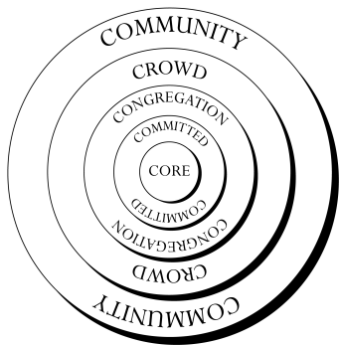

Slide 90
Purpose Driven Based Church Planting
“We intentionally did not build a building for 13 years until we were averaging over 10,000 in attendance. We wanted to prove you don’t need a building to grow. This allowed us to have more money for staff and programming.” – Rick Warren

Slide 91
Purpose Driven Based Church Planting
Not Dependent on Buildings. Most PDC plants thrive in rented facilities for years, just as Saddleback did. The PDC philosophy is that buildings are another tool, useful when they become the best way to accomplish the purposes of God. The reality is that most churches build too soon, and some, like cell church networks, will never build and yet remain healthy and reproducing.

Slide 92
Purpose Driven Based Church Planting
Targeted evangelism. Planters spend extensive time determining who their target group is, and what the bridges are from the target group’s life concerns to the Gospel. The most common misconception about targeting is that it is a process of excluding people the planter doesn’t want to reach. Targeting is actually a process of determining who the planter can best reach first and most effectively, but welcoming all seekers and expecting target groups to multiply as the church grows.

Slide 93
Purpose Driven Based Church Planting
When Rick did this study for the Saddleback Valley in Orange County, CA, he summarized the demographics memorably as a character known as Saddleback Sam.

Slide 94
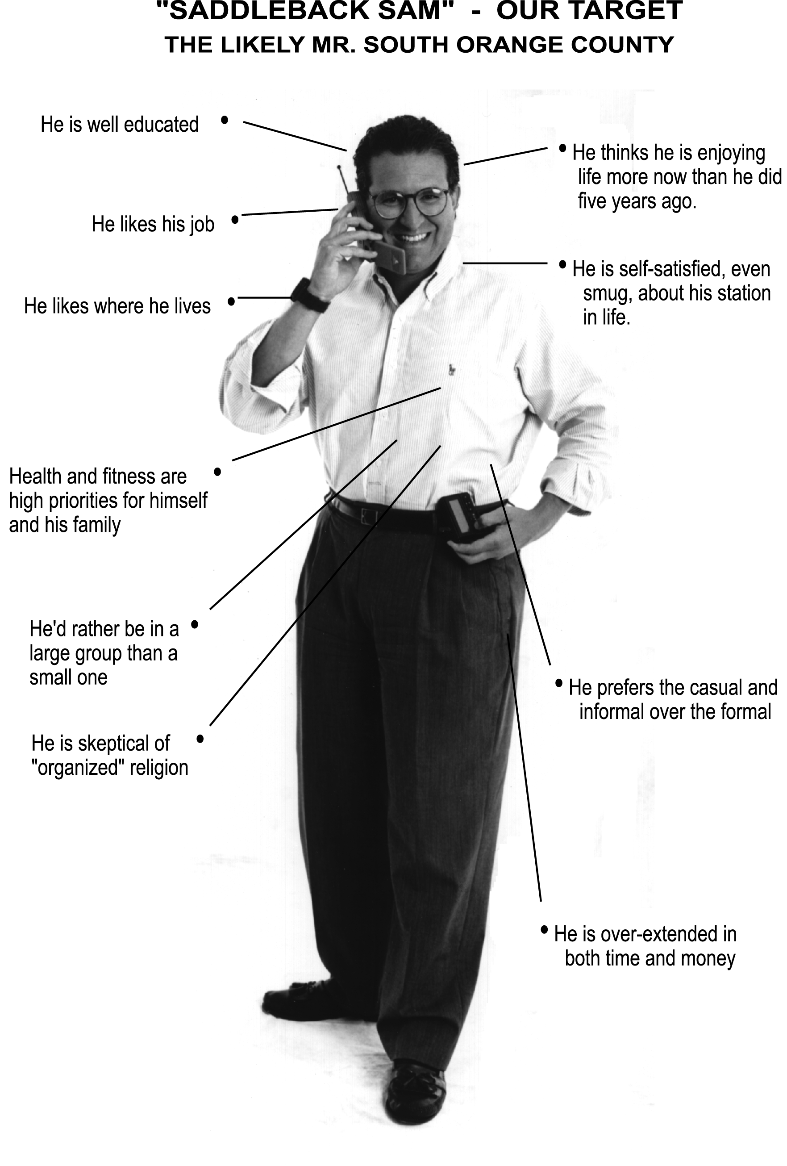

Slide 95
Purpose Driven Based Church Planting
Seeker-sensitive Events. Saddleback is committed to doing things in a way that puts seekers at ease and that eliminates unnecessary barriers to a clear understanding of the gospel. Since the average seeker needs multiple exposures to the gospel message before they respond, a Purpose Driven church does things in a way that keeps seekers coming back.

Slide 96
Purpose Driven Based Church Planting
At Saddleback there is an opportunity to make a conversion decision every week, but there is a strong call to commitment every six to eight weeks. This allows seekers to contemplate the message of Christ and the evidence of changed lives for several weeks before they are strongly urged to make a commitment to Him.

Slide 97
Purpose Driven Based Church Planting
Providing a simple path of discipleship. The path from seeker to reproducing disciple produces the best results when people are introduced to God’s purposes for their life through processes that are simple, logical, and linear. Saddleback developed a system called CLASS (Christian Life And Service Seminars) to introduce attendees to membership, and members to progressively deeper steps of commitment and maturity.

Slide 98
Purpose Driven Based Church Planting
Balanced small groups. The small groups of a purpose-driven church are intentionally balanced around the five purposes. This intentional balancing of biblical purposes has the goal of healthy group life which leads to growth and reproduction. This is one aspect of the scalability of the PDC paradigm.

Slide 99
Purpose Driven Based Church Planting
Developing members into ministers and leaders through progressive commitments to Christian life and service. Each step in the path toward spiritual maturity is marked by covenant commitments. The belief is that people grow as they learn to live out their commitments. One over-arching conviction of Rick is, “a great commitment to the great commandment and the great commission will build a great church.”

Slide 100
Purpose Driven Based Church Planting
Purpose driven church plants use progressively deeper commitments as a tool of discipleship. As maturity deepens there is intentional channeling of this commitment into service and involvement in missions, not just deeper knowledge.
Focusing on church health rather than church growth. Balancing the five purposes leads to a healthy church. A healthy church will grow, and multiply.

Slide 101
Purpose Driven Based Church Planting
This concept of church health is size independent. A planter can have a healthy church, whatever its current size. The use of PDC principles does not imply a goal of becoming a mega-church.
Depending on mobilized members to do the work of ministry. The purpose driven church develops its unique ministry in the community as its members discover their unique shaping by God for service in the Kingdom.

Slide 102
Purpose Driven Based Church Planting
A purpose driven church emphasizes pastors as equippers and laypeople as ministers. Ministries are lay-driven, and they emerge as laypeople find new ways to express who God made them to be.
Simple structure and system of decision-making. Time spent in committees and in business meetings is time people can’t invest in ministry to others.

Slide 103
Purpose Driven Based Church Planting
A purpose-driven church is staff led with congregational input, especially in areas that directly affect members’ time and money. Authority to accomplish tasks is given to teams rather than discussed in committee. There is an underlying value of trust that is at the core of a PDC church.

Slide 104
Purpose Driven Based Church Planting
A scalable paradigm used at every level of church life. The five purposes of God determine the emphases and structures of the whole church. This same five-fold paradigm guides the organization, development, and ministry of small groups, both individually, and as they work together in their community. Ultimately, the goal is to build into every member’s heart a deep commitment to a surrendered life of worship and service.

Slide 105
Purpose Driven Based Church Planting
At Saddleback Church, the PDC paradigm is also used to guide the age-related ministries of the church. Children’s ministry implements the PDC approach using age-appropriate symbols and terms. The same is true for junior high, high school, and college ministries. This consistency of vision and programming helps keep Saddleback’s staff working in harmony. It also insures that as the children of attendees grow, their Kingdom experience remains consistent, biblical, and balanced.

Slide 106
Purpose Driven Based Church Planting
PDC is primarily a paradigm, not a set of methods. This last distinctive is perhaps the most important for church planting. The methods of Saddleback can be copied, and the closer the setting is to Saddleback, the better they will work. But when adopted as a way of viewing the church, it becomes a flexible and adaptable framework to guide any planter in any setting in how to develop a healthy, balanced church that will attain all the size and ministry God intended when he placed the dream in that planter’s heart.

Slide 107
Purpose Driven Based Church Planting
The PDC approach to church and church planting has been used extensively in the United States, but often in ways that attempt to reproduce Saddleback Valley Community Church, where Rick Warren is senior pastor, rather than applying the above distinctives to a given context. As a paradigm, it has been successfully contextualized around the US and in many countries of the world.

Slide 108
Purpose Driven Based Church Planting
Countries where we know of a PDC church include Australia, Brazil, Canada, Germany, Hong Kong, Italy, Japan, Kenya, Mexico, Nigeria, Poland, Uganda, Ukraine, Russia, South Africa, and Taiwan.

Slide 109
Purpose Driven Based Church Planting
There are probably many more examples that we know nothing about. The most common setting for PDC church plants is in fast-growing suburbs of United States metro areas. The reason for this is probably that this setting is closest to South Orange County where Rick developed Saddleback. It takes the least amount of contextualizing to effectively use it in these settings.

Slide 110
The High Impact Based Church Plant
#12
On the rise is the launching of large new works from the initial stage of public worship. Usually large regional churches birth these new works as self sustaining full service congregations. These launches often begin with 200-300+ attendee's and grow quickly.
A expanded training manual
can be downloaded @
www.ChurchPlantingVillage.net
Church Planters Resources Library

Slide 111

Relation Based Church Planting
#13
A expanded training manual
can be downloaded @
www.ChurchPlantingVillage.net
Church Planters Resources Library

Slide 112
Relational-based Church Planting
Relational-based church planting is relatively new and attempts to solve the riddle of reaching and congregationalizing postmoderns. Relation based churches are nothing more than networks of single cell churches. These churches are fluid and spread along relational lines through people networks.

Slide 113
Relational-based Church Planting
What is a Relationally Based Church?
All churches are relational in some way because the nature of almost any regularly gathered group is relational, and because the gospel itself is relational. The relationally based church, however, derives it’s name because in it’s essence, it is built on and through relationship.

Slide 114
Relational-based Church Planting
What is a Relationally Based Church?
Just as the Purpose Driven Church structures itself around what it sees as the particular purposes of the church, and the Seeker Church is named because of it’s emphasis on being a church for the unchurched, the Relational Based Church is built principally around relationships.

Slide 115
Relational-based Church Planting
What is a Relationally Based Church?
The term is broadly used to define any kind of church that is based on relationships and is mostly used of smaller churches with loose structures and fluid organizations.

Slide 116
Relational-based Church Planting
In this study, churches in this broader category will be mentioned in the introductory material, but then the focus shifts to a particular type of emergent missional community: relationally based church networks. The relationally based networks that encompass the majority of this study are theologically and systemically whole and offer patterns for healthy church multiplication.

Slide 117
Relational-based Church Planting
Types of Relationally Based Churches
House churches. A house church in it’s best sense is a basic Christian community. In mathematics, consider the idea of least common denominator, with the church reduced to it’s essentials, but capable of performing all of the functions of church within itself. It is usually autonomous, and can be either highly egalitarian or very hierarchical. Single house churches, not related to the larger body of Christ, and not reproducing, can become ingrown and lose sight of mission.

Slide 118
Relational-based Church Planting
Types of Relationally Based Churches
Intentional Christian communities. Usually this term refers to Christians who live together in a household with a high value on communal life. Some intentional communities have survived the years and provide models from which new groups can learn. Intentional communities, though they might seem unstructured, sometimes move to high structure and formal rules in response to the struggles of living so closely with one another.

Slide 119
Relational-based Church Planting
Types of Relationally Based Churches
Cell churches. If loosely organized, organic, and less hierarchical these may be in the category of relationally based churches. They are usually organized with high value on both community and evangelism, but not necessarily church reproduction or mission to the world. In cell churches, each individual cell is a Christian community, and membership in the cell church may be dependent on membership in an individual cell.

Slide 120
Relational-based Church Planting
Types of Relationally Based Churches
All of the above, plus the relationally based church networks, may have some common characteristics as pictured in Robert Bank’s definition from his book, The Church Comes Home (p.6).

Slide 121
Relational-based Church Planting
Types of Relationally Based Churches
Relationally based church networks. These are networks of basic disciple-making communities relating to one another, built around a covenant relationship to Christ in the context of shared relationships between individuals and groups. Participants demonstrate a commitment to follow the way of Christ together and a desire to be on mission with one another.

Slide 122
Relational-based Church Planting
Types of Relationally Based Churches
Relationally based church networks. Each church is structurally autonomous, but spiritually and relationally accountable to other churches in the network that have shared values about community, mission and a simple life style of following Christ. It is this type of relationally based church networks (may be networks of house churches) that the remainder of this material considers.

Slide 123
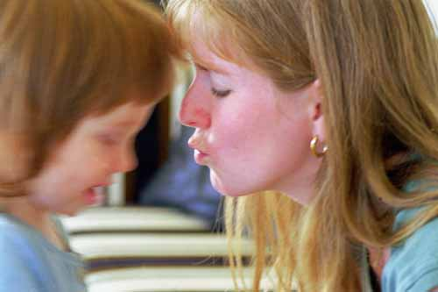
Ministry Based Church Planting…
#14
is the planting of a church that will go into the community, impact people’s lives, and draw them towards the gospel.
A expanded training manual
can be downloaded @
www.ChurchPlantingVillage.net
Church Planters Resources Library

Slide 124
Ministry Based Church Planting…
In North America and around the world, a great number of people are in need of a touch by Jesus. An alarming number of people in North America, over 200 million, have yet to accept Jesus Christ as their personal Lord and Savior. What if the same number of people in North America were dying with AIDS?, or being abused?, or dying of starvation? The outcry of God’s people would be tremendous! Yet there are no headlines announcing the tragedy that many people are dying in their sin, not experiencing salvation through Jesus Christ. A church planter who will be effective in seeing the lost get saved must be concerned, like Jesus, with the whole man. It is important for the church planter to understand the needs of the lost person in order for the lost person to listen to the Gospel. But the question is, “How can the church touch hearts and meet the diverse needs of so many?”

Slide 125
Ministry Based Church Planting…
The church can be involved in meeting needs if the church planter would take time to get to know his/her community. The church planter needs to know not only real needs but felt ones. A felt need is “an issue or concern that is perceived by a person that inhibits in meeting a variety of needs.” Historically, Southern Baptists have been involved in meeting the needs of people, and starting new churches. However the focus of the ministry was a social one rather than an evangelistic one.

Slide 126
Ministry Based Church Planting…
Ministry Evangelism Based church planting is the planting of a healthy church through meeting real, felt, and anticipatory needs. The rational is that people are hurting, and they need to know that God loves them and wants to meet their ultimate need, a personal relationship with Jesus Christ; however, the meeting of real or felt needs in the person’s life serves to demonstrate the compassion of Jesus Christ. Jesus Christ met many needs whether it was healing the blind, feeding the hungry, casting out demons, or even raising the dead. The ministry evangelism based strategy accomplishes its purpose by understanding the needs of the community and implementing an evangelism strategy to meet those needs. This strategy in church planting could be effective in many communities but especially in Urban areas and in reaching Ethnic groups.

Slide 127
Ministry Based Church Planting…
The new church must “fit the needs of the people. Culture, language, and education should all affect the ministry and structure of the church” according to Oscar Romo.[1]
Ministry Evangelism Based church planting is personal evangelism, and personal evangelism is suitable especially in the urban context.

Slide 128
Ministry Based Church Planting…
The implications of reaching people with the gospel through meeting needs means that the church planter will have to minister to people in their world of relationships. The failure of the church in urban and ethnic areas is related to the lack of effective evangelism and discipleship. Many churches go on mission trips and do many worthwhile projects; however, there is no follow-up on the people to whom they minister. Consequently, many of the same children are “being saved” over and over again because there was no follow-up with the children to help them understand the assurance of their salvation.

Slide 129
Ministry Based Church Planting…
Ministry Evangelism based church planting is also effective in reaching people from disadvantaged communities. The church cannot serve in poor areas without offering hope - the good news of Jesus. There are many social programs and agencies in such communities, but they have not changed the people’s ways of life. Caring for the personal needs of the poor is a part of evangelism and is an opportunity to reach them with the gospel of the Lord Jesus Christ.
[1]Ethnic Church Planting Guide pg. 2.

Slide 130
Ministry Based Church Planting…
Ministry Evangelism based church planting is a holistic process. The underlining desire is for fellowship and social interaction. Many people today are seeking the benefits of God rather than a personal commitment to him. They want peace, joy, hope, love and acceptance but not an experience resulting from surrendering to Jesus as Lord. Only Jesus can offer the ultimate fulfillment available through a personal relationship with Him.

Slide 131
Social Action
Advantages
  Incarnation of gospel
    integrated evangelism
  Contextualizes church
  Entry into urban area
  Expands planting gifts beyond “pastor”

Slide 132
Social Action (cont)
Disadvantages
  Tendency to “minister to”instead of “with”
  Can denigrate into “Social gospel”
  Usually slower growing

Slide 133
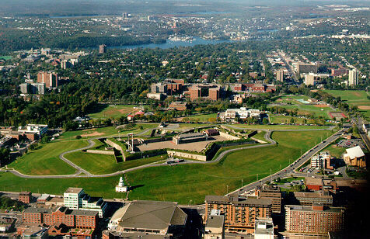
Pioneering Based Church Planting
#15
The Pioneering model is that a church planter usually starts from scratch without even having a core group. This model often has no sponsoring church per say so the planter does not have much core group development in place when he begins. In days past, people have referred to this launch type as starting from dirt and dirt only. Additionally, team members are slow to follow and the task falls to the responsibility of the planter to draw the net and gather people via relational and evangelistic skills. Critical in this model is the ability to start fast with the gathering of core group members and assimilation techniques. Strengths to this model include being able to fashion the new work according to biblical priorities and community contextualization. There are a variety of planter’s types that are involved in the use of pioneering models.

Slide 134

Mother/Daughter Based Church Planting
#16
Usually when you think of the parenting model you use the idea of a mother/daughter church relationship. This is where the mother church assumes responsibilities of starting daughter churches. Some modern day parishioners use the term “hiving off” of a new congregation, but the design is the same. This is when an existing church contributes to the new church plant resources of people, monies, guidance, coaching and sometimes use of the present church facilities as well.

Slide 135
Mother/Daughter Model
Advantages
  Well tried model
  Lessens Competition
  Sizeable core (congregation) group
  Planter goes out with a leadership team
  Low risk- can always return home
  Experienced supervision, resources
  Better knowledge of local community and target area

Slide 136
Mother/Daughter Model
Disadvantages
  “Cloning” risks as usual
  Less flexibility as new church often becomes exact copy of mother church
  Labor intensive (1 at time)
  Adjustments to mother church
  Experiences often the apron string phenomenon
  Lacks strategy
  Limited to larger churches
  Denomination may have little input or helpful direction into critical decisions of the new work

Slide 137
Colonization (Distance version of Mother/Daughter)
Advantages
  Strategic- target unchurched area
  Committed core group
  Home church resources
Disadvantages
  Major changes for colonists
  Cloning risk
  Retreat harder
  “Colonization” labels and mentality

Slide 138
Cross Cultural Based Church Planting
#17
Cross Cultural Based Church Planting should continue to be one of the priorities in starting new works as we seek to cross cultural boundaries so that others might be won to Christ! Reaching people everywhere has always been part of who church planters really are. We must continue to establish cross cultural communities of believers.

Slide 139

The Missional Sunday School Based Church Planting
#18
I have always been excited to see lay people get involved in church planting. One of the best ways I know is to begin missional Sunday School based plants that start off as an outreach bible study and grow into a fully functioning new work! In the Book of Acts we see seven laymen from one congregation begin to assist in the work of ministry (Acts 4:13). Southern Baptist’ owes its growth of the past in large measure to the historical emphasis on lay involvement. It was through the use of laymen to start Bible classes and
missional Sunday Schools that we
experienced our largest growth! The model
will still work today, I might add.

Slide 140
The Missional Sunday School Based Church Planting
#18
A Quick Planting Primer on Missional Sunday School Based Planting:
Laypeople who work faithfully in the present church are excellent choices for helping launch a new work.
Partnering churches can use this strategy to fulfill the great commission.
Harvest Christians are needed to carry out the plan and missional bible studies is a solid methodology that should be considered.

Slide 141
Associational Based Church Planting
#19
There has always been the debate as to who really plants churches! Churches plant churches! People plant churches! Groups plant churches. God has used anyone willing to be faithful towards the carrying out of the Great Commission. Local associates can even use all three examples above to plant new works. It is a little of all three if we are clear. The local association can help assist churches who have a desire to plant new works. In so doing they sometimes take the lead and sometimes follow it just depends on what god is doing at that time with all parties involved.

Slide 142
Second Generation Based Church Planting
#20
For assistance in second generation based church planting contact:
Mark Hobafcovich at mhobafcovich@namb.net or call 770-410-6228

Slide 143
Seeker Focused Based Church Planting
#21
…is the planting of churches that intentionally target specific seeker populations, and position themselves to respond to the target’s needs.
A expanded training manual
can be downloaded @
www.ChurchPlantingVillage.net
Church Planters Resources Library

Slide 144
Seeker Focused Based Church Planting
Since the birth of Willow Creek Community Church twenty-five years ago the seeker church movement has been gaining momentum. While the seeker church certainly contains many of the components found in any New Testament church, they are unique for the degree in which they focus on an unchurched/unsaved target.
Willow creek is a perfect example of this. While their vision is for creating a Biblically functioning community, they are committed to accomplish it by turning irreligious people into fully devoted followers of Christ. For them, at this point in time, the seeker service is the best tool for accomplishing their mission. With this in mind it is important to note that the defining element is not a certain type of service, but it is the relentless focus on reaching seekers.

Slide 145
Seeker Focused Based Church Planting
The beginning point for the seeker church is the seeker. In a very true sense the seeker church can be defined as “a church for the unchurched.”
The Evolving of Terms for a “Seeker Based” Church
Seeker Driven – When American evangelicals began to give notice to the ministry of Willow creek Community Church the model was described as a “seeker driven” model. This term seemed to indicate that the direction and focus of the ministry was determined (driven) by seekers. Leaders soon realized that “seekers” could not determine the purpose and direction of the church, by which its very nature was a community of believers, therefore a new term was needed to identify this unique way of doing church.

Slide 146
Seeker Focused Based Church Planting
The beginning point for the seeker church is the seeker. In a very true sense the seeker church can be defined as “a church for the unchurched.”
Seeker Targeted – The next term that leaders began to hear as they dove into the meaning and purpose of this model was the term “seeker targeted.” This term seemed to more accurately describe what was meant by their methods. A seeker targeted church would orient its vision, mission and strategy to reaching the unchurched / unsaved seeker. For many years this was the term that leaders around the world heard as they went to conferences and read books about Willow creek.

Slide 147
Seeker Focused Based Church Planting
The beginning point for the seeker church is the seeker. In a very true sense the seeker church can be defined as “a church for the unchurched.”
Outreach Oriented – In recent days another term has been tossed around describing the same model; “outreach oriented.” An “outreach oriented” church is much more palatable to the target audience which includes the unchurched/ unsaved person. It has been discovered that most seekers do not like to feel as if they are target practice for a church. Therefore, when a church says its mission, vision and strategy is to be “outreach oriented” then it is saying they are thinking more about reaching out than reaching in towards themselves.

Slide 148
Seeker Focused Based Church Planting
The beginning point for the seeker church is the seeker. In a very true sense the seeker church can be defined as “a church for the unchurched.”
The student of this model is likely to hear and use all of the above mentioned terms when they study a seeker-based church. The vision statement of Willow Creek Community Church now states that they are a place “where the doors are wide open to people from all backgrounds, regardless of where they’re at on their spiritual journey”. (www.willowcreek.org)
Regardless of what term you use to describe the seeker movement a distinction between seeker targeted and seeker sensitive needs to be made.

Slide 149
Seeker Focused Based Church Planting
The seeker targeted church can be distinguished by its focus on doing church exclusively for the unchurched/unsaved. Seeker targeted churches usually have a large group gathering designed exclusively for the unchurched/unsaved. While this large group gathering looks and feels very much like a worship service; it is not. It is in fact a very well put together production or presentation of some basic Christian truth.
The seeker sensitive church is distinguished in that its focus is doing church for believers. However, seeker sensitive churches go to great measures to make the experience user friendly for the person who hasn’t been church broke. While the seeker targeted church and the seeker sensitive church may appear very similar on the outside, they are fundamentally different in their approach. This is a distinction that needs to be made.

Slide 150
Seeker Focused Based Church Planting
Another way of looking at the seeker church is on a continuum. The degree in which a church is seeker targeted is the degree in which it becomes believer hostile. While on the other hand, the degree in which a church becomes believer targeted it becomes seeker hostile. While many may disagree with this, it is the tension in which purely seeker targeted churches operate.
For the church to continue to do business in the same ways we have for the past 200 years would spell certain decline. George Barna, Frog in the Kettle

Slide 151
Seeker Focused Based Church Planting
Just as all seeker churches are not the same, neither are all seekers the same. However an understanding of seekers is absolutely essential in seeker churches. One choosing this approach to church planting may want to consider the Engle Scale as a useful tool for gaining an understanding of what it means to reach seekers. Developed by George Engle as a tool for understanding traditionally pagan cultures, it is becoming an excellent and essential tool for understanding large segments of unchurched/unsaved people in North America. While North America is often viewed as a Christian nation and thus a harvesting field, that may no longer be true. Many believe that our nation is fast becoming a sowing field.

Slide 152
Seeker Focused Based Church Planting
George Hunter suggests in his book How to Reach Secular People, as a church we use to enjoy a home court advantage, but today we at best play on a neutral court and often on a hostile court. Many people, if not most, are beginning their journey toward Christ with their backs toward the cross. He goes on to state that there are at least 120 million secular people living in the United States age 14 and up. While he suggests that there are at least seven different types of secular people, he zeros in on three.

Slide 153
Seeker Focused Based Church Planting
George Hunter’s Three types of Secular People
Ignostics are those living today who have no Christian memory.
Notionals are those who assume because they are born in America that they are Christian, after all we do live in a Christian nation.
Nominals which can be represented by those who Paul warned Timothy about as having a form of Godliness, but denying the power therein. As Hunter put it they sit in our pews, but the implications of the gospel simply go over their heads.

Slide 154
Seeker Focused Based Church Planting
The seeker church understands that while seekers see the church as 1) lacking credibility, 2) boring, and 3) irrelevant they have a favorable disposition toward Christ. Lee Strobel shares some light on the seeker church approach to evangelism in his book, Inside the Mind of Unchurched Harry and Mary.
He suggests that people are in one of three camps when it comes to their disposition toward Christianity.
Camp A represents those who have no inclination toward Christ and the church.
Camp B represents a group that is not convinced of Christ’s significance, but are at least open to honest investigation and inquiry.
Camp C represents those who are convinced of Christ’s significance and his church.

Slide 155
Seeker Focused Based Church Planting
The seeker service is designed for those who are considering that move from one camp to another.
If its target primarily defines a seeker church, then it is important that we understand how the seeker church sees its target. There are four basic targets to which churches aim. They include:
Unchurched/Unsaved – those who have no Christian background and often have no Christian memory.
Unchurched/Saved – those who have a conversion experience but are outside the local church for a variety of reasons. Many who fit in this category are those who failed to see their childhood faith as relevant for today. Others dropped out while moving from place to place. A large number have experienced some kind of hurt in their life related to church and their faith.

Slide 156
Seeker Focused Based Church Planting
The seeker service is designed for those who are considering that move from one camp to another.
Churched/Unsaved – referring back to George Hunter, this group represents those he would refer to as nominal. They have a knowledge of the Christian message, but the implications of the gospel go right over their heads. Often they are a product of a religious culture instead of conversion.
Churched/Saved – obviously there are those deeply committed followers of Christ in his church. This group sees themselves as being on mission with Christ. It is important to note that any seeker church must have a large number of these folks to effectively impact the unchurched/unsaved arena.

Slide 157
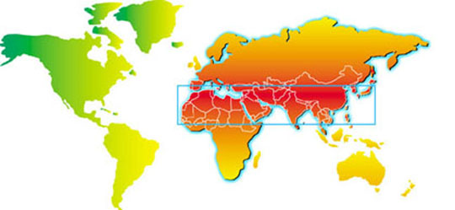
1040 Window Based Church Planting (International)
Bonus
#22
The core of the unreached people of our world live in a rectangular-shaped window known as the 10/40 Window. Also called the “Resistance Belt”, this window extends from West Africa to East Asia, from 10 degrees north to 40 degrees north of the equator.
This specific region encompasses the majority of the world’s Muslims, Hindus, and Buddhists - literally billions of spiritually impoverished souls.
An astonishing 97% of persons who inhabit the LEAST EVANGELIZED countries in the world live in the 10/40 Window!

Slide 158
1040 Window Based Church Planting
Bonus
#22
Facts About the 1040 window:
There are 62 Nations in the 1040 Window
4.1 billion of the world's 5.6 billion people live in the 1010 window
There are more than 1.2 Billion people under the influence of Communism
It contains over 1 billion Muslims, nearly 1 billion Hindus and 600 million Buddhists.
97% of the unreached people groups are located here.
The top fifty least evangelized cities in the world are all in the Window.
Most of the 10/40 Window nations are closed to western missionaries.
It is an area of great spiritual darkness known as the "resistance belt."
It contains over 70% of the world's people but only 8% of the missionary efforts.
Less than 1/2 of 1% of the budget of our churches goes to reach the 10/40 Window .
Millions in the 1040 Window have never even heard the name of Jesus
The 10/40 Window is an imaginary window between 10 degrees and 40 degrees north of the equator stretching from West Africa through Asia.

Slide 159
1040 Window Based Church Planting
Bonus
#22
Where is the 10/40 Window?
The 10/40 Window is a rectangular-shaped area extending from West Africa to East Asia, from ten degrees north to forty degrees north of the equator. Often called "The Resistant Belt," this specific region, encompasses the majority of the world's Muslims, Hindus, and Buddhists - billions of spiritually impoverished
WHAT IS THE 10/40 WINDOW? The 10/40 Window is located from 10 degrees to 40 degrees north of the equator, which includes Africa, the Middle East and Central Asia.
CHURCH PLANTING IS VITAL!

Slide 160
The Church Plant Based on a Split
Bonus
#23
No one likes to admit it but some churches do start from the splintering off of one church to become another. Usually this is the result of challenges that had not been addressed in the existing church. After a time members feel like they are not being heard by established members and they seek another means towards worshiping. Then a new work begins based on a split. Though this is never recommend, it does happen. The long term view is that both though they start as the result of unresolved conflict, both eventually begin to grow again and continue to reach the target area for Christ. It is better to have started a new work earlier than letting it become a split but some just hold on and both groups feel like they are frustrated that they have not other way out. This model, though we can point to many examples is never the best course of action! Another term for this model of planting is undiagnosed pregnancy based church planting.

Slide 161
Parachute Drop Based Church Planting
#24
This is when you launch a new work in an un-entered area with little or no preparation. The planter is parachute dropped into an area and told to go there and start with few resources.
Advantages: total exposure of planter to the target area.
It is usually passion driven.
There is a high risk/high potential gain in terms of new believers.
Requires a precise assessment of planter.

Slide 162
Parachute Drop Based Church Planting
#24
This is when you launch a new work in an un-entered area with little or no preparation. The planter is parachute dropped into an area and told to go there and start with few resources.
Disadvantages: Takes a great deal of time and money.
These launches are leader dependent so a long range strategy is a must. It usually results in a “lone ranger” mentality for ministry.
Burnout is highly possible.
The planter can become disconnected from denomination and possible support or encouragement networks.

Slide 163
The Apprentice Based Church Plant
#25
Apprentices are widely used in church planting and have been around for a long time. This is when an existing organization or convention calls an inexperienced individual to an already established church plant and they are mentored and trained. This usually happens for about 12-18 months where the apprentice gains valuable training that he will need for his own launch just around the corner.

Slide 164
The Apprentice Based Church Plant
#25
Advantages: the existing plant and church planter is the teacher.
The existing plant is a formation place for the apprentice to work out his eventual strategy design while growing in knowledge and experience.
The apprentices new work will become connected to a larger church plant from the launch.
The older new work could serve as an example for the new one as it continues to grow just ahead of the infant apprentice start.
Some organizations (not all) finance the apprenticeship and partnership with the existing church.

Slide 165
The Apprentice Based Church Plant
#25
Disadvantages: It is often hard to find a plant that is willing to take on this function.
Formation of the next work can get sidelined with the work of the existing one.
Ongoing training might provide problems and obstacles.
Apprentice may grow either to connected or to disconnected to the training program and either want to stay forever or depart prematurely.

Slide 166
Multi Denomination Based Church Plant
#26
Though this is very rare within my denomination, other groups have found this a viable tool in developing a new work. In places like New York City it is a design that has found a following. This is when two or more denominations start a new work together.

Slide 167
Multi Denomination Based Church Plant
#26
Advantages: Resources are usually shared.
It is becoming a model for the urban center and the rural areas across the land. (In the Urban fringe and suburbia has not caught on as of yet!)
Has a strong unity model and community appeal.
Appeals to those who are not brand loyal
Also works well in vacation or resort areas.

Slide 168
Multi Denomination Based Church Plant
#26
Disadvantages: There is a high demand on ones energy to keep the group together.
Loss of denominational identity.
People are not sure just who is in charge and responsible.
Lines of oversight and accountability become cloudy.
Not a clearly established chain of command.

Slide 169
The Restart Based Church Plant
Bonus #27
The restart based church plant model is being used all across North America. Any group planting churches should have a restart church planting strategy if it is going to be a wise steward. A complete change of leadership and direction is a must for this model to be successful.
A expanded training manual
can be downloaded @
www.ChurchPlantingVillage.net
Church Planters Resources Library

Slide 170
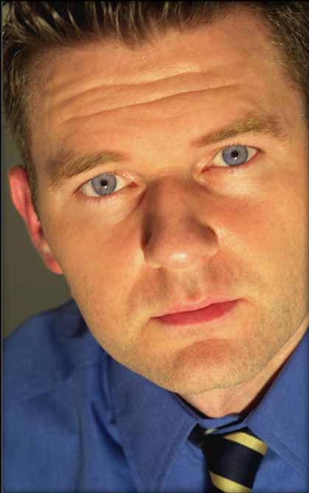
Minister of Missions Based Church Planting…
Bonus #28
Effective Minister of Missions in larger churches have found that hiving off of a core group from the mother church is an excellent way to launch a new work. This is more than sending two couples to lead the team but a complete core group ready to begin the work and function as the nucleus of the new work. One example in northern Atlanta held meetings on Sunday evenings for almost a year before they branched out to begin the new work. The result: the new church launched with 500+ people already committed and involved in the plant.

Slide 171

House Church Based Church Planting
#29
The House Church Based Church Planting is a way of living the Christian life and fulfilling the Great commission. It is a way people follow Jesus Christ in life. House churches are a communal expression that seek to draw the un-churched into community. It is a body of Christ meeting in a local home and functioning as a spiritual family with traits or characteristics of a New Testament Church.. Though it is a lesser used model and viable option for the young church early in existence due to limited resources for land and buildings, it is still a model and though many choose not to consider this model for the sake of completeness it is offered as an extra model.

Slide 172
Relational
Cell Churches
House Churches
A expanded training manual
can be downloaded @
www.ChurchPlantingVillage.net
Simple Church

Slide 173
Cell vs. House
Cell Churches may meet in houses
House Churches are not Cell Churches
Cell Churches divide around 15 members
House Churches grow into bigger House Churches usually around 25 – 35 members.
Cells have two main components
  Cells linked together for fellowship
  Celebration is a community event of linked cells

Slide 174
Cell vs. House
The Cell is the focus of the church
Cell needs network large enough to service Cell
A expanded training manual
can be downloaded @
www.ChurchPlantingVillage.net
Simple Church

Slide 175
Advantages of Cell & House
Focus on small groups
Focus on people vs. programs
Relational evangelism
Expectation of replication
Shared leadership
Low cost in fact usually no cost
Bi-vocational leadership

Slide 176
Advantages of Cell & House
Highly valued lay leadership
Very resilient
Needs training and support to grow
Never outgrows the living room or game room.

Slide 177
Network Churches
Ethnic
Youth
Not based on locality but commonality (New Testament?)
Fractures families
Nominality (isolated from world)
Based on HUP* (Homogeneous Unit Principle)
*C.f. Win Arn The Win Report #1, Oscar Romo American Mosaic & Donald McGavran Understanding Church Growth.

Slide 178
Other Church Planting Terms
One popular method of labeling models or designs is to give them biblical terminologies. Some have used:
Jerusalem Model
Samaria Model
Caesarea Model
Antioch Model
Galatia Model
Philippi Model
Thessalonica Model
Berean Model
Athens Model
Corinthian Model
Ephesian Model
A great resource in this area is Churches That Multiply: A Bible Study on Church Planting by Elmer Towns and Douglas Porter

Slide 179
Some Other Great Books to Consider:
Church Planting: Laying Foundations by Stuart Murray
Starting a New Church: the Church Planter’s Guide to Success by Ralph Moore
Church Planting the Next Generation by Kevin W. Mannoia
Reaching a Nation Through Church Planting by Richard H. Harris

Slide 180
My Challenge
To plant five million churches in the first part of the new millennium (2000- 2020) would require that each evangelical church, plant just three new churches each!
Here is my challenge, why not plant
  1 Ethnic
  1 African American
  1 Anglo
And see the Kingdom of God ushered in!
Think about it!

Slide 181
Twenty – One Church Planting Strategy Designs for the Twenty-First Century
Thank You!

