Slide 1
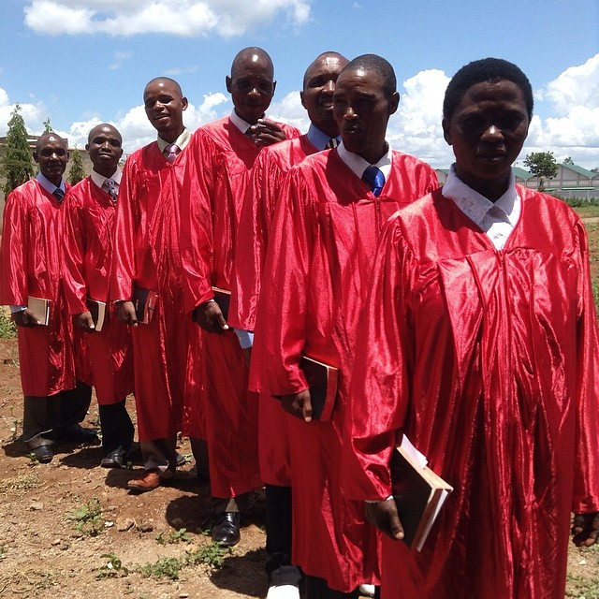
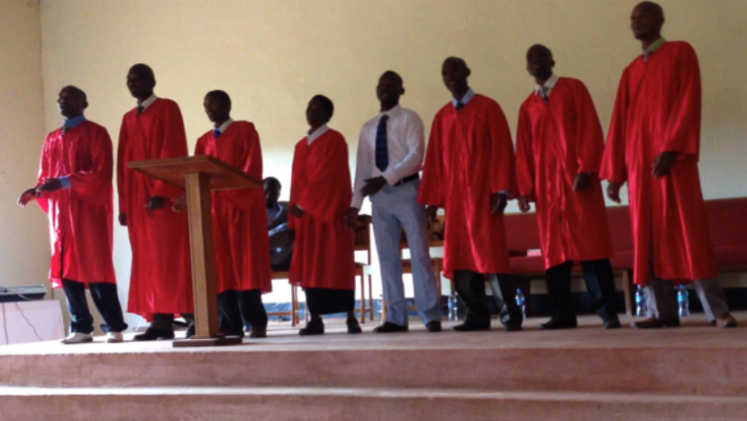
Deliverance
Bible
Institute
Tanzania
2014
Graduates

