Slide 1
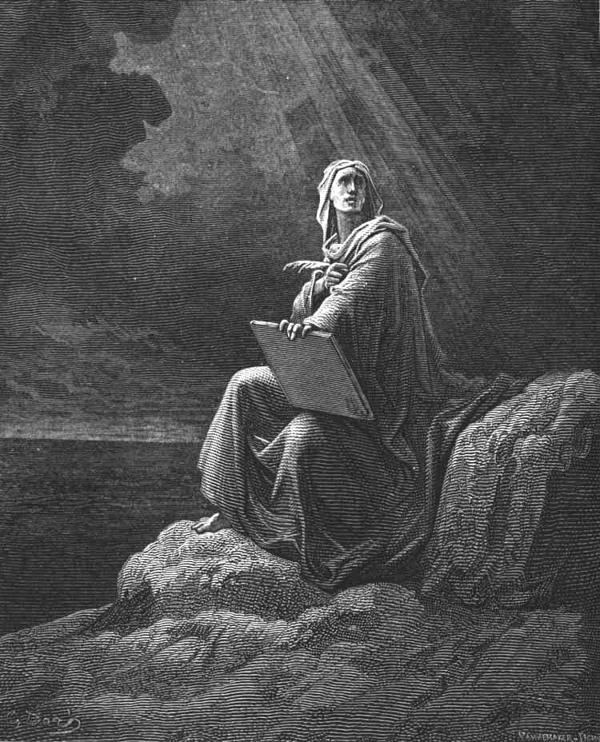
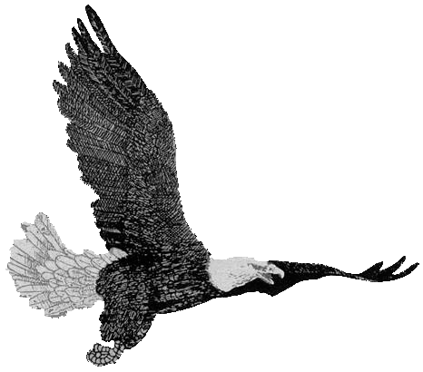
Revelation
Chapter 5:
Chapter 5:
Deliverance
Bible
Institute
The Sealed Book
The Sealed Book

Slide 2
Chapter 5: Scene
continuation of chapter four.
The scene is still…
the throne,
the Elders,
the Living creatures.
2

Slide 3
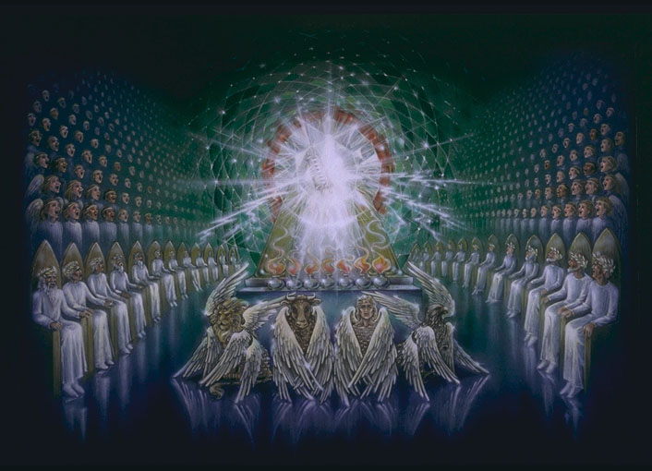
Throne of Majesty
24 Elders
4 Living Creatures
3

Slide 4
Revelation 5 Outline
The Sealed Book
The Nature of the Victor
The Response
4

Slide 5
The Sealed Book
Revelation 5:1
And I saw in the right hand of him that sat on the throne a book written within and on the backside, sealed with seven seals.
5

Slide 6
The Sealed Book
The book contained a revelation and demonstration of things to come at the consummation of this present age after the Rapture of the Church.
6

Slide 7
The Sealed Book
I. The Position of the Book
II. The Characteristics of the Book
III. The Dignity of the Book
IV. The Purpose of the Opening of the Book
7

Slide 8
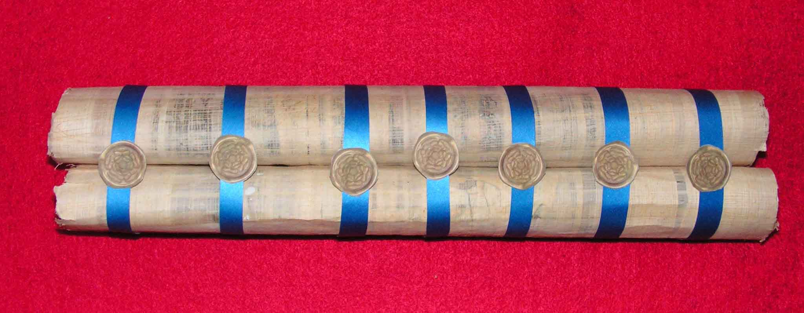
Artist’s Sealed Book
8

Slide 9
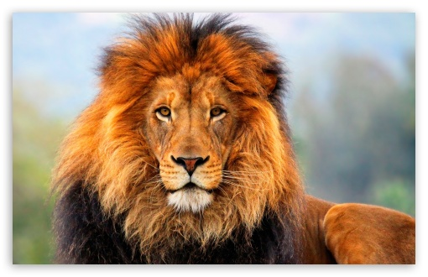
The Nature of the Victor
The Book’s Opener is presented as Victor!
A Lion
Both ROOT and OFFSPRING!
9

Slide 10
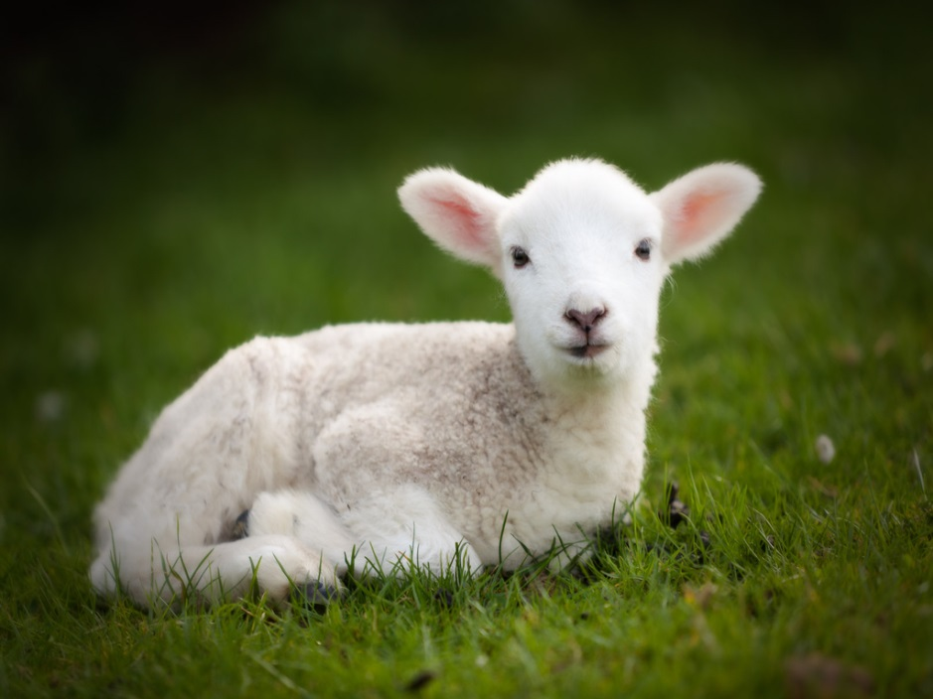
The Nature of the Victor
II. A Lamb
10

Slide 11
The Response
Four Beasts and 24 Elders
What Their Song is About
Of the Angels
Of All Creation
11

Slide 13
Revelation
Chapter 5:
Chapter 5:
Deliverance
Bible
Institute
The Sealed Book
The Sealed Book

