Slide 1
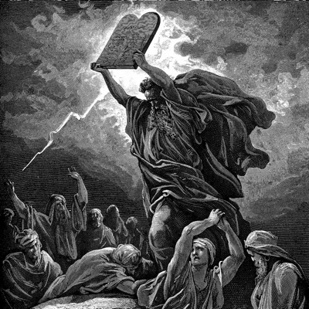
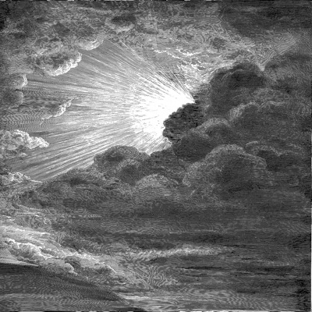
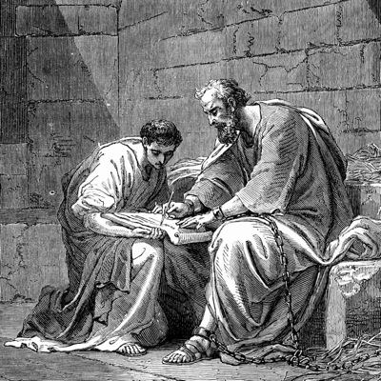
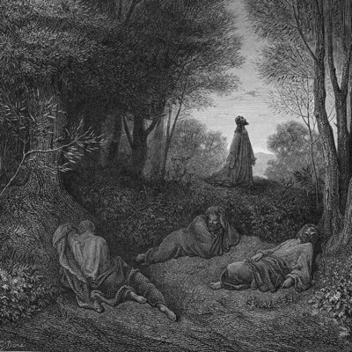
Bible exchange: Site Design
Entities
Collections
Styles
Routing

Slide 2
Entities

Slide 3
Entities
Users|Clients
Lessons|Articles|Studies (having properties)

Slide 4
Entities: User : Attributes

Slide 5
Entities: User : Roles
name | permissions
guest | can view ALL "index pages", can view certain "lesson pages"
trial | {guest}+, can view all "lesson pages" for a limited time
student | {guest}+ can view all "lesson pages"
instructor | {student}+ can edit "lesson text", can link "lesson media (audio/video)", can "schedule" "course events"
admin
Super Admin

Slide 6
Collections

Slide 7
Collections: Ownership
Highest Level: Track|Certification ("pastor")
  Topics|Courses|Subjects ("Homiletics")
    Events (Tests, General Experience)
    Series|Chapters ("Sermon Organization")
      Lessons ("Collecting Your Thoughts for a Sermon")
        HAS: Audio, Video, Text, Questions, Activity, Test, Responses|Answers

Slide 8
Collections: Example (#1)
Tracks | Courses (2) | Series (112) | Lessons
Personal Worker | Through the Bible | Genesis (4 lessons) | "How God Started it All"
 |  |  | "6 Important People in Genesis"
 |  |  | Textual Study of Genesis Ch. 1-28
 |  |  | Textual Study of Genesis 29-50
 |  | Exodus (3 lessons) | "The Start of a Deliverance"
 | Personal Evagelism | Media Witnessing (2 lessons) | "Giving Out Tracts"
 |  |  | "Giving Out Sermons"
..........................................................................................................................
..........................................................................................................................
..........................................................................................................................

Slide 9
Collections: Example (#2)
Personal Worker | Through the Bible | Genesis (4 lessons) | "How God Started it All"
 | Personal Evangelism |  | "6 Important People in Genesis"
..........................................................................................................................

Slide 10
Styles

Slide 11
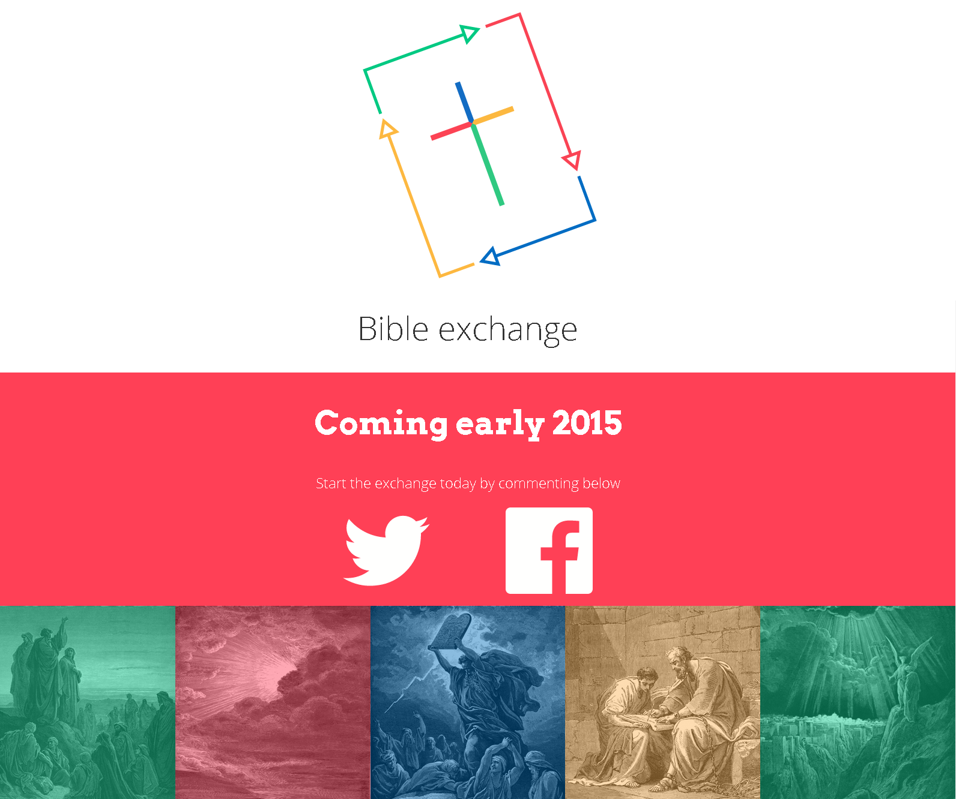
In Development Landing Page

Slide 12
Colors
"Red" - #FF4056 - 255,61,88
"Yellow" - # - 255,182,87
"Blue" - # - 0, 110, 189
"Green" - # - 0, 201, 137

Slide 13
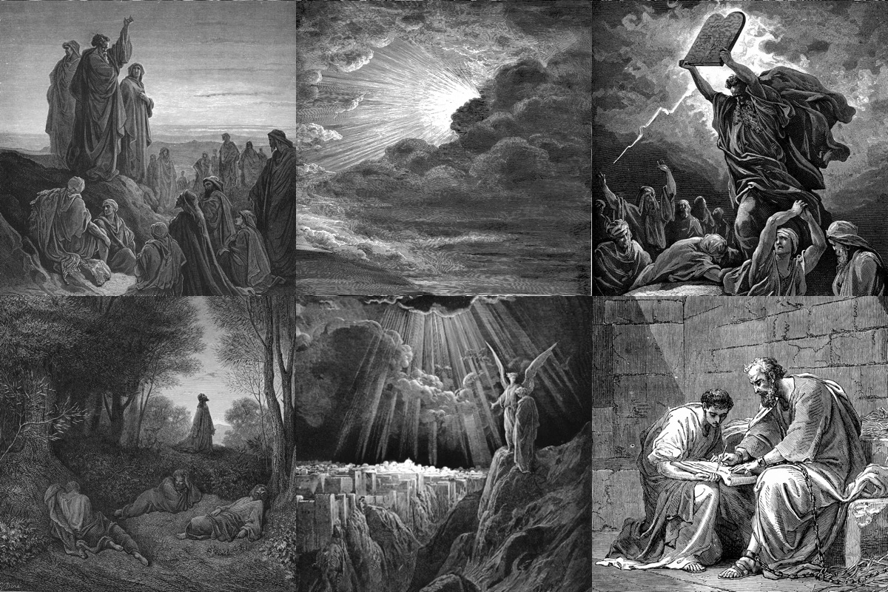
Images
Dore with Transparent (45%) Color Layer Added

Slide 14

Logo

Slide 15
Typography

Slide 16
Routing

Slide 17
Routing

