Slide 1
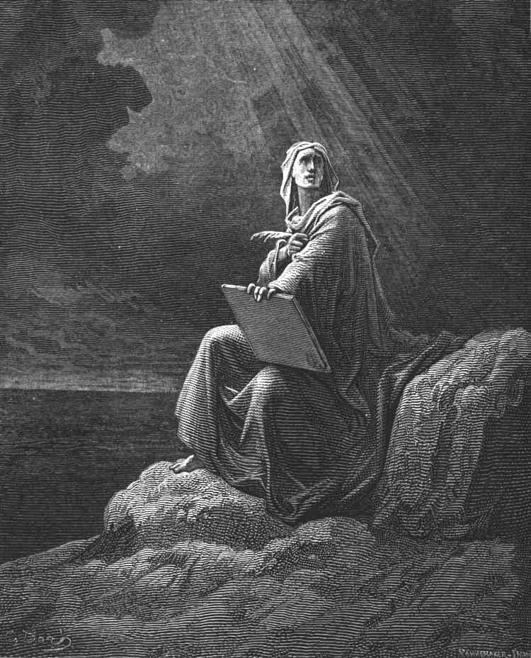
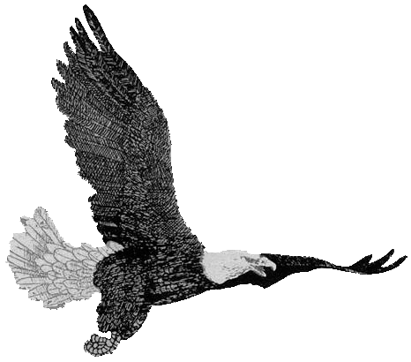
Revelation
Chapter 6-8:1
Chapter 6-8:1
Deliverance
Bible
Institute
The Opening of the Seven Seals
The Opening of the Seven Seals

Slide 2
Rev. 6-8:1 Outline
Introduction
Opening of the First Seal
Opening of the Second Seal
Opening of the Third Seal
Opening of the Fourth Seal
Opening of the Fifth Seal
Opening of the Sixth Seal
Sealing of the 144,000
Palm Bearing Multitude
Opening of the Seventh Seal
4

Slide 3
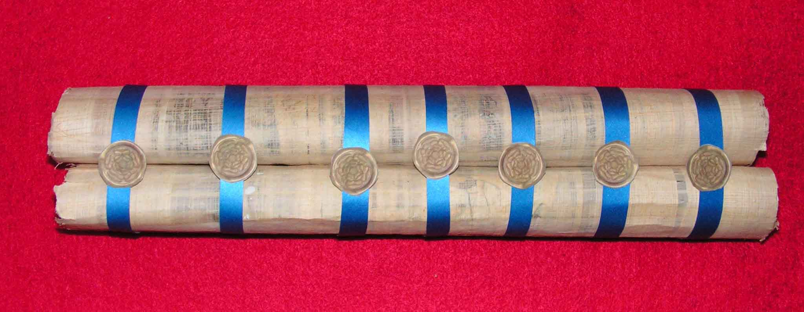
Artist’s Sealed Book
8

Slide 4
Chapter 6-8:1 Scene
John still is still…
the throne,
the Elders,
the Living creatures.
But as this section progresses the scene includes earth
2

Slide 5
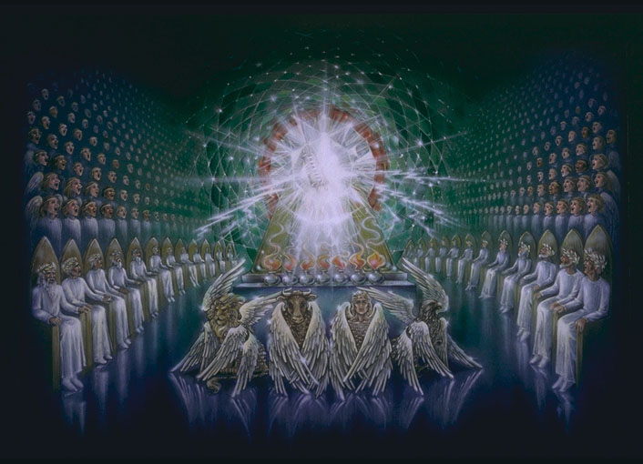
Throne of Majesty
24 Elders
4 Living Creatures
3

Slide 6
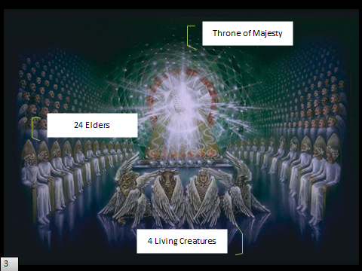


2

Slide 7
Chapter 6-8:1 Order
Translation
1st Half of Tribulation
rapture
seals
2

Slide 8
Similarities of 4
The Opener
The Seals Opened
The Command Given
The Source of the Command
5

Slide 9
Particulars of 7
The Number 7
The First 4 Distinguished
5

Slide 10
Revelation
Chapter 6-8:1
Chapter 6-8:1
Deliverance
Bible
Institute
The Opening of the Seven Seals
The Opening of the Seven Seals

